Slide 1
Raspberry Pi & Co
Practice and theory
Raspberry Pi software
Notes:
Opbouw
Werking (mechaniek)
Karakteristiek
Frequentie bereik
Impedantie
Rendement
Behuizing
Voordelen
Nadelen
Typisch gebruik

Slide 2
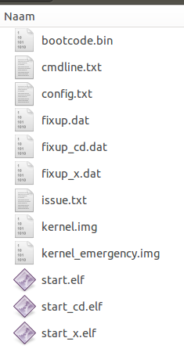
RPi Software
Raspberry Pi booting (SD-card)
  First stage:
  Mount the FAT32 boot partition on the SD card.
  Programmed in SOC
  (second stage bootloader can be accessed)
  Second stage:
  Dedicated risc-core executes bootcode.bin
  Load GPU firmware from the SD card
  Program and starts the GPU with start.elf
  Third stage:
  GPU is started and uses fixup.dat to configure
  the SDRAM-partition between GPU and CPU
  Once done CPU takes over
  Fourth stage:
  OS is loaded by CPU, default load kernel.img (Linux)
  But you can be override the default in config.txt

Slide 3
RPi Software
Raspberry Pi Operating Systems
  Raspbian
  A community-created port of Debian wheezy, optimised for the Raspberry Pi
  Fedora
  Pidora is a Fedora Remix optimized for the Raspberry Pi
  RaspBMC and OpenELEC
  XBMC Mediacenter distributions
  RISC OS
  OS dating from 1987, originally used for BBC Micro
  … and many more ….

Slide 4
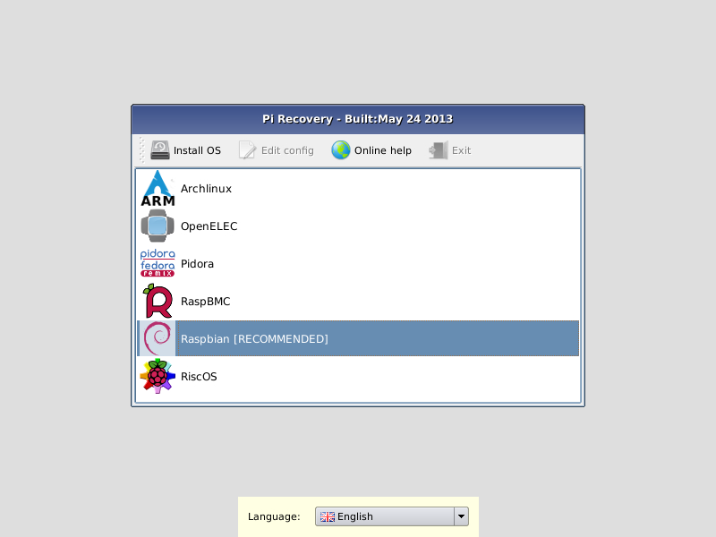
RPi Software
NOOBS (New Out Of Box Software)
  Advanced installation tool,
  recommended to starters
  Switch easily to different OS
  Overwrite corrupted card
  2 versions:
    Offline version containing
    Raspbian – Pidora – OpenElec and RaspBMC
    Online version (lite) for limited SD-cards

Slide 5
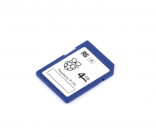
RPi Software
Prepared SD-cards
  In case you
    don't have access to another PC
    are in a hurry
    fear the command line
    just to lazy to do it your self
    ...
  you can buy a pre-installed
  and installed SD-card

Slide 6
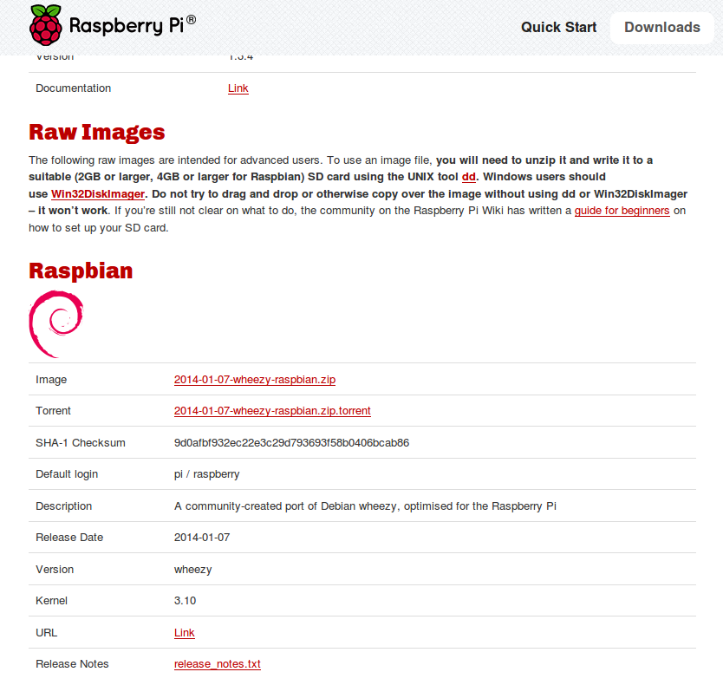
RPi Software
Getting started (example Raspbian)
  First step => go to:
  http://raspberrypi.org/downloads/
  Scroll down to Raspbian and download
  Why start with Raspbian?
    NOOBS to easy for an
    example
    Default OS for RPi
    and most support
    Built on one of the
    most stable OS ever
    Debian (Raspberry and Debian)

Slide 7
RPi Software
Getting started (example Raspbian)
  Second step => Software at you PC
  Not just copying the content of the zip on the SD-card
  Make sure you download tools for burning image (byte representation of the actual content) on sd-card
    dd for Linux, Mac and FreeBSD (command line tool)
    Image Writer for Windows
      https://launchpad.net/win32-image-writer

Slide 8
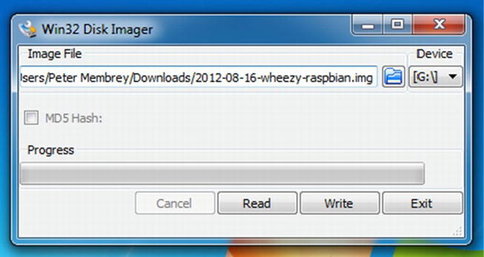
RPi Software
Getting started (example Raspbian)
  Third step => Burn the image
  Unzip the image
  Depending on your OS
    dd for Linux, Mac and FreeBSD
      sudo dd if=path_of_your_image.img of=/dev/diskn bs=1m
    Image Writer for Windows
      start image writer and follow instructions

Slide 9


RPi Software
Getting started (example Raspbian)
  Fourth step => Start up
  Plug in the SD in the SD-slot of the Rpi
  Make sure to have the RPi connected
    HDMI or DVI-screen
    Mouse and keyboard
    Network-cable
  Connect the RPi to a USB-power

Slide 10
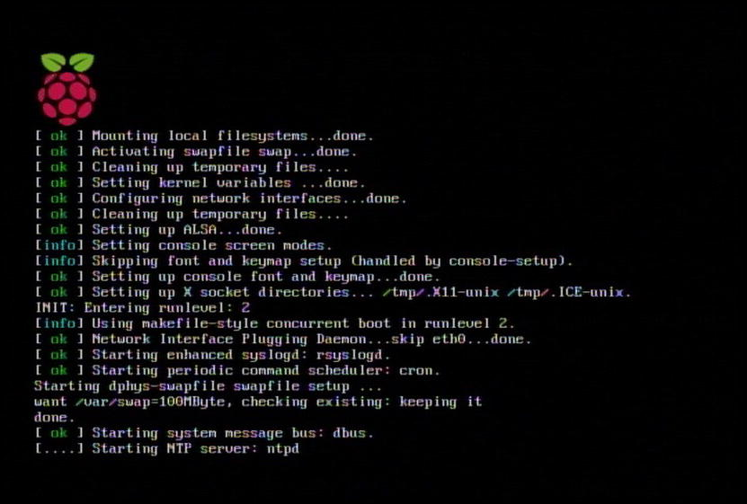
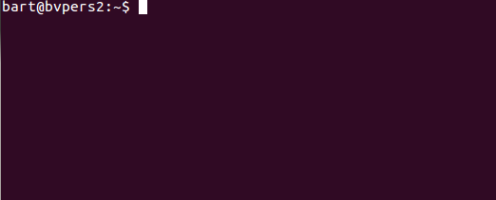
RPi Software
Getting started (example Raspbian)
  Fifth step => First boot
  Raspbian starts up
  And a command line appears
  Don't panic you won't need it too much
  Just for support:
    ls =>for listing files
    sudo ${othercommand} => running command as admin
    cd ${directory} => for navigating
    cd .. => go up
    pwd => current location
    mkdir => creating directory
    cat ${filename} => view content of file
    touch ${filename} => create empty file
    nano ${filename} => editing file
    vi ${filename => advanced editing file

Slide 11
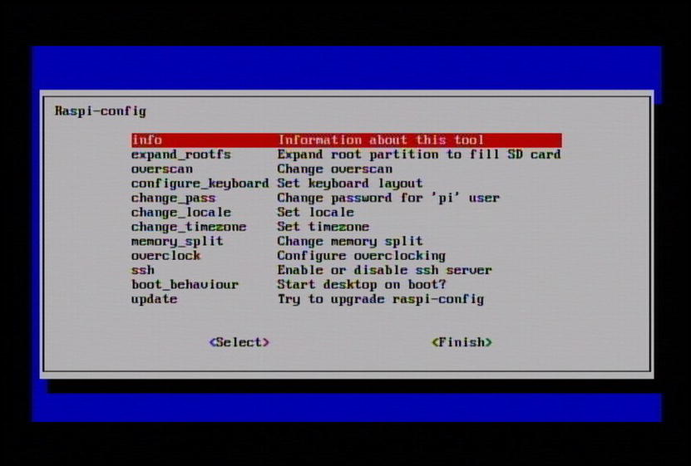
RPi Software
Getting started (example Raspbian)
  Sixth step => Time to configure your RPi
  $ sudo raspi-config
  Configure to boot directly in desktop-mode (boot_behavior)
  Change your password (change_pass)
  STRONGLY RECOMMENDED
  Configure key-board (configure_keyboard)
  Make sure that you use all the space of the
  SD-card (expand_rootfs)
  Overclock

Slide 12

RPi Software
Getting started (example Raspbian)
  Seventh step => Reboot after config
  After configuration you need to reboot with the command
    $ sudo shutdown -r now
    or
    $ sudo reboot
  Later when you just want to shutdown the Pi you
    $ sudo shutdown -h now
    or
    $ sudo halt
  Pay attention
    Don't plug out the micro usb-cable when the Rpi is running
    It might corrupt your SD-card

Slide 13


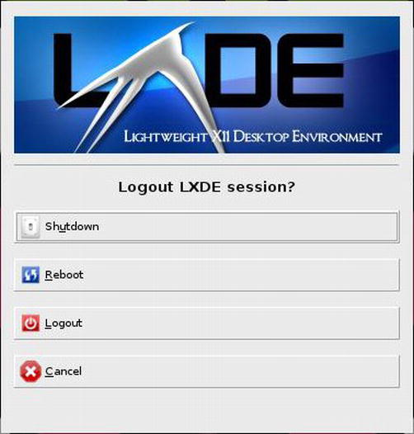
RPi Software
Working with the Rpi
  Raspbian boots the lxde-environment (very lightweight and fast)
  At the bottom you find the task bar
  Left
    An application launcher
    Desktop switcher
  Right
    CPU-monitor
    Clock
    Desktop log-off

Slide 14
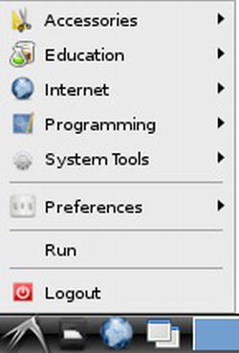
RPi Software
Working with the Rpi
  Application-launcher
    Browser
    System- and configuration-tools
    Office-tools
    Programming tools
    Games
    Command line
    ….

Slide 15
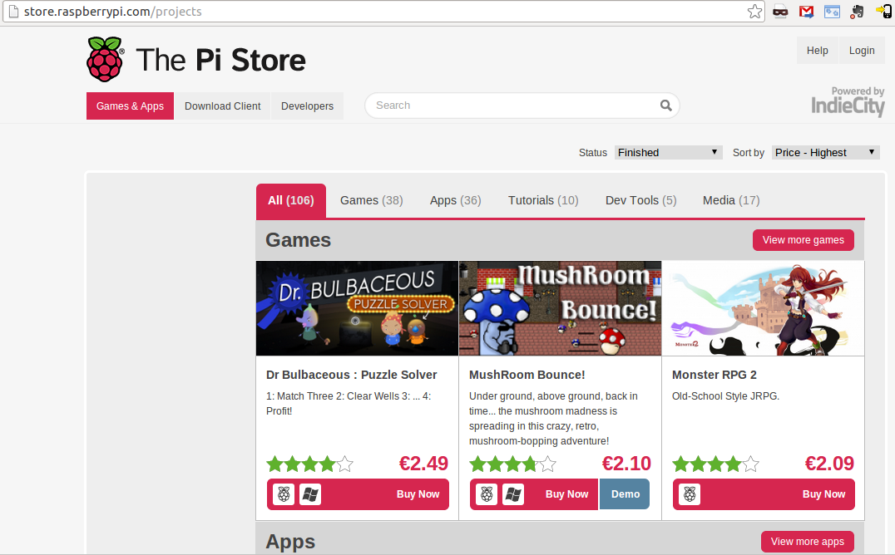
RPi Software
Installing applications
  Debian installation tool apt-get
    e.g. $ sudo apt-get install chromium
  Pi-store

Slide 16
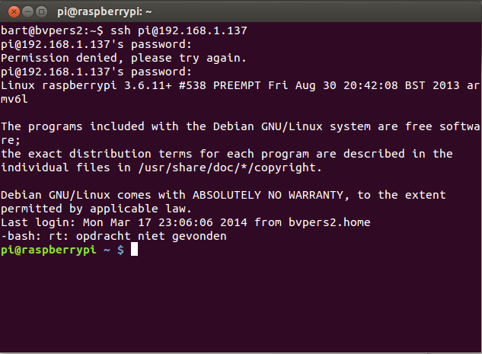
RPi Software
Using ssh to connect to your Pi via network
  ssh-server is enabled by default

Slide 17
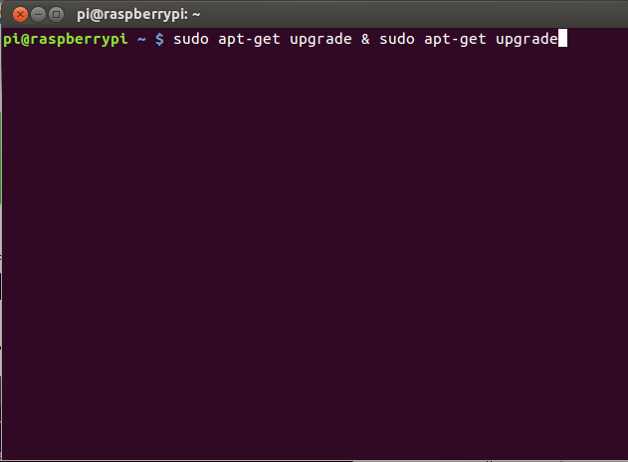
RPi Software
Upgrading software and firmware

Slide 18




RPi Software
Programming the Pi
  C
    advanced system programming
    bcm-libraries simplifying RTL
  Scratch (kids)
    http://scratch.mit.edu/
    get started
  Python
    simple but powerfull
    big community
  Java
    very powerfull
    fast (no as fast a c)
    libraries

Slide 19
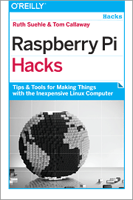
RPi Software
Advanced stuff
  Cross-compiler toolchains
    Building for RPi on another machine
    Building a custom kernel
  Manipulate split memory GPU-CPU
  config.txt
  Emulate the RPi
    with QEMU (Linux and Windows)
  Bare metal programming
  http://www.valvers.com/embedded-linux/raspberry-pi/step01-bare-metal-programming-in-cpt1
  ...

Slide 20
RPi Software
Interesting sites
Support
  http://elinux.org/
  http://www.raspbian.org/
  http://www.raspberrypi.org
Store
  http://store.raspberrypi.com
Buying hardware
  http://iprototype.nl
  http://antratek.be

