Slide 1
Raspberry Pi & Co
Practice and theory
Where to use for?
Positioning in current context.
Notes:
Opbouw
Werking (mechaniek)
Karakteristiek
Frequentie bereik
Impedantie
Rendement
Behuizing
Voordelen
Nadelen
Typisch gebruik

Slide 2
What's in for you?
What's in it for you?
Depends on what you need:
  A cheap PC
  Media center
  Server (print server, nas, build-server, application-server
  Hardware hacker or learning ARM
  Electronic projects needing user interaction
  Kids, Education
  Science, sensors, telemetry
  Artists
  Home automation
  Environment monitoring
  ...

Slide 3



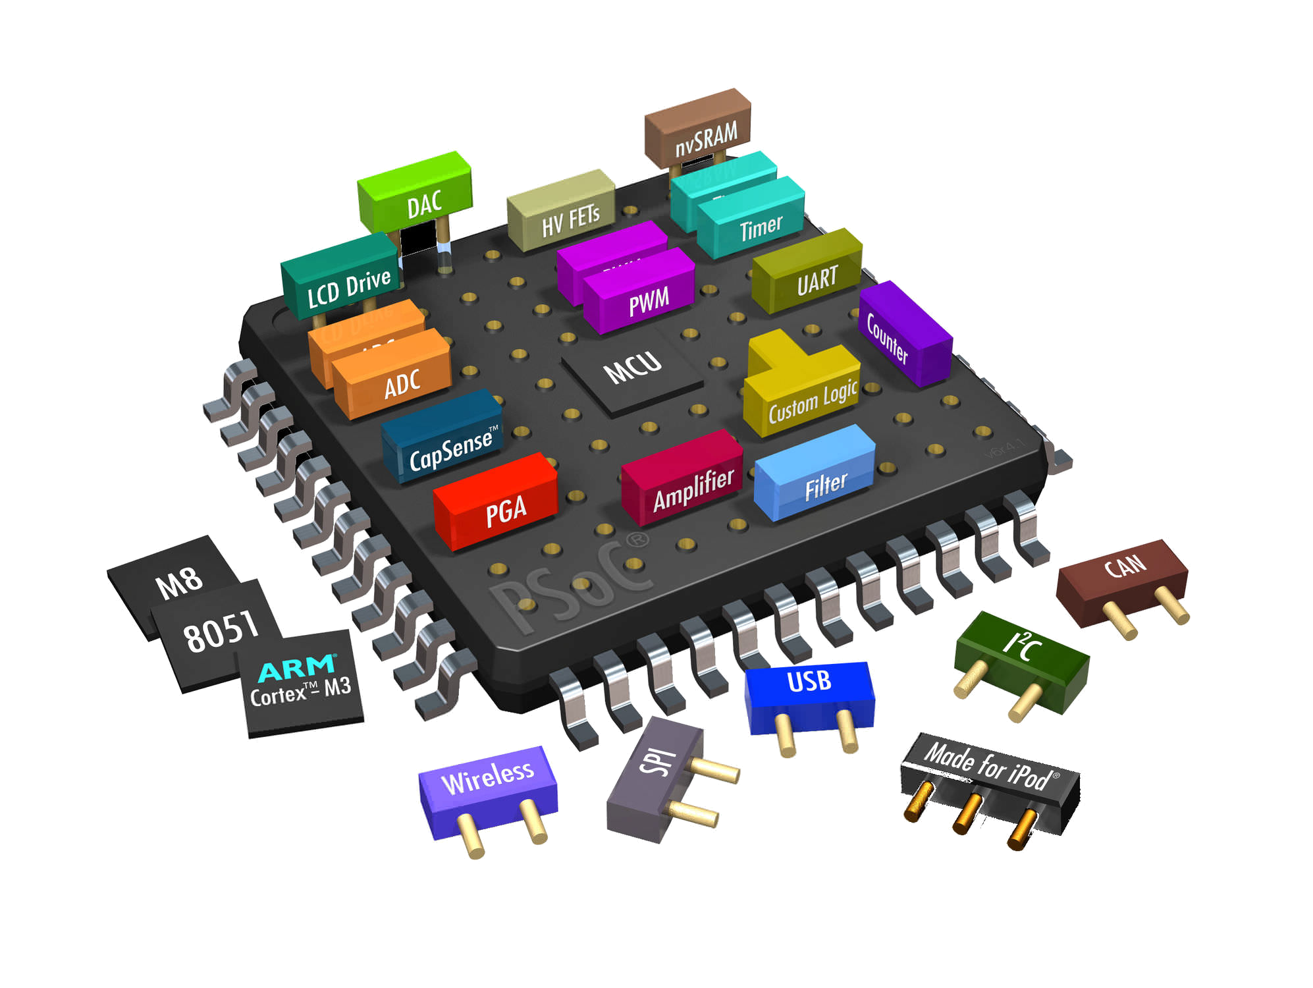
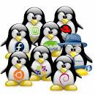







Context
What is about the Raspberry Pi?

Slide 4
Context
programming4kids
From Internet of things/Industrial Internet
From home automation to Automotive
DIY
m2m/mqtt
Open source
Linux and Android
Hacking
Mobile
Sensor networks
Embedded
Social coding
Crowdsourcing
Crowdfunding
Communities
Git

Slide 5
Context
Small/Big Data
Health Care
Xbee/Point-to-Piont networking/Distributed Network Data/Sensor-networks
Environmental monitoring
Telemetry
Crowdsourcing
ARM
SOC

