Slide 1
Rijksmuseum API
Bart Zwemmer, June 12th, 2023
Notes:
Intro, BZ,
Data Engineer
Kadaster
Spatial background

Slide 2
Overview
ELT Process
Extract and load is serial, due to API
Transformations in Databricks is faster
Medallion model
Bronze: XML’s as DataFrames
Silver: cleaned and organized data
Gold: Data Scientists products
Notes:
Why ELT
Why medallion model

Slide 3
Data download
Initial load:
EntirePublicDomainSet
The API only allows serial requests
Separate loader for inital download
Periodic loading new data:
Listrecords
If not in DataFrame:
Download
Else:
Skip / Upsert
Store XML’s to DBMS
Notes:
XMLs to DBMS, transformations in Dbricks

Slide 4
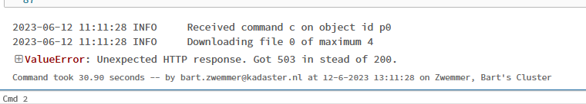
Data download improvements
Store XML’s to bucket/cloud storage for persistence
Only download new files
XML Parser in downloader in stead of splitting strings
Retry on failure

Slide 5
Bronze tables
DBMS Folder to DataFrame
GLOB pattern to read all XML files into DataFrames
XSD for table definition and data validation
Use DataFrames for validation/processing
Notes:
RAW XML data
Dbricks is faster
Backup if you want to change your ELT process / API becomes unavailable (think Twitter)

Slide 6
Bronze tables improvements
Joins are expensive
Optionally denormalize data into flat tables in stead of star model
Notes:
Optional suggestion to remove joins. Dataset is small

Slide 7
Silver tables
Convert bronze tables to star model
Only append new dimension and fact data

Slide 8
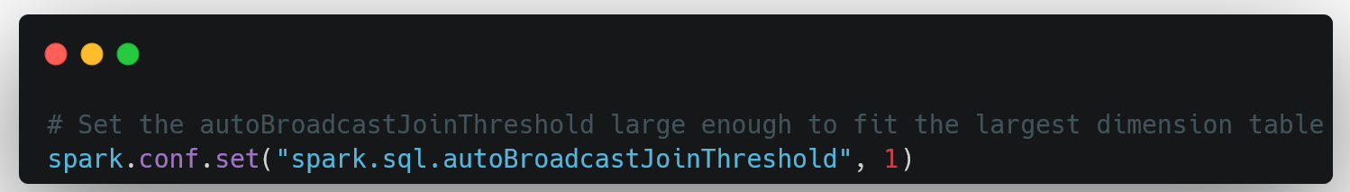
Improvements - joins
Optimizing joins by allowing boradcast joins
Notes:
Broadcast joins: small tables in memory of all worker nodes for fast joining

Slide 9
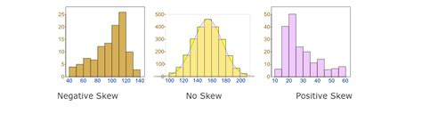
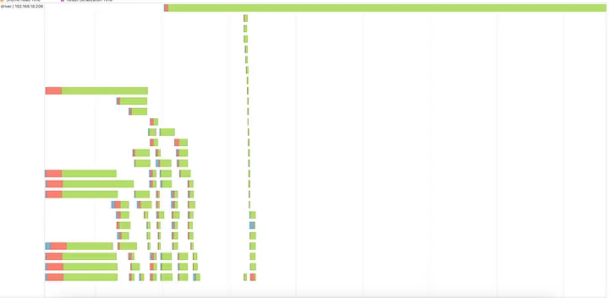
Improvements – data skew
Notes:
Detecting skew
Disable AQE
broadcast joins should be disabled as well
Spark UI

Slide 10
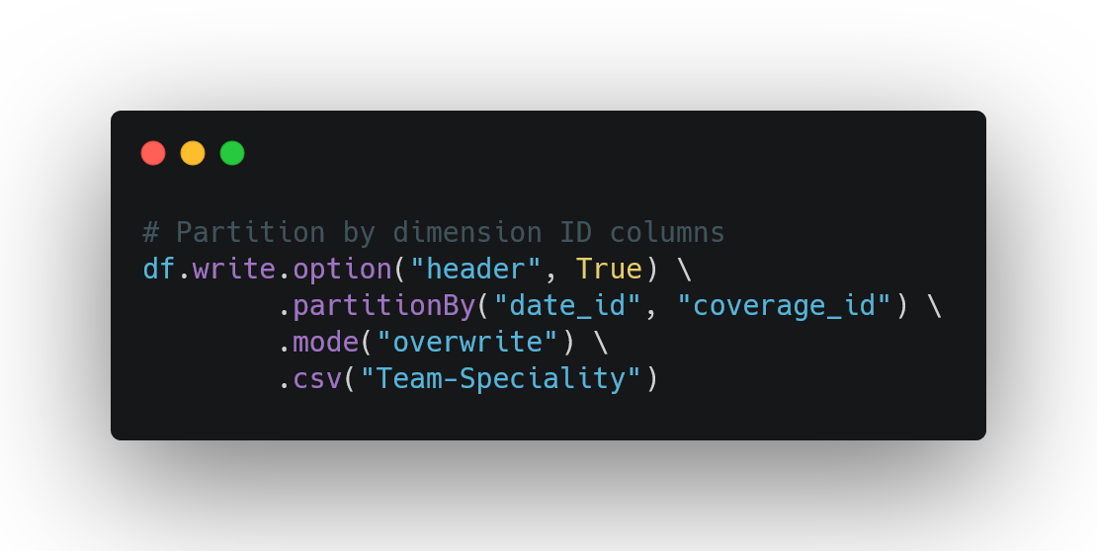
Improvements – data skew
Row number index
Using Adaptive Query Execution (AQE)
Notes:
Adaptive Query Execution is available in Spark 3.0 or newer, and is enabled by default for Spark 3.2.0 and newer versions. AQE uses “statistics to choose the more efficient query execution plan” as described in the documentation linked below.
Partition by ID columns, to have all matching ID’s in one partition (easier shuffeling)

