Slide 1

Department of Computer Science & Engineering Premier University, Chittagong
Supervised by
Mr. Khaleque Md. Aashiq Kamal
Assistant Professor
Department of Computer Science & Engineering
Premier University, Chattogram
Ashik Siddiquee
ID: 1202310200431
Chinmoy Khastagir
ID: 1302410200517
Jov Raj Barua
ID: 1302410200508

Slide 2
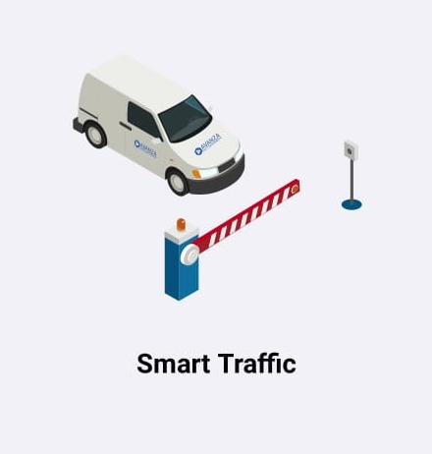
Smart Traffic An Android Application to Ease the Traffic Problems on Road

Slide 3
Outline of Presentation
Portion - 1
The Beginning
Portion - 2
Proposed System
Portion - 3
How Our System Works?

Slide 4
Portion - 1
The Beginning
Introduction
Problem Background
Motivation
Existing Work
Objective

Slide 5
Introduction
As the number of vehicles is soaring on roads, the load on traffic sergeants is increasing day by day.
If a driver does not keep his driving documents with him while driving, traffic sergeants have to impose traffic laws against the driver.
Therefore, we need an up-to-date system to solve these miscellaneous problems to make the life of traffic sergeants easier and to facilitate the traffic system for the common people travelling with vehicles on roads.

Slide 6
Problem Background
It is often seen that drivers and owners of vehicles on the roads of our country are often faced with unbearable sufferings related to documents.
The traffic condition in our country is already so bad that a traffic sergeant has to go through a lot of trouble in the course of his duty.
Traffic sergeants often have to check documents one after the other which sometimes contain fake documents.
Again, a common thing in our country is that the traffic sergeant gives illegal cases and fines which is not desirable at all.

Slide 7
Motivation
It is observed that drivers sometimes do not keep their license and vehicle papers while driving on the road, and cannot keep track of the cases issued on them.
Even, some unscrupulous drivers are seen carrying fake documents while driving on the road.
Traffic sergeants stop and check many vehicles on the road, and this results in more traffic congestions which waste a lot of time and reduce the efficiency of people.
On the other hand, traffic sergeants have a bad reputations in our country that they demand extortion in various ways without giving a case on the road.

Slide 8
Objective
Our objective is to develop a comprehensive system that eases the problem of both sergeants and general people by making both filing cases for traffic violations and managing documents, cases, and their payments in digital form, under one platform.

Slide 9

Existing Work
So far, the kind of system we are establishing has never been introduced in Bangladesh. Though an application named “BRTA Sheba” can be found on the web but does not fill the requirements that we are working on with our application.

Slide 10
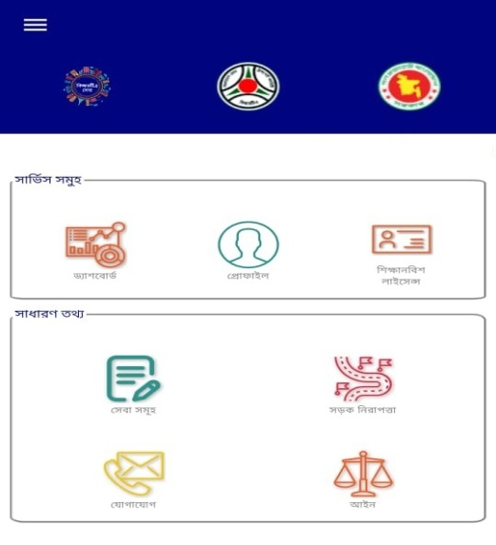
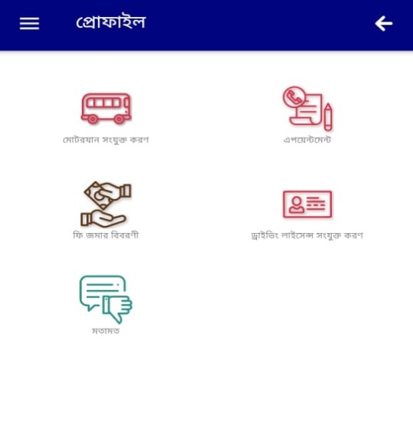
Analysis of “BRTA Sheba”

Slide 11
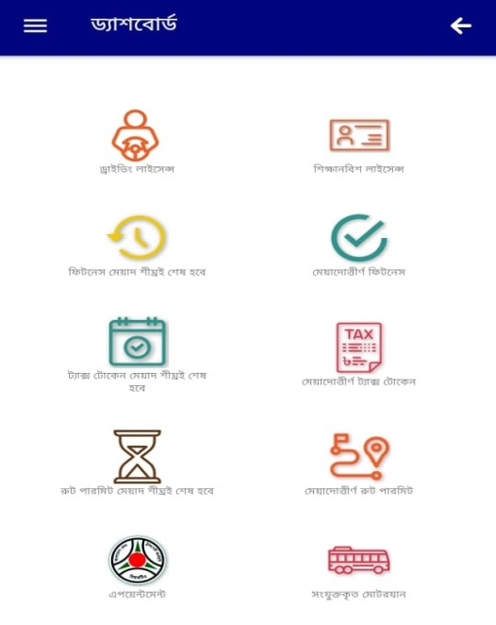
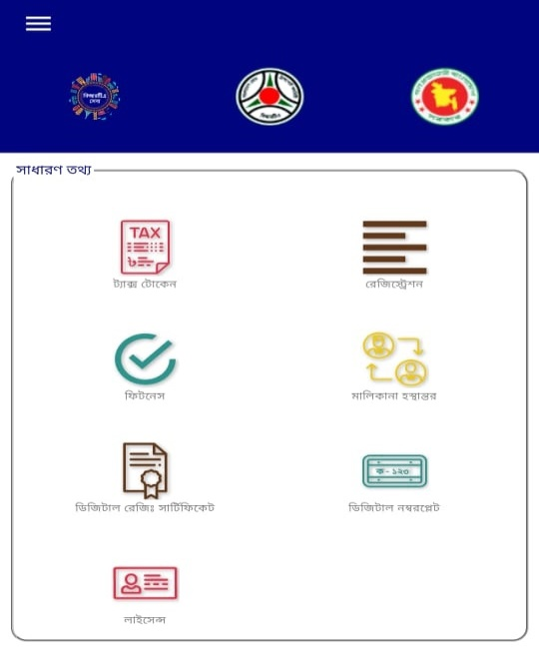

Slide 12
Portion - 2
Proposed System
Requirements & Analysis
Use Case Diagram
DFD / ER Diagram

Slide 13
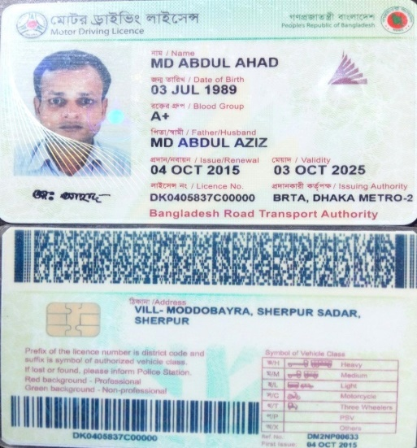
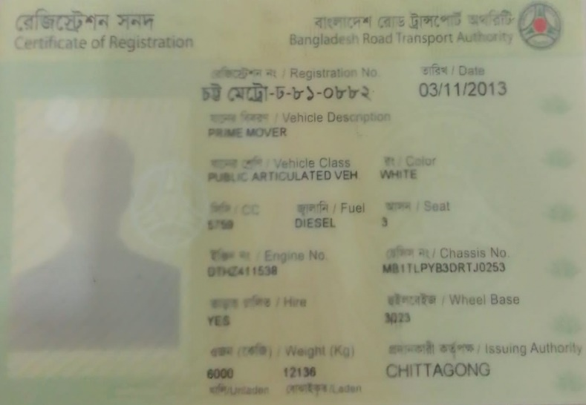
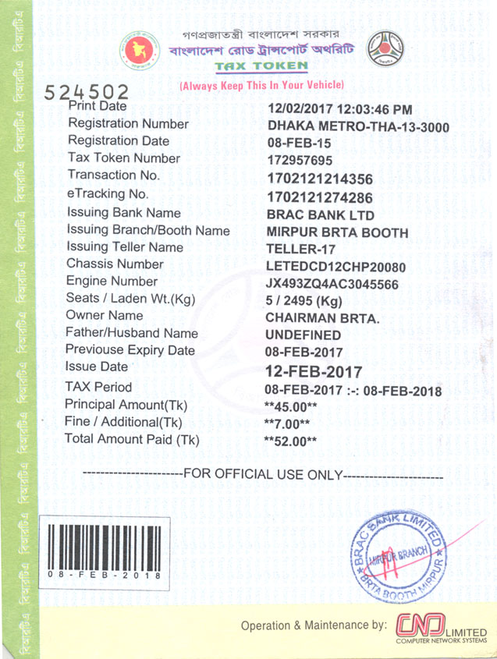
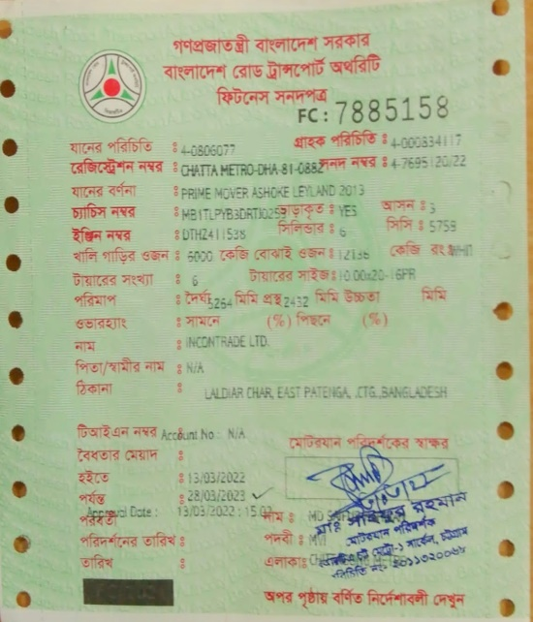
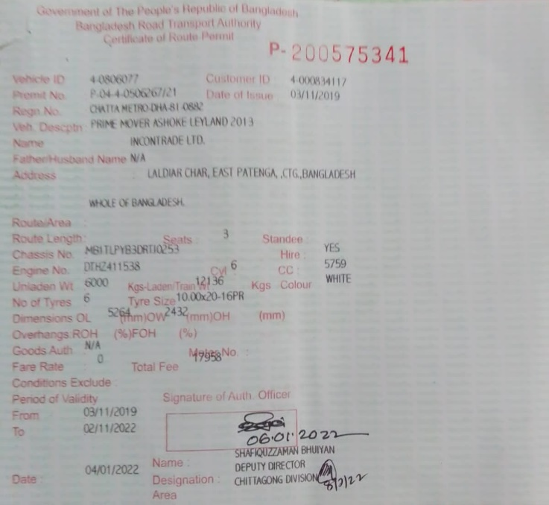
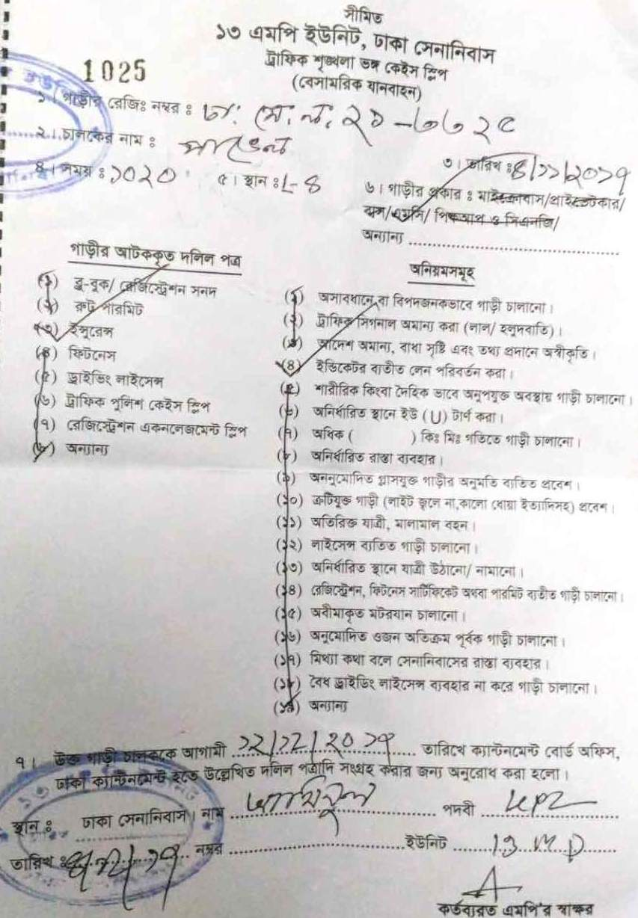
Requirements

Slide 14
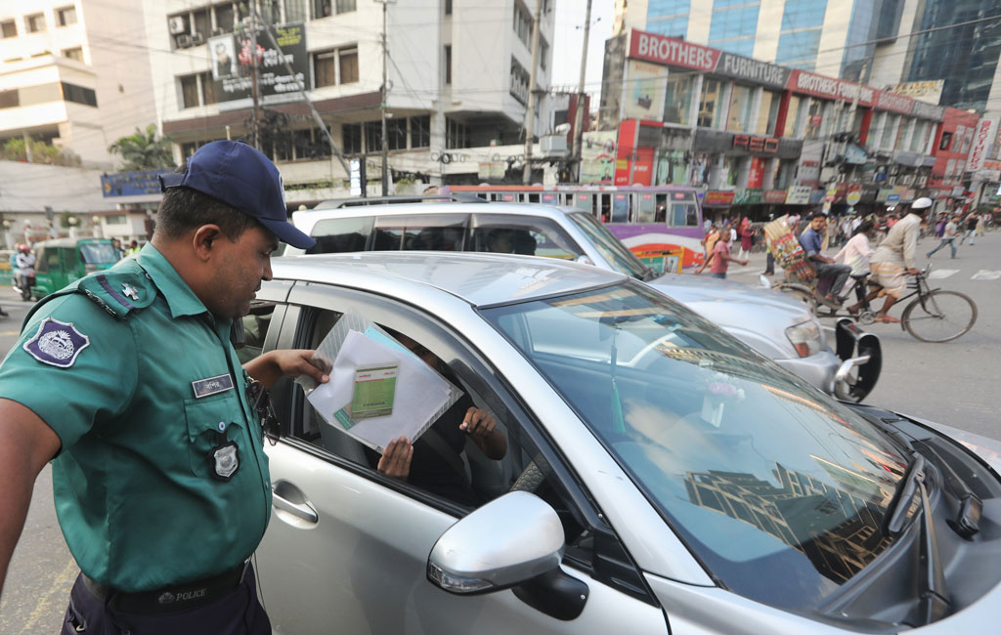
Analysis of How Traffic System Works on Road
At first, a traffic sergeant stops a vehicle on the road under assumption of the violation of law and checks the license of the driver.

Slide 15
2. Then, the traffic sergeant examines the vehicle body and the necessary documents of the vehicle.
3. If the traffic sergeant finds any fault of the driver, then he files a case against the driver’s license as per the section on prosecution. And, if he finds any defect in the vehicle or the vehicle documents, then he files a case against the owner of the vehicle as per the section on prosecution.
4. Finally, with the receipt of the case given by the traffic sergeant, the driver or the vehicle owner goes to the concerned authority and settles the case by paying the fine.

Slide 16
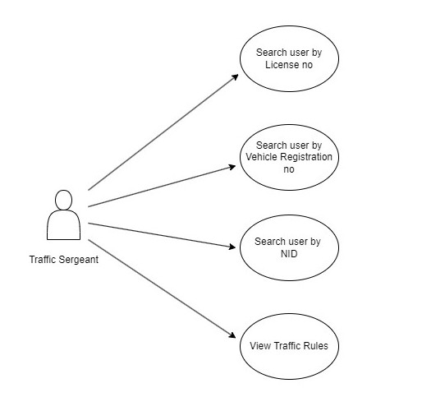
Use Case Diagram
Traffic Sergeant Panel

Slide 17
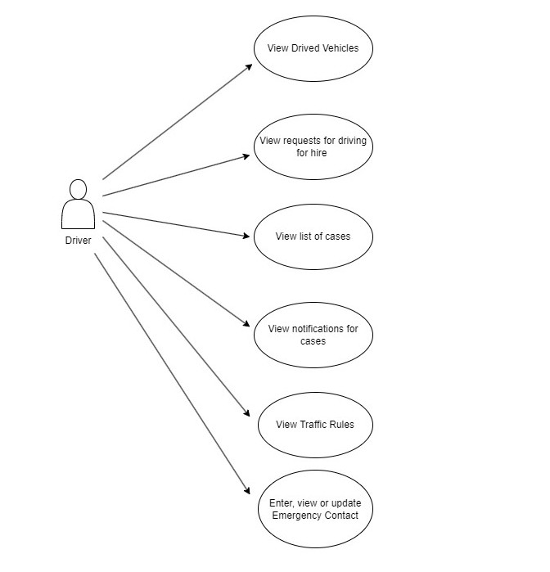
Driver Panel

Slide 18
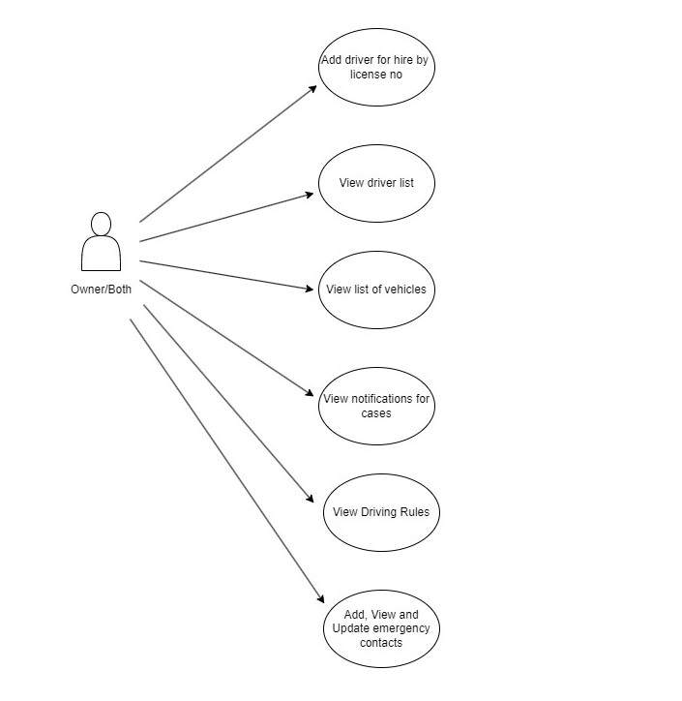
Owner/Both Panel

Slide 19
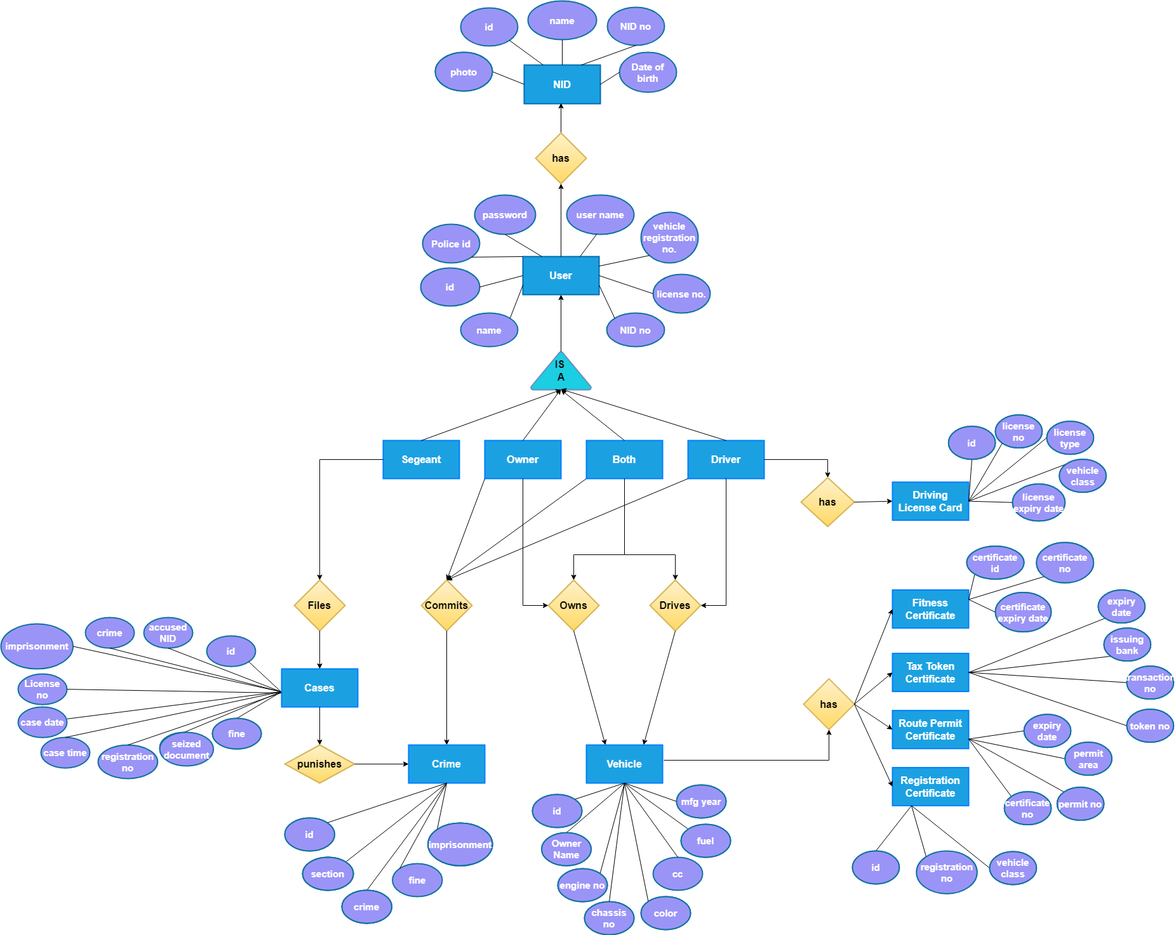
ER Diagram

Slide 20
Portion - 3
How Our System Works
Application Design Tools
Implementations & Results

Slide 21
Application Design Tools
IDE:
Android Studio 4.2.2;
Notepad++ 8.4.3;
Back-end:
JAVA;
JSON;
PHP;
Front-end:
XML;
HTML/BOOTSTRAP;
Database:
MySQL Database;

Slide 22
Limitations
So far, this application is not a complete alternative to all the documents of a vehicle as it does not contain all the information apart from the necessary information that have been used in this application.
On-field testing has not been done yet.
It is entirely dependent on mobile internet whose coverage and effectiveness is not equal in all parts of our country.

Slide 23
Future Developments
By performing on-field test, the application will be designed to make more user friendly for the users.
A feature will be added to inform the users about the road traffic condition based on their current location.
There will be another new feature for the users to report their complaints to the concerned authority faster.
The traffic sergeant will be able to make an emergency call through the application.

