Slide 1
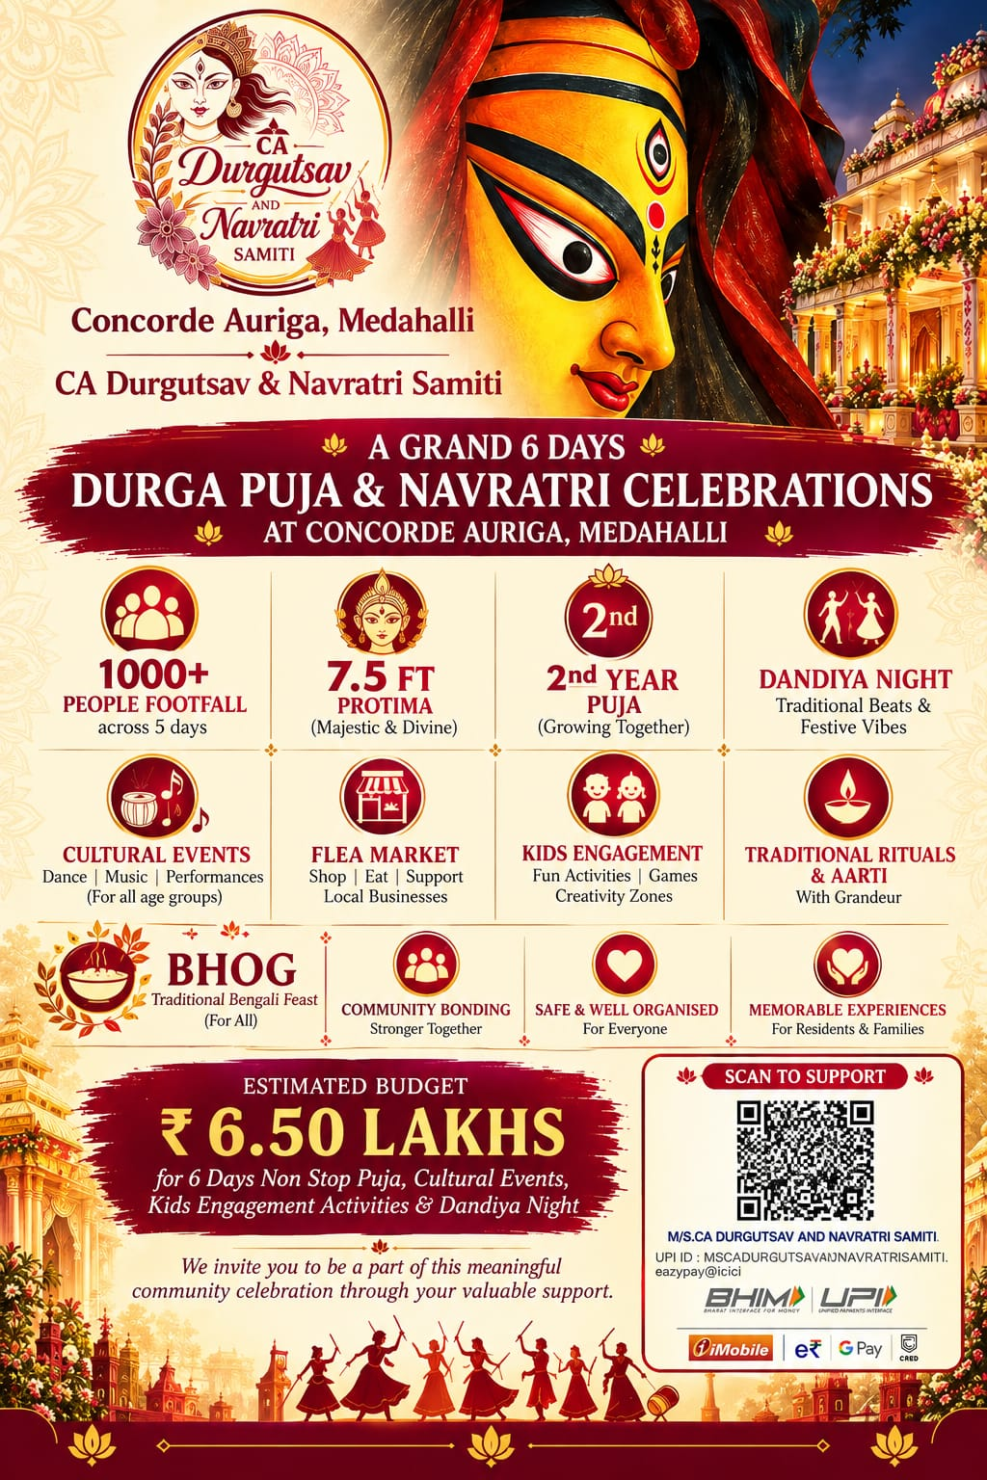

Second Year Celebration • 16–21 October 2026

Slide 2

A Grand Six-Day Community Celebration
2026
Dear Sir/Madam,
Greetings from CA Durgotsav & Navratri Samiti!
We are delighted to announce the Second Year Celebration of Durga Puja, organized by the residents of Concorde Auriga, from 16th October to 21st October 2026.
Building upon the overwhelming response to our inaugural celebration, this year's festival is planned on a larger scale with enhanced cultural programming, improved infrastructure, stronger community participation and an elevated visitor experience.
550+
Families at Concorde Auriga
6 Days
Festival & cultural programming
1,000+
Expected people footfall*
7.5 ft
Planned Durga idol
*Footfall figure reflects the event communication shared by the Samiti.
CA Durgotsav & Navratri Samiti • Concorde Auriga, Medahalli • 16–21 October 2026 | 2

Slide 3
Why This Year's Celebration Is Bigger
Community • Culture • Tradition
The 2026 Opportunity
• The inaugural Durga Puja & Navratri celebration received an incredible response from residents and visitors.
• The event was smoothly executed and received positive community feedback.
• For 2026, the Samiti has obtained the necessary approvals and the Occupancy Certificate (OC) for the celebration.
• Concorde Auriga is now home to 550+ families, creating a strong community platform for cultural engagement.
• The expanded celebration aims to offer a richer visitor experience and greater participation.
A celebration designed to bring residents, families, professionals and visitors together.
CA Durgotsav & Navratri Samiti • Concorde Auriga, Medahalli • 16–21 October 2026 | 3

Slide 4






Festival Highlights
What the sponsor supports
Durga Puja Mandap
Beautifully decorated puja space and devotional ambience
Cultural Performances
Dance, music, skits and stage performances for all age groups
Traditional Rituals
Pushpanjali, Sandhya Aarti, Sandhi Puja, Kanya Puja & more
Dandiya / DJ Night
Festive evening celebrating Navratri with the community
Kids Engagement
Competitions, games, creative activities and family participation
Flea Market & Food
Opportunities for local businesses, food and community commerce
CA Durgotsav & Navratri Samiti • Concorde Auriga, Medahalli • 16–21 October 2026 | 4

Slide 5
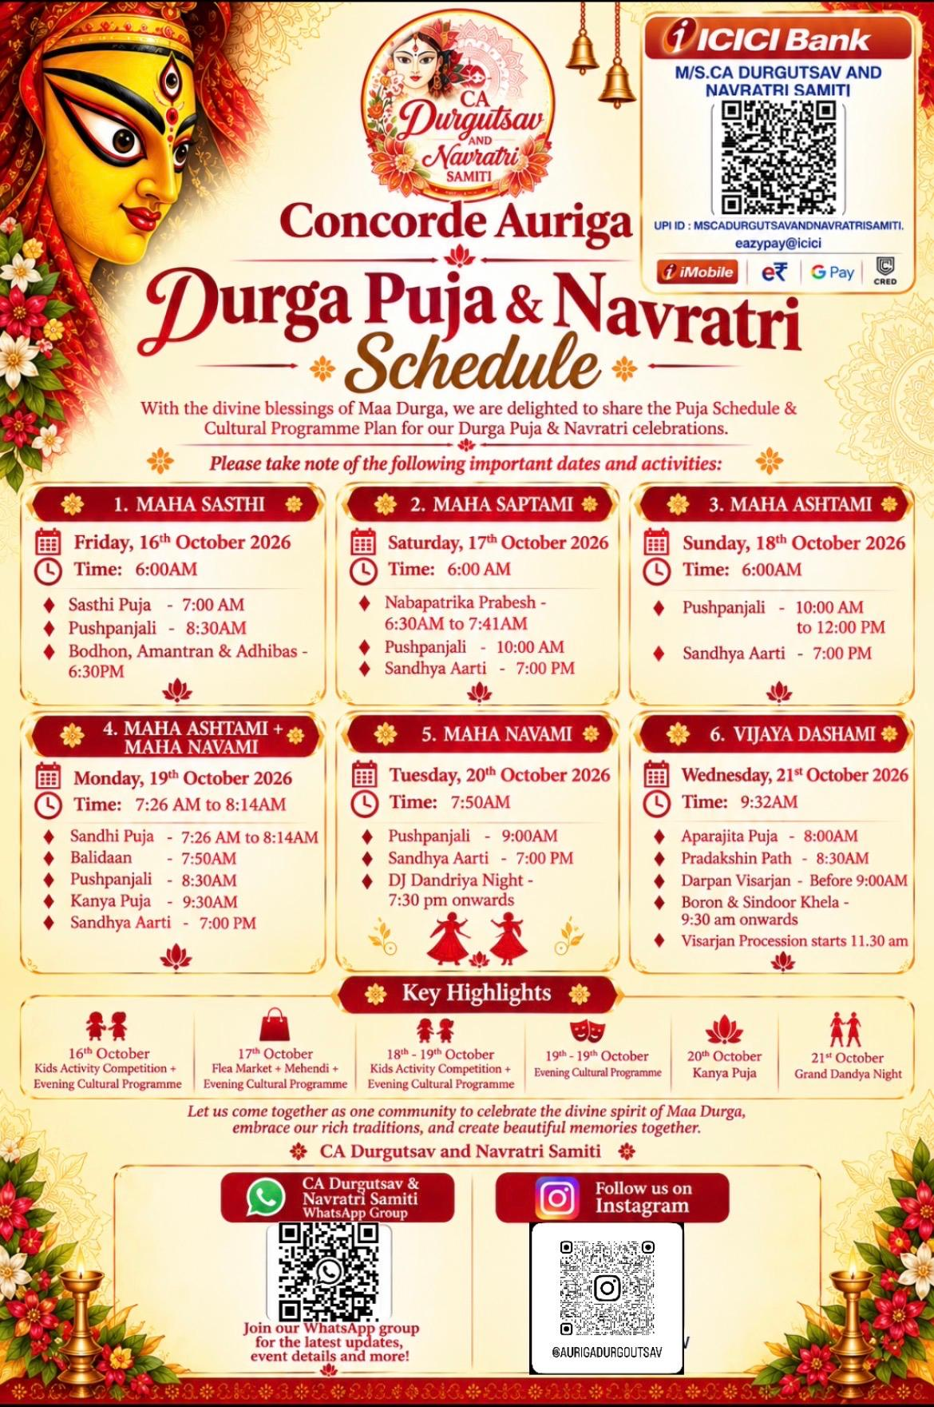
Indicative Puja & Cultural Schedule
16–21 October 2026
KEY DATES
16 Oct • Maha Sasthi
17 Oct • Maha Saptami
18 Oct • Maha Ashtami
19 Oct • Maha Ashtami + Maha Navami
20 Oct • Maha Navami
21 Oct • Vijaya Dashami
Plus cultural programmes, kids activities, flea market and Grand Dandiya Night.
PROGRAMME HIGHLIGHTS
• Kids activity competitions
• Evening cultural programmes
• Flea market + Mehendi
• Kanya Puja
• Grand Dandiya Night
• Traditional rituals & aarti
• Visarjan procession
CA Durgotsav & Navratri Samiti • Concorde Auriga, Medahalli • 16–21 October 2026 | 5

Slide 6
Community Engagement
A platform beyond the puja
A vibrant festival ecosystem for residents, families, children and local businesses
Families & Culture
• Family participation across six days
• Kids competitions and creativity zones
• Traditional rituals and devotional gatherings
• Cultural performances for multiple age groups
Community & Commerce
• Flea market and food stalls
• Opportunities for local businesses
• Brand interactions with community members
• A festive environment for repeat daily visibility
Brand Engagement
• Social media communication
• On-ground branding opportunities
• Stage announcements
• Association with a community-led cultural celebration
CA Durgotsav & Navratri Samiti • Concorde Auriga, Medahalli • 16–21 October 2026 | 6

Slide 7






Sponsor Visibility & Brand Benefits
Partnership opportunities
Venue Branding
Prominent company banners, standees and branding at the event venue.
Promotional Materials
Brand presence across selected event creatives and promotional communication.
Social Media Visibility
Brand acknowledgement through festival-related social media campaigns.
Stage Announcements
Sponsor recognition during selected cultural programmes and event announcements.
Community Partner Recognition
Recognition as a valued supporter of the local cultural celebration.
Activation Opportunities
Subject to mutual discussion: stalls, sampling, engagement or other suitable brand activities.
Specific branding inventory can be customized based on the sponsorship contribution and campaign objectives.
CA Durgotsav & Navratri Samiti • Concorde Auriga, Medahalli • 16–21 October 2026 | 7

Slide 8
Where Your Support Makes an Impact
Sponsorship opportunity
Your contribution directly helps create a safe, vibrant and memorable six-day celebration.
Beautifully decorated Durga Puja Mandap
Cultural performances and entertainment
Traditional rituals and community events
Bhog / food arrangements and hospitality
Lighting, tenting, décor and event infrastructure
Kids activities, gifts and community engagement
Dandiya / DJ Night and cultural programming
Logistics, operations and immersion-related arrangements
Estimated Overall Event Budget: ₹6.35 Lakhs
CA Durgotsav & Navratri Samiti • Concorde Auriga, Medahalli • 16–21 October 2026 | 8

Slide 9
Estimated Event Budget
As provided by the Samiti
Category | Amount
Durga Idol + Lakshmi Idol | ₹80,000
Priest | ₹45,000
Dhaki | ₹25,000
Tent + Light | ₹2,05,000
Bhog | ₹70,000
Pandal Decoration Items | ₹20,000
Flowers (all 8 days) | ₹50,000
Puja daily expenses + food + accommodation | ₹50,000
Dashakarma (including Lakshmi Puja) | ₹30,000
Dandiya / DJ Night | ₹22,000
Cultural event expenses + gifts | ₹18,000
Lakshmi Puja expenses | ₹15,000
Logistics & Bisarjan | ₹20,000
BUDGET CONTEXT
• Overall budget communicated: ₹6.50 lakh.
• Major cost heads include tent & lighting, idol, bhog, flowers and daily puja requirements.
• Sponsorship contributions may be allocated against agreed event components and visibility deliverables.
• Brand activation / customized deliverables can be discussed separately.
Note: Itemized figures are reproduced from the provided budget sheet.
CA Durgotsav & Navratri Samiti • Concorde Auriga, Medahalli • 16–21 October 2026 | 9

Slide 10
Digital & Community Presence
Stay connected
Follow the journey of Concorde Auriga Durgotsav
Instagram
@aurigadurgoutsav
Our community page showcases the festival journey, cultural programmes, celebrations and updates. Sponsors can also benefit from digital recognition as part of the event communication plan.
https://www.instagram.com/aurigadurgoutsav/
Community-led • Family-focused • Culture-driven
CA Durgotsav & Navratri Samiti • Concorde Auriga, Medahalli • 16–21 October 2026 | 10

Slide 11
Let's Build the Celebration Together
Sponsor partnership
A partnership that connects your brand with community, culture and celebration.
For Your Brand
• Brand visibility at the venue
• Recognition in event communication
• Association with a community cultural initiative
• Potential on-ground engagement
For the Celebration
• Support puja infrastructure
• Support cultural programming
• Support kids and family activities
• Support hospitality and community events
We would be pleased to discuss a sponsorship format aligned with your brand objectives and contribution level.
CA Durgotsav & Navratri Samiti • Concorde Auriga, Medahalli • 16–21 October 2026 | 11

Slide 12
Thank You
We look forward to partnering with you to create a memorable Second Year Durga Puja & Navratri Celebration.
CA DURGOTSAV & NAVRATRI SAMITI
Concorde Auriga, Medahalli
Durga Puja & Navratri • 16–21 October 2026
Instagram: @aurigadurgoutsav
Estimated Event Budget: ₹6.35 Lakhs
Your support will help strengthen community engagement and celebrate our rich cultural heritage.
CA Durgotsav & Navratri Samiti • Concorde Auriga, Medahalli • 16–21 October 2026 | 12

