Slide 1

Expenditure Analysis

Slide 2

Team Member
Mohit Kumar
Sumit Barua

Slide 3
Tool used for Visualization
Power BI

Slide 4
Table of Content
Distribution of Expenses
Data Source
Total Expense by Month and Year
Total Expense by Phase
Qoq % of total
Expenses
Summary Table
Conclusion

Slide 5
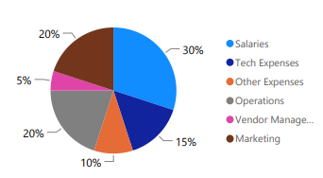
Distribution of Expenses

Slide 6
Data Source
Data From Jan’22-Jun’23
YTD: Year-to-Date
QTD :Quarter-over-Quarter

Slide 7
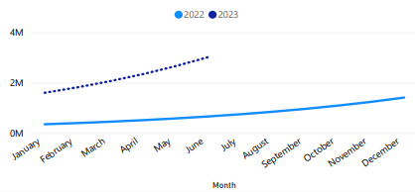
Total Expense By Month and Year

Slide 8
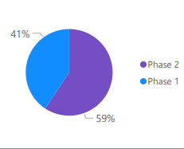
Total Expense by Phase

Slide 9
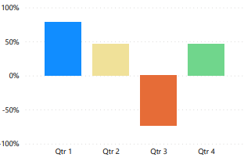
Quarter over Quarter % Total Expenses

Slide 10
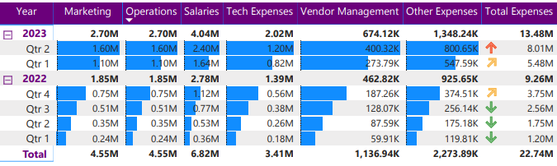
Summary Table

Slide 11
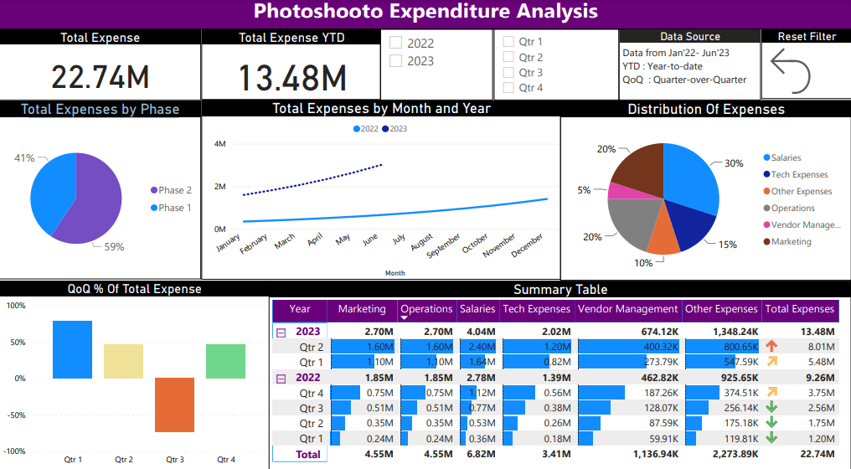

Slide 12

Conclusion
In the commencement new year our expenses in various heads vary in the, initial stage but as the business started our expense shoot up(as you cab see in second quarter.
In the third quarter our expenses dropped as compared to the previous quarter and in the fourth quarter our expenses began to rise.

Slide 13

Thank You

