Slide 1
AMD
AGENT
Autonomous Malware Detection Agent
Baruh Ifraimov | Dor Cohen
Advanced Cyber Defense Topics — Ariel University

Slide 2
Agenda
01
Problem & Motivation
07
ML Pipeline & Dynamic FPR Calibration
02
Related Work
08
Continual Learning: Cold Start & MADAR Retrain
03
System Architecture Overview
09
Drift Detection Logic & TESSERACT Evaluation
04
LangGraph Pipeline & State
10
LLM Sidecar (Ollama)
05
Autonomous Data Collection & Balancing
11
Live Demo
06
Feature Engineering & Selection
12
Results, Evaluation & Future Work

Slide 3
Problem & Motivation
450K+
Static
0
New malware variants
detected daily
Classifiers become
stale within weeks
Predefined datasets
allowed by this assignment
The Core Challenges:
Concept drift — new malware variants evade classifiers trained on old data
No static dataset — the agent must autonomously discover and collect live samples from the internet
Temporal leakage — random train/test splits inflate benchmark scores; chronological splits are required
Safe handling — live weaponized PE files require Docker isolation + iptables egress controls + no execution

Slide 4
Related Work
Tool / Paper | Role | Pros / Cons | How We Used It
EMBER | Feature representation | + Strong static baseline – Evadable by packing | Inspired our 2304-dim feature vector
MADAR | Continual learning | + Reduces catastrophic forgetting – Needs stored history | Family-aware replay before LightGBM retraining
TESSERACT | Evaluation framework | + No temporal leakage – Skips single-class splits | Chronological holdout + AUT metric + before/after delta
River / ADWIN | Drift detection | + Online & lightweight – Threshold tuning required | Entropy stream + multivariate window shift checks
MalwareBazaar | Live malware source | + Real-world, metadata-rich – API quotas, noisy | Primary malware discovery & PE download
OTX / CTI feeds | Threat intelligence | + Fresh indicators – Unstructured text, noisy | SHA256 extraction from pulses, Ollama-filtered
Ollama (LLM) | Semantic sidecar | + Local & private – Best-effort, needs fallbacks | CTI filtering, source selection, drift explanations
pefile | PE static parsing | + Mature, safe API – No runtime behavior | Headers, sections, imports, exports, entropy

Slide 5
System Architecture Overview
Source
Selector
Discovery
& Fetch
Validation
& Features
Drift
Monitor
Infer /
Retrain
TESSERACT
Eval
drift detected
→ retrain path
Fork A — Collection
Fork B — ML
Fork C — Evaluation
Balance class counts from SQLite, rotate providers with cooldown & success-rate ranking, reusable fetch/validate tools
ADWIN entropy + multivariate window → drift flag routes to MADAR retraining; otherwise direct to LightGBM inference
TESSERACT runs every 10 steady passes and after every retrain — strict chronological holdout, before/after delta logged
LLM (Ollama) is a semantic sidecar only — never the classifier. All hard validation gates run regardless. Setting OLLAMA_ENABLED=False keeps the pipeline fully operational.

Slide 6
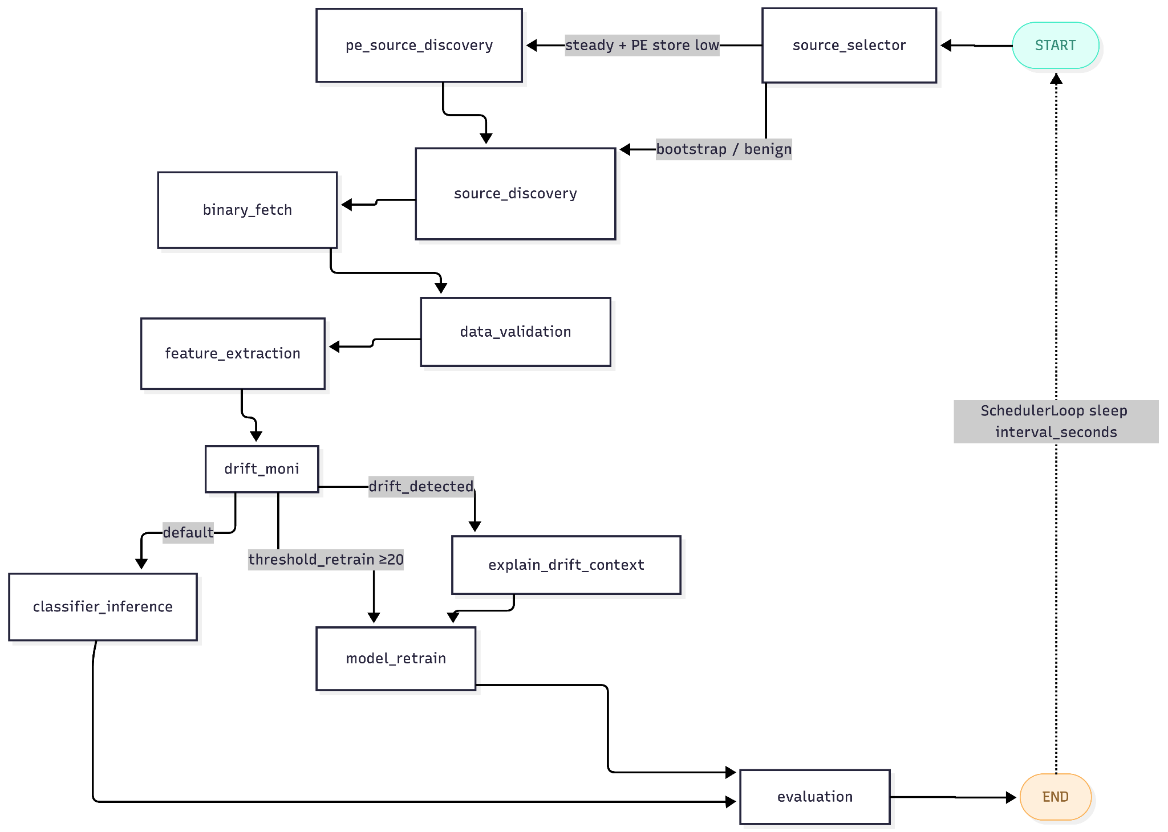
LangGraph Pipeline - Nodes & State Management

Slide 7
Data
MALWARE SOURCES
BENIGN SOURCES
MalwareBazaar
Sysinternals
Primary · metadata-rich · SHA256 verified · circuit-breaker · rate-limited
live.sysinternals.com + /tools — trusted Microsoft tool set
MalShare
GitHub Releases
Secondary · large repo · API key · MB_FALLBACK_MALSHARE flag
Notepad++, ShareX, git-for-windows, PowerToys release assets
ThreatFox
Benign-NET
IOC-tagged PE hashes · abuse.ch · tag queries: exe, dll, peexe, pedll
Curated benign PE git repository (bormaa/Benign-NET)
OTX Pulse CTI
AlienVault live pulses · Ollama semantic filter · confidence ≥ 0.6
Twitter / DFIR
Curated CTI feeds: DFIR Report, Talos, CISA · SHA256 scraping
Bootstrap: loops until ≥100 malware + ≥100 benign active | Steady: provider cooldown (12 h), success-rate ranking, balanced class control

Slide 8
We keep the dataset near 50/50 by counting active malware vs benign samples in SQLite and, on each collection run, downloading more of whichever class is behind (target ratio 1:1, with a threshold of ±10%) from malware feeds (MalwareBazaar, etc.) or benign feeds (Sysinternals, GitHub, Benign-NET) until both sides stay balanced.

Slide 9
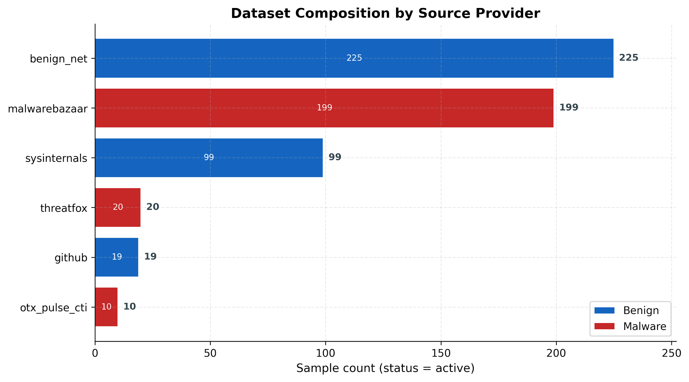

Slide 10
Feature Engineering — 2304-Dimensional EMBER-like Vector 1/2
128
256
256
1024 (Import Hash)
256
128
160
Scalars (128d)
What we extract: PE header fields (DOS/COFF/Optional), section counts/sizes/entropy stats, import/export counts, file size/overlay, string/URL/path/registry counters, Authenticode/parse flags, plus a few disassembly counters if Capstone exists.
How it helps: Captures “file structure + metadata” signals packed/obfuscated layout, suspicious sections, unsigned/overlayed binaries, and common malware behavior hints (e.g., many URLs/paths/registry strings).
Byte Histogram (256d)
What we extract: Normalized frequency of each byte value (0–255) across the whole file.
How it helps: Distinguishes normal code/data from compressed/encrypted blobs; many packers and droppers have very different byte profiles than benign software.
Export Hash (256d)
What we extract: Hashed export symbol names into 256 bins.
How it helps: Helps identify DLL-like behavior, loaders, and unusual exported surfaces; can separate typical apps from injected/hijack-style modules.
Import Hash (1024d)
What we extract: Hashed bag-of-imports from (DLL, API) names into 1024 bins.
How it helps: Represents “what the program can do” (networking, crypto, process injection, persistence APIs); malware families often have distinct import footprints.
Total: 2304 dims · Feature version: ember_static_v1 · XGBoost ranks all 2304 → top 384 fed to LightGBM
Notes:
“Every sample becomes a fixed 2304-number fingerprint: we parse the PE and scan bytes, hash imports and section names, and lightly disassemble code. No sandbox run. The model learns patterns in headers, entropy, strings, and API usage—typical malware signals like packing, odd sections, and dangerous imports.”

Slide 11
Feature Engineering — 2304-Dimensional EMBER-like Vector 2/2
128
256
256
1024 (Import Hash)
256
128
160
Byte-Entropy (256d)
What we extract: A 16×16 joint histogram: windowed entropy bucket × high‑nibble byte bucket.
How it helps: Detects “high-entropy regions” typical of packing/encryption and shows how that entropy is distributed, which helps separate packed malware from ordinary binaries.
Printable Strings (96d)
What we extract: Distribution of printable ASCII characters (plus scalar string stats live in Scalars).
How it helps: Flags binaries with lots of human-readable content such as URLs, file paths, registry keys, command strings, and embedded configs often useful for malware detection.
Section Hash (128d)
What we extract: Hashed section tokens (name + characteristics), weighted by section size.
How it helps: Captures section layout patterns: UPX/packer naming, executable/writable sections, abnormal section configurations that correlate with obfuscation or loaders.
Opcode Features (160d)
What we extract: Disassembly-derived opcode / control-flow pattern counts (calls, branches, rets, indirect branches, memory/immediate usage), when Capstone is available.
How it helps: Approximates “code shape” unpacking stubs, shellcode-like control flow, and other low-level behavior signatures without running the binary.
Total: 2304 dims · Feature version: ember_static_v1 · XGBoost ranks all 2304 → top 384 fed to LightGBM
Notes:
“Every sample becomes a fixed 2304-number fingerprint: we parse the PE and scan bytes, hash imports and section names, and lightly disassemble code. No sandbox run. The model learns patterns in headers, entropy, strings, and API usage—typical malware signals like packing, odd sections, and dangerous imports.”

Slide 12
Feature Selection — Dimensionality Reduction Logic
Full 2304-dim Feature Vector
XGBoost Importance Ranking System
Final Top 384 Informative Features
filter_list
The Ranking Process
• Training: We train a small XGBoost classifier on the training split to learn feature relationships.
XGBoost builds many decision trees, each time a tree uses a feature to split the data, that split helps the model make the two groups more separable (more “malware-like” vs “benign-like”).
• Extraction: After training we call ranker.feature_importances_ attribute that returns array of 2304 with score per feature, that score basically ranks the feature on “how useful was this feature in those splits?”
• Selection: We sort it from high to low and take the top K features.
Top 384 features are fed into LightGBM after ranking to reduce noise and training latency.

Slide 13
ML Pipeline — LightGBM, Optuna & Dynamic FPR Calibration
F
X
384
O
L
τ
2304-dim
Vector
XGBoost
Ranking
Top 384
Dims
Optuna
25 Trials
LightGBM
Classifier
Threshold
τ Calibrate
Dynamic FPR Target — tightens automatically as the benign corpus grows:
Corpus Size | FPR Target | Phase | Rationale
< 1,000 benign | ≤ 5% | Bootstrap | Relaxed — low data, model still stabilizing
1,000 – 4,999 | ≤ 1% | Growth | Tightening as benign coverage improves
≥ 5,000 benign | ≤ 0.1% | Production | Minimizes analyst alert fatigue
Why FPR matters: False positives burn analyst time. AMD-Agent calibrates threshold τ on the validation split after every Optuna session. FN spikes from novel packing routines are absorbed by MADAR retraining without violating the FPR ceiling.
Notes:
The 3-Step Training Process
Step 1: Feature Selection (Filtering the Noise)
Every file starts with 2,304 features (data points) extracted from it.
To keep the model fast and smart, a quick, temporary XGBoost model is trained.
Its only job is to rank the features by importance and keep only the top 384 features, throwing away the rest. (If this fails, it falls back to keeping the features with the highest variance).
Step 2: Optuna (Finding the Best Settings)
Using only those 384 features, an optimization tool called Optuna runs up to 25 quick tests.
It experiments with different settings (hyperparameters) for the main model, LightGBM.
It scores each test based on finding the most malware (True Positive Rate) while strictly keeping false alarms (False Positive Rate) under a specific target (e.g., 5%, 1%, or 0.1%).
Step 3: Final Model (The Decision Maker)
The best settings from Step 2 are used to train the final LightGBM model.
It calculates the exact final "threshold" (the cutoff score) required to catch maximum malware without crossing the allowed false alarm limit.
Everything is saved into a single bundle file (model.pkl): the trained LightGBM model, the final cutoff threshold, and the list of the 384 chosen features.

Slide 14
Continual Learning Loop

Slide 15

Phase 1: Cold Start - Building the First Detector
What type of problem are we solving?
We have no detector yet (model.pkl doesn’t exist or isn’t ready). We need a first working classifier before the agent can score new files in “steady” mode but we only want to train when we have enough examples of both classes (malware and benign), and we want each training pile to have a fair mix so the model doesn’t learn “everything is malware” (or everything is benign).
How it works?: Collect malware and benign PE files (bootstrap runs; balance logic pushes toward ~50/50).
Extract static features into SQLite (same 2304-d feature vectors as later).
When counts hit targets (default ≥100 malware and ≥100 benign with features), cold_start_train runs.
Split data randomly but balanced: 70% train · 15% validation · 15% test .
Train a new LightGBM model, pick threshold on validation, save model.pkl.
Next runs use classifier_inference to score new samples.
The "Fair Mix" Requirement:
By enforcing strict stratification during the Cold Start, we ensure the baseline model doesn't learn from a skewed pile, preventing initial bias before transitioning to "Steady" mode.
System State: --bootstrap | Module: classifier_inference | Objective: Establish reliable performance floor

Slide 16
Phase 2: MADAR - Retrain loop
What type of problem are we solving?
malware detection is non-stationary: new families arrive, feature distributions shift, and a old model.pkl drifts. Retraining on “everything in the DB” overfits the recent tail and forgets rare older families; training on the newest slice leaks future into overfit and inflates offline metrics. So we put them into test and training accordingly.
How it works?: When drift fires or we hit >=50 untrained samples, MADAR re-trains production LightGBM. Newest 15% stays out of training. Up to three thousand replay samples stop catastrophic forgetting. Output: new model.pkl, previous weights archived.
The Goal of Adaptation:
Adapt to new malware without cheating on "future" data and without forgetting past families. Replay picks diverse old examples via Isolation Forest to maintain long-term performance.
System State: --retrain | Module: model_retrain | Path: drift_monitor → model_retrain
Notes:
Problem
malware detection is non-stationary: new families arrive, feature distributions shift, and a old model.pkl drifts. Retraining on “everything in the DB” overfits the recent tail and forgets rare older families; training on the newest slice leaks future into overfit and inflates offline metrics. So we put them into test and training accordingly.

Slide 17
Phase 3: TESSERACT - The Honest "Final Exam"
REPORTING PROTOCOL
What type of problem are we solving?
Training and scoring on all the data makes results look too good, because the model has already seen those samples. TESSERACT fixes that by testing on the newest chunk only, using a separate practice model, so we get an honest grade without changing the real model.pkl.
Evaluation Module (Report Only)
When: After retrain or every 10 steady runs (skipped in bootstrap).
What it does: Trains a temporary model — does not change model.pkl.
Split: Oldest 70% learn · next 15% tune · newest 15% test (chronological).
Output: Performance metrics & logs (Accuracy, FPR) — a "report card."
Purpose: "How would we do on data the model never saw?"
How it works?: Sort all labeled samples oldest → newest (by when they entered the database).
Train a temporary model on the oldest 70%, validate it on the next 15%.
Test it on the newest 15% — data that model never trained on.
Save the scores (accuracy, false-alarm rate, etc.) to logs and charts.
Do not change model.pkl — production keeps running as before.
Real-World Readiness:
By reserving the newest 15% of the corpus as "tomorrow's files," TESSERACT simulates deployment. This allows the system to grade the brain's readiness without risking a bad production update.
System State: --evaluate | Module: evaluation_node | Objective: Measure real-world performance floor
Notes:
What you use it for (practical)
Monitoring — track accuracy/FPR over time (are we stable?).
After retrain check — did the last MADAR run look OK on “future” data?
Slides / papers — honest temporal metric, not full-DB cheating.
Trigger discussion — sustained drop → drift path / more data / investigate s
TESSERACT is monitoring and documentation; MADAR is what actually changes the model. Bad TESSERACT scores don’t auto-fix anything — they tell you (and the logs) that it may be time to investigate or that the last retrain should be reviewed.

Slide 18


Drift Detection: Multi Statistical Triggers
TECHNICAL PIPELINE
MATHEMATICAL LOGIC
How we flag a drift?
IF (mean/variance shift too big) OR (correlation shift too big)
1. We keep a stable window that collects the strongest 64 dimension of the PE file that have been selected by the trained model. 2. After that we split the PE files into two blocks, the older half - PREV WINDOW and the newest half - CURR WINDOW 3. We compute two difference scores: 1) Mean/Variance Shift (Normalized mean change)
Compute per-feature mens.
Compute per-feature std
Compute the normalized shift per feature (DELTA i)
Take the average across features.
2) Correlation shift (relationship change)
Compute correlation matrix between the PE features, C-Prev and C-Curr (rows = N PE samples, columns = d selected features)
Compute average absolute difference
1) Mean/Variance Shift (Z-Shift)
Measures normalized change in feature distribution:
Did the typical value of features move a lot compared to normal variation?
2) Correlation Shift (Structural Change)
Detects changes in relationships between features:
Even if averages look similar, did features start moving together differently?

Slide 19
LLM Sidecar — Ollama Integration
Source Strategy Selection
CTI Hash Filtering
Helps source_selector choose bootstrap vs. steady strategy based on live SQLite class counts and provider yield metrics
Structured semantic verdicts on OTX pulse raw text — extracts SHA256 indicators with confidence score ≥ 0.6, skips during bootstrap
PE Parse-Error Triage
Drift Explanation Report
Reviews pefile parse warnings during feature extraction — helps skip corrupted or suspicious files faster, avoiding re-queuing
Generates plain-text summary of drift events from ADWIN alert stats, anomalous PE features, and affected malware families
Deterministic fallback: All LLM calls have hard fallbacks. MZ header check, PE\0\0 signature, SHA256 filename match, duplicate detection, and SQLite quarantine run unconditionally. OLLAMA_ENABLED=False disables all LLM calls without breaking the pipeline.

Slide 20
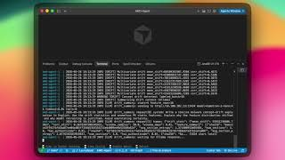
▶
LIVE DEMO
[Insert demo video here]
Bootstrap → Sample collection → Feature extraction → Drift detection → Model retrain → Evaluation

Slide 21
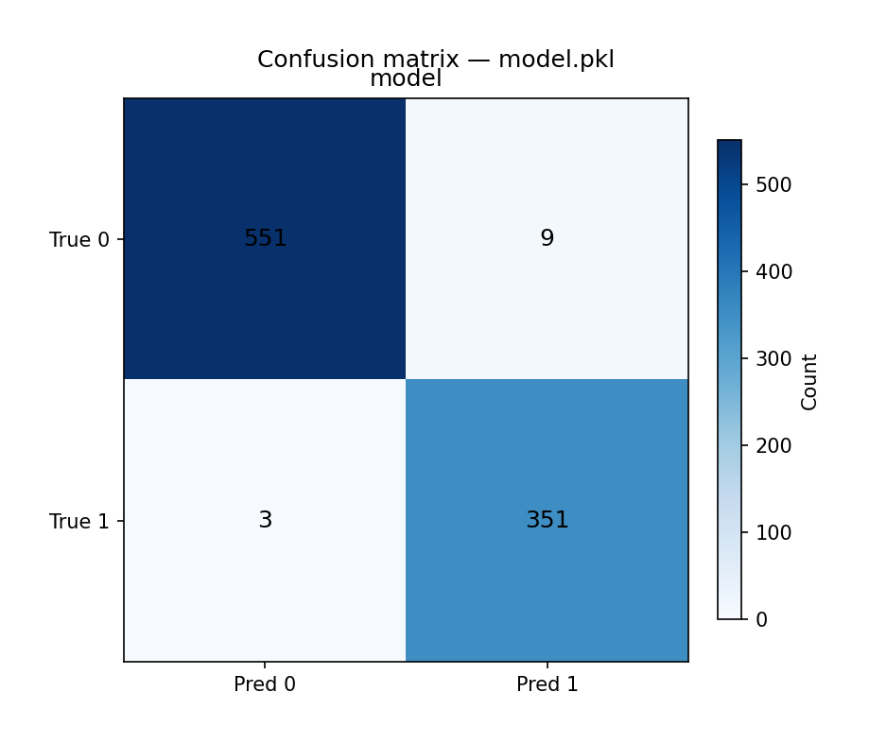
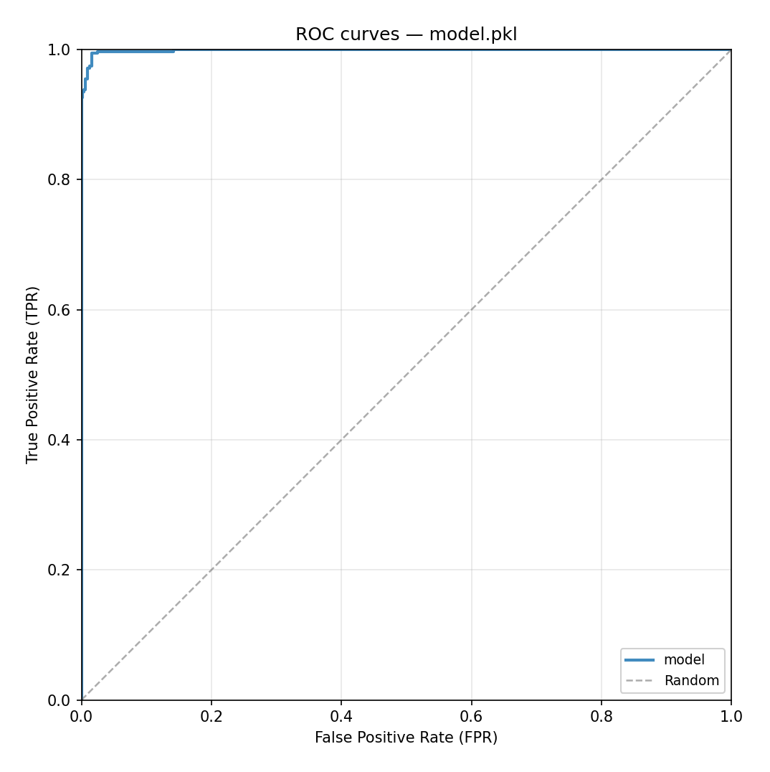
Last Model Performance Results
EXPERIMENTAL RESULTS OVERVIEW
Comprehensive evaluation metrics demonstrating the model's efficacy and reliability across varied test scenarios.

Slide 22
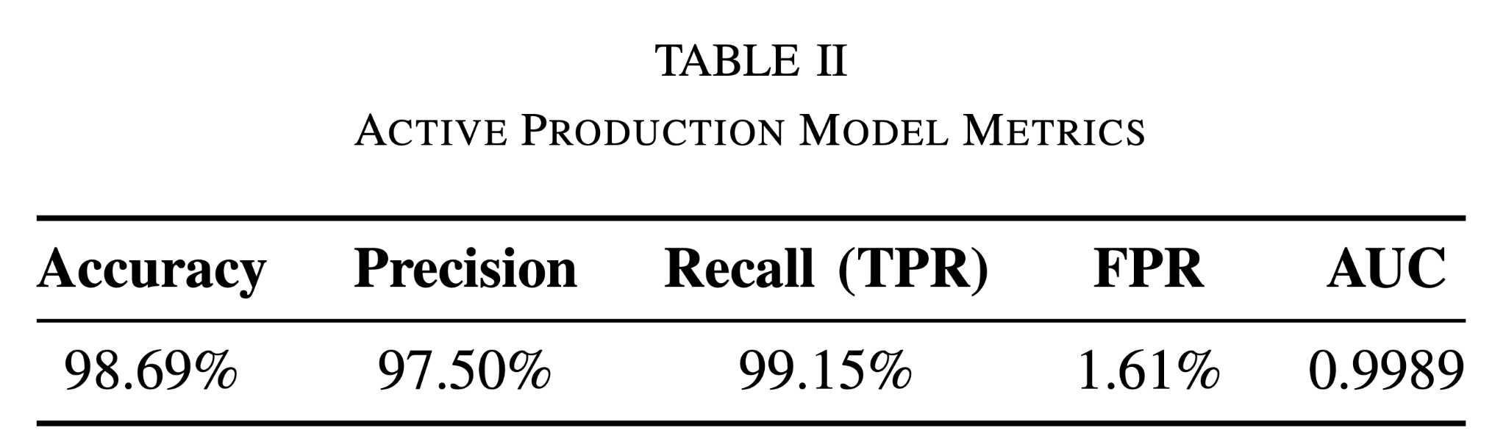


Slide 23
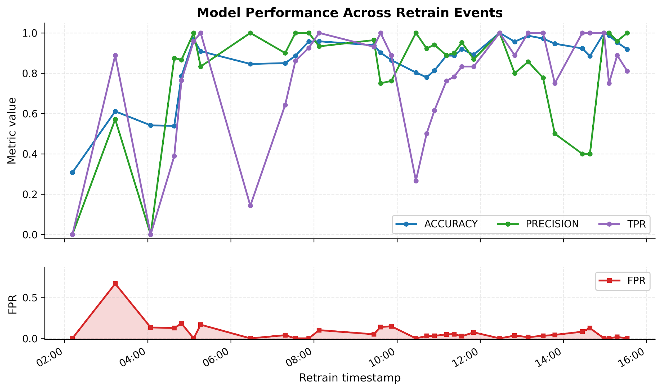
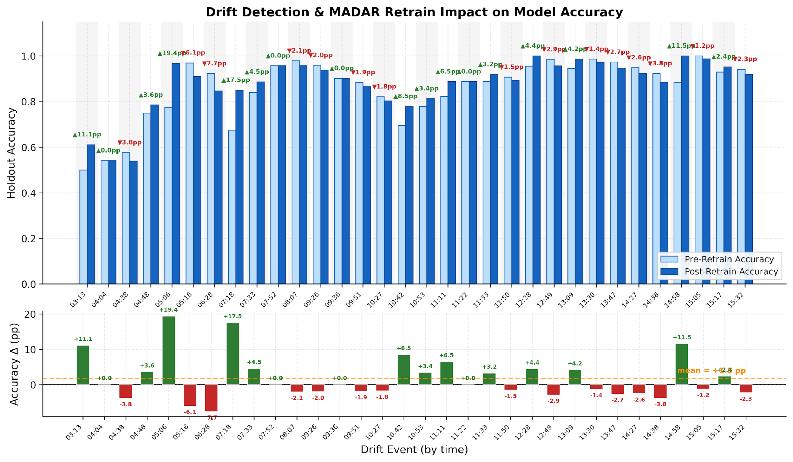
Performance over Time & Drift Results & Evaluation
Performance Over Time (Acc/Prec/Rec/FPR)
Drift → Retrain Delta (before/after)

Slide 24
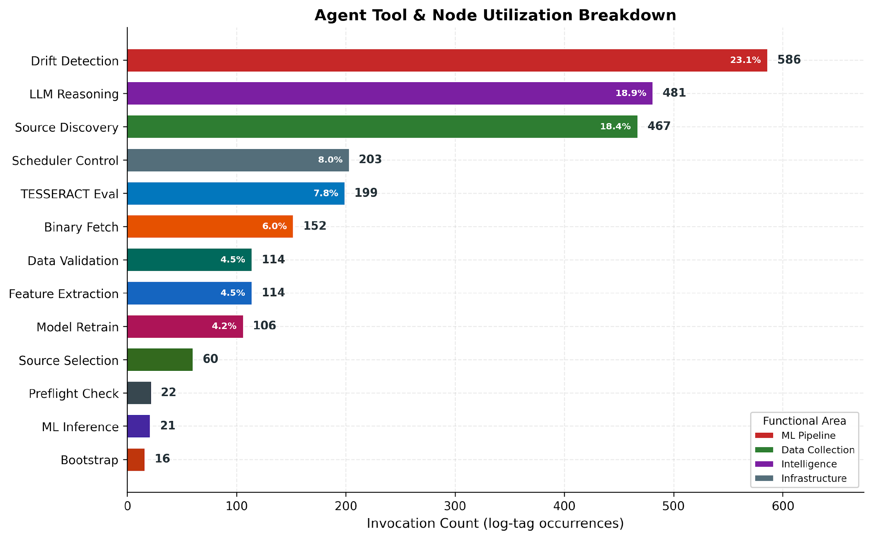
Additional Metrics — Source & Tool Analysis
Agent Tool Usage Breakdown
Sample Distribution per Source

Slide 25
Conclusion
Fully autonomous PE malware detection — no predefined dataset
9 live data sources with circuit breakers, cooldown & success-rate ranking
2304-dim EMBER-like vector, XGBoost selection → top 384 features
Dual drift detection: ADWIN entropy stream + multivariate window shift
MADAR-inspired replay: family-proportional + Isolation Forest ranking
TESSERACT chronological holdout prevents temporal data leakage
Ollama LLM sidecar for CTI filtering & drift explanations — fully optional
Docker-first with iptables egress for safe live malware handling
Future Work:
Multi-agent LangGraph subgraphs · RL-based source selection · Automatic query generation · Malware clustering + explainability
Thank you!

