Slide 1
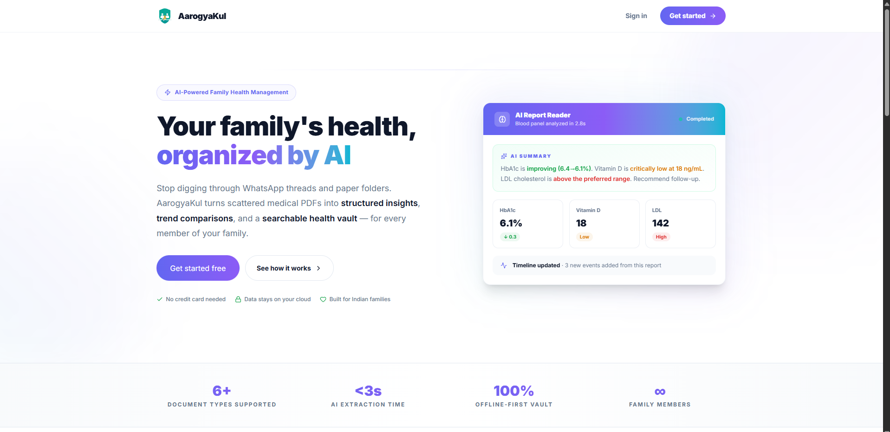
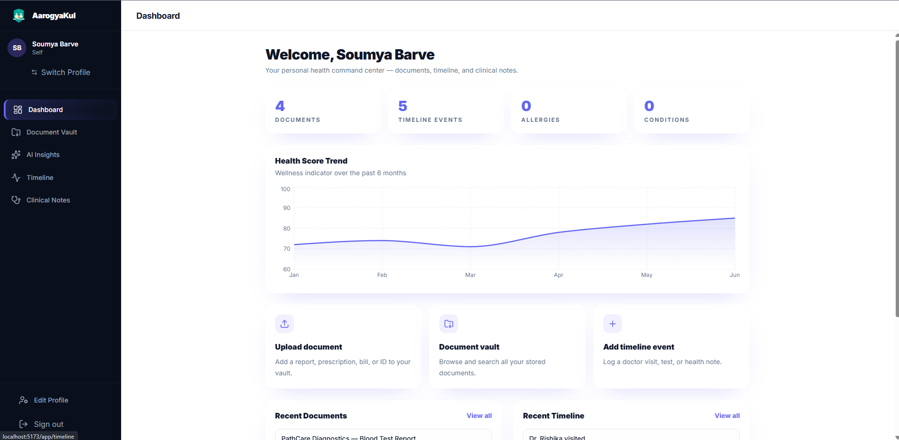
ROUND 2 — BHARAT ACADEMIX CODEQUEST 2026
AarogyaKul
We Built It.
A fully working AI-powered family health platform — built from the ground up in Round 2.
< 3s
18+
7-Stage
AI Extraction
REST Endpoints
AI Pipeline
DEMO VIDEO
Team FutureStack • Akshat Barve • Soumya Barve

Slide 2
What We Delivered
Every feature promised in Round 1 — built and working.
AI
AI Report Reader
V
Document Vault
P
Multi-Profile Workspace
7-stage pipeline: PDFBox + OCR + Llama 3.1 extracts, compares, and summarises lab parameters in plain English.
Centralized storage for 8 document types — blood reports, prescriptions, bills, insurance, X-rays, and more.
Netflix-style family profile picker. Each member has fully independent health data under one account.
T
Health Timeline
C
Clinical Notes
S
Smart AI Insights
Auto-generated timeline events on every upload. Add doctor visits, vaccinations, and health notes manually.
Record allergies with severity levels, chronic conditions with diagnosis dates — all per family member.
Color-coded anomaly flags, trend arrows, reference ranges, and AI-generated plain-English summaries.
✓ Authentication • ✓ Family Profiles • ✓ Document Upload (S3) • ✓ AI Pipeline • ✓ Timeline • ✓ Clinical Notes

Slide 3
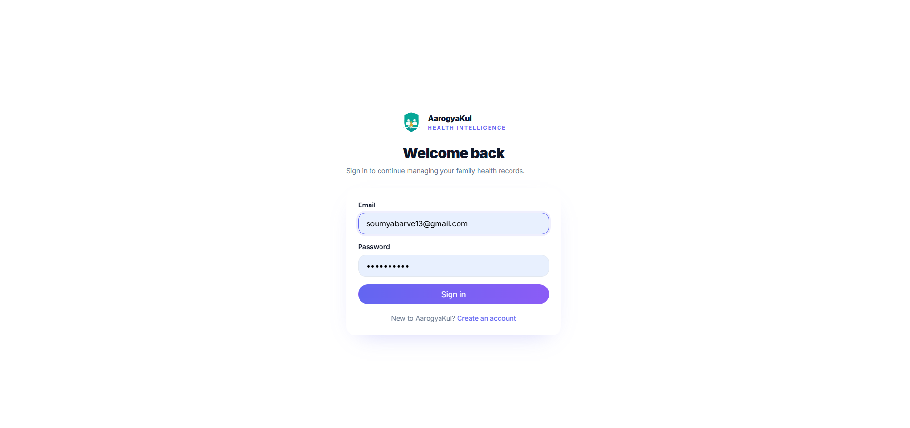
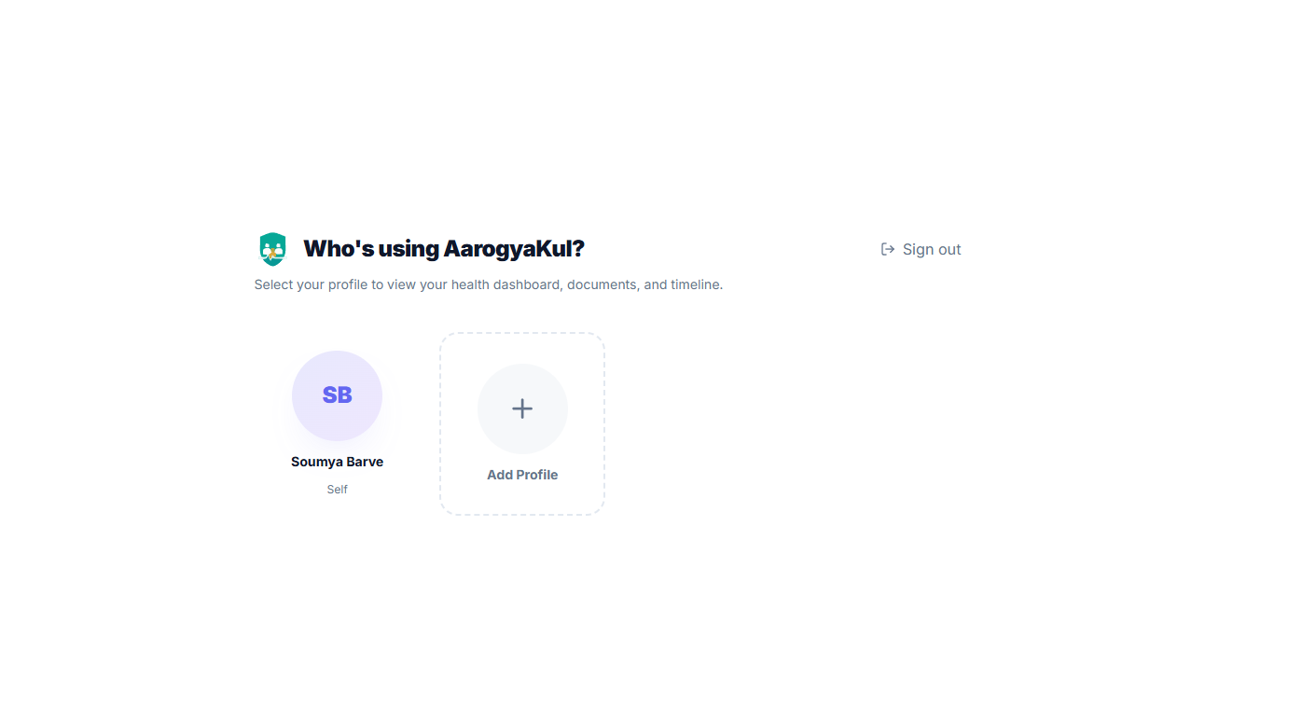
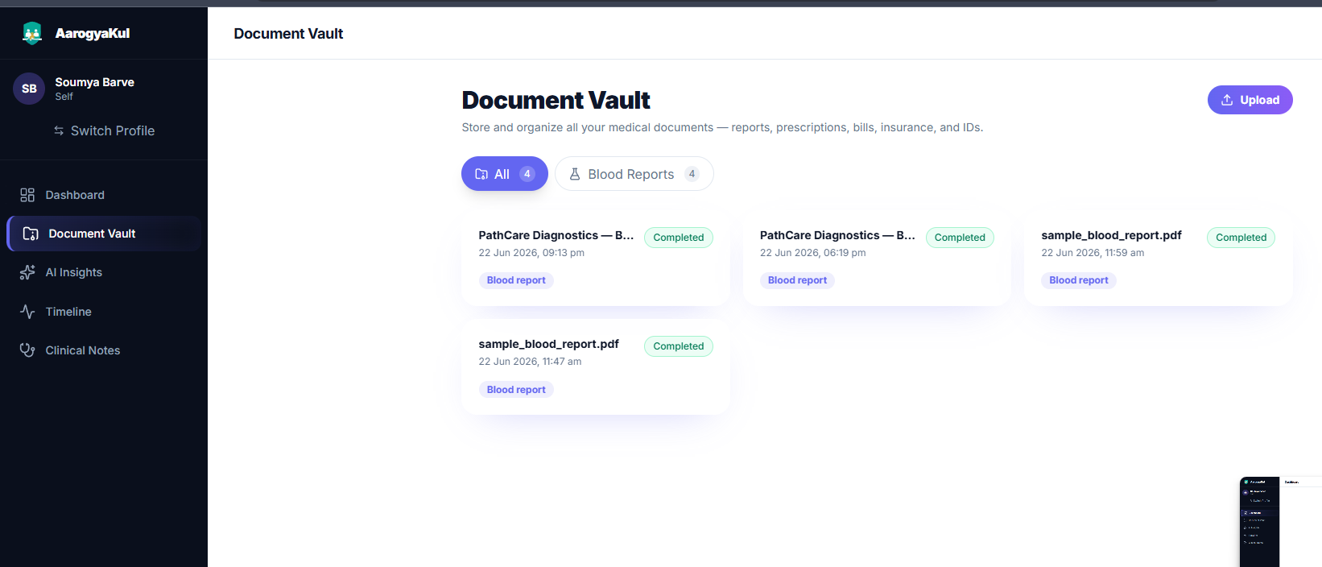
Working Prototype
Live, functional application — not a mockup.
Secure Login
Profile Picker
Personal Dashboard
Document Vault

Slide 4
CORE INNOVATION
AI Report Reader — 7-Stage Pipeline
Transforms a raw PDF into actionable health intelligence in under 3 seconds.
1
2
3
4
5
6
7
Intake
Extract
Parse
Normalize
Persist
Compare
Summarize
Validate PDF ≤15MB, store via S3/Local
PDFBox text + OCR fallback (Tesseract)
Llama 3.1 JSON extraction + recovery
Synonym map 26 variants → 12 canonical
Save Medical Parameter rows to DB
Query prior value → Δ & trend direction
Llama plain- English AI summary
→
→
→
→
→
→
PDFBox + OCR
JSON Recovery
Clinically Meaningful Trend
Handles both digital and scanned PDFs — never fails on image-based lab reports.
Strips markdown fences, regex-recovers partial JSON from LLM output.
Values moving toward normal midpoint = IMPROVING, even if still out of range.

Slide 5
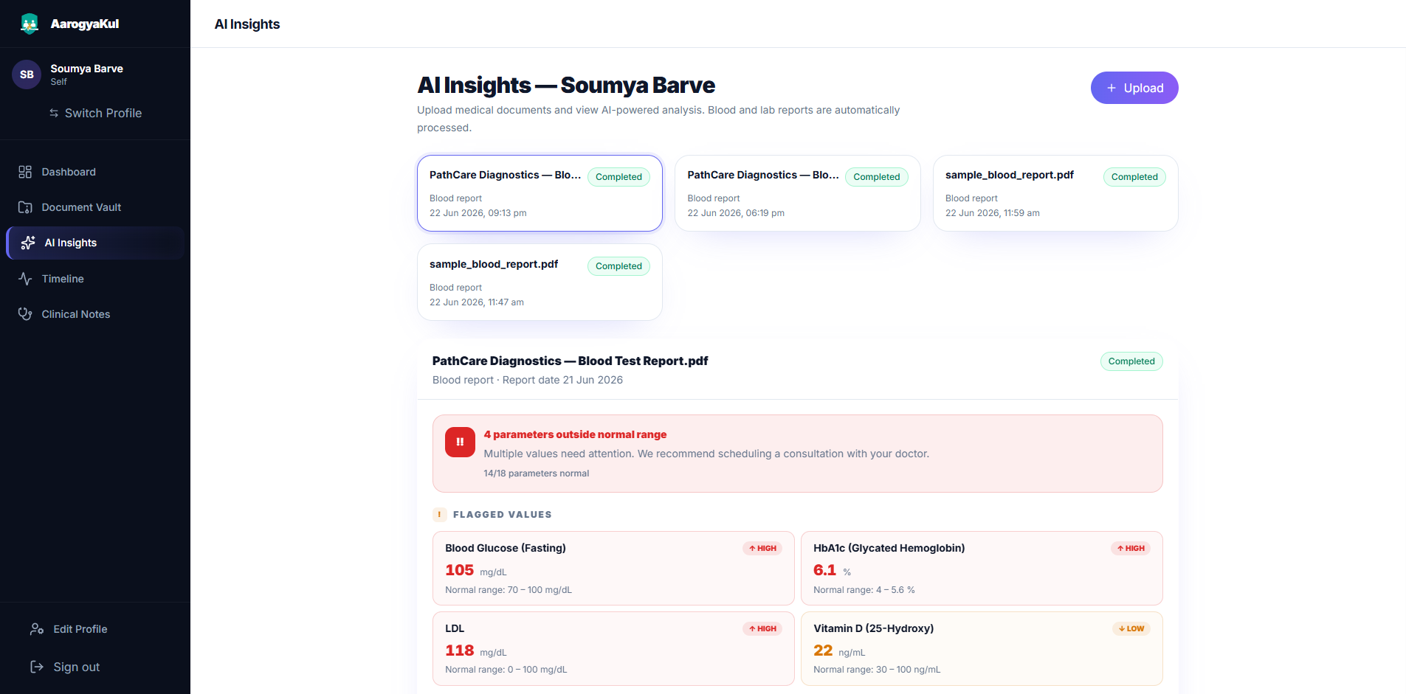
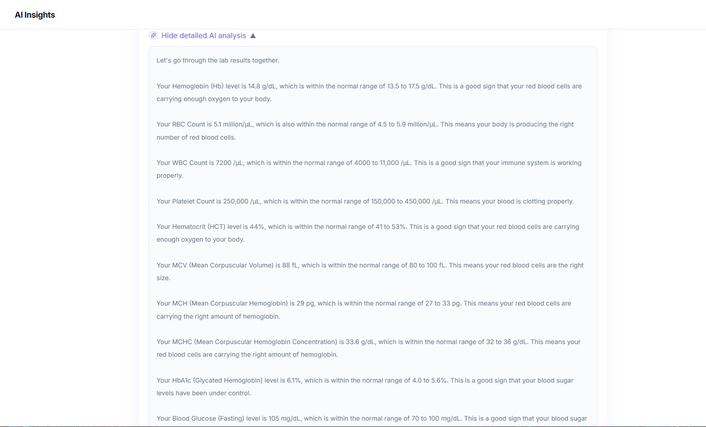
AI Insights — In Action
Real output from a real blood report processed through the pipeline.
Flagged Parameters with HIGH/LOW badges
Plain-English AI Summary per parameter
Real extraction output: Blood Glucose 105 (HIGH), HbA1c 6.1% (HIGH), LDL 118 (HIGH), Vitamin D 22 (LOW) — all with reference ranges and trend comparison.

Slide 6
System Architecture
Production-grade full-stack architecture with async AI processing.
CLIENT
AI LAYER
DATA LAYER
React 19 + TypeScript
AI Pipeline (Async)
PostgreSQL 17
SPA · Vite · Tailwind · Recharts · Axios
@Async executor · 2-4 threads · Queue 20
ACID · UUID PKs · 9 entities · BigDecimal values
Spring Boot 3.5 / Java 21
HTTPS + JWT
HuggingFace Llama 3.1
JPA / SQL
AWS S3 SDK v2
REST Controllers · JWT Filter · Services · JPA
←→
Structured extraction · Plain-English summary
←→
Pre-signed URLs · Regional bucket · Pluggable
Spring Security 6
PDFBox + Tesseract OCR
Docker Compose
HS256 JWT · BCrypt-12 · Stateless filter chain
Dual-mode extraction · 250 DPI fallback
One-command PostgreSQL dev provisioning
User → React → Axios (JWT Bearer) → Spring Security → Controller → Service → JPA → PostgreSQL
All upload responses return 202 Accepted immediately; AI pipeline runs async on bounded thread pool

Slide 7
Technology Stack
Modern, production-grade tools — every version chosen deliberately.
Frontend
Backend
Data & AI
• React 19 — Hooks, concurrent features, component model
• Spring Boot 3.5 / Java 21 — Virtual threads, records
• PostgreSQL 17 — ACID, UUID PKs, BigDecimal values
• Vite 8 — Sub-second HMR, native ESM build
• Spring Security 6 — Stateless JWT filter chain
• AWS S3 SDK v2 — Pre-signed URLs, pluggable storage
• Tailwind CSS 4 — Utility-first with semantic color tokens
• Spring Data JPA — Repository abstraction over Hibernate
• HuggingFace Inference API — Managed Llama 3.1 8B
• Recharts 2 — Health trend charts, composable API
• Apache PDFBox 3 — Pure-Java PDF text extraction
• Docker Compose — One-command local DB setup
• React Router 7 — Nested layouts, private routes
• Tess4j (Tesseract 5) — OCR for scanned reports
• Axios 1.9 — JWT interceptors, error mapping

Slide 8
Scalability & Design Decisions
Every architectural choice built for growth — not just for the demo.
Async AI Processing
Pluggable Storage
UUID Primary Keys
Upload returns 202 Accepted instantly. AI runs on @Async bounded executor (core=2, max=4, queue=20). Frontend polls at 5s intervals — auto-stops when complete.
StorageService interface with LocalStorageService and S3StorageService implementations. Switch via config — zero code change.
All 9 entities use UUID PKs — no sequential integers exposed in URLs. Ownership chain: User → Family → FamilyMember → all downstream data.
Why it matters: Prevents HTTP timeout under AI latency. Handles 20 concurrent uploads without resource exhaustion.
Why it matters: Dev uses local FS, prod uses S3. Cloud-ready from day one.
Why it matters: Prevents ID enumeration attacks and enables horizontal scaling without key conflicts.
Parameter Canonicalization
BigDecimal for Medical Values
Ownership-Scoped Authorization
Static synonym map: 26 input variants → 12 canonical names. 'HbA1c' from Lab A matches 'Glycated Hemoglobin' from Lab B for trend comparison.
All lab values stored as BigDecimal — never floating-point. Comparison and trend calculation use exact decimal arithmetic.
Every data access passes through requireOwnedMember(memberId, userId) — does member belong to a family owned by this user? Hard 403 if not.
Why it matters: Deterministic matching guarantees consistent longitudinal analysis across different lab formats.
Why it matters: Floating-point imprecision is unacceptable in clinical data — a value of 7.10000001 is not 7.1.
Why it matters: Prevents any cross-user data access. Security enforced at service layer, not just controller.

Slide 9
Security Design
Healthcare data demands production-grade security — implemented, not planned.
Authentication Flow
Security Measures
User submits email + password
Password Hashing
BCrypt, cost factor 12
↓
Spring Security → AuthService
Token Algorithm
HS256 (HMAC-SHA256), 24h expiry
↓
BCrypt.matches() password verify
CORS Policy
Explicit origin whitelist
↓
JwtUtil.generate() → HS256 token
File Validation
PDF MIME + extension + 15 MB cap
↓
Token stored in localStorage
S3 Access
Short-lived pre-signed URLs only
↓
All requests: Authorization: Bearer <token>
SQL Injection
JPA parameterized queries — no raw SQL
↓
JwtFilter validates on every request
DTO Boundary
JPA entities never serialized to HTTP
↓
403 Forbidden if ownership check fails
Ownership Guard
User → Family → Member chain enforced

Slide 10
User Impact
Built for the 300M+ Indian families managing health records the hard way.
77M+ Diabetics in India
Scattered Records Problem
Caregivers Managing Parents
Chronic patients need longitudinal HbA1c, blood glucose, and cholesterol tracking — AarogyaKul makes trends visible at a glance.
Average family has reports on WhatsApp, email, paper, and hospital portals. AarogyaKul consolidates all 8 document types in one vault.
One tech-savvy family member manages health records for elderly parents — our Netflix-style profiles are designed exactly for this.
Doctor Visit Preparation
No Consumer App Does This
Zero Setup, Instant Value
Patients arrive with a complete AI-generated summary: past reports, flagged anomalies, trend directions — saving clinical time.
No Indian consumer health app automatically extracts, compares, and explains blood test values. AarogyaKul is first-of-its-kind.
Upload a PDF → get structured parameters, trend comparison, and AI summary in under 3 seconds — no manual data entry.

Slide 11
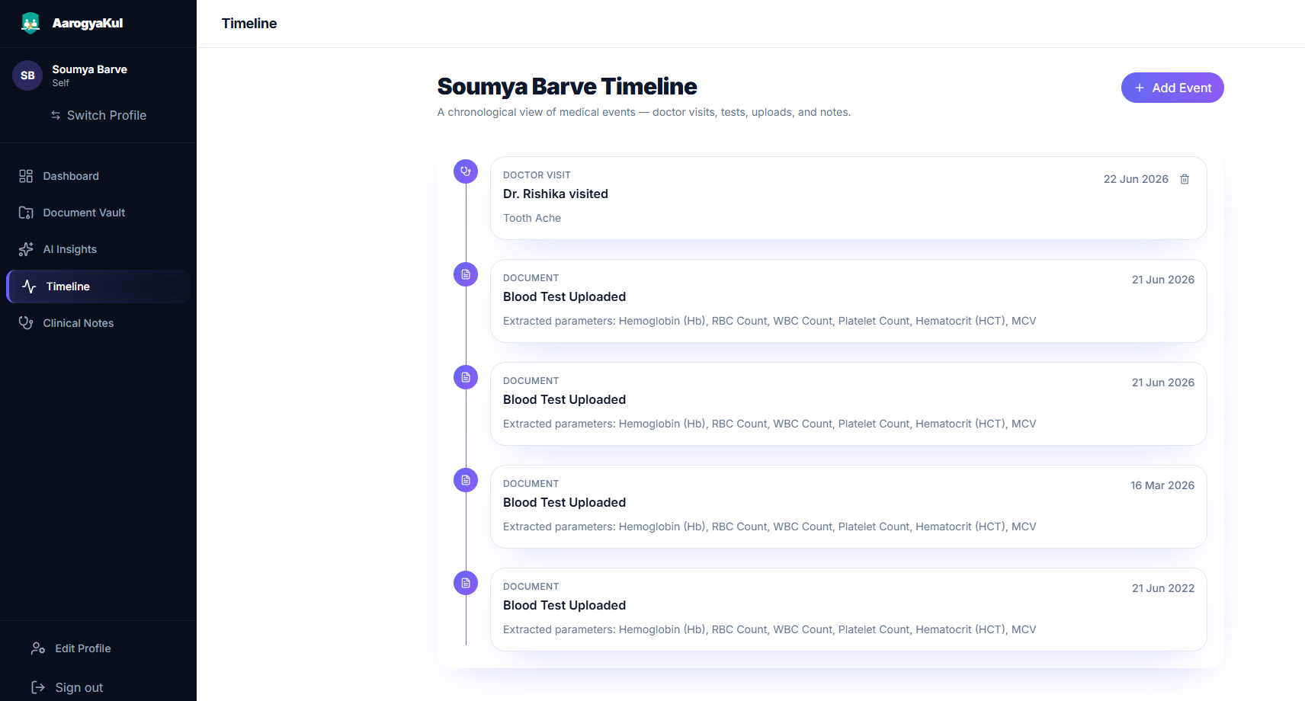
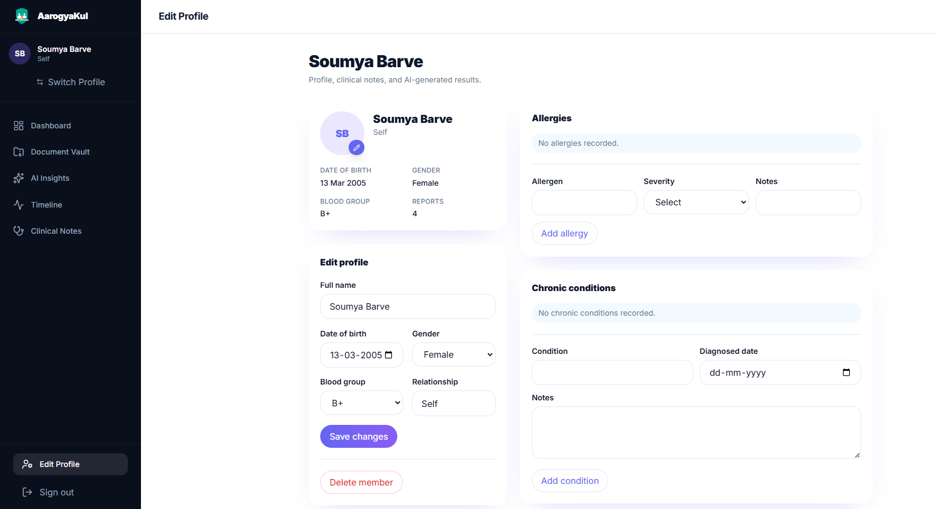
Health Timeline & Clinical Notes
Every interaction with the healthcare system — logged, searchable, and contextual.
Health Timeline
Clinical Profile
Auto-events on every upload + manual doctor visits, vaccinations, notes
Allergies with severity, chronic conditions with diagnosis dates, per member

Slide 12
Project Roadmap
What we built in each round of CodeQuest
Round 1 ✓
Round 2 ✓
Grand Finale
Idea Submission
Prototype — DELIVERED
Full Product
✓ Problem statement defined
✓ Auth + JWT security layer
• Medication tracking + refill alerts
✓ Solution architecture designed
✓ Netflix-style family profiles
• FHIR R4 data export
✓ Tech stack finalized
✓ Document vault (8 types + S3)
• Hindi / regional AI summaries
✓ DB schema & API contracts
✓ 7-stage AI pipeline (live)
• Smart push notifications
✓ Feature roadmap presented
✓ Health timeline (auto + manual)
• Consent-based doctor sharing
✓ Clinical notes (allergies + conditions)
• AES-256 at-rest encryption
✓ AI insights with trend comparison
• Audit trails for compliance
Round 2 delivered ALL planned features — including the AI Report Reader that is live and demo-ready today.

Slide 13
BHARAT ACADEMIX CODEQUEST 2026 — ROUND 2
What we built:
AarogyaKul
7
18+
One platform. Every family member. Total health clarity.
AI pipeline stages
REST API endpoints
An AI-powered healthcare platform that transforms scattered medical PDFs into structured, comparable, actionable family health intelligence.
9
26
AB
SB
database entities
parameter synonyms mapped
Akshat Barve
Soumya Barve
Backend & Cloud Architecture
Frontend & Product Design
<3s
8
Java · Spring Boot · AWS · System Design
React · TypeScript · UI/UX · Tailwind
AI extraction time
document types supported
Team FutureStack

