Slide 1
Single Image Motion Deblurring Using Transparency
Team: ProximaCentauri
Abhinaba Bala(2020701001), Neel Mishra(2020701009), Ritam Basu(2020701005), Jigyasu Khandelwal(2020702013)

Slide 2
Overview
Motion blur is a phenomena which is caused by the movement of object or camera shake at the time of triggering of camera shutter.
The paper proposes a way to deblur the image.
It is done by proposing a model for motion blur using transparency.

Slide 3

Understanding the problems
The previously proposed model for image deblurring are mainly centred on solving an equation
The main concern regarding restoring a still image containing motion blur is that the background may not undergo the same motion blur.
The notion of transparency will help in resolving this.
02
03

Slide 4
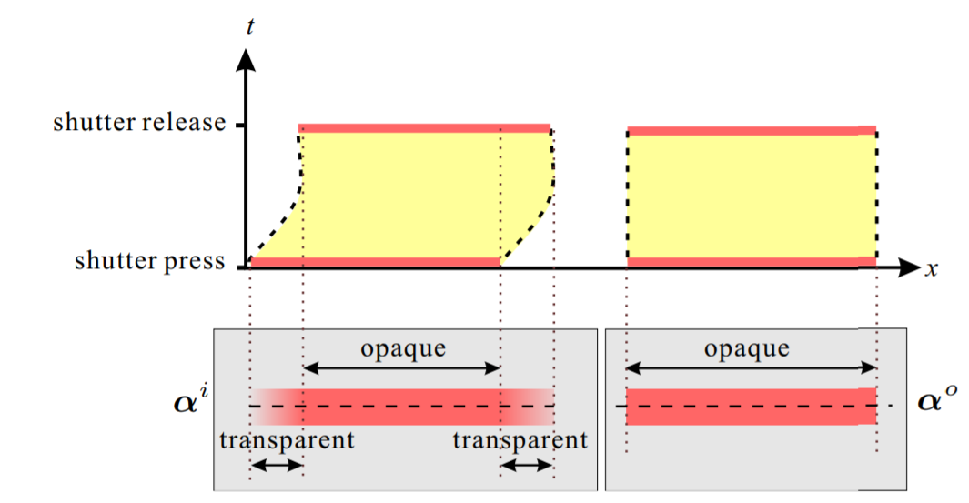
Where does transparency come in?
Transparency is the proportion of time that the background is exposed.
We use transparency to model the blur filter.
defines transparency corresponding to blurred image pixels.
defines transparency values corresponding to non blurred image pixels.

Slide 5


Analysis of object motion blur
A formulation of motion blur from transparency point of view can be given as:
A MAP approach is proposed to recover the motion blur filter using transparency.
Using Bayes rule:

Slide 6



Analysis of object motion (cont)
The likelihood measures the similarity between the input and convolved alpha values.
And the prior is taken to be:

Slide 7
Generalised Transparency In Motion Blur
The aim here is to estimate the blur filter due to camera shake.
The entire image is not required to be taken into computation.
Considering the alpha blending of background and foreground colors, we obtain that we have to compute the same blur filter as we did before.

Slide 8
Deconvolution, lucy-richardson method
After estimating the blur filter, we either apply the Lucy Richardson method, or some other deconvolution method to deconvolve the blurred image.

Slide 9
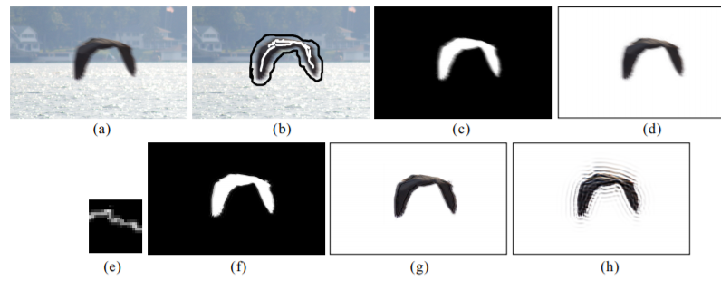
Paper output
Example of object motion blur.
(a) Input image containing a blurred flying bird.
(b) The strokes to indicate foreground and background.
(c) The computed alpha matte.
(d) The extracted flying bird.
(e) The estimated blur filter from paper’s method.
(f) The restored alpha matte.
(g) The deblurred bird from our method.
(h) The deblurred bird using ’deconvblind(·)’ in Matlab.

Slide 10
Conclusion
In this paper a novel approach have been proposed to restore motion blurred images using transparency.
The optimization can be neatly applied to solve the problem of camera motion blur by introducing the generalized transparency.
After the blur filter is estimated, we can deconvolve and get back the deblurred image.

