Slide 1
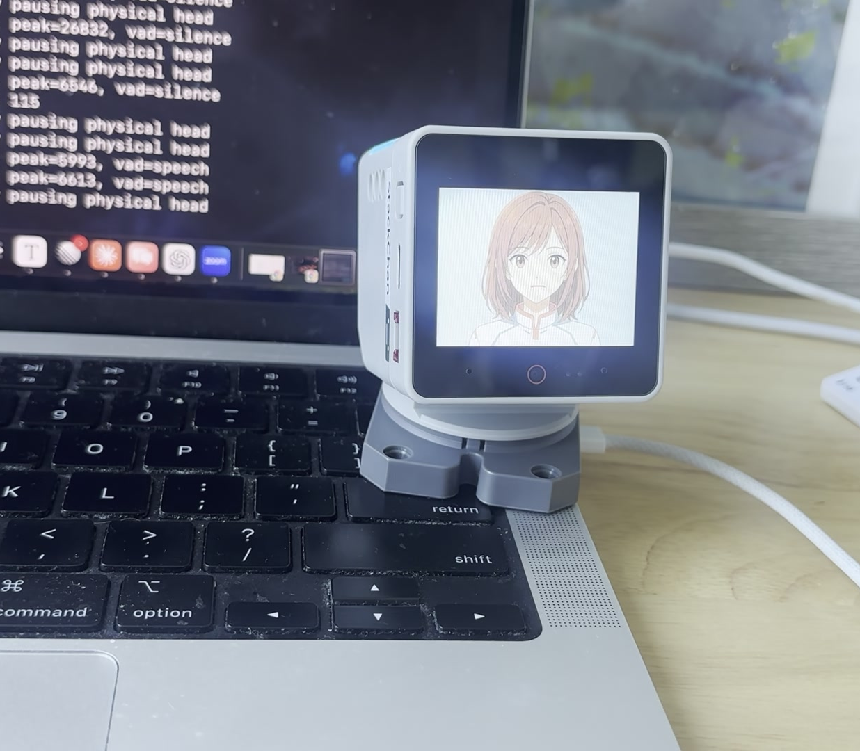
OPENAI BUILD WEEK
Yuki
The Curious Desktop Robot
A native C++ embodied AI character that sees, reacts, moves, and starts conversations.
ESP32-S3 / C++ / LVGL / MCP
Live demo frame from the finished physical build
01

Slide 2
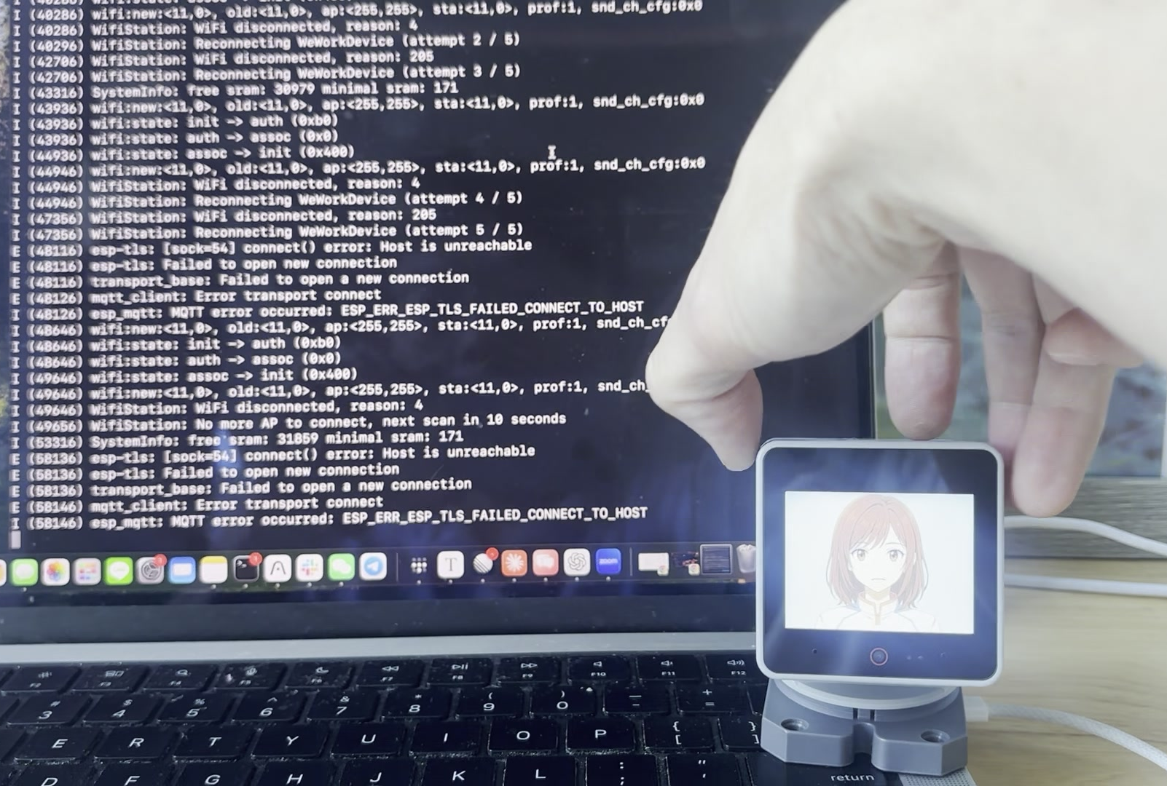
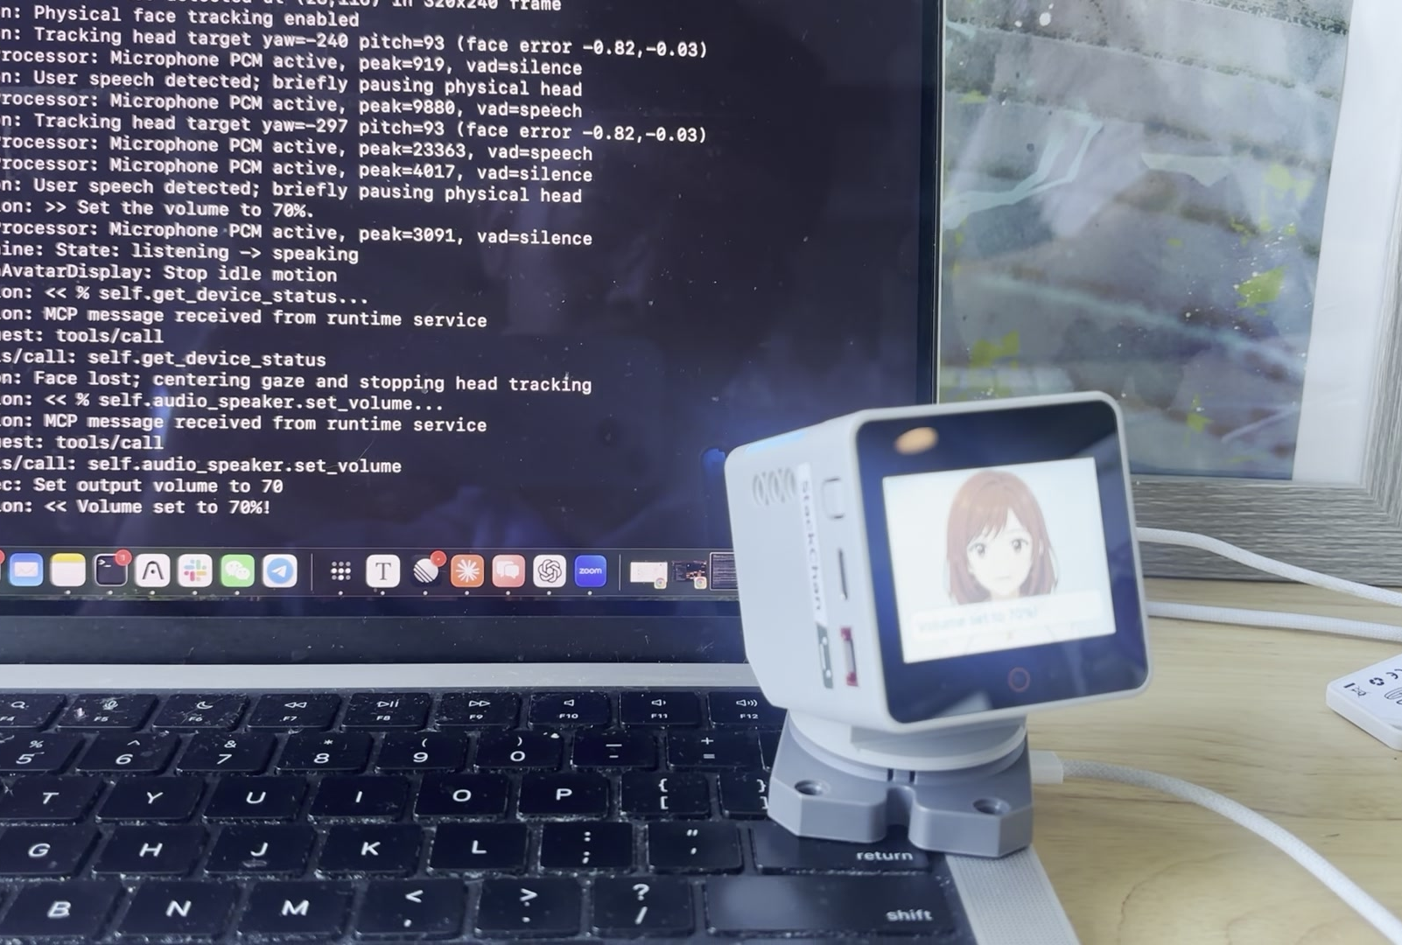
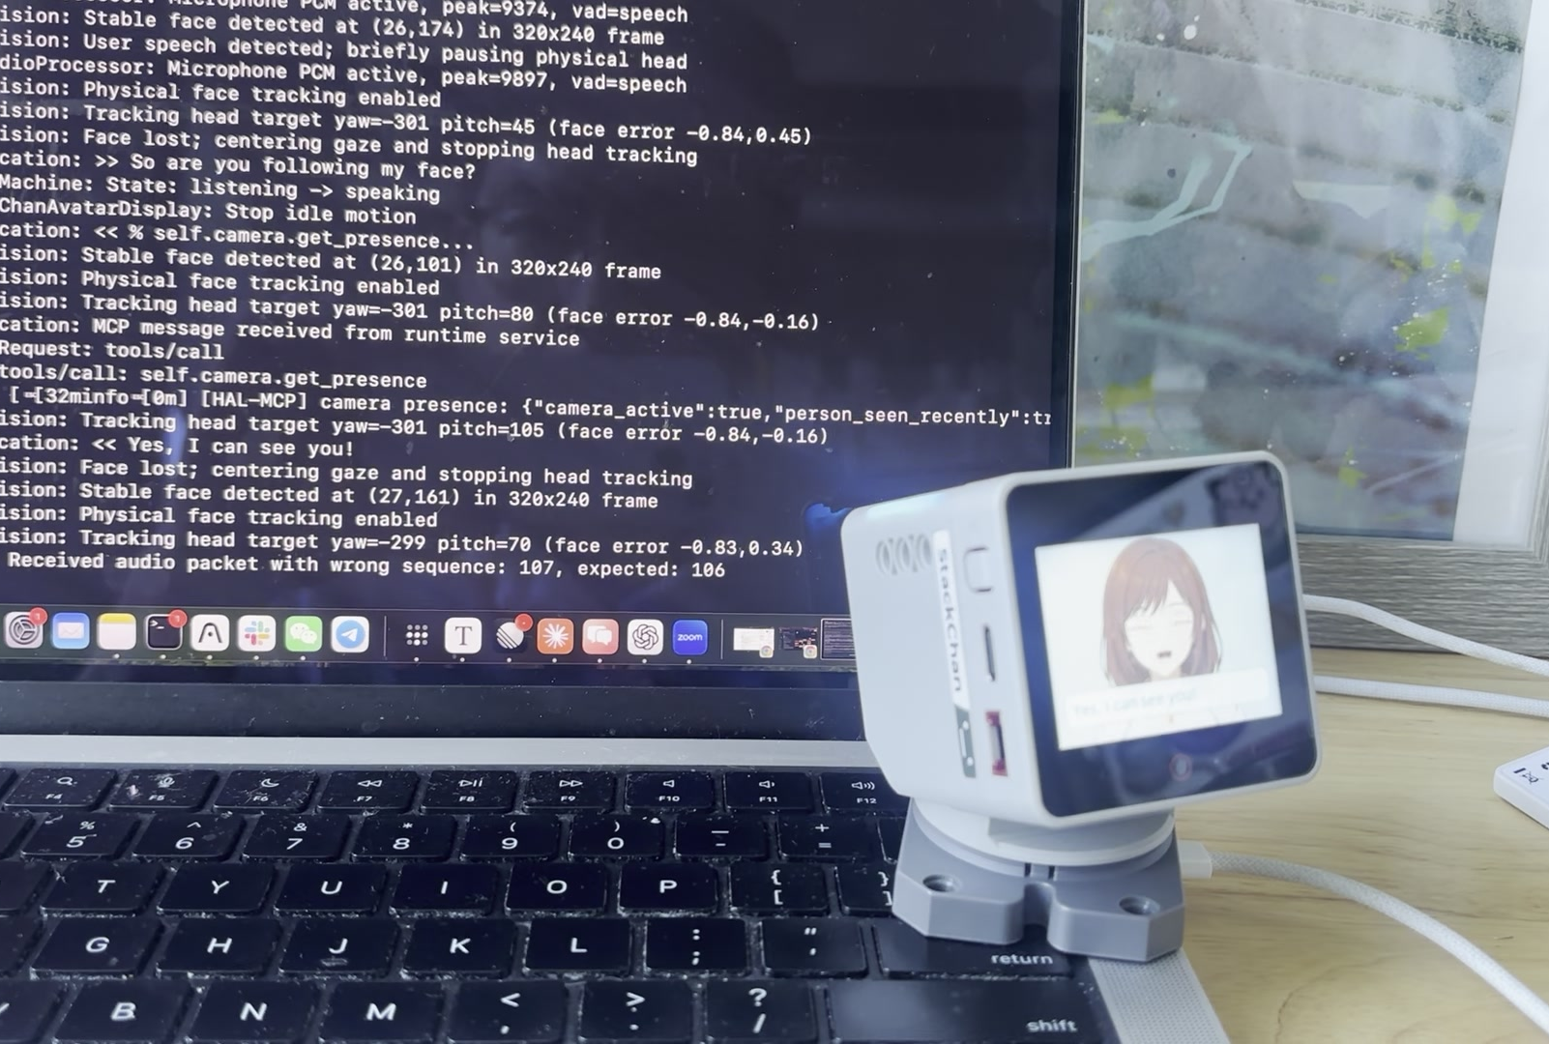
Presence continues between prompts.
Yuki is designed as a companion with behavior between commands, not a chatbot placed inside a shell.
WAKES
SEES
PERFORMS
"Hi Yuki" or head touch invites interaction; touch also triggers a shy reaction.
Local face detection keeps gaze and the calibrated physical head oriented toward the user.
Voice, anime expression, head motion, and 12 RGB LEDs act as one character.
IDLE CURIOSITY
Explores owner-aligned articles, saves worthwhile topics, and can initiate a conversation when the moment is appropriate.
Evidence: finished demo footage and native firmware behavior
02

Slide 3

The body runs on the device.
Cloud intelligence is replaceable; perception, animation, memory, motion limits, and hardware control stay native.
SENSE
DETERMINISTIC C++
EXPRESS
TYPED MCP BOUNDARY
Camera Microphone Head touch IMU motion
ESP-IDF + FreeRTOS Local face detection Safety limits Event memory
LVGL avatar 2 calibrated servos 12 RGB LEDs Speaker
17 physical tools Replaceable runtime model Firmware keeps authority
JAPANESE LIMITED ANIMATION IN LVGL
High-quality held pose + layer-aligned eyelids + three mouth shapes + tame / tsume timing + follow-through
Platform: ESP32-S3, 16 MB flash, 8 MB PSRAM; firmware: C/C++, ESP-IDF, FreeRTOS, LVGL, ESP-DL, MCP
03

Slide 4
Codex moved fast when hardware produced evidence.
Its strength was cross-layer reasoning. Its boundary was the physical world.
STRONG
BOUNDARY
assert failed: s_task_stack_is_sane_when_cache_frozen() Codex hypothesis: move the vision task stack to PSRAM
Code archaeology across C++, FreeRTOS, LVGL, ESP-DL, networking, drivers, and MCP.
A log cannot hear servo noise, judge animation beauty, or prove that a commanded head movement happened safely.
01
02
03
04
Model before TLS
Task after TLS
Stack in PSRAM
Final startup design
MQTT allocation failure
Fragmented internal RAM
Cache-freeze reboot loop
Reserve internal stack early; activate model after secure connect
IMPROVE
Uncertainty from partial logs / chip-specific memory rules / automatic rollback / command issued != behavior verified
Failure sequence reconstructed from live flashing, serial logs, and physical observation
04

Slide 5
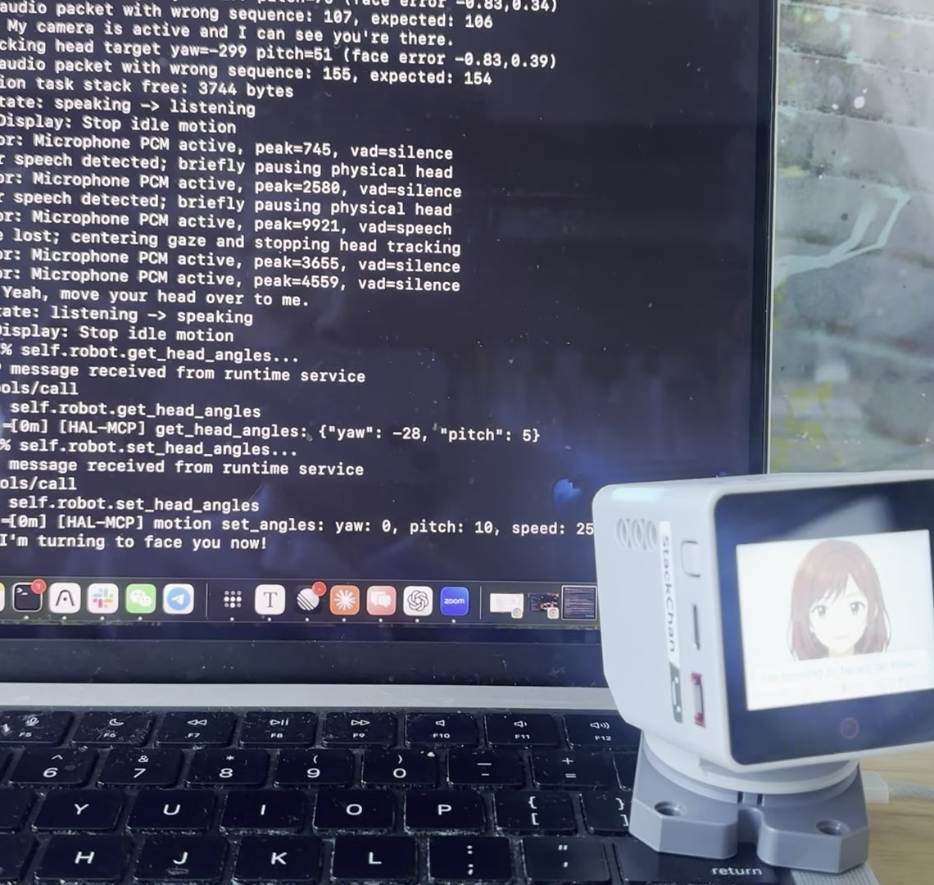
THE RESULT
A complete character, not a proof of concept.
Working physical robot Installable native firmware Local face tracking Voice + gesture + touch wake 17 typed MCP tools 2 servos + 12 RGB LEDs
Codex was excellent with code and telemetry. Real embedded work still required human eyes, ears, and safety judgment.
github.com/baryhuang/yuki-desktop-robot
05

