Slide 1
JUnit4/JUnit5
features

Slide 2
JUnit4 - Basic Assertions
org.junit.Assert.assertTrue
org.junit.Assert.assertFalse
org.junit.Assert.assertNotNull
org.junit.Assert.assertNull
org.junit.Assert.assertEquals
org.junit.Assert.assertArrayEquals
org.junit.Assert.assertSame
org.junit.Assert.assertNotSame
org.junit.Assert.assertThat - uses org.hamcrest.Matcher (allow to write more readable tests)

Slide 3
Hamcrest Matchers
JUnit4 contains core Hamcrest Matchers
For more you need to include additional dependency: Maven: <dependency> <groupId>org.hamcrest</groupId> <artifactId>hamcrest-all</artifactId> <version>1.3</version> </dependency>
Other assertion libraries: AssertJ, Truth

Slide 4
Example Hamcrest Matchers
assertThat(numer, is(equalTo(5)));
assertThat(number, is(not(nullValue())));
assertThat(string, both(containsString("a")).and(containsString("b")));
assertThat(number, either(equalTo(3)).or(equalTo(4))));
assertThat(list, hasItems("one", "three"));
assertThat(list, everyItem(containsString("n")));
assertThat(string, allOf(equalTo("good"), startsWith("go")));
assertThat(string, anyOf(equalTo("bad"), equalTo("good")));
assertThat(instance, not(sameInstance(otherInstance)));

Slide 5
JUnit4 - Assumptions
Assumptions allow to run tests only when certain conditions are met. For example:
Running only locally or on CI server
Running only on particular OS
Running only on particular day (not on Friday for example ☺)
Basic assumptions:
assumeFalse / assumeTrue
assumeThat

Slide 6
JUnit4 - Rules
Rules allow very flexible addition or redefinition of the behavior of each test method in a test class.
Base Rules provided with JUnit
TemporaryFolder
TestName
Timeout
ExpectedException
RuleChain
…
You can write your own custom rules

Slide 7
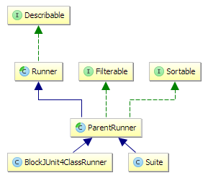
JUnit4 - Runners
JUnit Runner is class that extends JUnit's abstract Runner class. Runners are used for running test classes.
Example runners:
@RunWith(Suite.class)
@RunWith(Parameterized.class)
@RunWith(Categories.class)
@RunWith(Theories.class)
By default BlockJUnit4ClassRunner is used if no @RunWith is set
There is many third party runners available:
SpringJUnit4ClassRunner
MockitoJUnitRunner
…

Slide 8
JUnit4 - Categories
Marker interfaces
@Category + marker interface at class/method level
At suite level:
@RunWith(Categories.class)
@IncludeCategory
@ExcludeCategory
Maven: maven-surefire-plugin

Slide 9
JUnit4 - Parameterized tests
@RunWith(Parameterized.class)
When running a parameterized test class, instances are created for the cross-product of the test methods and the test data elements.

Slide 10
JUnit4 - Theories
@RunWith(Theories.class)
@Theory
@DataPoint
@TestedOn
@ParametersSuppliedBy

Slide 11
JUnit5 – why we need new JUnit?
JUnit4 was released a decade ago
Testing evolved since then, it is not just about writing unit tests.
Lack of support for java 8 (streams, lambdas)
Known JUnit4 issues
For example runners are not composable: Parametrized + SpringRunner --> no way SpringClassRule / SpringMethodRule instead of SpringJUnit4ClassRunner
We need modularity instead of current big ball of mud (THE junit.jar!) IDEs like Eclipse/IntelliJ call internal private junit code using reflection!

Slide 12
JUnit5 – (version: 5.0.0-M4)
JUnit 5 is composed of several modules (platform + Jupiter + Vintage)
JUnit platform serves as a foundation for launching testing frameworks on the JVM. Provides a uniform API for the tools
JUnit Jupiter TestEngine for running Jupiter based (JUnit5) tests on the platform.
JUnit Vintage TestEngine for running JUnit 3 and JUnit 4 based tests on the platform.

Slide 13
JUnit5 - features
Modular
Extensible
Modern
Forward and backward compatibile. Junit platform supports junit 3.8, junit 4 and junit 5
JUnit4 can run JUnit5 tests with @RunWith(JUnitPlatform.class)

Slide 14
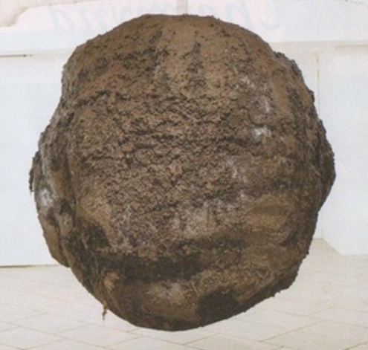
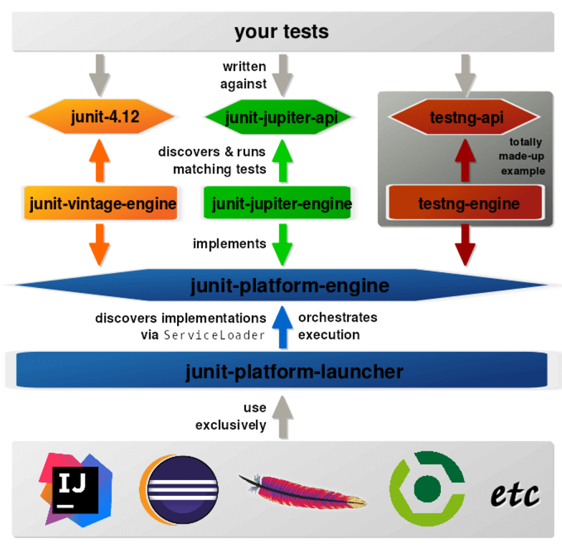
JUnit4 vs JUnit5 - architecture

Slide 15
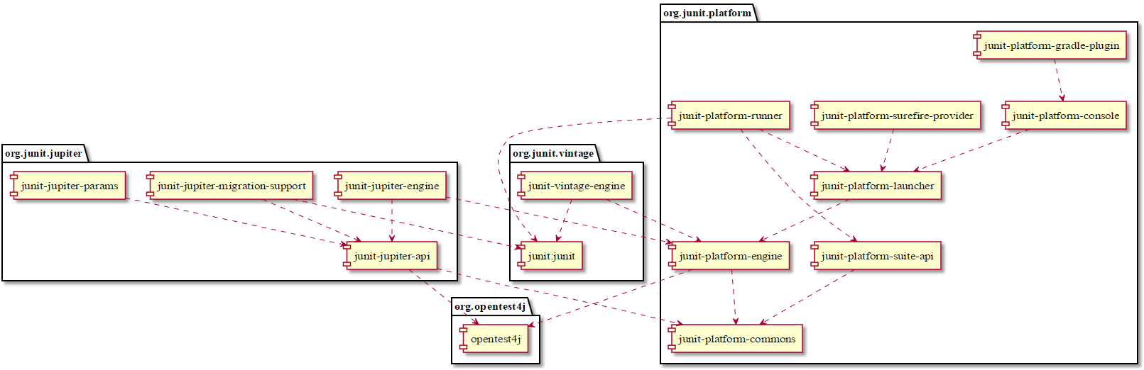
JUnit5 – dependency Diagram

Slide 16
JUnit5 – what`s new
New package: org.junit.jupiter.api
Lambda expressions and lazy evaluation of messages
New assertions:
assertThrows
assertTimeout
assertTimeoutPreemptively
Meta annotations
Nested tests
Repeated tests
Dependency Injection for Constructors and Methods (ParameterResolver)
Dynamic tests
Parameterized Tests (lots of changes compared to JUnit4)

Slide 17
JUnit5 - annotations
JUnit5 | JUnit4
@Test | @Test
@BeforeAll | @BeforeClass
@AfterAll | @AfterClass
@BeforeEach | @Before
@AfterEach | @After
@Disable | @Ignore
@Tag | @Category
@ExtendWith (composable) | @RunWith (not composable)
@TestFactory | N/A
@Nested | N/A
@RepeatedTest | N/A
@DisplayName | N/A

Slide 18
JUnit5 - IDE suport
IntelliJ IDEA since 2016.2
Eclipse 4.7 Oxygen – beta suport (see https://wiki.eclipse.org/JDT_UI/JUnit_5)

Slide 19
JUnit - links
JUnit4: https://github.com/junit-team/junit4/wiki
JUnit5: http://junit.org/junit5/docs/current/user-guide/
DEVOXX: Deep Dive into JUnit 5 by Sam Brannen https://www.youtube.com/watch?v=UHN_HcjZa7o

Slide 20
THE END

