Slide 1
Amateur Astronomy
  The Bangalore Astronomical Society®

Slide 2
Overview
What is Amateur Astronomy?
Amateur Astronomy as a hobby
  We wish to share the joys of Amateur Astronomy with you
Scientific Contributions by hobby astronomers
  Various means of contributions
  Why these are important
What you can do
  Some ideas for students

Slide 3
Amateur Astronomy - What?
What is Amateur Astronomy?
  Amateur, Not Professional, a Hobby
  May have productive outcome
  Observing celestial objects
  Photography of the sky and celestial objects
  Observing “variable” stars
  Hunting down new comets, asteroids and variable stars
  Observing meteor showers, arourae, and other such atmospheric phenomena

Slide 4
What professionals do
Explain physically, the origin and characteristics of celestial objects and events
  How do galaxies form? Make a physical model...
  Why does this star change in brightness randomly?
  Why are the planets' orbits confined more-or-less to a single plane?
  What are comets made of?

Slide 5
What professionals do
Cosmology
  Trace back to the origins of the universe
  Scientific history of the universe
  Dark Matter and Dark Energy
  Cosmic Microwave Background Radiation
Data Collection
  Collect data for future analysis and physical modeling
  Eg: Variation in brightness of stars

Slide 6
What amateurs do
Have fun – a hobby
  See beautiful nebulae, galaxies etc and enjoy
Learn, at the same time, by doing
  How telescopes work, optics of telescopes
  Telescope making – make your own telescope from scratch
  Observe features of nebulae, galaxies, star clusters etc and learn why they are that way

Slide 7
What amateurs do
Contribute to scientific research
  Find comets and asteroids, so professionals can study them
  Hunt for supernovae, so that professionals can find what's going on there
  Collect data on variation of brightness of stars
  Recover “lost” comets
  Lots more...

Slide 8
Amateur Astronomy – a Hobby
Observation – look at the sky, the celestial objects and atmospheric phenomena
Amateur Astrophotography – take photographs, of the sky, and the celestial objects
Amateur Telescope making – make telescopes and other instrumentation
Reducing light pollution?

Slide 9
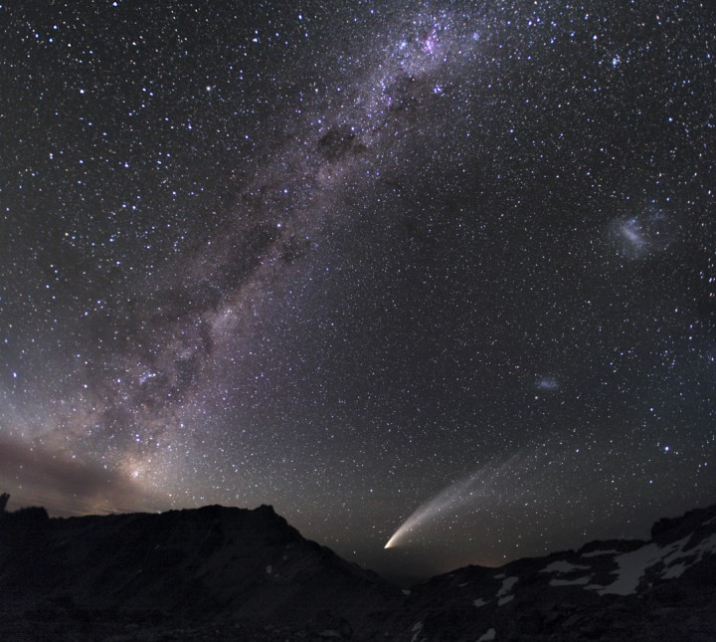
What you get to see
`
Not as dramatic as the photos though, unfortunately!

Slide 10
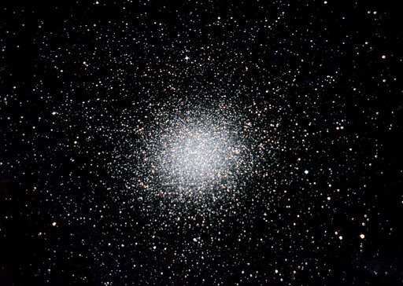
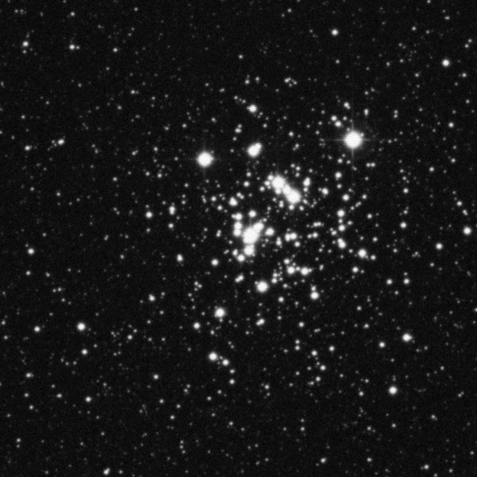
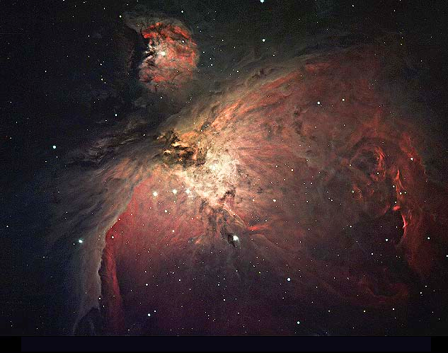
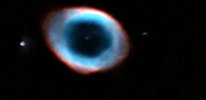
©Dr Suresh Mohan
©AAO
©Dr Suresh Mohan

Slide 11
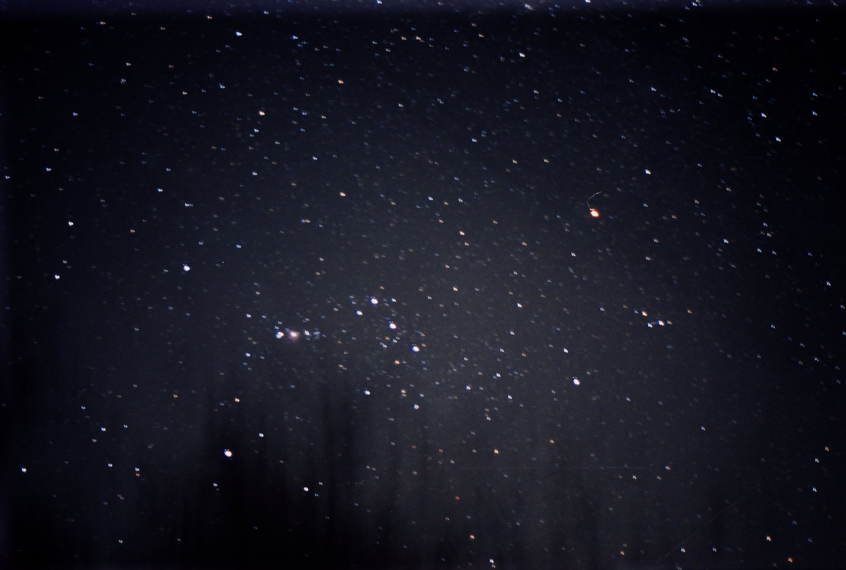
Astrophotography
What you need
  A camera capable of long exposures
  A tripod
Scientific Value
  Comet, asteroid and nova discovery
  Variable Stars
Constellation Orion by Shashank H.J.

Slide 12
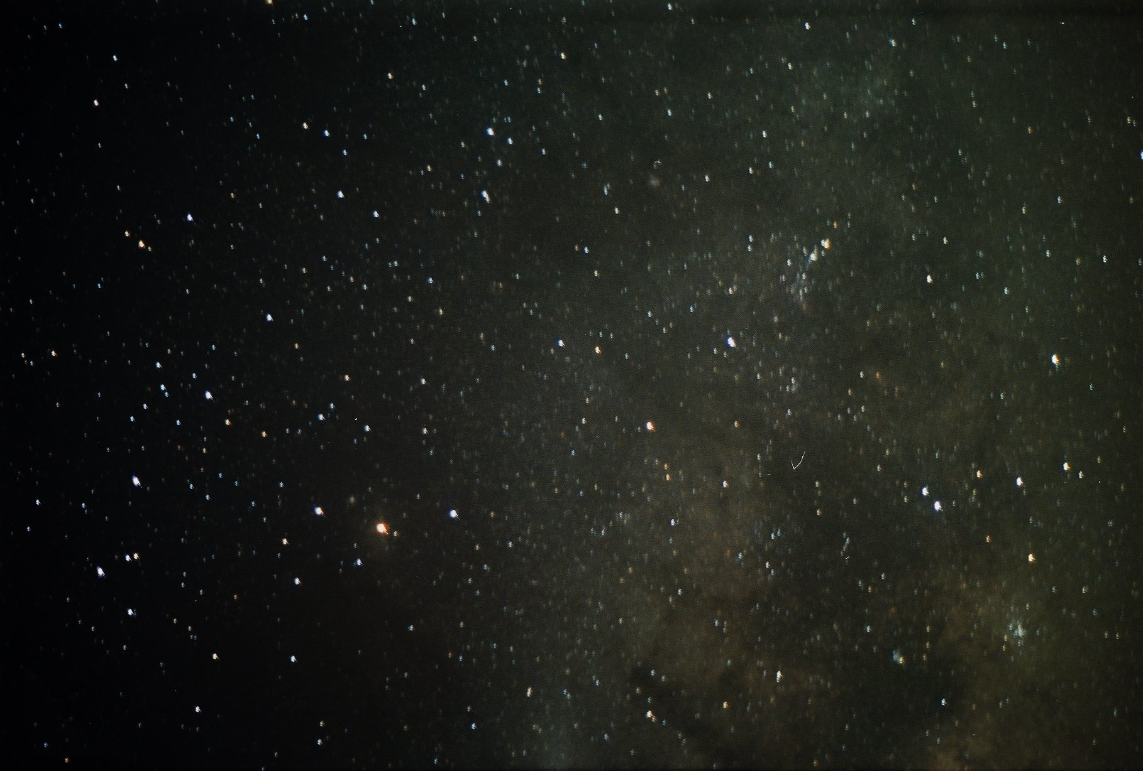
Constellation Scorpius by Shashank H.J.

Slide 13
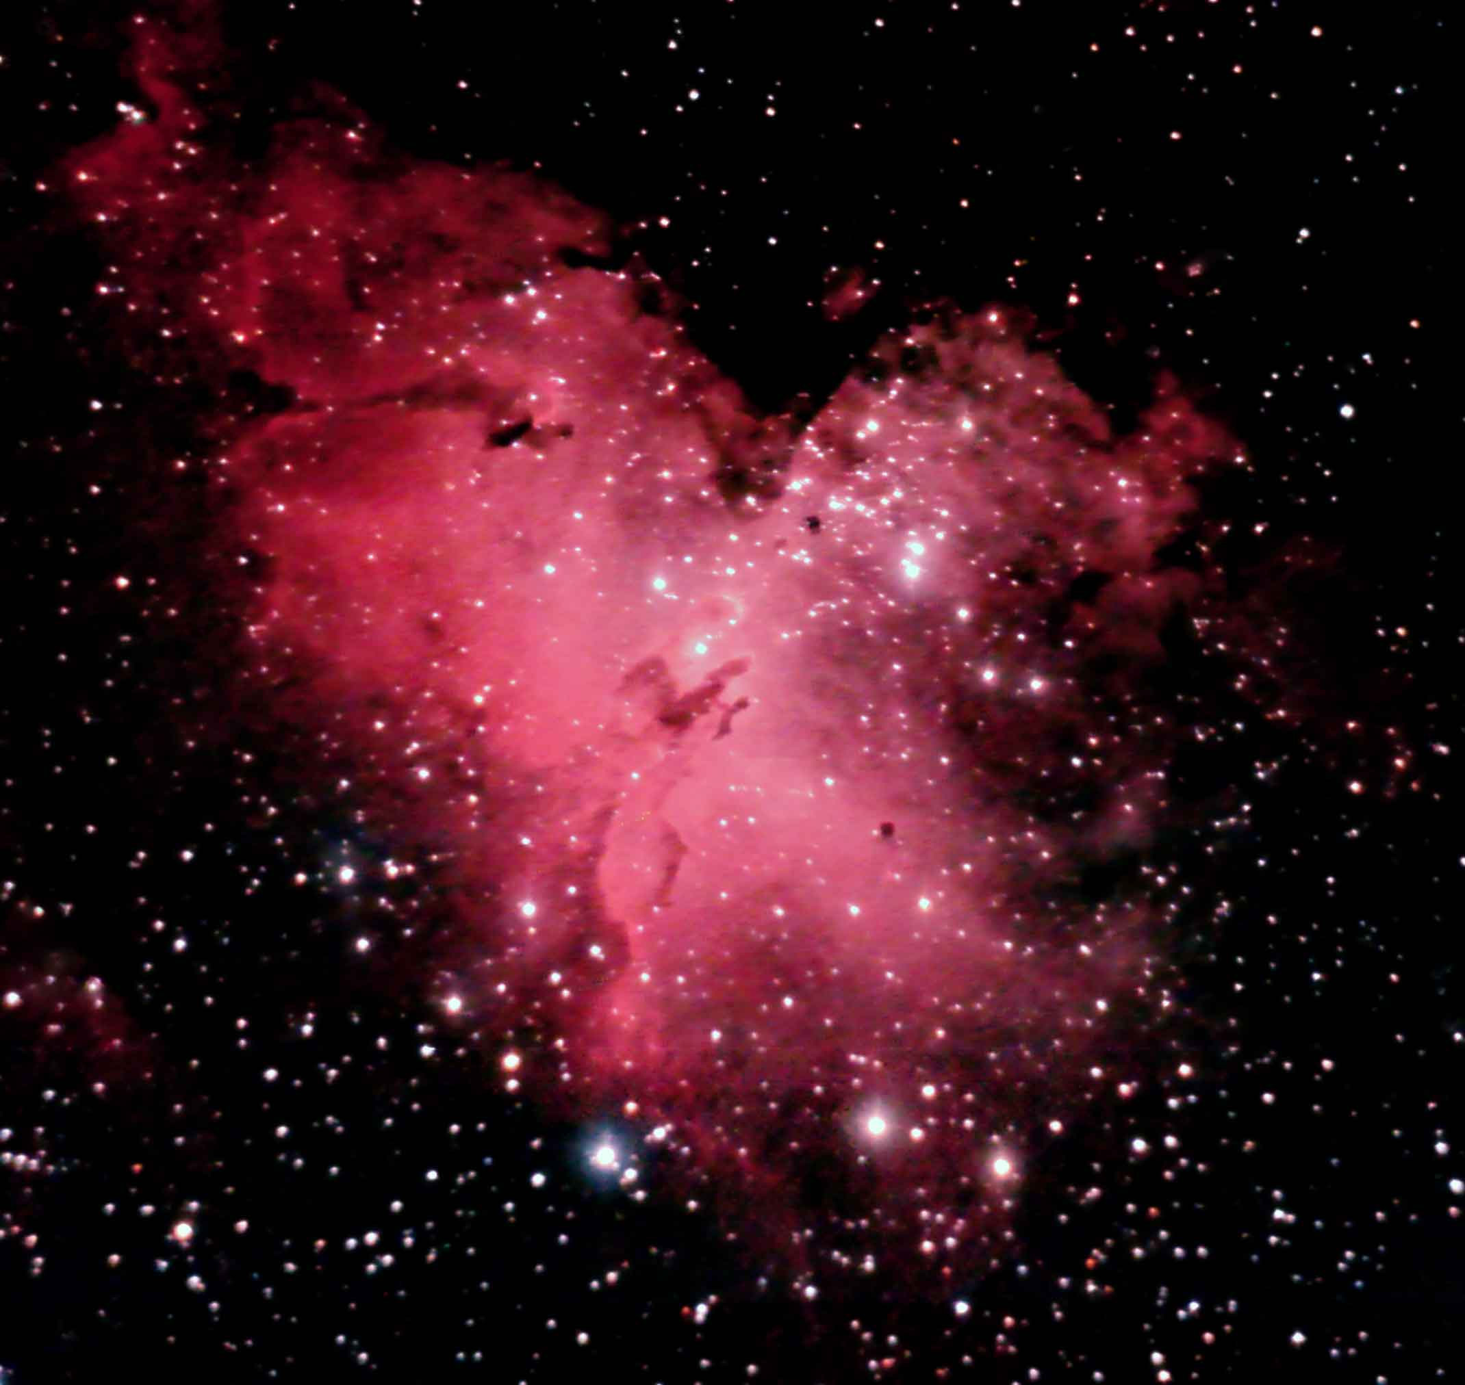
Eagle Nebula by Dr. Suresh Mohan

Slide 14
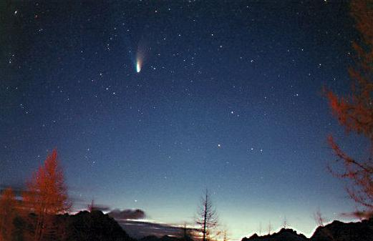
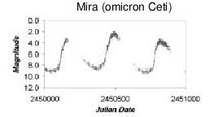
Scientific Work from Amateurs
Comet Hale Bopp, discovered by Thomas Bopp and Alan Hale (also a professional).
Light curve of Mira, a variable star frequently observed by amateurs

Slide 15
What YOU can do!
Try observing the motion of planets across the sky (Retrograde and Prograde motion)
How does the time of moonrise change everyday
  Find the orbital period of the moon
  Calculate the distance to the moon! (How?)
When does the sun rise on the summer solstice and winter solstice?
  Find your latitude! (How?)
  Look up on the cosine rule for a triangle on a sphere!

Slide 16
What YOU can do!
Variable Stars: Find the distance to stars!!!
  Observe and find the time periods of Cepheid Variables
Plot light curves of various variable stars
  http://www.aavso.org - Online resource

Slide 17
What YOU can do!
(From dark skies)
Look around for fuzzy patches in the sky
  What are these fuzzy patches?
Observe the Milky Way
  Why do we see the Milky Way, our galaxy, like a band in the sky?
Estimate your Naked Eye Limiting Mangitude and the Bortle Sky Class (google these terms down!)

Slide 18
What YOU can do!
(With a telescope)
Find the mass of Jupiter!
  How?
Find the speed of light!
  Observe eclipses of Jupiter's moons and predict an eclipse six months later.
  Observe the actual eclipse six months later
  How????
What are those black spots in the nebula?
  Jeans Instability Condition

Slide 19
What YOU can do!
(With a camera)
Take photographs of the sky
  What is the faintest star in the photograph?
  Is there some way of finding out the magnitudes of stars photographically?
Learn how photography works – camera optics
  How much of the sky can my camera cover at a time?
  How would you calculate this?

Slide 20
If you are really interested...
Try to get your school's telescope ready and use it!
Join us:
  http://www.bas.org.in
Thank You

