Slide 1
How a Receptive Field is Built
A walkthrough of the receptive-field mapping pipeline
Worked example: session 2022-06-17_ST16-02 (ST16-02) · microneurography + psychophysics

Slide 2
ORIENTATION
What we are building
A neuron is one microneurography unit. Every millisecond we know its instantaneous firing frequency (IFF) and where the forearm was touched. The receptive field is the patch of skin where touch reliably drives the neuron.
0 · Preprocessing
Merged CSV → clean per-touch contacts on the forearm; unwrap the 3-D surface to a flat 2-D map.
1 · Reduce a touch
Each single touch → a sparse per-vertex IFF map.
2 · Aggregate
Average all touches → one smooth heatmap on the 2-D surface.
3 · Define the RF
Trace a boundary around the responsive region; measure its area, centroid, shape.

Slide 3
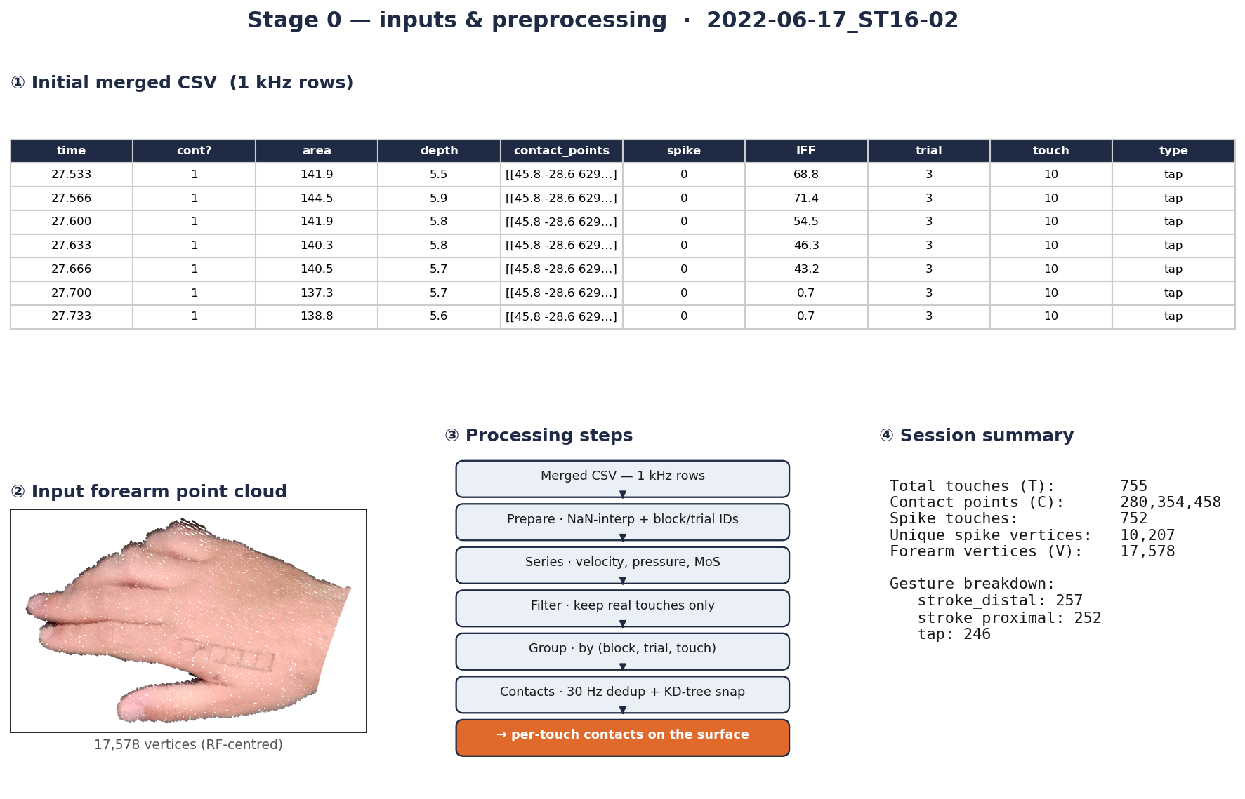
STAGE 0 · PREPROCESSING
Inputs & preprocessing
① the initial merged CSV (contacts, spikes, IFF, IDs per 1 kHz row); ② the input forearm point cloud (17,578 RF-centred vertices); ③ the preprocessing steps; ④ session summary — 755 touches, 280 M contact points, 752 spike touches.
Merged CSV (1 kHz) + forearm point cloud → grouped, de-duplicated, snapped per-touch contacts.

Slide 4
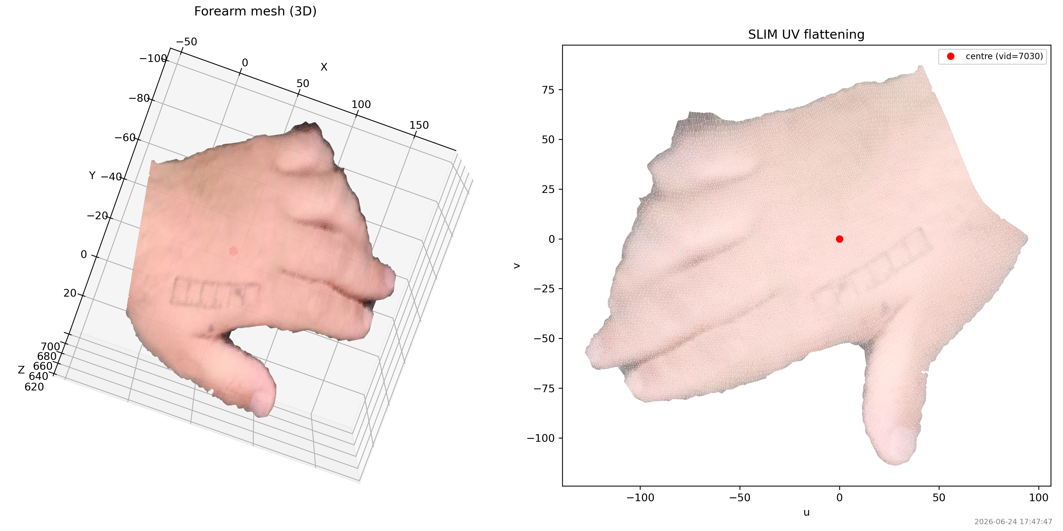
STAGE 0 · PREPROCESSING
Unwrapping the forearm (SLIM UV)
• The forearm is curved — area & boundaries are easier on a flat map
• run_slim_pipeline_core builds + cleans a mesh, then flattens it
• Every vertex gets a 2-D (U, V) coordinate
• IFF-weighted centroid = origin, so the RF sits near (0, 0)
– Cached once per session as <session>_slim_uv.npz
Left: 3-D forearm mesh. Right: the same mesh flattened to the UV plane — every later figure lives here.

Slide 5
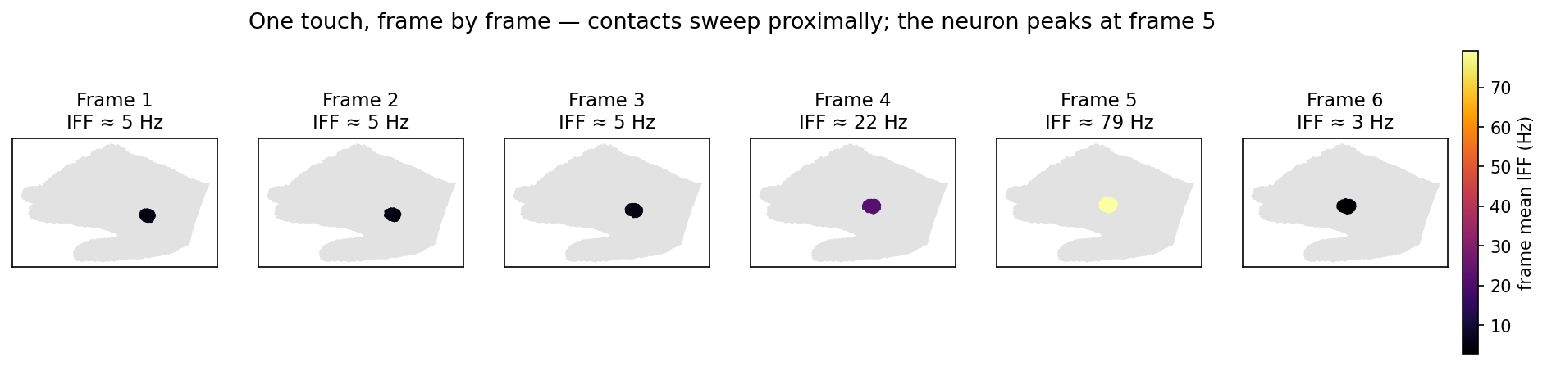
STAGE 1 · INSIDE ONE TOUCH
Frame by frame — the RF in miniature
The fingertip sweeps proximally; the neuron fires at ~5 Hz (frames 1–3), climbs to 22 Hz (frame 4), spikes to 79 Hz (frame 5), then drops to 3 Hz (frame 6). It responds strongly only where the contact crosses one patch of skin — that patch is the receptive field.
Touch #166 = 200 frames at 1 kHz, but contact updates at ~30 Hz → 6 contact frames.

Slide 6
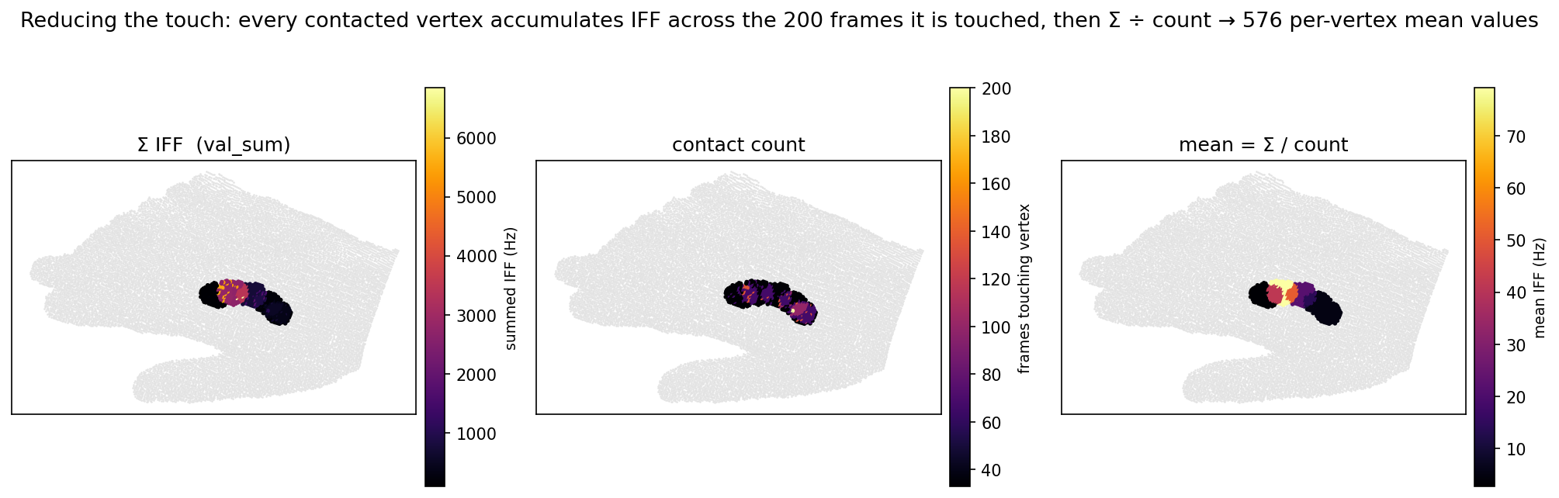
STAGE 1 · INSIDE ONE TOUCH
Grouping & averaging (mean)
Left: Σ IFF per vertex. Middle: how many of the 200 frames touched each vertex. Right: mean = Σ / count — the 576-value sparse map. The bright core is where the high-IFF frame 5 landed.
_compute_touch_rf: each vertex accumulates IFF over the frames that touch it, then Σ ÷ count.

Slide 7
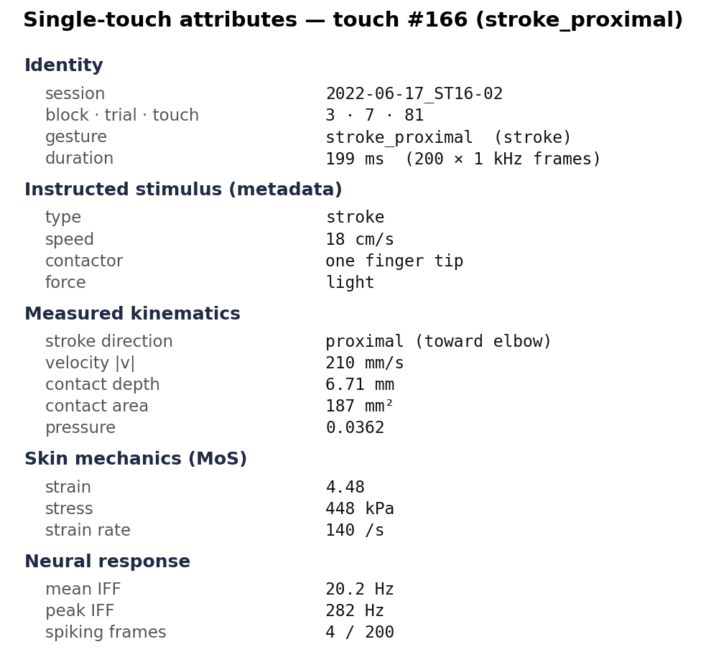
STAGE 1 · INSIDE ONE TOUCH
This touch's attributes
• Every touch carries stimulus + kinematic context
• Instructed: light, one-finger-tip proximal stroke @ 18 cm/s
• Measured: ~210 mm/s, 6.7 mm depth, 187 mm² area
• Skin mechanics: ~448 kPa stress (MoS model)
• Neuron: 20 Hz mean, 282 Hz peak over the touch
– Used later to relate RF responses to how the skin was touched

Slide 8
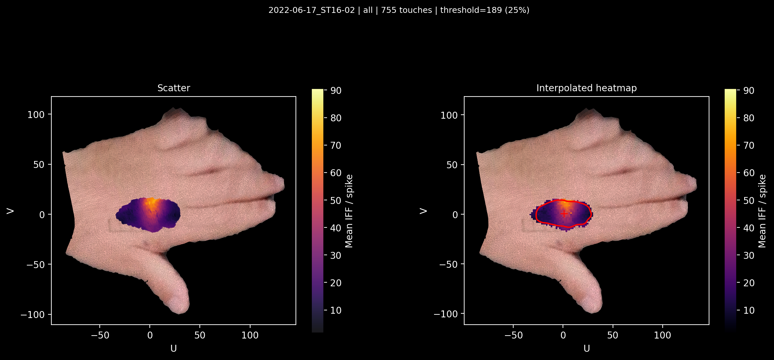
STAGE 2 · AGGREGATE TOUCHES
Averaging into one heatmap
• compute_rf_heatmap averages each vertex across all touches
• 25% overlap threshold drops fringe vertices (few touches)
• Island cleanup keeps the blob containing the peak
• PCA-align, then interpolate to a smooth 150×150 grid (grid_z)
– This grid IS the neuron's response field
ST16-02 over all 755 touches (threshold = 189 touches). Left: per-vertex averages; right: interpolated grid_z with the fitted RF boundary (red) and centroid (+).

Slide 9
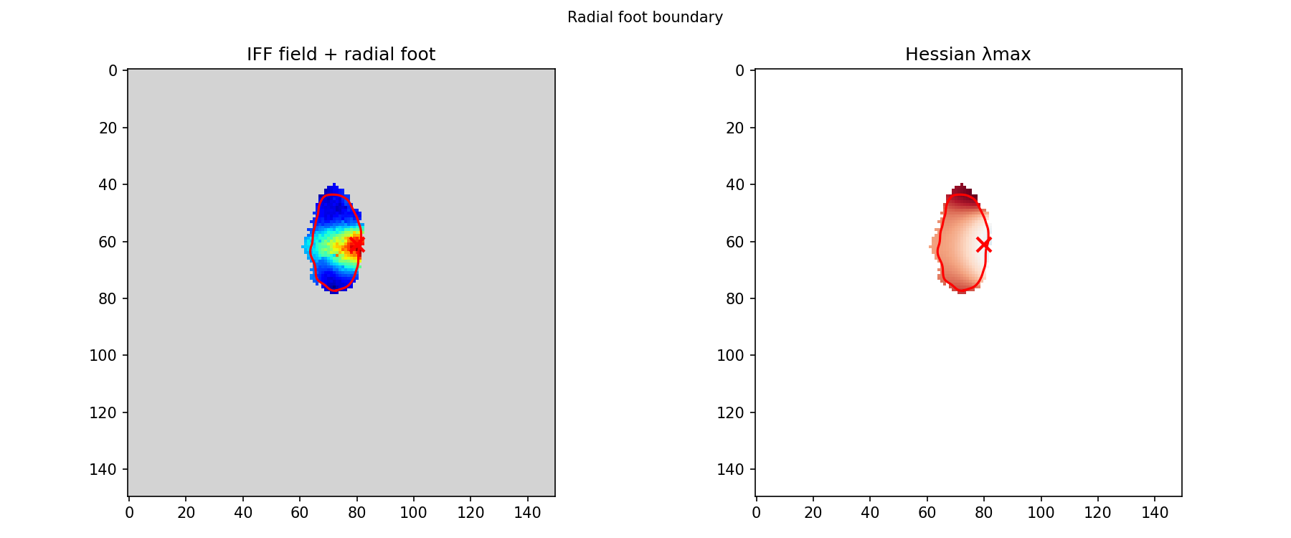
STAGE 3 · DEFINE THE RF
Radial “foot of the mountain” boundary
• Treat the heatmap as a hill; the RF edge is where it flattens
• compute_radial_foot_boundary uses the Hessian λmax field
• Rays from the peak stop at the first concave-up point
• Curve is clipped to the actually-touched footprint
– Alternatives: gradient-ridge & inflection (Laplacian)
Left: IFF field with the red radial-foot contour and peak (×). Right: the Hessian λmax field the rays are traced on.

Slide 10
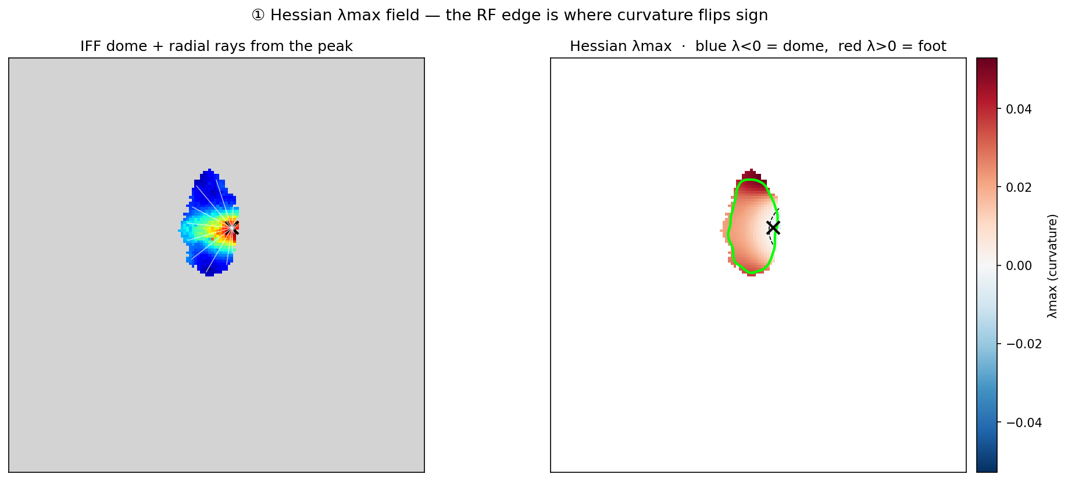
STAGE 3 · IN DEPTH
The Hessian λmax field
λmax < 0 over the concave-down dome (blue), > 0 at the concave-up foot (red ring). The RF edge is that sign flip — not a fixed IFF threshold — so it adapts to each neuron's dome shape.
λmax = larger principal curvature of the Gaussian-smoothed IFF surface (gauss σ=8, Hessian σ=5).

Slide 11
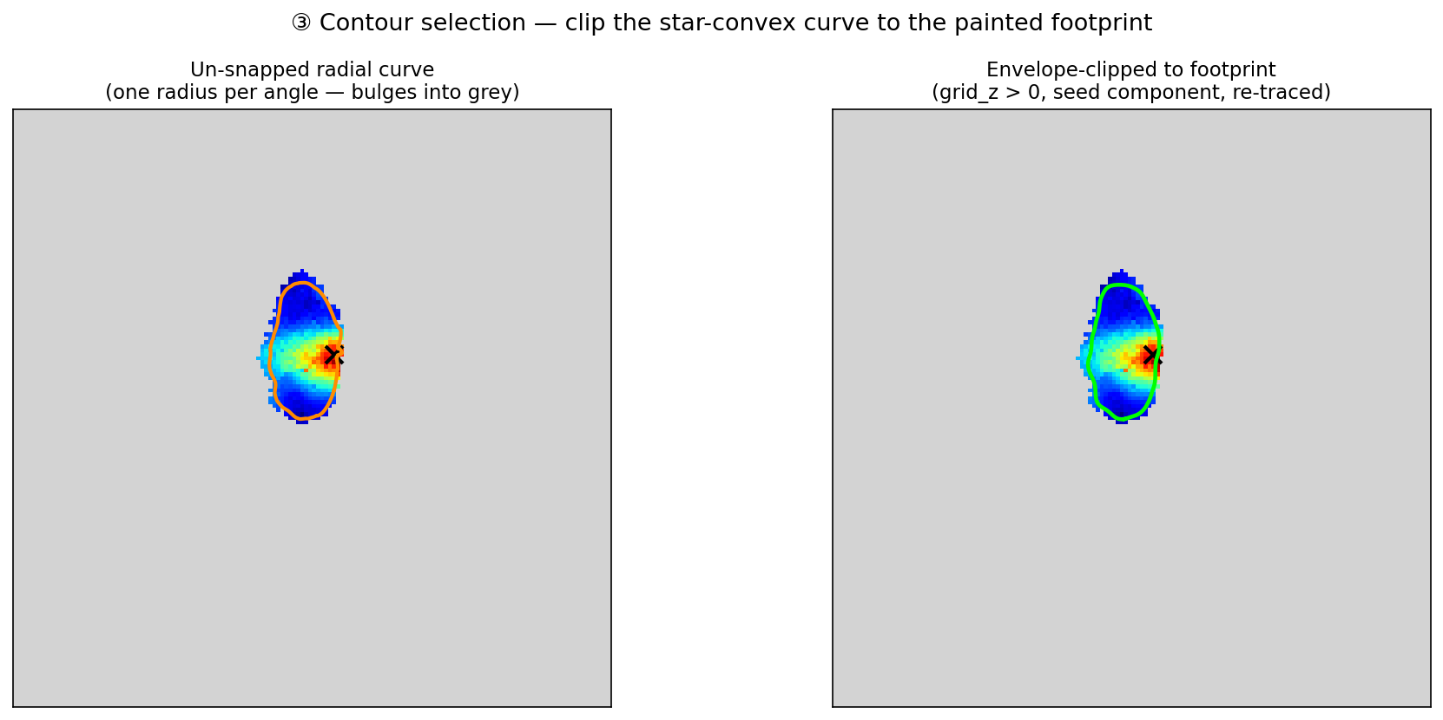
STAGE 3 · IN DEPTH
Contour selection — footprint envelope
One-radius-per-angle chords bulge into non-painted cells where the footprint is concave (left, orange). Pass 2 intersects with grid_z > 0, keeps the peak's connected component, and re-traces it (right, green) — fail-fast, no fallback ring.
The star-convex radial curve is clipped to the painted footprint (grid_z > 0).

Slide 12
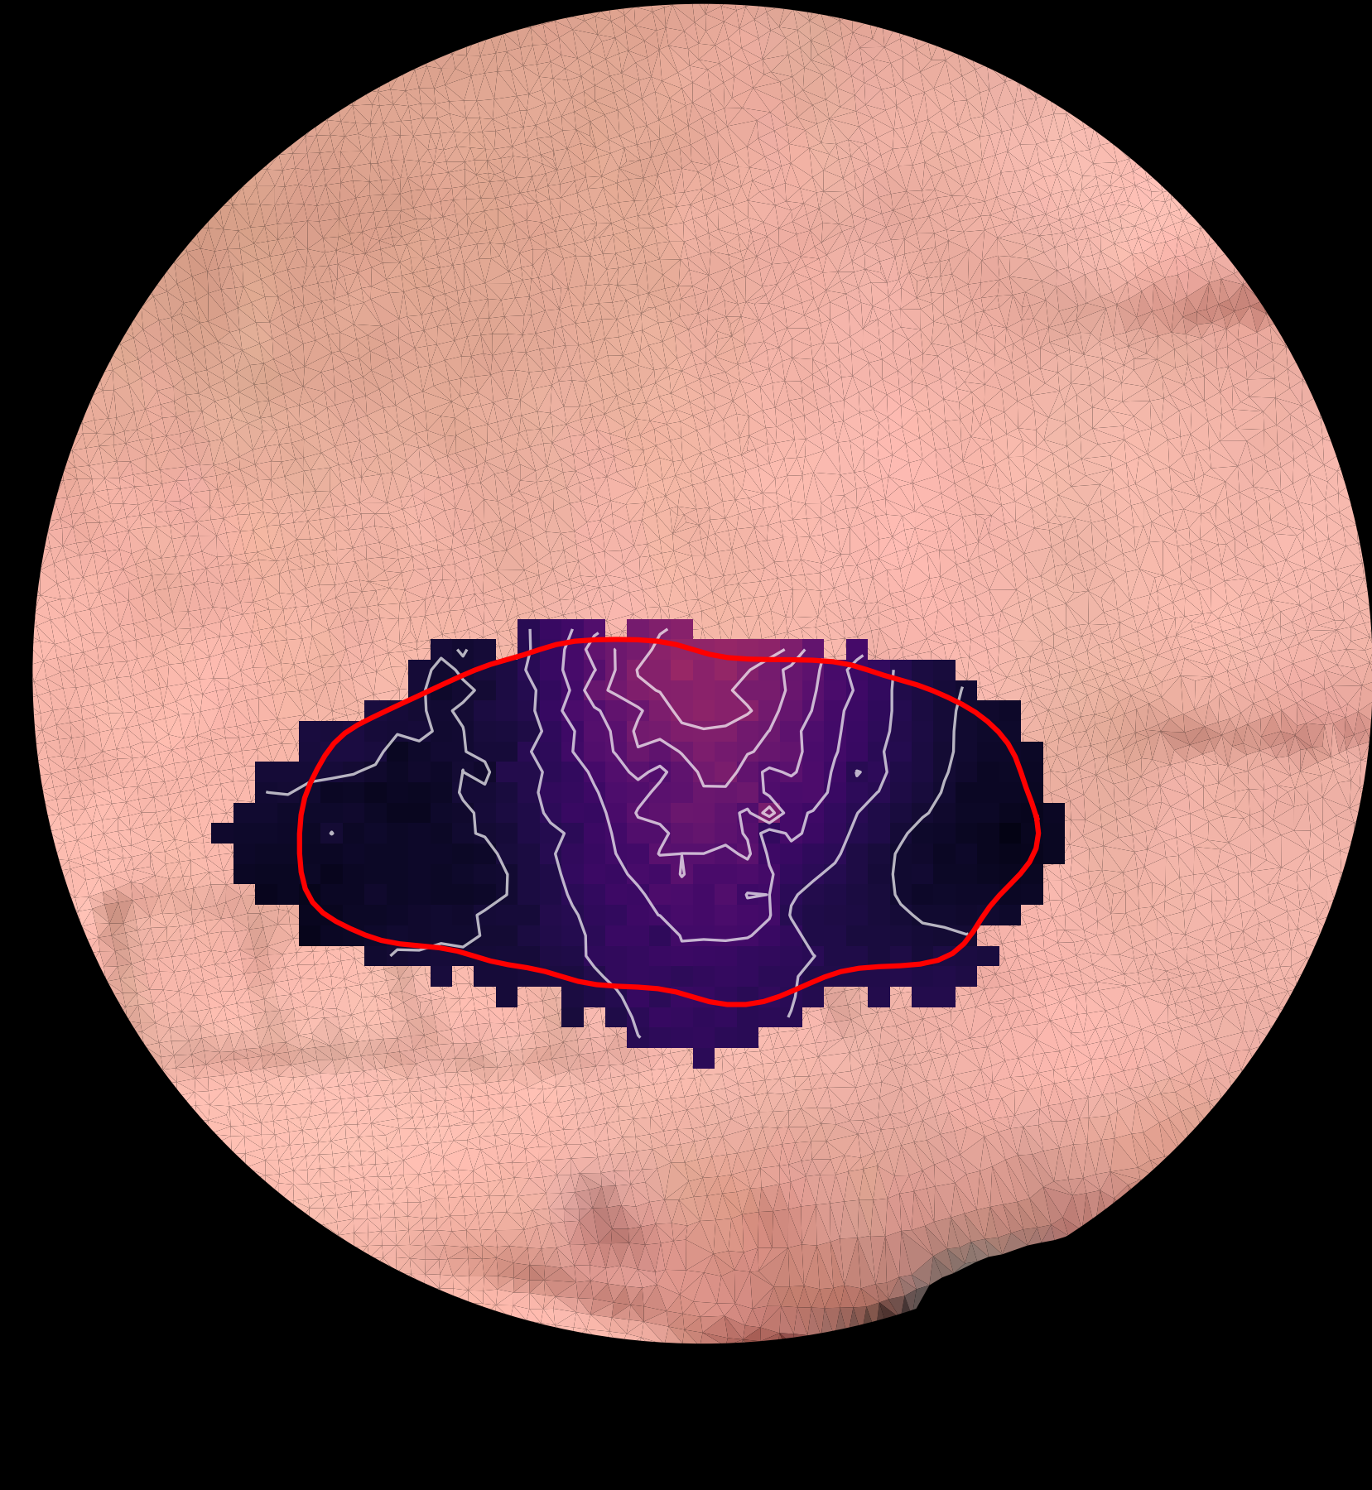
STAGE 3 · DEFINE THE RF
The receptive field & its metrics
• From the closed contour the pipeline derives:
– Area in real mm² (mapped back via uv_points_to_xyz)
– Perimeter, circularity, centroid, peak
– PCA ellipse: major/minor axis + orientation
• Saved to <session>_population_response_fields.npz
The final receptive field for ST16-02: red outline on the interpolated heatmap (cropped, on the skin texture), iso-IFF contour lines inside.

Slide 13
PIPELINE
Where this runs
DAG tasks in configs/analyse_workflow_processing_dag.yaml, chained by dependency:
touch_prepare_sessions + touch_compute_series
clean CSVs, kinematics
▼
spatial_map_single_touch
Stage 1 — single_touch_rf_maps_*.npz
▼
spatial_precompute_slim_uv
Stage 0 — <session>_slim_uv.npz
▼
spatial_extract_boundaries
Stages 2 & 3 — population_response_fields.npz + PNGs
▼
spatial_extract_rf_profiles
Stage 4 — 1-D profiles
Key options on spatial_extract_boundaries: iff_metric=mean · min_overlap_pct=25 · boundary_method=radial · flip_u=true

