Slide 1
Extracting the RF Boundary
The spatial_extract_boundaries step — the radial “foot of mountain” workflow
Worked example: session 2022-06-17_ST16-02 (ST16-02) · gesture = all

Slide 2
INPUT
How grid_z is built
The boundary method consumes one 2-D field, grid_z — a 150×150 mean-IFF heatmap on the flattened forearm surface, NaN outside the touched footprint.
• Per-vertex mean IFF across the gesture's touches — iff_metric: mean (compute_rf_heatmap)
• Coverage threshold — drop vertices touched by < min_overlap_pct % (25%)
• SLIM UV flattening — unwrap the curved mesh to a flat (U,V) plane; PCA-aligned so the RF long axis is horizontal; flip_u: true
• Harmonic interpolation onto the 150×150 grid (igl.harmonic, ∇²z = 0); median_filter_size: null (disabled)
• Island cleanup — keep only the blob containing the peak → grid_z

Slide 3
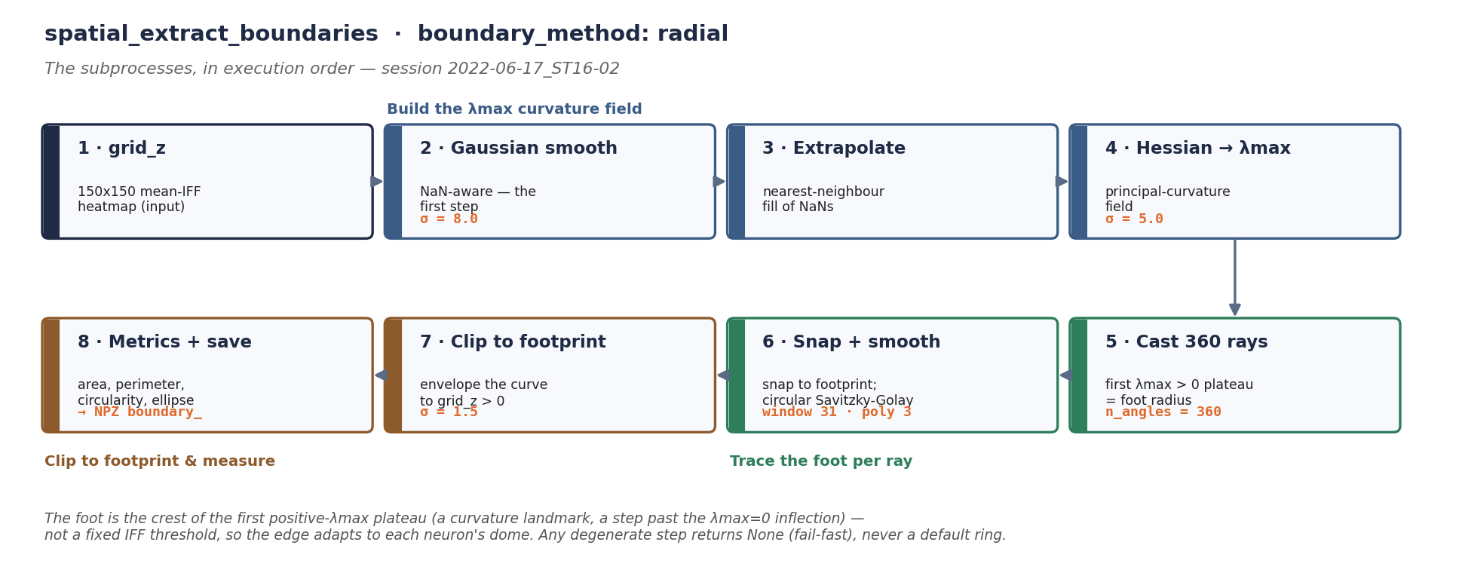
WORKFLOW
The radial-foot subprocesses, in order
Build the λmax field (steps 2–4) → trace the foot per ray (5–6) → clip to the footprint & measure (7–8). The foot is the crest of the first positive-λmax plateau — a curvature landmark a step past the λmax=0 inflection — so the edge adapts to the dome, no fixed IFF threshold.
Smoothing comes first (Gaussian, σ=8), then the Hessian (σ=5), then the rays, then the footprint clip (σ=1.5).

Slide 4
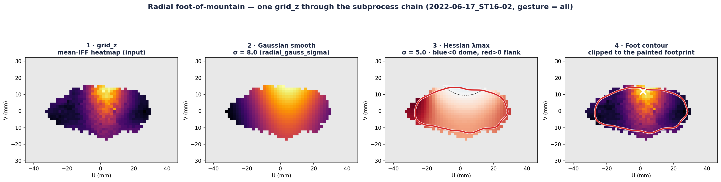
WORKFLOW
One grid_z through the subprocess chain
λmax is negative (blue) over the concave-down dome and positive (red) on the concave-up flank; the red contour tracks the crest of the first positive-λmax plateau, then is clipped to the painted footprint.
grid_z → Gaussian-smoothed (σ=8) → Hessian λmax (σ=5) with the contour → final foot contour on the heatmap.

Slide 5
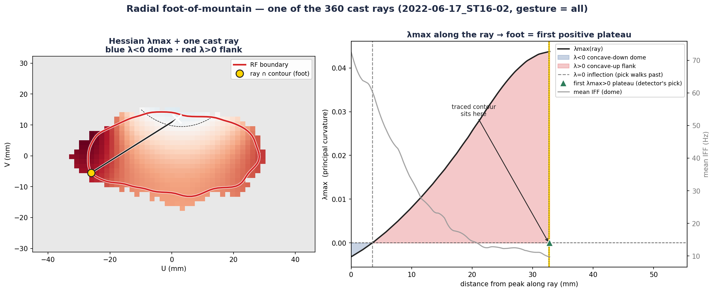
WORKFLOW
One of the 360 cast rays
The boundary is a curvature landmark, not an IFF threshold: on each ray the foot is the centre of the first λmax > 0 plateau — the crest of the concave-up ridge, a step past the λmax=0 inflection, not the sign-flip itself.
Left: the Hessian λmax heatmap with one ray from the peak. Right: λmax along that ray — negative (dome cap) → zero (inflection) → positive crest; the traced contour sits at the crest of the first positive-λmax plateau, a step past the zero-crossing.

Slide 6
CONFIG
The actual parameter values
configs/analyse_workflow_processing_dag.yaml · spatial_extract_boundaries:
neuron_mode: iff iff_metric: mean min_overlap_pct: 25
median_filter_size: # null (disabled)
flip_u: true cmap: inferno contour_color: red
boundary_method: radial
radial_gauss_sigma: 8.0 # step 2 · Gaussian pre-smooth
radial_hess_sigma: 5.0 # step 4 · Hessian derivative kernel
radial_envelope_smooth_sigma: 1.5 # step 7 · footprint envelope smooth
inflection_sigma: 5.0 is present in the config but is not consumed by the radial path — it only drives side-computed comparison markers.
Setting inflection_sigma: null disables boundary computation entirely.

Slide 7
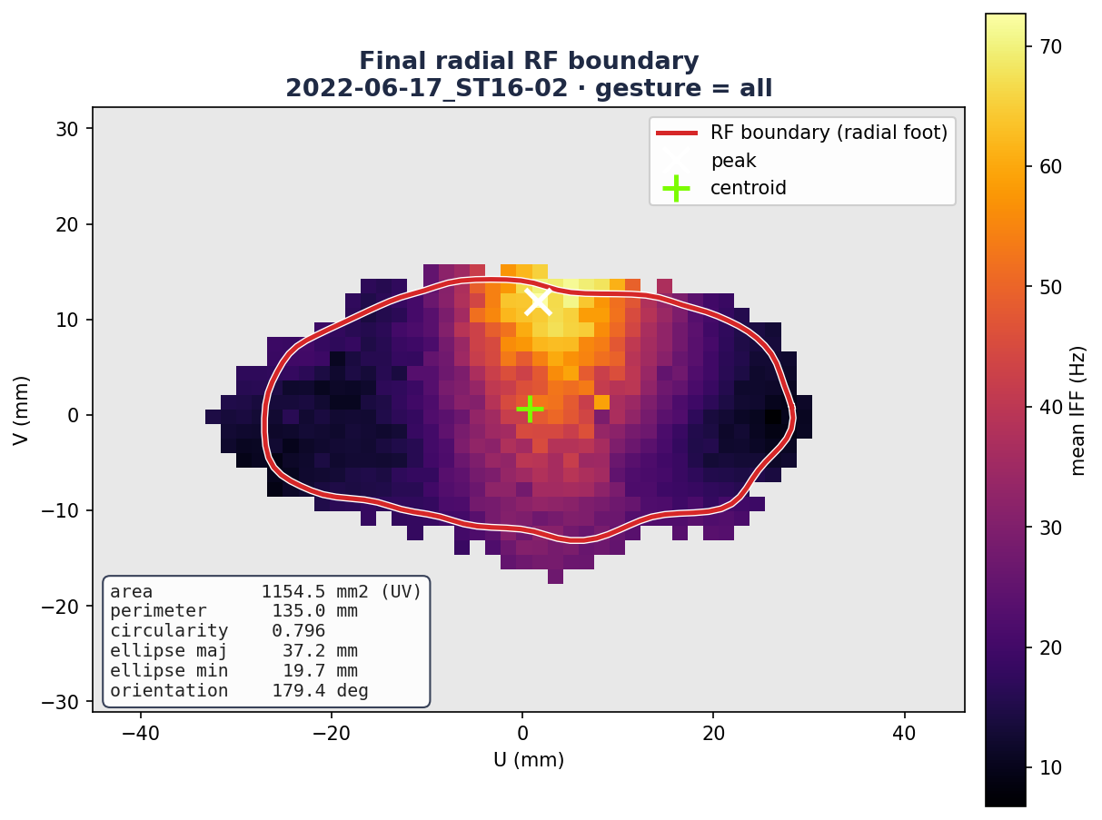
OUTPUT
The boundary → the RF metrics
• The closed contour yields:
– area — shoelace polygon area in UV mm²
– perimeter — summed segment lengths (UV mm)
– centroid — polygon centroid
– circularity — 4·π·area / perimeter²
– PCA ellipse — major/minor axis + orientation
• Written to <session>_population_response_fields.npz under the boundary_ prefix (+ a boundary_method key)
• Consumed by spatial_extract_rf_profiles
The final radial RF boundary on ST16-02 (peak ×, centroid +), with the derived metrics annotated.

Slide 8
PIPELINE
Where it runs
spatial_map_single_touch + spatial_precompute_slim_uv
spatial_extract_boundaries ← this step (grid_z → radial boundary + metrics)
spatial_extract_rf_profiles (consumes the active boundary contour)
Run: python scripts/analysis_workflow_processing.py — or the GUI runner.
Full write-up: docs/spatial_extract_boundaries/README.md

