Slide 1




DEPARTMENT OF COMPUTER SCIENCE AND ENGINEERING INTERNAL GUIDE – Ms. Sandhiya B ( Associate Professor) EXTERNAL GUIDE – Mr. Tirumal Mutalikdesai (Program Coordinator)
Kumbara-Kala:
Digital Branding for Clay Artisans
Theme: State Pride / Handicraft Revival
Title of the Internship: ANDROID APP DEVELOPMENT USING GEN AI
Visvesvaraya Technological University
MindMatrix
JSS Academy of Technical Education, Bengaluru

Slide 2
COMPANY OVERVIEW
NAME OF THE COMPANY: MindMatrix
ADDRESS: MindMatrix, #651, Kiran Arcade, 4th Floor, 13th Cross, 27th Main Road, 1st Sector, HSR Layout, Bangalore – 560102
It is an IT services and education company established in 2017, focused on industry-aligned training.
DURATION OF THE INTERNSHIP
STARTING DATE: 02 February 2026
ENDING DATE: May 2026
MODE OF INTERSHIP: Online
ADDRESS: HSR Layout
NAME OF THE EXTERNAL GUIDE: Mr Tirumal Mutalikdesai
DESIGNATION: Program Coordinator

Slide 3
INTERNSHIP OBJECTIVES
• To gain practical exposure to industry-level tools and workflows in AI and cloud-based environments.
• To understand and implement AI-driven customer service automation using Salesforce platforms.
• To learn how to design and configure intelligent service agents for real-world applications.
• To develop skills in flow-based automation to improve efficiency and reduce manual work.
• To enhance knowledge of cloud computing through hands-on practice using Salesforce Playgrounds.
• To improve problem-solving, technical, and professional skills required in a corporate environment.
• To bridge the gap between academic learning and real-world industry practices.

Slide 4
ROLES AND RESPONSIBILITIES
• Attended regular training sessions to understand AI concepts, Salesforce platform, and industry practices.
• Completed hands-on codelabs and guided exercises to gain practical experience.
• Practiced using Salesforce Playgrounds for development, testing, and simulation of applications.
Performed application testing, debugging, and UI improvements.
• Documented daily learning progress and maintained internship reports.
• Collaborated with peers and followed instructions from mentors to complete assigned tasks.

Slide 5
Problem Statement & Objective
PROBLEM STATEMENT
Potters losing business to plastic/steel
No digital marketing knowledge
People unaware of clay health benefits
OBJECTIVE
Help artisans digitally promote products
Generate Benefit Story Cards
Enable easy WhatsApp sharing

Slide 6
PROJECT OVERVIEW
Developed an Android application named KumbaraKala to promote traditional clay products digitally.
Implemented dynamic product listing with Firebase Firestore integration.
Created personalized digital benefit cards for users.
Enabled WhatsApp and social media sharing of generated cards.
Designed an attractive gallery-style user interface using RecyclerView and CardView.
Promoted eco-friendly and sustainable clay products through mobile technology.

Slide 7
LEARNING OUTCOMES
Technical Skills • Hands-on experience in configuring AI Service Agents, generating intelligent AI responses
• Skilled in Salesforce Playgrounds, flow-based automation, and cloud lab environments for developing, testing, and managing scalable cloud-based applications.
Learned Kotlin-based Android development, responsive UI/UX design using XML, Firebase Firestore integration, and image generation using Canvas API.
Enhanced debugging, testing, problem-solving, and real-time application development skills through practical project implementation.
Professional Skills • Developed strong communication, professionalism, responsibility, punctuality, and ethical conduct while working on assigned tasks and collaborating in an industry-oriented environment. • Maintained continuous learning and professional growth through self-review, documentation, and active LinkedIn profile enhancement.
Conceptual Understanding •Acquired practical understanding of Android application development, Firebase cloud integration, and Generative AI-assisted software development workflows.

Slide 8

Technologies Used
Kotlin
Cloud Firestore
Material Design 3
Android Studio
Android Canvas API

Slide 9
Technologies Used
Kotlin – Android application development
Android Studio – Development environment
XML – User interface design
Firebase Firestore – Cloud backend database
RecyclerView & CardView – Dynamic product display
Canvas API & FileProvider – Image generation and sharing

Slide 10
Architecture
Story Generator Module
🎨
Catalog Module 📸
Artisan Profile Module
👤
Share Module
📤

Slide 11

Core Features
📸 Catalog → clay products (pots, lamps)
🎨 Story Generator → creates benefit card
👤 Artisan Bio → maker story
📤 WhatsApp Share

Slide 12
Firebase Usage
Artisan Details: Stores the potter’s profile including name, contact, and heritage information.
Generated Cards: Displays digitally created product story cards with benefits for sharing
Story Card Generation Flow
Select product
Add benefit text
Overlay text on image (Canvas)
Export image
Share via WhatsApp

Slide 13
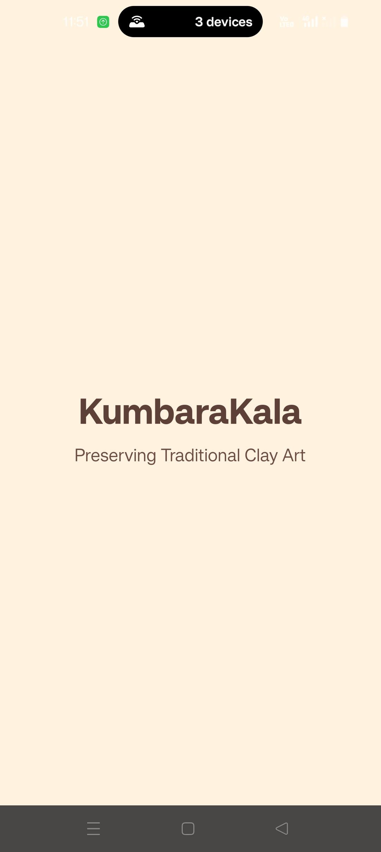
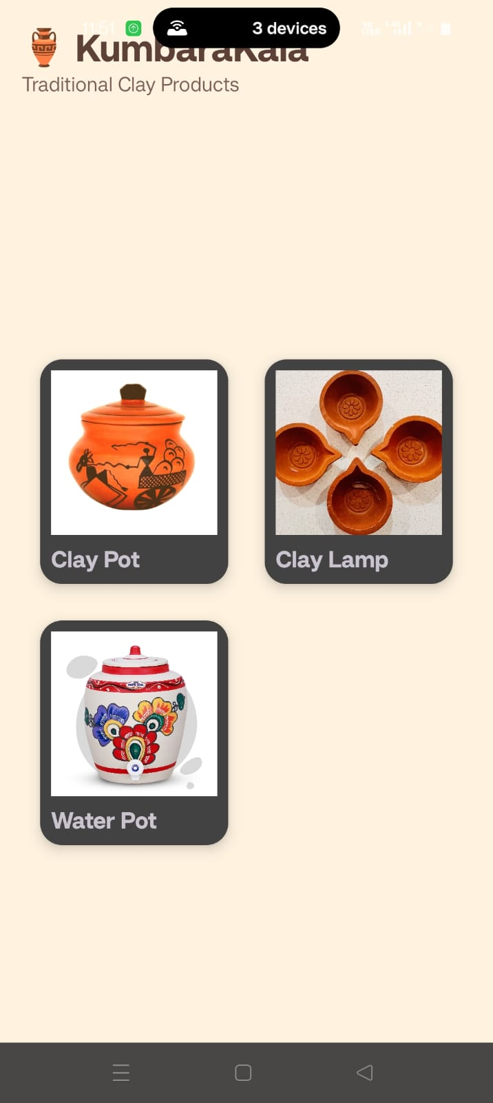
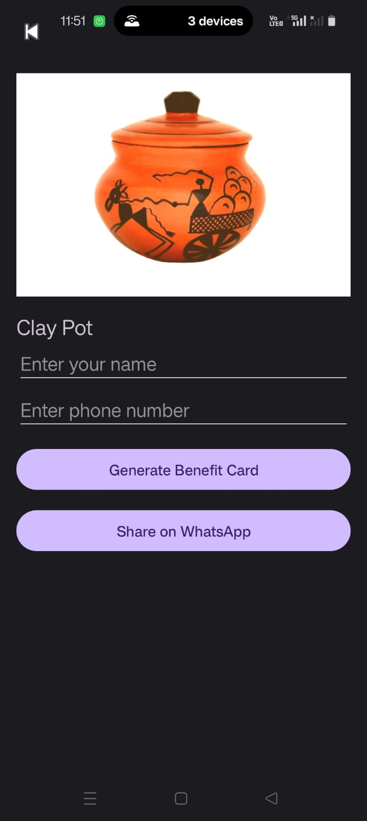
Application Screenshots

Slide 14
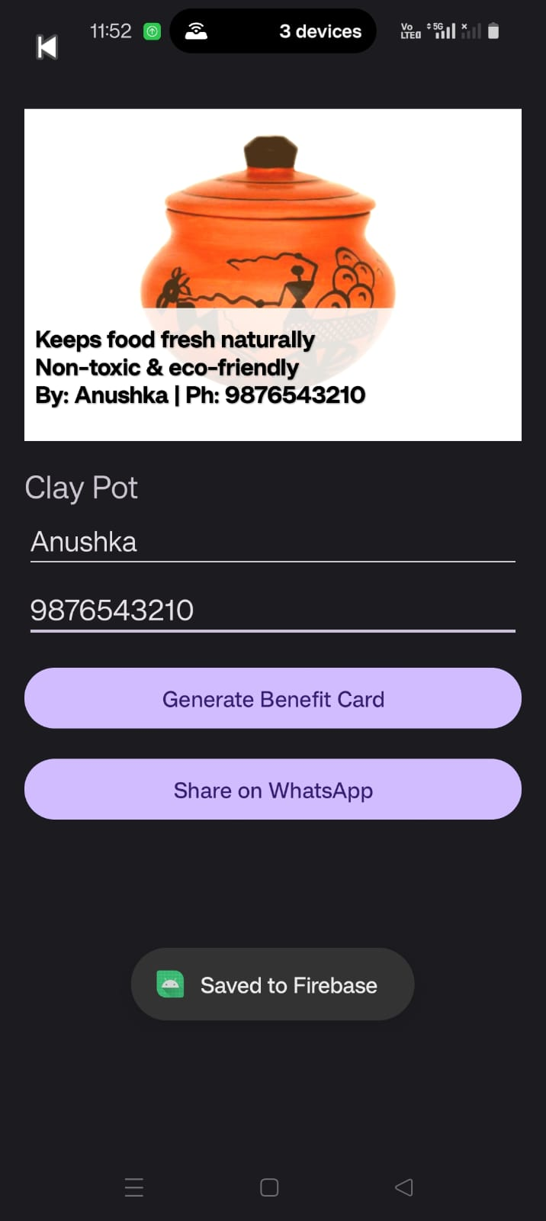
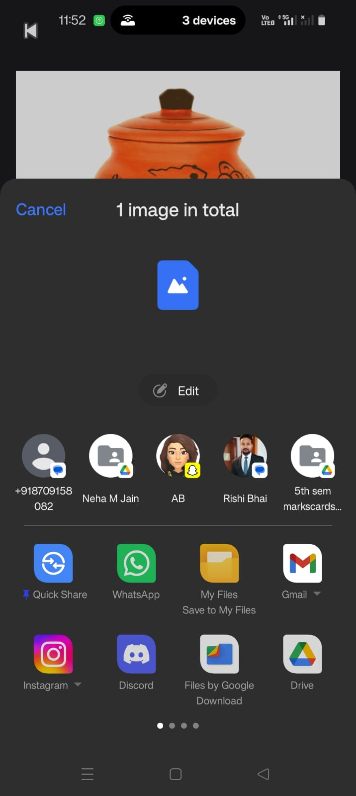
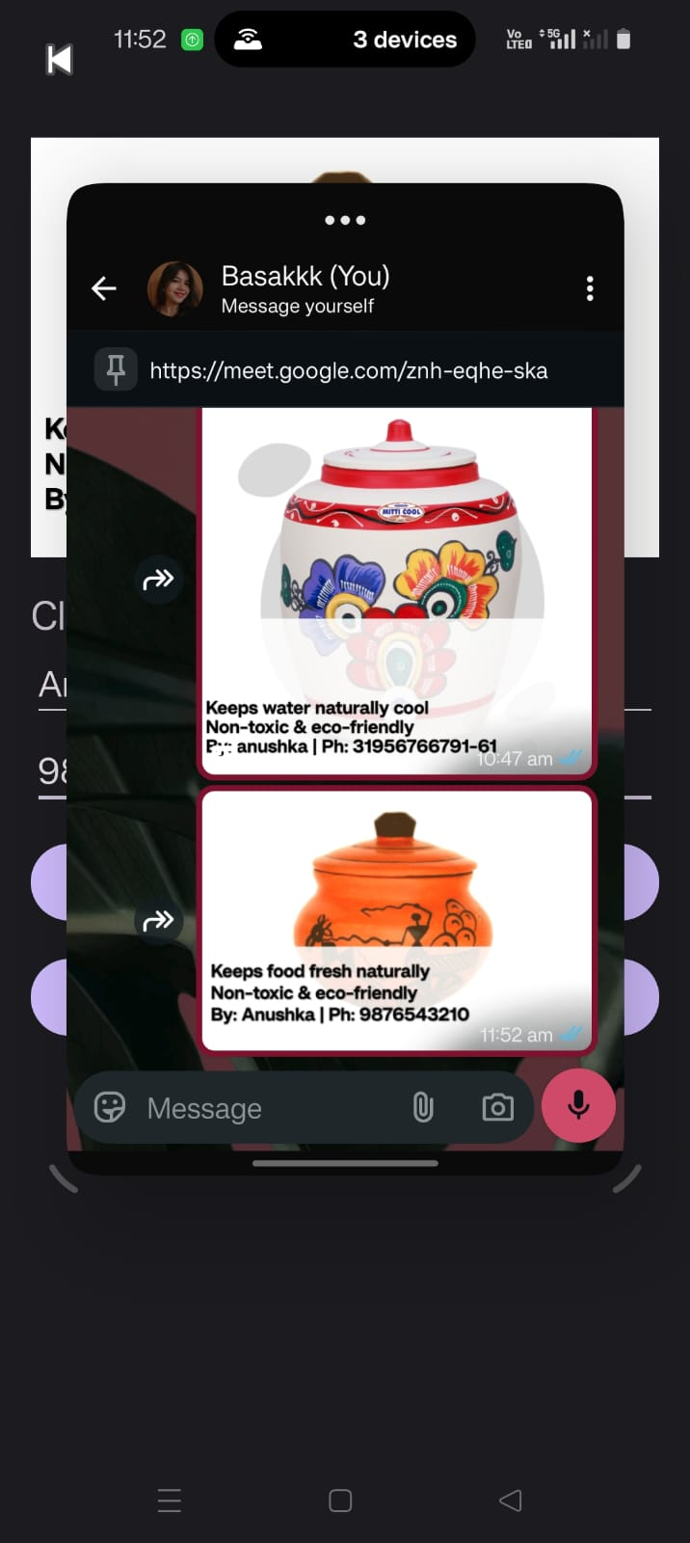
Application Screenshots

Slide 15
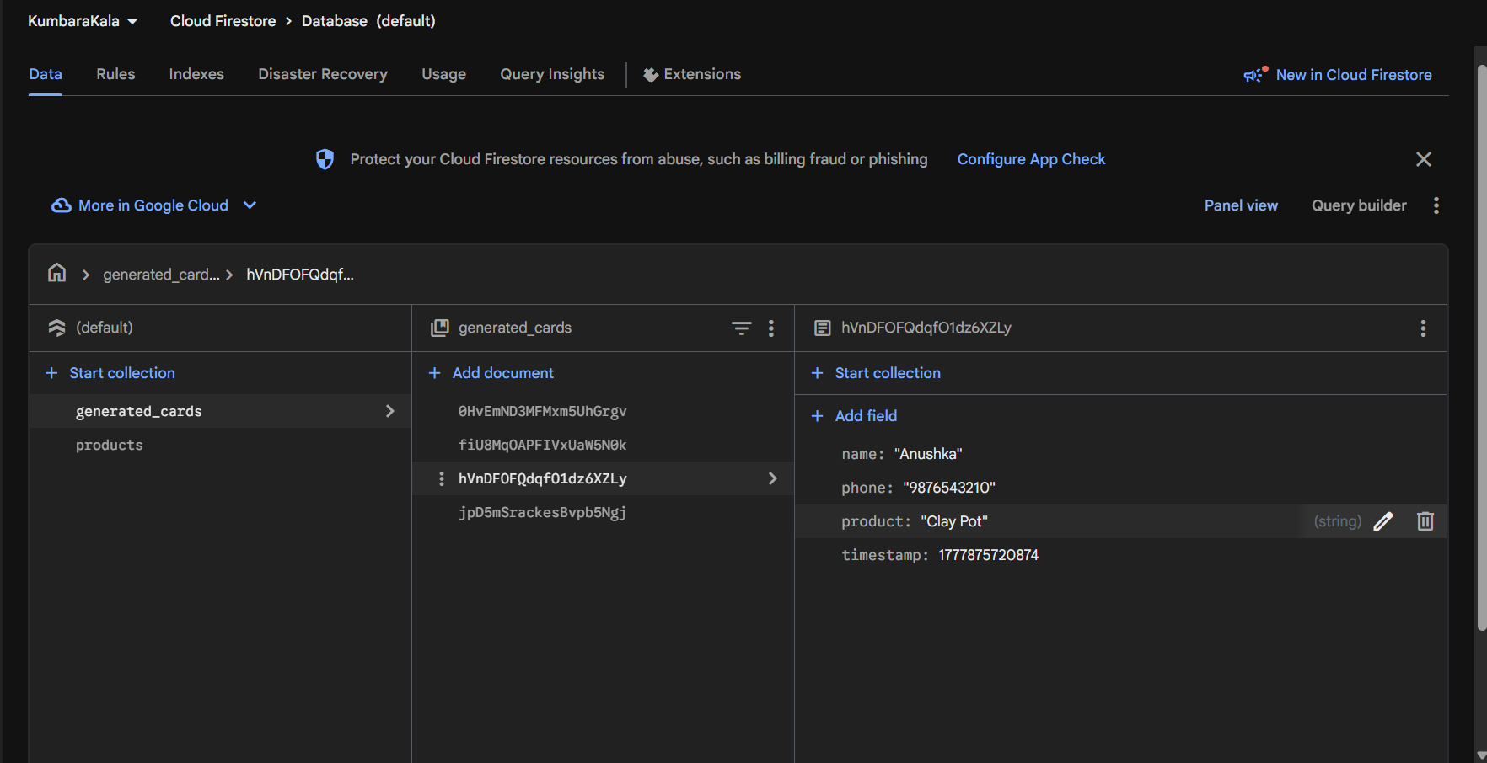

Slide 16
Success Criteria
High-quality readable card
Artisan name + phone editable
Gallery-like UI
Impact
Support rural artisans
Promote eco-friendly living
Replace plastic usage

Slide 17
Challenges
ISSUES
Overlaying text on images
Maintaining image quality
WhatsApp sharing
SOLVED BY
solved using Canvas
compression handling
Intent integration

Slide 18
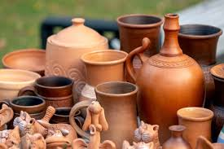
CONCLUSION
The KumbaraKala application successfully promotes traditional clay products through a modern Android platform. It is an AI-assisted app which also supports eco-friendly and sustainable products.

Slide 19
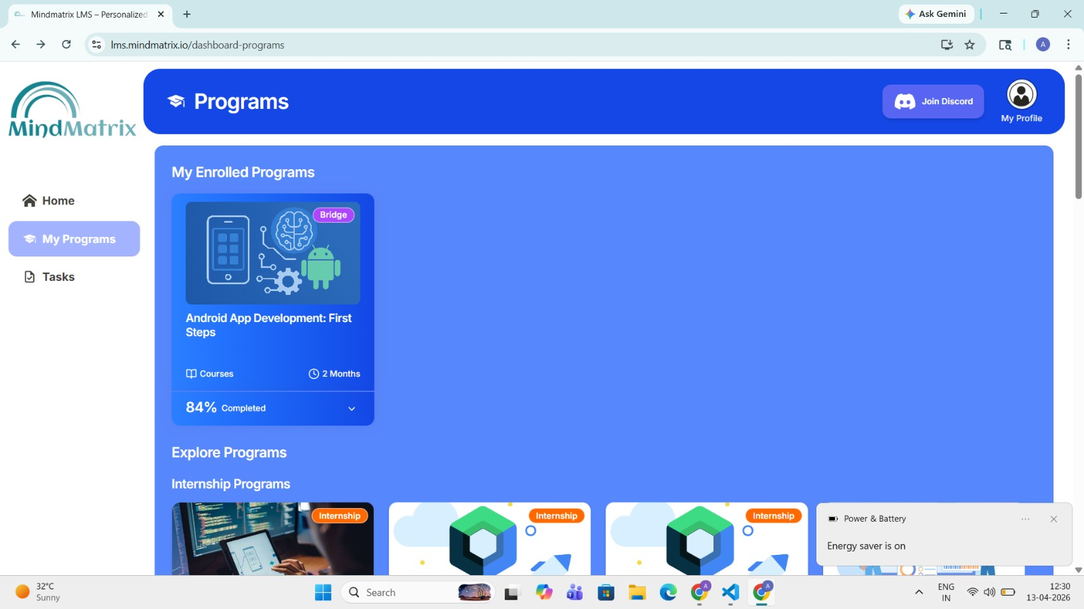
INTERNSHIP TASKS SCREENSHOTS

Slide 20
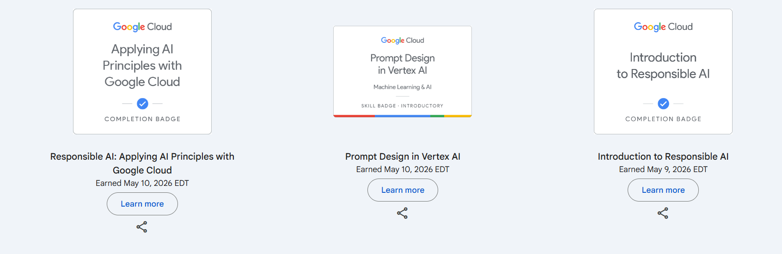
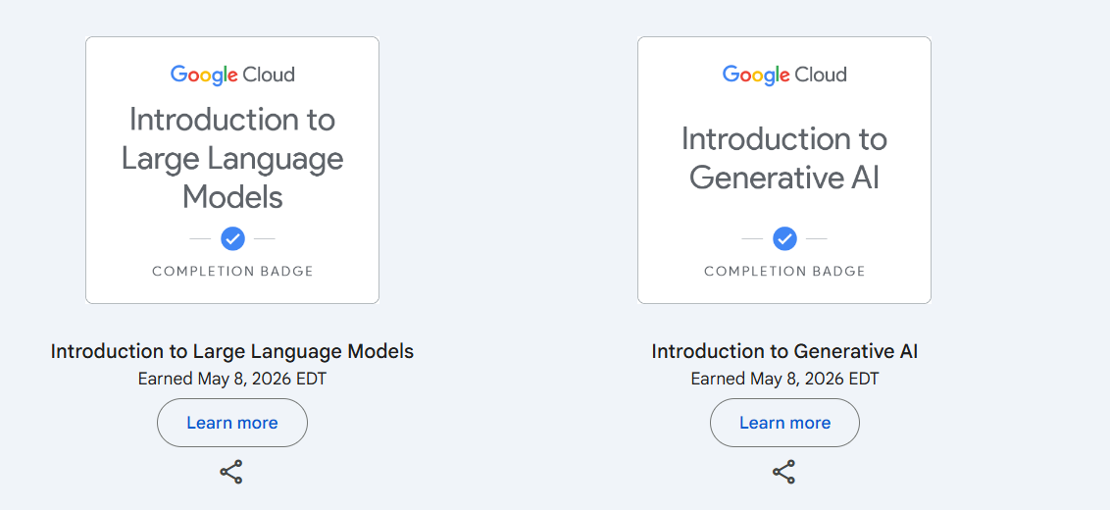

Slide 21
Key Learning Outcomes from Google Cloud Skill Badges
• Applying AI Principles with Google Cloud – Learned ethical and responsible AI practices.
• Prompt Design in Vertex AI – Created and tested prompts using Vertex AI.
• Introduction to Responsible AI – Understood safe and unbiased AI development.
• Introduction to Large Language Models – Learned basics of Large Language Models (LLMs).
• Introduction to Generative AI – Explored concepts and uses of Generative AI.

Slide 22
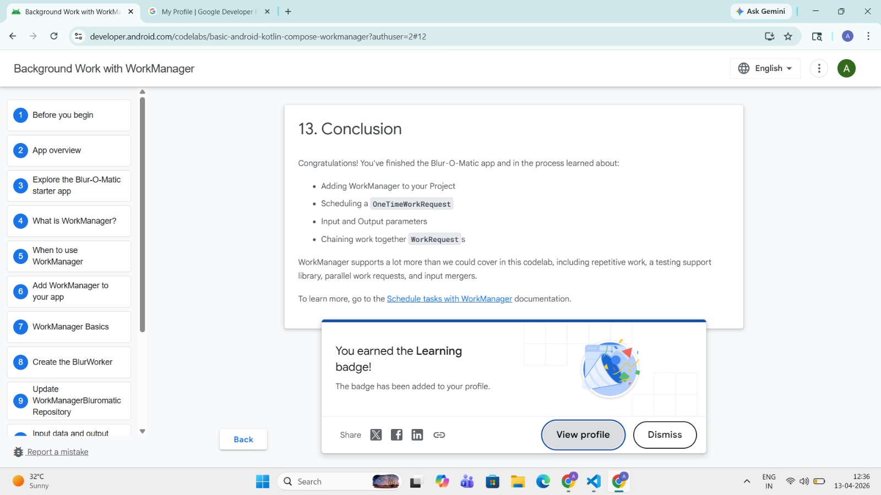
Completed the WorkManager codelab, learning how to use Android’s WorkManager library to schedule and manage background tasks efficiently.

Slide 23
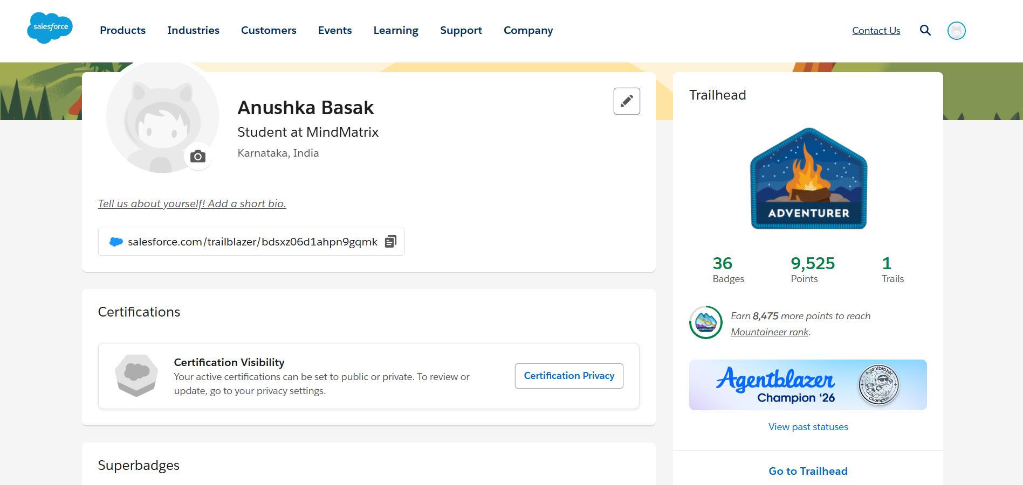

Slide 24
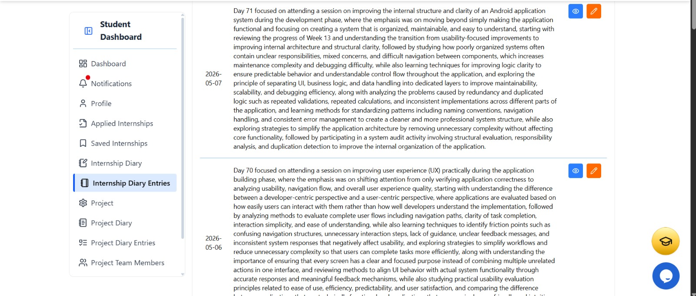
INTERNSHIP DIARY ENTRIES

Slide 25
SUMMARY
• Successfully completed an internship centered on AI-driven customer support automation using the Salesforce platform.
• Acquired practical knowledge through interactive training programs, codelabs, and real-time project simulations.
• Explored the setup and management of AI-powered service agents along with cloud application concepts.
• Enhanced technical expertise as well as communication and teamwork skills aligned with industry standards.
• The internship experience strengthened understanding of AI technologies, automation processes, and professional work environments.

Slide 26
THANK YOU
Presented by: Anushka Basak USN – 1JS22CS024 JSS Academy of Technical Education, Bengaluru

