Slide 1
SQL Tables
Project_3

Slide 2


Job Titles & Income Relationship

Slide 3


Sofware Engineers Statistics

Slide 4
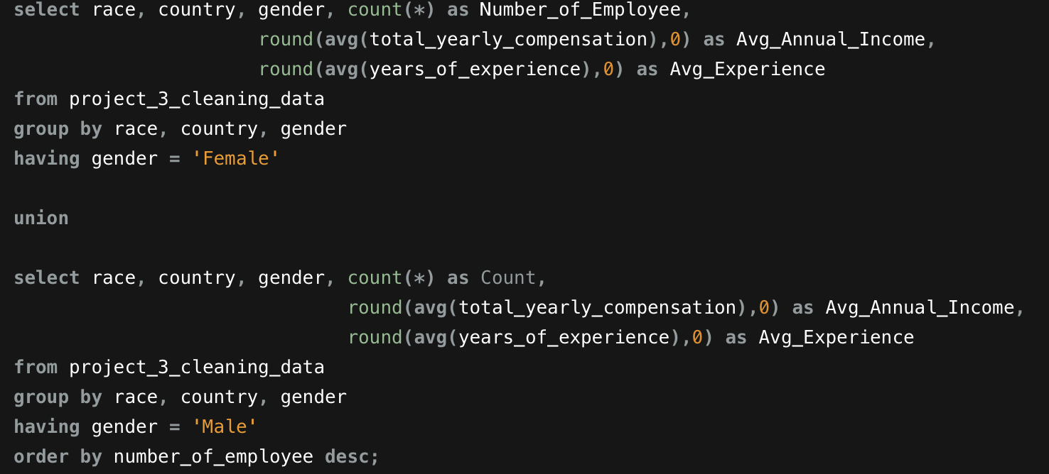

Gender, Race and Income Statistics for Countries

