Slide 1
What is Behavior-Driven Development (BDD)
Behavior-driven development (BDD) is an agile software development methodology that prioritizes collaboration among developers, testers, and non-technical stakeholders to ensure customer-centric outcomes.
In BDD, requirements are defined in terms of desired behaviors and user stories, enabling clearer communication and a focus on delivering business value.

Slide 2
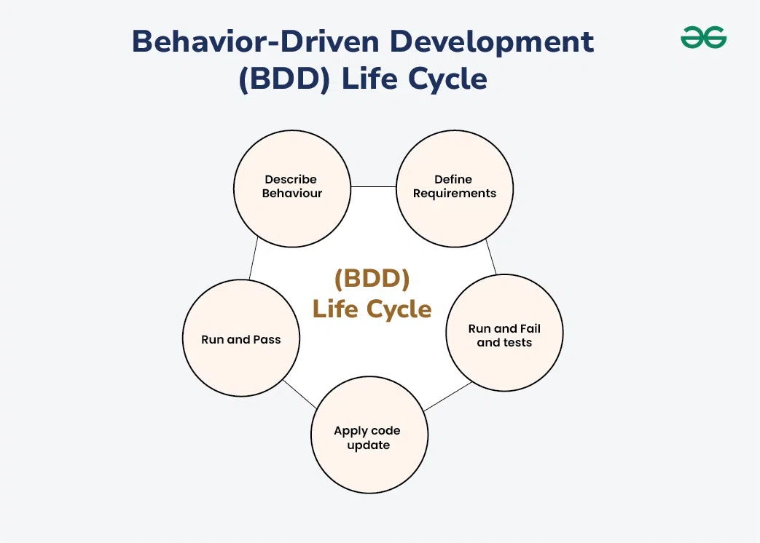
Behavior-Driven Development (BDD) Life Cycle

Slide 3
Describe behavior –This includes the flow and features of the product means the main vision.
Define requirements –Modeled requirements with business rules for a shared understanding.
Run and fail the tests –Develop and run the test cases.
Apply code update –Refactor it according to the requirement.
Run and pass the tests –Run the updated code and pass the test cases.

Slide 4
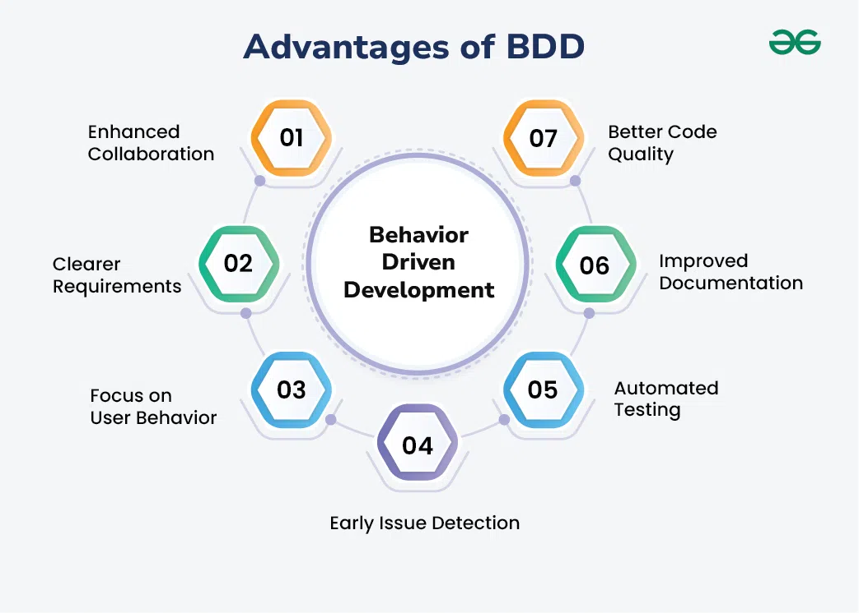
Advantages of BDD

Slide 5
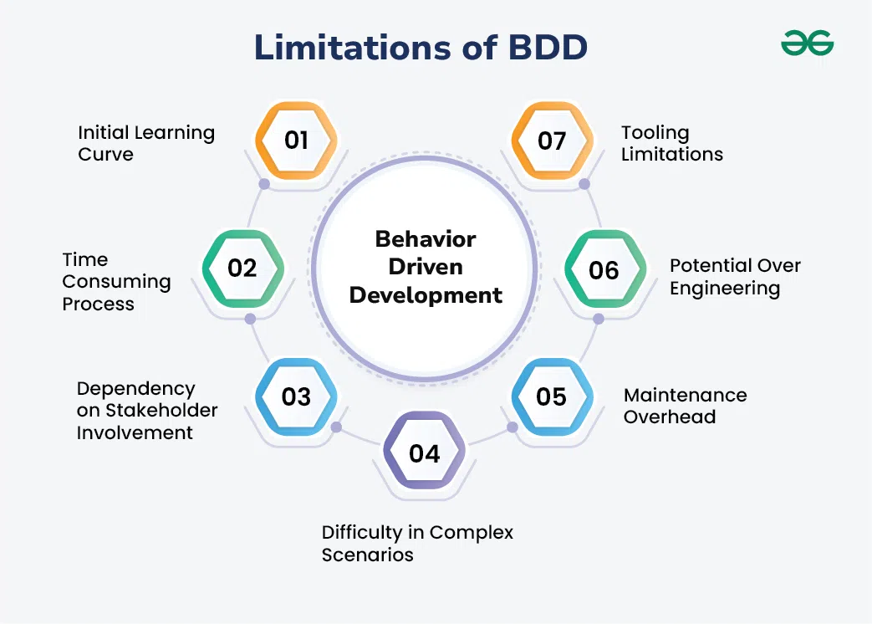
Limitations of BDD

Slide 6
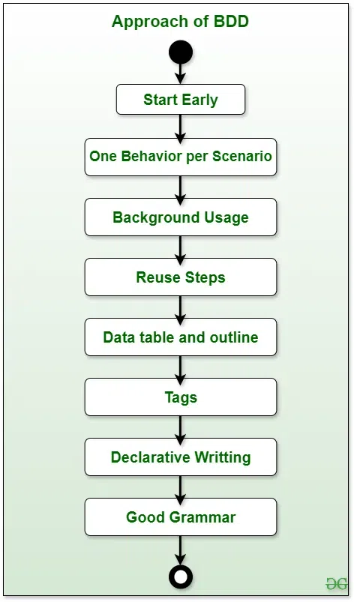
BDD Best Practices
When using Behavior-Driven Development (BDD), it’s important to follow some key practices to make the most out of it:

Slide 7
Data Tables and Outlines: When dealing with large data sets, use Data Tables and Scenario Outlines for clarity and organization.
Tags: Use tags to organize and run specific groups of scenarios, similar to labeling food containers in the fridge for easy access.
Declarative Writing: Write scenarios in a way that mirrors how a user would describe them, avoiding overly technical language.
Good Grammar: Ensure scenarios are well-written with correct grammar and spelling to avoid confusion and maximize understanding.

Slide 8
Start Early: Begin writing your test scenarios early to define software behavior and foresee potential issues. It’s like planning your trip before you hit the road, saving time and reducing problems later.
One Behavior per Scenario: Keep each scenario focused on one behavior. Just like cooking one dish at a time ensures perfection, this makes scenarios easier to understand and maintain.
Background Usage: If certain steps are repeated in every scenario, put them in the Background section for clarity and efficiency.
Reuse Steps: Save time by reusing step definitions frequently used in different scenarios.

