Slide 1
NATIONAL RAILWAY RESERVATION DATABASE SYSTEM
BASANT KUMAR MEENA (14CS01007)
SHAILESH KUMAR (14CS01038)

Slide 2
OBJECTIVES
Reservation of Tickets (up to max 6 persons )
Cancellation of Tickets
PNR Status
Check train between stations
Create account to access database
Check fair and distance of trains

Slide 3
TOOLS REQUIRED
MySQL Database
HTML
PHP
CSS
JAVASCRIPT
HOSTING SERVER (Apache)
Sublime Text

Slide 4
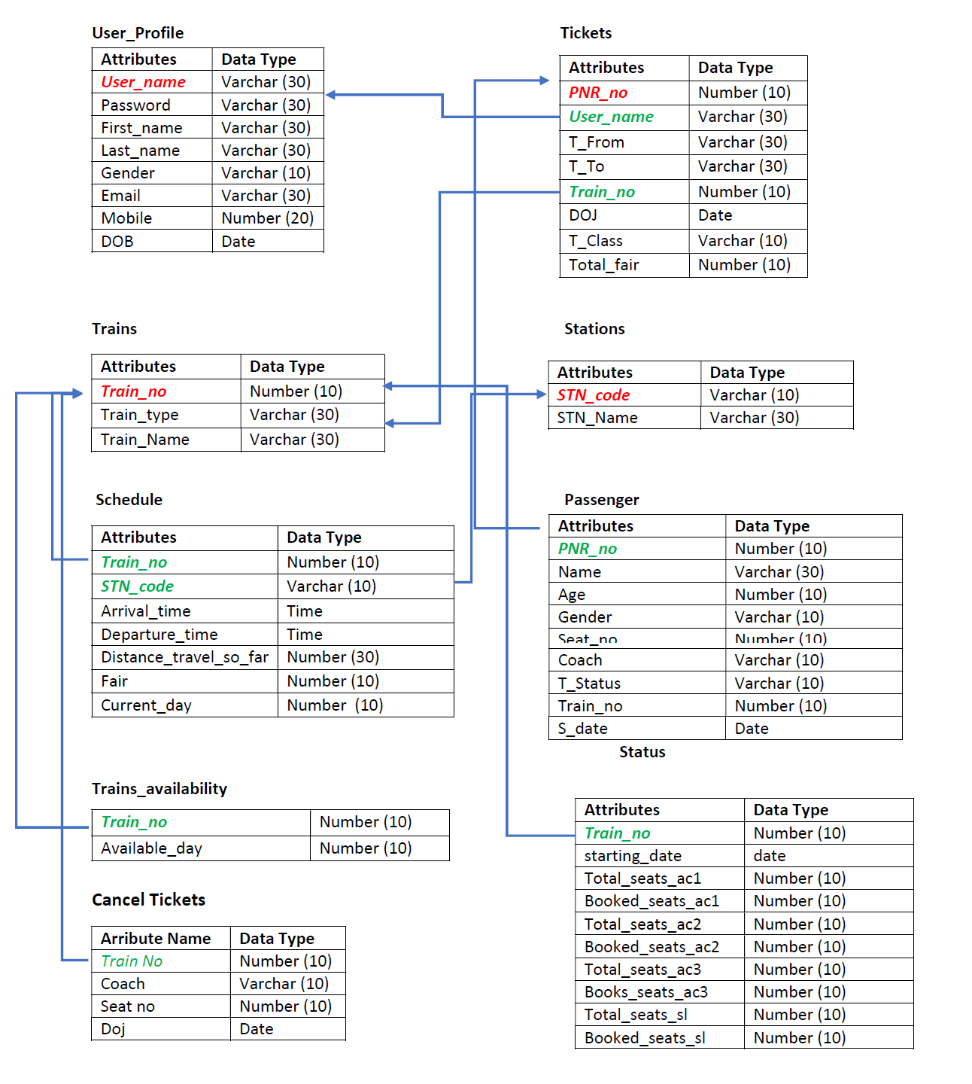

Slide 5
DATABASE DESCRIPTION
TRIGGERS
Auto Increment Booked Seats
When a person books a ticket, status of booked seats for that train gets incremented automatically.
Cancel Ticket
Whenever a person cancels his tickets, that seat gets transfer to person in waiting list.
PROCEDURE
Search trains
It takes source, destination and date of journey and gives back all possible trains between them.
Status new entry
Its creates a new instance of trains in status table for a particular date.
Current status
Its gives current status (#available seats) of train from status table for a particular date.

Slide 6
LIMITATIONS
There no Procedure for transaction like online payment has not been implemented, similarly after cancellation of ticket you are not going to get refund.
Implementation of real time tracking of trains is not done. For example, if a train gets delayed we are not providing any details.
This database system does not contain all data of trains and stations of our country.

Slide 7
THANK YOU

