Slide 1
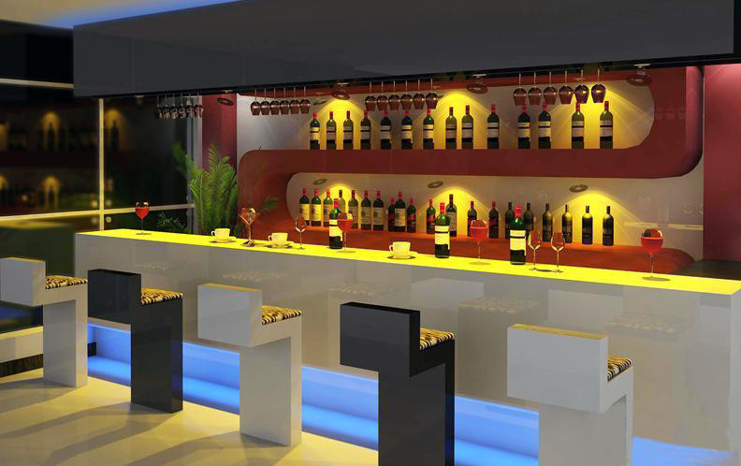
Best Bars in New York City
Basant Dhital

Slide 2
Project Outline:
# Why I decided to do this project?
# What are the questions that would like to get answer after with this project?
# Challenges for that I went through while collecting and cleaning data
# Data analysis
# Conclusion

Slide 3
Which is Neighborhood in New York City has the most active night life?
Which are the best bars in New York city?
Which day of the week is best and worst to go to bars?
What percentage of bars are wheel chair accessible?
What percentage of bars have happy hours and bar TV?

Slide 4
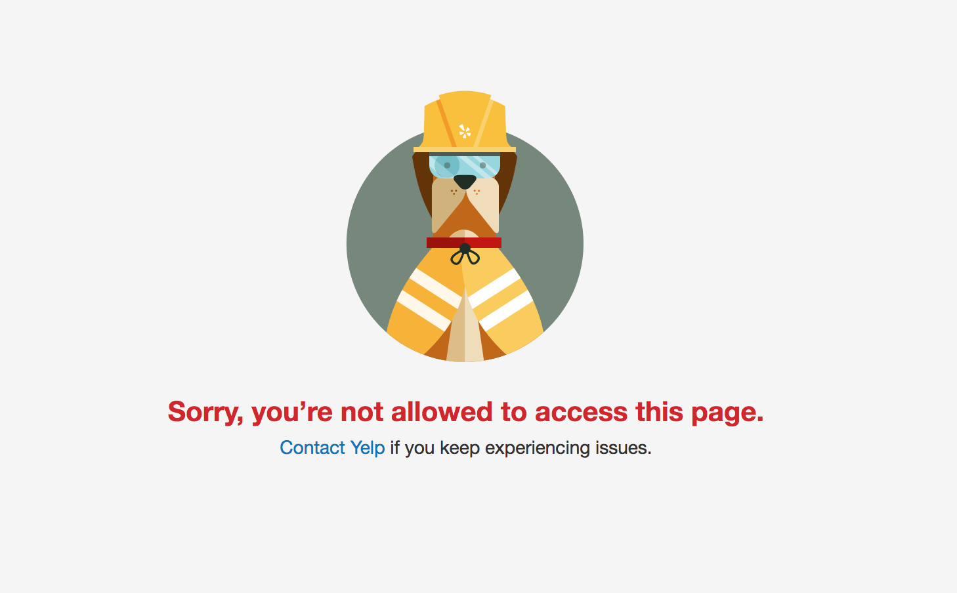
Challenges:
Finding correct x-path for each attributes as
description and attributes were embedded
under same class
Choosing neighborhood in New York City bars from scraping yelp

Slide 5
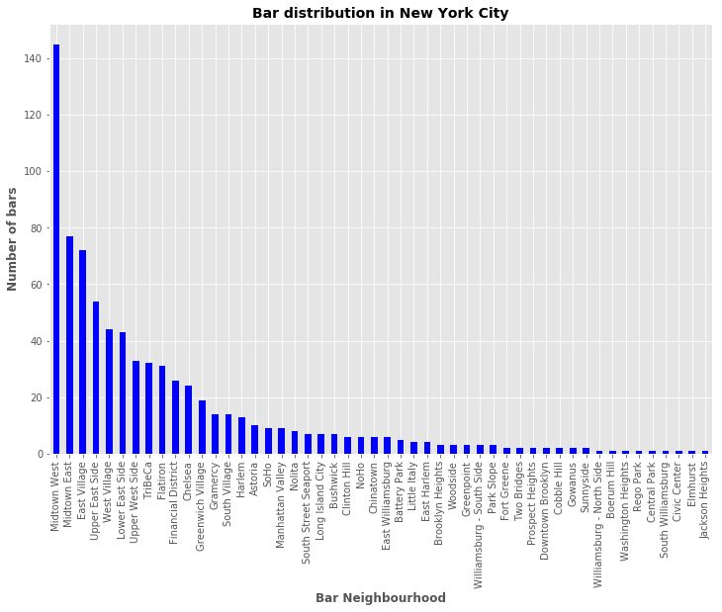
Top Five neighborhood with Active
Night life:
Mid town West
Mid town East
East Village
Upper East Side
West Village

Slide 6
Best bars on the basis of popularity index
Bar Name | Popularity index | Price range
The Park | 565.33 | 2
The Smith | 534.25 | 2
Bea | 491.00 | 2
Angel’s Share | 431.77 | 2
Please Don’t Tell | 397.75 | 2
The Smith | 393.71 | 3
Frying Pan | 347.00 | 4
Death & Co | 341.75 | 2
Employees only | 336.50 | 2
Verlaine | 333.75 | 3
Apothèke | 320.57 | 3
Popularity index = (Number of reviews )/ ratings

Slide 7
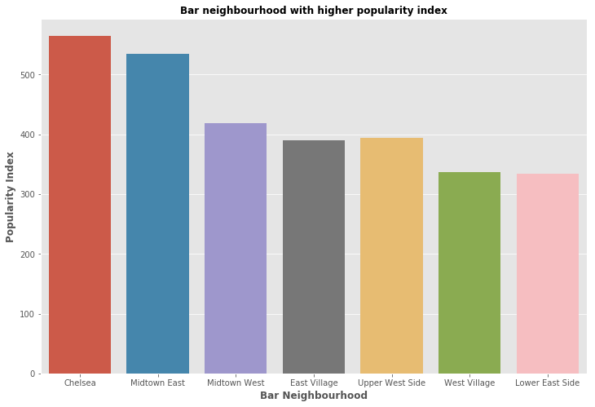

Slide 8
Which is the best and worst night to go bars in
New York city ?
Days | Total popularity index by a day of week | Normalized Pop. Index for each day
Sunday | 4783.85 | 3.72
Monday | 1287.31 | 1.00
Tuesday | 3250.44 | 2.52
Wednesday | 16025.03 | 4.68
Thursday | 25381.67 | 19.72
Friday | 30632.43 | 23.79
Saturday | 29120.72 | 22.62
Best night:
Friday
Worst night:
Monday

Slide 9
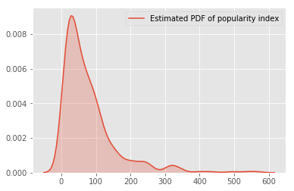
Wheel-chair accessible bars 30.01 %
Bar dancing 8.15 %
Bar TV 51.23 %
Bar Reservation 53.56 %
Bar Parking------garage 9.44 %
Bar Happy Hour 53.04 %

Slide 10
Conclusion :
These are the bar information to chose your best bars in New York City
From business point of view, this project provides area to improve such as bar parking,
bar dancing in order to have best bars in New York city
Future Direction:
I would like to have more information about male to female ratio by scraping the individual
reviewer which I left for future
Finding zones of popular drinking site (may be using heat map) might provider driving
Industry new area to focus to expand their business

Slide 11
Questions please…………………….
if any…………………

