Slide 1
Apparent/Real Age estimation using deep learning
Basavaraj Hampiholi
basavaraj.hampiholi@dfki.uni-kl.de
Mohamed Selim

Slide 2
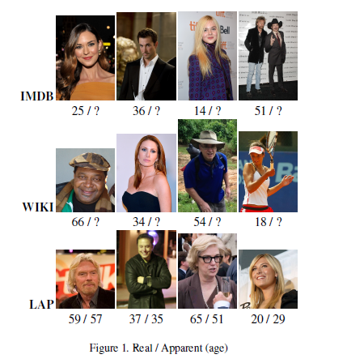
Problem Statement
Estimation of apparent/ biological age using convolutional
neural networks(CNNs) for single still images
2

Slide 3
Procedure: DEX approach
First training phase-Real Age Estimation
IMDB-Wiki
Dataset
260K
Face Detection
& Alignment
(Provided)
Fine tune
Pre-trained VGG16
Second training phase – Apparent age
LAP Dataset
8K
Face Detection
& Alignment
Dataset Augmentation
Train the
Fine tuned VGG16
Rasmus Rothe et. al, DEX: Deep EXpectation of apparent age from a still face image, ICCVW-2015
3

Slide 4
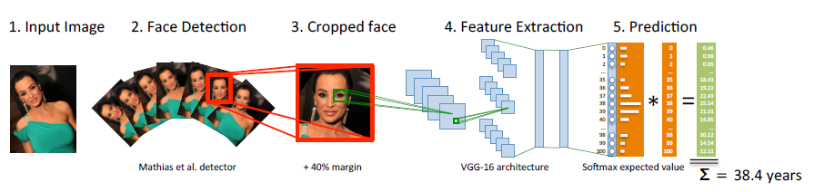
Pipeline
Rasmus Rothe et. al, DEX: Deep EXpectation of apparent age from a still face image, ICCVW-2015
4

Slide 5
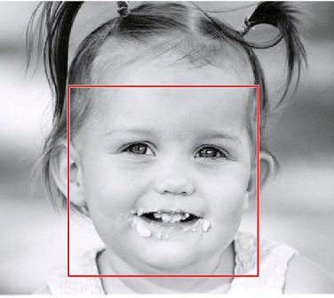
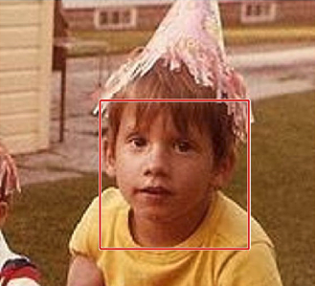
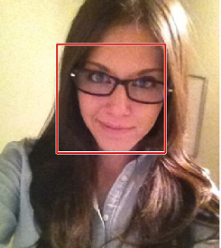
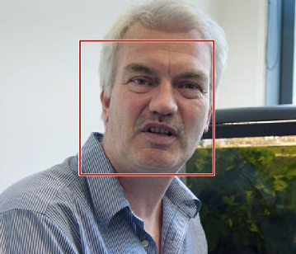
Face Detection
Mathias face detector
Extracted the face locations from image
Cropped image as per locations
5

Slide 6
Dataset
Real age estimation
IMDB-WIKI dataset(223K) and Adience (8K)- 231K images
Split dataset into train(167K), valid(41K) and test(23K)
Apparent age estimation
LAP dataset with train(4.1K), valid(1.5K) and test(2)- 7.6K images
6

Slide 7
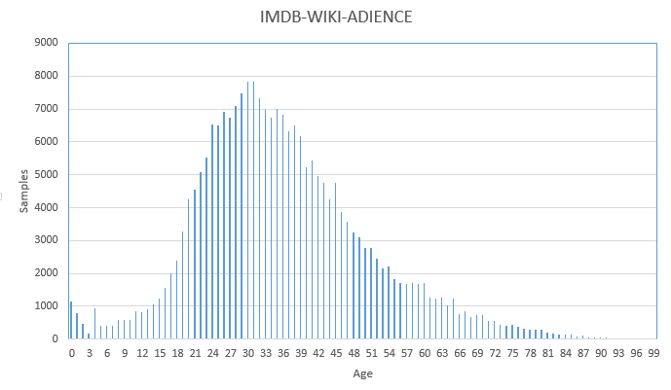
Dataset
7

Slide 8
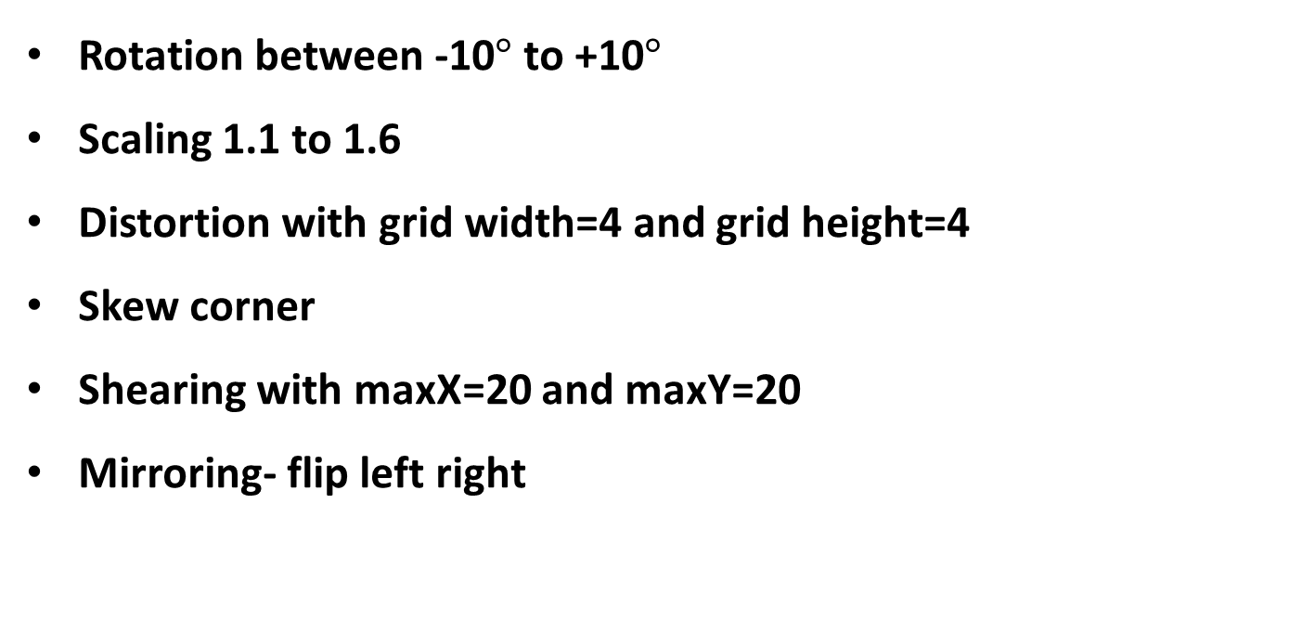
Data Augmentation
Rotation between -10$°$ to +10$°$
Scaling 1.1 to 1.6
Distortion with grid width=4 and grid height=4
Skew corner
Shearing with maxX=20 and maxY=20
Mirroring- flip left right
8

Slide 9
Data Augmentation
IMDB-WIKI-Adience: Performed data augmentation on train dataset for classes between 0-20 and 60-100 as there are less number of samples in each of these classes
LAP dataset: Performed augmentation on train dataset about 9 times. Split the dataset again into 8 equal training sets
9

Slide 10
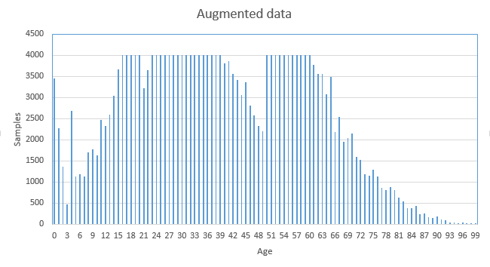
Data Augmentation
10

Slide 11

CNN Architecture
A pre-trained VGG-16 architecture is used for training
Softmax activation function
Two custom fully connected layers
Classification of 100(0-99) classes
11

Slide 12
CNN Training – Real Age Estimation
Using Backpropagation algorithm
Fine-tuned pre-trained vgg-16 on IMDB-WIKI dataset
Expected value- product of softmax probabilities and estimated age
Calculated expected value for test dataset
Calculated Mean Absolute Error
12

Slide 13
CNN Training- Hyper parameters
Learning rate- 0.001, 0.0001, 0.00001
Momentum- 0.9
Epochs- 30
Batch size- 8, 32
Optimizer- SGD
Loss function- Cross Entropy Loss
13

Slide 14
CNN Training – Regularization
Weight decay - 0.00001
One custom drop out layer with probability 0.7
Weighted cross entropy- assigned weights as,
vec(w) = N/T
N- Number of samples per class
T- Total number of samples in dataset
w- resultant weights
14

Slide 15
CNN Training – Apparent Age Estimation
Fine-tune the pre-trained models on real age estimation using LAP dataset
Fine-tuned 8 models on 8 different splits of LAP dataset
Calculated expected value
Ensemble the expected values of all 8 models
Calculate the Gaussian error
15

Slide 16
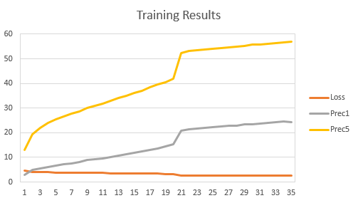
Results
16

Slide 17
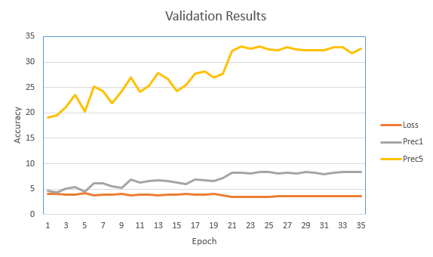
Results
17

Slide 18

Results
Real Age Estimation:
MAE= 4.9
Apparent Age Estimation:
$ε−error:0.41$
18

Slide 19
Conclusion
The current results are not equal to the state of the art
The results can be improved by using pre-trained model on face dataset
More training of the IMDB-WIKI dataset by setting proper hyper parameters can give better accuracy for real age estimation
The best model from real age estimation can give better results for apparent age estimation
19

Slide 20
Thank You
20

