Slide 1

Problem statement
Implement a system to ensure consistent, optimum spray coverage over uneven terrain and varying crop height, and to prevent the boom from impacting crops or soil, its height must be monitored and adjusted. Immune to the effects of dust, dirt, and chemicals, and able to detect surfaces of any color with identical accuracy.

Slide 2
Introduction
In precision agriculture, maintaining the optimal height of a sprayer boom is essential for consistent and efficient spray coverage over uneven terrain and varying crop heights. If positioned too high, the spray may be ineffective; if too low, it risks damaging crops or soil. A system is required to continuously monitor and adjust the boom height in real-time. Utilizing an ARM Cortex processor with a real-time operating system (RTOS), the system manages the measurement and adjustment of height. The sensor continuously monitors the boom's height, while a stepper motor adjusts the boom to ensure optimal clearance. Automating this process improves efficiency, reduces resource waste, and minimizes crop damage, benefiting modern agricultural operations.

Slide 3
Problem Analysis
1.Features Selected
Accurate height measurement for uneven terrain and crops using sensor.
Continuously monitor and update boom height for immediate adjustments.
2.Assumption made
Minimal impact from wind and obstacles on sensor readings.
Constant target height.
3. Peripherals
Ultrasonic Sensor: Measures the height.
Servo Motor : Adjust the sprayer booms height.
ARM-Cortex Processor.

Slide 4
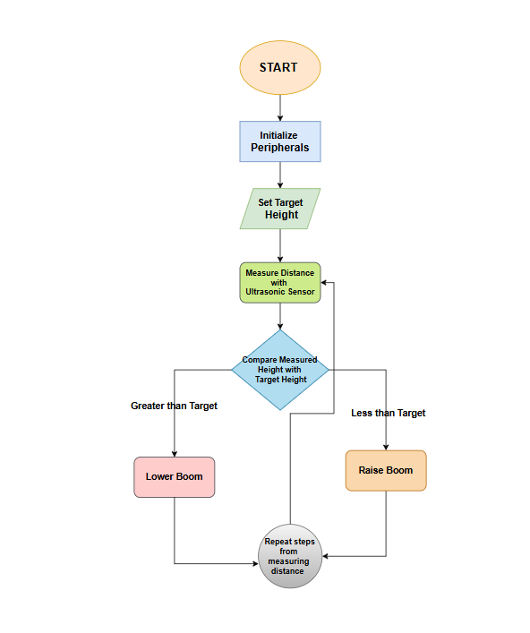
Flowchart

Slide 5
Algorithm
Step1:Start – Initialize the Ultrasonic sensor, servo motor and UART.
Step2:Set the correct target height.
Step3:Measure the height using the ultrasonic sensor.
Step4:Compare the measured height with target height.
Step5:Adjust the height using the stepper motor.
1.If height grater than the target height lower the boom.
2.If less ,than raise the boom to the target height.
Step5:Continue to loop, measuring and adjusting the height periodically to maintain the desired height.
Step6:Display the current boom height and status on the UART interface.
Step7:End.

Slide 6
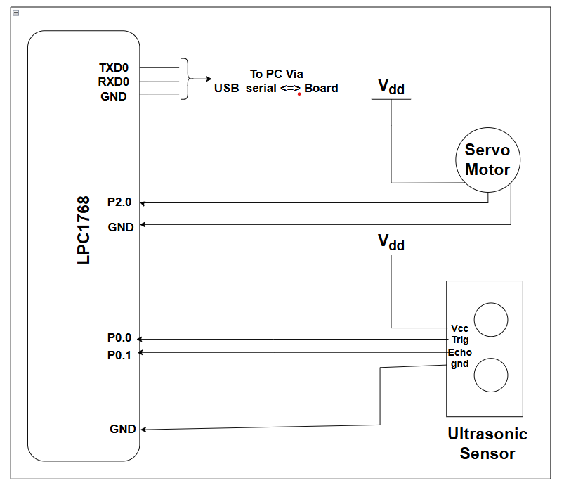
Interfacing Diagram

Slide 7
Hardware components specifications:
Ultrasonic sensor:
Power Supply: DC 5VWorking Current: 15mAWorking Frequency: 40HzRanging Distance : 2cm – 400cm/4mResolution : 0.3 cmMeasuring Angle: 15 degreeTrigger Input Pulse width: 10uSDimension: 45mm x 20mm x 15mm
Servo Motor
Operating Voltage is +5V typicallyTorque: 2.5kg/cmOperating speed is 0.1s/60°Gear Type: PlasticRotation : 0°-180°Weight of motor : 9gm

Slide 8
RTOS Objects and Justification
Task Management: The RTOS schedules the task1 to continuously measure the distance using the ultrasonic sensor, compare it with a target height, and control the servo motor and UART communication accordingly.
Timers and Time Management: Timers are used to measure the ultrasonic sensor's echo response and provide precise delays for motor control and communication.
UART Communication: The system sends data (servo status, measured distance) through UART without blocking other tasks, ensuring smooth communication.
Real-Time Control and Response: RTOS ensures quick response to distance changes by controlling the servo motor in real time based on sensor input.
System Initialization: RTOS efficiently handles the initialization of hardware peripherals like the ultrasonic sensor, servo motor, and UART before task execution.

Slide 9
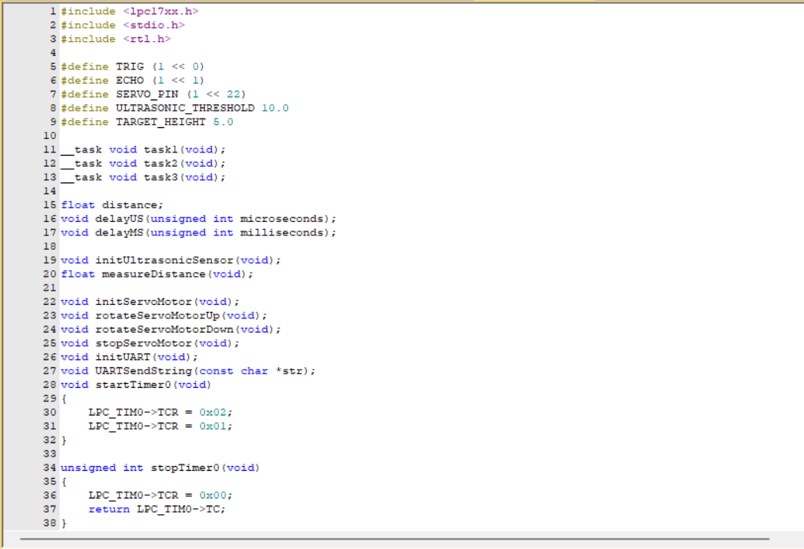
Code

Slide 10
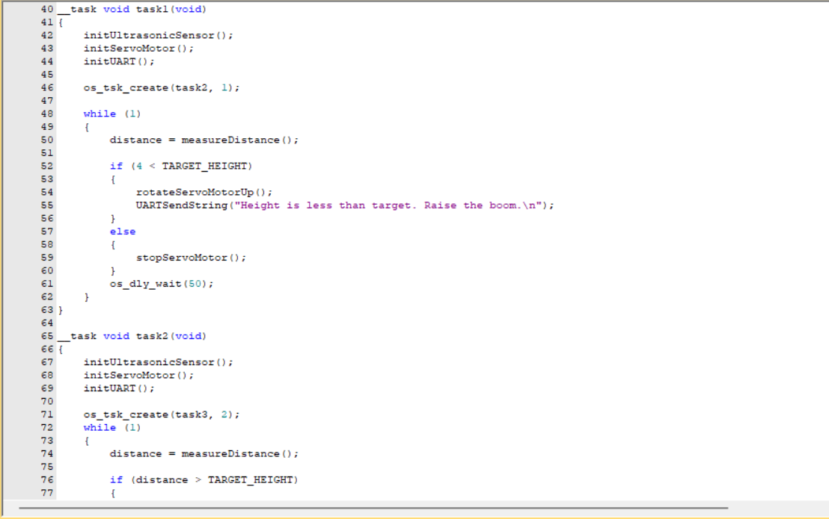

Slide 11
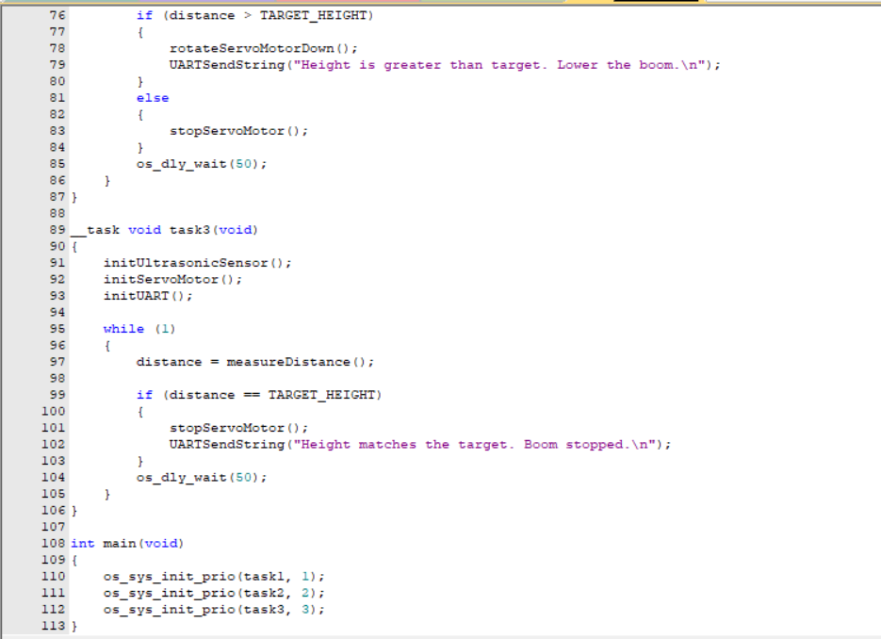

Slide 12
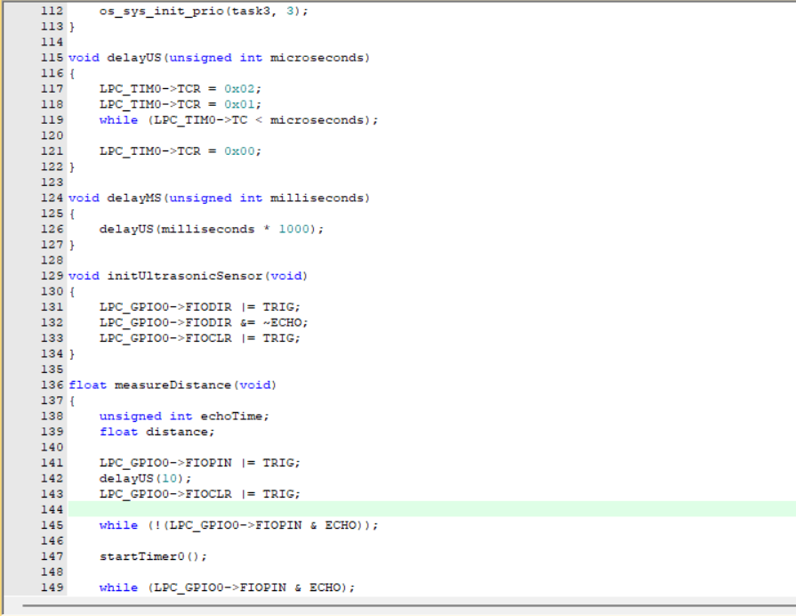

Slide 13
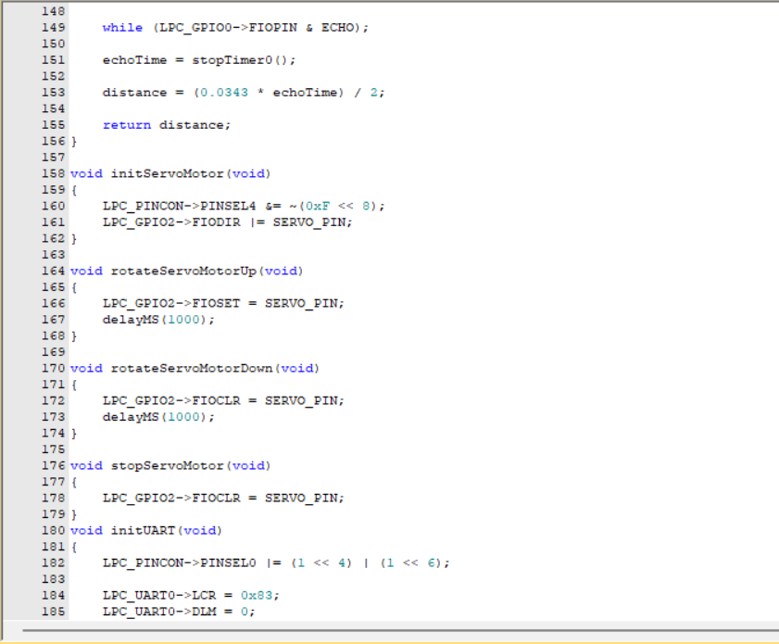

Slide 14
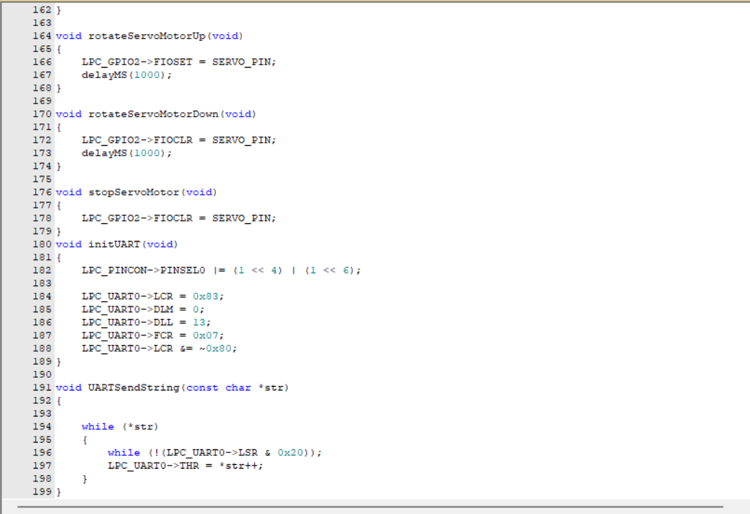

Slide 15
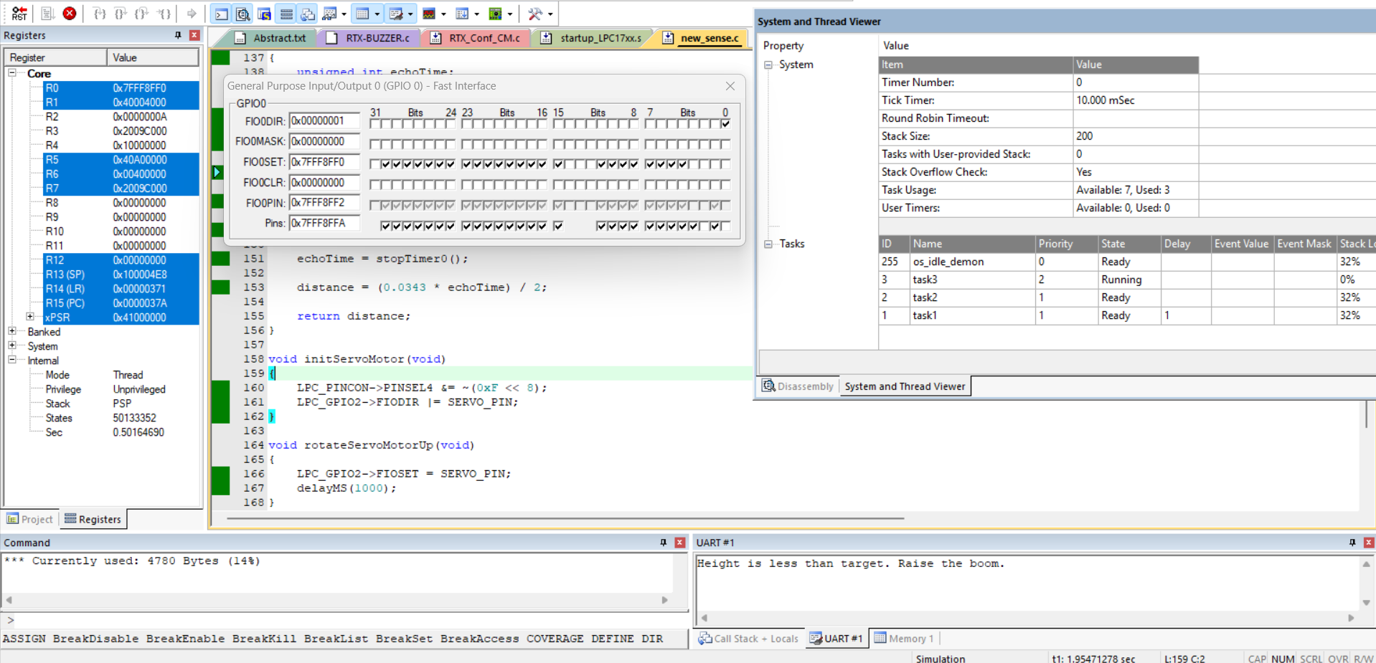
Results
Software :
The software results specify that Task 1 will control the servo motor, while Tasks 2 and 3 will compare and control the ultrasonic sensor's distance measurements.

Slide 16
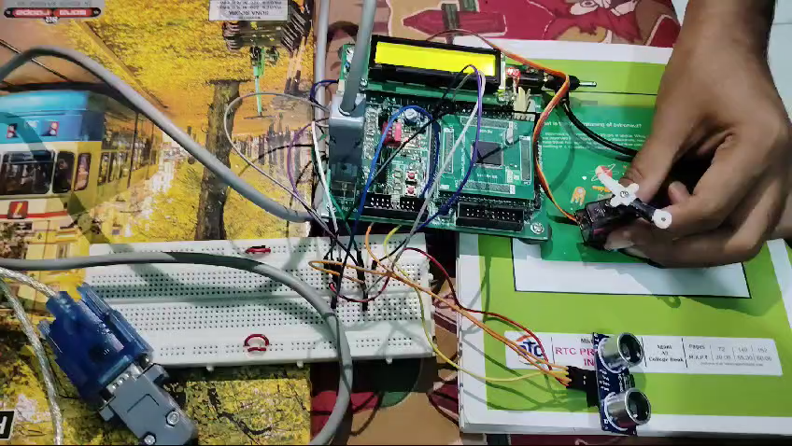
Results
Hardware :
The results are observed on the hardware and boom height is set according the distance measured by the ultrasonic sensor.

Slide 17
Thank You

