Slide 1

THREE-BODY COPILOT
BHX Quant
Transforming ESG data into decisions through intelligent quantitative insight.
Type a ticker. I'll do the polite version of judgement.
FTSE100 · Materiality Dataset · March 2025
API LIVE · OLLAMA · 79 COMPANIES

Slide 2




THE PROBLEM
ESG data is noise before it's signal.
ESG disclosures are complex, inconsistent, and scattered across hundreds of pages per company — making it extremely difficult for investors and business leaders to separate what is financially material from what is noise.
“Type a ticker. I’ll do the polite version of judgement.”
79
1,000+
Hours
FTSE 100 companies in the workbook
pages of disclosure per filing season
spent per ticker on manual review, today
2

Slide 3
THE FRAMING
The Three-Body Problem
No company's materiality can be judged in isolation. Every metric only means something relative to three orbiting bodies — and our copilot keeps all three in view at once.
Company
Peers
Market
The selected ticker's own disclosed financials and materiality scores.
How the same metrics compare across sector peers in the index.
Where the company sits against the full FTSE100 distribution.
3

Slide 4
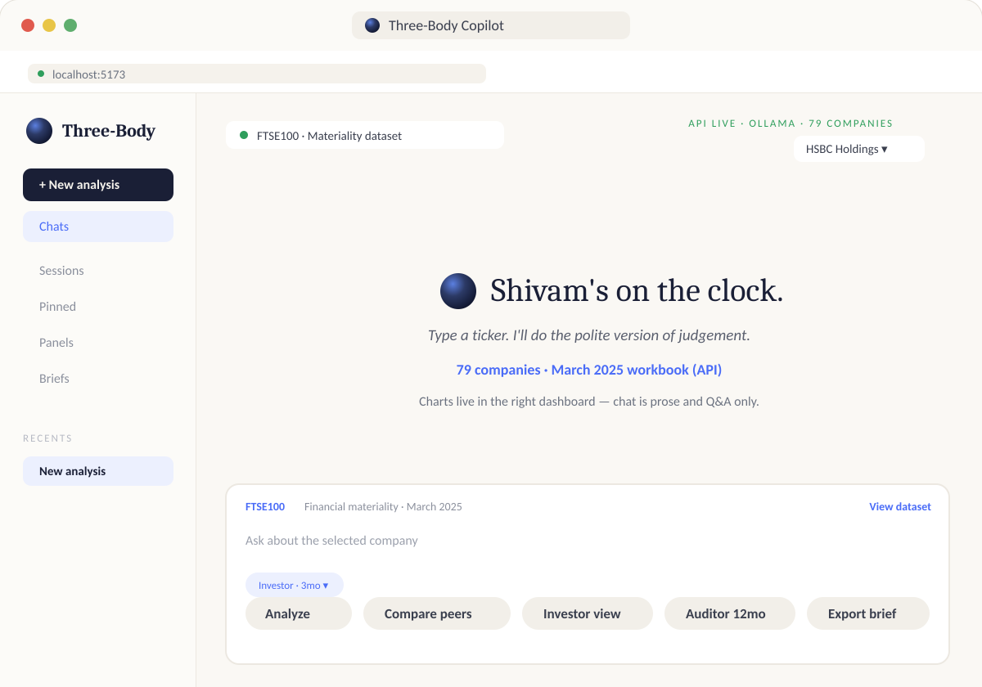
THE PRODUCT
Meet the Three-Body Copilot
One workspace: chat on the left for prose and Q&A, live charts on the right. Select a company, ask a question, get an investor- or auditor-ready read in seconds.
4

Slide 5


DECISION SUPPORT
How the solution shapes a decision
01
02
03
04
Select
Ask
See
Decide
Pick a ticker from the live FTSE100 dataset — 79 companies, refreshed each quarter.
Pose a question in plain language. The copilot frames it against Company, Peers, and Market.
Live charts render alongside the chat — financial materiality scored and visualised in real time.
Switch lenses — Investor view, Auditor 12mo — and export a brief with the judgement attached.
5

Slide 6




THE FRAMEWORK
Introducing MIND
Four lenses the copilot applies to every company — turning a flood of disclosures into a structured, explainable judgement.
M
I
N
D
Maxwell Data
Industry
Narrative Divergence
Decision Making
The structured financial-materiality dataset that grounds every answer.
Sector-relative context — how a company's metrics compare within its peer group.
Where a company's story diverges from its numbers — flagged automatically.
Synthesises M, I and N into an investor- or auditor-ready recommendation.
6

Slide 7
MIND · FRAMEWORK
Maxwell Data
M
The structured backbone: a curated financial-materiality dataset spanning all 79 FTSE100 companies, refreshed quarterly and served live via the Ollama-backed API.
1
79 companies, one schema
Every ticker normalised against the same materiality taxonomy — no apples-to-oranges comparisons.
2
March 2025 workbook, API-live
The dashboard reads directly from the workbook, so charts update the moment data refreshes.
3
Foundation for M-I-N-D
Every downstream lens — Industry, Narrative, Decision — is computed from this single source of truth.
7

Slide 8
MIND · FRAMEWORK
Industry
I
Materiality only means something in context. The Industry lens places a company's scores against its sector peers, surfacing where it leads, lags, or sits squarely in the pack.
1
Peer-group benchmarking
Automatic grouping by GICS sector so comparisons are always like-for-like.
2
“Compare peers” in one tap
The chat surface exposes a dedicated peer-comparison action, mirrored live in the dashboard.
3
Relative, not absolute, scoring
A score is only flagged as a concern when it diverges from sector norms — reducing false alarms.
8

Slide 9
MIND · FRAMEWORK
Narrative Divergence
N
What a company says and what its numbers show don't always agree. This lens flags the gap between disclosed narrative and underlying financial-materiality data — the moments that deserve a closer look.
1
Automated divergence flags
The copilot highlights where qualitative disclosure language outruns (or undersells) the quantitative score.
2
“Polite version of judgement”
Findings are surfaced as plain-language prose, not raw deltas — readable by investors and auditors alike.
3
Feeds the audit trail
Divergence flags carry into the Auditor 12mo view for longer-horizon tracking.
9

Slide 10
MIND · FRAMEWORK
Decision Making
D
The synthesis layer. M, I and N are combined into a single, explainable recommendation — tailored to whether the reader is an investor weighing a position or an auditor reviewing a 12-month trend.
1
Investor view
A forward-looking read — materiality trends, peer standing, and narrative risk distilled for allocation decisions.
2
Auditor 12mo view
A backward-looking trail — tracks how scores and disclosures have moved over the past year.
3
Export brief
One click turns the session into a saved, shareable brief — chat as prose, dashboard as evidence.
10

Slide 11


IN ACTION
From ticker to judgement, end to end
1
Type a ticker
HSBC Holdings selected from the FTSE100 · Materiality dataset.
Quick actions in the workspace
Analyze
2
MIND runs in the background
Maxwell Data, Industry, Narrative Divergence and Decision Making lenses compute together.
Compare peers
Investor view
3
Chat returns prose, dashboard returns charts
The two surfaces stay in sync — ask a question, watch the right-hand panel update.
Auditor 12mo
4
Choose a lens and export
Export brief
Investor view or Auditor 12mo, then Export brief for the record.
11

Slide 12
THREE-BODY COPILOT
Thank you.
Questions? Type a ticker and let's find out.
Shivam Tiwari · Hackathon · FTSE100
API LIVE · OLLAMA · 79 COMPANIES

