Slide 1
Unit – 2 Software Engineering
Naresh. E | Dept. of ISE | MSRIT | Bangalore.

Slide 2
Software Requirements

Slide 3
Objectives
To introduce the concepts of user and system requirements
To describe functional and non-functional requirements
To explain how software requirements may be organised in a requirements document

Slide 4
Requirements engineering
The process of establishing the services that the customer requires from a system and the constraints under which it operates and is developed.
The requirements themselves are the descriptions of the system services and constraints that are generated during the requirements engineering process.

Slide 5
What is a requirement?
It may range from a high-level abstract statement of a service or of a system constraint to a detailed mathematical functional specification.
This is inevitable as requirements may serve a dual function
May be the basis for a bid for a contract - therefore must be open to interpretation;
May be the basis for the contract itself - therefore must be defined in detail;
Both these statements may be called requirements.

Slide 6
Types of requirement
User requirements
Statements in natural language plus diagrams of the services the system provides and its operational constraints. Written for customers.
System requirements
A structured document setting out detailed descriptions of the system’s functions, services and operational constraints. Defines what should be implemented so may be part of a contract between client and contractor.

Slide 7
Definitions and specifications
User requir
ement definition
1. T
he softw
ar
e m
ust pr
o
vide a means of
r
epr
esenting and
1.
accessing e
xternal files cr
ea
ted b
y other tools
.
Syst
em requir
ements specification
1.1 The user should be pr
o
vided with facilities to define the type of
1.2
external files
.
1.2 Each e
xternal file type ma
y ha
v
e an associa
ted tool w
hich ma
y be
1.2
applied to the file
.
1.3 Each e
xternal file type ma
y be r
epr
esented as a specific icon on
1.2
the user’
s displa
y
.
1.4 F
acilities should be pr
o
vided f
or the icon r
epr
esenting an
1.2
e
xternal file type to be defined b
y the user
.
1.5 When a user selects an icon r
epr
esenting an e
xternal file
, the
1.2
effect of that selection is to apply the tool associated with the type of
1.2
the external file to the file represented by the selected icon.

Slide 8
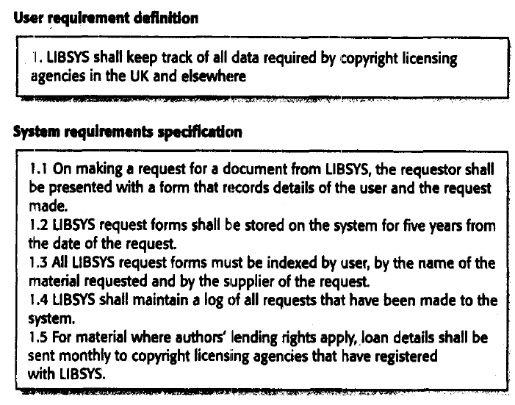
Example - 1

Slide 9
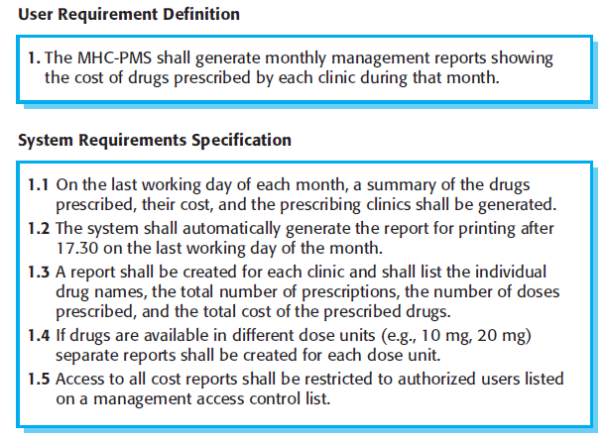
Example - 2

Slide 10
Requirements readers

Slide 11
Functional and non-functional requirements
Functional requirements
Statements of services the system should provide, how the system should react to particular inputs and how the system should behave in particular situations.
Non-functional requirements
constraints on the services or functions offered by the system such as timing constraints, constraints on the development process, standards, etc.
Domain requirements
Requirements that come from the application domain of the system and that reflect characteristics of that domain.

Slide 12
Functional requirements
Describe functionality or system services.
Depend on the type of software, expected users and the type of system where the software is used.
Functional user requirements may be high-level statements of what the system should do but functional system requirements should describe the system services in detail.

Slide 13
The LIBSYS system
A library system that provides a single interface to a number of databases of articles in different libraries.
Users can search for, download and print these articles for personal study.

Slide 14
Examples of functional requirements
The user shall be able to search either all of the initial set of databases or select a subset from it.
The system shall provide appropriate viewers for the user to read documents in the document store.
Every order shall be allocated a unique identifier (ORDER_ID) which the user shall be able to copy to the account’s permanent storage area.

Slide 15
Requirements imprecision
Problems arise when requirements are not precisely stated.
Ambiguous requirements may be interpreted in different ways by developers and users.
Consider the term ‘appropriate viewers’
User intention - special purpose viewer for each different document type;
Developer interpretation - Provide a text viewer that shows the contents of the document.
Notes:
Imprecision – inaccuracy, not exactness
Ambiguous - Having more than one possible meaning

Slide 16
Requirements completeness and consistency
In principle, requirements should be both complete and consistent.
Complete
They should include descriptions of all facilities required.
Consistent
There should be no conflicts or contradictions in the descriptions of the system facilities.
In practice, it is impossible to produce a complete and consistent requirements document.

Slide 17
Non-functional requirements
These define system properties and constraints e.g. reliability, response time and storage requirements. Constraints are I/O device capability, system representations, etc.
Process requirements may also be specified mandating a particular CASE system, programming language or development method.
Non-functional requirements may be more critical than functional requirements. If these are not met, the system is useless.

Slide 18
Non-functional classifications
Product requirements
Requirements which specify that the delivered product must behave in a particular way e.g. execution speed, reliability, etc.
Organisational requirements
Requirements which are a consequence of organisational policies and procedures e.g. process standards used, implementation requirements, etc.
External requirements
Requirements which arise from factors which are external to the system and its development process e.g. interoperability requirements, legislative requirements, etc.

Slide 19
Non-functional requirement types

Slide 20
Requirements measures
Notes:
How do you apply these metrics to your daily life?

Slide 21
Requirements interaction
Conflicts between different non-functional requirements are common in complex systems.
Spacecraft system
To minimise weight, the number of separate chips in the system should be minimised.
To minimise power consumption, lower power chips should be used.
However, using low power chips may mean that more chips have to be used. Which is the most critical requirement?

Slide 22
User requirements
Should describe functional and non-functional requirements in such a way that they are understandable by system users who don’t have detailed technical knowledge.
User requirements are defined using natural language, tables and diagrams as these can be understood by all users.

Slide 23
LIBSYS requirement
Example:
LIBSYS shall provide a financial accounting system that maintains records of all payments made by users of the system. System managers may configure this system so that regular users may receive discounted rates.

Slide 24
Problems with natural language
Lack of clarity
Precision is difficult without making the document difficult to read.
Requirements confusion
Functional and non-functional requirements tend to be mixed-up.
Requirements amalgamation
Several different requirements may be expressed together.
Notes:
Precision - The quality of being reproducible in amount or performance; the quality of having high accuracy and consistency;

Slide 25
Guidelines for writing requirements
Invent a standard format and use it for all requirements.
Use language in a consistent way. Use shall for mandatory requirements, should for desirable requirements.
Use text highlighting to identify key parts of the requirement.
Avoid the use of computer jargon, abbreviations, and acronyms .
Notes:
Jargon – e.g., Architecture, Module, etc.

Slide 26
Alternatives to NL specification

Slide 27
The requirements document
The requirements document is the official statement of what is required of the system developers.
Should include both a definition of user requirements and a specification of the system requirements.
It is NOT a design document. As far as possible, it should set of WHAT the system should do rather than HOW it should do it

Slide 28
Users of a requirements document

Slide 29
Requirements document structure
Preface
Introduction
Glossary
User requirements definition
System architecture
System requirements specification
System models
System evolution
Appendices
Index

Slide 30
References
Roger.S.Pressman, Software Engineering-A Practitioners approach, 7ed,McGraw-Hill, 2007.
Ian Sommerville, Software Engineering, Eight Edition, Person Education, 2007.

