Slide 1
Imaging Modalities

Slide 2
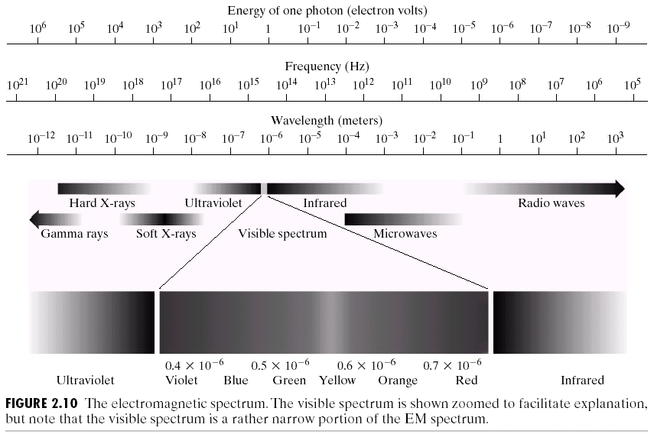
Electromagnetic Spectrum

Slide 3
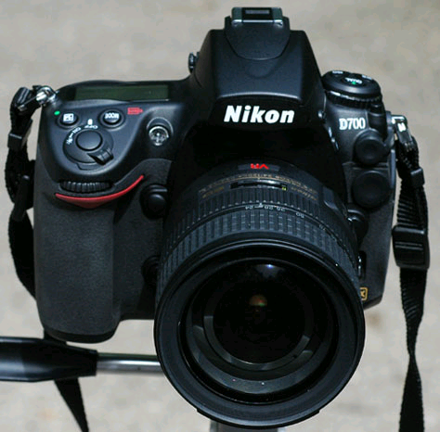
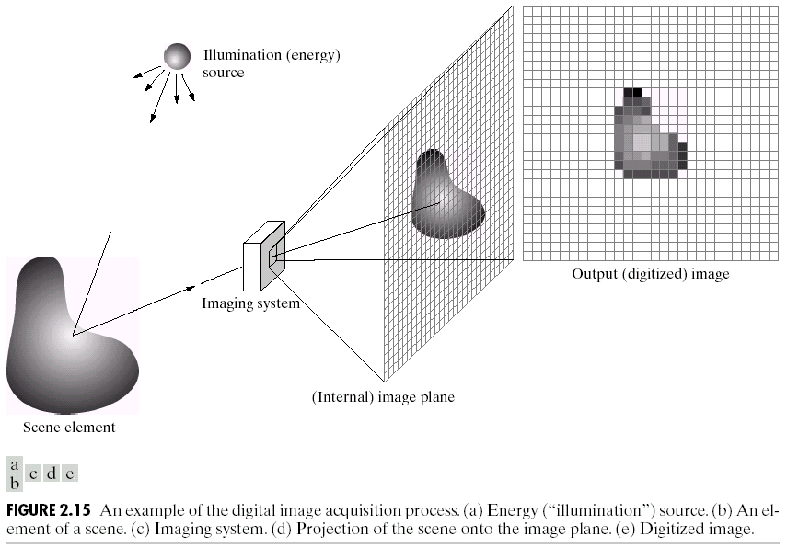
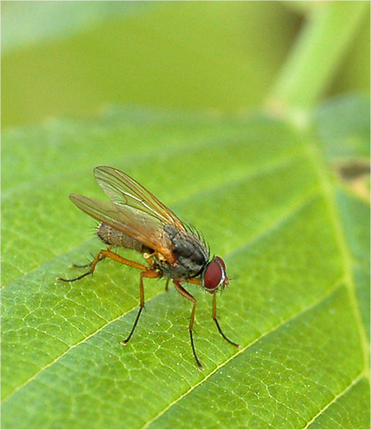
1) Visible Light

Slide 4
Beyond Visible
Gamma Ray
X-ray
Ultraviolet
Microwave
Infrared
Radio waves

Slide 5
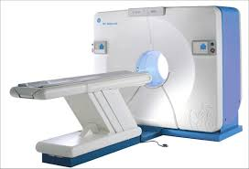
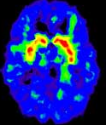
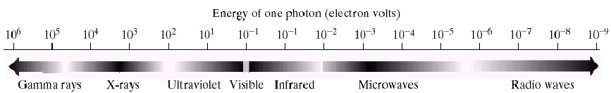
2) Gamma Rays
Gamma Rays: Carry the most energy and have the shortest wavelengths.
Used in Nuclear medicine (PET scan)

Slide 6
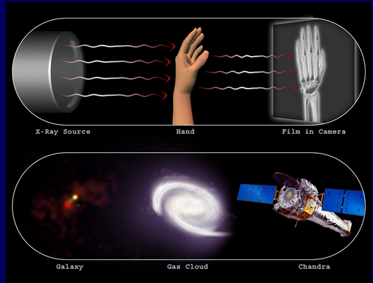
3) X-ray
These rays have enough energy to penetrate deep into tissues and cause damage to cells; are stopped by dense materials, such as bone.
Used in Medical, astronomy and industrial applications

Slide 7
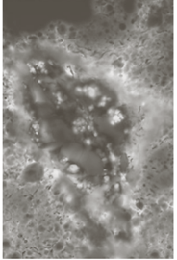
4) Ultraviolet
Energy is high enough with UV rays to penetrate living cells and cause them damage.
Used in Industry, microscopy and lasers(sterilization).
Infected corn(microscope)

Slide 8
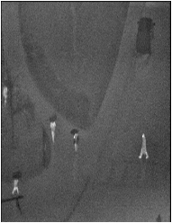
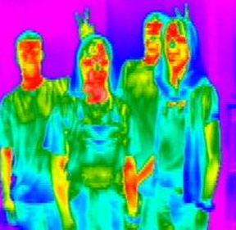
5) Infrared
--A infrared camera is a device that forms an image using infrared radiation. The higher an object's temperature, the more infrared radiation is emitted .
--Used in Astronomy, Industry and remote sensing.

Slide 9
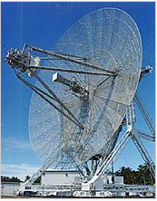
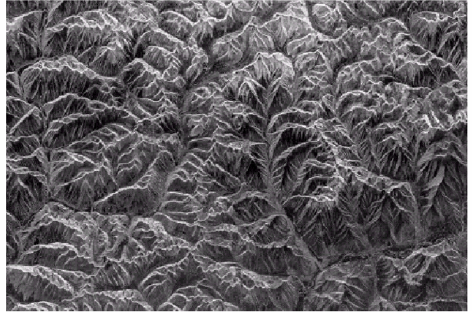
6) Microwave
-- Used in NDTE, concealed weapon detection, through-the-wall imaging.
Radar

Slide 10
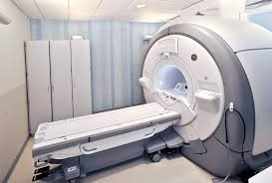
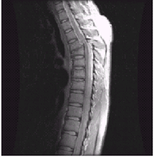
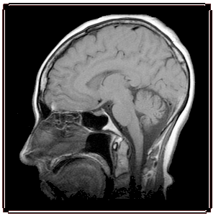
7) Radio Waves
--Have the longest wavelengths and the lowest frequencies. Non-ionizing radiation.
--Used in: RADAR, cooking food, satellite transmissions, MRI

