Slide 1

“Smart-grid technology starts in the home.”
Understand your energy usage.
Take control to save money!
Notes:
Intro Slide: introduce team and mission

Slide 2
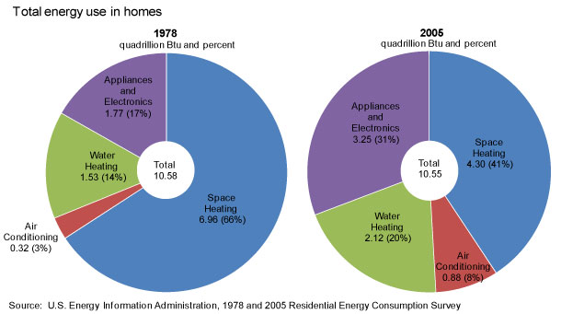
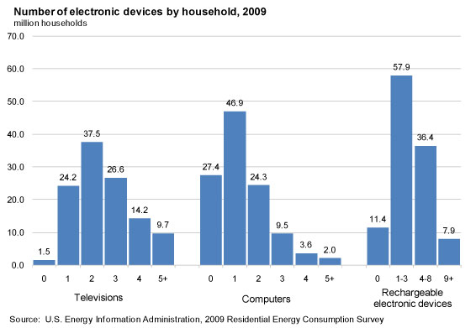
Home Electricity Usage
1
Household electronics have doubled in past 30 years.
We want you to be aware of your usage, which could be reduce by as much as 20%.
*DOE suggested in 2005
Notes:
Problem: household electronics has doubled in the past 30 years and will continue to rise
How many people here spend more than the average household on electricity each month? ~$140
DOE claims that just being aware of how much electricity your devices are using will reduce by as much as 20%. That’s about $336 per year.
We want to provide you with that awareness using an affordable and expandable systems. So how will it work?

Slide 3
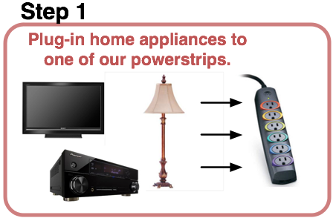
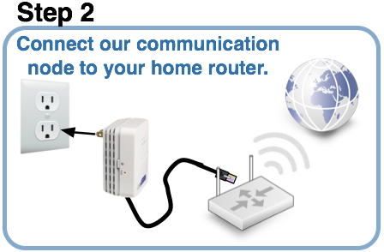
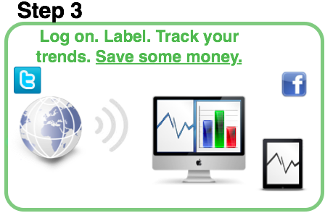
System Setup
2
Notes:
How it works: 3 steps

Slide 4
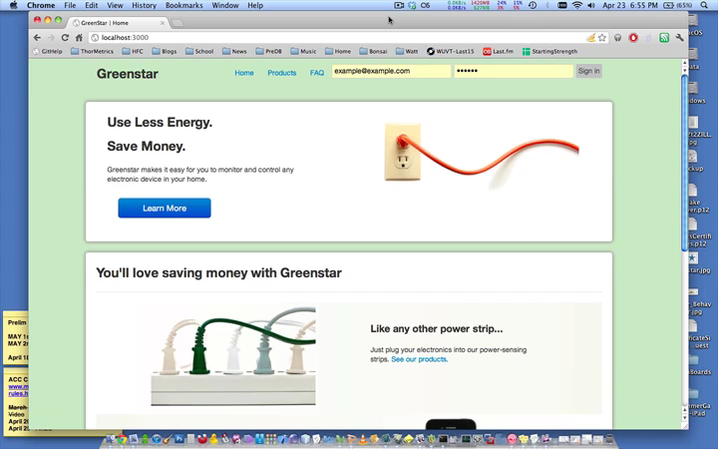
Video Demo
3
Notes:
Go to web browser
Log in
Show real-time graphs of current outlets, this is our TV, DVR and stereo at home. I could turn this off if I wanted to.
We have another power strip that is plugged in at our house, we just need to register it.
Type in PRODUCT_DEMO2, show real-time usage – Lamp, computer and monitor.

Slide 5
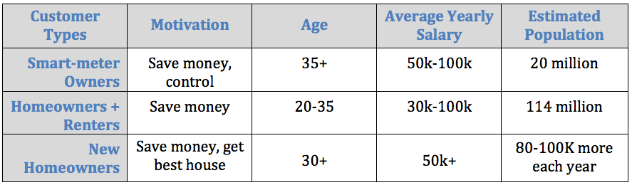
Potential Market
4
*Pikes Research 2011
*ABI Research 2009
*GreenTechMedia 2011
*US Census 2011
Notes:
Let’s talk about the industry and market that our product will be dealing with. Our product falls in two industries, home automation and home energy management. Pike’s Research estimates that this industry will be over 20 billion by the year 2020.
There are three major players in these industries: (1) utility companies that offer smart-meters, (2) service providers that offer complete home solutions at a hefty price, and (3) retail/consumer-based solutions. This last one is where we fit in. We call it a bottoms-up approach, you can start with a few outlets and expand to more depending on your needs. Pikes research predicts that while the first two competitors (utility companies and service providers) are controlling the market now, our types of products will begin to dominate in the next decade. That’s what this graph shows on the left.
On the right, ABI Research estimates that of these home automation and energy management systems, 12 million will be sold just in 2016.
It is an ideal time for our product to hit the market and we need to act fast.
We will talk about this in more detailed in a minute, but the three groups of people that we will market to are the 20 million home-owners with smart-meters, the 114 million homeowners and renters who want green technology, and the 80-100k new home owners each year.
GreenTechMedia did a poll in 2011 and found that 87% of people want green, energy-efficient products like ours.

Slide 6
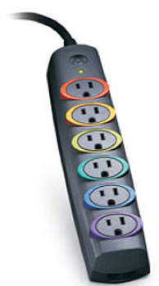
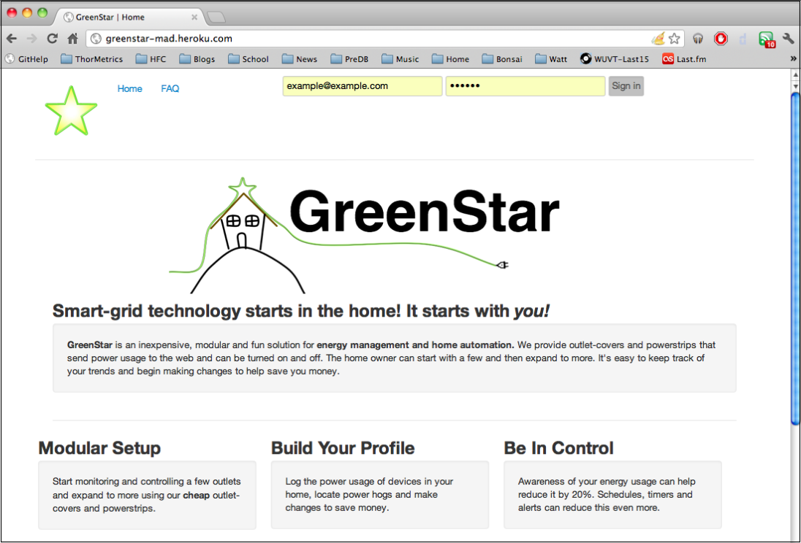
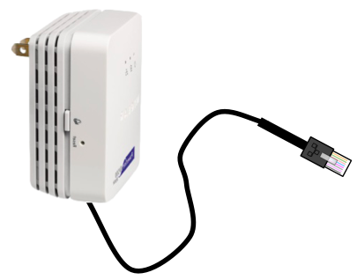
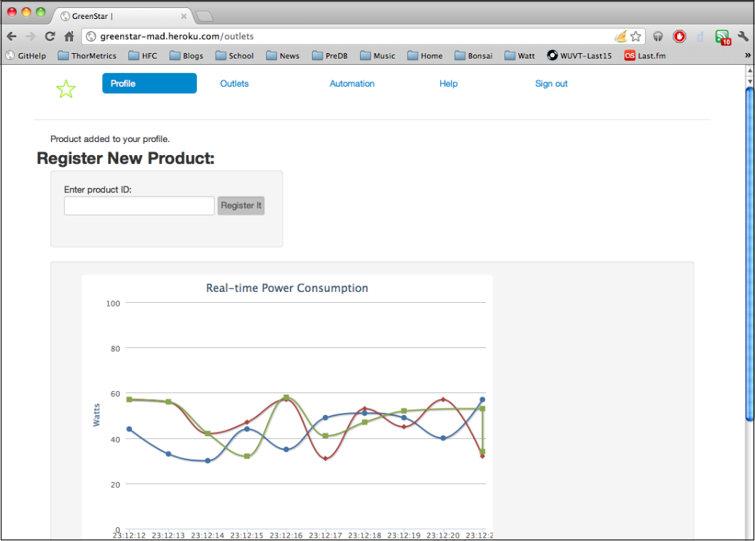
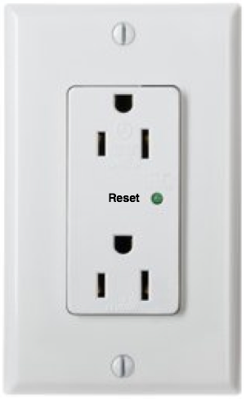
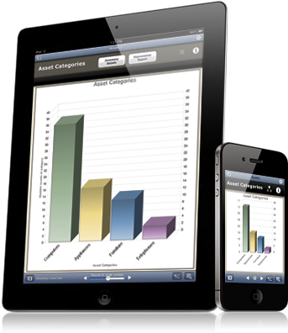
Initial Rollout
6
Starter Kit:
Free Web/Mobile App
+
= $99
6-outlet
Power strip
*cost to manufacture = $20-30
Add-ons:
Outlet-cover
$39
$19
*cost to manufacture = $15
*cost to manufacture = $5
Notes:
We have designed and tested our devices and are ready to start building. During our initial rollout, we will offer a starter kit for $99. This includes a communication node and a 6-outlet power strip.
An additional power strip will be $39 dollars and an additional outlet-cover will be $19.
Our initial web and mobile app will be free. Customers will be able to monitor their usage and create schedules and alerts from anywhere.

Slide 7
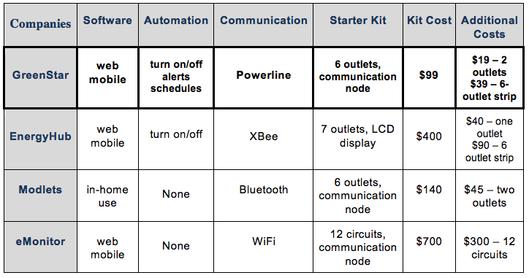
Competition
5
Notes:
3 of our closest competitors are EnergyHub, Modlets and eMonitor
Because we use power line communication, we are a quarter of the price of our closest competitor, which means our customers will start saving money 4 times faster.
Let’s talk more about our starter kit and initial rollout:

Slide 8
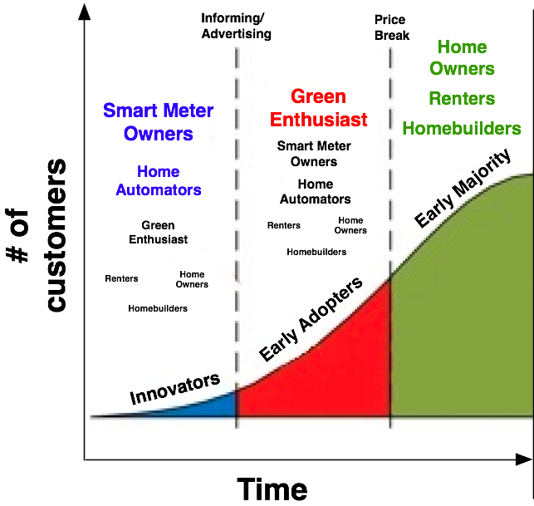
Initial Market
7
Year 1
Year 2
Year 3
Notes:
During our initial rollout, we will market to two main groups: the %4 of households that use home automation, and the smart-meter customers, which is currently about 20 million households in the US. Our product complements these smart-meters that keep people informed about peak electricity times. Customers can use our product as a way to react and save money during those peak hours.
A current barrier in energy management systems such as ours is that only about 5% of Americans actually know they exist. Through targeted advertising and marketing, we hope to attract green enthusiasts. And, after a year of development, we believe our prices will reduce to attract part of the 87% of homeowners, renters and home builders that want green technology, that’s about 100 million potential households.

Slide 9
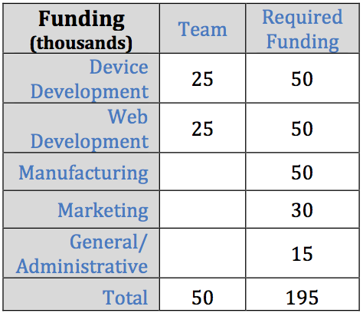
Funding
8
Short-term goals:
- Build all three of our devices
- Continue working on web development (graphics designer needed)
- Explore licensing and exclusivity with utility companies (need marketing)
Long-term goals:
- Expand to product line of smart outlets for all home appliances
- Expand to support online communities that can share, learn and compete

Slide 10
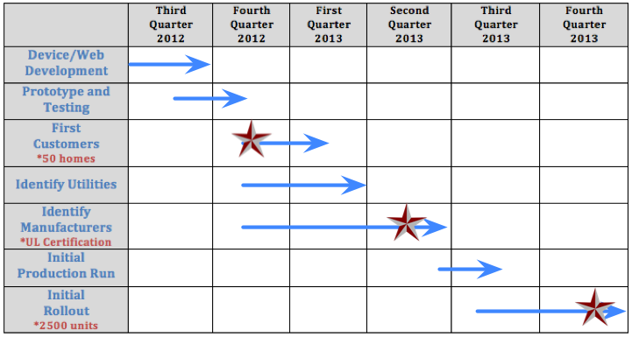
Short Term Goals
9

Slide 11
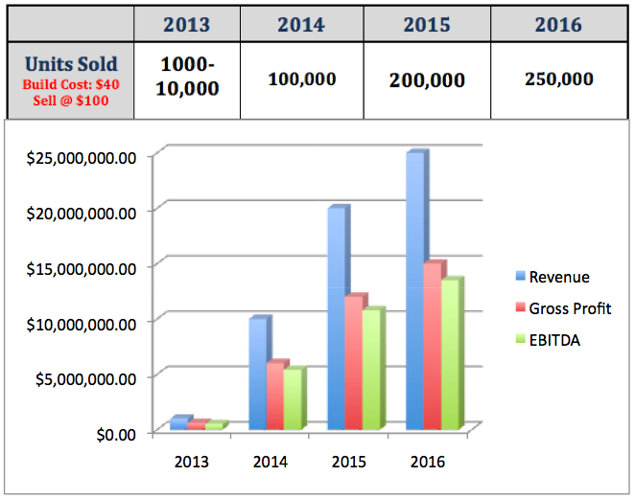
Projections
10
That’s ~1% of projected units sold just in 2016 (ABI 2009)
Notes:
These projections are conservative, build costs that are at $40 will drop after a year of development
Our number of units sold by 2016 is about ~1% of projected sold just in 2016.

Slide 12
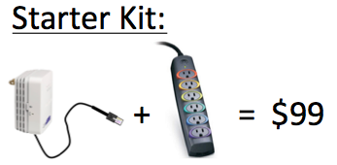
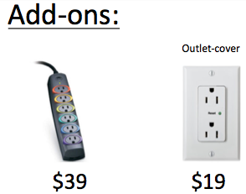
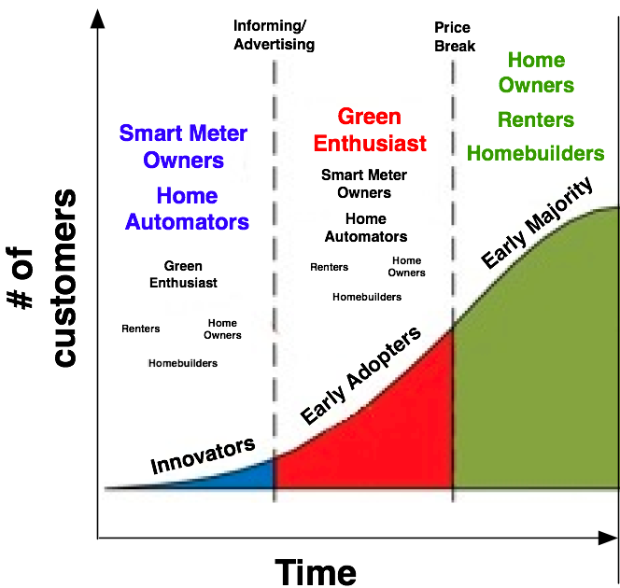
Summary
11
Our Team: Experienced in building both hardware and software solutions using unique and innovative technologies.
Our Motivation: Help you understand how much electricity your devices are using and help you take control to save money.
Our Product: Affordable and expandable set of outlet-covers and powerstrips that send power usage data to the web and can be remotely turned on and off.
Short Term Goals:
Boards and devices are designed, we need funding to begin building first versions.
Website is under construction, need graphics designer.
Research patent and licensing opportunities.
Long Term Goals:
Expand to product line of smart outlets for high energy devices (HVAC, washer/dryer, etc.)
Support online communities that can share, learn and even compete.

