Slide 1
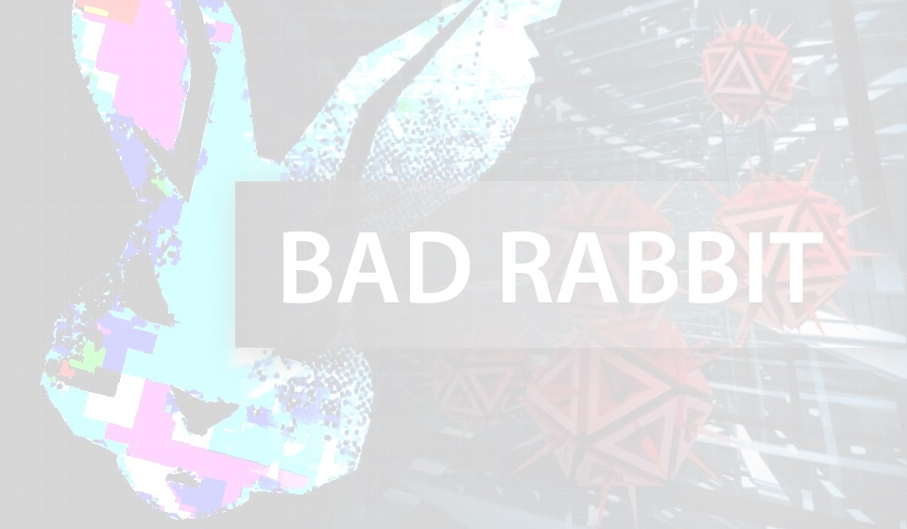
BadRabbit
The Ransomware
Brian Ascani
Jack Wisialowski
Eric Velazquez
Karma Tobgyel

Slide 2

What is BadRabbit?
Ransomware
Type of harmful attack that hijacks control of the user’s system and demands payment to restore the system to normal settings.
Cryptovirus
Virus that will encrypt files on a computer, essentially scrambling the contents of the file so the user cannot access them.

Slide 3
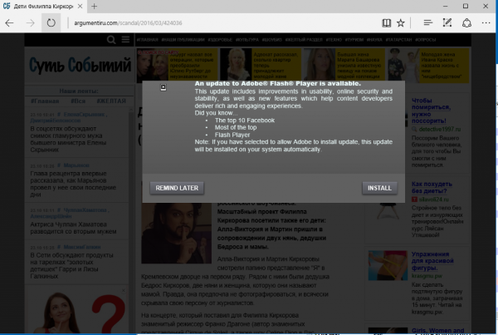
How does it work?
Click install.exe, run fake Adobe Flash Update
runs BadRabbit.exe
Run rundll32.exe, upload viral code
utilizes infpub.dat
uses mimikatz, grab credentials

Slide 4
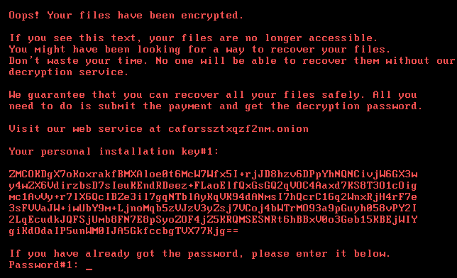
How does it work?
Run dispci.exe, encrypt files
utilizes cscc.dat
uses dcrypt.sys

Slide 5
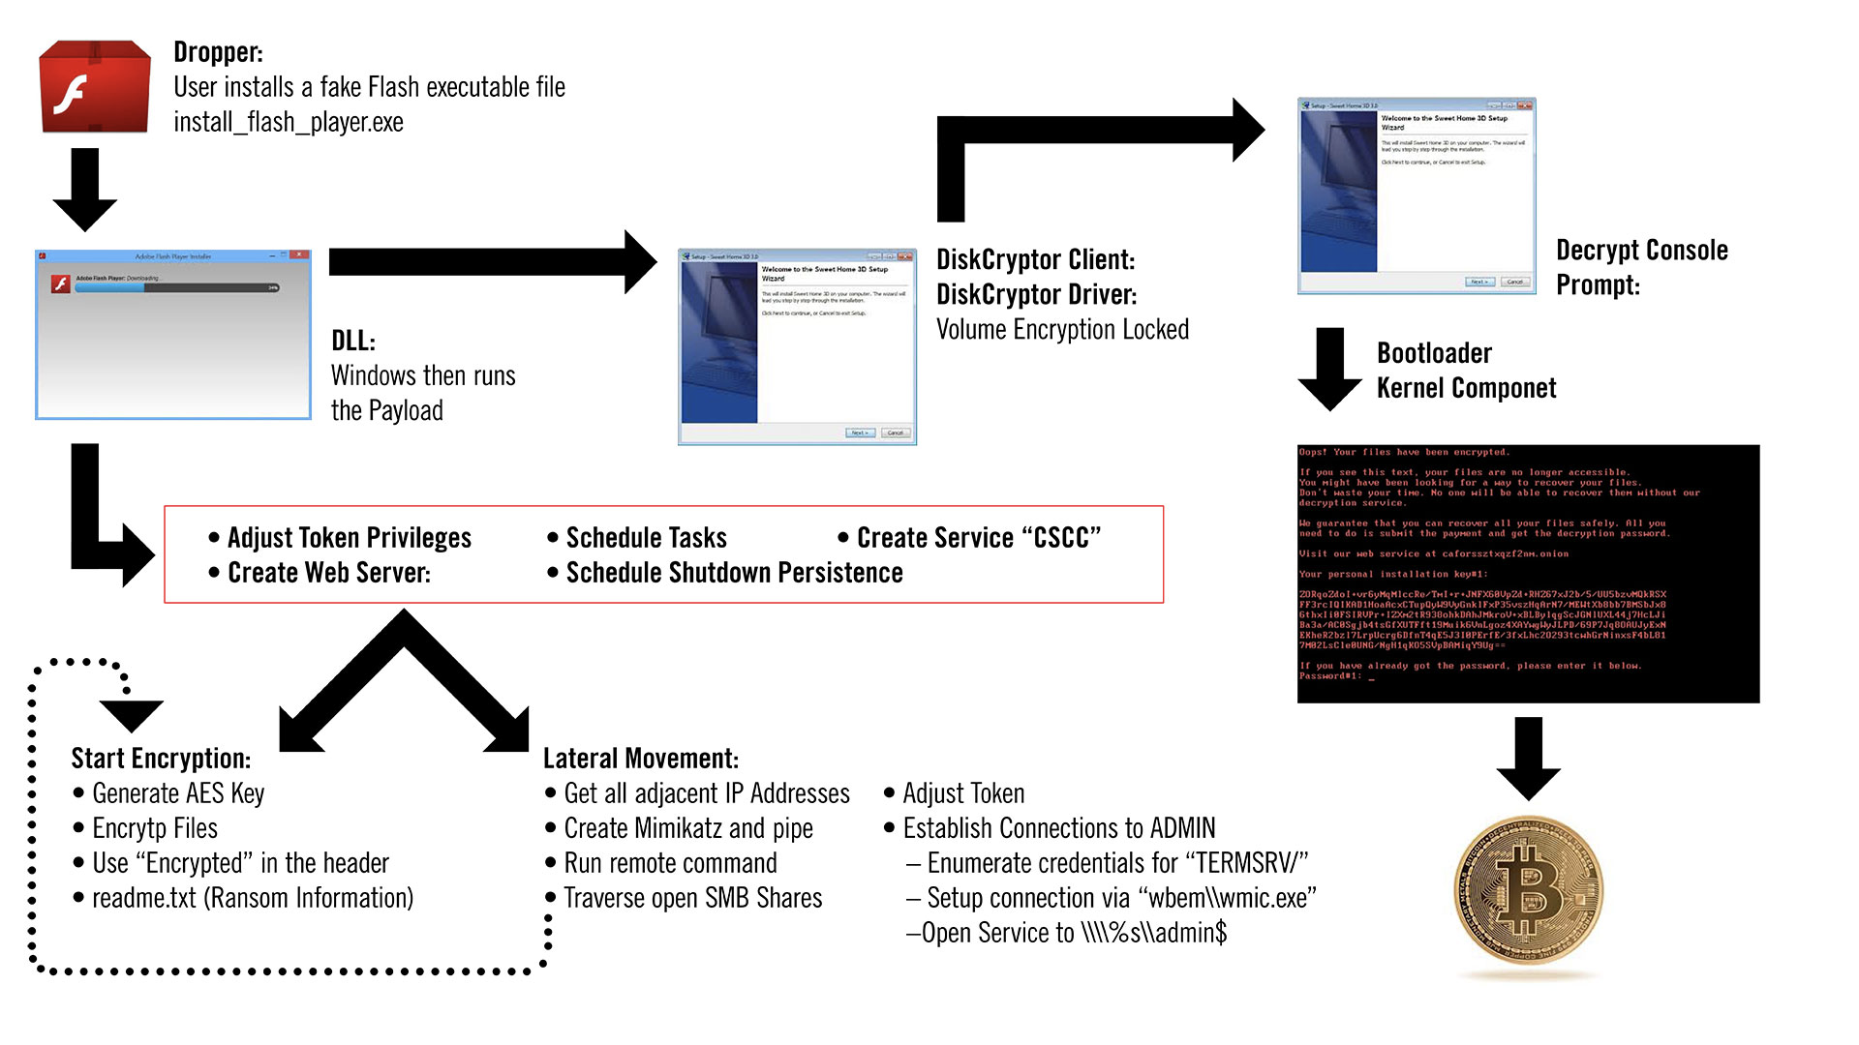

Slide 6
Identification of Threat & Repercussions
BadRabbit first started infecting systems on October 24th 2017. It infected hundreds of computers across Russia and Ukraine as well as a small number in Germany and Turkey. While it was a disruptive attack it only lasted until about midday, with isolated attacks being reported up to 8pm Moscow time when the distribution server for the dropper went down
Primary Targets in Russia were mostly media outlets, such as Interfax
Primary Ukrainian targets were transportation hubs such as the Odessa International Airport and the Kiev Metro as well as the MInistries of Finance and Infrastructure
There were over 200 targets with hundreds more computers infected on targeted networks

Slide 7
Identification & Repercussions Cont.
Major delays and interruptions of travel, domestic and international, in the Ukraine occurred as a result of this attack
Serhiy Denedyuk, head of Ukrainian cyber police says that the attack was also a cover for a phishing campaign aimed at major Ukranian entities trying to establish undetected back doors into vital systems.
Due to the similarities with NotPetya (similar propagation method as well as similar code structure) experts believe the attacks could have been carried out by the same group with some even accusing the Russian GRU as the possible culprits.
Whomever was behind the attack appears to be fans of the show Game of Thrones as there are references to the show in the tasks scheduled by the ransomwares attacks

Slide 8
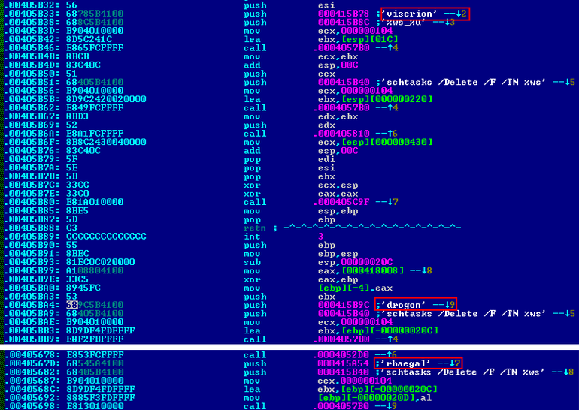



References to Game of Thrones in the code
Drogon- Shuts down the machine
Rhaegal- Executes the Decryptor File
Viserion- Reboots the target machine

Slide 9

Remedy against Infection
It’s unknown if it’s possible to decrypt files encrypted by BadRabbit without giving in and paying the ransom.
There are currently no reports that personal files have been recovered by paying the ransom, however, organizations are using backups to reset their systems.
BadRabbit may have rapidly lost steam but it will continue to pose a threat unless you take preventative steps to mitigate these risks.

Slide 10
Remedy against Infection
Here are few ways to protect from the spread of BadRabbit:
Do not download Adobe files from any media websites under any circumstance. If you need adobe update, download it directly from the adobe site
Keep your anti-virus software updated at all times
Use multi-layered security to protect your website and email points of entry from hackers
Always backup your data

