Slide 1
Are you sure your APIs are secure?
Bas Dijkstra
bas@ontestautomation.com
www.ontestautomation.com

Slide 2
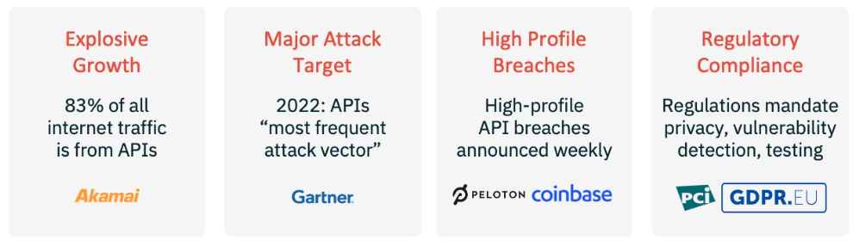
Why API security testing?
Notes:
In the first 8 years of my career I wrote an awful lot of horrible automation

Slide 3
But isn’t API security testing something best left to the experts?
Notes:
In the first 8 years of my career I wrote an awful lot of horrible automation

Slide 4
You can do a lot with some basic tools and a healthy dose of curiosity and creativity
Notes:
In the first 8 years of my career I wrote an awful lot of horrible automation

Slide 5
Let’s have a look at some examples
Notes:
In the first 8 years of my career I wrote an awful lot of horrible automation

Slide 6
Vulnerability: injection
Notes:
In the first 8 years of my career I wrote an awful lot of horrible automation

Slide 7
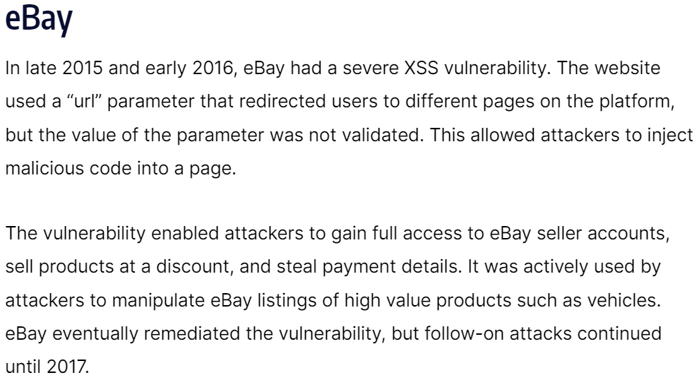
Notes:
In the first 8 years of my career I wrote an awful lot of horrible automation

Slide 8
Where to perform input validation / sanitizing? Frontend, backend or both? Why?
Notes:
In the first 8 years of my career I wrote an awful lot of horrible automation

Slide 9
The OWASP API security top 10
https://owasp.org/API-Security/editions/2023/en/0x00-header/
Notes:
In the first 8 years of my career I wrote an awful lot of horrible automation

Slide 10
Example
Notes:
In the first 8 years of my career I wrote an awful lot of horrible automation

Slide 11
Vulnerability: Broken Object Level Authorization (BOLA) 2023 OWASP API security top 10: #1
Notes:
In the first 8 years of my career I wrote an awful lot of horrible automation

Slide 12
Look out for …
Predictable or findable resource IDs
Insufficient or lack of rate limiting
https://owasp.org/API-Security/editions/2023/en/0xa1-broken-object-level-authorization/

Slide 13
Also covered: vulnerability: Unrestricted Resource Consumption 2023 OWASP API security top 10: #4
Notes:
In the first 8 years of my career I wrote an awful lot of horrible automation

Slide 14
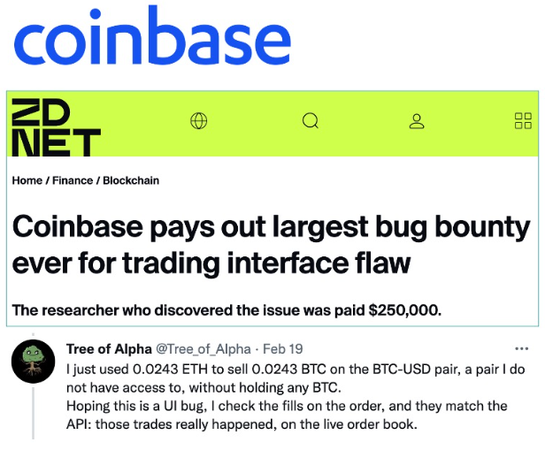
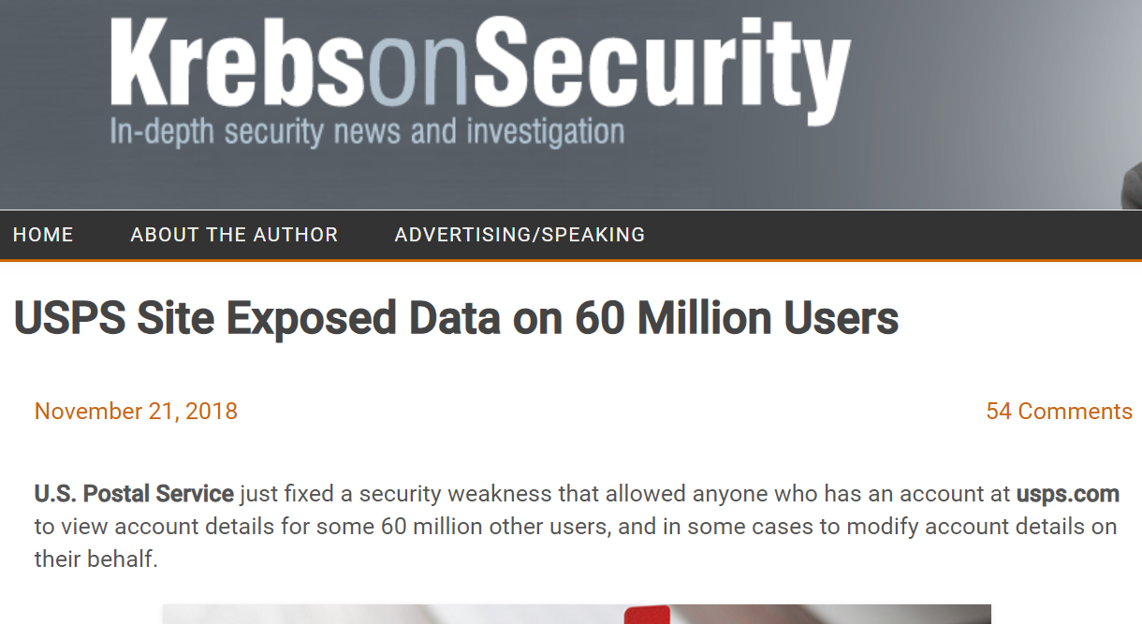
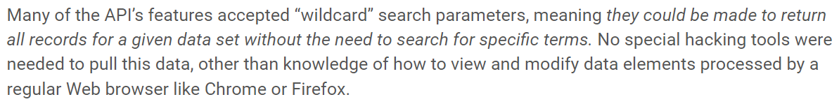
Notes:
In the first 8 years of my career I wrote an awful lot of horrible automation

Slide 15
How about altering data?
Notes:
In the first 8 years of my career I wrote an awful lot of horrible automation

Slide 16
Vulnerability: Broken Function Level Authorization (BFLA) 2023 OWASP API security top 10: #5
Notes:
In the first 8 years of my career I wrote an awful lot of horrible automation

Slide 17
Also look out for …
Access to admin endpoints by regular users
https://owasp.org/API-Security/editions/2023/en/0xa5-broken-function-level-authorization/

Slide 18
BFLA and BOLA
Where BOLA is about accessing data…
… BFLA is about the ability to alter or delete data
So, if you happen upon a BOLA vulnerability…
… it might be a good idea to check for BFLA, too
Notes:
In the first 8 years of my career I wrote an awful lot of horrible automation

Slide 19
Another example
Notes:
In the first 8 years of my career I wrote an awful lot of horrible automation

Slide 20
Vulnerability: Unrestricted Access to Sensitive Business Flows 2023 OWASP API security top 10: #6
Notes:
In the first 8 years of my career I wrote an awful lot of horrible automation

Slide 21
Prevention
First identify sensitive business flows…
… then take prevention measures
https://owasp.org/API-Security/editions/2023/en/0xa6-unrestricted-access-to-sensitive-business-flows/

Slide 22
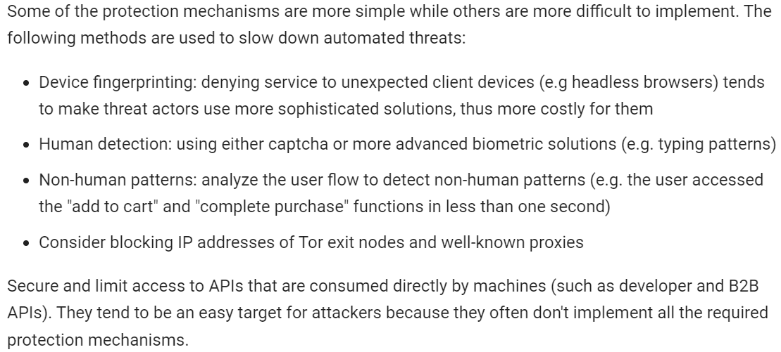
Notes:
In the first 8 years of my career I wrote an awful lot of horrible automation

Slide 23
Yet another example
Notes:
In the first 8 years of my career I wrote an awful lot of horrible automation

Slide 24
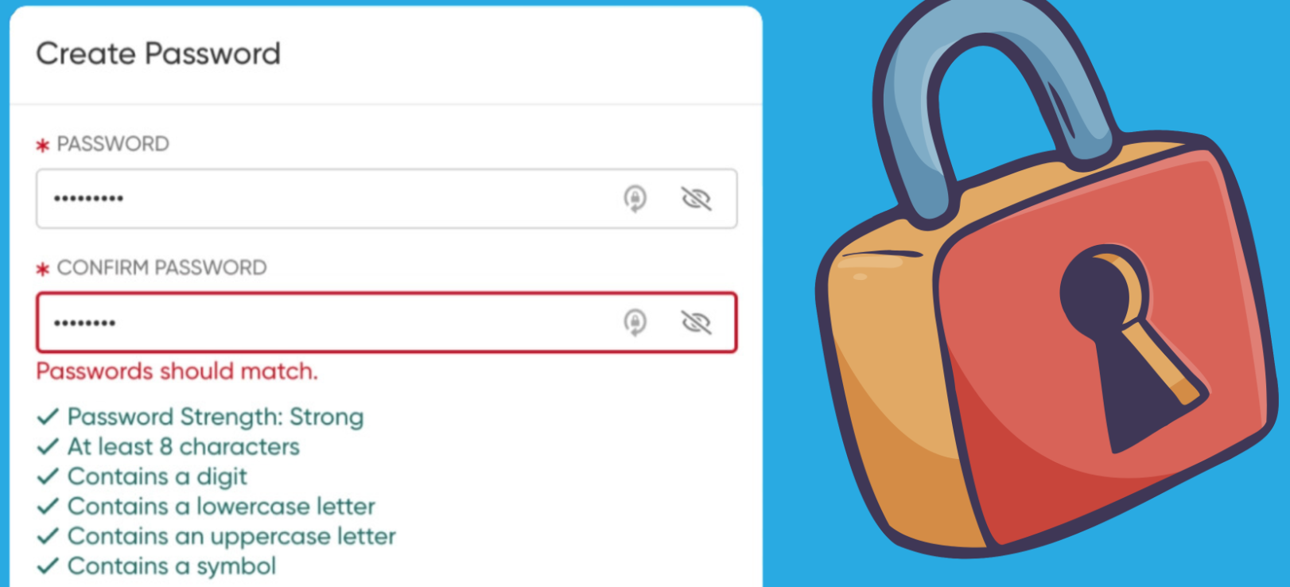
Notes:
In the first 8 years of my career I wrote an awful lot of horrible automation

Slide 25
Vulnerability: Broken Authentication 2023 OWASP API security top 10: #2
Notes:
In the first 8 years of my career I wrote an awful lot of horrible automation

Slide 26
Vulnerability: Improper Inventory Management 2023 OWASP API security top 10: #9
Notes:
In the first 8 years of my career I wrote an awful lot of horrible automation

Slide 27
We covered many potential security issues today!
Notes:
In the first 8 years of my career I wrote an awful lot of horrible automation

Slide 28
The 2023 OWASP API security top 10 entries we missed
Notes:
In the first 8 years of my career I wrote an awful lot of horrible automation

Slide 29
#1 Broken Object Level Authorization #2 Broken Authentication #4 Unrestricted Resource Consumption #5 Broken Function Level Authorization #6 Unrestricted Access to Sensitive Business Flows #9 Improper Inventory Management
#3 Broken Object Property Level Authorization
#7 Server Side Request Forgery
#8 Security Misconfiguration
#10 Unsafe Consumption of APIs
Notes:
In the first 8 years of my career I wrote an awful lot of horrible automation

Slide 30
Server Side Request Forgery: an example
Notes:
In the first 8 years of my career I wrote an awful lot of horrible automation

Slide 31
That’s a lot you can do! (and there’s more…)
Notes:
In the first 8 years of my career I wrote an awful lot of horrible automation

Slide 32
https://www.apisecuniversity.com
Notes:
In the first 8 years of my career I wrote an awful lot of horrible automation

Slide 33
?

Slide 34
Contact
Email: bas@ontestautomation.com
Website: https://www.ontestautomation.com
LinkedIn: https://www.linkedin.com/in/basdijkstra

