Slide 1
RESTful API testing with REST Assured
Workshop Romanian Testing Conference 2017
Bas Dijkstra
bas@ontestautomation.com
www.ontestautomation.com
@_basdijkstra

Slide 2
RESTful API testing with REST Assured
Workshop Romanian Testing Conference 2017
Bas Dijkstra / bas@ontestautomation.com / www.ontestautomation.com / @_basdijkstra

Slide 3
Preparation
Setup a JDK (1.8 strongly preferred)
Install an IDE (IntelliJ, Eclipse, …)
Also install Maven and TestNG support (for Eclipse)
Download and import the Maven project
https://github.com/basdijkstra/rtc2017
http://www.ontestautomation.com/files/rtc2017workshop.zip
Run tests in RestAssuredSmokeTest.java

Slide 4
What are we going to do?
RESTful APIs
REST Assured
WireMock
Get your hands dirty

Slide 5
Experience?

Slide 6
What are RESTful APIs?
HTTP request methods (GET, POST, PUT, …)
URI’s
CRUD operations on data
POST Create
GET Read
PUT Update
DELETE Delete
… …

Slide 7



Where are RESTful APIs used?
Mobile
Internet of Things
API economy

Slide 8
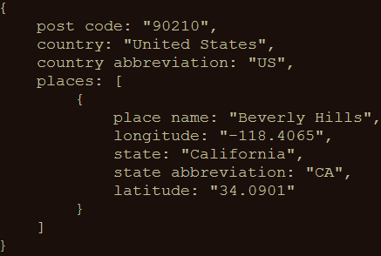
An example
GET http://api.zippopotam.us/us/90210
Result:

Slide 9
Test automation pyramid
E2E
Customer journeys
(Often) user interface-driven
‘Ultimate integration test’
Integration
Layer / component integration
Data / business logic exposure
(Often) API-driven
‘The forgotten layer’
Unit
Component level
Code driven
Mocks and stubs

Slide 10
Case study How applying API testing saved us from thousands of slow end-to-end tests

Slide 11
Tools for testing RESTful APIs
Browser (using plugins like Postman for Chrome)
Open source (SoapUI, REST Assured, …)
COTS (Parasoft SOAtest, SoapUI Pro, …)
Build your own (using HTTP libraries for your favourite programming language)

Slide 12
REST Assured
Java DSL for writing tests for RESTful APIs
Removes a lot of boilerplate code
Powerful, readable and maintainable tests
Developed and maintained by Johan Haleby

Slide 13
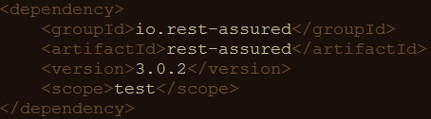
Configuring REST Assured
Download from http://rest-assured.io
Add as a dependency to your project
Maven
Gradle

Slide 14
REST Assured documentation
Usage guide
https://github.com/rest-assured/rest-assured/wiki/Usage
Links to other documentation (JavaDoc, getting started, release notes)
http://rest-assured.io/

Slide 15
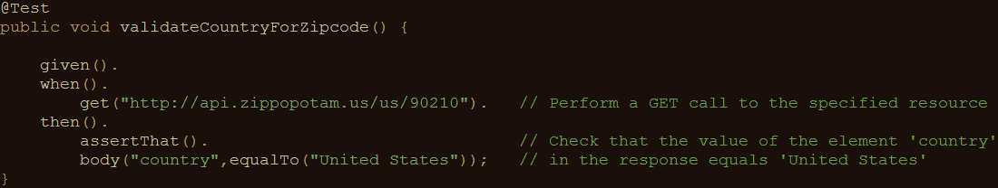
A sample test

Slide 16
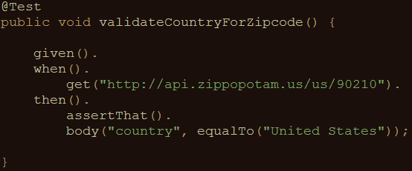
REST Assured features
Support for HTTP methods (GET, POST, PUT, …)
BDD/Gherkin – like syntax
Use of Hamcrest matchers for checks (equalTo)
Use of JsonPath for
selecting elements from
JSON response

Slide 17
About Hamcrest matchers
Express expectations in readable language
Examples:
http://hamcrest.org/JavaHamcrest/javadoc/1.3/org/hamcrest/Matchers.html
equalTo(X) | Does the object equal X?
hasItem(“Rome”) | Does the collection contain an item “Rome”?
hasSize(3) | Does the size of the collection equal 3?
not(equalTo(X)) | Inverts matcher equalTo()

Slide 18
About JsonPath
JsonPath is a path expression language for JSON
Similar aims and scope as XPath for XML
Uses Groovy GPath syntax
same syntax for JSON and XML
Documentation and examples:
http://groovy-lang.org/processing-xml.html#_gpath
http://groovy.jmiguel.eu/groovy.codehaus.org/GPath.html

Slide 19
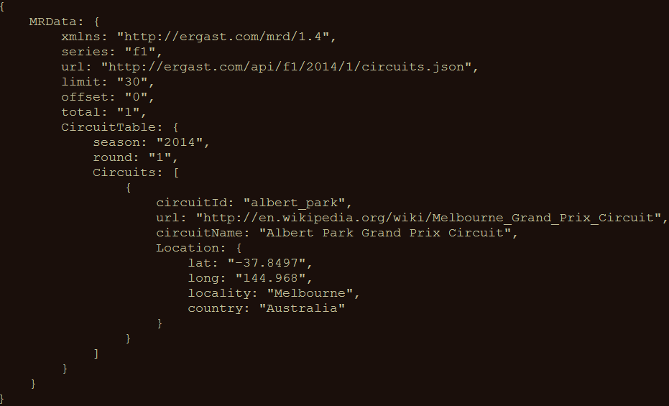
JsonPath example
http://goessner.net/articles/JsonPath/

Slide 20
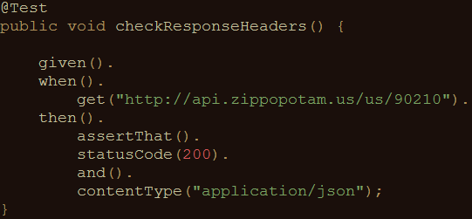
Validating technical response data
HTTP status code
MIME-type of received responses
Cookies and their value
…

Slide 21

Our application under test
Ergast F1 API
Offers historical data of Formula 1 races, drivers, circuits, etc.
API documentation at http://ergast.com/mrd/
Mocked for demo effect mitigation purposes using WireMock

Slide 22
Some examples
Data for driver Max Verstappen (in JSON):
http://ergast.com/api/f1/drivers/max_verstappen.json
A list of circuits for the 2015 season (in JSON):
http://ergast.com/api/f1/2015/circuits.json

Slide 23
Demo
Starting the stub server
How to use the test suite
Executing your tests
Reviewing test results

Slide 24
Get your hands dirty!
RestAssuredExercises1
Simple checks
Validating individual elements
Validating collections and items therein
Validating technical response properties
Stubs are predefined
You only need to write the tests using REST Assured
RestAssuredExamples contains the zipcode example

Slide 25
Parameters in RESTful APIs
Path parameters
Identify specific (set of) resource(s)
http://ergast.com/api/f1/drivers/max_verstappen.json
http://ergast.com/api/f1/drivers/hamilton.json
Query string parameters
Filter a set of resources
http://md5.jsontest.com/?text=testcaseOne
http://md5.jsontest.com/?text=testcaseTwo
There is no official standard!

Slide 26
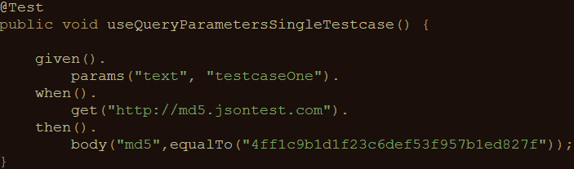
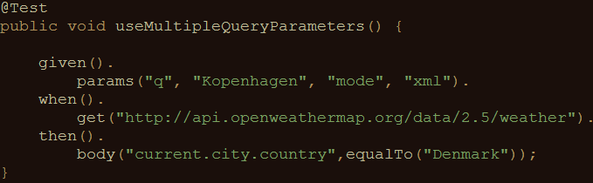
Using parameters in REST Assured
Examples for query parameters:
Call to http://md5.jsontest.com/?text=testcaseOne
Call to http://api.openweathermap.org/data/2.5/weather/?q=Kopenhagen&mode=xml

Slide 27
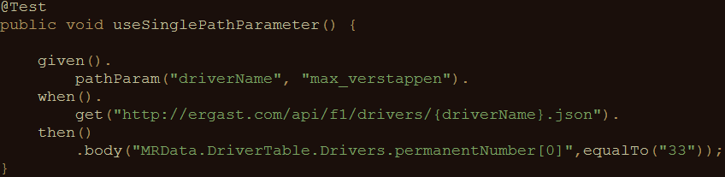
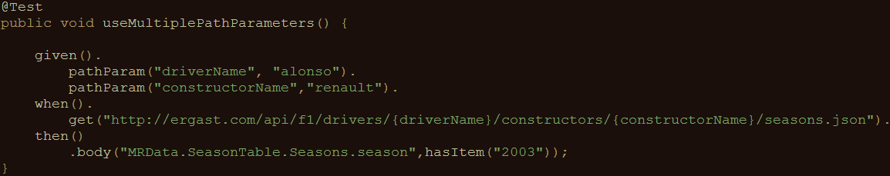
Using parameters in REST Assured
Examples for path parameters:
Call to http://ergast.com/api/f1/drivers/max_verstappen.json
Call to http://ergast.com/api/f1/drivers/alonso/constructors/renault/seasons.json

Slide 28
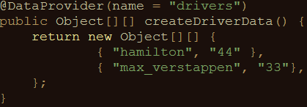
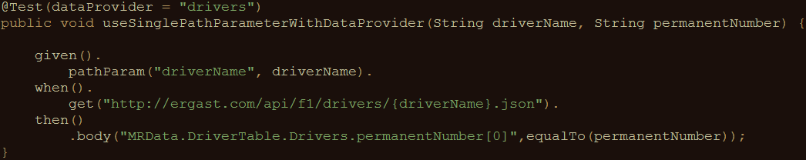
Using parameters in REST Assured
Iterating over a collection of parameter values:
Creating pairs of driver ID’s and numbers:
Using test data in API calls and validation of response data:

Slide 29
Get your hands dirty!
RestAssuredExercises2
Data driven tests
Creating a test data object
Using test data in calling the right URI
Using test data in assertions
RestAssuredExamples contains all examples from the presentation

Slide 30
Reuse
Improving maintainability
Avoiding duplicate code
Sharing variables between steps
Reusing request or response specifications

Slide 31
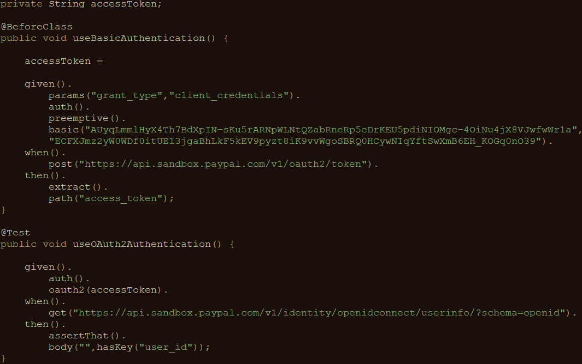
Sharing variables between tests
REST Assured
supports this
with extract()

Slide 32
Sharing checks between tests
Example: checking status code and MIME type for all responses
Maintenance burden if specified for each individual test
What if we could specify this once and reuse throughout our tests?

Slide 33
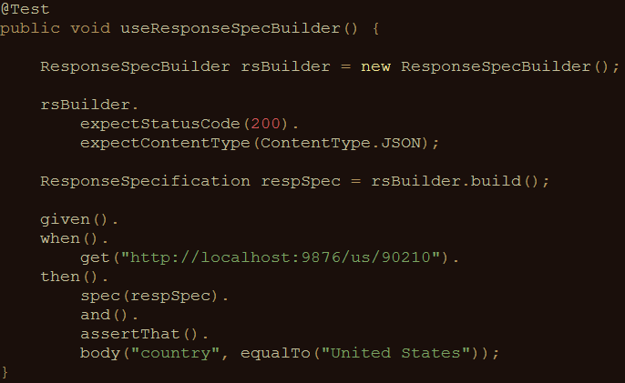
Sharing checks between tests
Solution: ResponseSpecBuilder

Slide 34
Get your hands dirty!
RestAssuredExercises3
Try it for yourself
Can you think of additional applications for reuse ?
RestAssuredExamples contains all examples from the presentation

Slide 35
Authentication
Securing APIs
Basic authentication (preemptive / challenged)
OAuth(2)
Digest / Form

Slide 36
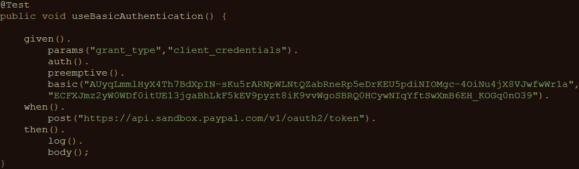
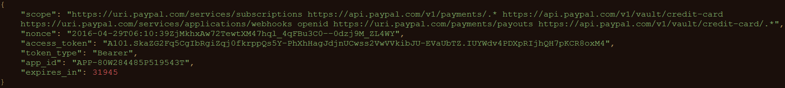
Basic authentication
Username/password sent in header for every request

Slide 37
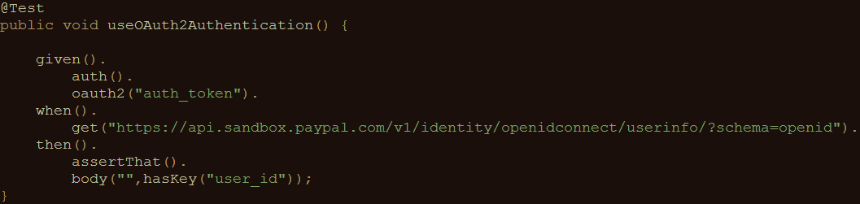
OAuth(2)
Request of authentication token based on username and password (Basic authentication)
Include authentication token in header of all subsequent requests

Slide 38
Measuring response times
Measuring response times for individual requests
Setting response time thresholds
Test fails when threshold is exceeded
No full-fledged performance test
First rough indication of API performance

Slide 39
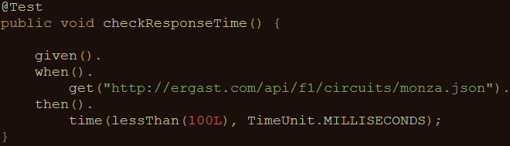
Measuring response times
An example:

Slide 40
Get your hands dirty!
RestAssuredExercises4
Communicating with an OAuth2-secured API
Requesting authentication token
Using authentication token in subsequent requests
Measuring API response times
Execute a specific API call
Evaluate response time against predefined threshold
RestAssuredExamples contains all examples from the presentation

Slide 41
XML support
So far, we’ve only used REST Assured on APIs that return JSON
It works just as well with XML-based APIs
XmlPath instead of JsonPath

Slide 42
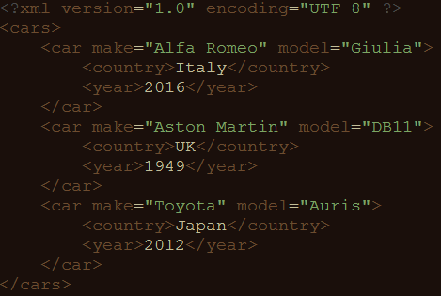
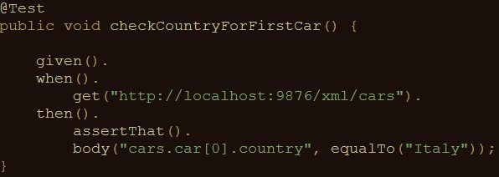
XmlPath – examples
Check country for the first car in the list

Slide 43
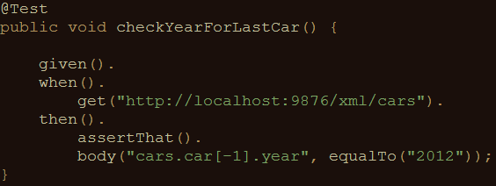
XmlPath – examples
Check year for the last car in the list

Slide 44
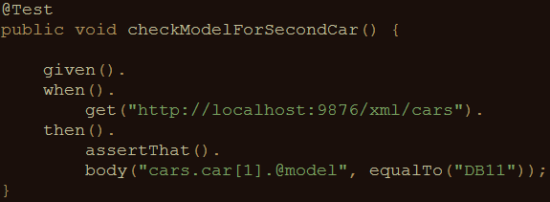
XmlPath – examples
Check model for the second car in the list

Slide 45
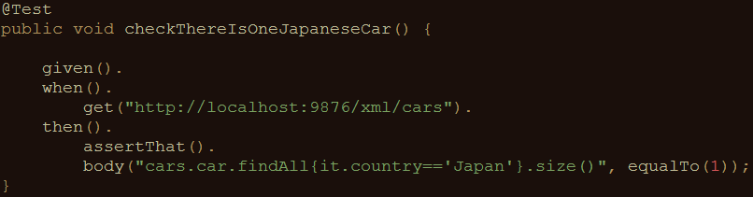
XmlPath – examples
Check there’s only one car from Japan in the list

Slide 46
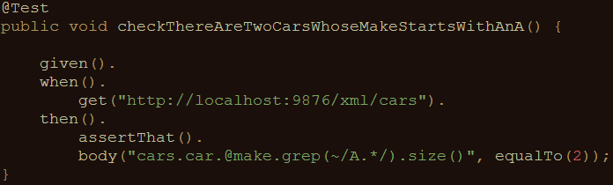
XmlPath – examples
Check there are two cars in the list whose make starts with ‘A’

Slide 47
Get your hands dirty!
RestAssuredExercises5
Communicating with an API returning an XML document
Use XmlPath to select the right nodes
Use filters, in, grep(), size() where needed
All examples can be reviewed in RestAssuredExamplesXml.java

Slide 48
?

Slide 49
Problems in test environments
Systems are constructed out of of many different components
Not all of these components are always available for testing
Parallel development
No control over testdata
Fees required for using third party component
…

Slide 50
Problems in test environments
Mobile app
SaaS dependency
Under development
Access fees
System under test
No suitable test data
Limited access
Backend system
Mainframe

Slide 51
Simulation during test execution
Simulate dependency behavior
Regain full control over test environment
Available on demand
Full control over test data (edge cases!)
No third party component usage fees
…

Slide 52
Stubbing
Mocking
Service virtualization

Slide 53
Problems in test environments
Mobile app
SaaS dependency
Under development
Access fees
System under test
No suitable test data
Limited access
Backend system
Mainframe

Slide 54
Simulation in test environments
Simulated mobile app
Simulated SaaS dependency
Unrestricted access
Unrestricted access
System under test
Unrestricted access
Unrestricted access
Simulated backend system
Simulated mainframe

Slide 55
WireMock
http://wiremock.org
Java
HTTP mock server
only supports HTTP(S)
open source
developed and maintained by Tom Akehurst

Slide 56
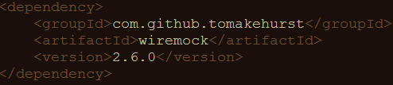
Install WireMock
Add .jar file to Java project
Maven
Gradle

Slide 57
Run WireMock
In Java (via Junit @Rule)
In Java (without using JUnit)
Standalone

Slide 58
Configure responses
In (Java) code
Using JSON mapping files

Slide 59
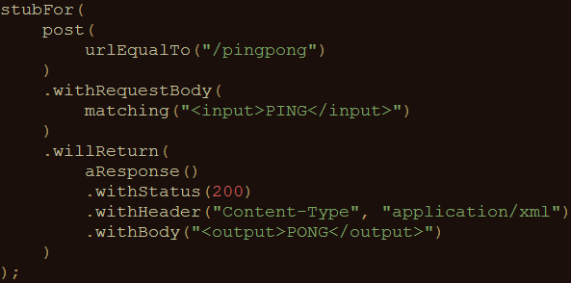
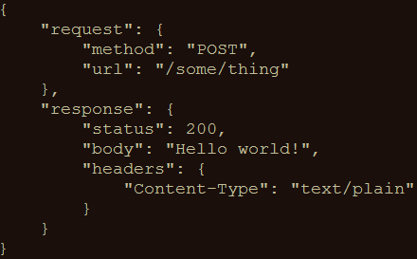
An example mock
In Java
In JSON

Slide 60
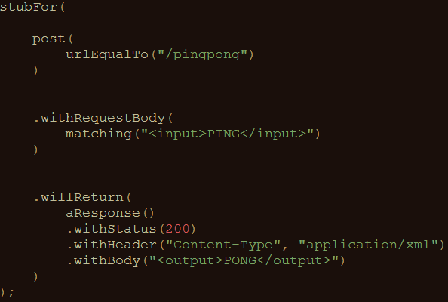
Syntax
This stub responds to:
A HTTP POST to /pingpong
With body <input>PING</input>
With an answer having:
HTTP status code 200
body type application/xml
body <output>PONG</output>

Slide 61
Useful WireMock features
Verification
Verify that certain requests are sent by application under test
Record and playback
Generate mocks based on request-response pairs (traffic)
Fault simulation
…
Full documentation at http://wiremock.org/docs/

Slide 62
Get your hands dirty!
WireMockExercises1
Create simple mocks
Exercises are defined in the comments
Verify your solution by running the tests
These can be found in the same class as the exercises

Slide 63
Request matching
Determine response to be sent based on specific request characteristics
Options:
URL
HTTP method
Query parameters
Headers
Request body elements
…

Slide 64
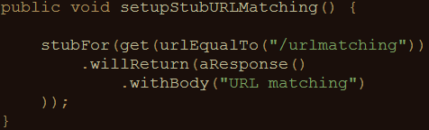
Example: URL matching
Other URL options:
urlPathEqualTo
urlMatching (using regular expressions)
urlPathMatching (using regular expressions)

Slide 65
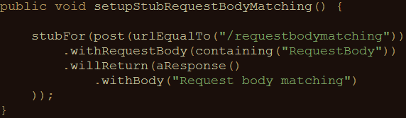
Example: body element matching
Other request body matching options:
equalTo
matching, notMatching (using regular expressions)

Slide 66
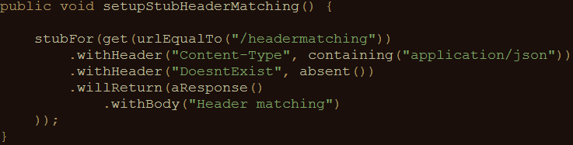
Example: header matching
absent(): check parameter is not in request

Slide 67
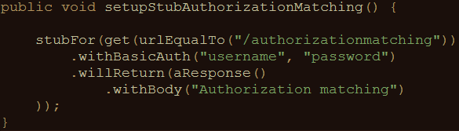
Example: basic authentication matching
No support (yet) for other authentication mechanisms
Like OAuth2
HTTPS is supported

Slide 68
Get your hands dirty!
WireMockExercises2
Use request matching
Exercises are defined in the comments
Verify your solution by running the tests
These can be found in the same class as the exercises

Slide 69
Fault simulation
Extend test coverage by simulating faults
Often hard to do in real systems
Easy to do using stubs or mocks
Test exception handling application under test

Slide 70
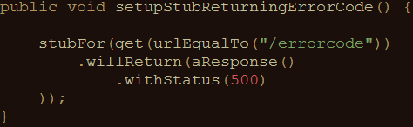
Example: HTTP status code
Often used status codes:
Client error Server error
403 (Forbidden) 500 (Internal server error)
404 (Not found) 503 (Service unavailable)

Slide 71
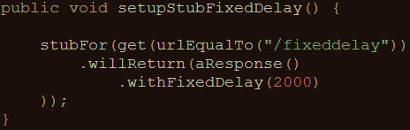
Example: timeout
Other delay options:
Random
Uniformly distributed
Can be configured on a per-stub basis as well as globally

Slide 72
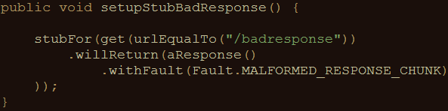
Example: bad responses
HTTP status code 200, but garbage in response body
Other options:
RANDOM_DATA_THEN_CLOSE (as above, without HTTP 200)
EMPTY_RESPONSE

Slide 73
Get your hands dirty!
WireMockExercises3
Use fault simulation
Exercises are defined in the comments
Verify your solution by running the tests
These can be found in the same class as the exercises

Slide 74
Stateful mocks
Mocks until now have been stateless
Order of calling mocks does not influence behavior
Not always true in the real world
Request A > request B might be different from request B > request A

Slide 75
Stateful mocks in WireMock
Scenario
Status transitions
Response being sent is determined by
Current status
Request received

Slide 76
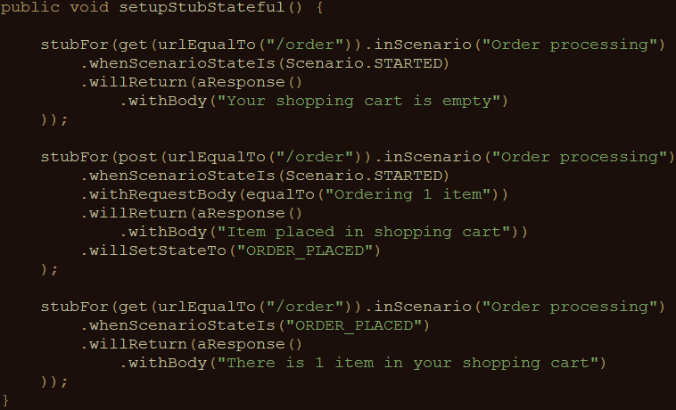
Stateful mocks: an example

Slide 77
Get your hands dirty!
WireMockExercises4
Use stateful mocks
Exercises are defined in the comments
Verify your solution by running the tests
These can be found in the same class as the exercises

Slide 78
Record and playback options
Use WireMock as a proxy
Record request-response pairs (traffic)
Genererate mock from recorded traffic

Slide 79
Pros and cons of record and playback
Pros:
Easy creation of mocks
Analyse traffic of which there are no specifications
Cons:
Rerecording necessary when interface changes
Mocks are not flexible
Mocks are hard to extend
Similar to record and playback in test automation

Slide 80
?

Slide 81
It’s a wrap!
REST Assured
Powerful Java DSL for testing RESTful APIs
Given/When/Then in a single line of code
Easy to use
Easy to include in CI/CD pipeline
WireMock
Powerful Java DSL for writing RESTful API stubs
Stub definition in a single line of code
Easy to use
Easy to include in CI/CD pipeline

Slide 82
Contact
Email: bas@ontestautomation.com
Blog: http://www.ontestautomation.com
LinkedIn: https://www.linkedin.com/in/basdijkstra
Twitter: @_basdijkstra
GitHub: https://github.com/basdijkstra/rtc2017

