Slide 1
No API? No problem!
API mocking with WireMock.Net
An open source workshop by …
Originally created by Bas Dijkstra – bas@ontestautomation.com – https://www.ontestautomation.com
Notes:
Please replace the … with your own name. I would really like it if you left the bottom line intact though, as a way of thanking me. That’s really all I’m asking for, the rest of the workshop is yours to butcher (erm, improve).
1

Slide 2
What are we going to do?
Stubbing, mocking and service virtualization
WireMock.Net
Exercises, examples, …
Notes:
The workshop starts with a background on how stubbing, mocking and service virtualization can help you remove bottlenecks in your test environment. Then, we’re going to take a look at how WireMock enables you to write mocks in Java using a powerful and intuitive API. And of course, most importantly, the participants are going to do the hard work..
2

Slide 3
Preparation
Install .NET 6
Install Visual Studio 2022 (or any other IDE)
Import project into your IDE
  https://github.com/basdijkstra/restsharp-workshop
Notes:
Depending on the way you deliver this workshop, this sheet can be altered or even removed. When I delivered it, I had participants bring in their own laptop and asked them to follow installation instructions. I only provided them for Eclipse and mentioned that whenever they wanted to use a different IDE, they were allowed to do so. I wanted to keep things simple and therefore did not provide installation instructions for other IDEs.
3

Slide 4
Section 0:
An introduction to service virtualization
Notes:
In the first 8 years of my career I wrote an awful lot of horrible automation
4

Slide 5
Problems in test environments
Systems are constructed out of of many different components
Not all of these components are always available for testing
  Parallel development
  No control over testdata
  Fees required for using third party component
  …

Slide 6
Problems in test environments
Mobile app
SaaS dependency
Under development
Access fees
System under test
No suitable test data
Limited access
Backend system
Mainframe

Slide 7
Simulation during test execution
Simulate dependency behaviour
Regain full control over test environment
  Available on demand
  Full control over test data (edge cases!)
  No third party component usage fees
  …

Slide 8
Problems in test environments
Mobile app
SaaS dependency
Under development
Access fees
System under test
No suitable test data
Limited access
Backend system
Mainframe

Slide 9
Simulation in test environments
Virtualized mobile app
Virtualized SaaS dependency
Unrestricted access
Unrestricted access
System under test
Unrestricted access
Unrestricted access
Virtualized backend system
Virtualized mainframe

Slide 10
API consumer
request
API provider
response
System
System
Notes:
In the first 8 years of my career I wrote an awful lot of horrible automation
10

Slide 11
Simulating APIs for more efficient testing and automation
request
Simulation
API consumer
API provider
response
System
Notes:
In the first 8 years of my career I wrote an awful lot of horrible automation
11

Slide 12

Our system under test
ParaBank
The world’s least safe
online bank
Request Loan process
Loan application is processed by 3rd party loan provider component
Notes:
Explain why this API was chosen (simple, lots of features, very ‘real’ data, something lots of people can relate to)
Mocks are included in the project to avoid the risk of the API being unavailable during the workshop (this actually happened to me once), feel free to remove it and test against the actual API
Alternatively, you can always use your own API of course!
12

Slide 13
ParaBank development team
3rd party development team
Frontend
/
API client
API
ParaBank middleware
API
Loan Processor service
Notes:
In the first 8 years of my career I wrote an awful lot of horrible automation
13

Slide 14
ParaBank development team
WireMock.Net
Frontend
/
API client
API
ParaBank middleware
API
Simulated Loan Processor service
Notes:
In the first 8 years of my career I wrote an awful lot of horrible automation
14

Slide 15
What might we want to simulate?
Start testing against features under development
Easy setup of state for edge cases
Delays, fault status codes, malformatted responses, …
…
Notes:
15

Slide 16
Section 1:
Getting started with WireMock.Net
Notes:
In the first 8 years of my career I wrote an awful lot of horrible automation
16

Slide 17
WireMock
https://github.com/WireMock-Net/WireMock.Net/
C#
HTTP mock server
  only supports HTTP(S)
open source
  developed and maintained by Stef Heyenrath

Slide 18
Configuring WireMock.Net
Install as a NuGet package
Notes:
18

Slide 19
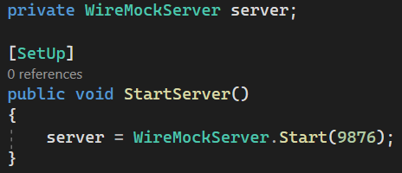
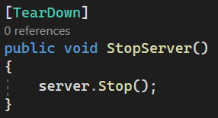
Starting and stopping the WireMock.Net server
Starting the server
Stopping the server

Slide 20
Starting WireMock.Net (standalone)
Useful for exploratory testing purposes
Allows you to share WireMock.Net instances between teams
Long-running instances
Use WireMock.Net.StandAlone library
We’re not going to run WireMock in that mode in this workshop

Slide 21
Configure responses
In C# code
  This is what we’ll do in the workshop
Using JSON mapping files
  See https://github.com/WireMock-Net/WireMock.Net/wiki/Stubbing#json-mapping-example for an example how to get started with JSON mapping files

Slide 22
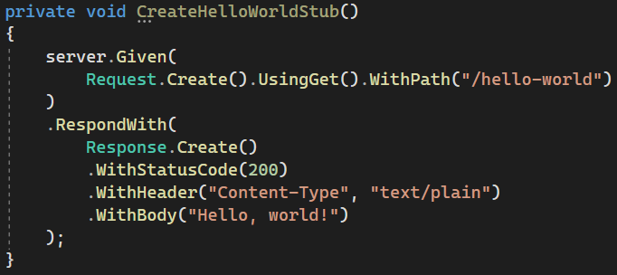
An example mock defined in C#

Slide 23
Now it’s your turn!
Exercises > Exercises01.cs
Create a couple of basic mocks
  Implement the responses as described in the comments
Verify your solution by running the tests in the same class
Answers are in Answers > Answers01.cs
Examples are in Examples > Examples01.cs
Notes:
23

Slide 24
Section 2:
Request matching strategies and fault simulation
Notes:
In the first 8 years of my career I wrote an awful lot of horrible automation
24

Slide 25
Request matching
Send a response only when certain properties in the request are matched
Options for request matching:
  URL
  HTTP method
  Query parameters
  Headers
  Request body elements
  …

Slide 26
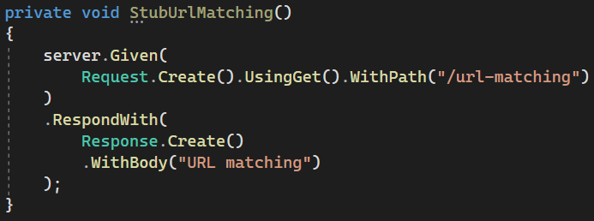
Example: URL matching
Matchers can be used for more flexible matching
  https://github.com/WireMock-Net/WireMock.Net/wiki/Request-Matching#two-matchers

Slide 27
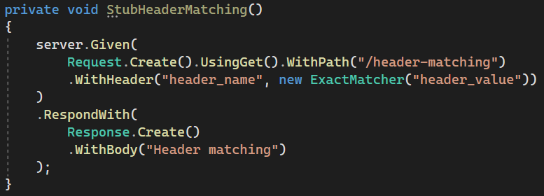
Example: header matching
Matchers can be used for flexible matching
  https://github.com/WireMock-Net/WireMock.Net/wiki/Request-Matching#two-matchers

Slide 28

Example: cookie matching
Matchers can be used for flexible matching
  https://github.com/WireMock-Net/WireMock.Net/wiki/Request-Matching#two-matchers

Slide 29
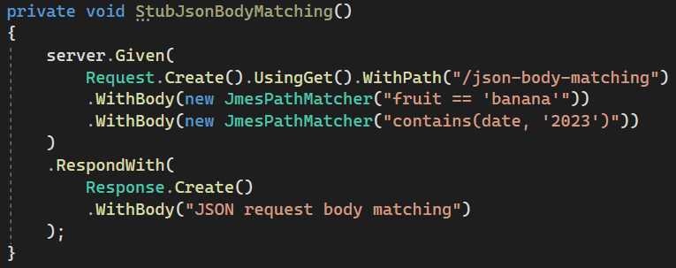
Example: JSON body matching
Matchers can be used for flexible matching
  https://github.com/WireMock-Net/WireMock.Net/wiki/Request-Matching#two-matchers

Slide 30
Fault simulation
Extend test coverage by simulating faults
Often hard to do in real systems
Easy to do using stubs or mocks
Used to test the exception handling of your application under test

Slide 31
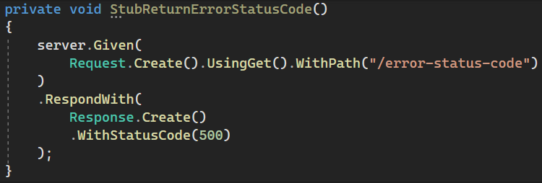
Example: HTTP status code
Some often used HTTP status codes:
Consumer error Provider error
403 (Forbidden) 500 (Internal server error)
404 (Not found) 503 (Service unavailable)

Slide 32
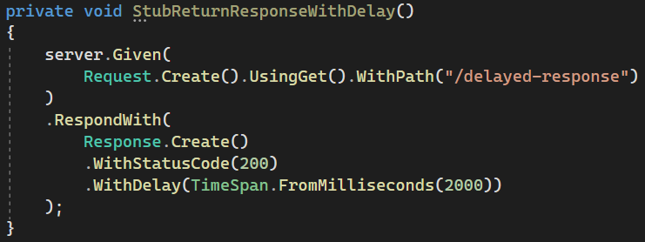
Example: delays

Slide 33
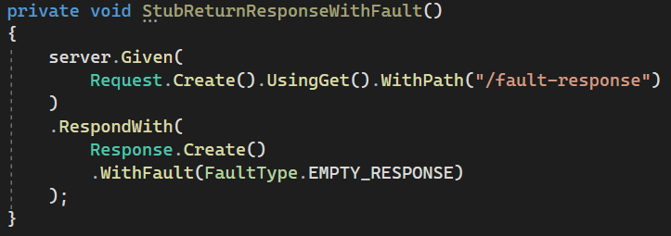
Example: faults
Options:
  NONE (no fault)
  EMPTY_RESPONSE (does what it says on the tin)
  MALFORMED_RESPONSE_CHUNK (HTTP 200, garbage in body)

Slide 34
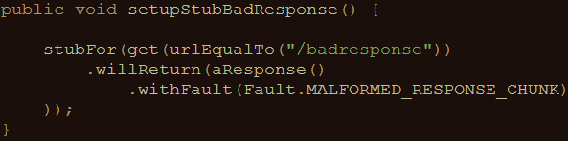
Example: bad responses (Java)
HTTP status code 200, but garbage in response body
Other options:
  RANDOM_DATA_THEN_CLOSE (as above, without HTTP 200)
  EMPTY_RESPONSE (does what it says on the tin)
  CONNECTION_RESET_BY_PEER (close connection, no response)

Slide 35
Now it’s your turn!
Exercises > Exercises02.cs
Practice fault simulation and different request matching strategies
  Implement the responses as described in the comments
Verify your solution by running the tests in the same class
Answers are in Answers > Answers02.cs
Examples are in Examples > Examples02.cs
Notes:
35

Slide 36
Section 3:
Creating stateful mocks
Notes:
In the first 8 years of my career I wrote an awful lot of horrible automation
36

Slide 37
Statefulness
Sometimes, you want to simulate stateful behaviour
Shopping cart (empty / containing items)
Database (data present / not present)
Order in which requests arrive is significant

Slide 38
Stateful mocks in WireMock.Net
Supported through the concept of a Scenario
Essentially a finite state machine (FSM)
  States and state transitions
Combination of current state and incoming request determines the response being sent
  Before now, it was only the incoming request

Slide 39
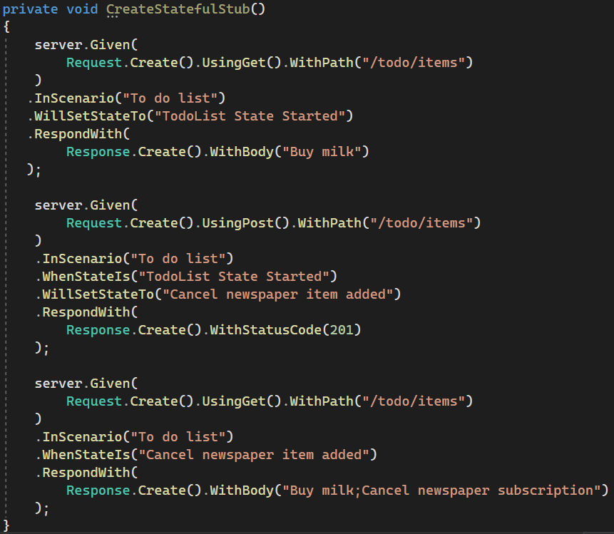
Stateful mocks: an example
Responses are grouped by scenario name
Response depends on both the incoming request as well as the current state
The first mock should define the initial state
Incoming requests can trigger state transitions

Slide 40
Now it’s your turn!
Exercises > Exercises03.cs
Create a stateful mock that exerts the described behaviour
  Implement the responses as described in the comments
Verify your solution by running the tests in the same class
Answers are in Answers > Answers03.cs
Examples are in Examples > Examples03.cs
Notes:
40

Slide 41
Section 4:
Response templating
Notes:
In the first 8 years of my career I wrote an awful lot of horrible automation
41

Slide 42
Response templating
Often, you want to reuse elements from the request in the response
  Request ID header
  Unique body elements (client ID, etc.)
  Cookie values
WireMock.Net supports this through response templating

Slide 43
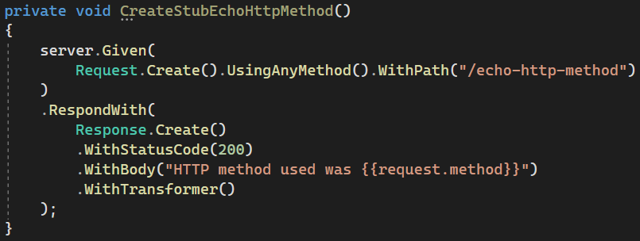
Enable/apply response templating
This template reads the HTTP request method (GET/POST/PUT/…) using {{request.method}} and returns it as the response body
This call to WithTransformers() is necessary to activate response templating for this stub

Slide 44
Request attributes
Many different request attributes available for use
  request.method : HTTP method (example)
  request.PathSegments.[<n>] : n^{th} path segment
  request.query.<key> : query parameter value
  …
All available attributes listed at
https://github.com/WireMock-Net/WireMock.Net/
wiki/Response-Templating#the-request-model

Slide 45
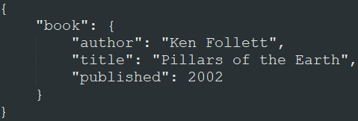
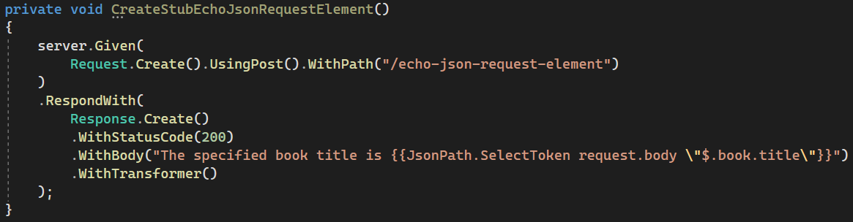
JSON extraction example
When sent this JSON
request body:
This stub returns a response with body “The specified book title is Pillars of the Earth”:

Slide 46
Now it’s your turn!
Exercises > Exercises04.cs
Create dynamic mock by using response templating
  Implement the responses as described in the comments
Verify your solution by running the tests in the same class
Answers are in Answers > Answers04.cs
Examples are in Examples > Examples04.cs
Notes:
40

Slide 47
?
Notes:
92

