Slide 1

(Federated) Identity and Access Management Date
Funded by DFG as part of NFDI. Grant Numbers: 521453681, 521460392, 521462155, 521463400, 521466146, 521471126, 521473512, 521474032, 521475185, 521476232

Slide 2
Identity (and Access) Management

Slide 3
Identity (and Access) Management
The correct group of persons has
at the correct time
the correct kind of access
to the correct resources.

Slide 4
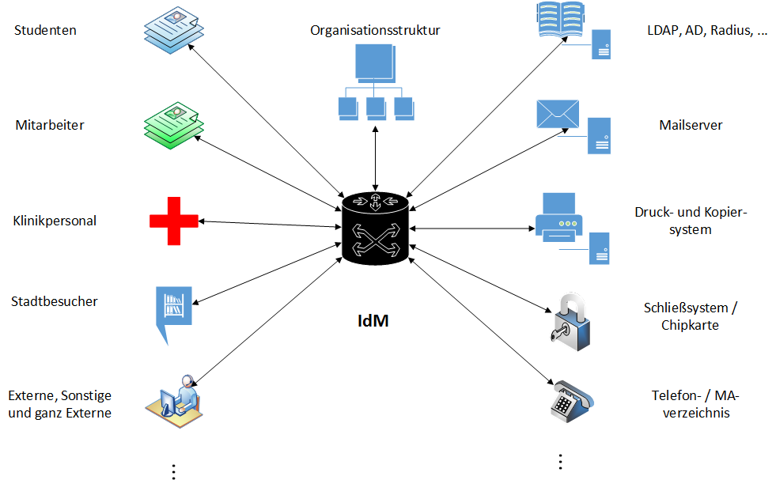
Identity (and Access) Management

Slide 5
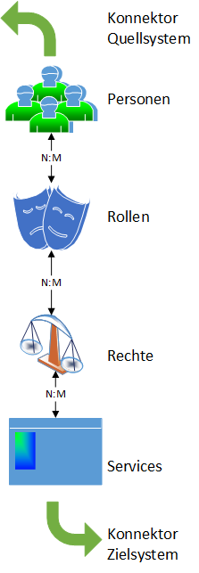
Inside the IAM

Slide 6
Persons: Identities
How do you identify a person?
Given name, surname, other parts of the name
Date and place of birth
Enrollment number, employee number, …
Don’t use mail addresses as identifiers! They are prone to change!

Slide 7
Persons and their attributes
Attribut | Wert
givenName | Frank
sn | Stein
displayname | Dr. Frank N. Stein
uid | mus42ter
ou | biologie
mail | stein@hs-pw.de, frank.stein@bio.hs-pw.de
eduPersonPrincipalName | mus42ter@hs-pw.de
eduPerson[Scoped]Affiliation | member, employee, faculty, staff, student, affiliate [@hs-pw.de]
eduPersonEntitlement | urn:mace:dir:entitlement:common-lib-terms, http://rarp-kl.de/entitlement/hpc
schacPersonalUniqueCode | urn:schac:personalUniqueCode:de:hs-pw.de:Matrikelnummer:123456

Slide 8
Persons and their attributes
Attributes to use as Primary Keys for persons:
Subject ID: long-lived, non-reassignable, omni-directional identifier suitable for use as a globally-unique external key
Pairwise ID: long-lived, non-reassignable, uni-directional identifier, suitable for use as a unique external key specific to a particular relying party
Example: MCE6NXEQ3FC3PUKY4M75EYCOWN4TGKBH@testscope.dfn.de
https://doku.tid.dfn.de/de:aai:attributes_best_practice
https://cvs.data.kit.edu/nfdi-aai-doc/attributes/

Slide 9
Roles
(“Primary”-)Roles:
Professors, research staff, administrative and service staff, students, „Hiwis“, interns, alumni, emeriti, guests, affiliates, whathaveyou…
More roles:
Leader of an organizational unit (OU), president, members of committees or departments,
Students of study path X, dean of department X,
Members of a project,
Substitutes,
…

Slide 10
Inside the IAM:
Rights:
Like read, create, delete, …
Services:
Target systems to which accounts are provisioned

Slide 11
Processes
Example: Creation of a new account
A new member of an OU arrives and asks for an account.
The head of the OU (or someone with an approriate authority) approves this.
The computing center gets noticed, compares the data with the employee database and creates the account.
The new member activates the account, perhaps together with a consent to a usage policy.

Slide 12
Processes
Recurring questions
Where does the data come from?
Which kind of data / attributes are being delivered?
When and how often is the data delivered?
How reliable are quality and up-to-dateness?
Who sends notices of sporadic changes (e.g. transfer of personnel)?
Who approves or confirms this?

Slide 13
Further IAM topics:
Reporting and audit
Identity matching
IDs: ORCID, Edu-ID, identity card
Group management
User selfservice
Password management
Authentication techniques (MFA)
Federated Identity Management

Slide 14
Federated Identity Management

Slide 15
Over to you, Wolfgang!

Slide 16
Things you should know when operating a Community AAI (and reasons why you might need one)

Slide 17
Identity / User Management Where do users come from?
DFN-AAI, Edugain, Google, …?
Discovery Service: Is a restricted list (of home institutions or of NFDI communities) useful?
Can the same user come from several sources?
If yes: How do you match identities? (Name, date and place of birth, ….)
Don‘t use the email address as primary key to identify users!
Will most likely become easier with the Edu-ID-Proxy.
If using Google or other social media accounts: Do you need and have sponsors?
→ Principal Investigators / VO-Managers
On existing systems: Migration of users to a new login way.

Slide 18
Authorization
Who decides about the rules for access to the system?
How can you implement these rules?
Do you get all the neccesary attributes (values) from the IdPs?
Do these have to get transformed? Are there standards for entitlement values?
Who can set attribute values manually, if necessary?
Can there be manual additions to user objects by service admins? If yes:
Who are the service admins?
Who confirms service admins or informs about personnel changes?
Does the service have / need admin groups?

Slide 19
Identity / User Management Deprovisioning
Who clears the service of users that are no longer members?
Can you do this via AttributeQuery (cf. https://doku.tid.dfn.de/de:shibidp:config-deprovisionierung)? (Will also get easier with the Edu-ID-Proxy.)
Can you check whether necessary attributes (values) are still present?
Can you lock users temporarily or permanent?
What happens when a user is deprovisioned?
Which data of the user can or must be deleted?
Which data should stay (we are an NFDI…) and for how long?
Who takes care of these?

Slide 20
Technical aspects
How gets a service connected technically (SAML, OIDC, LDAP, …)?
If LDAP: Does the service has its own LDAP that needs to be filled by the CAAI? Or does the CAAI have to provide an LDAP (-tree)?
Does the service need a certain tree structure? Special groups?
When SSL certificates are changed (on the service or the CAAI): Can the certificates be provisioned automatically, e.g. via DFN-AAI metadata administration?
Reporting and audit

Slide 21
Organisatorial aspects
Who are the contact persons for a service?
Is there a service description for the users? Who writes this?
Who gives user support on which level?
For all persons who decide things: Is there a substitute, e.g. during holidays?
Reporting and audit
Bug hunting in multi-stage system like this needs coordination
There are at least three stages: IdP → CAAI → Service ( + the user)
Up to five stages: IdP → Edu-Id-Proxy → CAAI → Infrastructure Proxy → Service ( + the user)

Slide 22
Funded by DFG as part of NFDI. Grant Numbers: 521453681, 521460392, 521462155, 521463400, 521466146, 521471126, 521473512, 521474032, 521475185, 521476232

