Slide 1
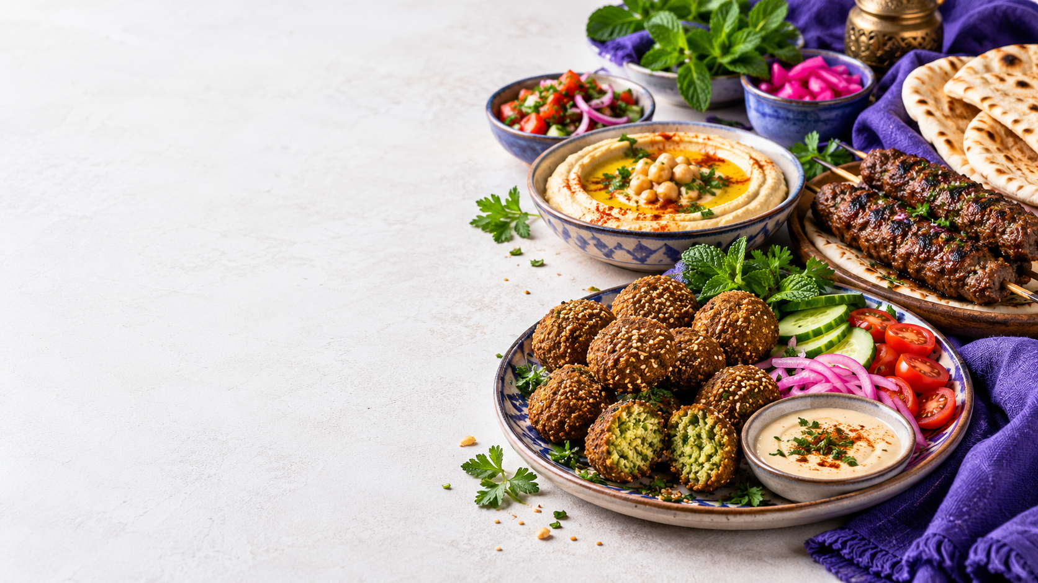
STREETBITE V1.0
Street food
within reach
A Flutter food ordering app
Presented by Basel Samer

Slide 2
PROJECT DEVELOPER
Meet the developer
Basel
Samer
Flutter capstone project
Designed and built StreetBite V1.0 around a clear customer journey and maintainable app architecture.
02

Slide 3
STREETBITE V1.0
Development process
01
Define the journey
Auth, meal discovery, cart, orders, map, and profile
02
Structure the code
Domain, data, and presentation layers with dependency injection
03
Connect services
TheMealDB, local cache, Firebase, Maps, and device features
04
Verify and deliver
Flutter tests, release APK, and Firebase beta distribution
03

Slide 4
STREETBITE V1.0
How the app is organized
Presentation
Domain
Data
Flutter screens, widgets, and Bloc/Cubit state
Entities, repository contracts, and use cases
API, Firebase, cache, maps, and device implementations
The UI calls use cases through injected interfaces. Data services stay behind repository contracts.
04

Slide 5
STREETBITE V1.0
Discover meals
LIVE MENU
Featured meals
TheMealDB supplies meal names, images, categories, and details.
A swipeable banner highlights menu items.
Hot offers
A horizontal list keeps five meals in view.
The latest successful menu is cached for later app launches.
05

Slide 6
STREETBITE V1.0
Choose, order, track
01
02
03
04
Choose
Cart
Order
Track
Open meal details and save favourites.
Add or remove meals and see the total update.
Place a cash order saved to Firestore.
Read the order history and current status.
Menu prices in the beta are sample prices.
06

Slide 7
MORE APP FEATURES
Nearby and personal
Vendor map
Profile
Google Maps shows five sample vendors across Egyptian cities, with cuisine and rating.
Profile photo upload, activity summary, and biometric unlock on supported devices.
Language
Appearance
English and Arabic interface resources.
Light and dark themes with the StreetBite purple palette.
07

Slide 8
RELEASE & NEXT STEPS
Beta delivered
28
Android release APK built and distributed to two Firebase App Distribution testers.
Flutter tests passed
Next: connect a card gateway and use a dedicated production signing key.
github.com/baselSamer/street-bite-basel
08

