Slide 1

CS.102
Fall 2025-2026
Lab 1

Slide 2
What is Computer Science?
Computer Science (CS) is the study of computers, algorithms, and problem-solving.
It covers both theoretical foundations (mathematics, logic, algorithms) and practical applications (software, databases, networking, AI, cybersecurity).
At its core, CS is about using computers to solve problems efficiently.

Slide 3
What is Programming?
Programming is the process of writing instructions that a computer can understand and execute.
A program tells the computer what to do, step by step.
Programming is like giving a recipe to a chef: clear instructions must be followed exactly.

Slide 4
Why do we program?
01
02
03
To Automate Tasks
e.g., payroll systems
To Analyze Data
e.g., scientific computing, data science
To Create Applications
e.g., games, mobile apps, AI systems

Slide 5
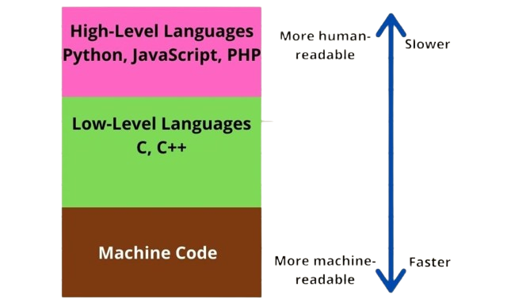
Programming Languages

Slide 6
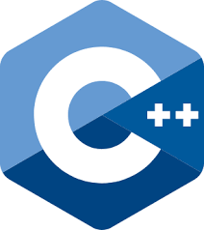
Our Company
Your logo
Programming

Slide 7
Why C++ for Programming?
C++ is one of the most widely used programming languages in the world.
It is a general-purpose, compiled, high-performance language.
Combines:
  Low-level power of C (close to hardware).
  High-level abstraction via Object-Oriented Programming (OOP).
Used in games, operating systems, finance, simulations, and embedded systems.
✅ Learning C++ gives you strong programming fundamentals that transfer easily to other languages (Python, Java, C#, etc.).

Slide 8
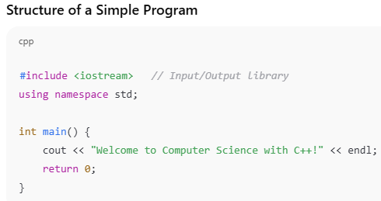
First Steps in Programming with C++
Notes:
#include <iostream> // Input/Output library
using namespace std;
int main() {
cout << "Welcome to Computer Science with C++!" << endl;
return 0;
}

Slide 9
First Steps in Programming with C++
allows input/output operations.
makes code simpler to write.
the starting point of the program.
indicates successful completion
indicates successful completion.
Notes:
#include <iostream> // Input/Output library
using namespace std;
int main() {
cout << "Welcome to Computer Science with C++!" << endl;
return 0;
}

Slide 10
Your Turn

Slide 11
Online Compiler
An online compiler is a web-based tool that allows you to write, compile, and run code directly in a web browser without needing to install any software on your local machine.
Now open google in your pc and type online c++ complier.

Slide 12

Let’s write your first C++ program by yourself

Slide 13
Exercise 1
Write c++ program to print the following information:
  Your name
  Your ID
  Your email

Slide 14
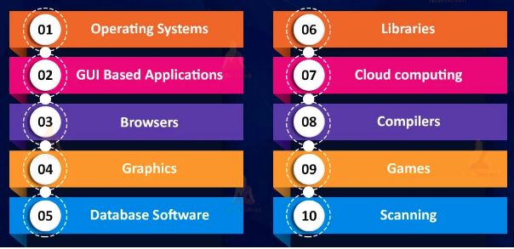
Applications of C++

Slide 15
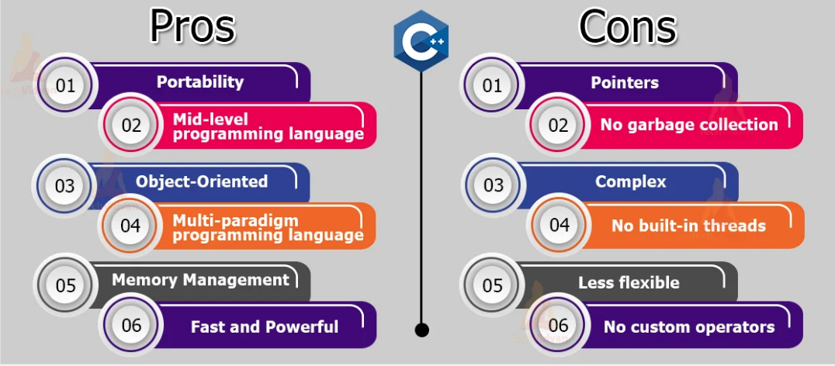
Pros and Cons of C++

Slide 16

Your lab assessment will be on two parts:
1- Lab quiz out of 5
2- Assignment out of 5
3- Final lab out of 20

Slide 17


