Slide 1
Blockchain
Team number
23

Slide 2
Definition Blockchain
A blockchain is a continuously growing list of records,called blocks, which are linked and secured using cryptography.

Slide 3
Follow,
blockchain is a data structure like linked lists,But more complex datastructure.
they are connected using a peer-to-peer network

Slide 4
a blockchain, each node is called a “block” and each block has an index,timestamp, hash of itself, hash of the previous block and of course the data(Sender and reciver and amount)

Slide 5
Accuracy in Security
The hash is generated only once when the block is created.
So, if any of the values are changed, the
hash will no more be valid.

Slide 6
Validation
the validity of the hash
1- comparing the stored hash with a newly calculated.
2- the previousHash attribute is storing the same value as the hash.

Slide 7
Hacking Blockchain
To successfully hack a blockchain,the
hacker has to know the location of all blocks and simultaneously change all their hashes and relink the whole blockchain.

Slide 8
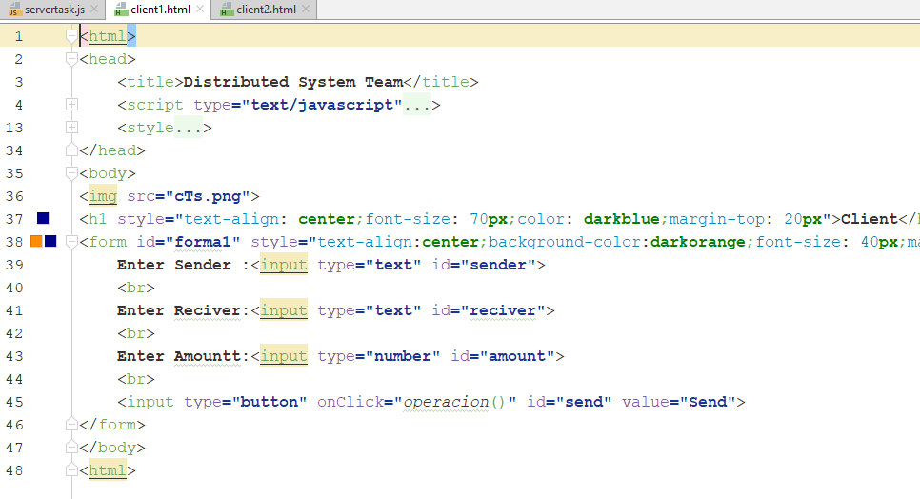
Client 1

Slide 9
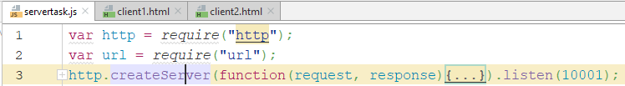
Server

Slide 10
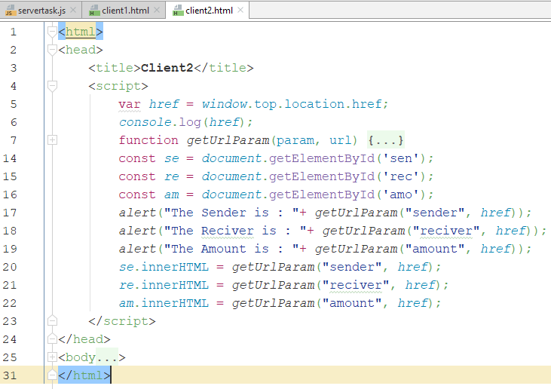
Client 2

Slide 11
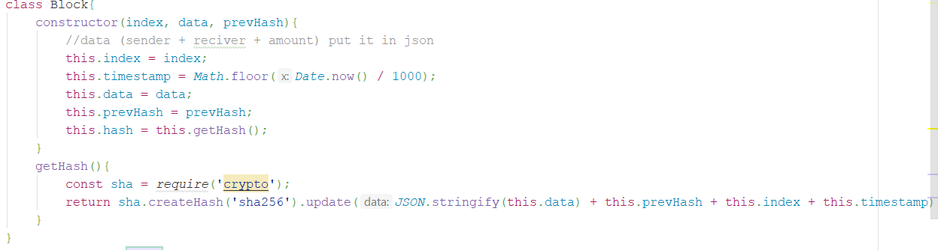
Block

Slide 12
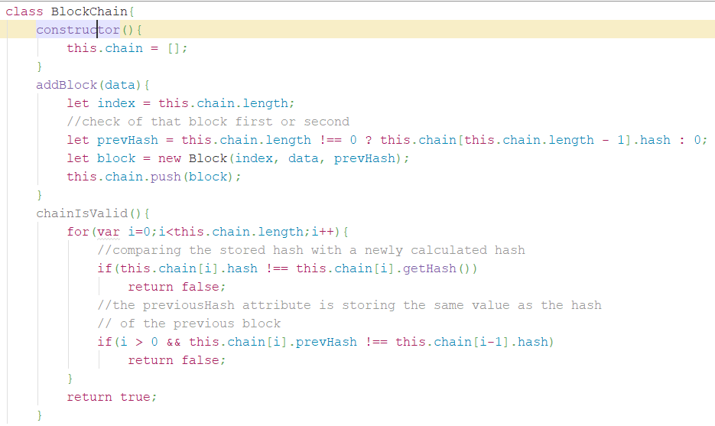
BlockChain

Slide 13
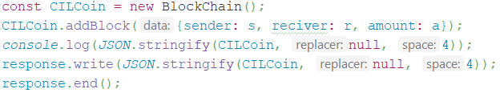
Output

Slide 14
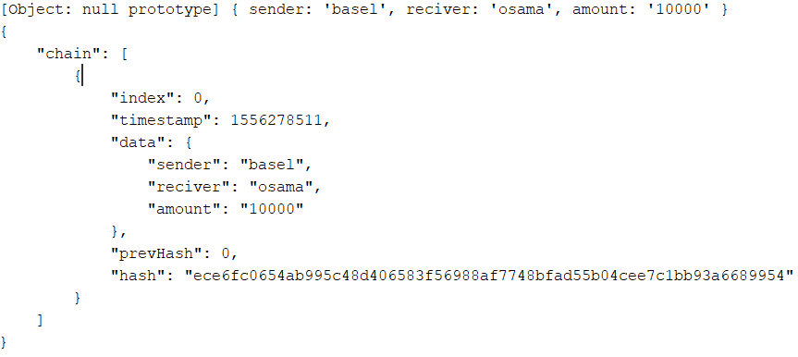
Output

