Slide 1
A Comparative Evaluation of Unit Testing Techniques on a Mobile Platform 2DV610 Software Testing
Presentation by: Mohammed Basel Nasrini

Slide 2
About the paper
“A Comparative Evaluation of Unit Testing Techniques on a Mobile Platform”
Published in 2012 in the ninth International Conference on Information Technology- New Generation
Authors: Selin Benli, Anthony Habash, Andy Herrmann, Tyler Loftis, Devon Simmonds
University of North Carolina Wilmington

Slide 3
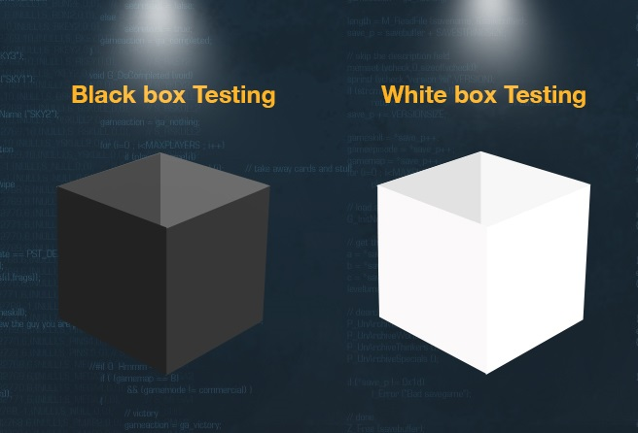
Why the authors did this study?
Black Box Unit Testing Vs White Box Unit testing

Slide 4
Research Method
A time tracking application built on the Android used as a software under test
The testing approach was to:
Generate test cases
Record the time and difficulty of creating each set of test cases
Execute the test cases and record the number of errors uncovered by each approach
Analyze the results to compare testing techniques.
Test cases created using JUnit and the program under test was seeded with errors.

Slide 5
Research Method
 | Complexity | Effectiveness | Efficiency
Black / White Box Testing | Development time, LOC and method calls | # of bugs found per test coverage | Time for a test case to discover the bug(s).

Slide 6
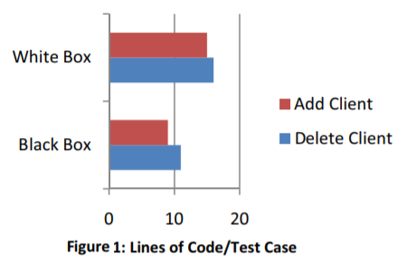
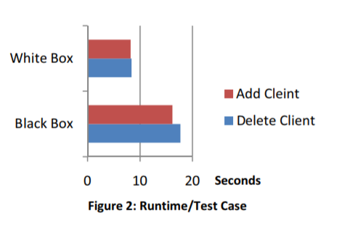
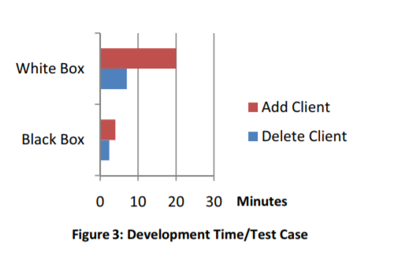
Results

Slide 7
Conclusion
The research results have several important implications for software development and software testing
While White Box test cases proved to be more effective and efficient, their complexity was greater than Black Box test cases. Therefore, their ability to find errors must be weighed against the cost of their development versus the speed and simplicity of Black Box testing
White Box testing was the better testing technique for test effectiveness and efficiency, but the worst technique for testing complexity.

Slide 8
What’s next?
Further research is needed to explore the kinds of errors that each strategy is more likely to uncover

Slide 9
Personal Opinion …

