Slide 1
Learning data transformations with minimal user effort
Minh Pham, Craig A. Knoblock, and Jay Pujara
Information Science Institute
University of Southern California
Notes:
NOTE:
To change the image on this slide, select the picture and delete it. Then click the Pictures icon in the placeholder to insert your own image.

Slide 2
Outline
Problem
Approach
Evaluation
Conclusion and Future Work

Slide 3
Problem

Slide 4
Example: New York City Data
Name | Address | Phone | Website | Latitude | Longitude
Sosa Borella | 832 Eighth Ave | 2122628282 | http://www.sosaborella.com | 40.762444 | -73.985983
Starbucks | 871-879 Eighth Ave | 2122467699 | http://www.starbucks.com | 40.763644 | 73.985134
Data Integration
Name | Phone | Website | Location
Paramount Hotel | (212) 764-5500 | http://www.nycparamount.com/ | (40.759132, -73.986348)
Doubletree Guest Suites | 2127191600 | www.nycdoubletreehotels.com | (40.759055, -73.98471
The Westin New York at Times Square | (212) 868-1900 ext 245 | www.westinny.com | (40.757482, -73.988309)
Notes:
Change example

Slide 5
Example: People names
Name
Mark Slipper
Tom A. Clerverley
Cahill, Michael
Edward David
Sergio R. Garcia
Pogba, Paul
…
…
Name
Mark Slipper
Tom Clerverley
Michael Cahill
Edward David
Sergio Garcia
Paul Pogba
…
…
Normalize

Slide 6
General Problem
Given two data sources S and S’,
learn the transformation program P to transform S to the format of S’
Source data
S
Data
Format
S’
Transformation
Blackbox
S’’
Target data
Transformed data

Slide 7
Approach

Slide 8
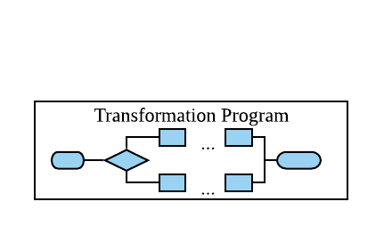
Overall Approach
Jin et al, 2018
S
Transformation Learning
Syntactic Clustering
Source Data
Pattern Tree
S’
Target Data
Transformation Validation
S’’
True|False
Transformed Data

Slide 9
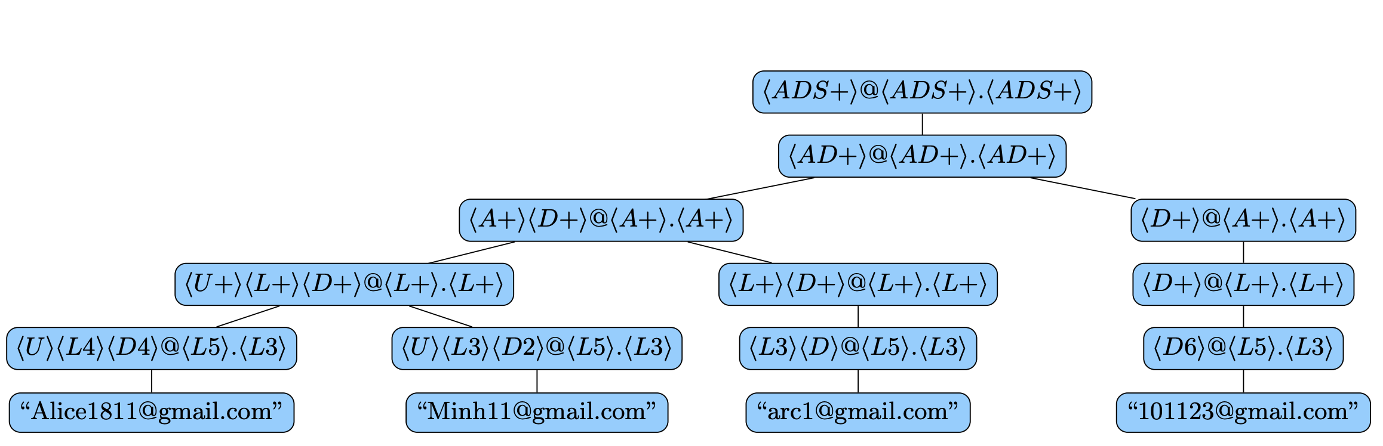
Pattern and Pattern Tree
<AD+> | @ | <AD+> | . | <AD+>
Alice1811 | @ | gmail | . | com
Minh11 | @ | gmail | . | com
… | … | … | … | …

Slide 10
Transformation Program
Source Pattern
Patterns
<A+> | (space) | <A+>
Mark |  | Slipper
Edward |  | David
… | … | …
<A+> | (space) | <A+>
Mark |  | Slipper
Edward |  | David
… | … | …
Name
Mark Slipper
Tom A. Clerverley
Cahill, Michael
Edward David
…
…
Substr(0,1) | ConstStr(“.”) | ConstStr(“ ”) | Keep
<A+> | , | (space) | <A+>
Cahill | , |  | Michael
… | … | … | …
<A+> | . | (space) | <A+>
W | . |  | Smith
T | . |  | Cruise
… | … | … | …
…
Target Pattern

Slide 11
Transformation Learning
Jin et al, 2018
S
Transformation Learning
Syntactic Clustering
Source data
Pattern trees
S’
Target data
Transformation Validation
S’’
True|False
Transformed data

Slide 12
Transformation Learning – Bottom Up
Score
String function learning
Same-level pattern mapping
Pattern-level ranking

Slide 13
String Function Learning
For each
token pair
Source pattern
Score
Transform
Compare
Target pattern

Slide 14

Scoring Model
Source token t
Transformed token O(t)
Target token t’
<AD+>
Mark
Edward
Tim
<AD+>
M
E
T
\d{3}
W
T
D
Substr(0, 1)
Compare
$$Score\left(O, t, t^{′}\right)=sim\left(O\left(t\right), t\right)$$
$$Score\left(t, t′\right)=\max_{O}{Score(}O, t, t′)$$

Slide 15
String Function Learning
Source pattern
Find best mapping
Hungarian algorithm
Target pattern

Slide 16
Same-level Pattern Mapping
<A+> | (space) | <A+>
Mark |  | Slipper
Edward |  | David
… | … | …
<A+> | . | (space) | <A+>
W | . |  | Smith
T | . |  | Cruise
… | … | … | …
<A+> | (space) | <A+> |  | <A+>
Edgar |  | Steven |  | Davids
Jose |  | Luis |  | Garcia
… | … | … | …
<A+> | . | <A+> | . | (space) | <A+>
J | . | P | . |  | Marquess
D | . | C | . |  | Leary
… | … |  |  | … | …
Source patterns
Target patterns
Find the best mapping => Learn the correct transformation

Slide 17
Pattern-level ranking
Source patterns
<U+> | <L+> | (space) | <U+> | <L+>
M | ark |  | S | lipper
E | daward |  | D | avid
… |  | … | …
<A+> | (space) | <A+>
Mark |  | Slipper
Edward |  | David
… | … | …
<ADS+>
Mark Slipper
Edward Daid
…
What is the best level
to learn the transformation ?
<U+> | . | (space) | <U+> | <L+>
W | . |  | S | mith
T | . |  | C | ruise
… |  | … | …
<A+> | . | (space) | <A+>
W | . |  | Smith
T | . |  | Cruise
… | … | … | …
<ADS+>
W. Smith
T. Cruise
…
Target patterns

Slide 18
Transformation Learning
Jin et al, 2018
S
Transformation Learning
Syntactic Clustering
Source Data
Pattern Tree
S’
Target Data
Transformation Validation
S_{i}
True|False
Transformed Data

Slide 19
Transformation Validation
Source Pattern
Transformed data
Desiree S.
Alaina P.
<AD+> |  | <AD+>
Desiree |  | Seamons
Chong |  | Aylward
Transformed data
R. Mcgaughey
C. Latimore
Have the same pattern?
X
Which one is
first names
<AD+>
Samuel
Maryann
Ambigous in matching tokens
Target data
Andrew C.
Bradford L.
Target Pattern
Notes:
Examples

Slide 20
Evaluation

Slide 21
Evaluation
- Our system: UDATA
- Two baseline systems:
IPBE (Wu et al, 2015)
FlashFill (Gulwani et al, 2012)

Slide 22
Validation Evaluation
Goal of validation: find all wrong transformations in the systems = high recall
 | Precision | Recall | F-measure
Validation Result | 0.63 | 0.99 | 0.73
Validation Result |  | Groundtruth
 |  | Incorrect Transform | Correct Transform
Validation Prediction | Incorrect Transform | 20.0% | 11.7%
 | Correct Transform | 0.2% | 68.1%
31% scenarios require human-interaction
vs
100% scenarios require human-interaction without UData
Notes:
More explanations

Slide 23
Running Time
Notes:
No user time

Slide 24
Conclusion

Slide 25
Conclusion and Future Work
Conclusion
An unsupervised data transformation system with high accuracy
A validation module which can detect “almost” any error made by the system
Future Work
Improve scalability and reduce running time
Include semantic transformation

Slide 26
Thank you

