Slide 1
Feature Selection Methods For Understanding Business Competitor Relationships
Rahul Gupta¹, Jay Pujara¹, Craig Knoblock¹,
Shushyam Sharanappa¹, Bharat Pulavarti¹,
Gerard Hoberg¹, Gordon Phillips²
1: University of Southern California; 2: Dartmouth College
Data Science for Macro-modeling with Financial and Economic Data
6/15/18
Funded by National Science Foundation under grants 1561057 and 1561068.

Slide 2
What is competition?
Products and differentiation (Hotelling, 1929)
Production processes and industries (Pearce, 1957)
Capital structure and financial performance (Fama & French, 1997)
Co-occurrence in text and queries (Lee+, 2015)

Slide 3
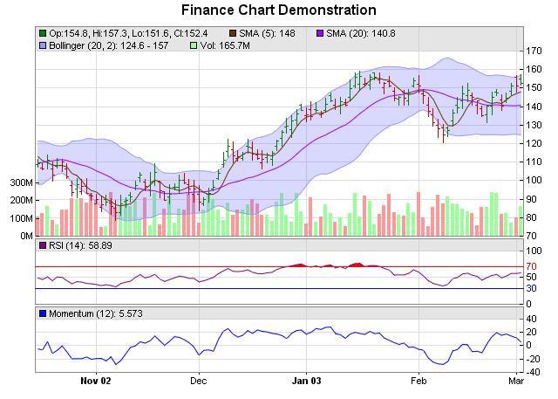
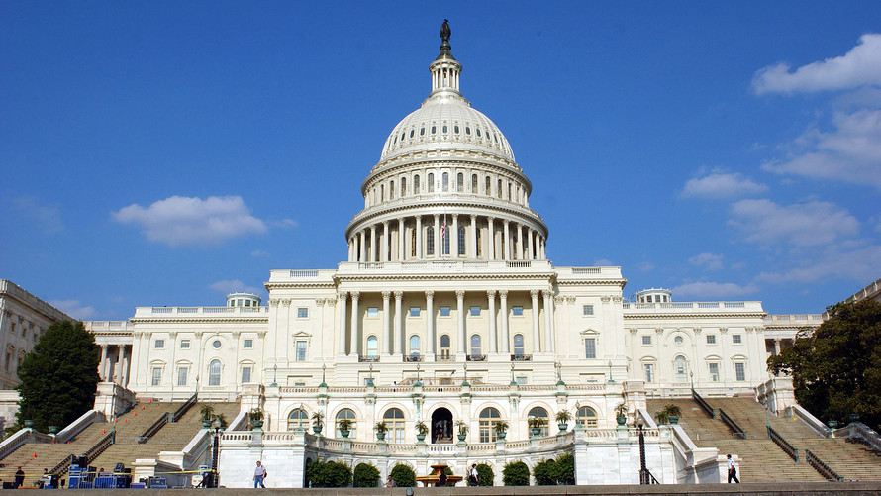


Why do we care about competition?

Slide 4
How Does Data Science Keep Up?
"Cloud"
"Ridesharing"
"Blockchain"
Need for data-driven approaches that adapt to competition

Slide 5
Prior work: Text-Based Network Industry Classes
Approach:
Use text from the business descriptions of SEC filings
Filter to remove non-noun phrases, locations, frequent terms
Use Jaccard similarity of text
Drawbacks:
Restricted to public firms
SEC filings lack detail and have limited text

Slide 6
Web Text-Based Network Industry Classification
Key idea: use company webpages instead of SEC filings
Massive data collection:
400K companies
20 years
8TB compressed text
Developing more scalable comparison approaches
Open question: how informative are company webpages?

Slide 7
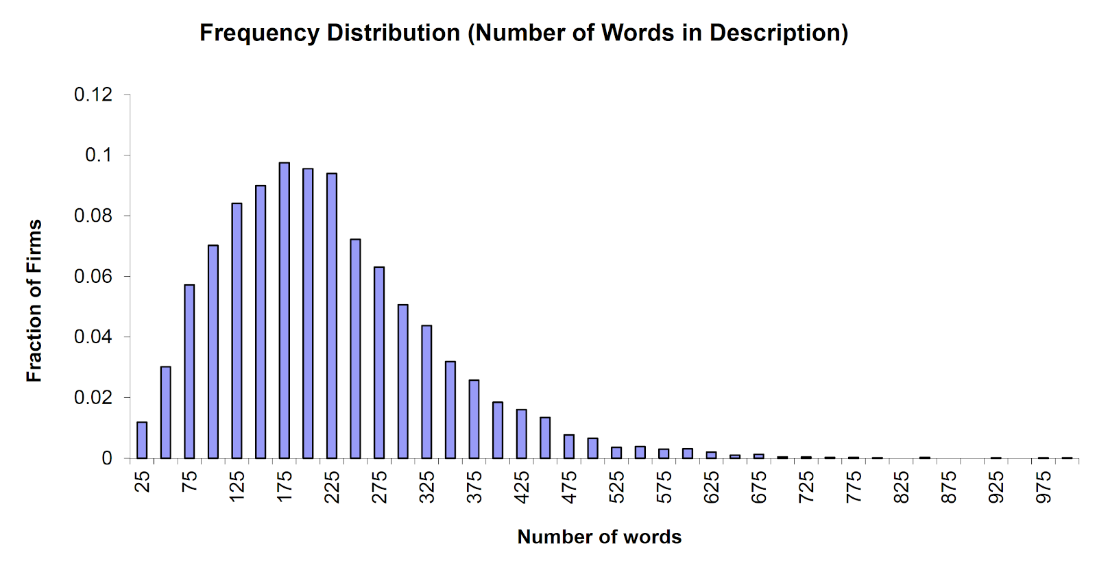
Comparing SEC filings and Company Webpages
200K Unique Words

Slide 8
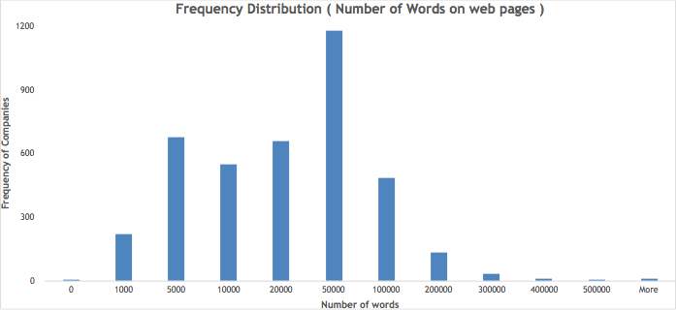
Comparing SEC filings and Company Webpages
1.7M Unique Words

Slide 9
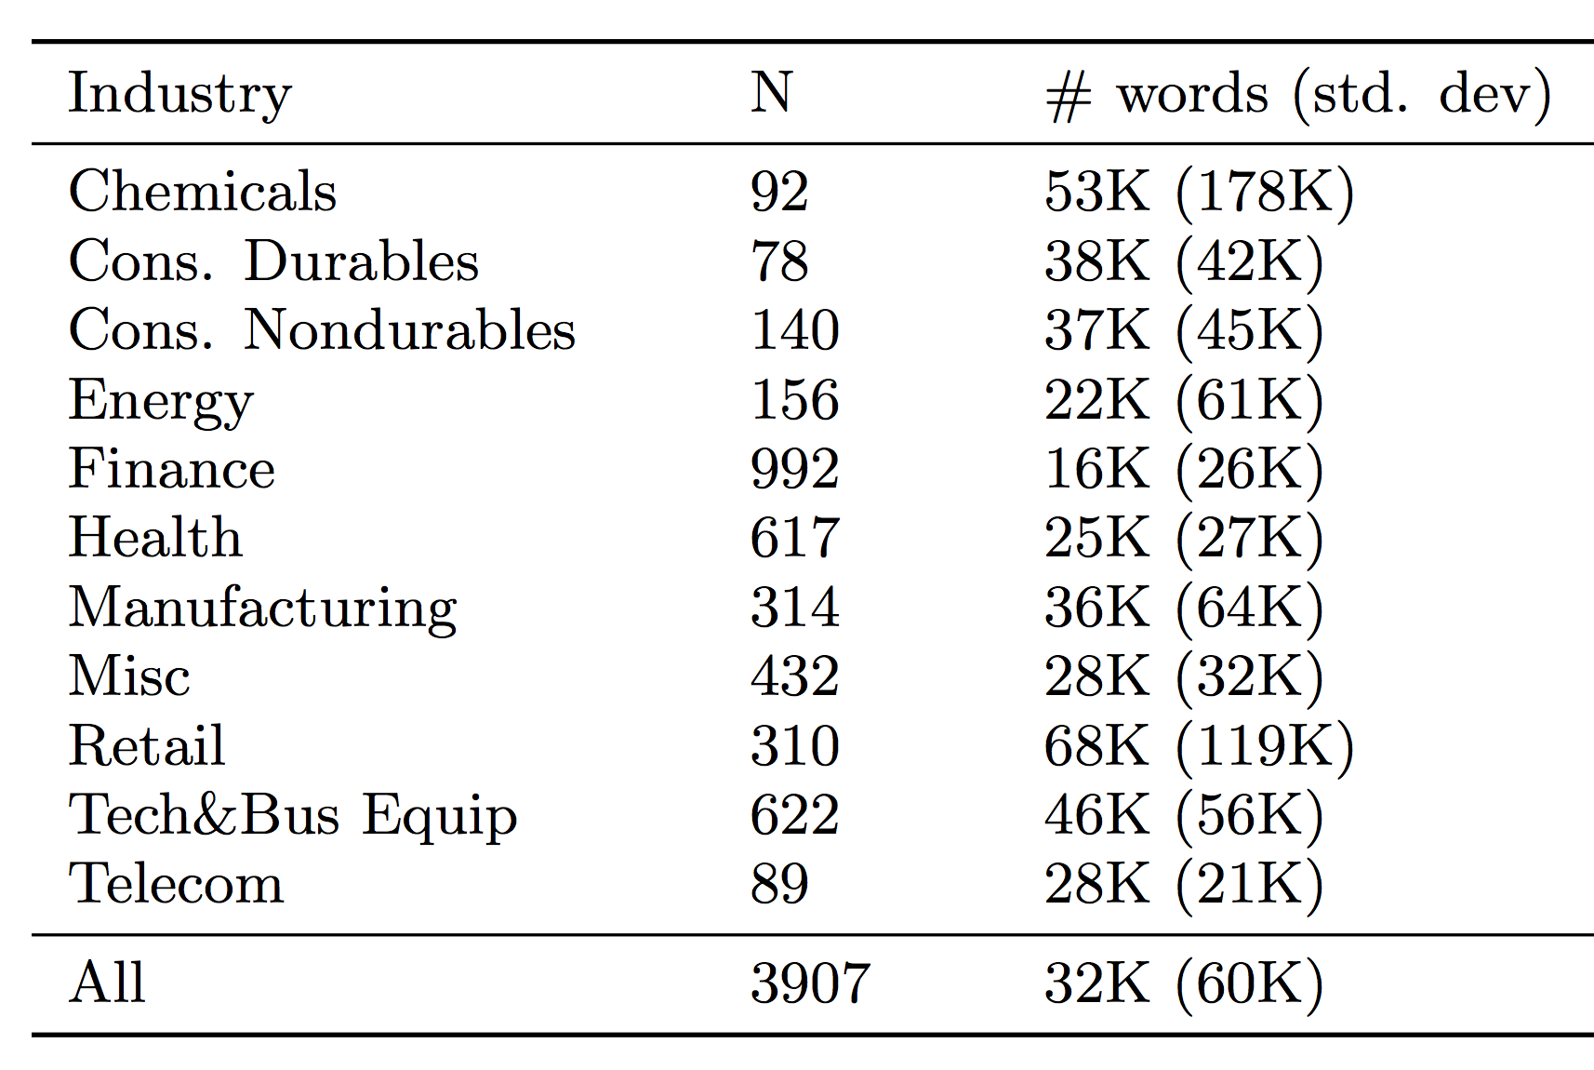
Comparison of Webpage Words

Slide 10
What text should we use?
Webpages contain all types of text, only some of which is relevant
Terms used in SEC business descriptions are likely relevant
Low coverage, must be extended
Information retrieval approaches are optimized to find relevant terms
High noise, must be filtered

Slide 11
Curated Term Lists
Start with terms in business descriptions
Identify frequent or discriminative terms and manually add these to a white list
“ethernet carrier”, “sleeper”, “tumor”
Identify terms that are not relevant and manually add these to a black list
“admiralty”, “gardner”, “steinberg
Extract only whitelisted terms from webpage text

Slide 12
Term-Frequency, Inverse Document Frequency
Use traditional information-retrieval metric for text
Defined over entire corpus (e.g., average TF-IDF of term)

Slide 13
Evaluation Approach
Data corpus of 3907 publicly traded firms with SEC business descriptions in 2015 10-K filing
Webpages from Compustat Financial Database, use 500 webpages per company
Predict asset-adjusted company profits using competitors

Slide 14
Data Issues: Proprietary Terminology
Terms frequently used by a single company have high rankings:
countsbaker
geon
ultratuf
wilflex
oncap
Min Companies | R²
0 | 0.258
3 | 0.262
5 | 0.259
10 | 0.252

Slide 15
Data Issues: Long words
kuwaitkyrgyzstanlaoslatvialebanonlesotholiberialibyaliechtensteinlithuanialuxembourgmacaumacedoniamadagascarmalawimalaysiamaldivesmalimaltamarshall
apioverviewcollectionsprojectsoverviewdeleteeventsprojects
cashprovidedbyusedinoperatingactivitiesdiscontinuedoperations
repaymentsofnotespayable
Max Length | R²
None | 0.262
17 | 0.284
20 | 0.286
25 | 0.285

Slide 16
Top-ranked terms by TF-IDF metric
blog
accessories
clinical
shop
cloud
hughes
loans
cards
brands
loan
oil
Top % | R²
10 | 0.289
15 | 0.286
20 | 0.220

Slide 17
Comparing Manual and Automatic Feature Selection
Feature Selection Method | R²
Curated word lists | 0.261
Filtered TF-IDF scores | 0.286

Slide 18
Conclusion
Competitor relationships can be difficult to define or predict
Company-associated text often contains implicit signals of product offerings, markets, production processes, and strategic goals
Feature selection is important for identifying the meaningful terms
Manual feature curation works, but using automated approaches from the information retrieval community performs better

