Slide 1
Learning with Previously Unseen Features
Yuan Shi Craig A. Knoblock
Computer Science Department Information Sciences Institute
University of Southern California
Notes:
Online results:
0.05
0.04
-
-
-

Slide 2

Motivating Example
weather station
temperature, pressure sensor humidity
Training data:
Feature Label
Temperature (°F) | Pressure (in) | Humidity (%)
73 | 29.9 | 65
68 | 29.3 | 72
71 | 29.4 | 73
68 | 29.1 | 77
Notes:
Online results:
0.05
0.04
-
-
-

Slide 3
Motivating Example
Training data:
Feature Label
Temperature (°F) | Pressure (in) | Humidity (%)
73 | 29.9 | 65
68 | 29.3 | 72
71 | 29.4 | 73
68 | 29.1 | 77
Test data:
Dew point (°F)
60
62
61
65
Temperature (°F) | Pressure (in)
69 | 29.9
68 | 29.3
72 | 29.4
68 | 29.1
Humidity?
Notes:
Online results:
0.05
0.04
-
-
-

Slide 4
Motivating Example
Training data:
Feature Label
Temperature (°F) | Pressure (in) | Humidity (%)
73 | 29.9 | 65
68 | 29.3 | 72
71 | 29.4 | 73
68 | 29.1 | 77
Test data:
Dew point (°F)
60
62
61
65
Temperature (°F) | Pressure (in)
69 | 29.9
68 | 29.3
72 | 29.4
68 | 29.1
Dew point can help predict humidity!
Humidity, dew point and temperature are inter-correlated
Notes:
Online results:
0.05
0.04
-
-
-

Slide 5
Problem
Context: Machine learning systems deployed in an open environment
May access features that are previously unseen in the labeled training set
Goal: Improving a machine learning model by automatically identifying and using features that are not in the training set
Without additional labels
Notes:
Online results:
0.05
0.04
-
-
-

Slide 6
Problem
feature
label
1
2
3
N
training
…
…
1
2
3
M
testing
?
…
…
…
new feature
Notes:
Online results:
0.05
0.04
-
-
-

Slide 7
How to Leverage New Features?
Approach 1: Ignore them
But new features may contain complementary information over original features
Extreme case: new feature = label
Notes:
Online results:
0.05
0.04
-
-
-

Slide 8
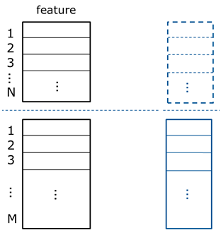
How to Leverage New Features?
Approach 1: Ignore them
But new features may contain complementary information over original features
Extreme case: new feature = label
Approach 2: Predict new features and combine them with original features
But prediction can be very challenging…
Notes:
Online results:
0.05
0.04
-
-
-

Slide 9
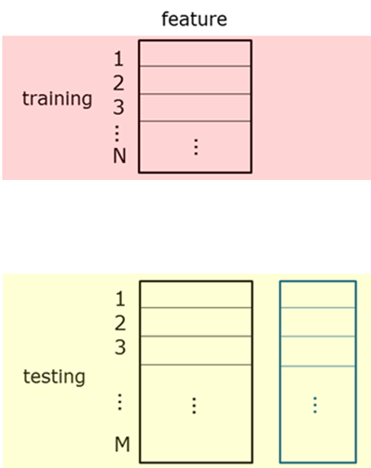
Related Work: Heterogeneous domain adaptation
Heterogeneous domain adaptation [Pan and Yang, 2010]
Source domain
Most existing approaches attempt to match the feature space of two domains: ignoring new features just maximizes the match! [Dai et al., 2008; Socher et al., 2013; Zhou et al., 2014; Kulis et al., 2011;Wang and Mahadevan, 2011; Argyriou et al., 2008; Duan et al., 2012; Shi et al., 2010; Harel and Mannor, 2010; Wei and Pal, 2011; Yeh et al., 2014]
Some work require additional labels to leverage new features [Zhao and Hoi, 2010; Hou and Zhou, 2016]
Target domain
Notes:
Online results:
0.05
0.04
-
-
-

Slide 10
Our Approach:
Learning with previously Unseen Features (LUF)
Notes:
Online results:
0.05
0.04
-
-
-

Slide 11
Our Approach - Intuition
training data
g(temperature)
f(temperature, dew point)
humidity
77
72
68
68
68
temperature
Notes:
Online results:
0.05
0.04
-
-
-

Slide 12
Our Approach - Intuition
training data
g(temperature)
f(temperature, dew point)
humidity
77
72
68
68
68
temperature
matching the joint distribution p(humidity, temperature)
Notes:
Online results:
0.05
0.04
-
-
-

Slide 13
Our Approach - LUF
feature
label
1
2
3
N
training
…
…
1
2
3
M
testing
?
…
…
…
f
Notes:
Online results:
0.05
0.04
-
-
-

Slide 14
Our Approach - LUF
feature
label
Two sets have the same joint distributions!
1
2
3
N
training
…
…
1
2
3
M
testing
?
…
…
Notes:
Online results:
0.05
0.04
-
-
-

Slide 15



Our Approach - LUF
Two sets have the same joint distributions!
Notes:
Online results:
0.05
0.04
-
-
-

Slide 16


Our Approach - LUF
Two sets have the same joint distributions!
Two sets of samples mixed as much as possible
Notes:
Online results:
0.05
0.04
-
-
-

Slide 17
Our Approach - LUF
Two sets of samples mixed as much as possible
Two sets of samples mixed as much as possible
Minimize cross-domain k-nearest neighbor distances
Notes:
Online results:
0.05
0.04
-
-
-

Slide 18


Our Approach - LUF
Minimize cross-domain k-nearest neighbor distances
’s k neighbors in the target domain
’s k neighbors in the target domain
Notes:
Online results:
0.05
0.04
-
-
-

Slide 19
Our Approach - LUF
Minimize cross-domain k-nearest neighbor distances
’s k neighbors in the target domain
’s k neighbors in the target domain
non-smooth in , because neighbors are dependent on : alternating optimization
Notes:
Online results:
0.05
0.04
-
-
-

Slide 20
Empirical Study
Notes:
Online results:
0.05
0.04
-
-
-

Slide 21
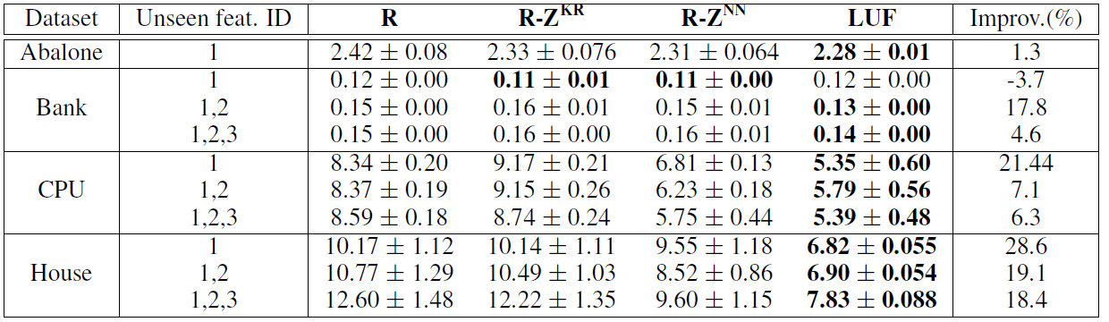
Regression Tasks
Errors in regression tasks
New features
Ignore new features
Predict new features
Similar trend on classification tasks
Notes:
Online results:
0.05
0.04
-
-
-

Slide 22
Sensor Adaptation for Weather Station
A weather station contains several sensors
Sensor failure happens
Time | Temp. | Humidity | Wind Speed
8:50 AM | 24.2 | 16.7 | 4.3
8:55 AM | 24.3 | ? | 3.0
9:00 AM | 24.8 | ? | 3.9
9:05 AM | 25.2 | ? | 1.4
Notes:
Online results:
0.05
0.04
-
-
-

Slide 23
Sensor Adaptation for Weather Station
A weather station contains several sensors
Sensor failure happens
When a sensor fails, we allow it to access the same sensor from a nearby station
But directly using the new sensor may perform poorly!
Time | Temp. | Humidity | Wind Speed
8:50 AM | 24.2 | 16.7 | 4.3
8:55 AM | 24.3 | ? | 3.0
9:00 AM | 24.8 | ? | 3.9
9:05 AM | 25.2 | ? | 1.4
Time | Humidity
8:50 AM | 17.6
8:55 AM | 16.8
9:00 AM | 16.3
9:05 AM | 17.9
Nearby station
Notes:
Online results:
0.05
0.04
-
-
-

Slide 24
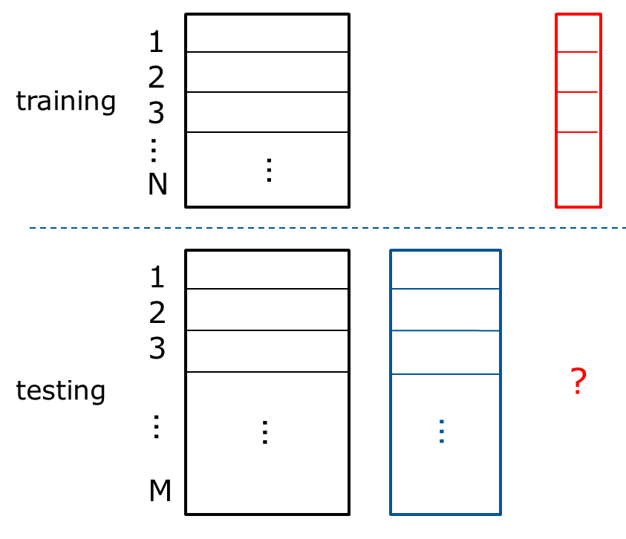
Sensor Adaptation for Weather Station
Can we reconstruct the failed sensor using the remaining sensors and new sensor?
remaining sensors
failed sensor
new sensor
Notes:
Online results:
0.05
0.04
-
-
-

Slide 25
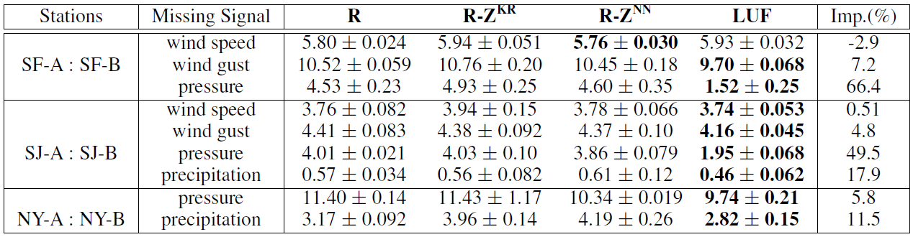
Sensor Adaptation for Weather Station
Reconstruction errors
Ignore new features
Average improvement: 17.9%
failed sensor
Predict new features
Notes:
Online results:
0.05
0.04
-
-
-

Slide 26
Thank You!
Question?
Notes:
Online results:
0.05
0.04
-
-
-

