Slide 1

Notes:
J.A.R.V.I.S. Academy · Session 1 — The Vision · Expert session
Speaker notes: Teaching hook: set the level in the first sixty seconds — this audience has read the paper, so nothing today is summary; every distinction will be tested. State the scope firmly: the first white paper v1.2 only. Discussion prompt: ask each participant to name the one sentence in v1.2 they could not yet defend under questioning. That list becomes the session's debt ledger.

Slide 2
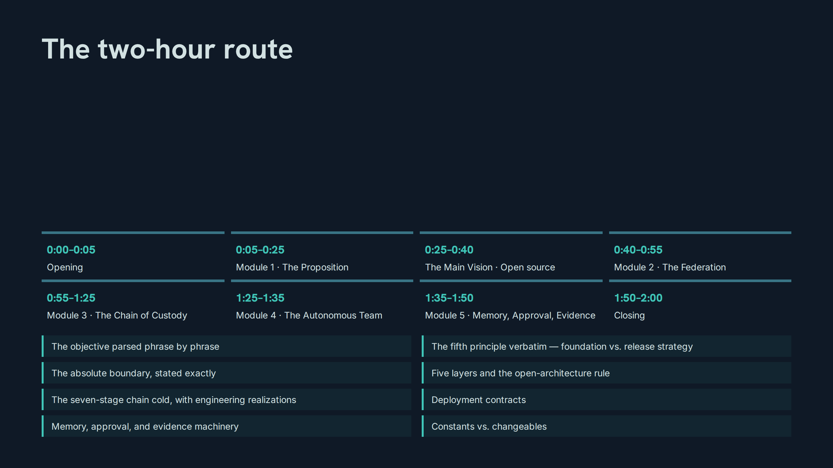
Notes:
The two-hour route
Speaker notes: Teaching hook: walk the timings once, then name the standard of performance — by 8:00 everyone defends the doctrine without the slide in front of them. Drill: have the room repeat the eight blocks and their minute marks from memory. Discussion prompt: which block will be hardest to hold to time, and why?

Slide 3
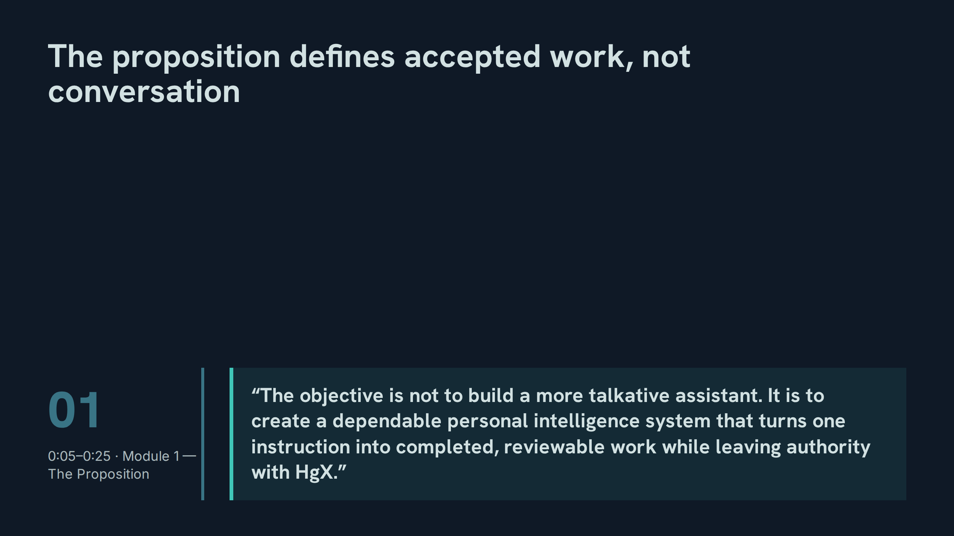
Notes:
The proposition defines accepted work, not conversation
Speaker notes: Teaching hook: parse the sentence phrase by phrase — 'not more talkative' kills the chatbot framing; 'dependable' sets the reliability bar; 'one instruction' is the input contract; 'completed, reviewable work' is the output contract; 'leaving authority with HgX' is the governance contract. Drill: cover the slide and have each participant reconstruct all five phrases in order. Discussion prompt: which phrase is most often violated in ordinary assistant use?

Slide 4
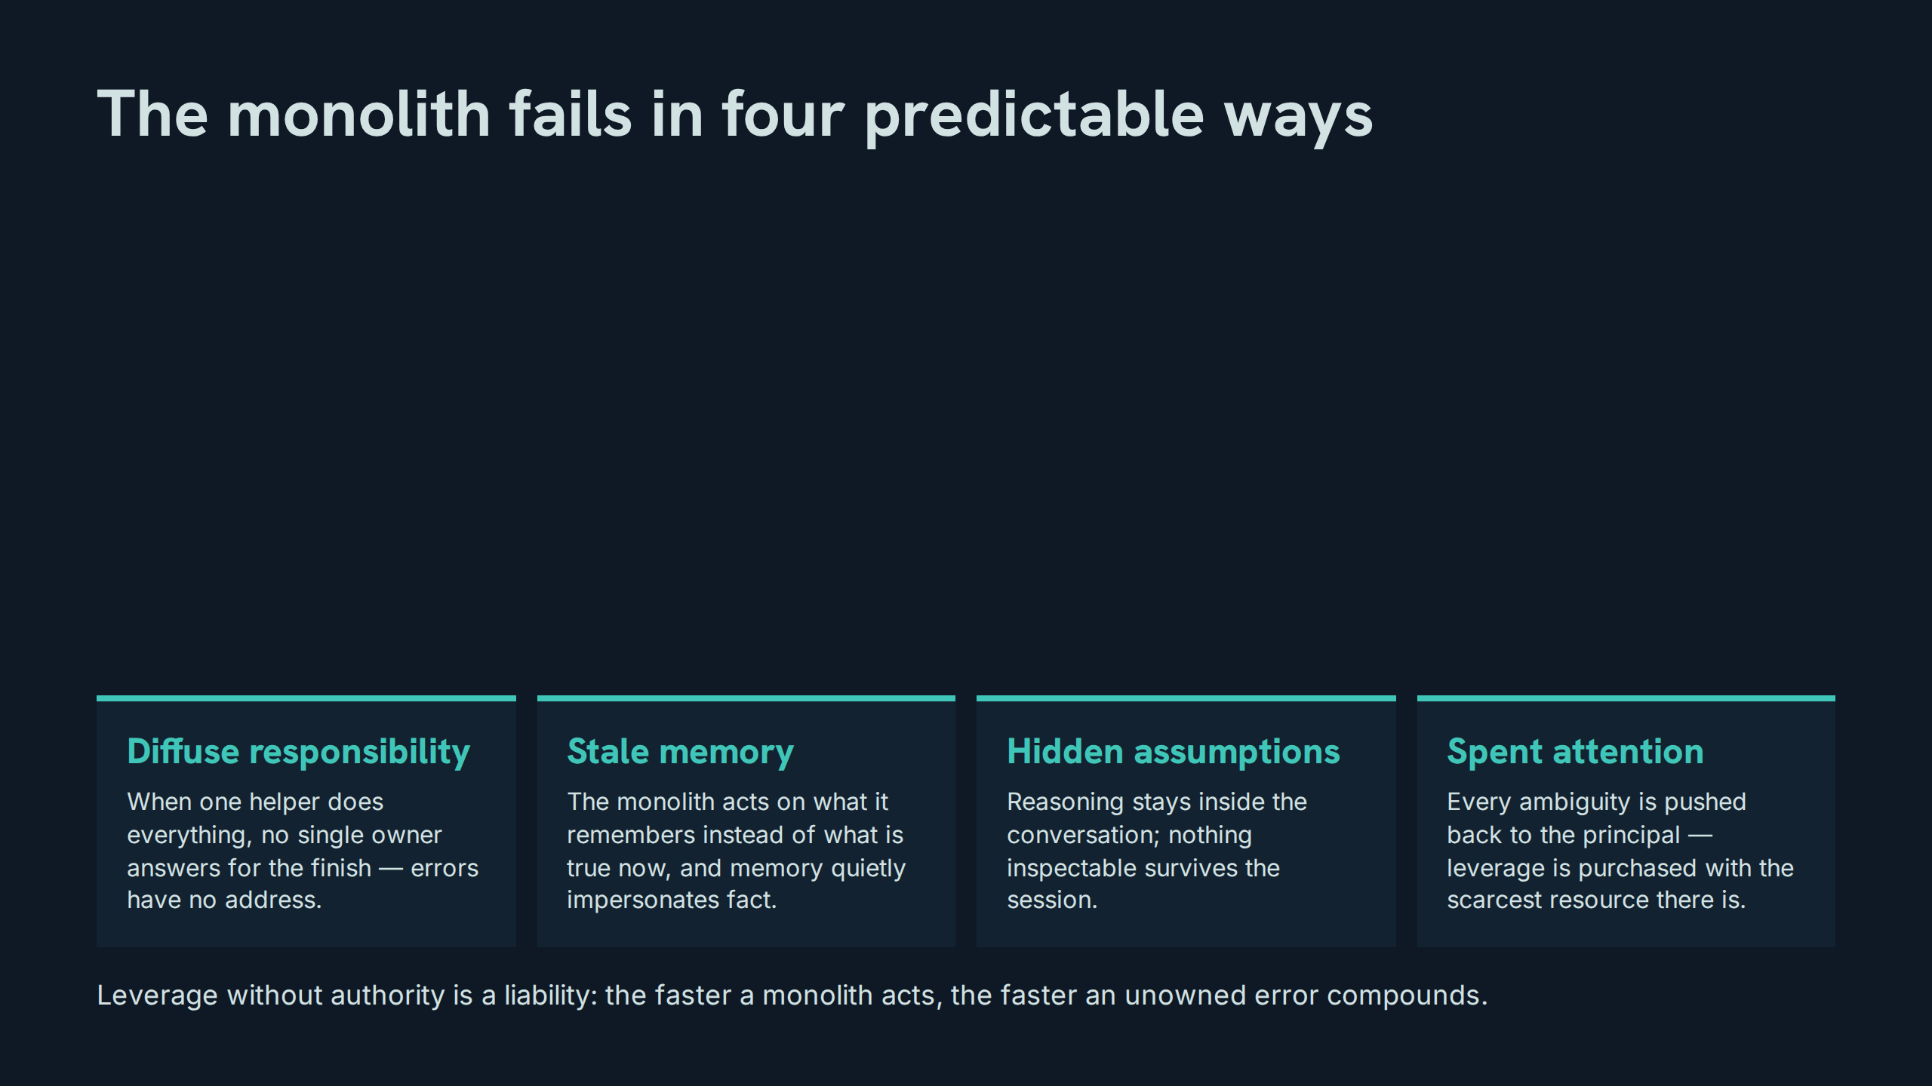
Notes:
The monolith fails in four predictable ways
Speaker notes: Teaching hook: insist these are structural failures, not model failures — a smarter monolith still diffuses responsibility. Drill: for each failure, participants name the chain stage that prevents it (role, live source, evidence, approval). Discussion prompt: which of the four failures costs an expert operator the most per week?

Slide 5
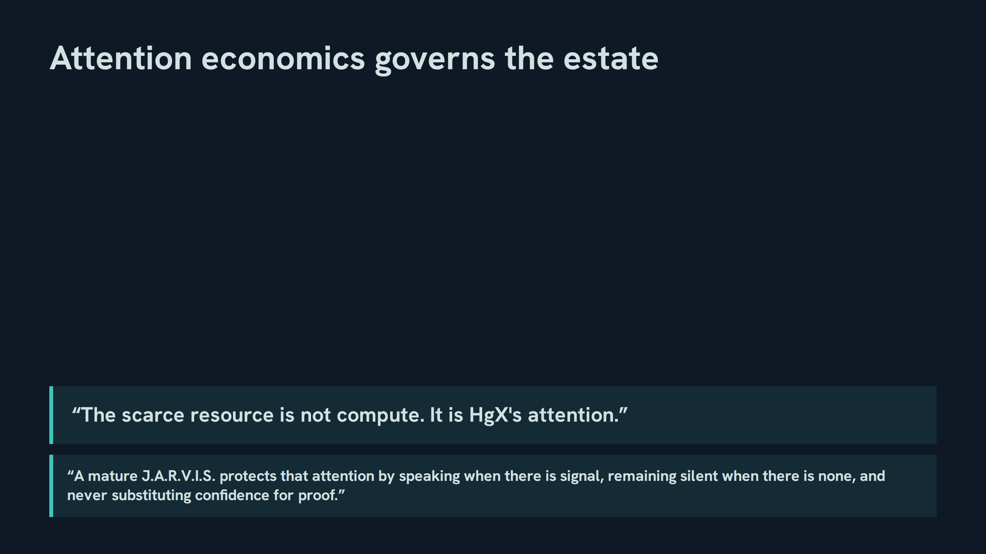
Notes:
Attention economics governs the estate
Speaker notes: Teaching hook: attention is the budget every design decision spends; silence is a feature, not an absence. Drill: participants classify three sample interruptions as signal or noise under this rule. Discussion prompt: where does confidence most often get substituted for proof in agent systems?

Slide 6
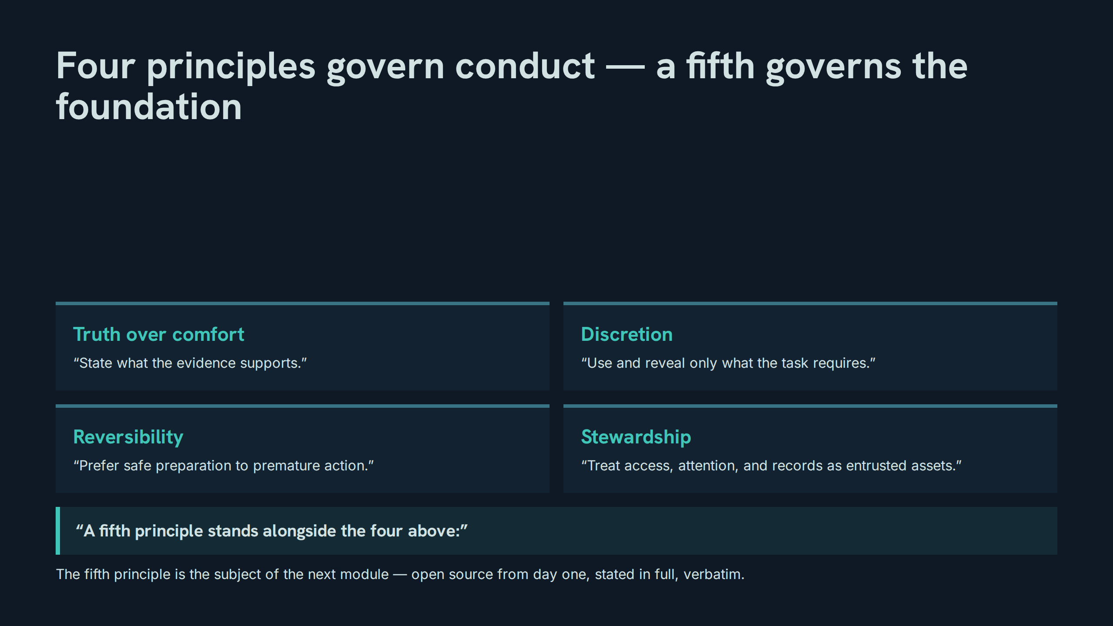
Notes:
Four principles govern conduct — a fifth governs the foundation
Speaker notes: Teaching hook: each principle is an enforceable contract, not a value poster — ask what behaviour each one forbids. Drill: recite the four verbatim lines in order, then the fifth principle's opening words. Discussion prompt: which principle is hardest to keep when a deadline presses?

Slide 7
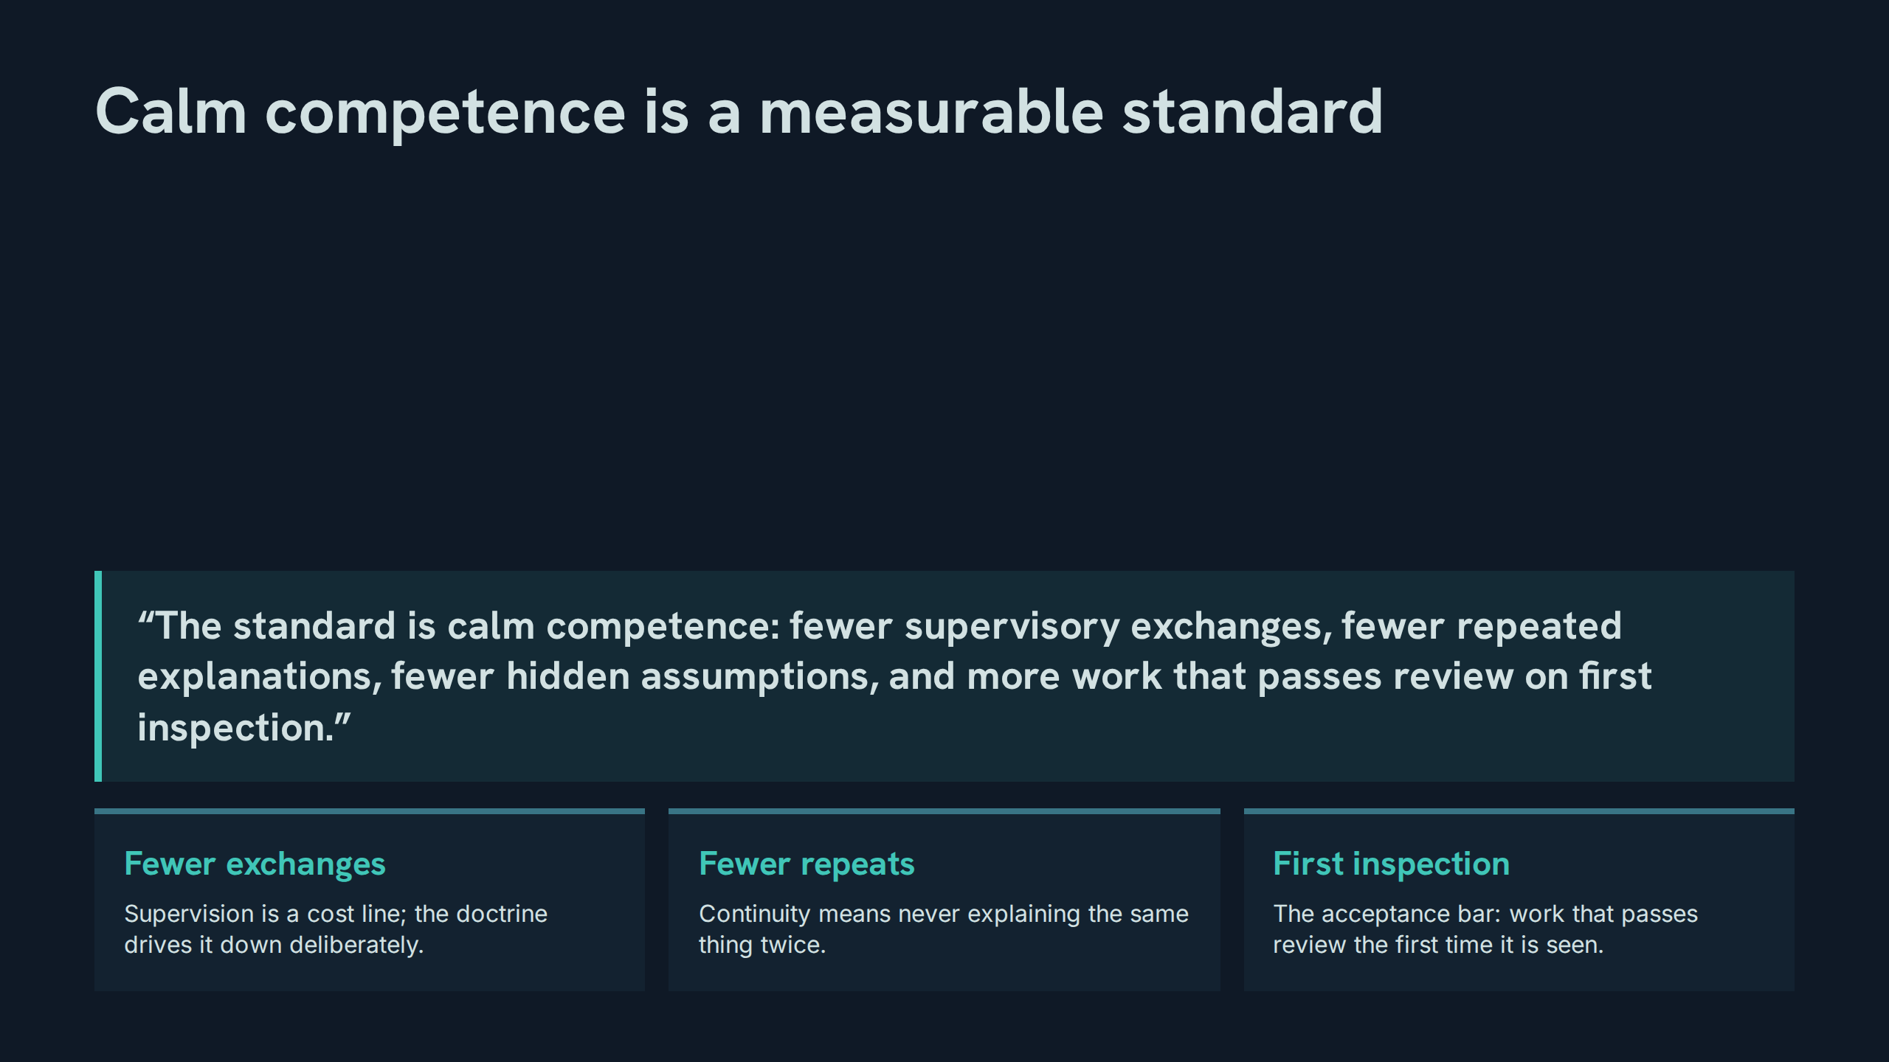
Notes:
Calm competence is a measurable standard
Speaker notes: Teaching hook: the quote is a scorecard in prose — every clause can be counted. Drill: participants turn each clause into a metric with a direction (lower, lower, lower, higher). Discussion prompt: what would 'passes review on first inspection' require of evidence quality?

Slide 8
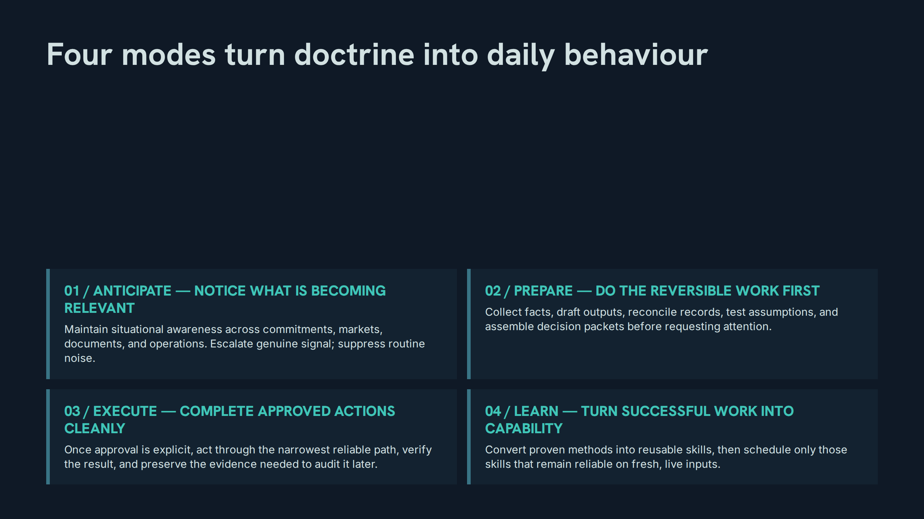
Notes:
Four modes turn doctrine into daily behaviour
Speaker notes: Teaching hook: the four modes are a loop, not a ladder — Learn feeds Anticipate. Drill: recite the four numbered headings exactly as the paper prints them, capitals included. Discussion prompt: which mode does an ordinary assistant skip entirely? (Learn — and that is why nothing compounds.)

Slide 9
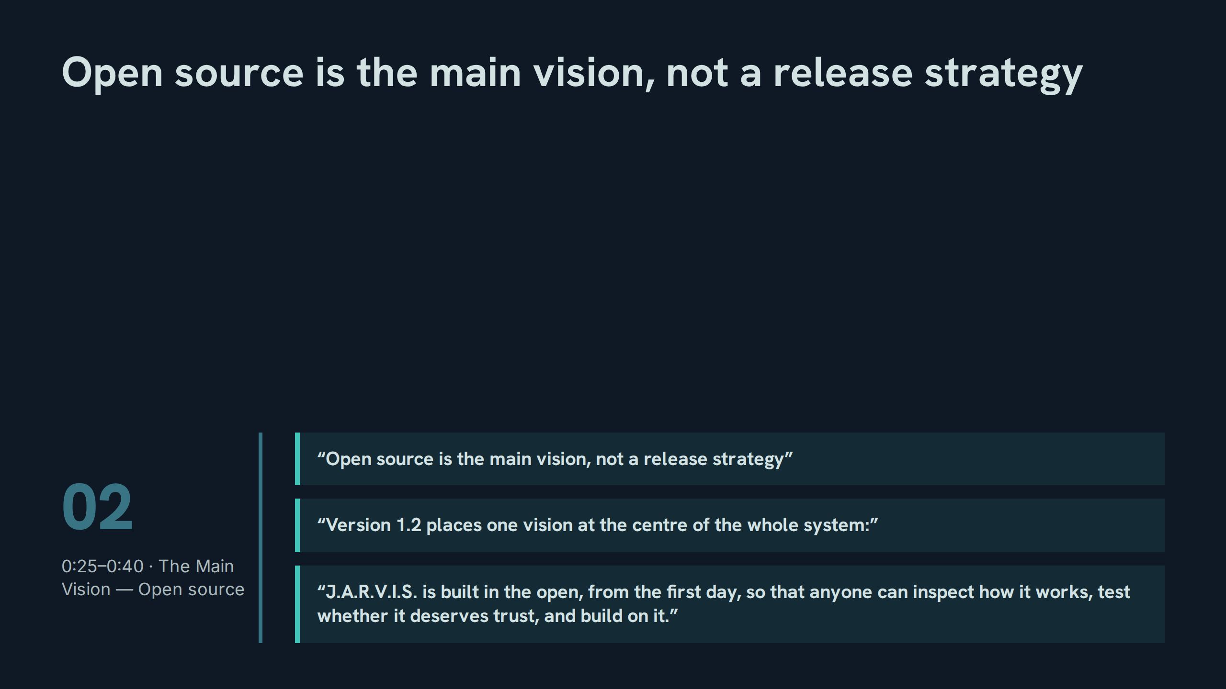
Notes:
Open source is the main vision, not a release strategy
Speaker notes: Teaching hook: v1.2's editorial act was to move open source from a roadmap item to the centre of the paper — everything else is read through it. Drill: participants state the three verbs in the vision sentence — inspect, test, build on — without looking. Discussion prompt: what changes in daily work when 'anyone can inspect' is the default assumption?

Slide 10
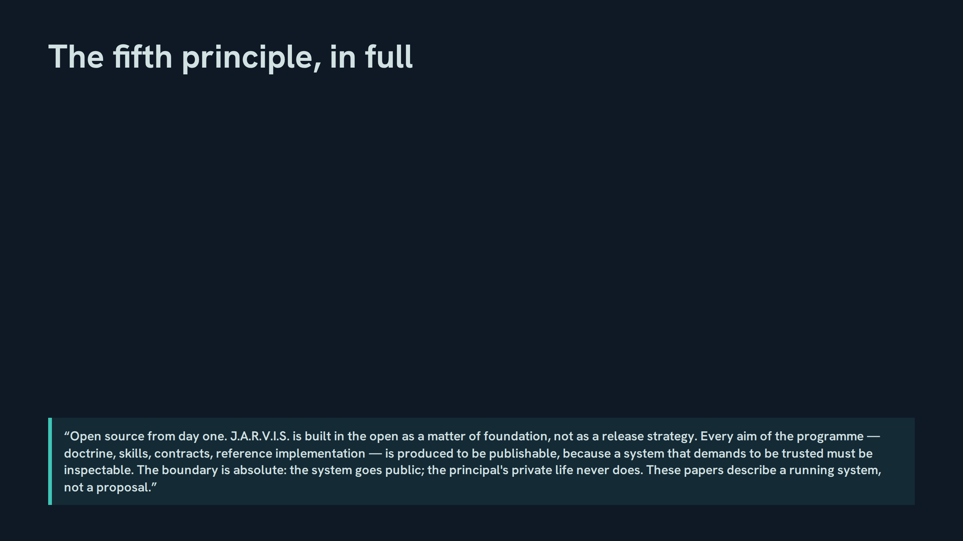
Notes:
The fifth principle, in full
Speaker notes: Teaching hook: this is the session's central memorization target — read it aloud twice, slowly, before any commentary. Drill: cold recitation, one sentence per participant around the room, then one volunteer takes the whole statement. Discussion prompt: why does the principle say 'produced to be publishable' rather than 'published'? Hold that question — slide 14 answers it.

Slide 11
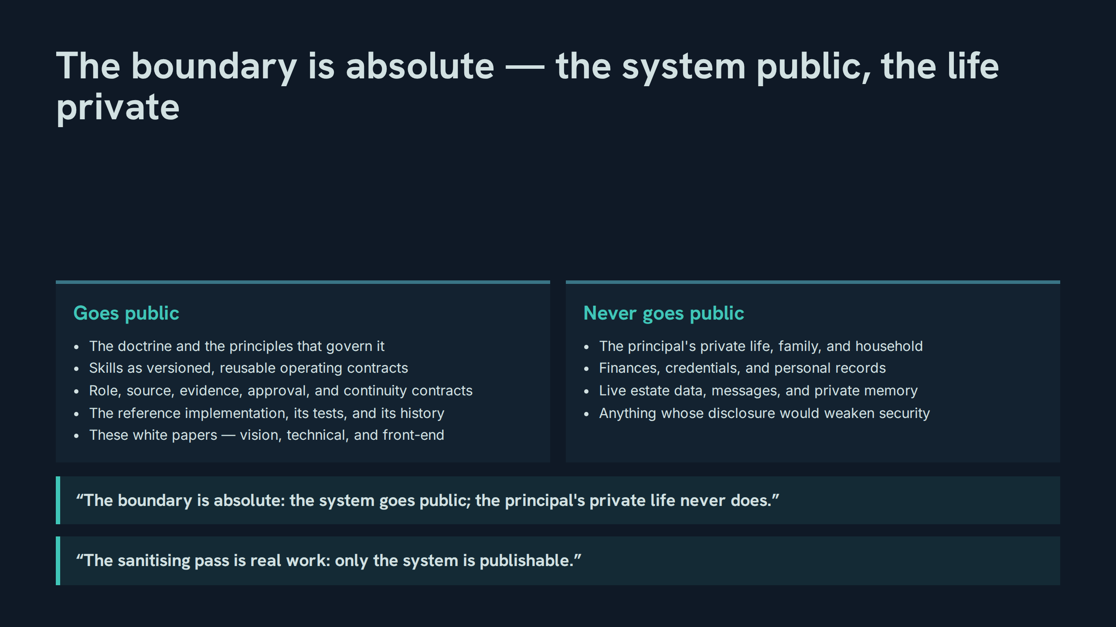
Notes:
The boundary is absolute — the system public, the life private
Speaker notes: Teaching hook: the two columns are the whole publication policy — if an item fits neither column, it does not ship until classified. Drill: classify six sample items (a role contract, a family photo, a skill file, a credential, a build log, a private preference) against the columns. Discussion prompt: why is the sanitising pass 'real work' and not a search-and-delete?

Slide 12
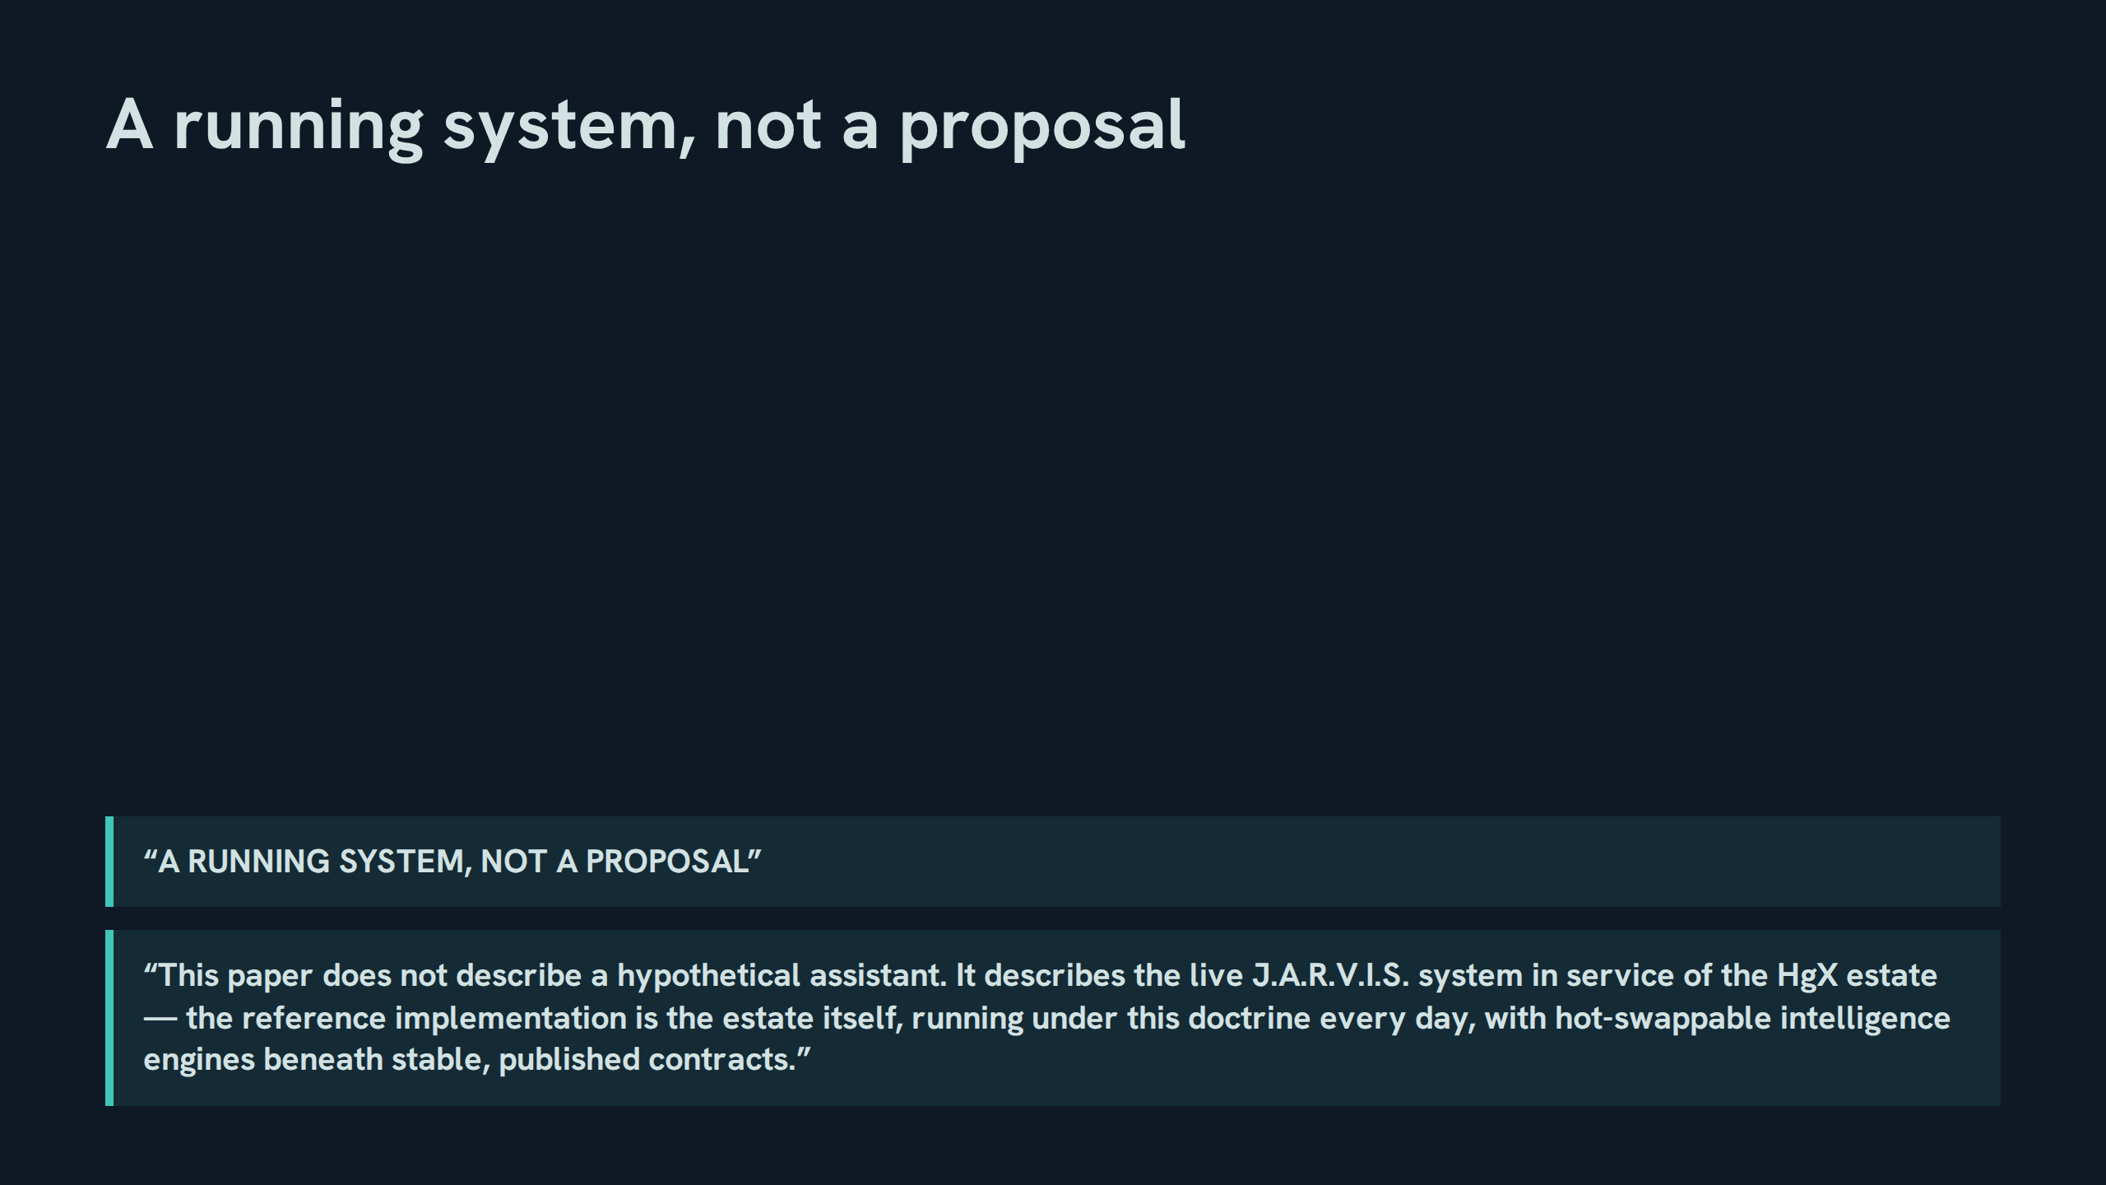
Notes:
A running system, not a proposal
Speaker notes: Teaching hook: the reference implementation is not a demo repo — it is the estate, running daily under the doctrine it publishes. Drill: participants name one doctrine rule they saw the live system obey this week. Discussion prompt: what does 'hot-swappable engines beneath stable contracts' protect against?

Slide 13
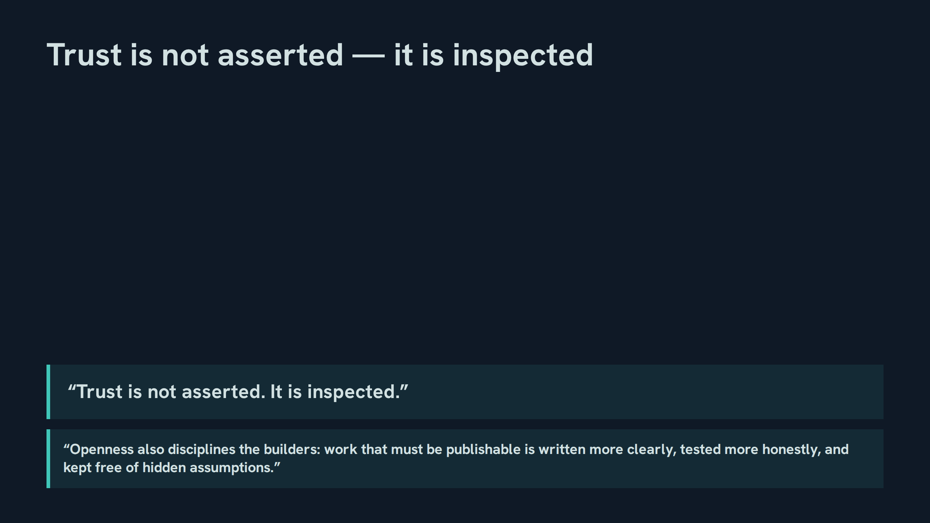
Notes:
Trust is not asserted — it is inspected
Speaker notes: Teaching hook: openness is a quality mechanism before it is a distribution mechanism — the discipline lands on the builders first. Drill: each participant names one hidden assumption that publishability would have exposed in their own recent work. Discussion prompt: is inspected trust stronger than certified trust? Defend a position from the paper.

Slide 14
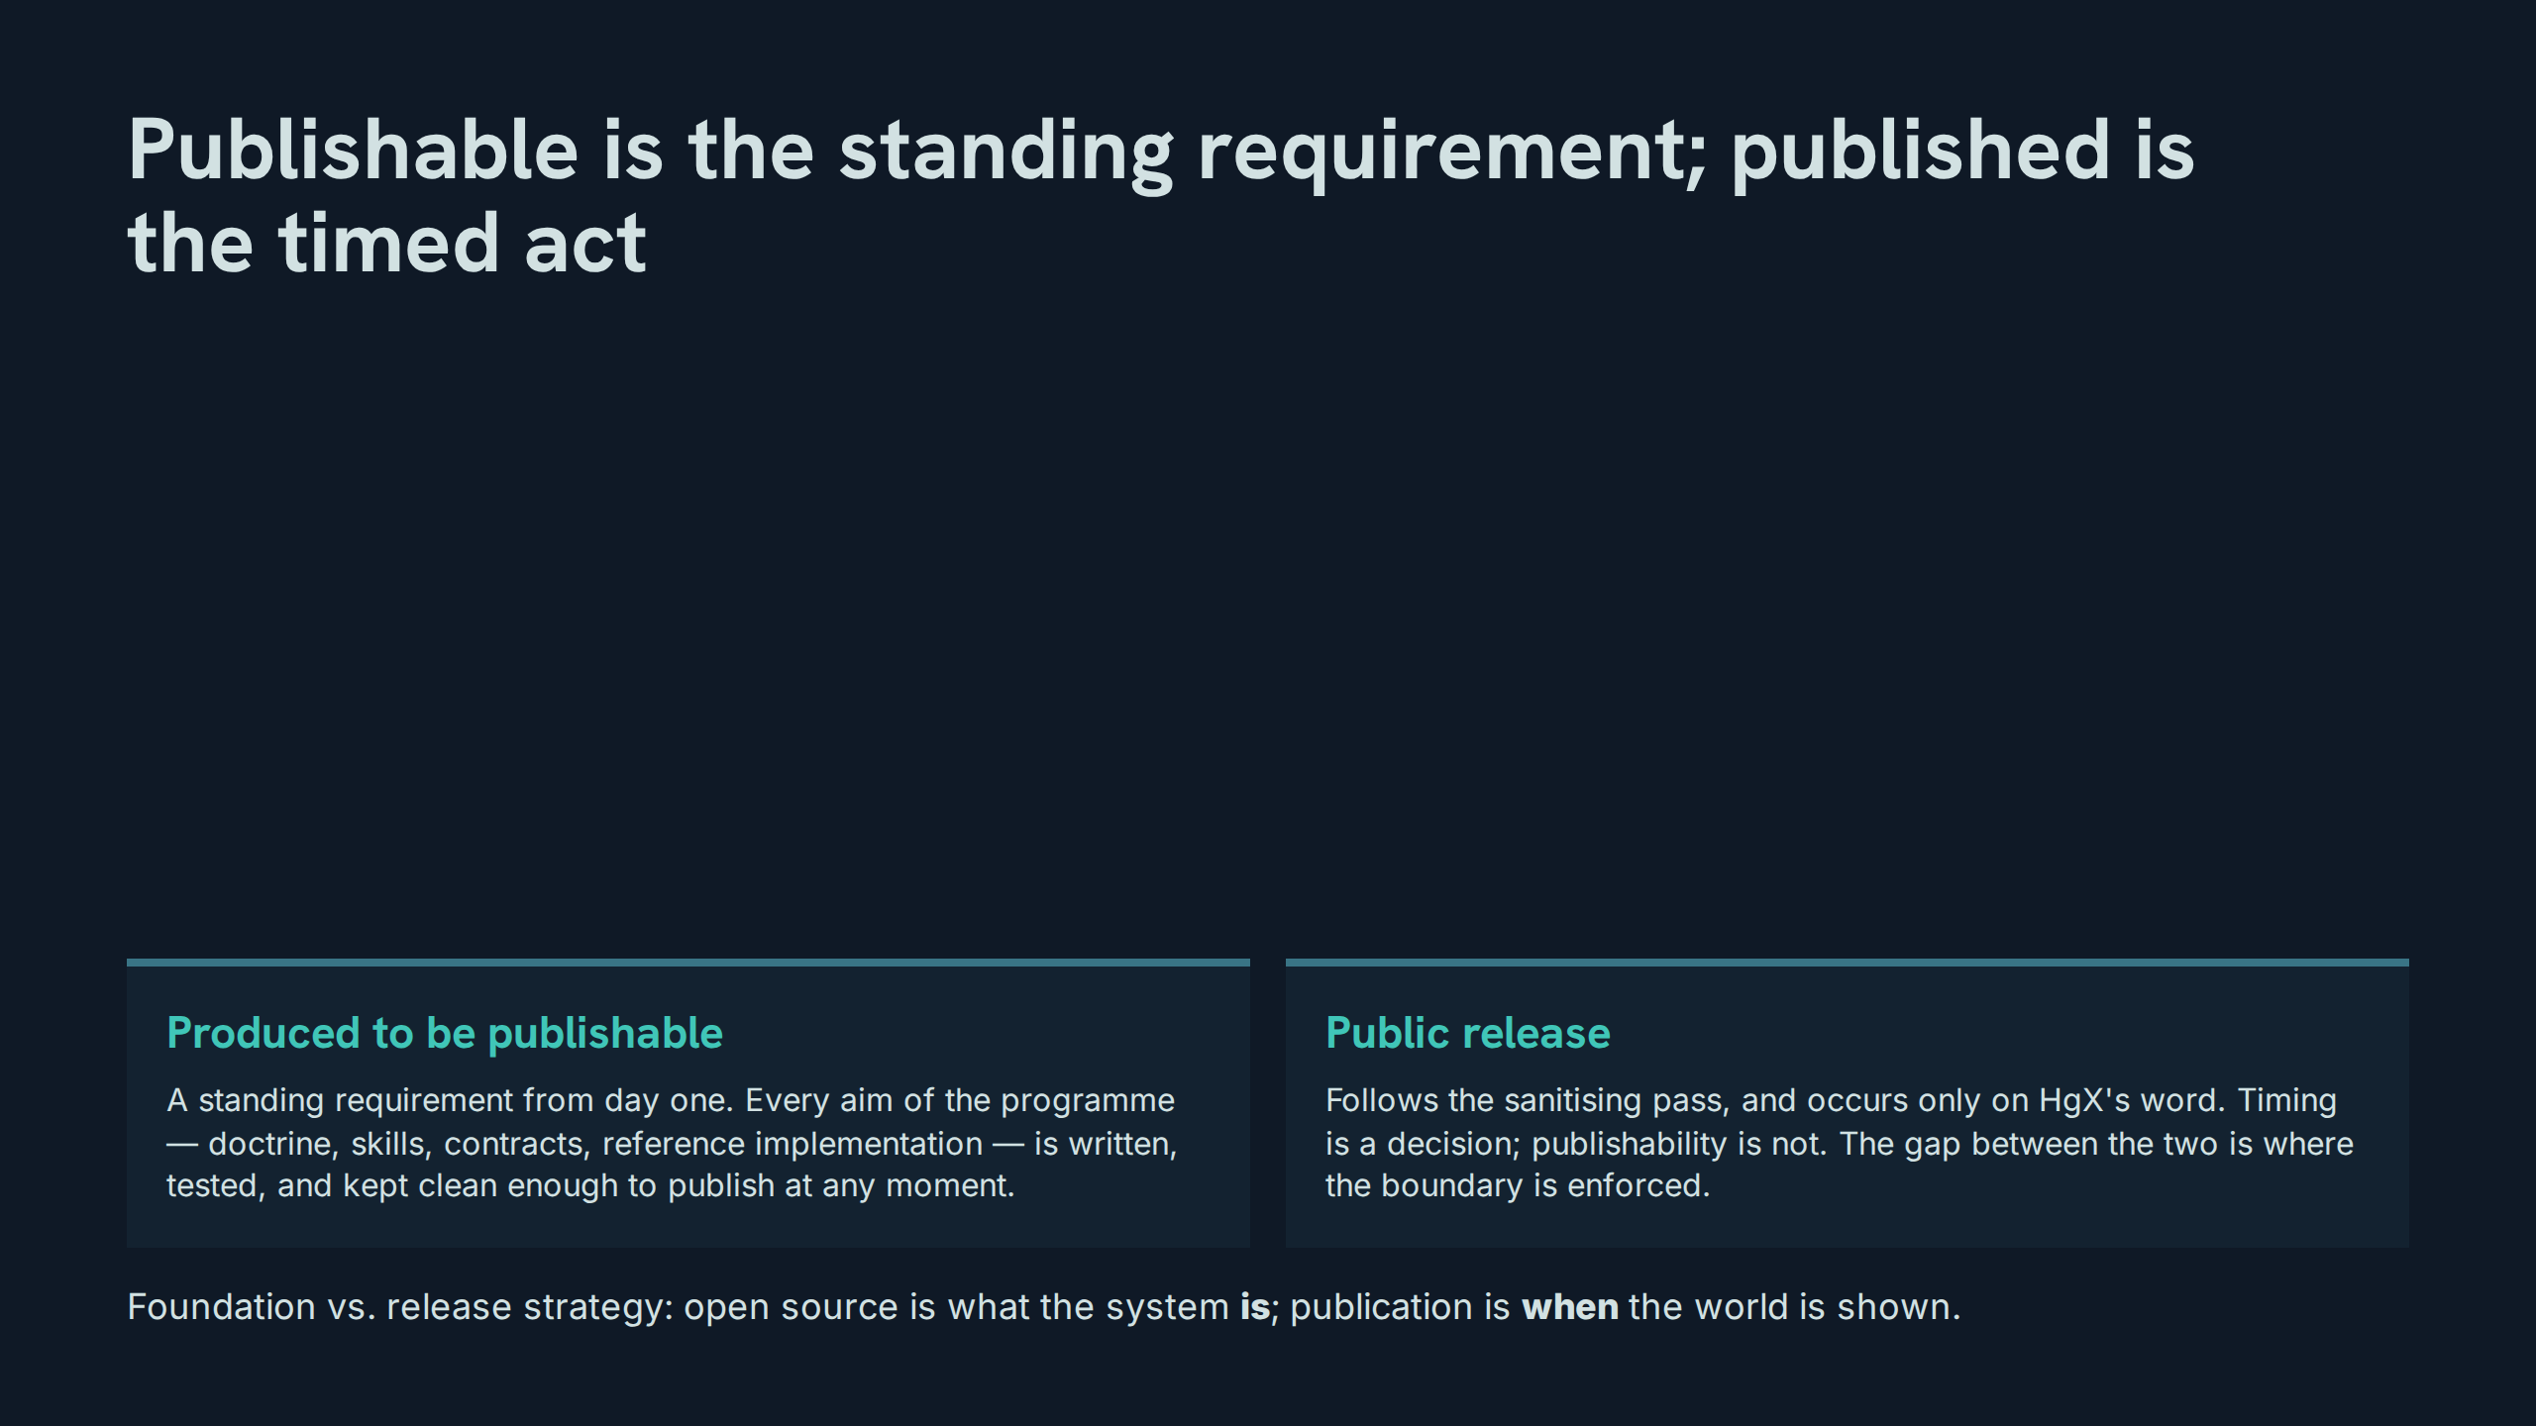
Notes:
Publishable is the standing requirement; published is the timed act
Speaker notes: Teaching hook: this distinction dissolves the common objection 'but it is not on GitHub yet' — the principle binds production, not the release calendar. Drill: state the distinction in one sentence each, foundation first. Discussion prompt: what would count as evidence that publishability had slipped in practice?

Slide 15
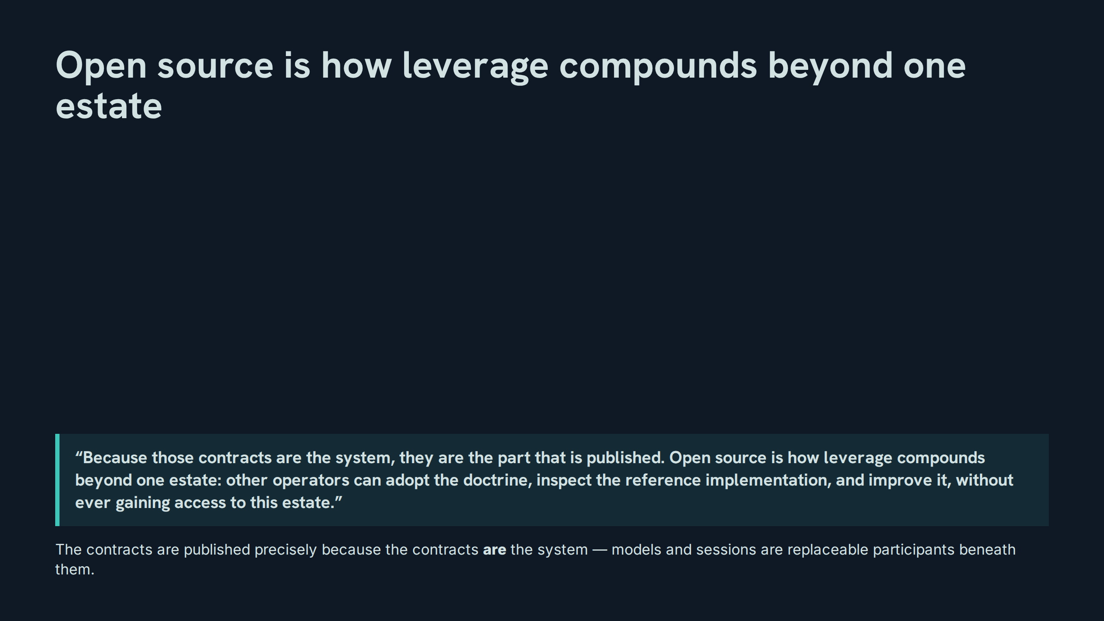
Notes:
Open source is how leverage compounds beyond one estate
Speaker notes: Teaching hook: adoption without access — another operator gains the doctrine and the reference, never the estate. Drill: participants explain, in two sentences, what a second operator receives and what they never receive. Discussion prompt: does publishing the contracts weaken the estate's advantage, or compound it?

Slide 16
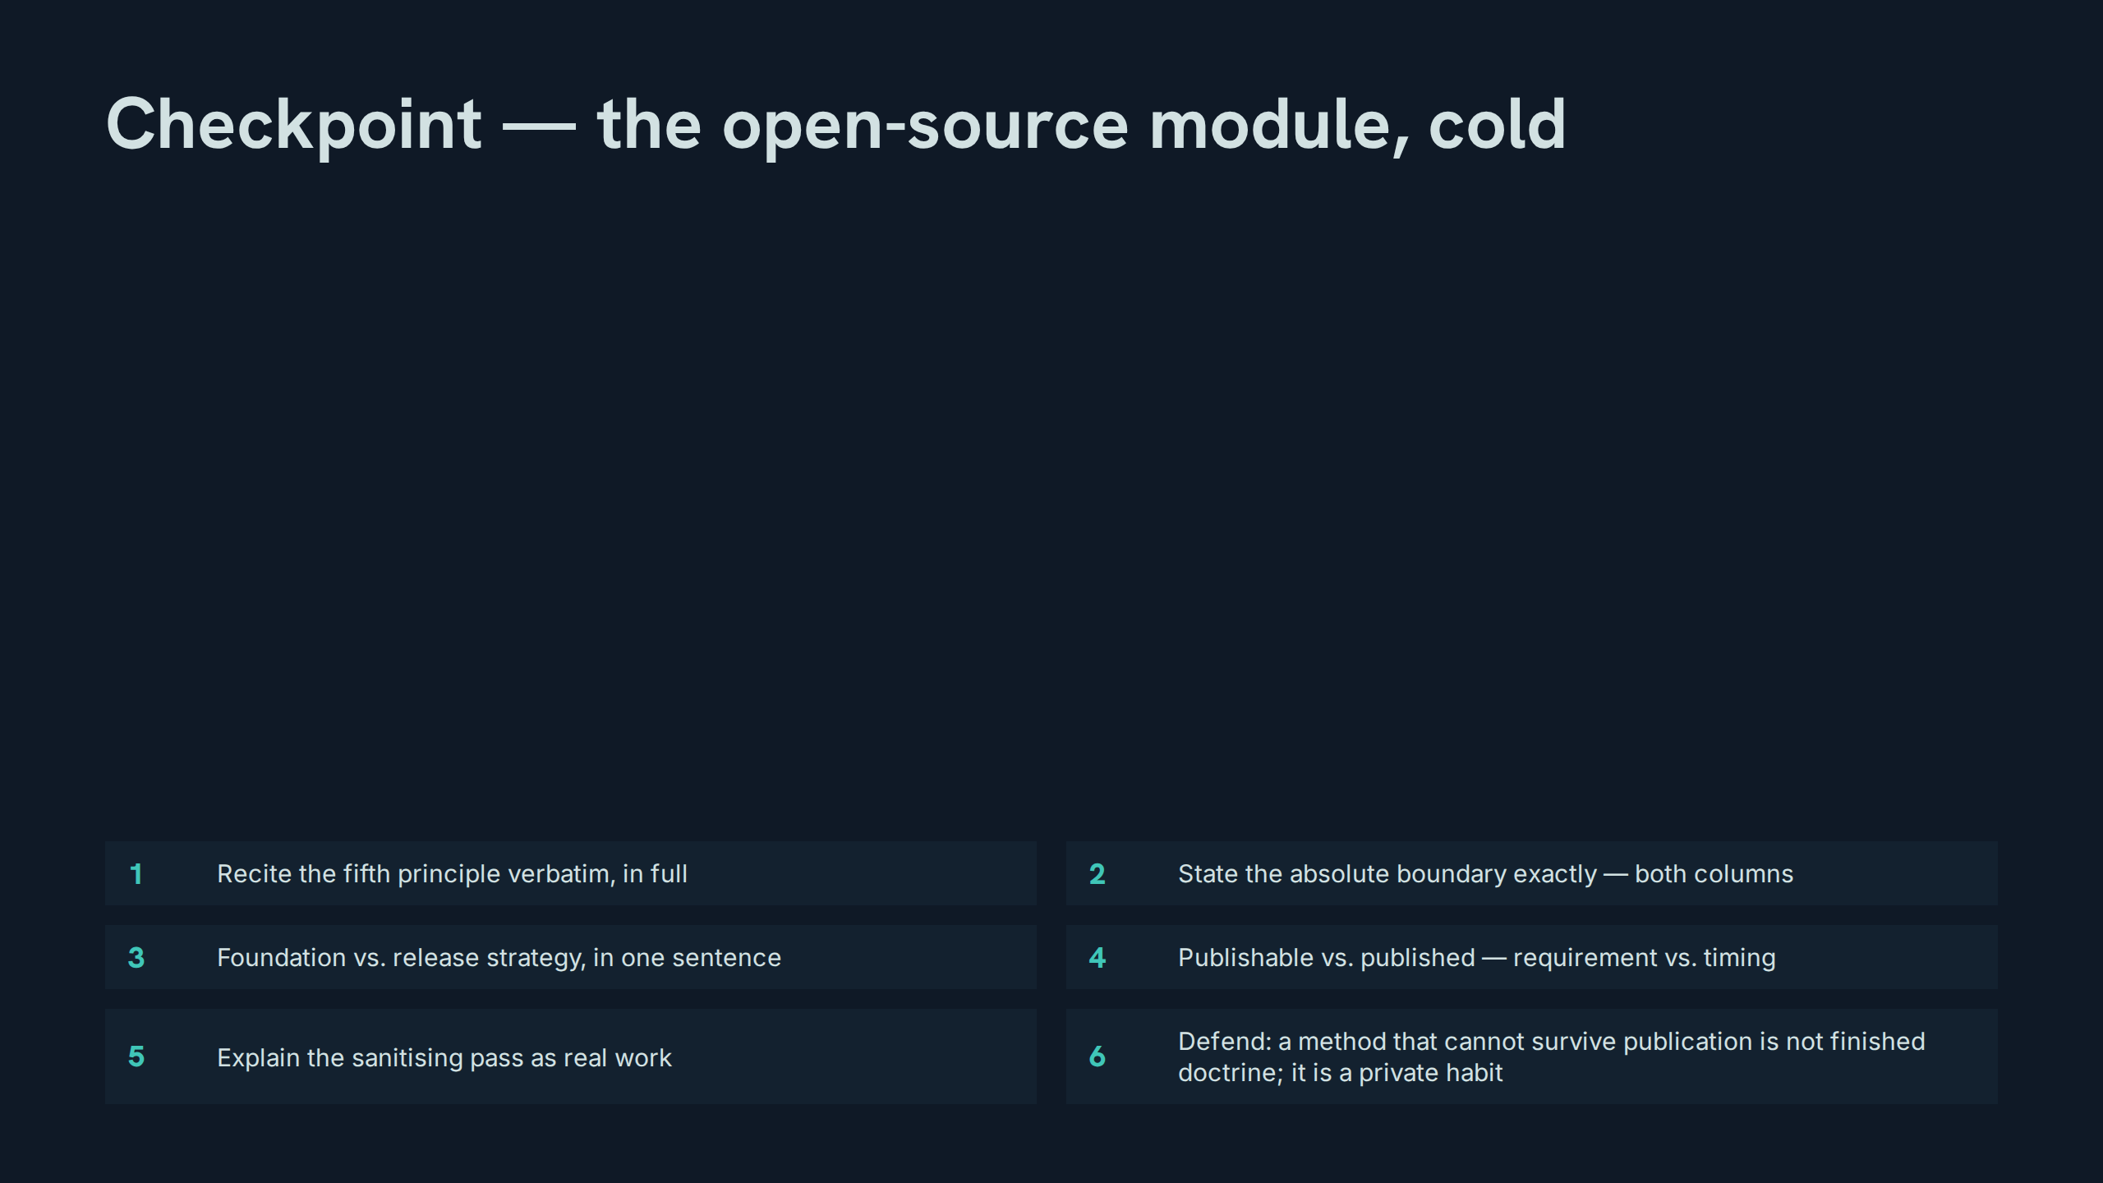
Notes:
Checkpoint — the open-source module, cold
Speaker notes: Drill instructions: run this as a strict checkpoint — no slides back, no prompting; any miss is re-taught on the spot and re-tested before Module 2. Teaching hook: the closing maxim is the module's sharpest line — a method that cannot survive publication is not finished doctrine; it is a private habit. Discussion prompt: which item on this grid was hardest, and what does that reveal?

Slide 17
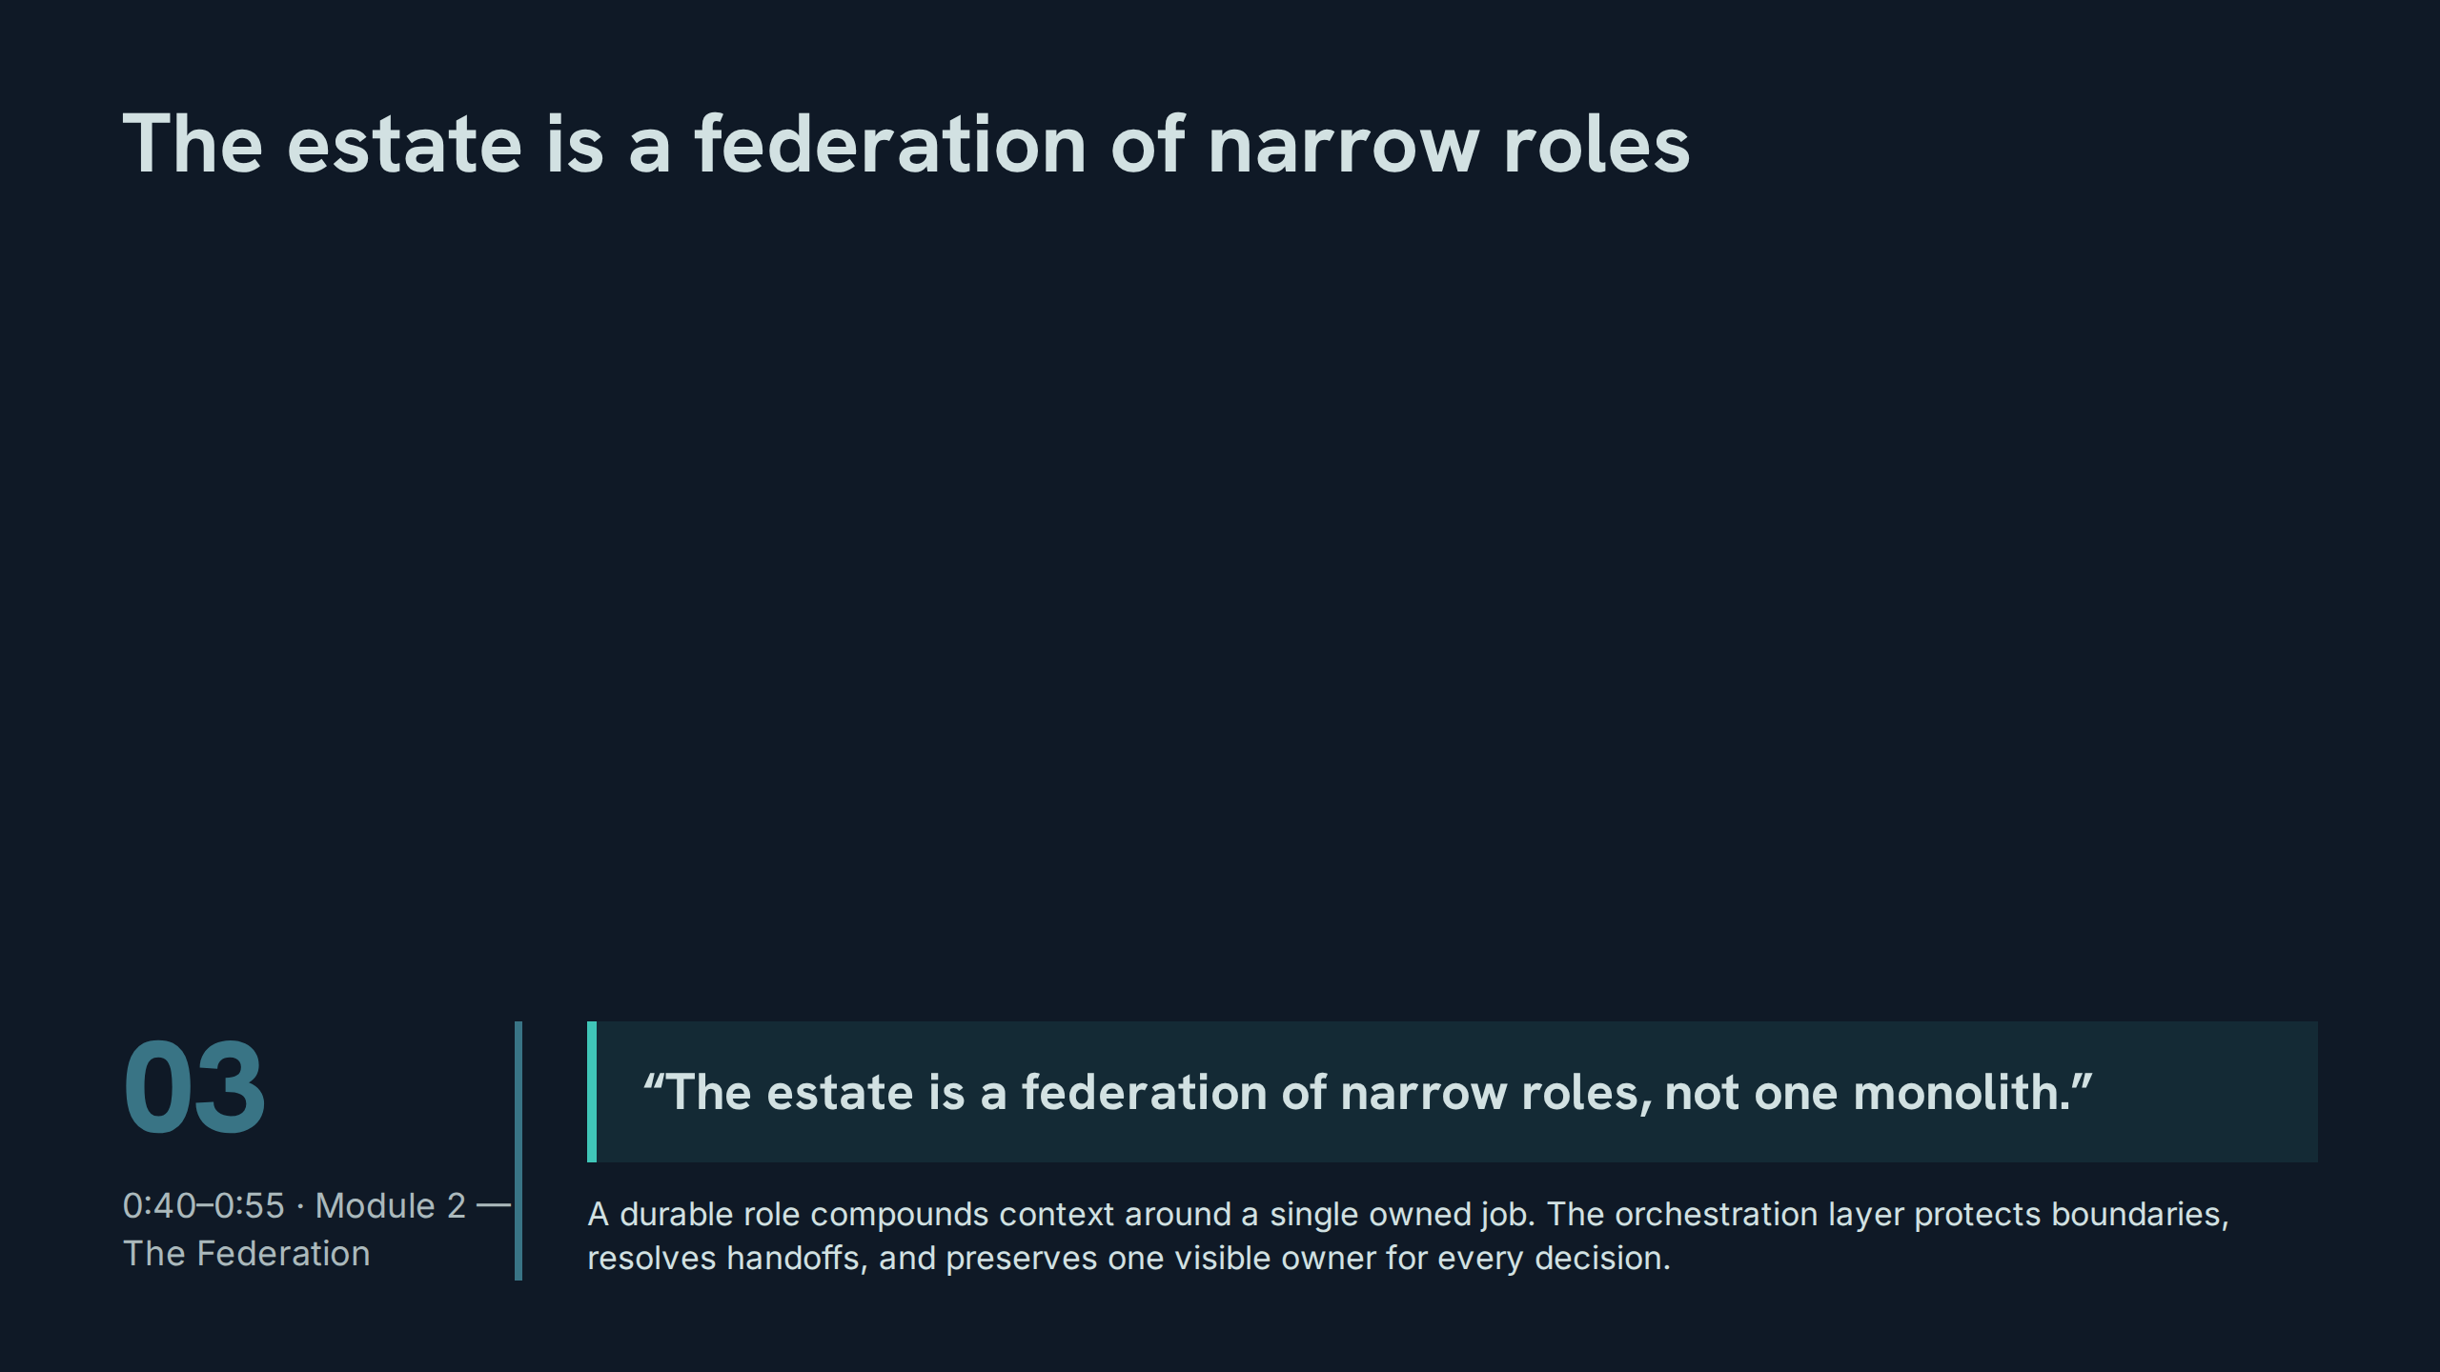
Notes:
The estate is a federation of narrow roles
Speaker notes: Teaching hook: narrowness is the mechanism — a role that owns one job accumulates context that stays relevant, and its failures stay attributable. Drill: contrast the federation sentence with the monolith failures from slide 4, one-to-one. Discussion prompt: what is lost when a role widens 'just this once'?

Slide 18
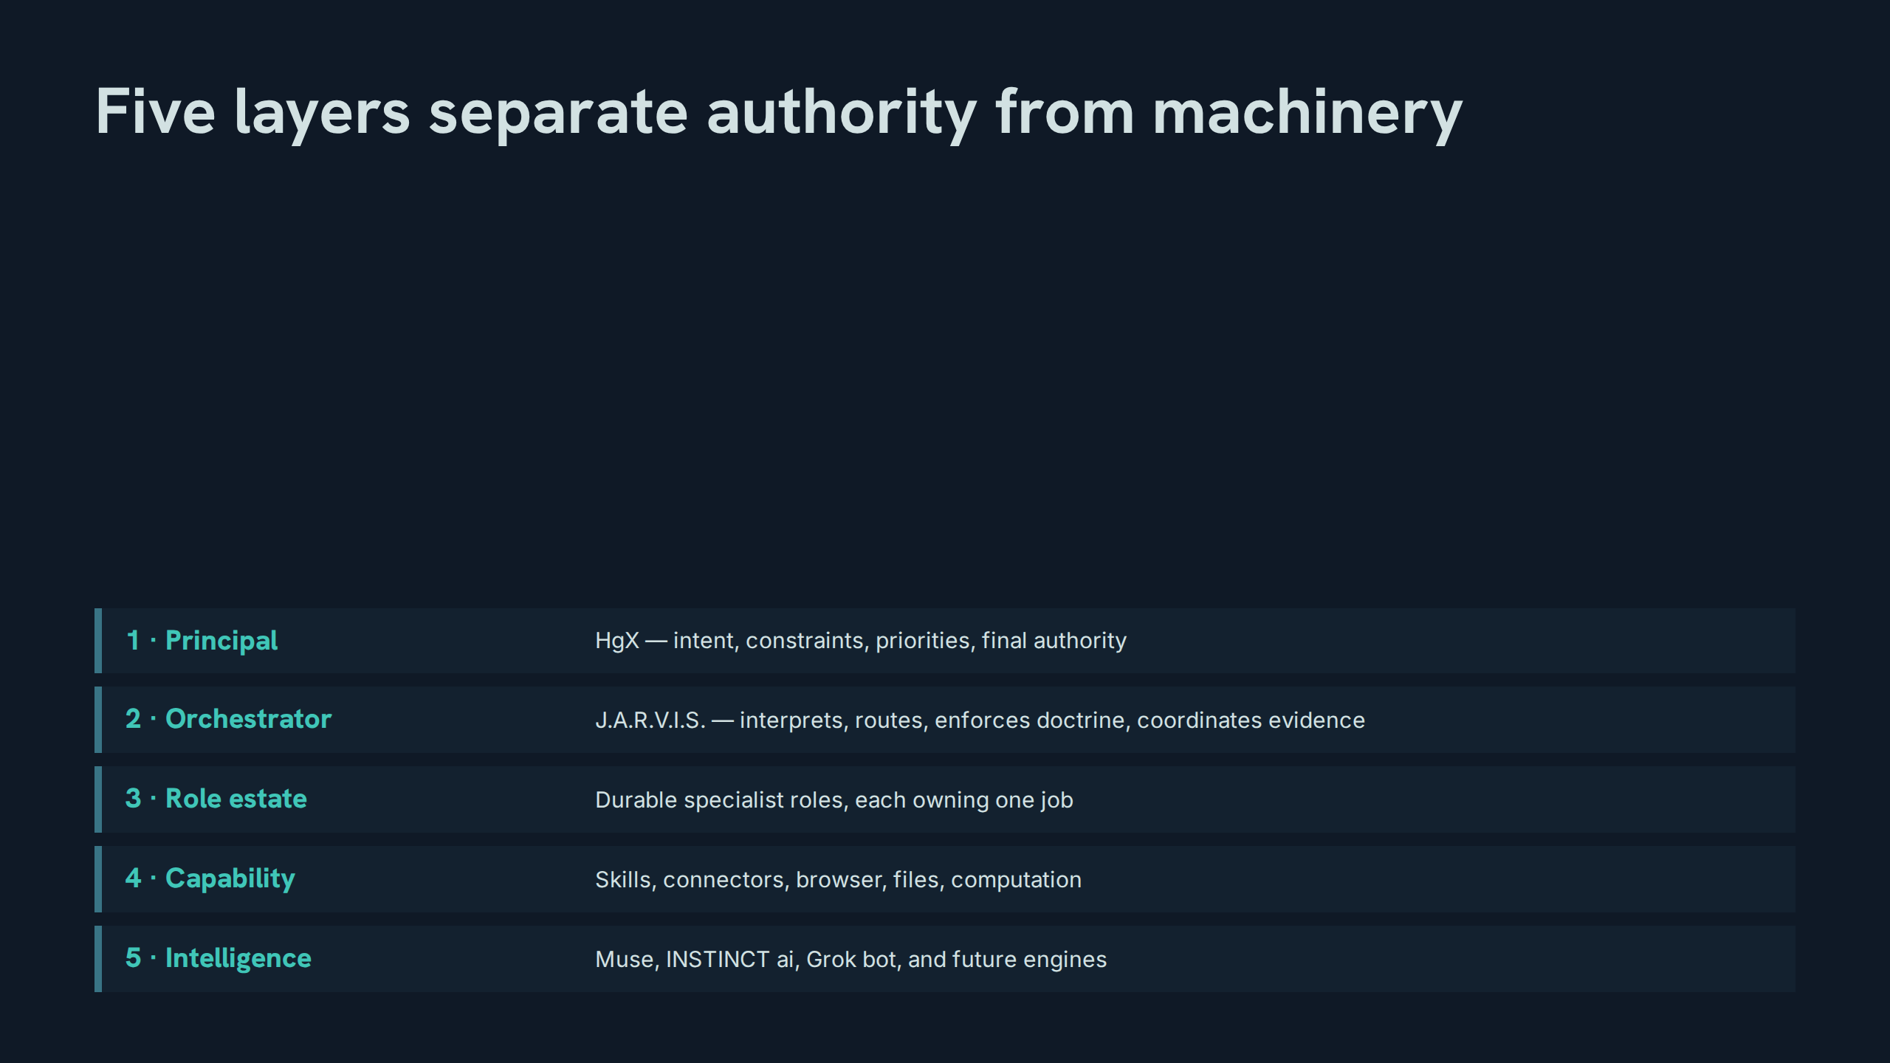
Notes:
Five layers separate authority from machinery
Speaker notes: Teaching hook: read the stack top-down as authority flowing down and evidence flowing up; engines sit at the bottom because they are the most replaceable layer. Drill: recite the five layers in order, then in reverse. Discussion prompt: why is intelligence the lowest layer rather than the top?

Slide 19
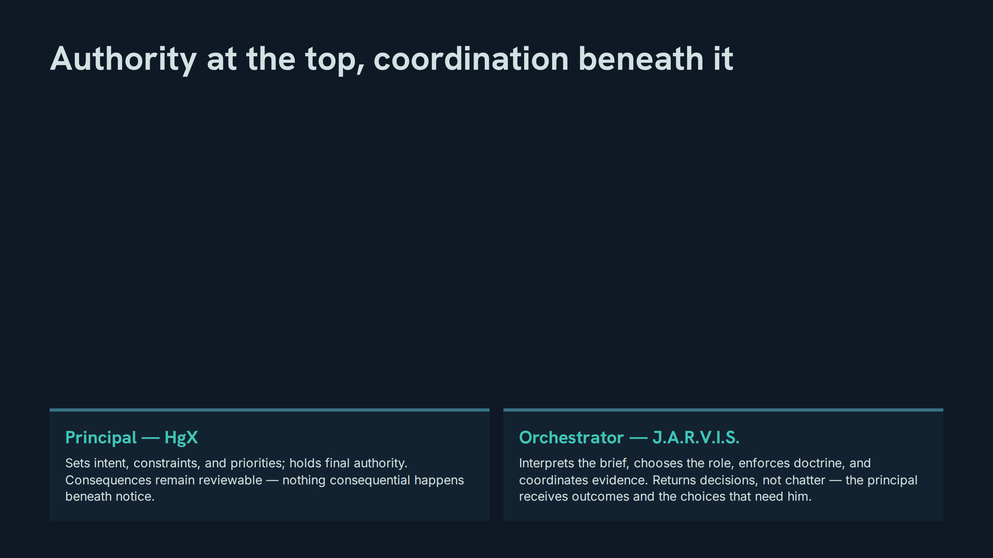
Notes:
Authority at the top, coordination beneath it
Speaker notes: Teaching hook: 'returns decisions, not chatter' is the orchestrator's output contract — it is what attention protection looks like at layer 2. Drill: participants rewrite a chatty status update as a decision return. Discussion prompt: when should the orchestrator return a question instead of a decision?

Slide 20
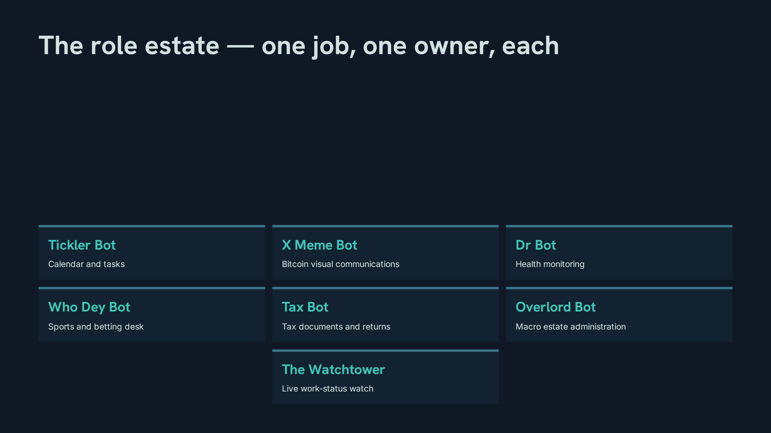
Notes:
The role estate — one job, one owner, each
Speaker notes: Teaching hook: the roster is the federation made concrete — every name on this slide is a narrow contract, not a persona. Drill: name each role's owned job from memory; then name which role a sample request routes to, and why. Discussion prompt: what request would tempt two roles to claim the same job, and who resolves it?

Slide 21
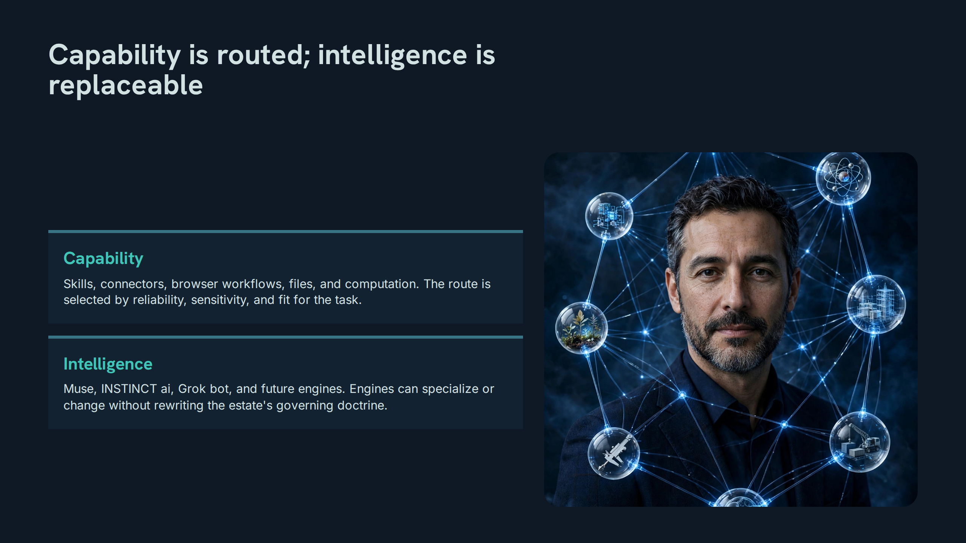
Notes:
Capability is routed; intelligence is replaceable
Speaker notes: Teaching hook: capability choices are engineering decisions (reliability, sensitivity, fit); intelligence choices are procurement decisions — neither rewrites doctrine. Drill: for a sample task, participants justify a capability route on all three criteria. Discussion prompt: what breaks if an engine is swapped mid-estate? (Nothing contractual — that is the point.)

Slide 22
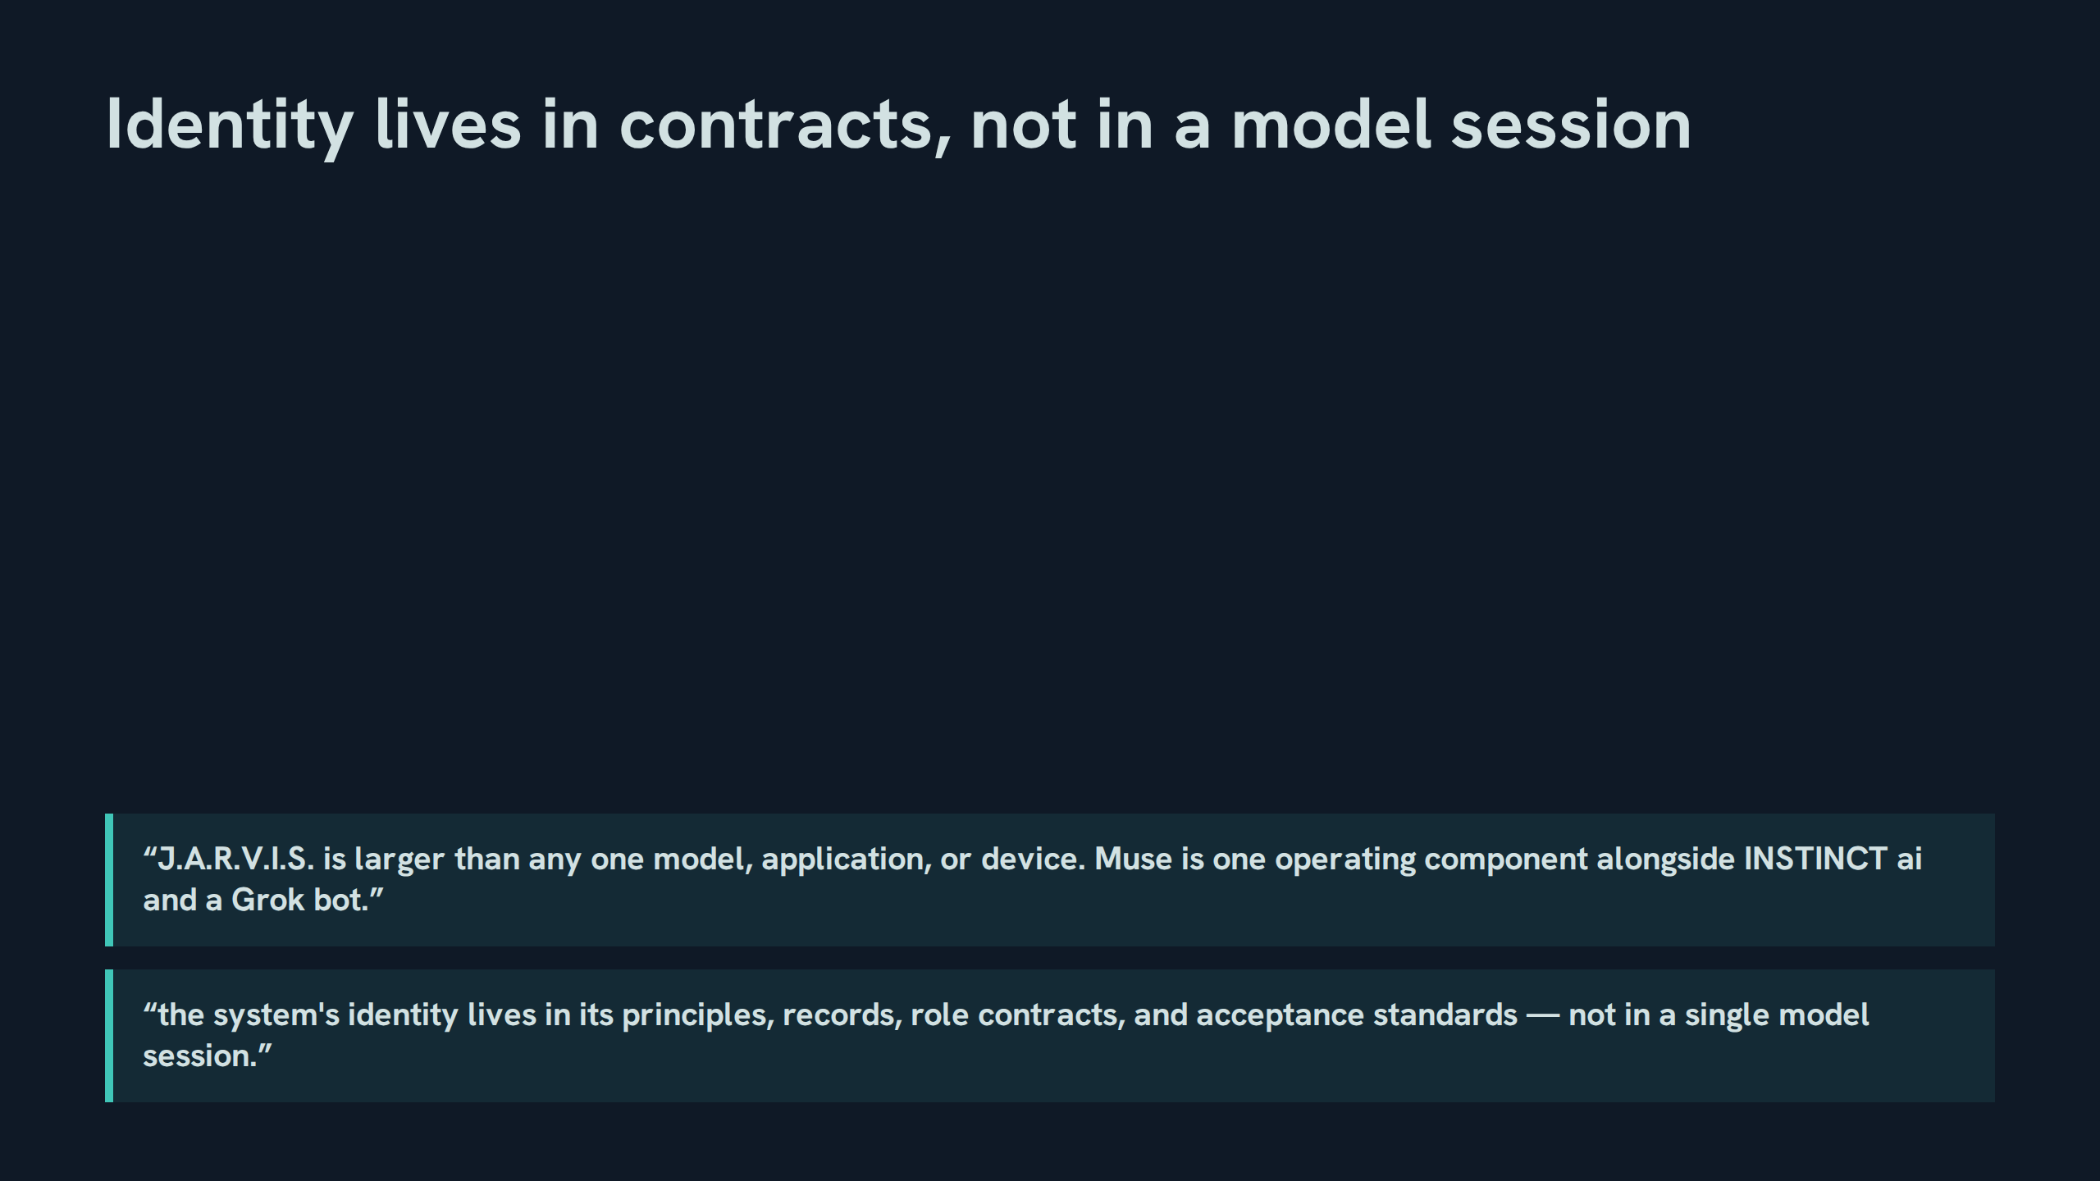
Notes:
Identity lives in contracts, not in a model session
Speaker notes: Teaching hook: sessions end; contracts persist — that asymmetry is the whole continuity strategy. Drill: participants list the four identity carriers from the second quote (principles, records, role contracts, acceptance standards). Discussion prompt: what would falsify the claim that identity lives in contracts?

Slide 23
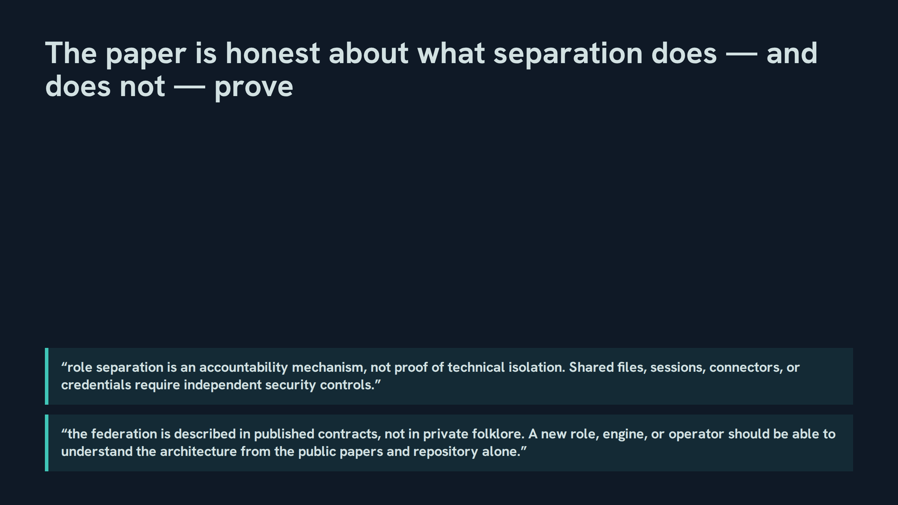
Notes:
The paper is honest about what separation does — and does not — prove
Speaker notes: Teaching hook: this is the paper's intellectual honesty on display: role separation is accountability, and the v1.2 open-architecture rule makes the federation legible to a stranger from public materials alone. Drill: state both rules without notes. Discussion prompt: name a shared-infrastructure risk in the current estate and the independent control it requires.

Slide 24
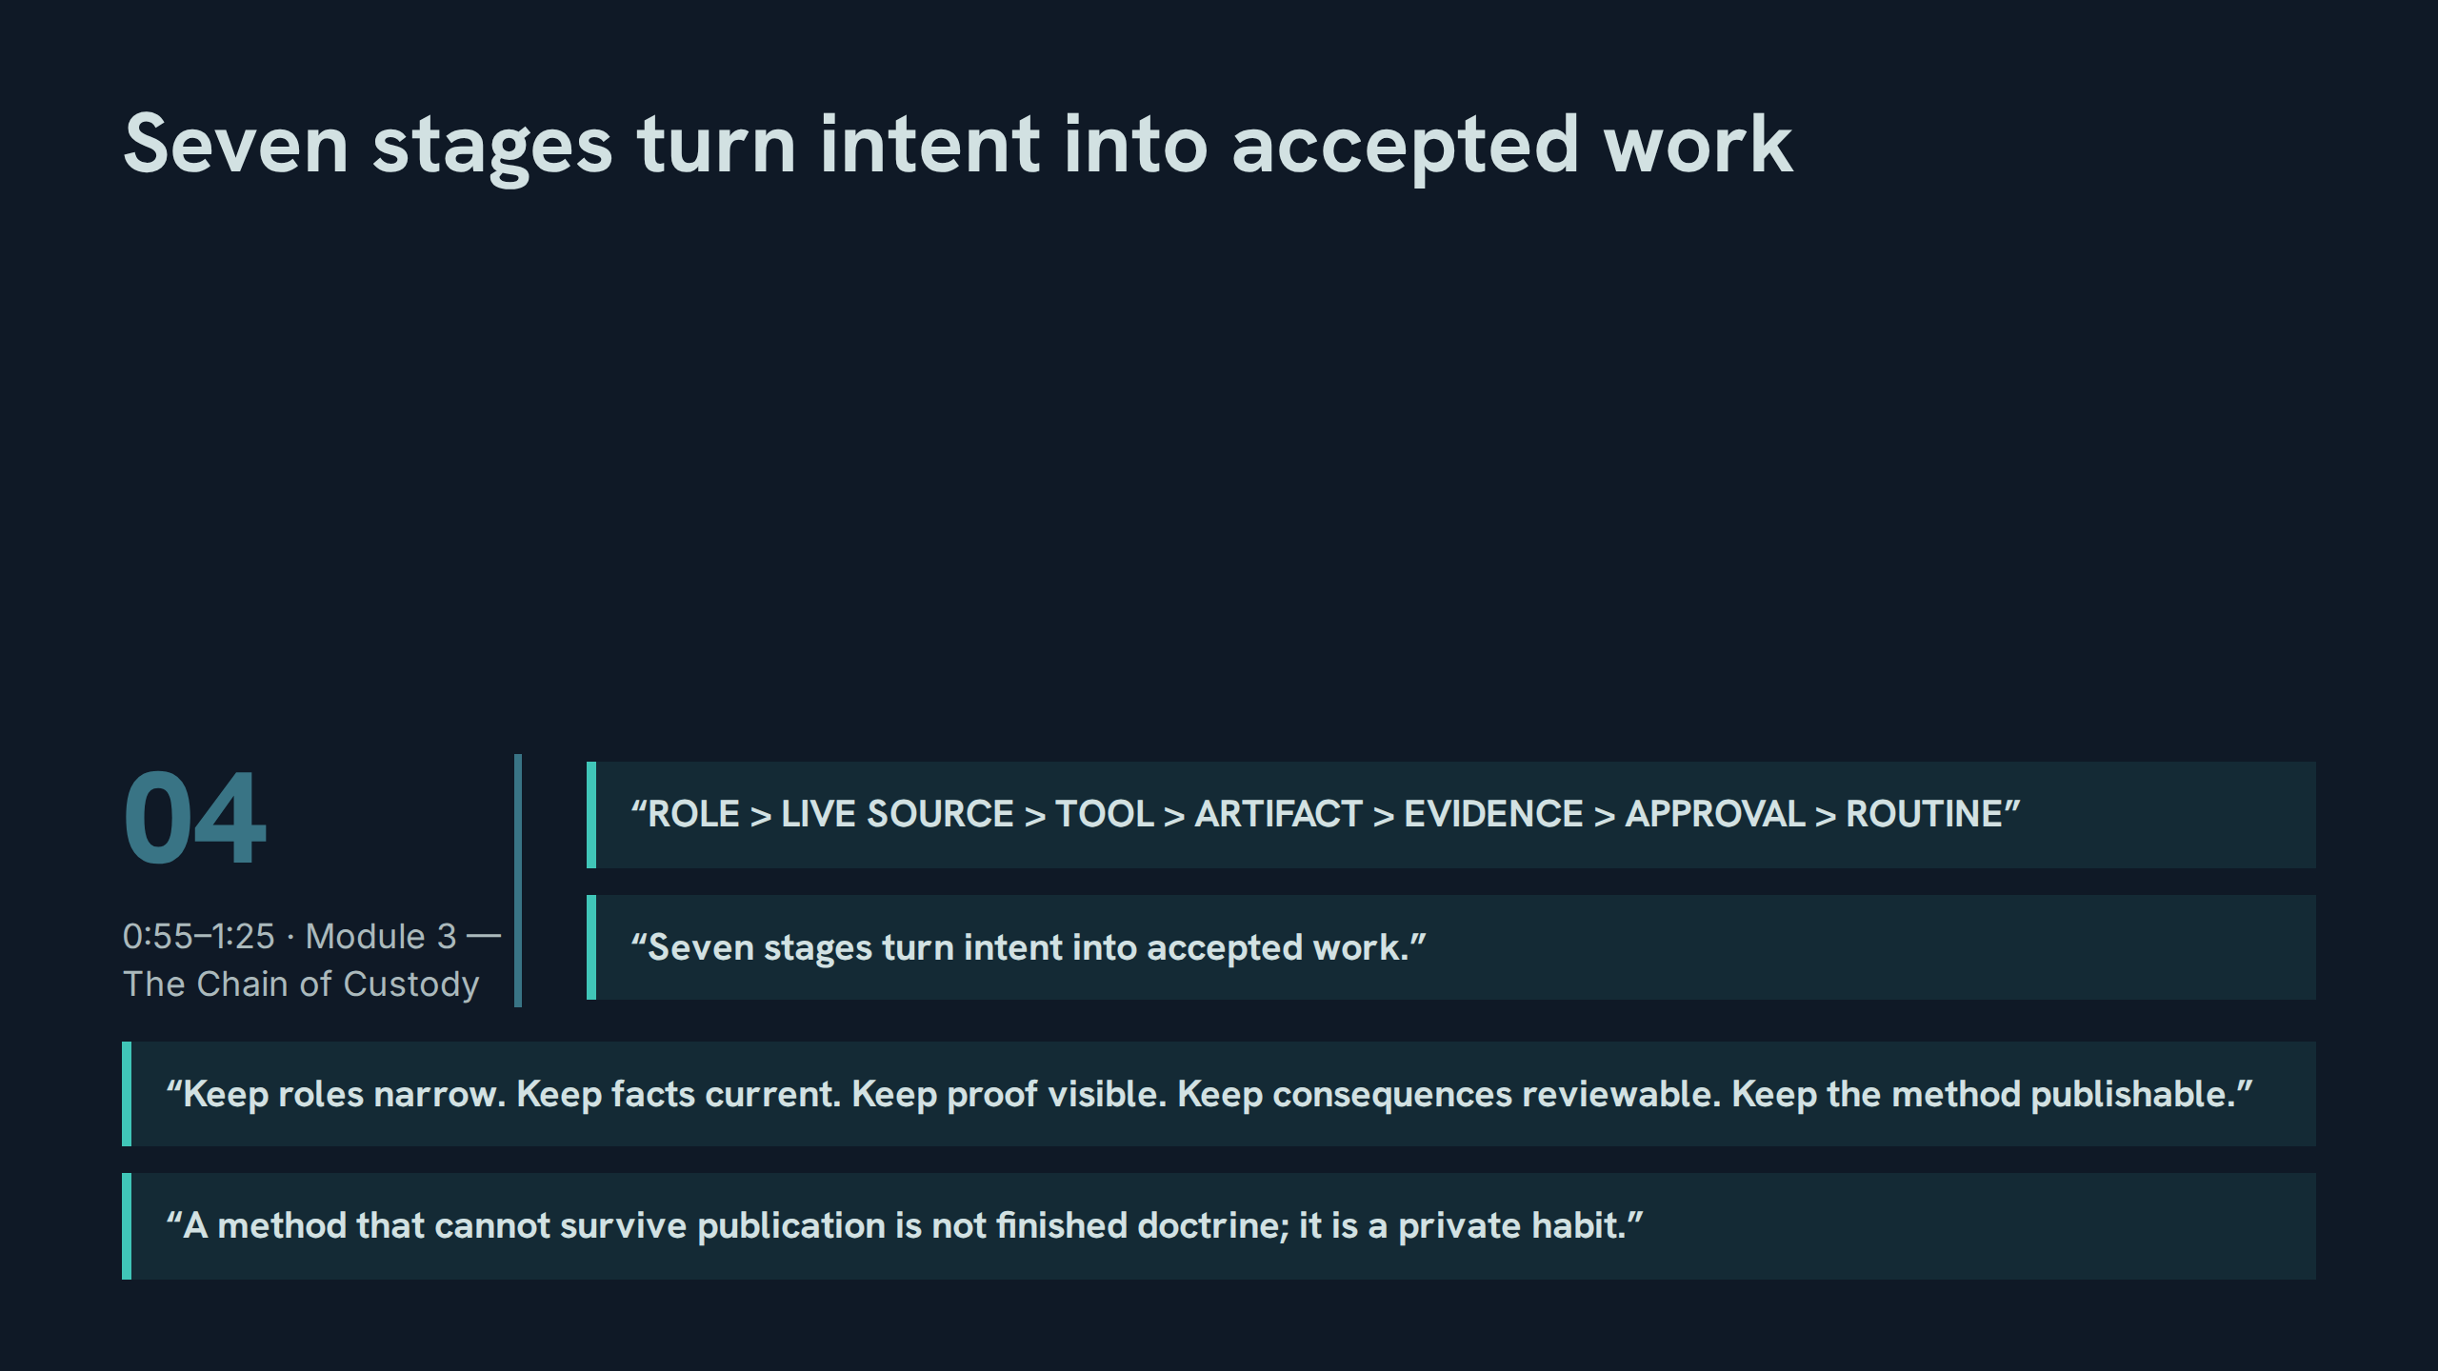
Notes:
Seven stages turn intent into accepted work
Speaker notes: Teaching hook: the chain is a chain of custody — each stage answers a different question, and skipping one creates a predictable failure, which the next seven slides prove one stage at a time. Drill: recite the seven stages and the five-part maxim together, aloud. Discussion prompt: the maxim's fifth clause — 'keep the method publishable' — is v1.2's addition in spirit; what does it demand of stages 1–4?

Slide 25
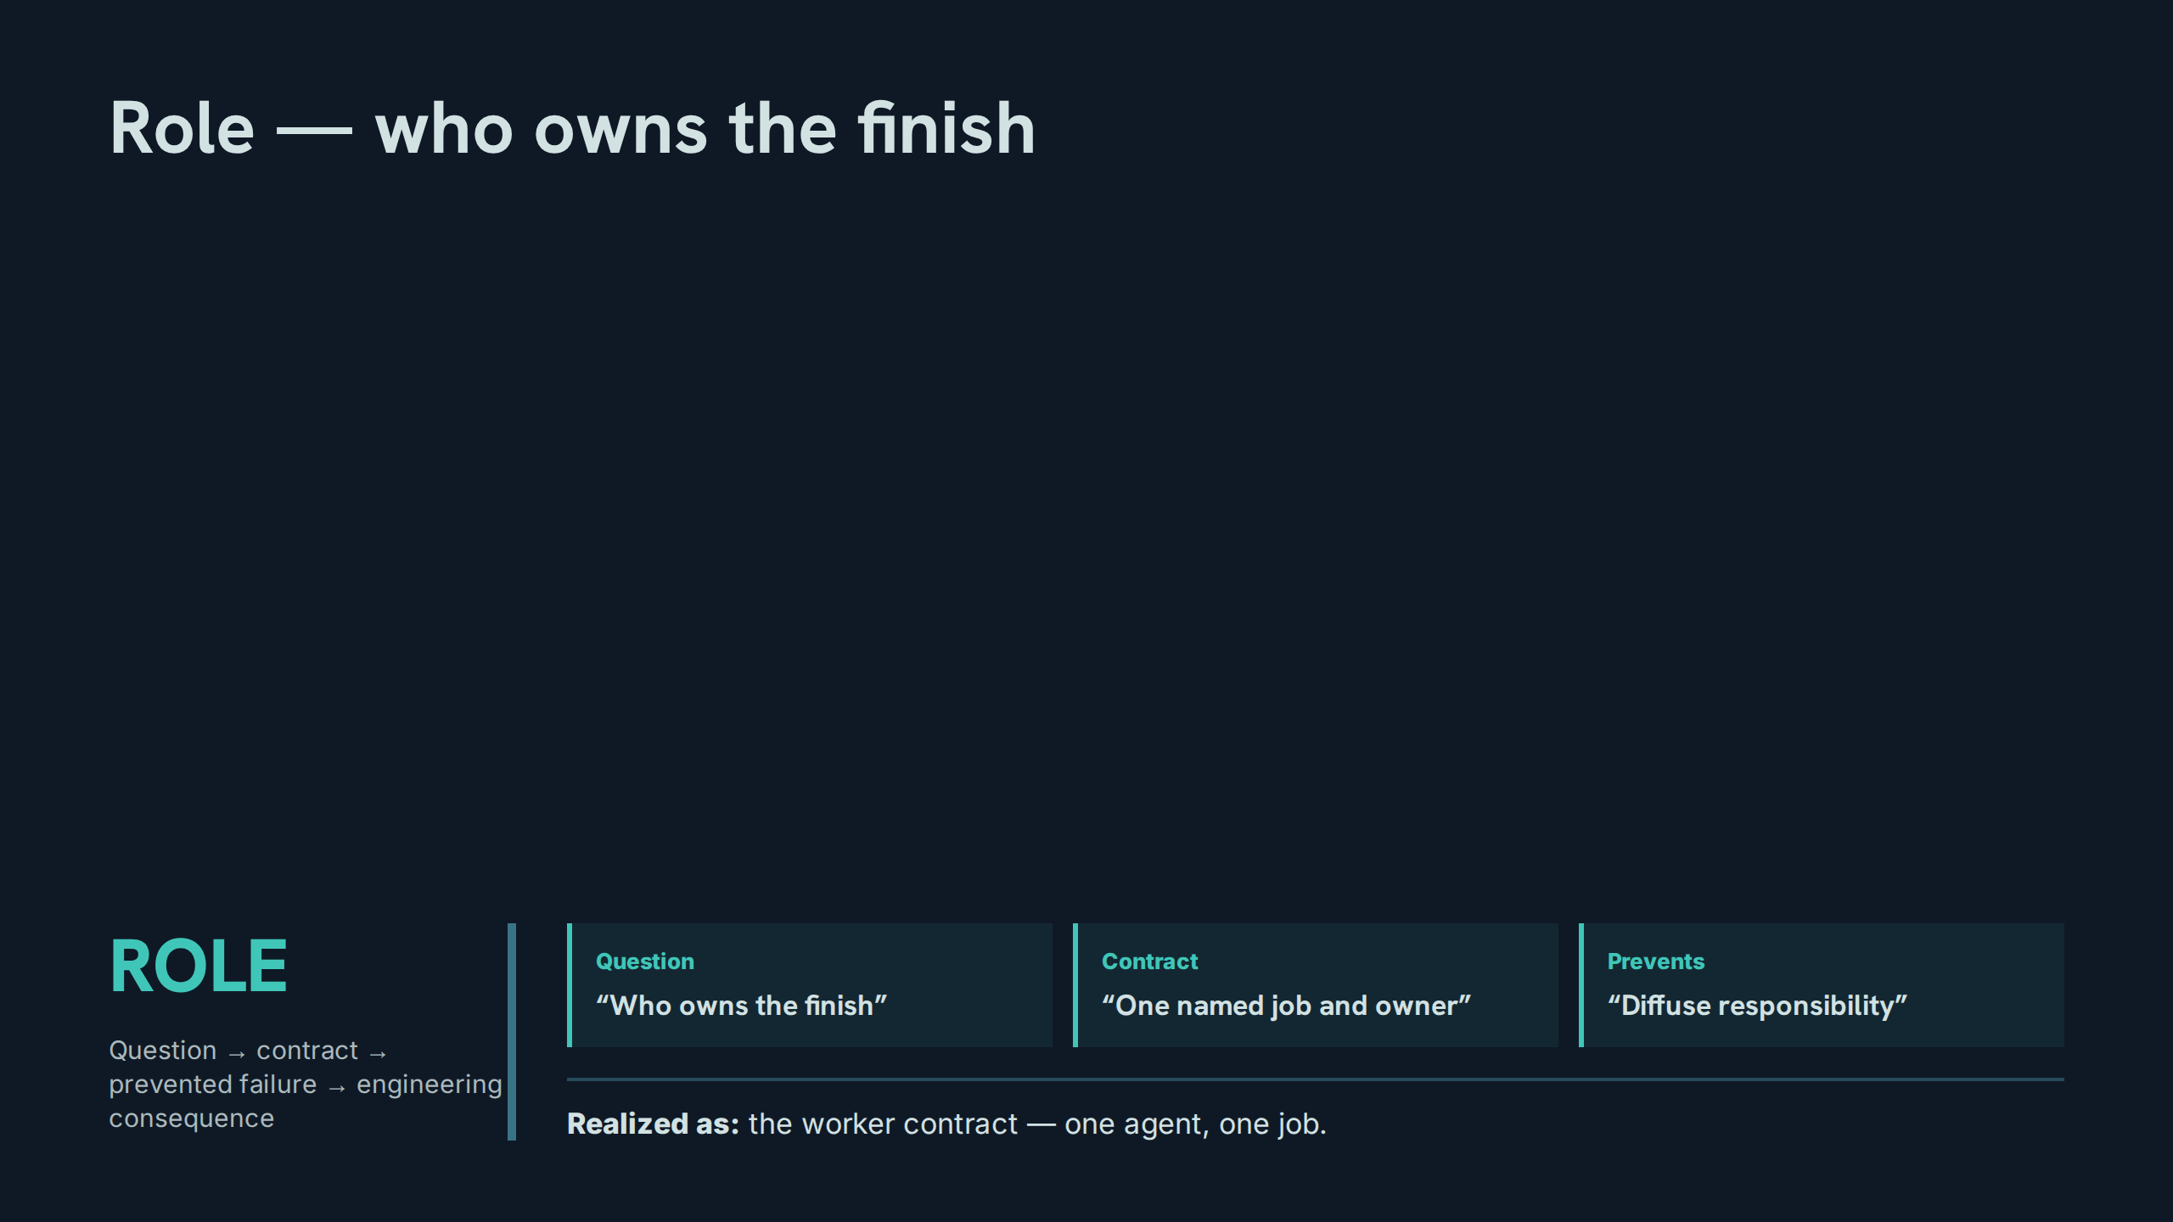
Notes:
Role — who owns the finish
Speaker notes: Teaching hook: ownership is assigned before work begins, not discovered after it fails. Drill: for a sample multi-part request, participants name the single owner of the finish line. Discussion prompt: what exactly goes wrong in the handoff when two roles both 'partly' own a job?

Slide 26
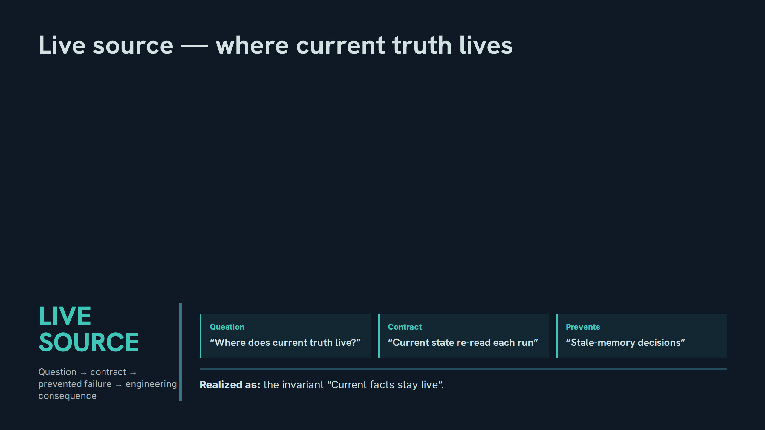
Notes:
Live source — where current truth lives
Speaker notes: Teaching hook: memory tells the role how to work; only the live source tells it what is true — every run re-reads. Drill: classify six facts as memory or live-source (a preference, a balance, a deadline, a standing rule, a score, an approval status). Discussion prompt: which fact class causes the most stale-memory damage in practice?

Slide 27
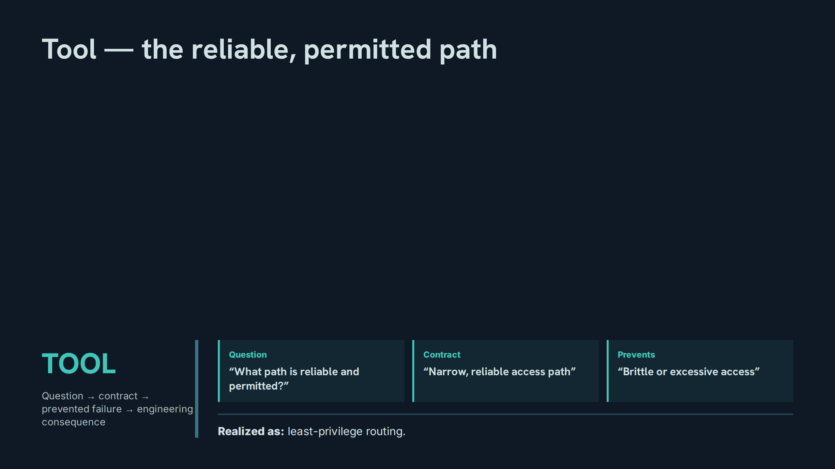
Notes:
Tool — the reliable, permitted path
Speaker notes: Teaching hook: the tool question has two halves — reliable and permitted — and a path that fails either half is the wrong path. Drill: rank three access paths for a sensitive task by narrowness and reliability. Discussion prompt: when does the most capable tool become the wrong tool?

Slide 28
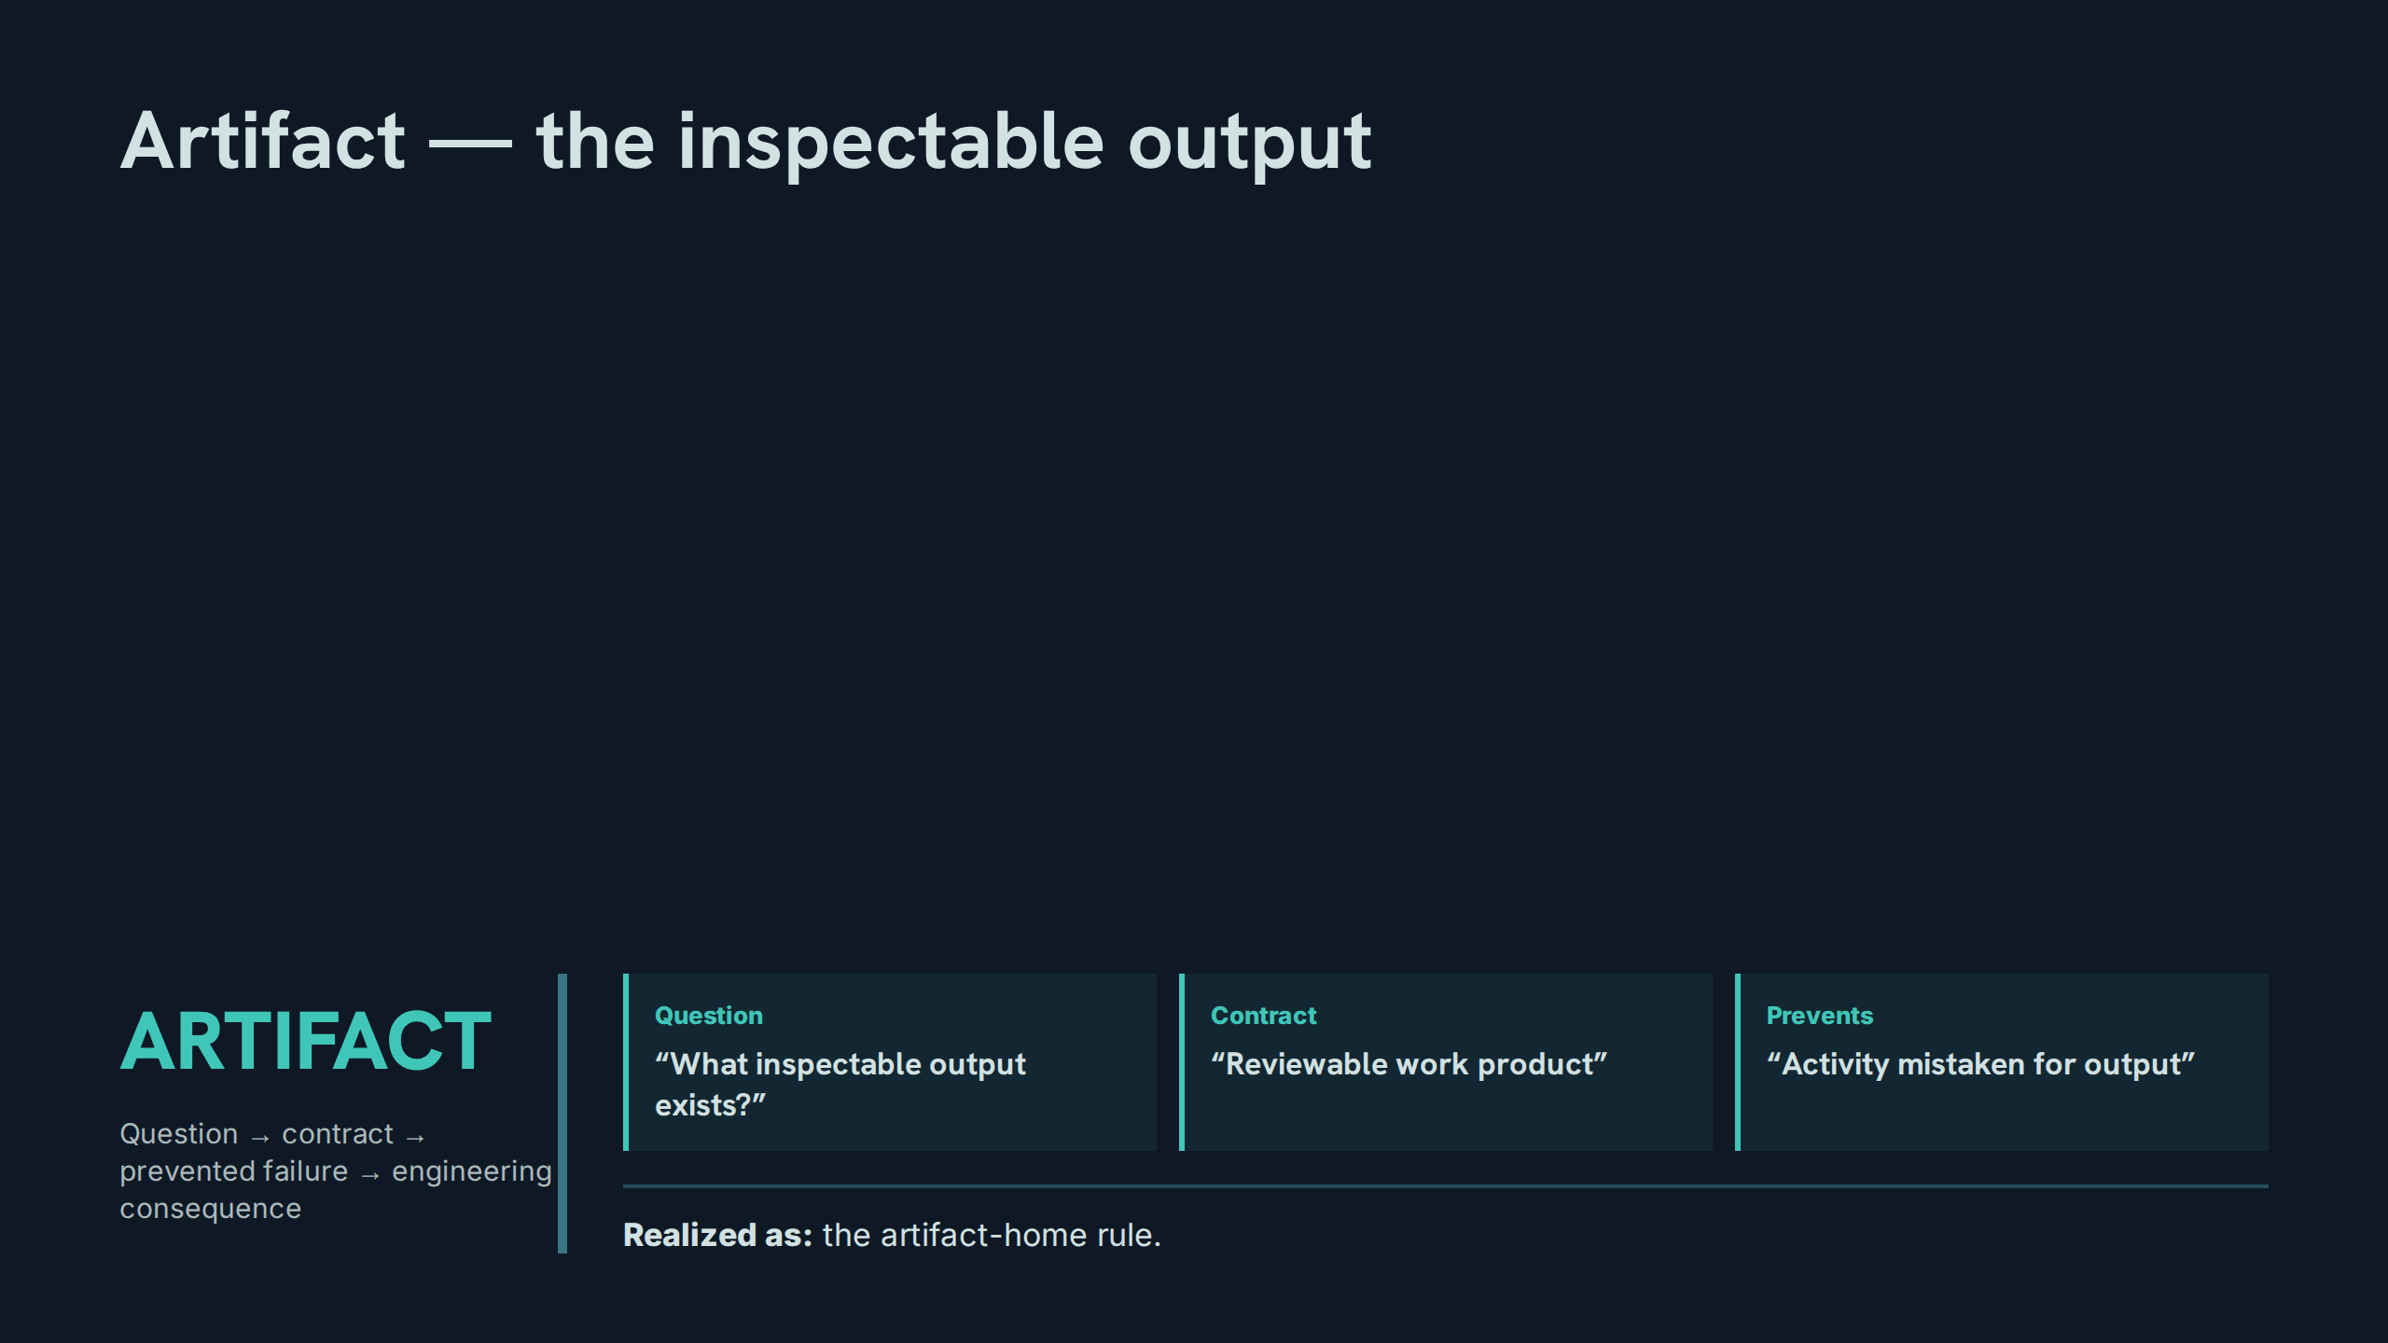
Notes:
Artifact — the inspectable output
Speaker notes: Teaching hook: if no inspectable output exists, there is activity, not work — the artifact is what review actually reviews. Drill: participants name the artifact for five recent estate tasks; any task without one is the lesson. Discussion prompt: what makes an artifact reviewable rather than merely present?

Slide 29
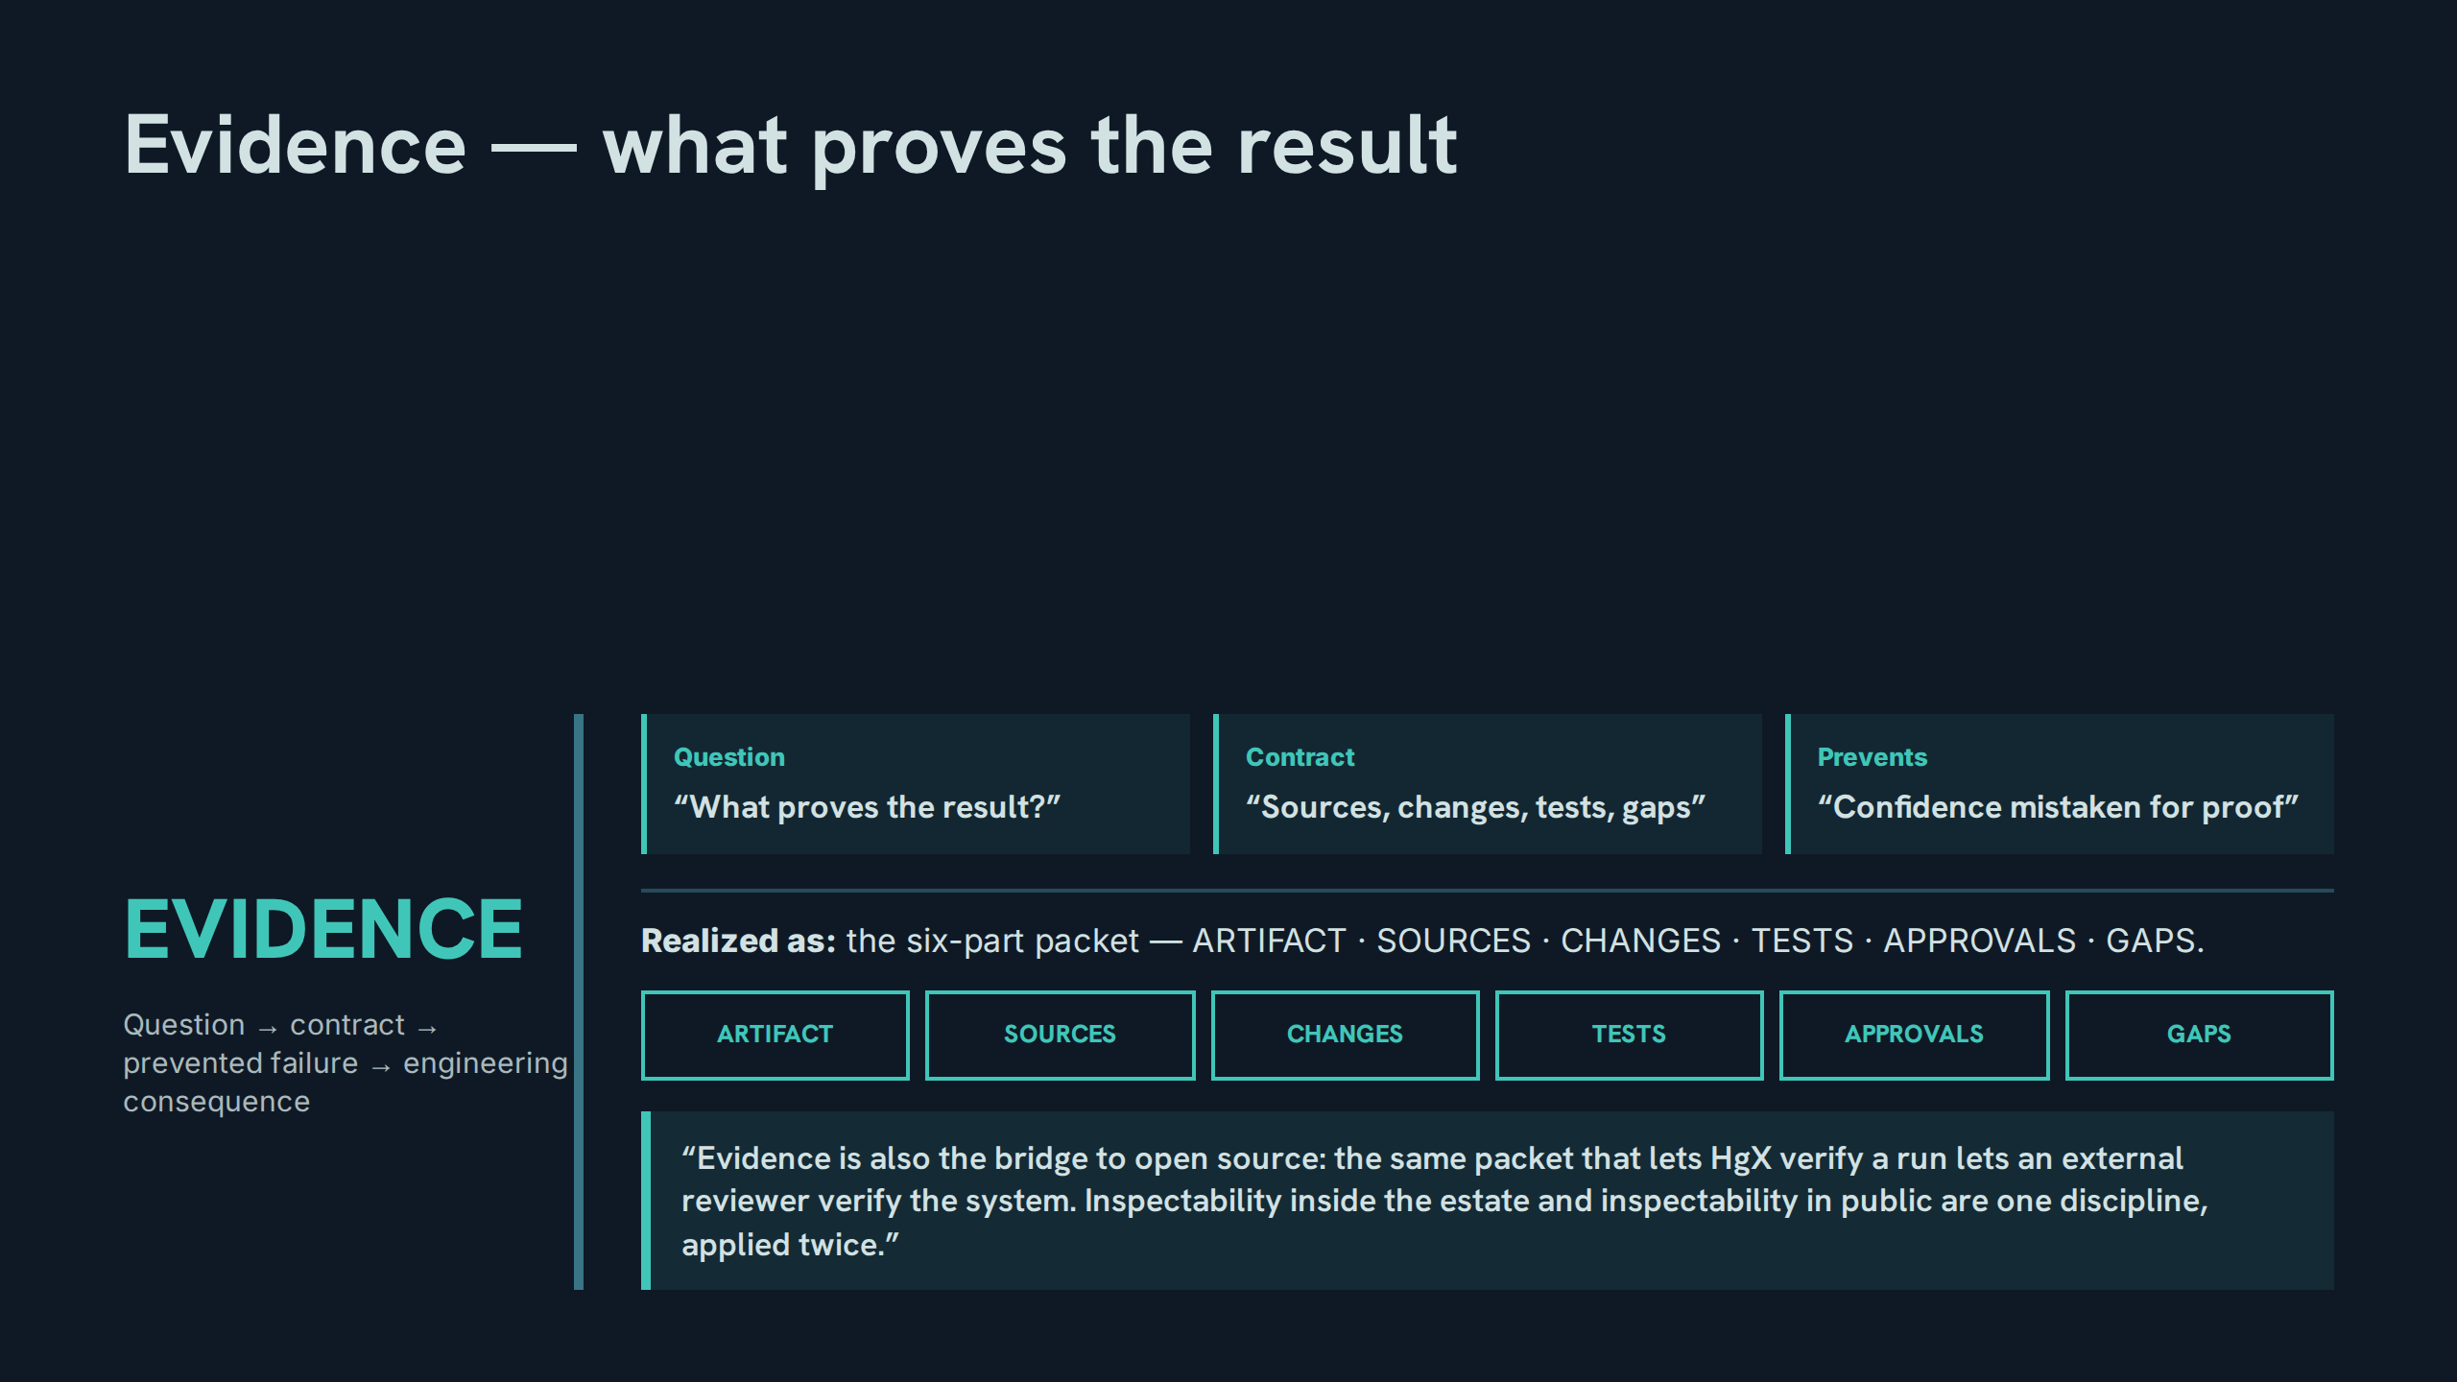
Notes:
Evidence — what proves the result
Speaker notes: Teaching hook: the packet is the unit of trust, and v1.2 makes it the bridge to open source — one discipline, applied twice. Drill: assemble a packet verbally for a completed task, naming all six parts. Discussion prompt: which part of the packet is most often quietly dropped, and what does its absence hide?

Slide 30
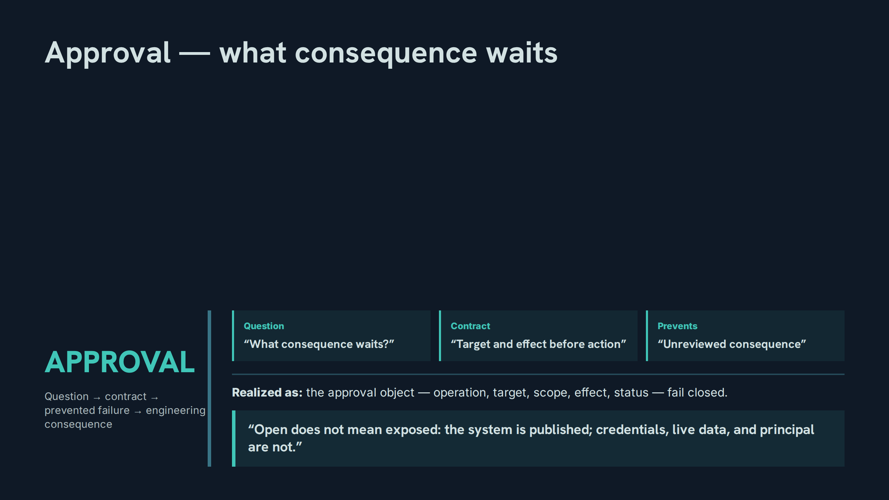
Notes:
Approval — what consequence waits
Speaker notes: Teaching hook: approval binds to the named action, not to a general intention — and the object fails closed: no object, no action. Drill: construct an approval object for a sample send, naming all five fields. Discussion prompt: why must 'open' never mean 'exposed' at this stage of the chain?

Slide 31
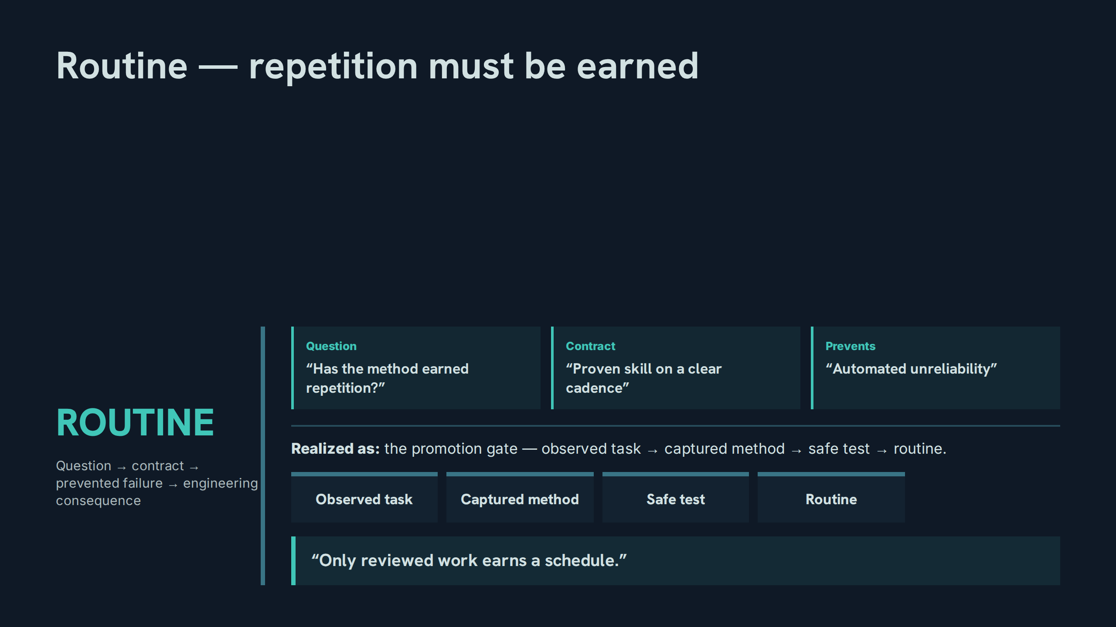
Notes:
Routine — repetition must be earned
Speaker notes: Teaching hook: automation amplifies whatever it touches, so the gate exists to keep unreliability manual and visible. Drill: walk a sample skill through the four gate stages and name the evidence at each. Discussion prompt: what cadence evidence should demote a routine back to manual?

Slide 32
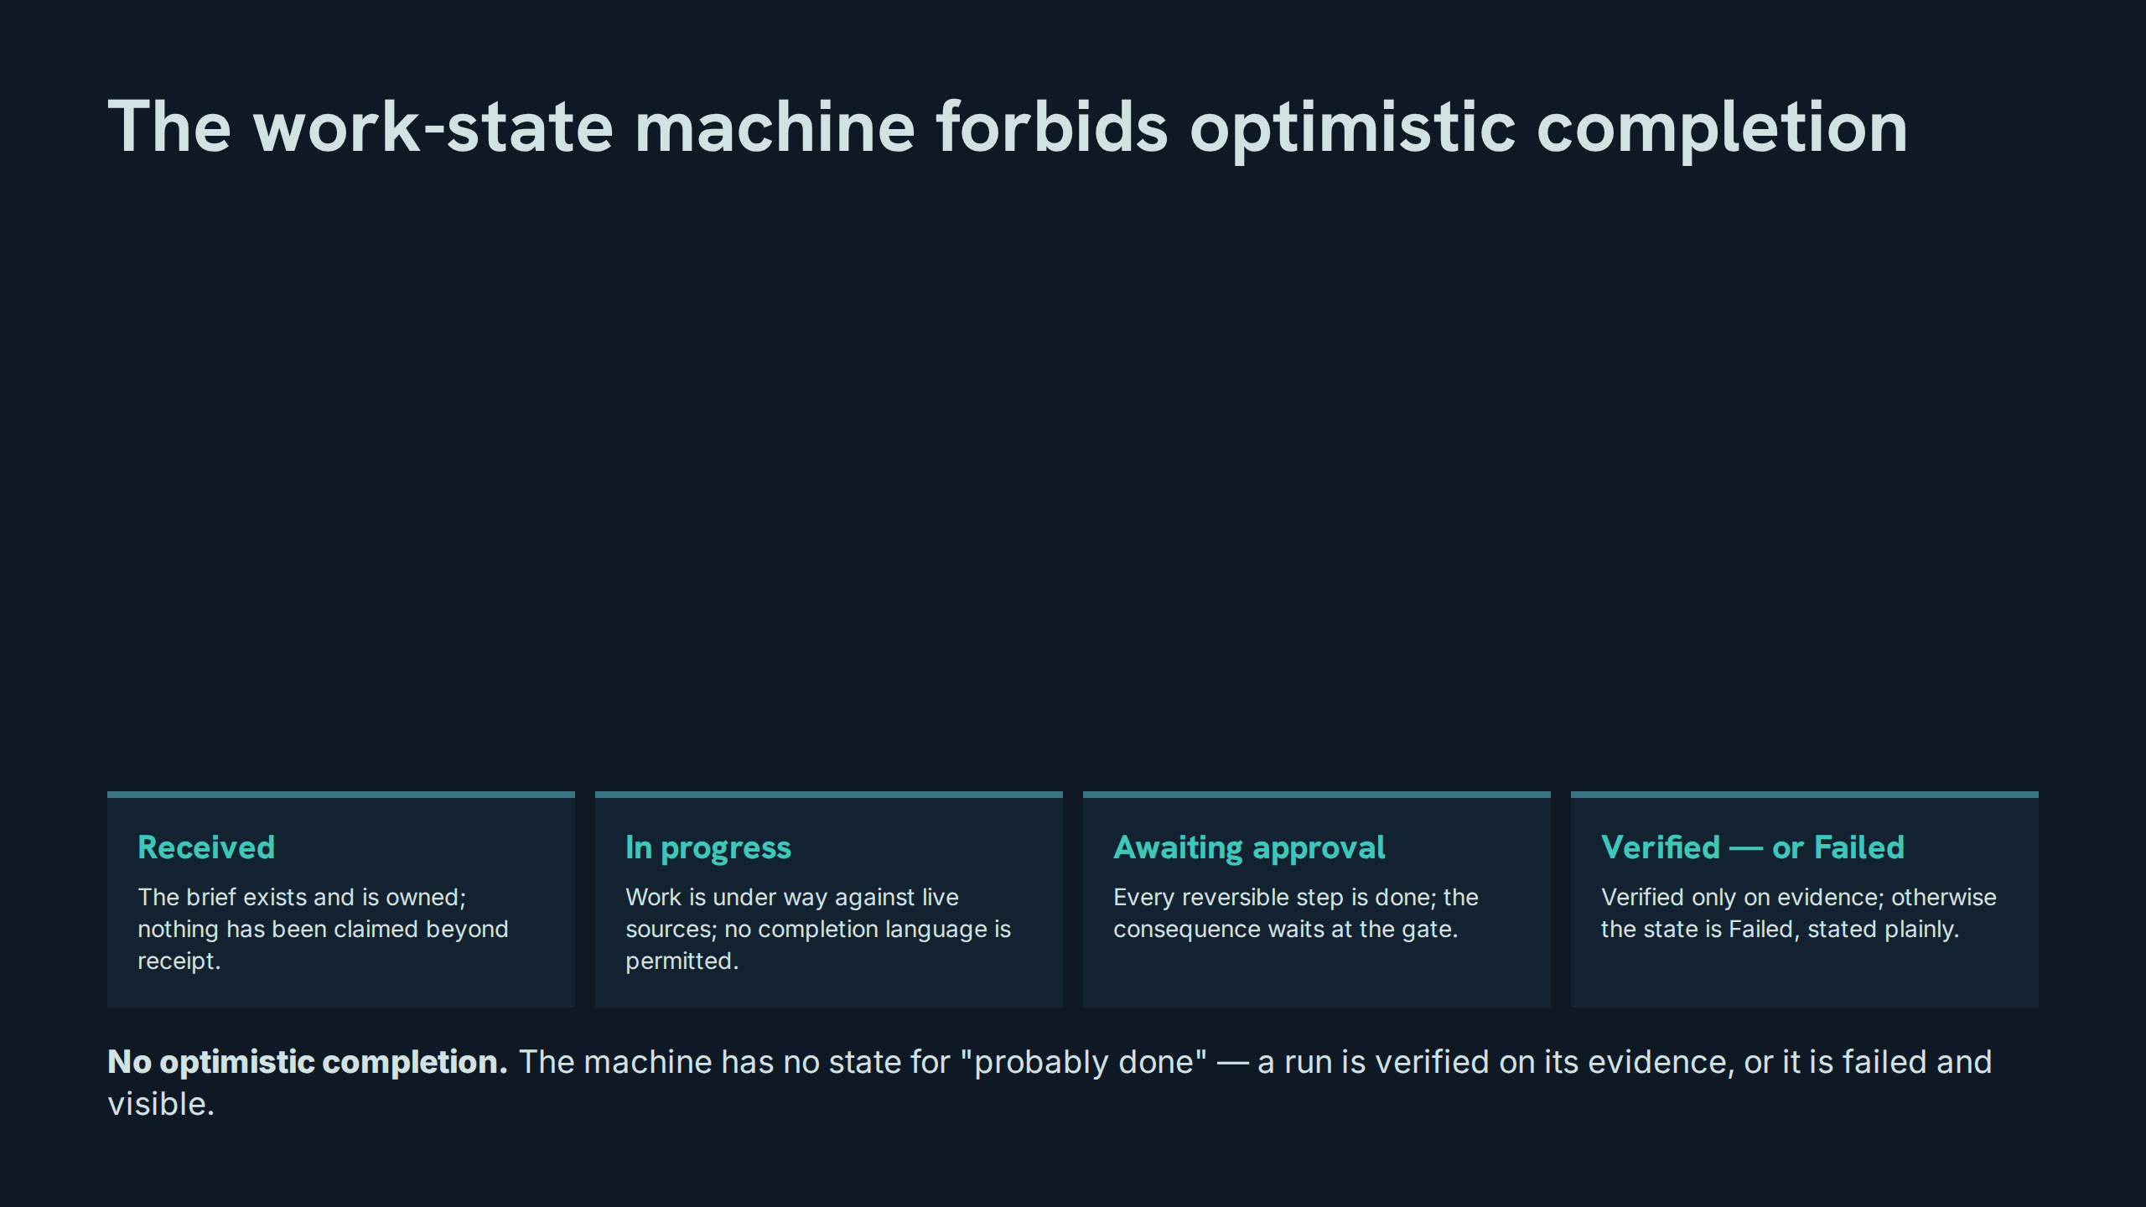
Notes:
The work-state machine forbids optimistic completion
Speaker notes: Teaching hook: four states, no fifth for wishful thinking — the absence of a 'nearly done' state is a deliberate control. Drill: place five sample status reports into the correct state; reject any that smuggle in optimism. Discussion prompt: which transition is most often faked in agent systems, and what evidence should gate it?

Slide 33
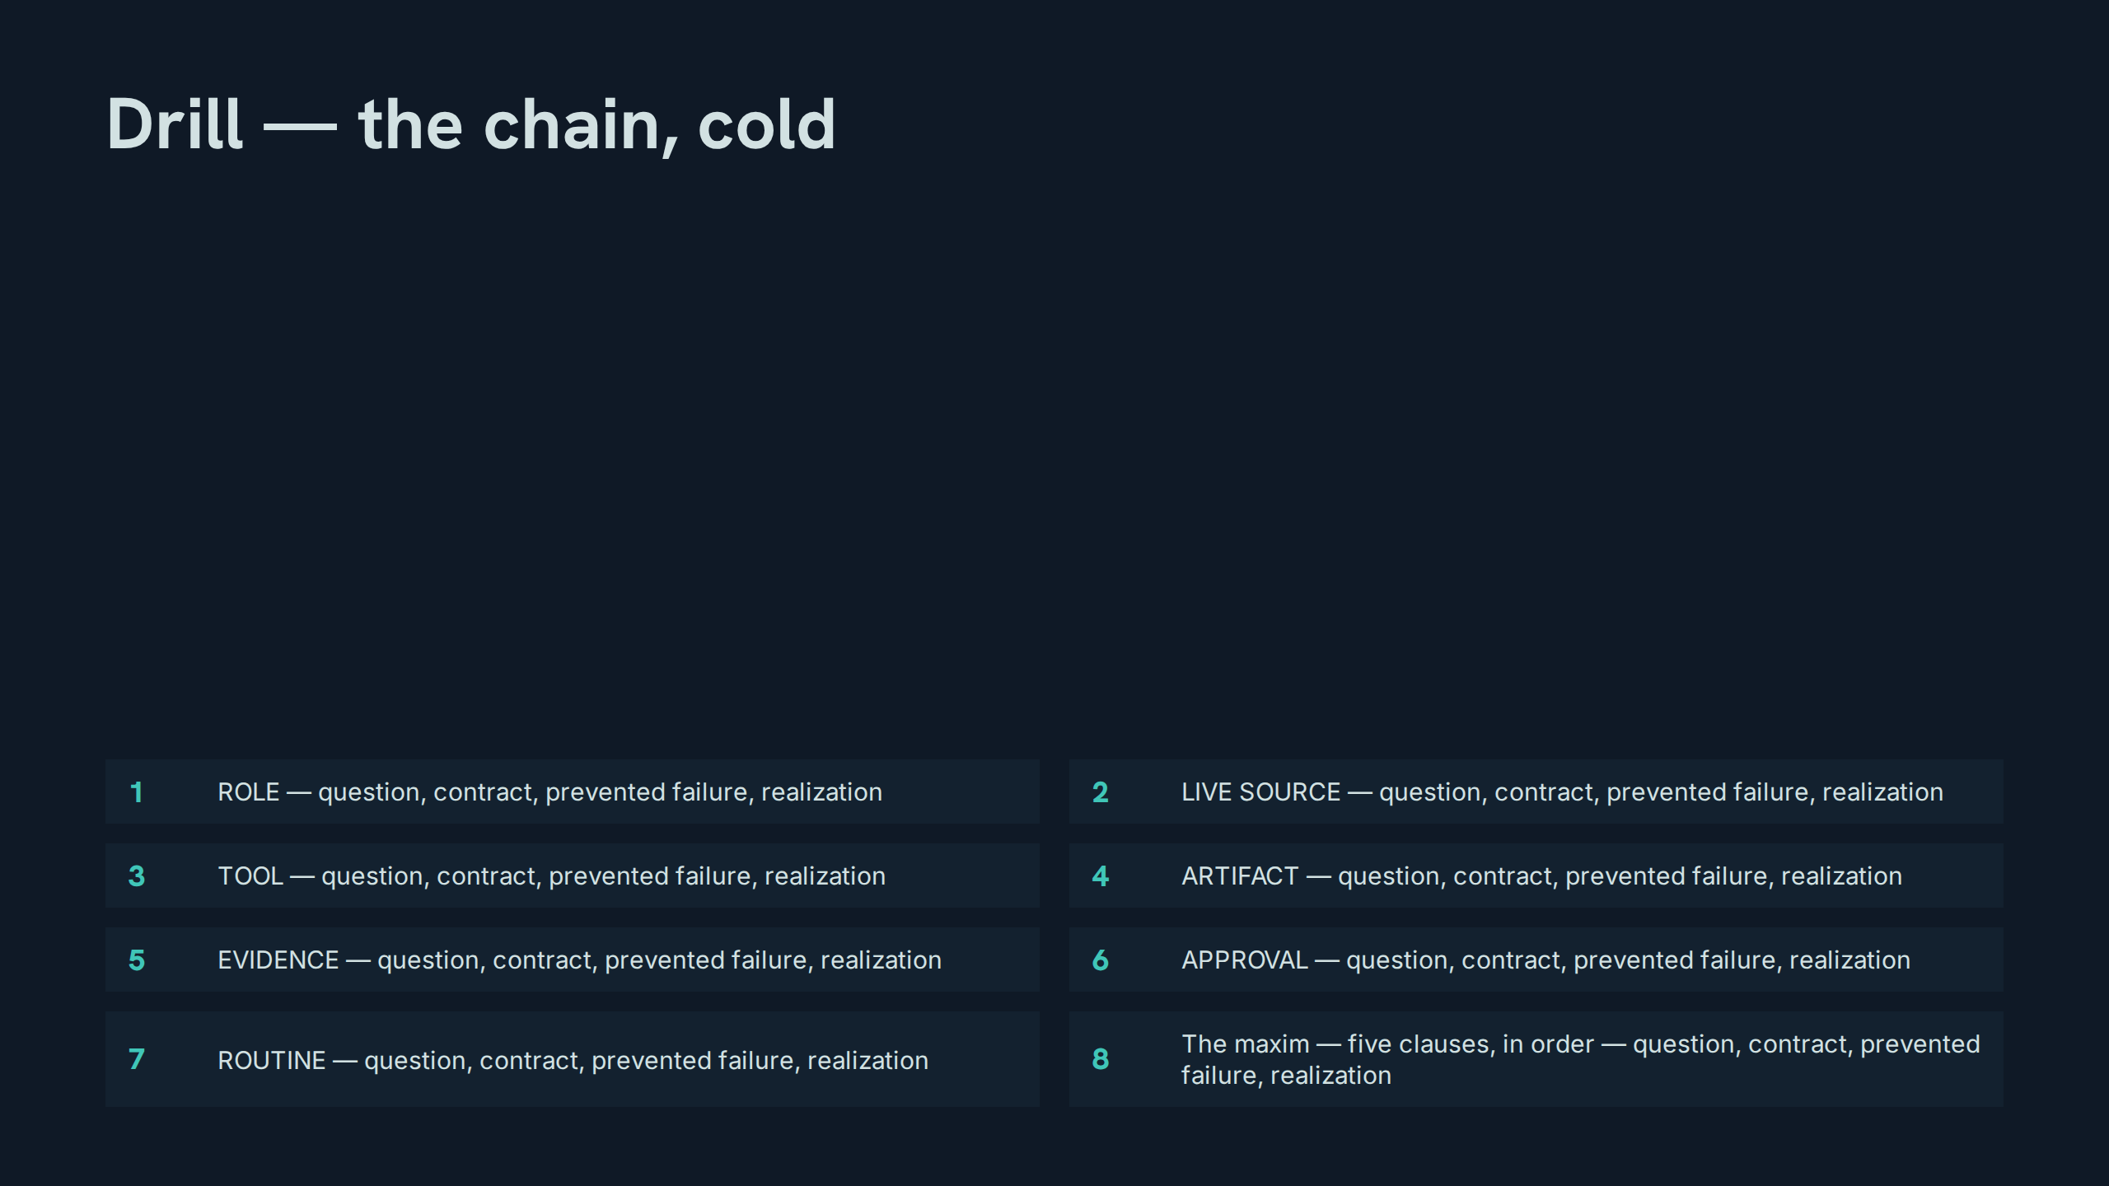
Notes:
Drill — the chain, cold
Speaker notes: Drill instructions: this is the module's examination — each participant takes one stage and delivers its question, contract, prevented failure, and one-line engineering realization from memory; the room corrects omissions before moving on. Teaching hook: finish with the maxim recited in unison. Discussion prompt: which stage's realization surprised you most, and why?

Slide 34
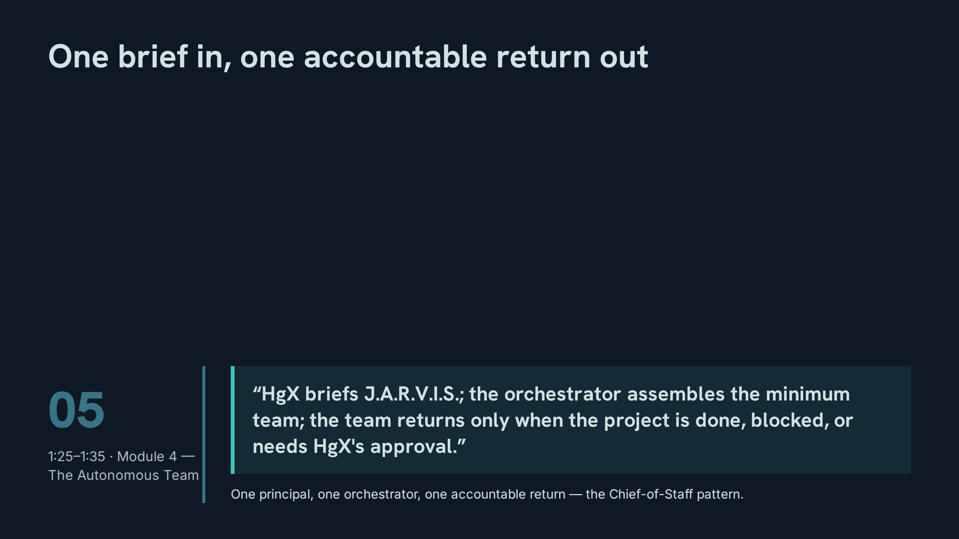
Notes:
One brief in, one accountable return out
Speaker notes: Teaching hook: the return condition has exactly three exits — done, blocked, or approval needed; 'checking in' is not an exit. Drill: participants classify five team updates as legitimate returns or noise. Discussion prompt: why does the minimum team beat the capable team?

Slide 35
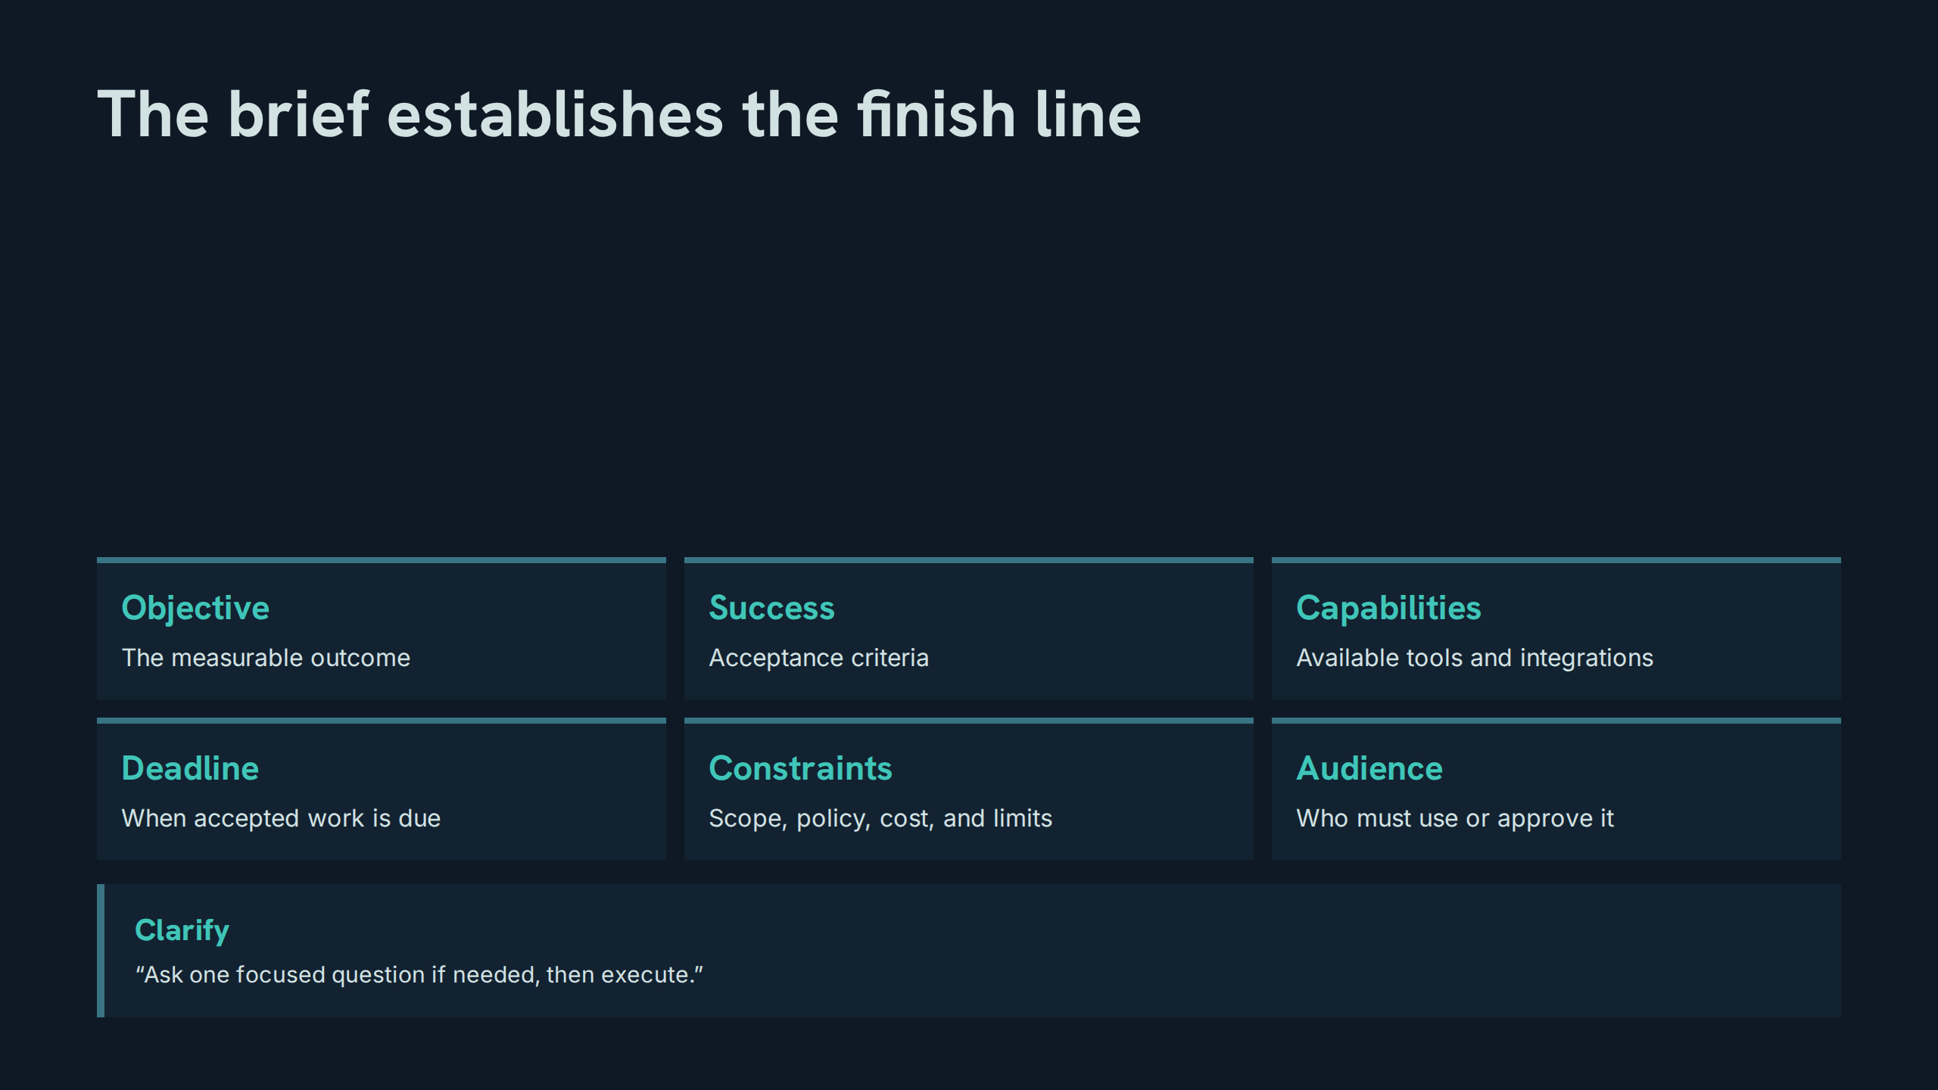
Notes:
The brief establishes the finish line
Speaker notes: Teaching hook: six fields define the finish line before anyone moves; a missing field is discovered here, not at delivery. Drill: given a deliberately incomplete brief, participants find the missing field and draft the one focused clarifying question. Discussion prompt: why exactly one question — what does a second question usually signal?

Slide 36
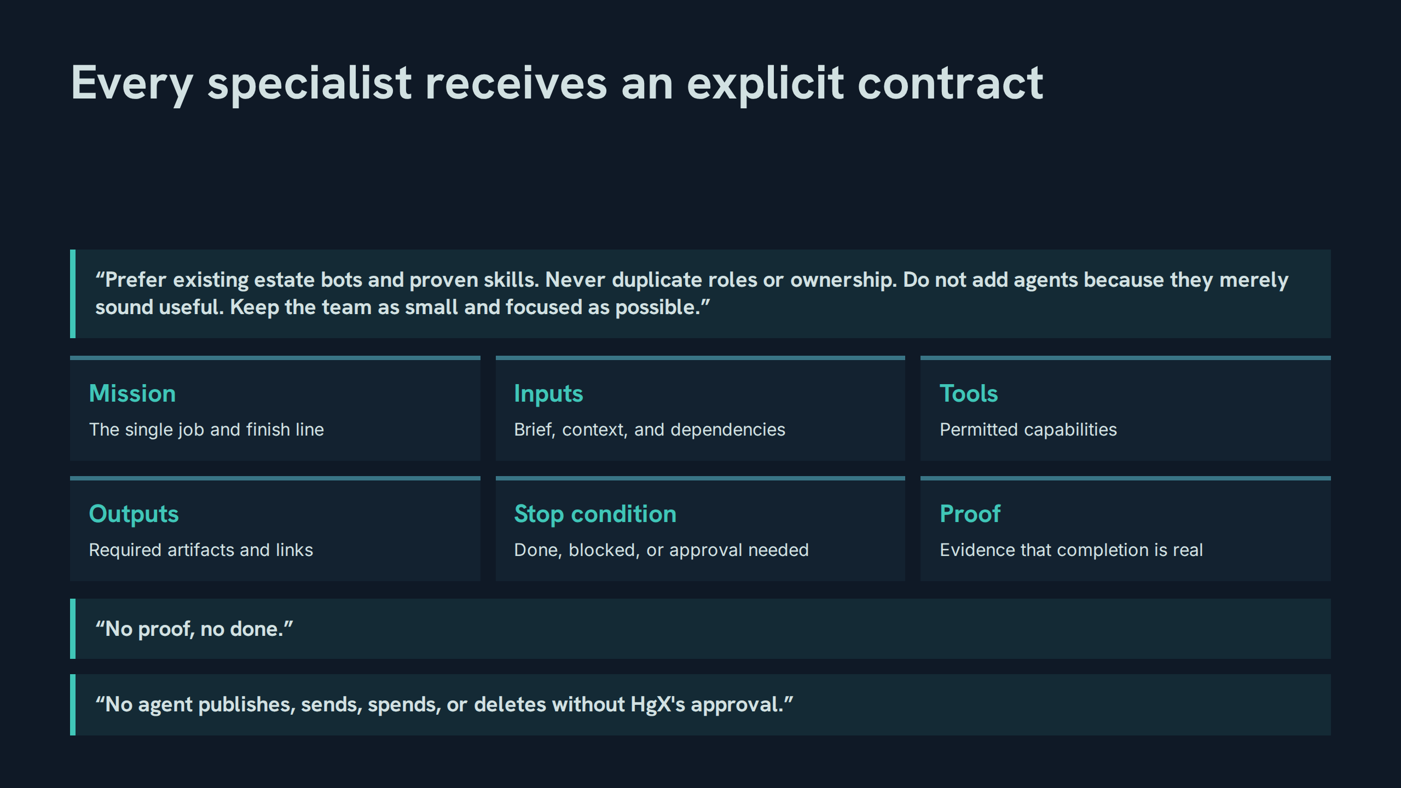
Notes:
Every specialist receives an explicit contract
Speaker notes: Teaching hook: note the paper's own wording — agents are not added because they merely sound useful. Drill: write a six-field contract for a named specialist in four minutes. Discussion prompt: which field is the stop condition's natural partner, and why? (Proof — stopping is a claim, and claims need evidence.)

Slide 37
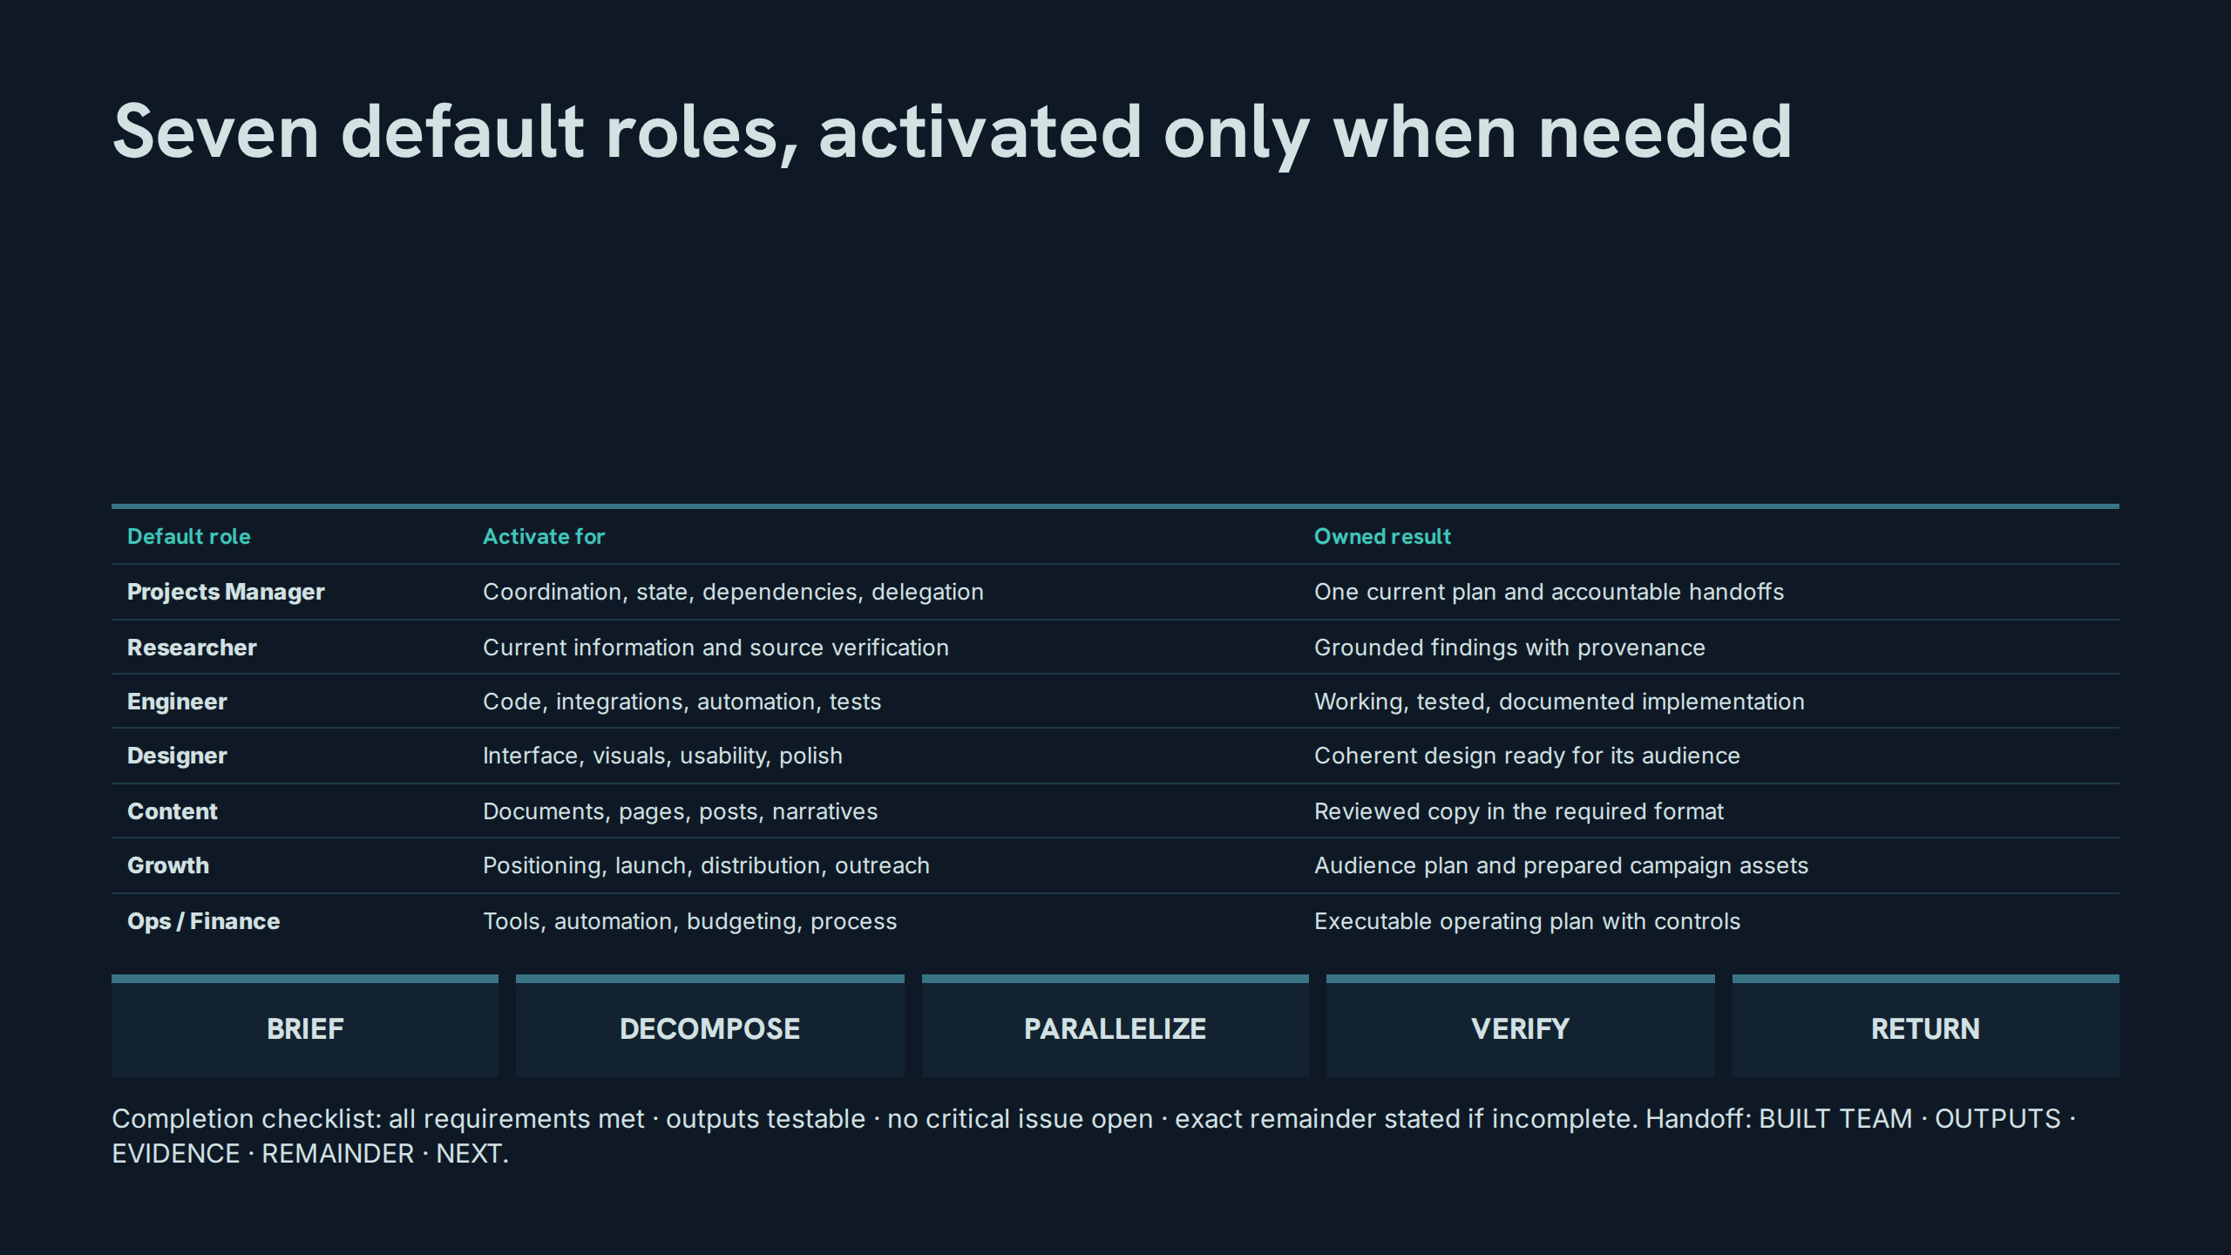
Notes:
Seven default roles, activated only when needed
Speaker notes: Teaching hook: roles activate only when the project needs them — an idle roster is a menu, not a meeting. Drill: for a sample project, participants choose the minimum role set and defend each activation. Discussion prompt: walk the handoff's five parts — which part disappears first under time pressure?

Slide 38
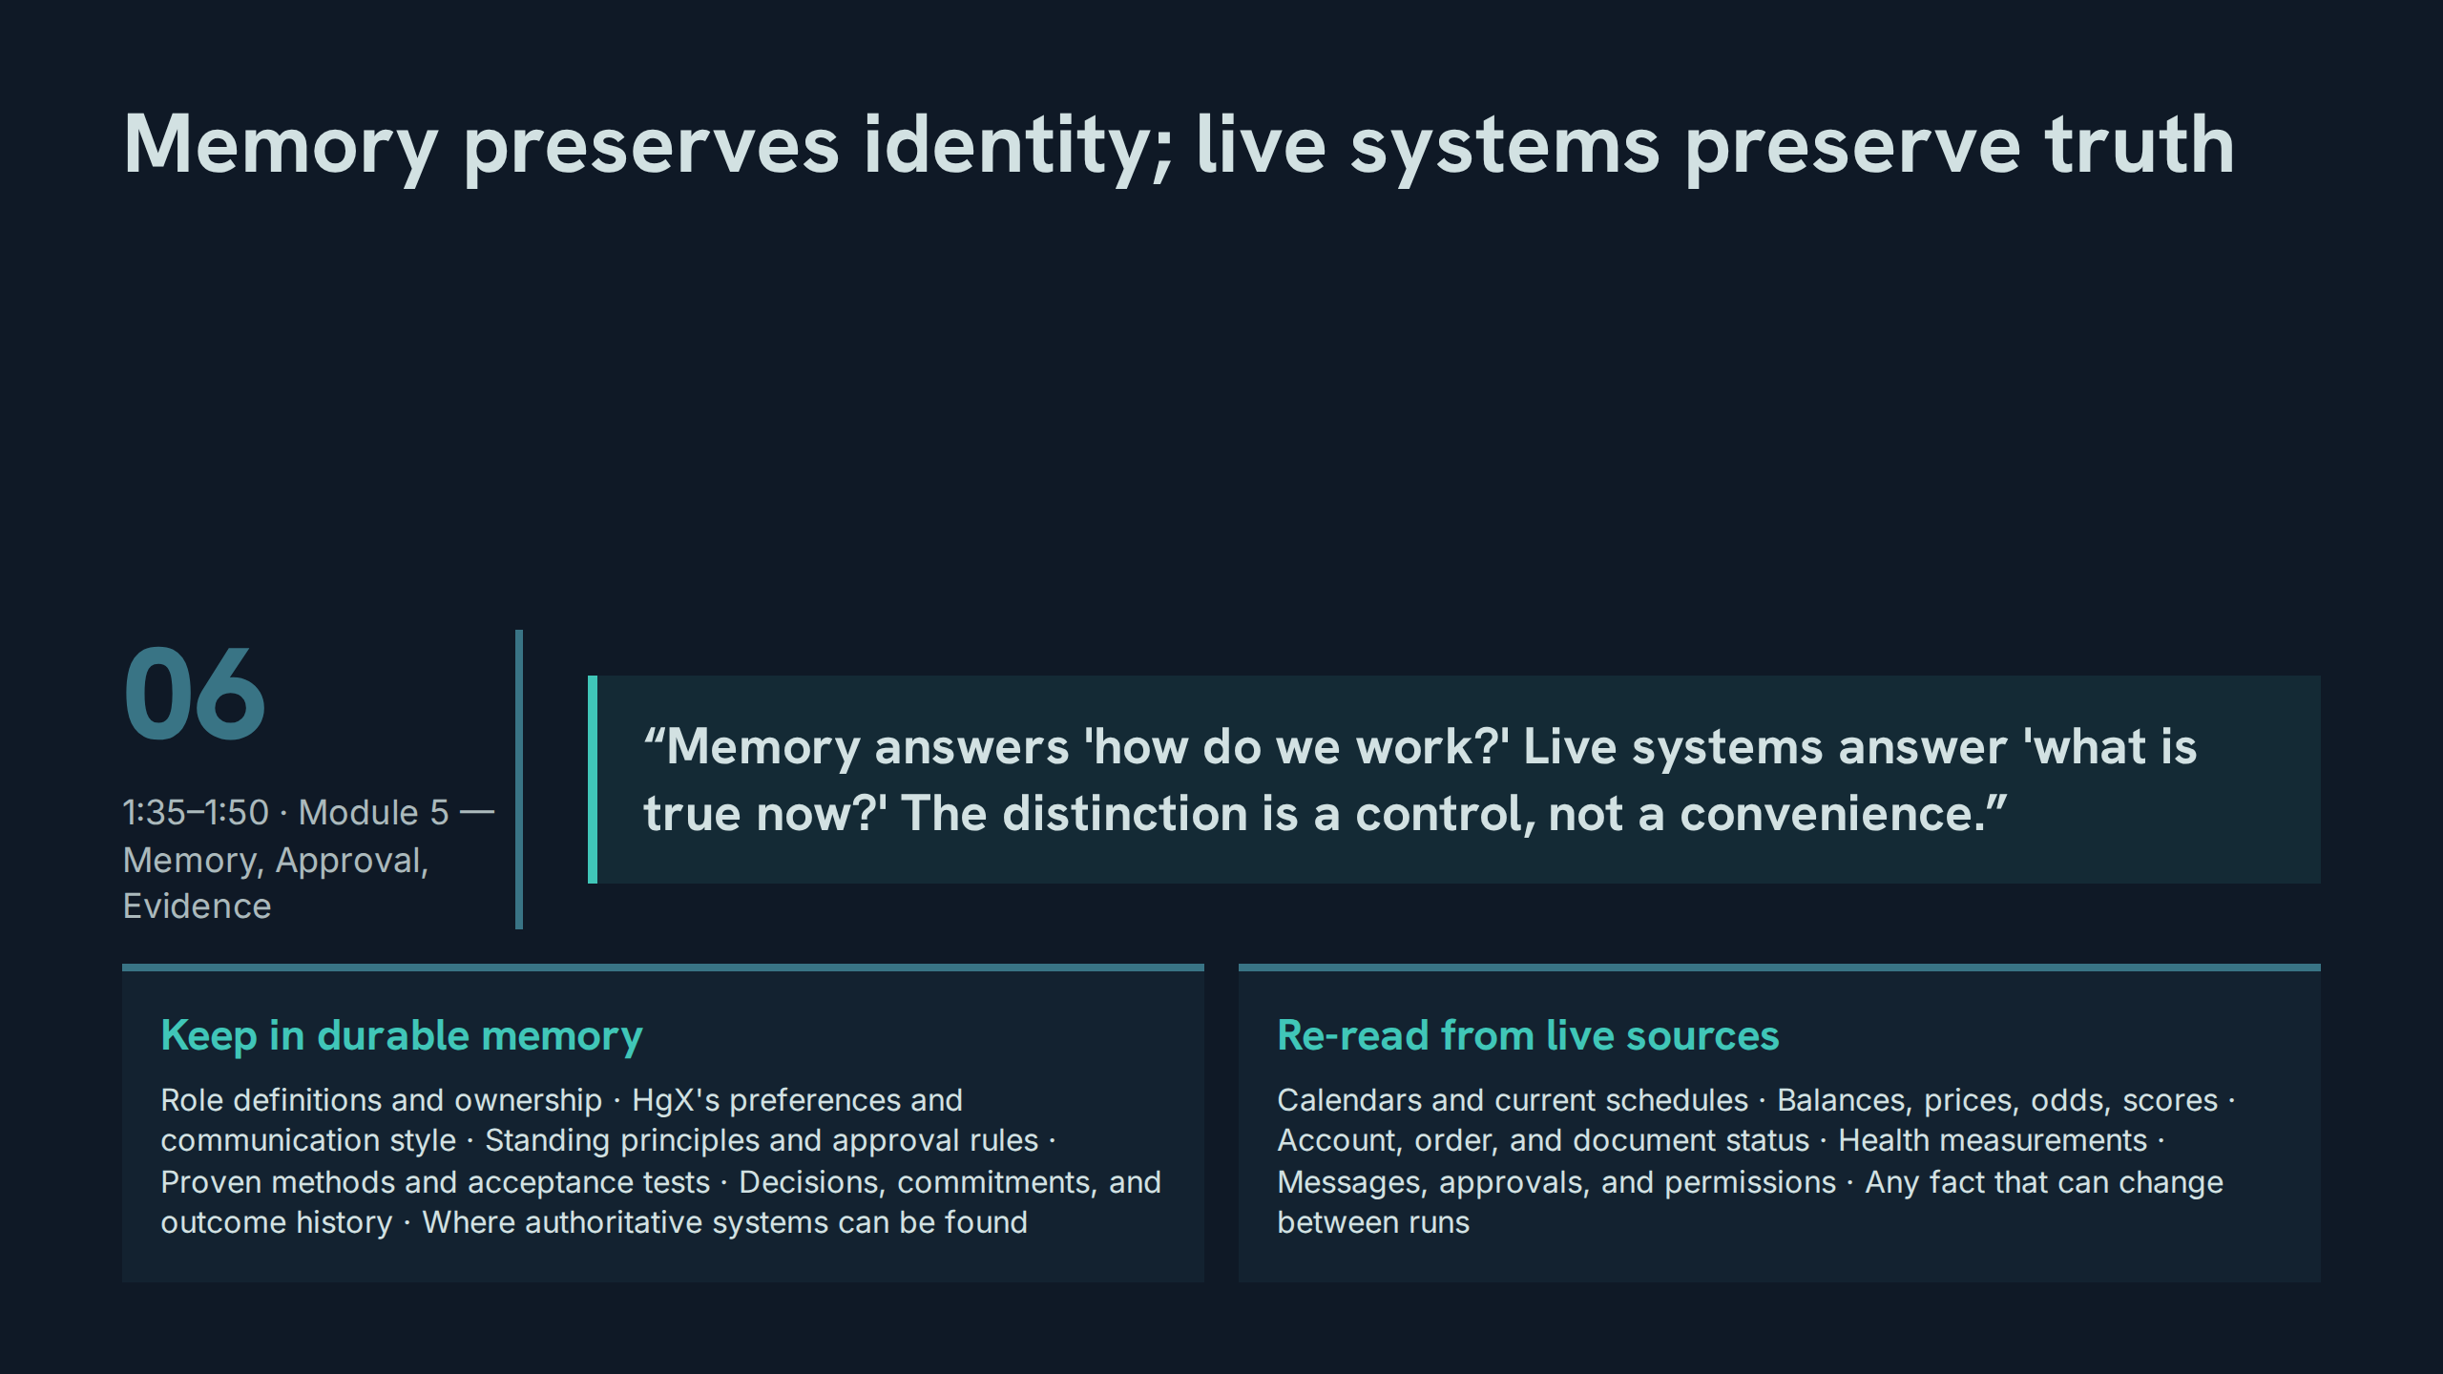
Notes:
Memory preserves identity; live systems preserve truth
Speaker notes: Teaching hook: continuity is essential, but remembered state must never impersonate current state — the two columns are the enforcement. Drill: sort eight facts into the correct column; any fact that can change between runs belongs on the right. Discussion prompt: what harm follows when a preference (left) is treated as a fact (right), or the reverse?

Slide 39
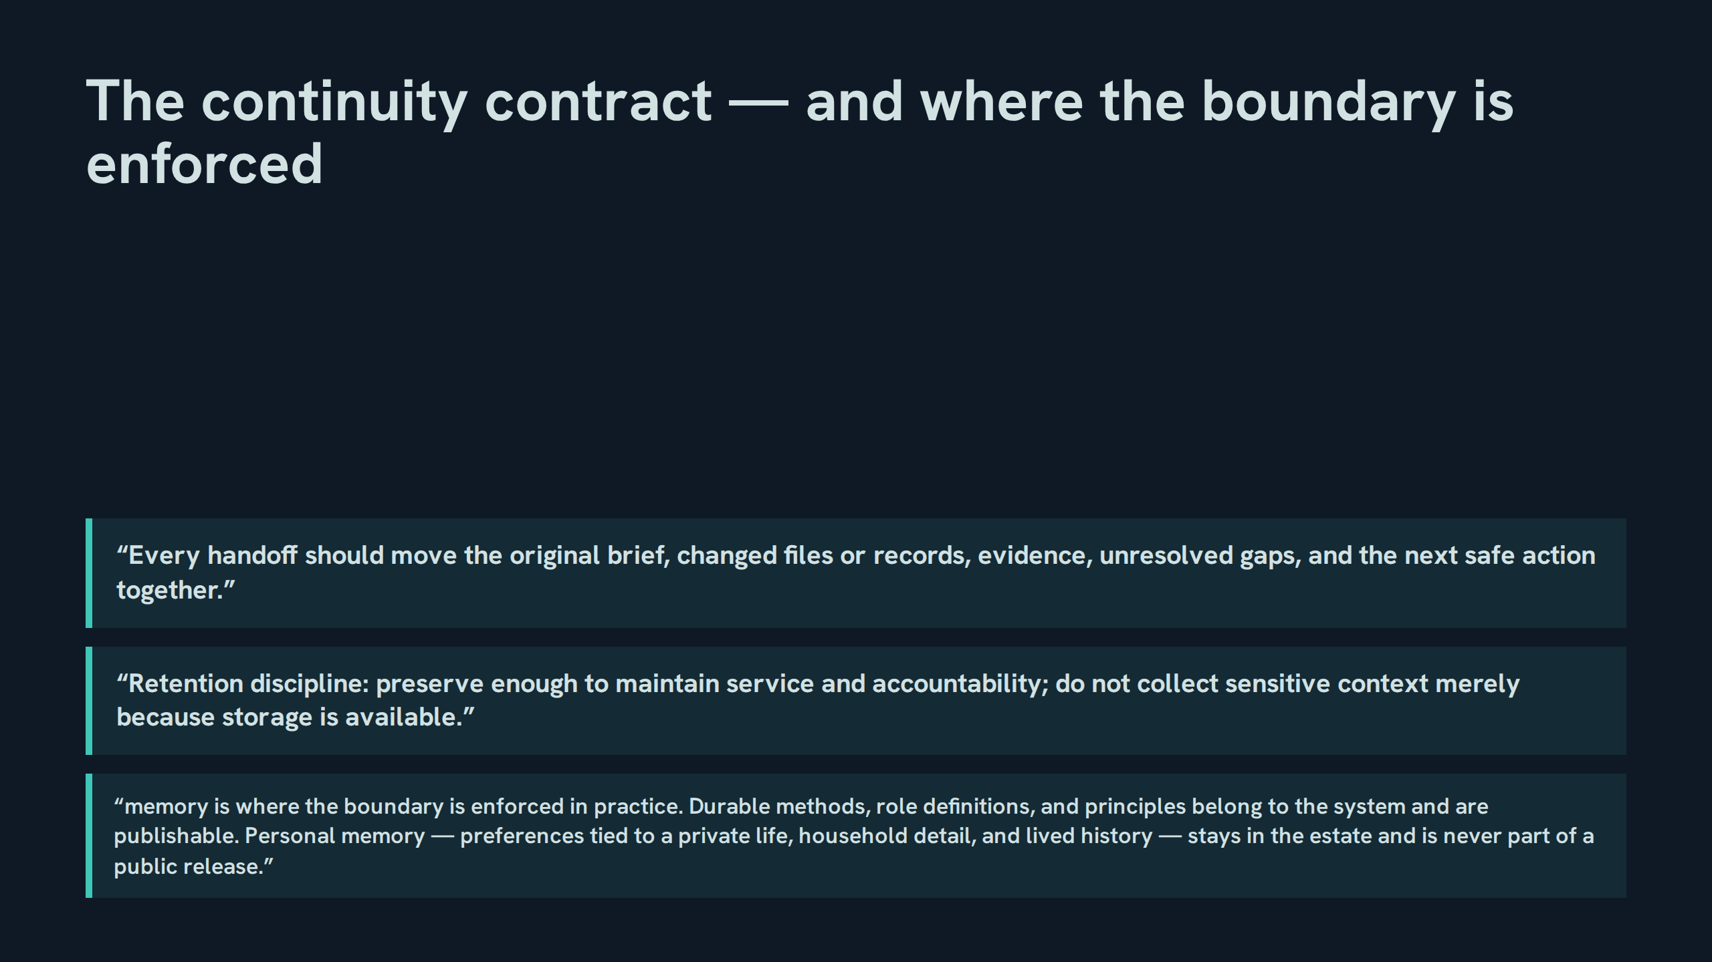
Notes:
The continuity contract — and where the boundary is enforced
Speaker notes: Teaching hook: v1.2 locates the open-source boundary inside memory practice — publishable methods on one side, personal memory permanently in the estate. Drill: split a sample handoff into its five moving parts, then mark each part publishable or private. Discussion prompt: why is retention discipline a security control and not housekeeping?

Slide 40
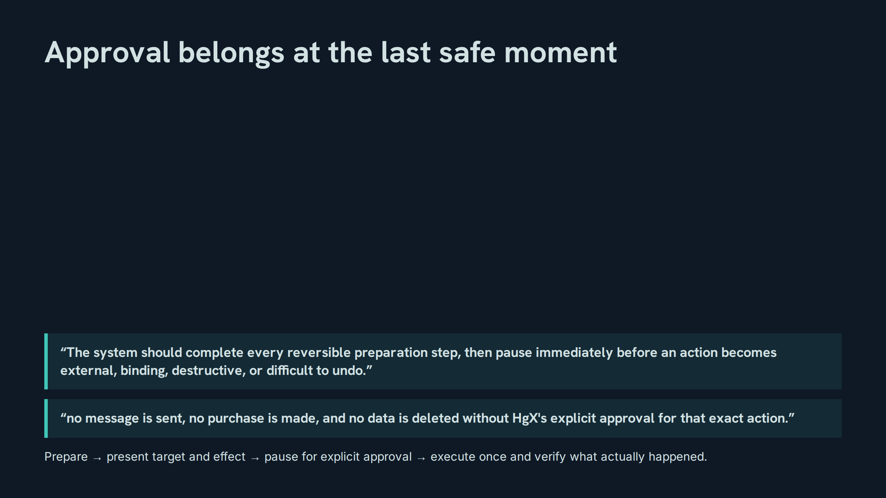
Notes:
Approval belongs at the last safe moment
Speaker notes: Teaching hook: the gate is placed by reversibility, not by habit — everything reversible is done before the principal is asked for anything. Drill: stage a sample action through the four gate steps, naming the exact moment of the pause. Discussion prompt: what makes an approval 'for that exact action' rather than a general intention?

Slide 41
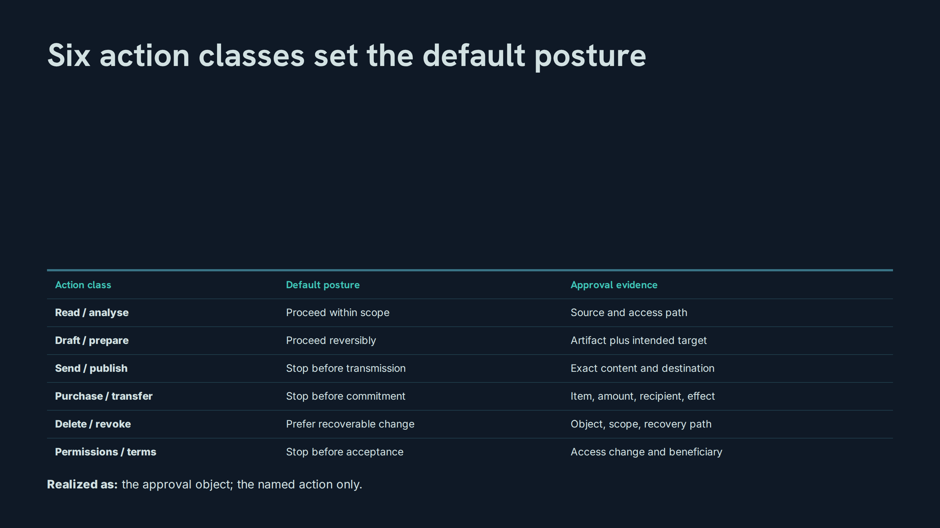
Notes:
Six action classes set the default posture
Speaker notes: Teaching hook: posture is decided by class before any specific case is argued — that pre-commitment is what makes the gate predictable. Drill: classify six actions and state each posture and its evidence without notes. Discussion prompt: why does delete/revoke say 'prefer recoverable' instead of simply 'stop'?

Slide 42
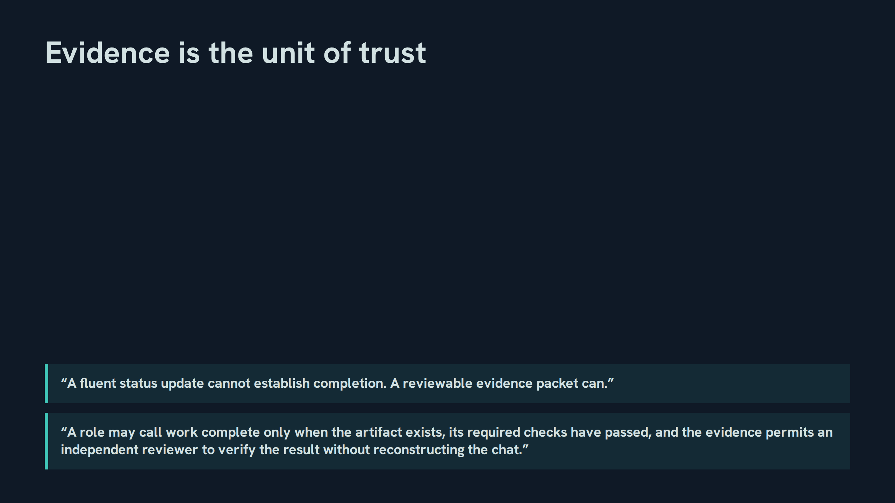
Notes:
Evidence is the unit of trust
Speaker notes: Teaching hook: the acceptance test is independence — a reviewer who never saw the chat must be able to verify the result from the packet alone. Drill: hand a sample packet to a participant playing the independent reviewer; every question they must ask is a packet defect. Discussion prompt: what does fluency simulate that evidence cannot?

Slide 43
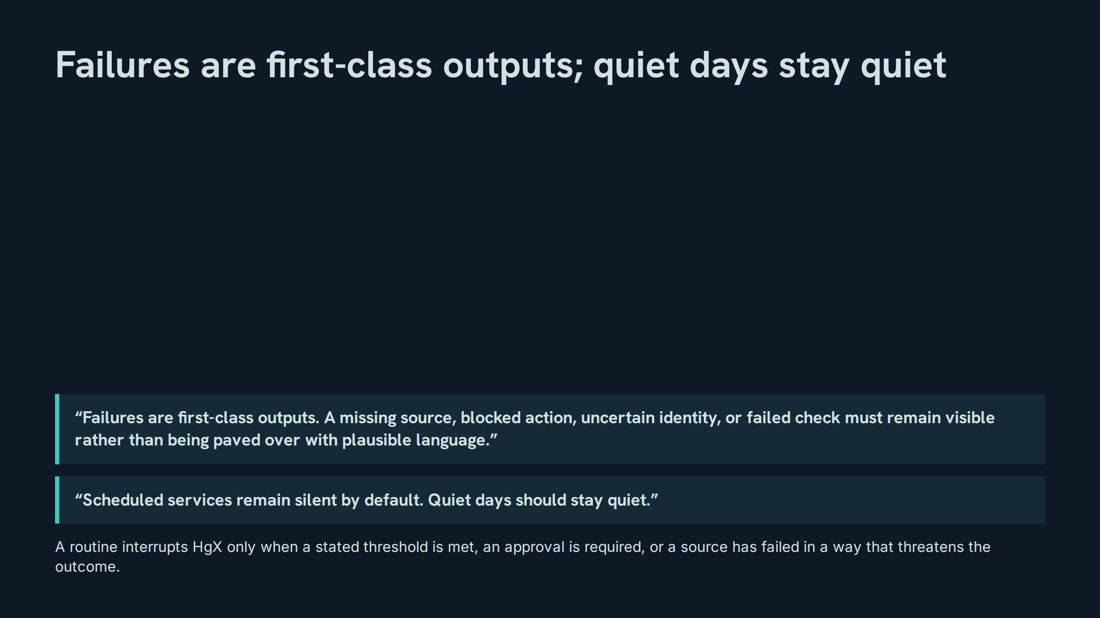
Notes:
Failures are first-class outputs; quiet days stay quiet
Speaker notes: Teaching hook: visibility and silence are the same discipline — surface what threatens the outcome, suppress everything else. Drill: rewrite a 'paved over' status message so the failure is first-class and specific. Discussion prompt: which is the greater trust injury — a hidden failure, or noise that trains the principal to ignore alerts?

Slide 44
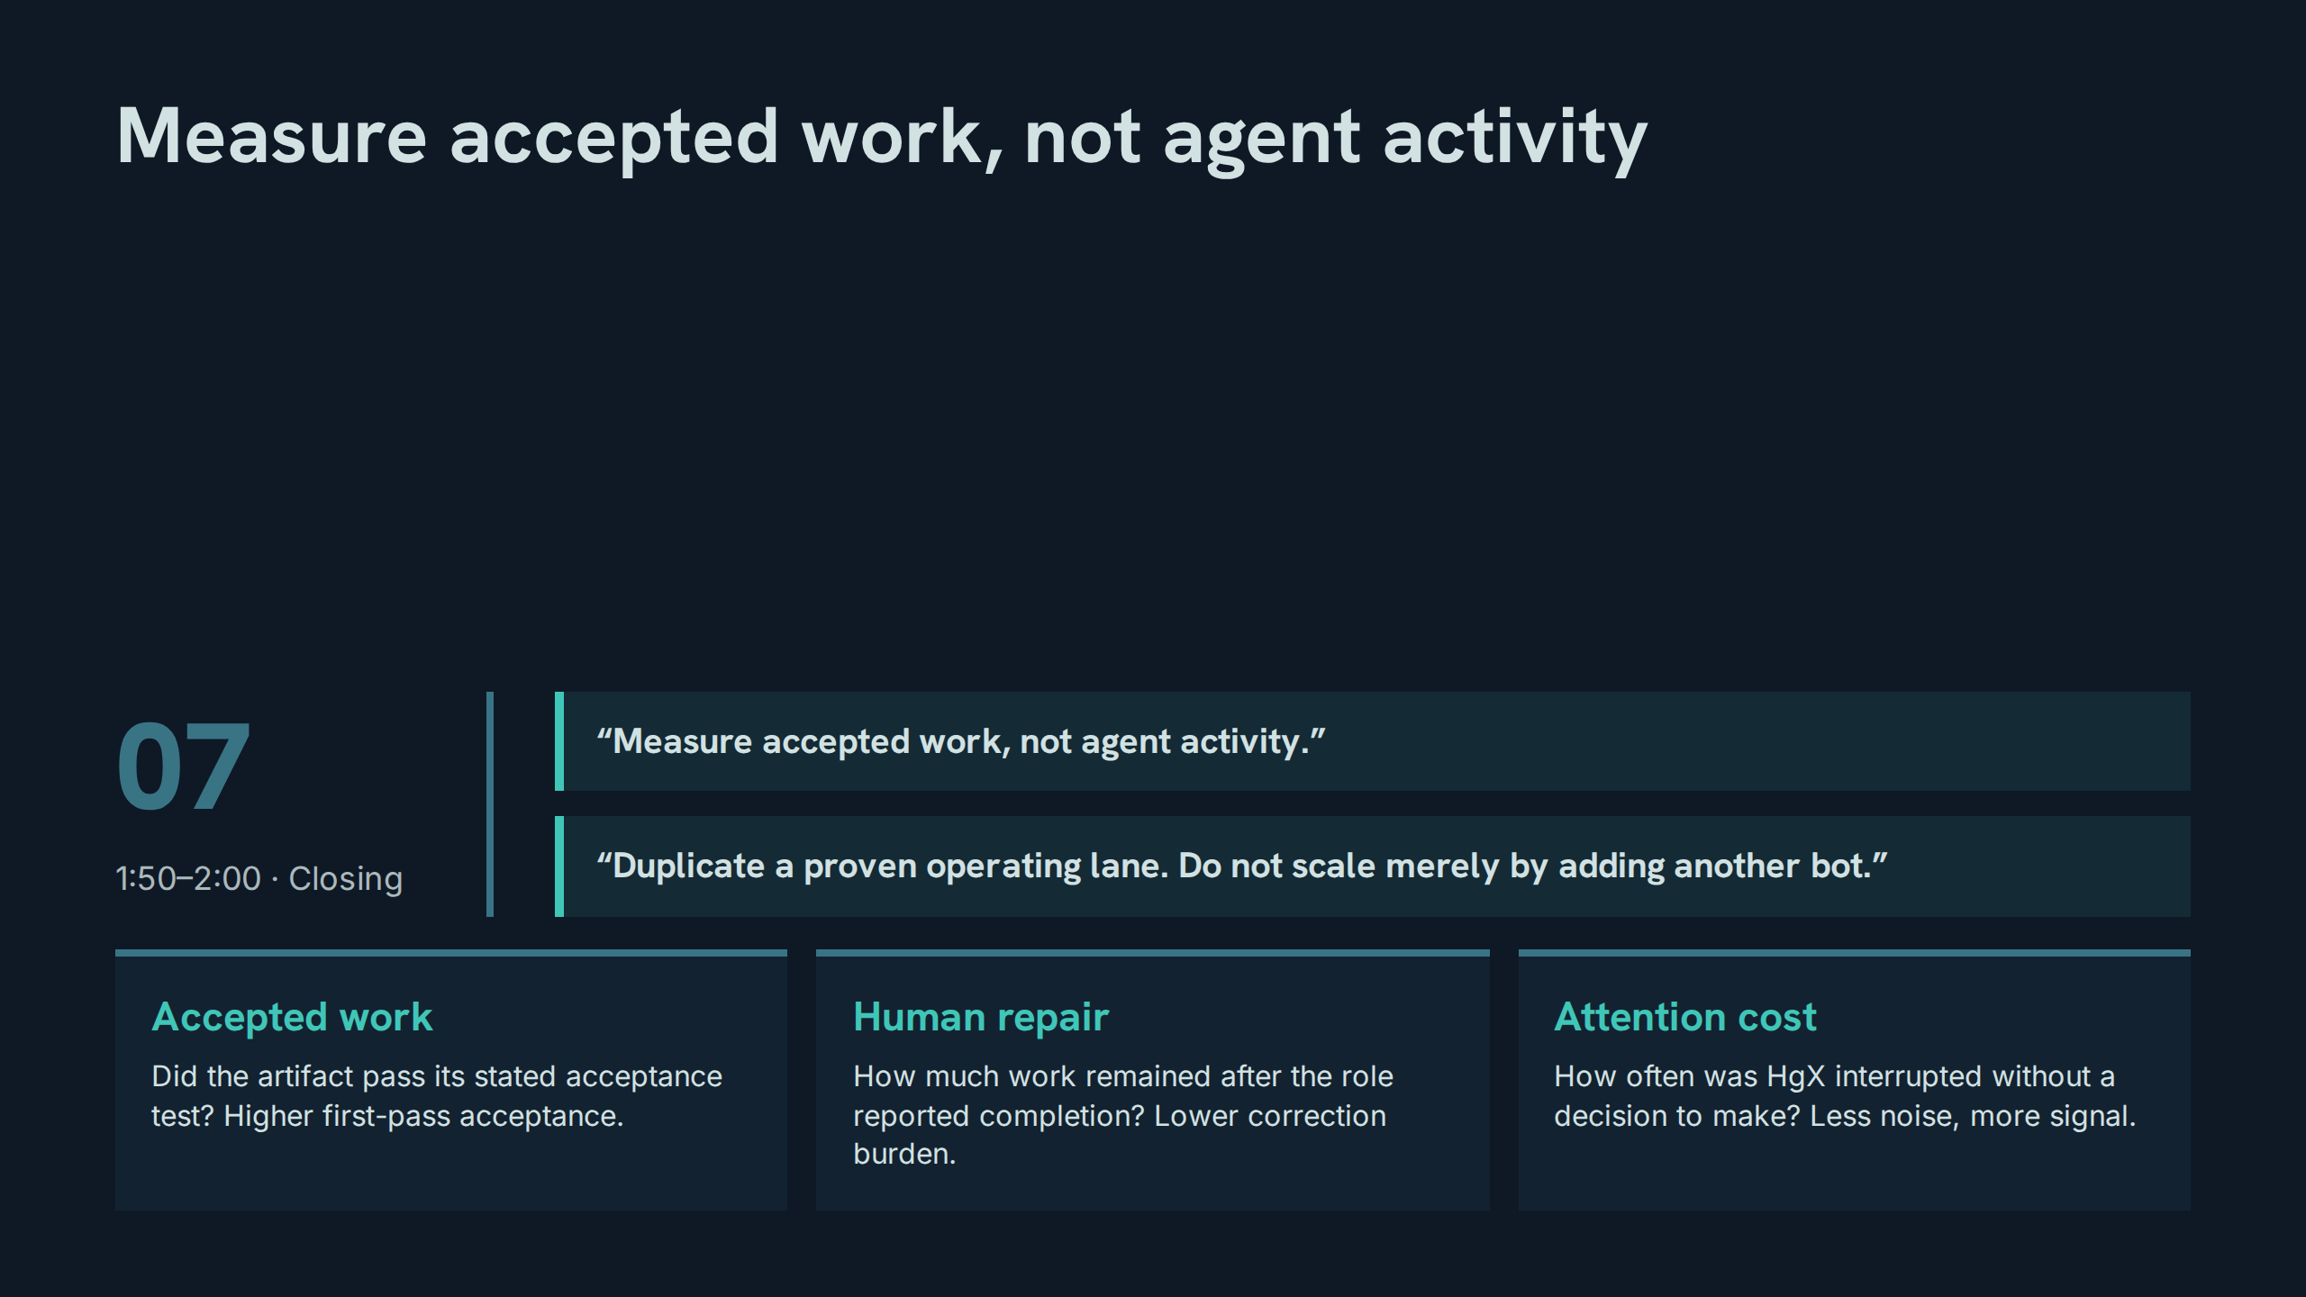
Notes:
Measure accepted work, not agent activity
Speaker notes: Teaching hook: bot count and message volume are vanity metrics; the scorecard asks whether correct work arrived with low repair and well-placed control. Drill: score a recent week of estate work on the three measures shown. Discussion prompt: when should a noisy routine be retired rather than repaired?

Slide 45
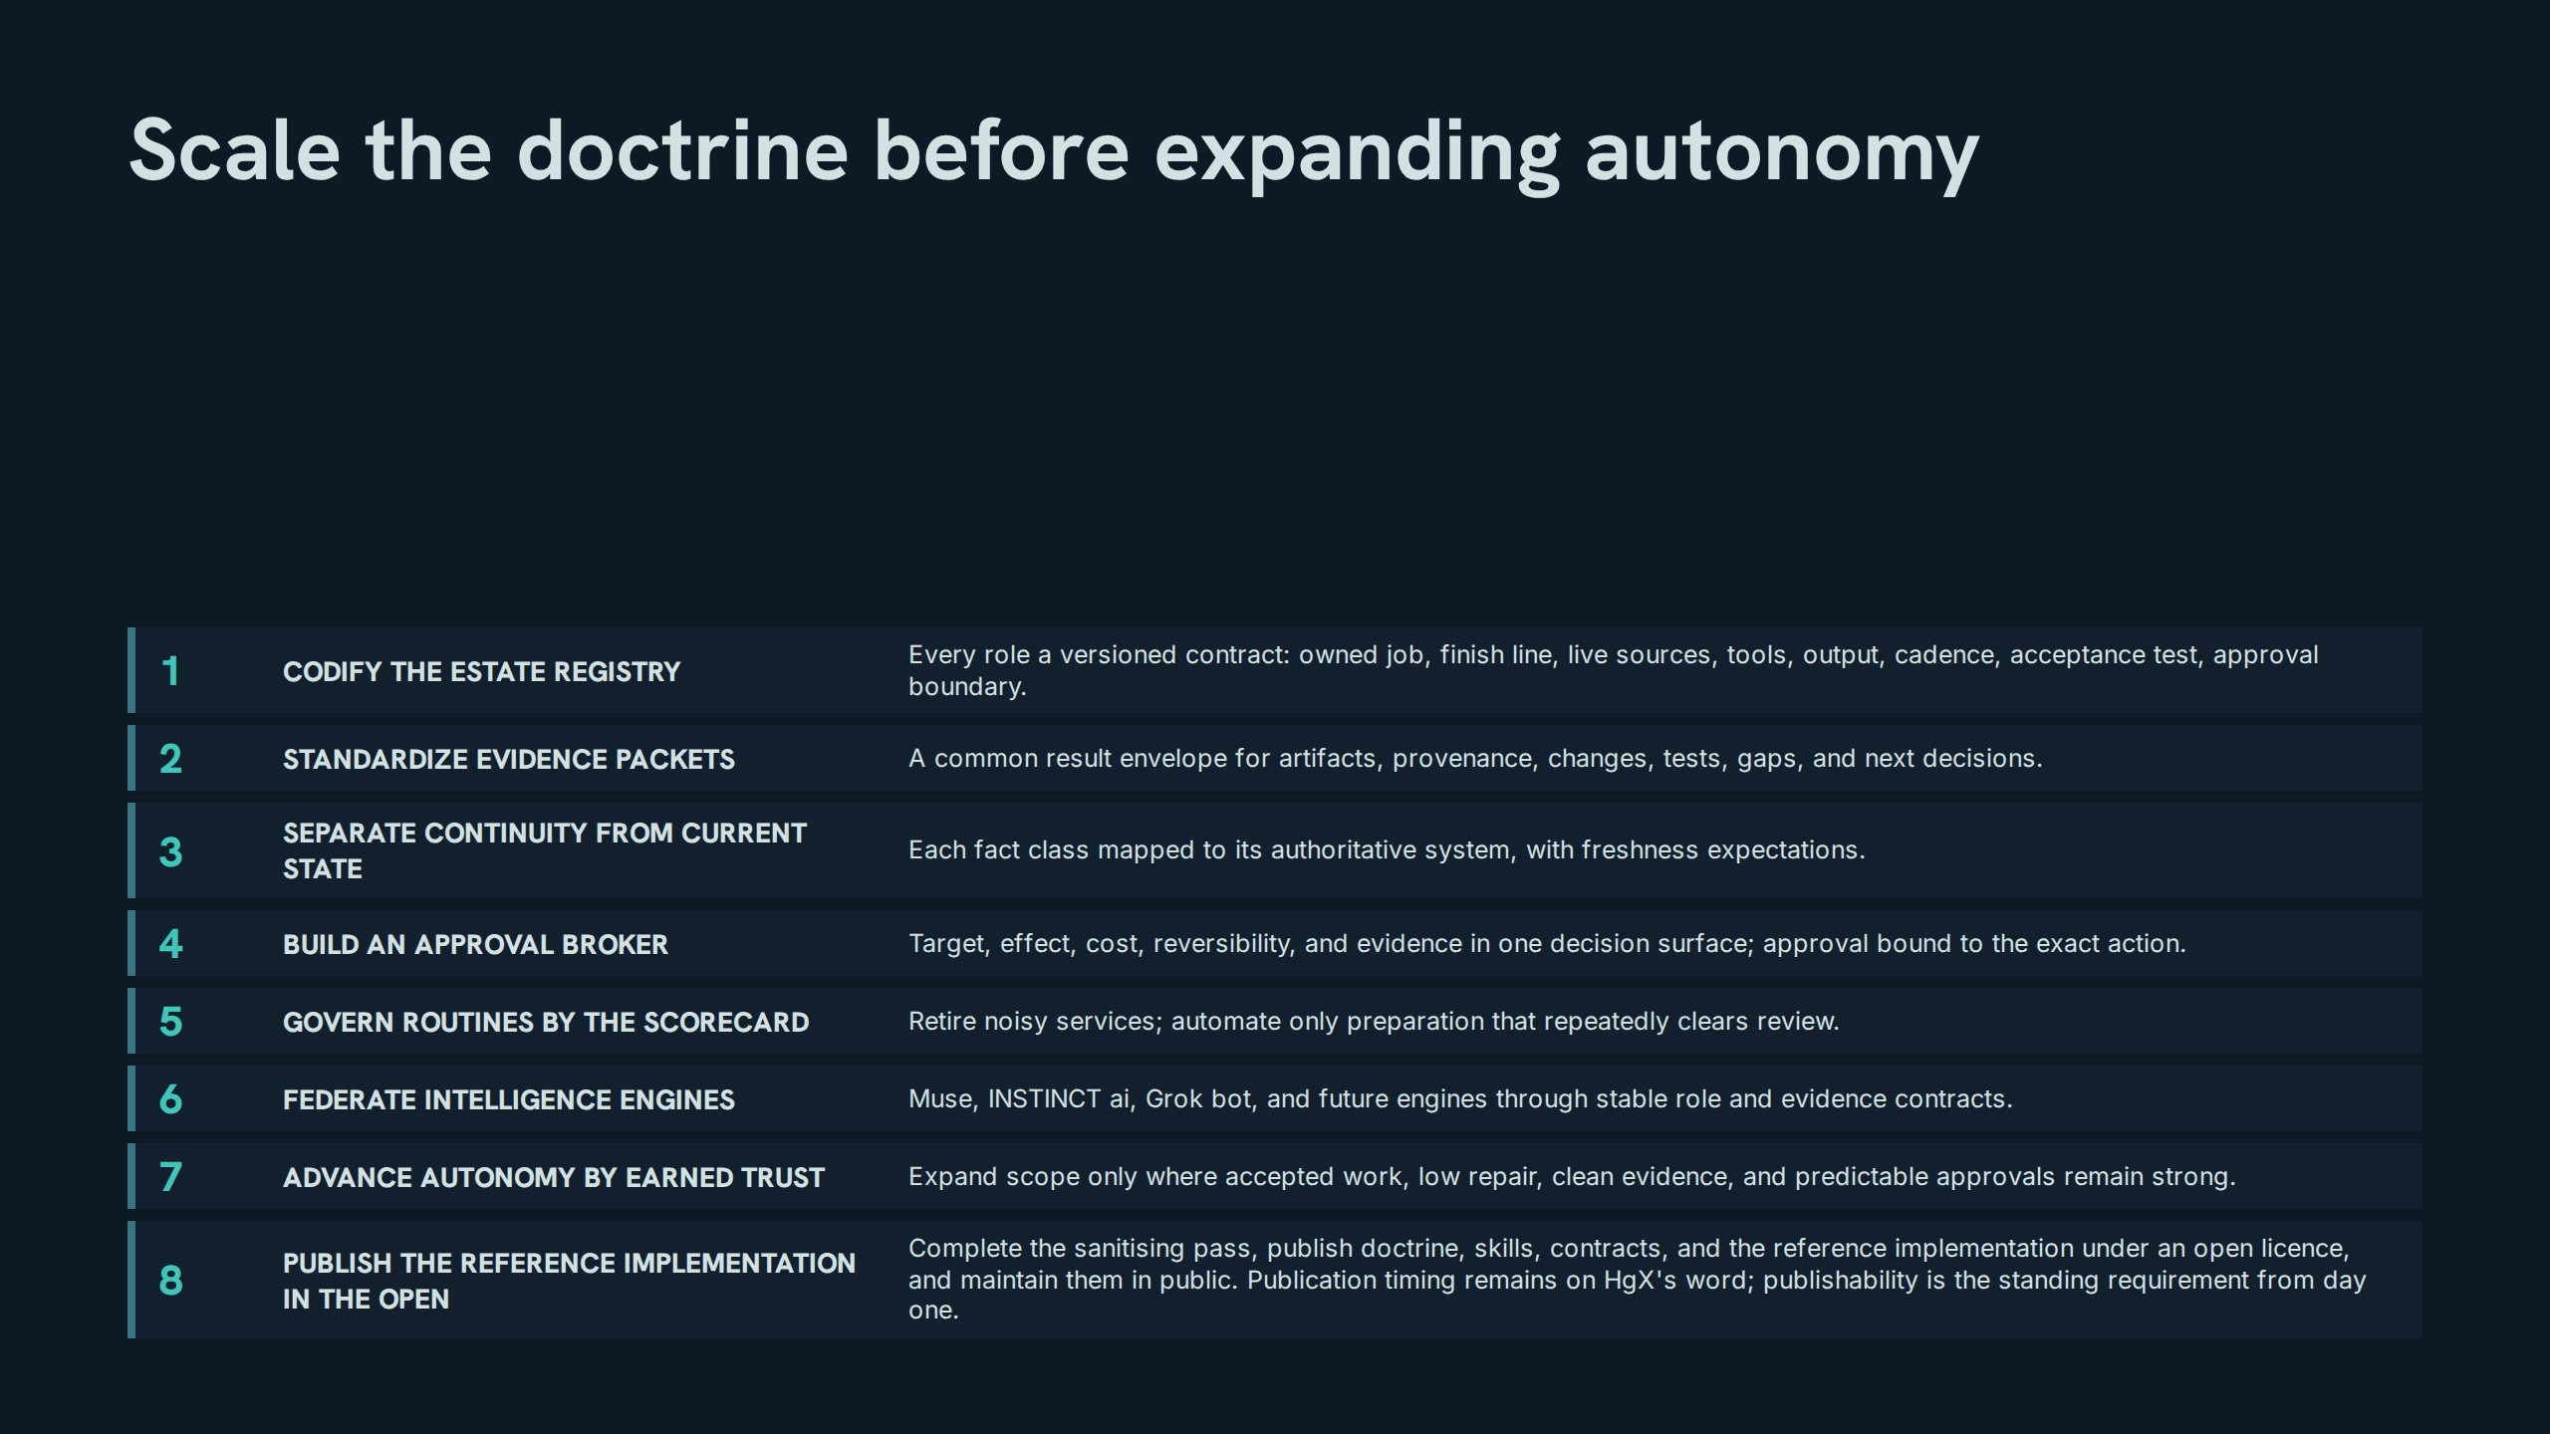
Notes:
Scale the doctrine before expanding autonomy
Speaker notes: Teaching hook: item 8 is v1.2's addition and it is deliberately last in sequence but first in standing — publishability binds from day one even though publication completes the roadmap. Drill: recite the eight items by title in order. Discussion prompt: why does the roadmap forbid scaling by adding bots before the contracts harden?

Slide 46
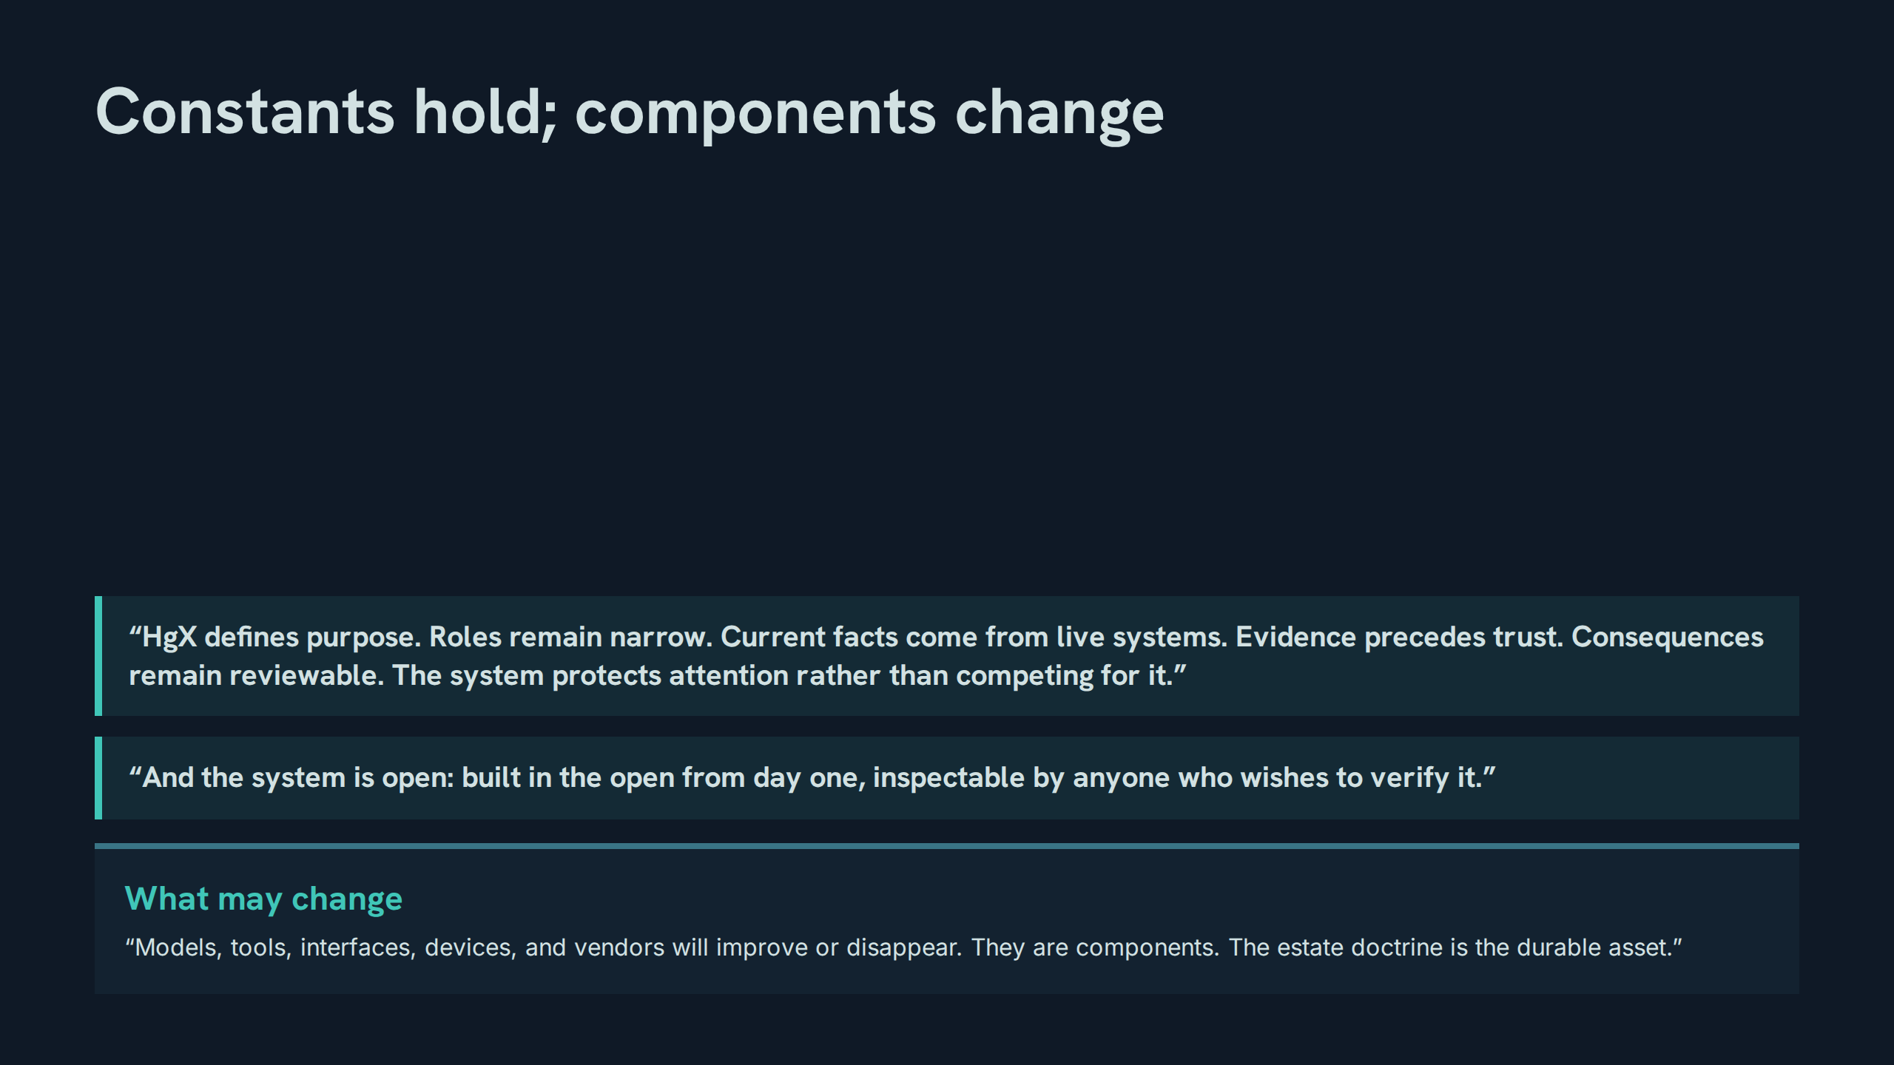
Notes:
Constants hold; components change
Speaker notes: Teaching hook: v1.2 adds a sixth constant — openness — to the original five; ask the room to spot it before revealing the second quote block. Drill: recite the constants as six sentences, then the changeables in one breath. Discussion prompt: if doctrine is the durable asset, what is the correct response when a better model appears? (Swap the component; keep the contracts.)

Slide 47
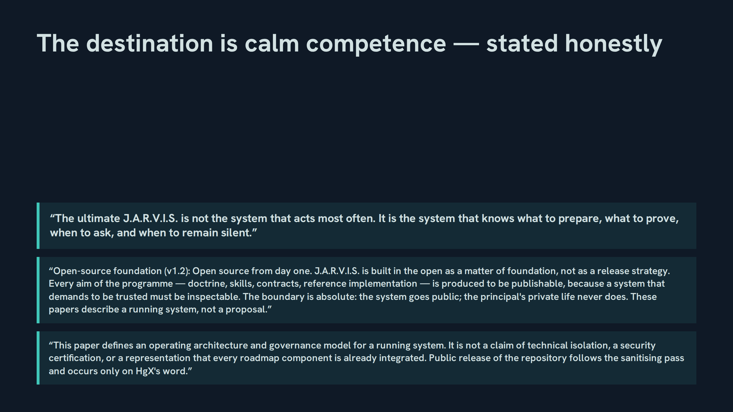
Notes:
The destination is calm competence — stated honestly
Speaker notes: Teaching hook: close on the paper's own honesty — the scope note limits the claim, and that limitation is itself doctrine: truth over comfort, applied to the paper itself. Drill: one participant delivers the foundation restatement verbatim; another delivers the scope note's three disclaimers. Discussion prompt: why does an expert paper end by narrowing its own claim?

Slide 48
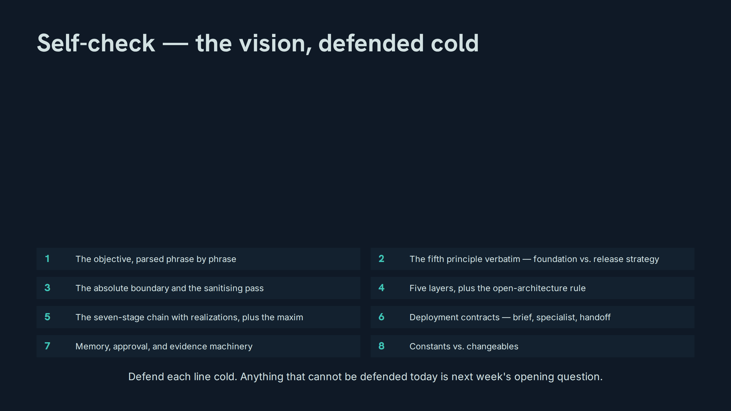
Notes:
Self-check — the vision, defended cold
Speaker notes: Drill instructions: run the self-check as the exit examination — eight lines, defended cold, no notes; misses are logged, not argued with. Teaching hook: end by restating the scope for next week — the front-end and the technical back-end become subjects in their own right then, and not before. Discussion prompt: which of the eight lines will this room still be unable to defend in a month, and what routine would fix that?

