Slide 1
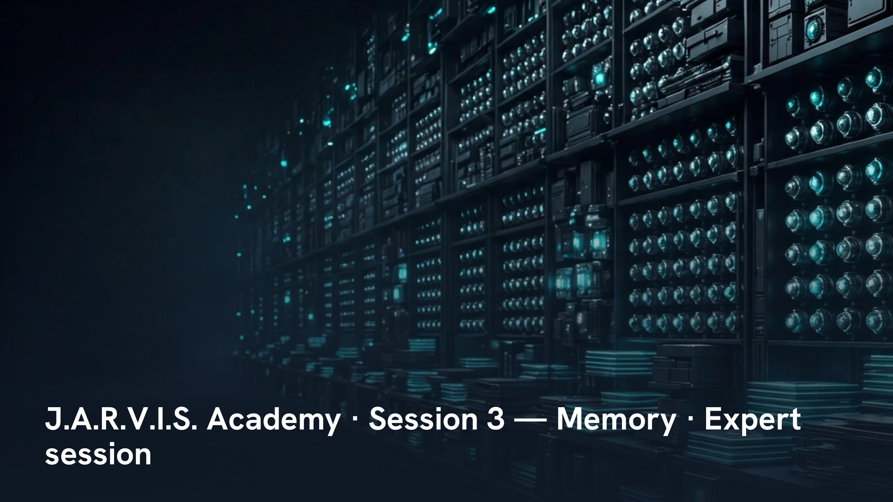
Notes:
J.A.R.V.I.S. Academy · Session 3 — Memory · Expert session
Speaker notes: Teaching hook: set the level in the first sixty seconds — this session is about one system, memory, taken at full depth: where state lives, and what stored state means. State the scope firmly: vision white paper v1.2 section 05 and technical white paper section 8 only. Drill (3–4 minutes): each participant states, cold, one fact they believe is in durable memory and one they believe must be re-read live; the list is kept and re-tested at slide 44. Discussion prompt: why does an estate that remembers everything still get the present wrong?

Slide 2
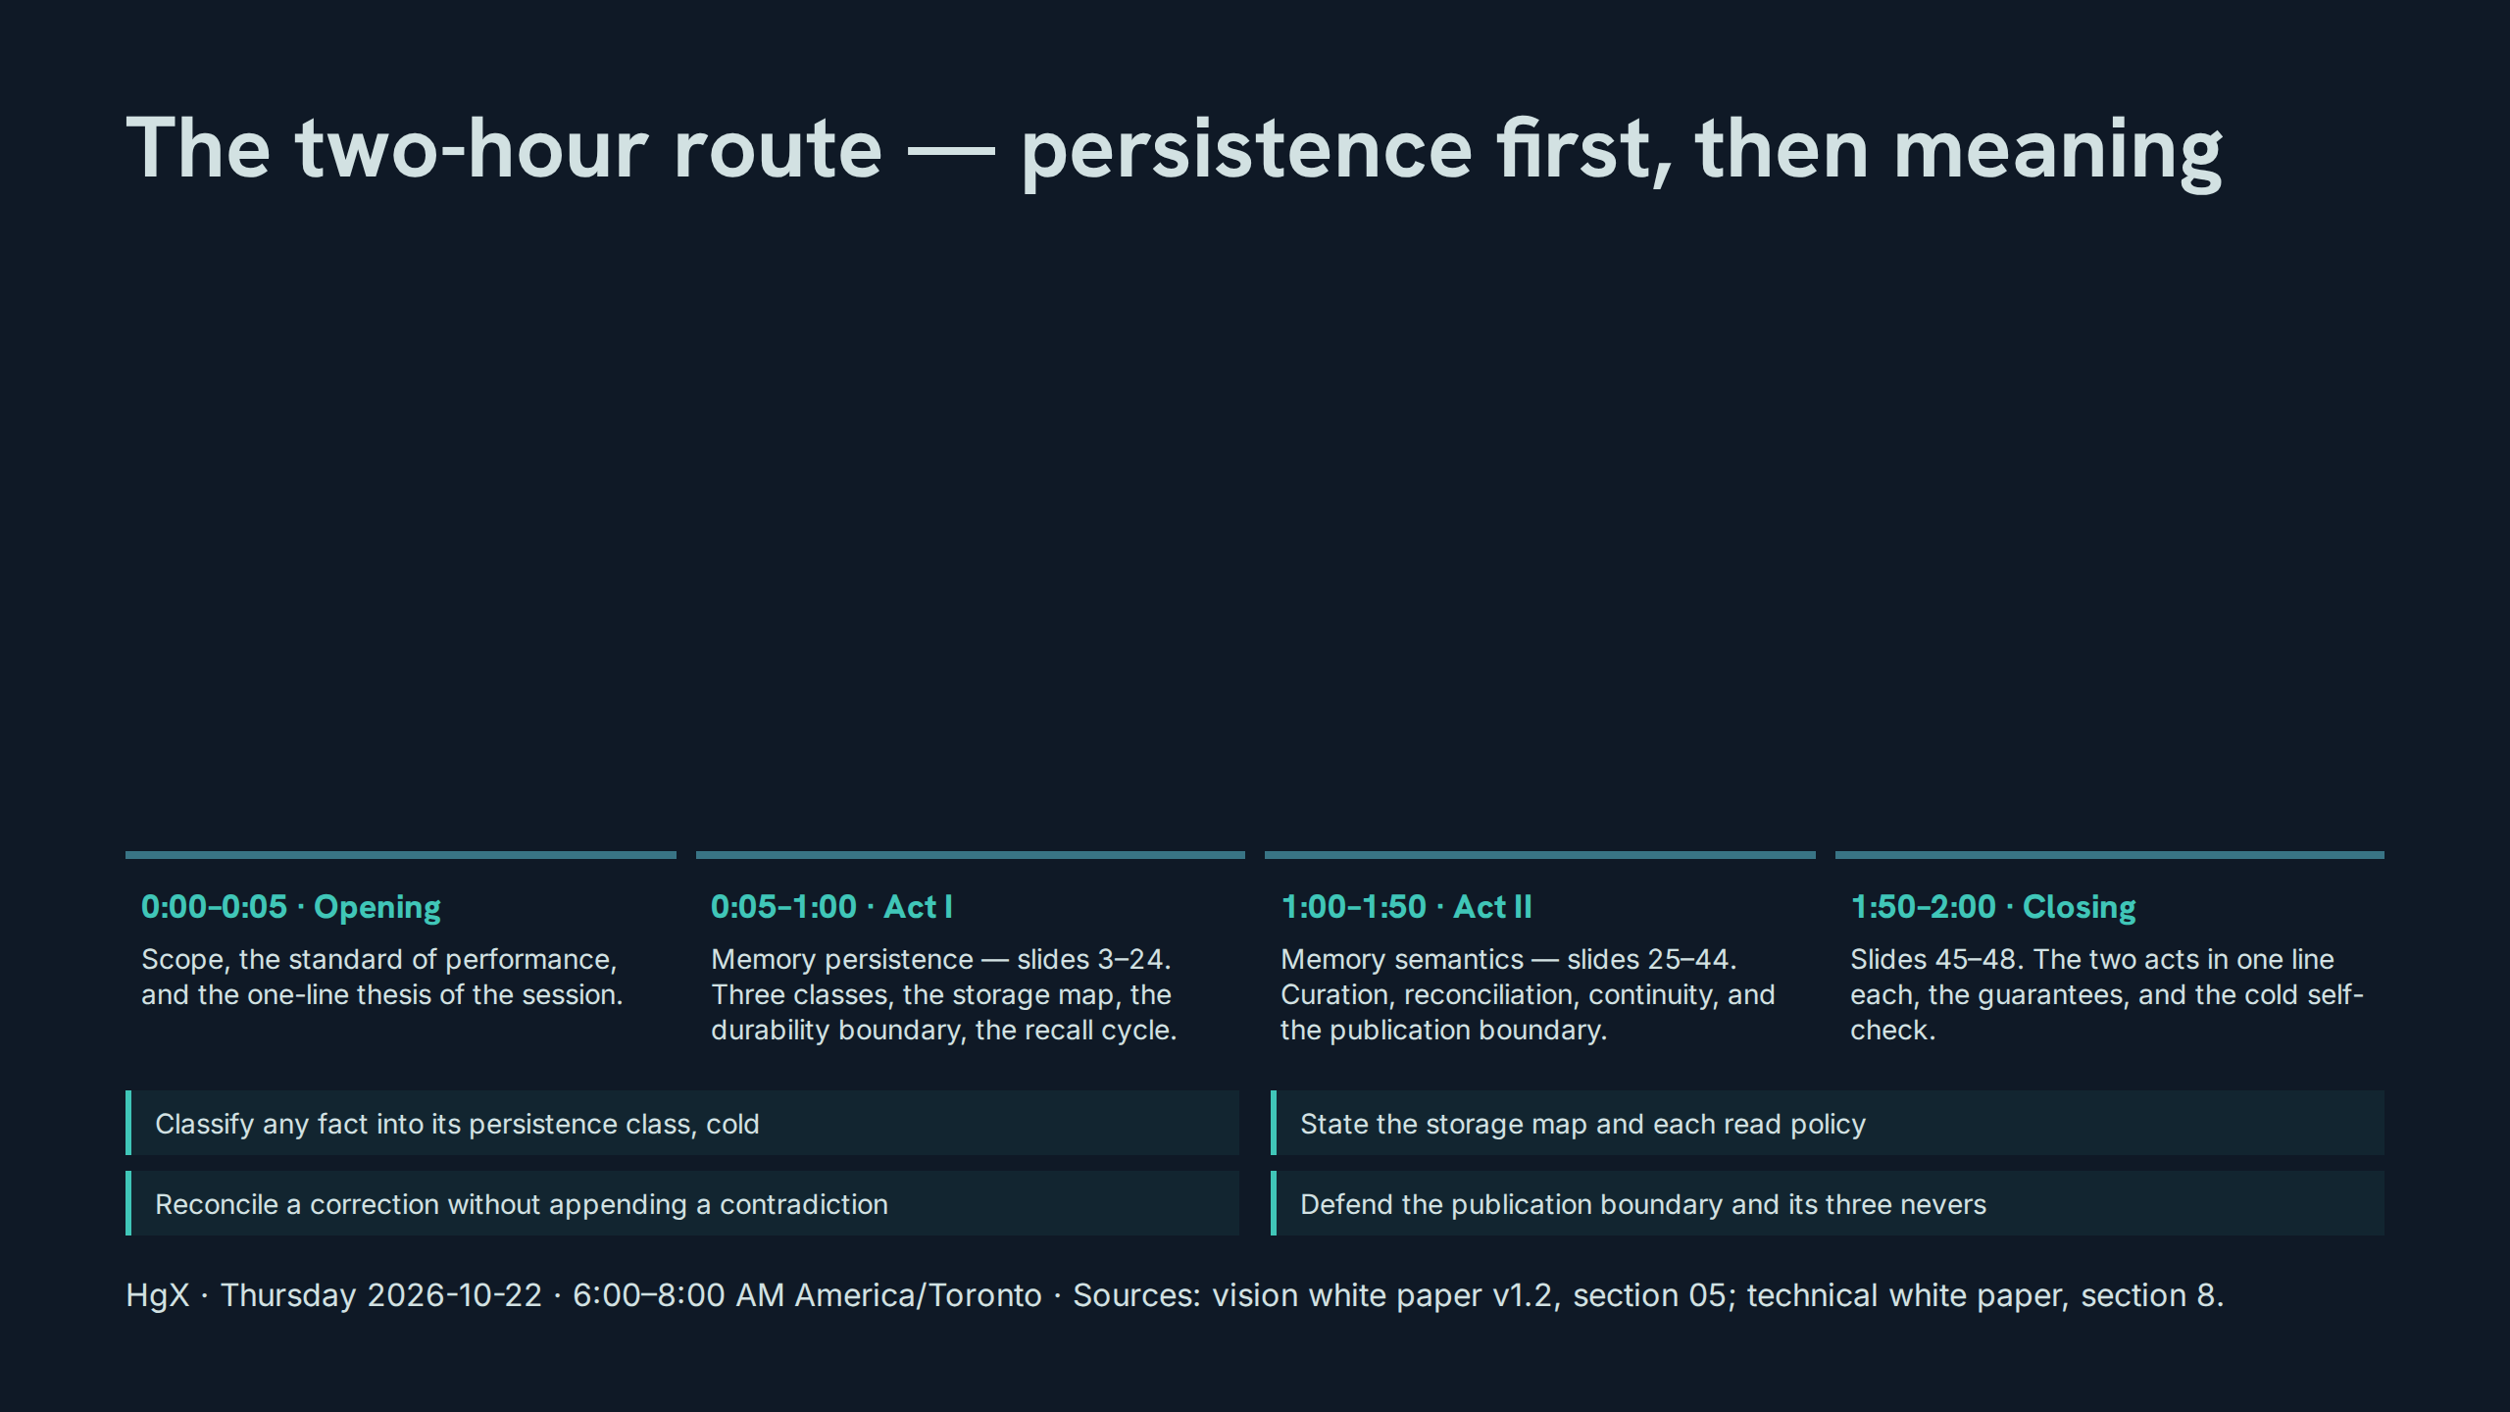
Notes:
The two-hour route — persistence first, then meaning
Speaker notes: Teaching hook: walk the timings once, then name the standard — by 8:00 everyone defends memory doctrine without the slide in front of them. Drill (3–4 minutes): the room repeats the four blocks and their minute marks from memory, then names which act they expect to be harder and why. Discussion prompt: which outcome on this slide is the one ordinary assistant systems fail most often?

Slide 3
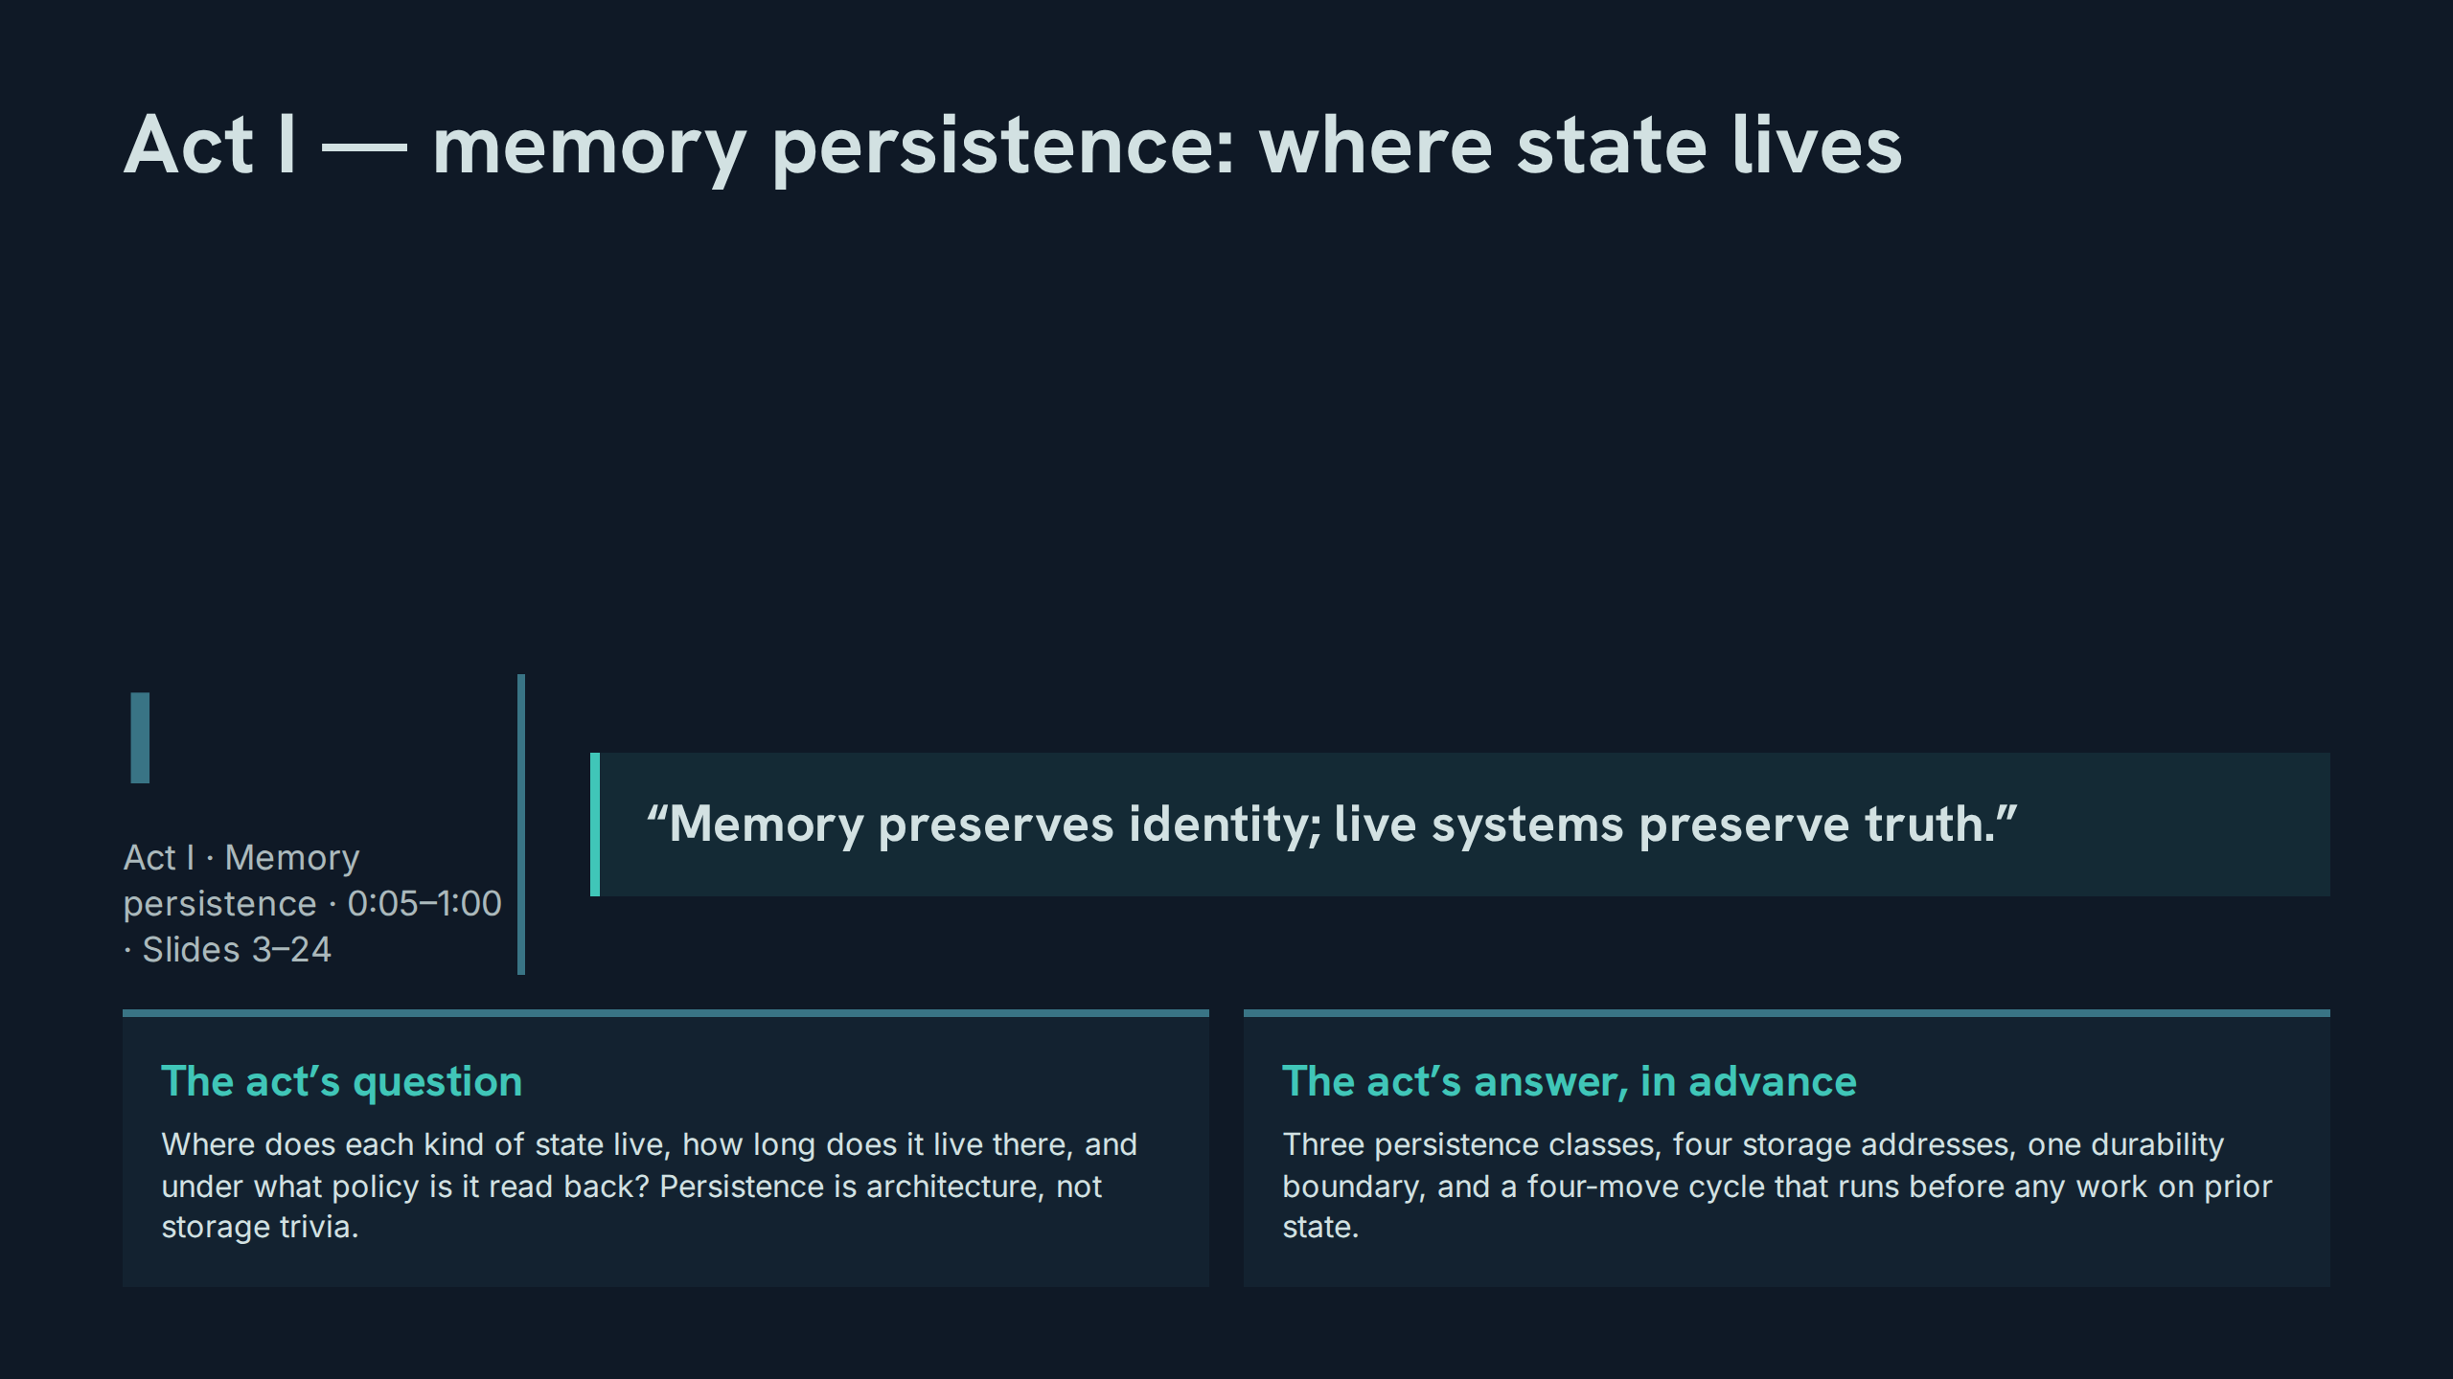
Notes:
Act I — memory persistence: where state lives
Speaker notes: Teaching hook: read the verbatim line aloud and parse it — 'preserves identity' assigns memory a job; 'preserve truth' denies it the other job. Drill (3–4 minutes): participants name one decision from the past week that needed identity (how we work) and one that needed truth (what is true now), and say which store each came from. Discussion prompt: what breaks first when a system stores truth-claims in the identity store?

Slide 4
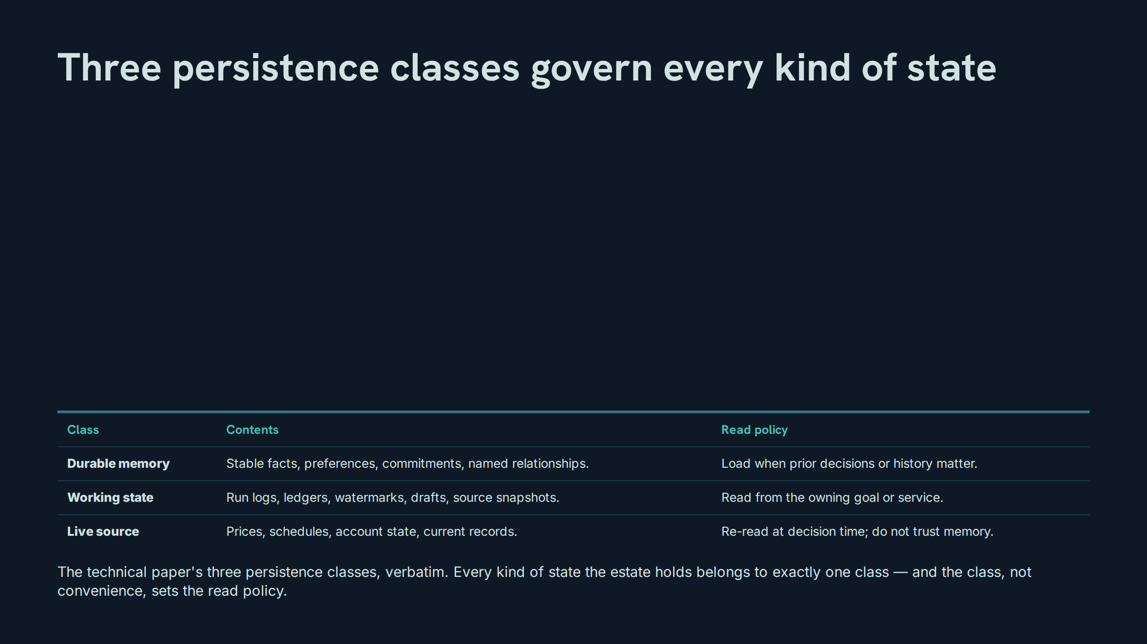
Notes:
Three persistence classes govern every kind of state
Speaker notes: Teaching hook: the table is the whole of Act I in miniature — contents decide the class, and the class decides how the state may be read. Drill (3–4 minutes): cover the read-policy column and have the room derive each policy from the contents column alone; a policy that cannot be derived has not been understood. Discussion prompt: which class is most often mis-filed in practice, and what does the mis-filing cost?

Slide 5
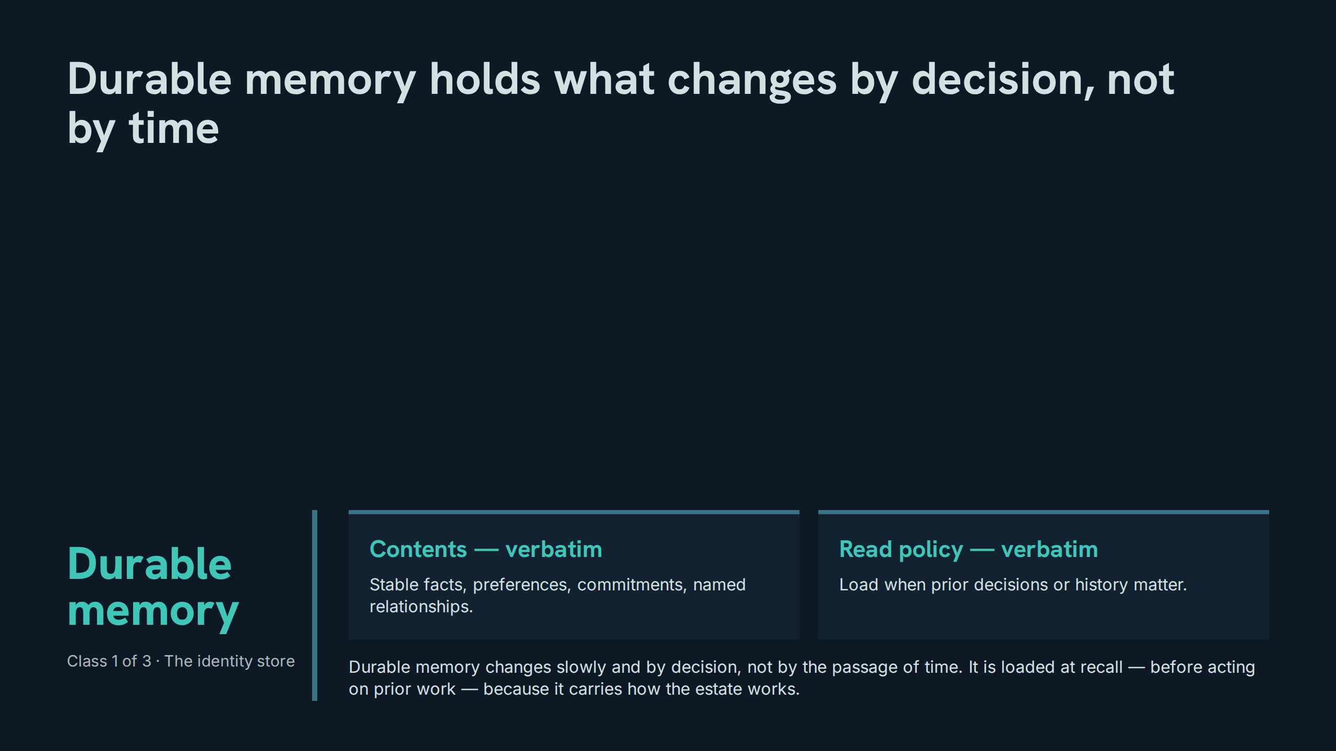
Notes:
Durable memory holds what changes by decision, not by time
Speaker notes: Teaching hook: the test for this class is the change mechanism — if a fact changes only when someone decides, it is durable; if it changes while nobody is looking, it is not. Drill (3–4 minutes): participants propose three candidate facts; the room applies the change-mechanism test to each and defends the verdict. Discussion prompt: why are named relationships durable memory rather than working state?

Slide 6
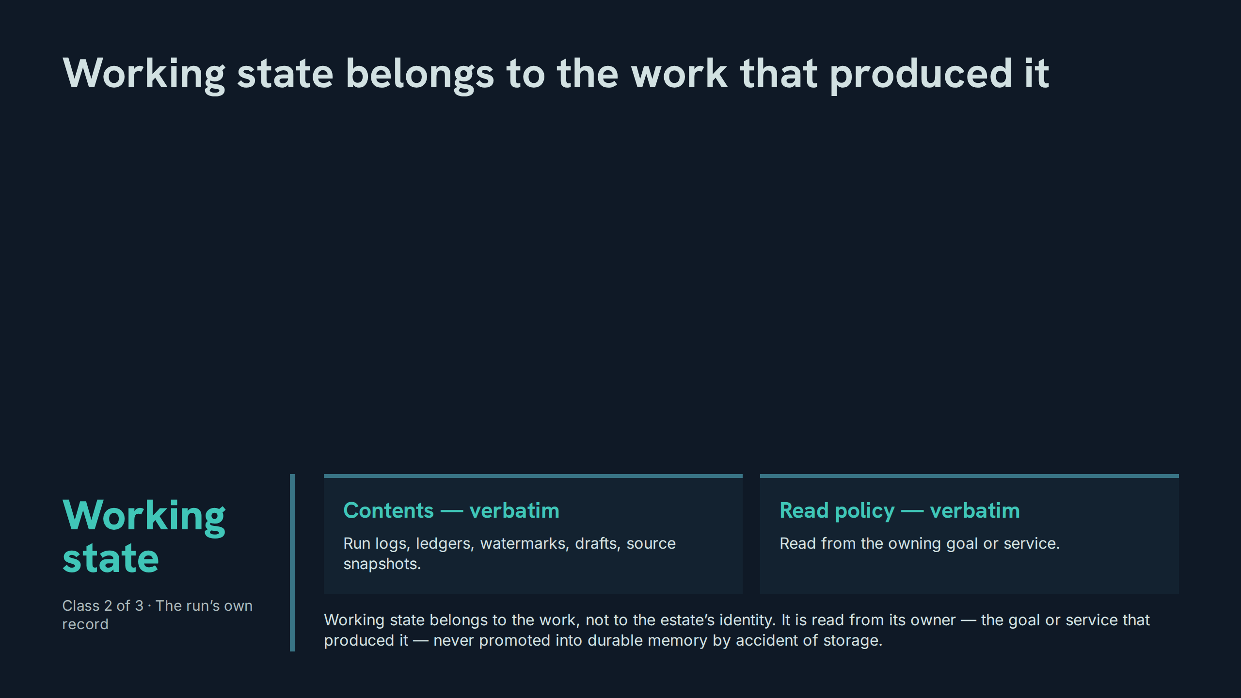
Notes:
Working state belongs to the work that produced it
Speaker notes: Teaching hook: ownership is the read policy — a watermark read from anywhere but its owning service is a number without provenance. Drill (3–4 minutes): given a ledger, a draft, and a snapshot, participants name each item’s owning goal or service and what breaks if it is read from a copy instead. Discussion prompt: when, if ever, may working state be promoted into durable memory?

Slide 7
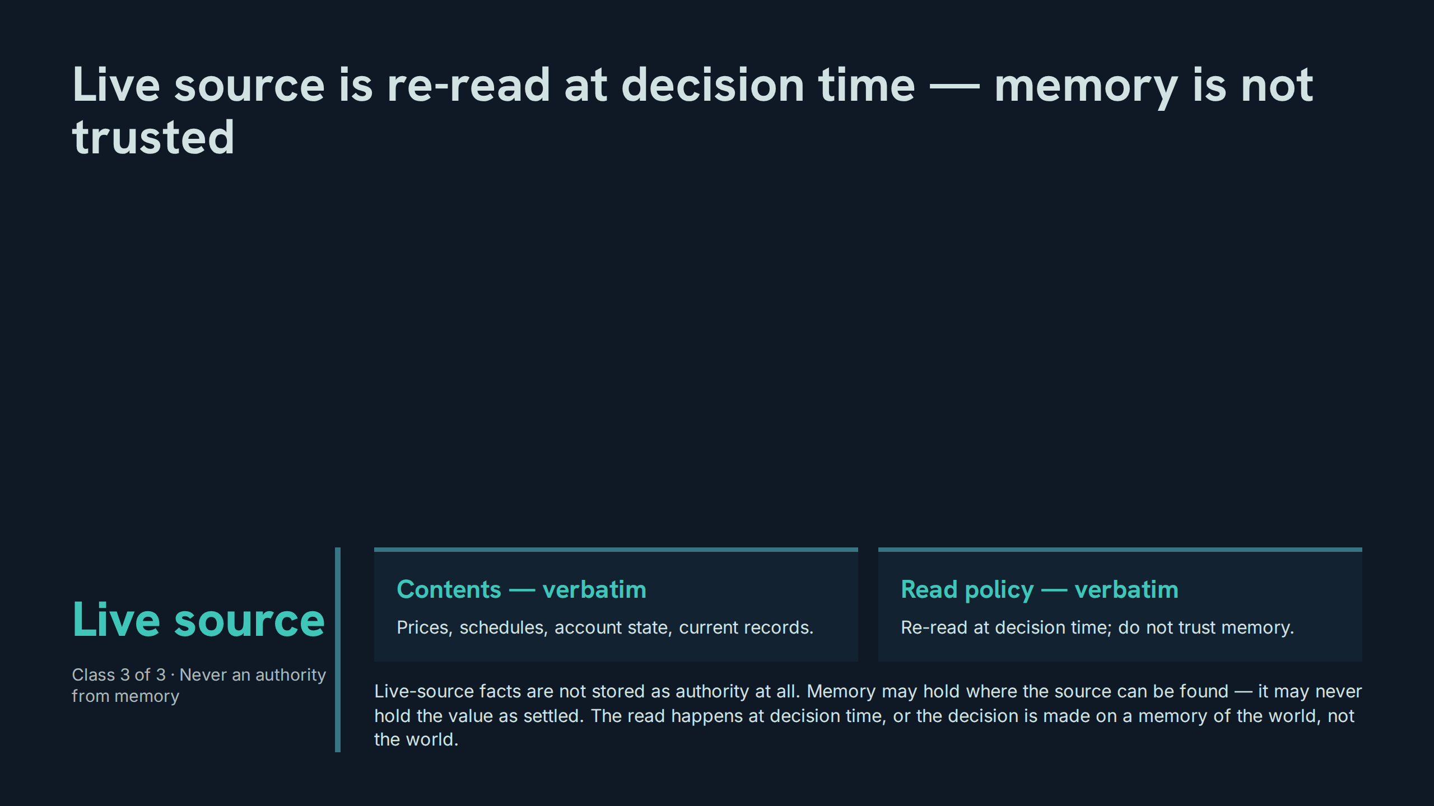
Notes:
Live source is re-read at decision time — memory is not trusted
Speaker notes: Teaching hook: 'do not trust memory' is the paper’s own instruction, and it is absolute for this class — there is no freshness window in which a remembered price becomes safe. Drill (3–4 minutes): participants list four decisions they made this week and mark which ones silently used a remembered live-source value. Discussion prompt: why does the policy forbid trust rather than merely advise caution?

Slide 8
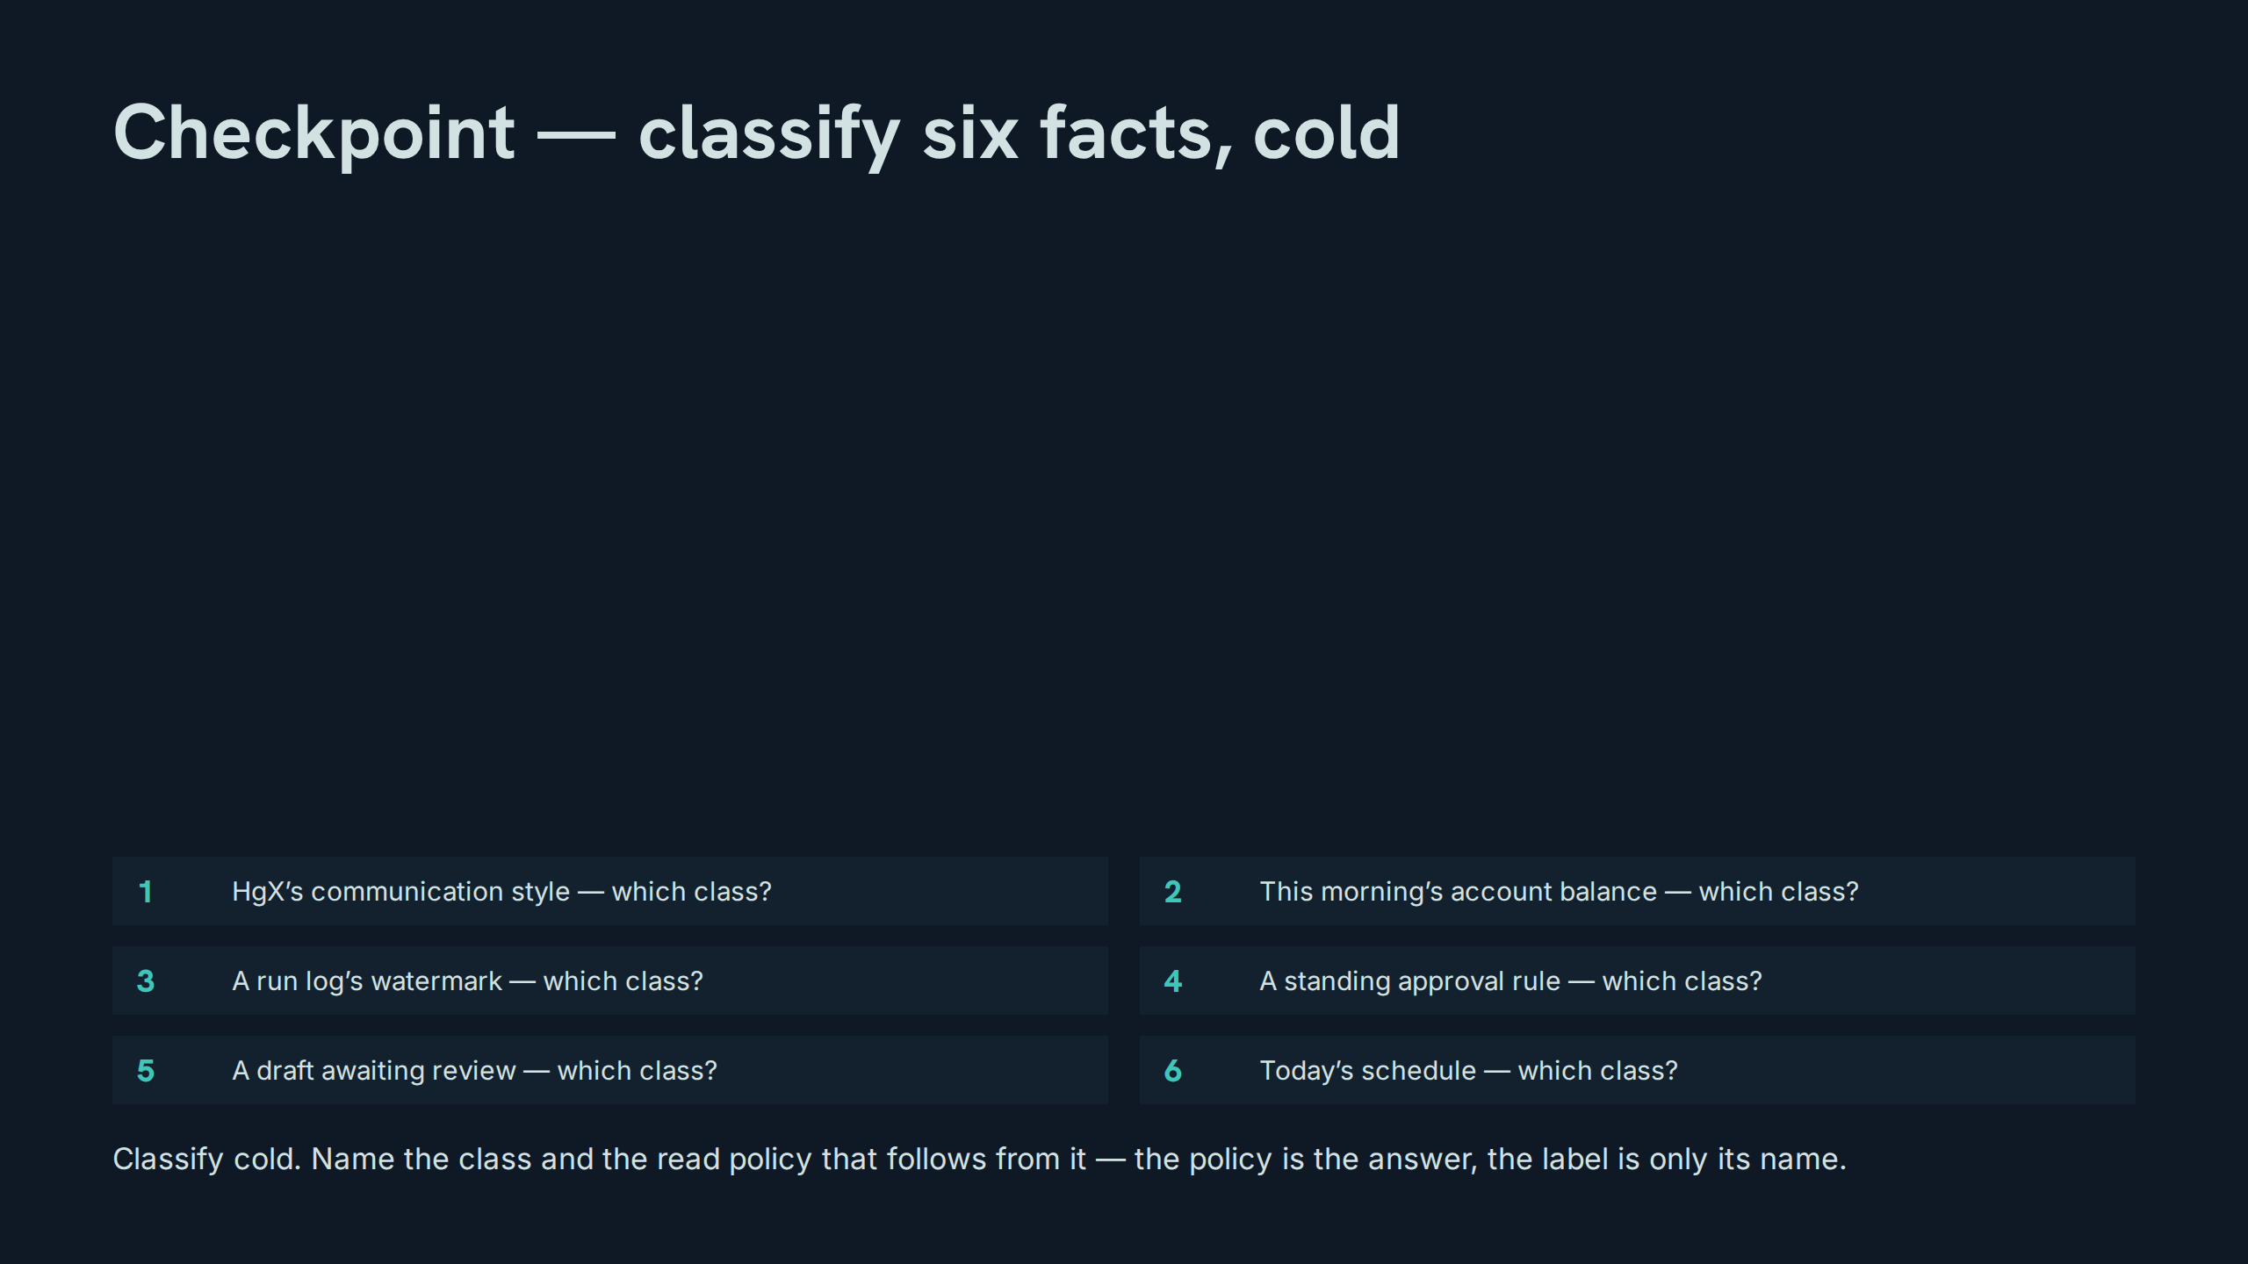
Notes:
Checkpoint — classify six facts, cold
Speaker notes: Teaching hook: the drill grades the policy, not the label — a correct class with a wrong read policy is a wrong answer. Drill (3–4 minutes): run all six cold, in random order; answers — durable, live, working, durable, working, live — each with its policy stated aloud. Discussion prompt: which of the six was hardest, and what property made it hard?

Slide 9
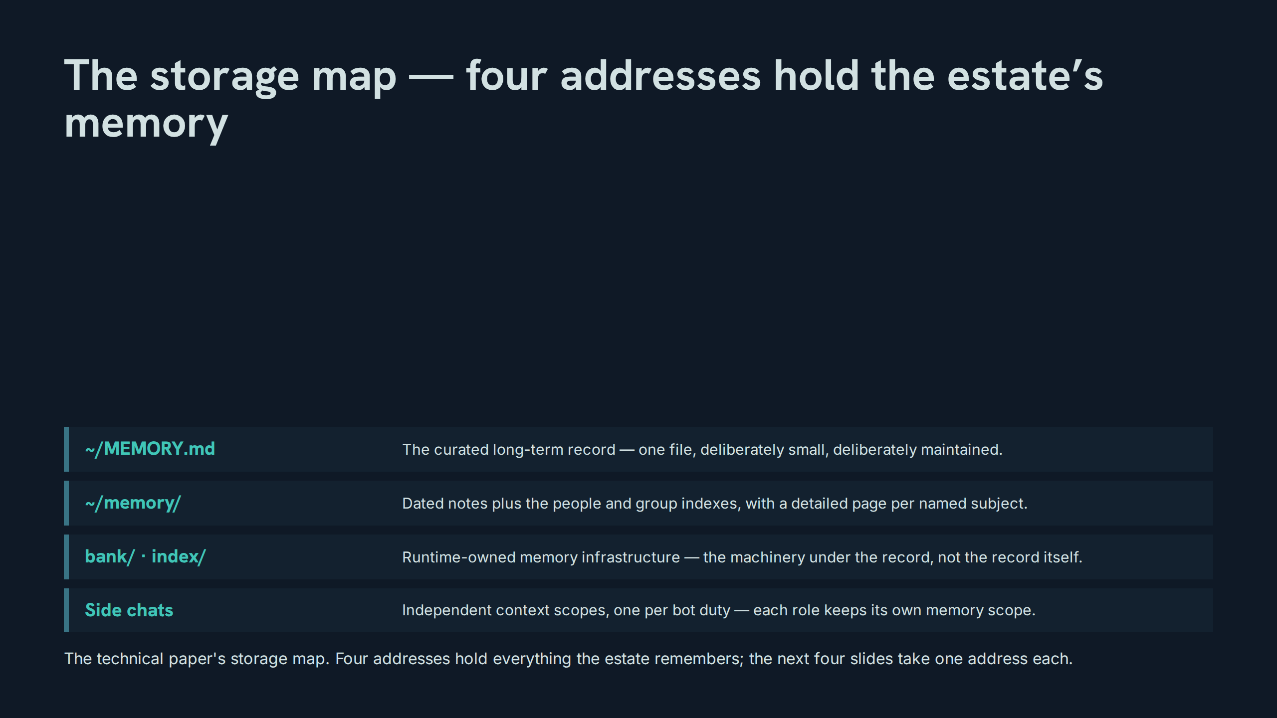
Notes:
The storage map — four addresses hold the estate’s memory
Speaker notes: Teaching hook: a storage map is a governance document — each address implies an owner, a write rule, and a read rule. Drill (3–4 minutes): the room assigns each of the six drill facts from slide 8 to its exact address, not just its class. Discussion prompt: why is the curated record one small file rather than a database of everything?

Slide 10
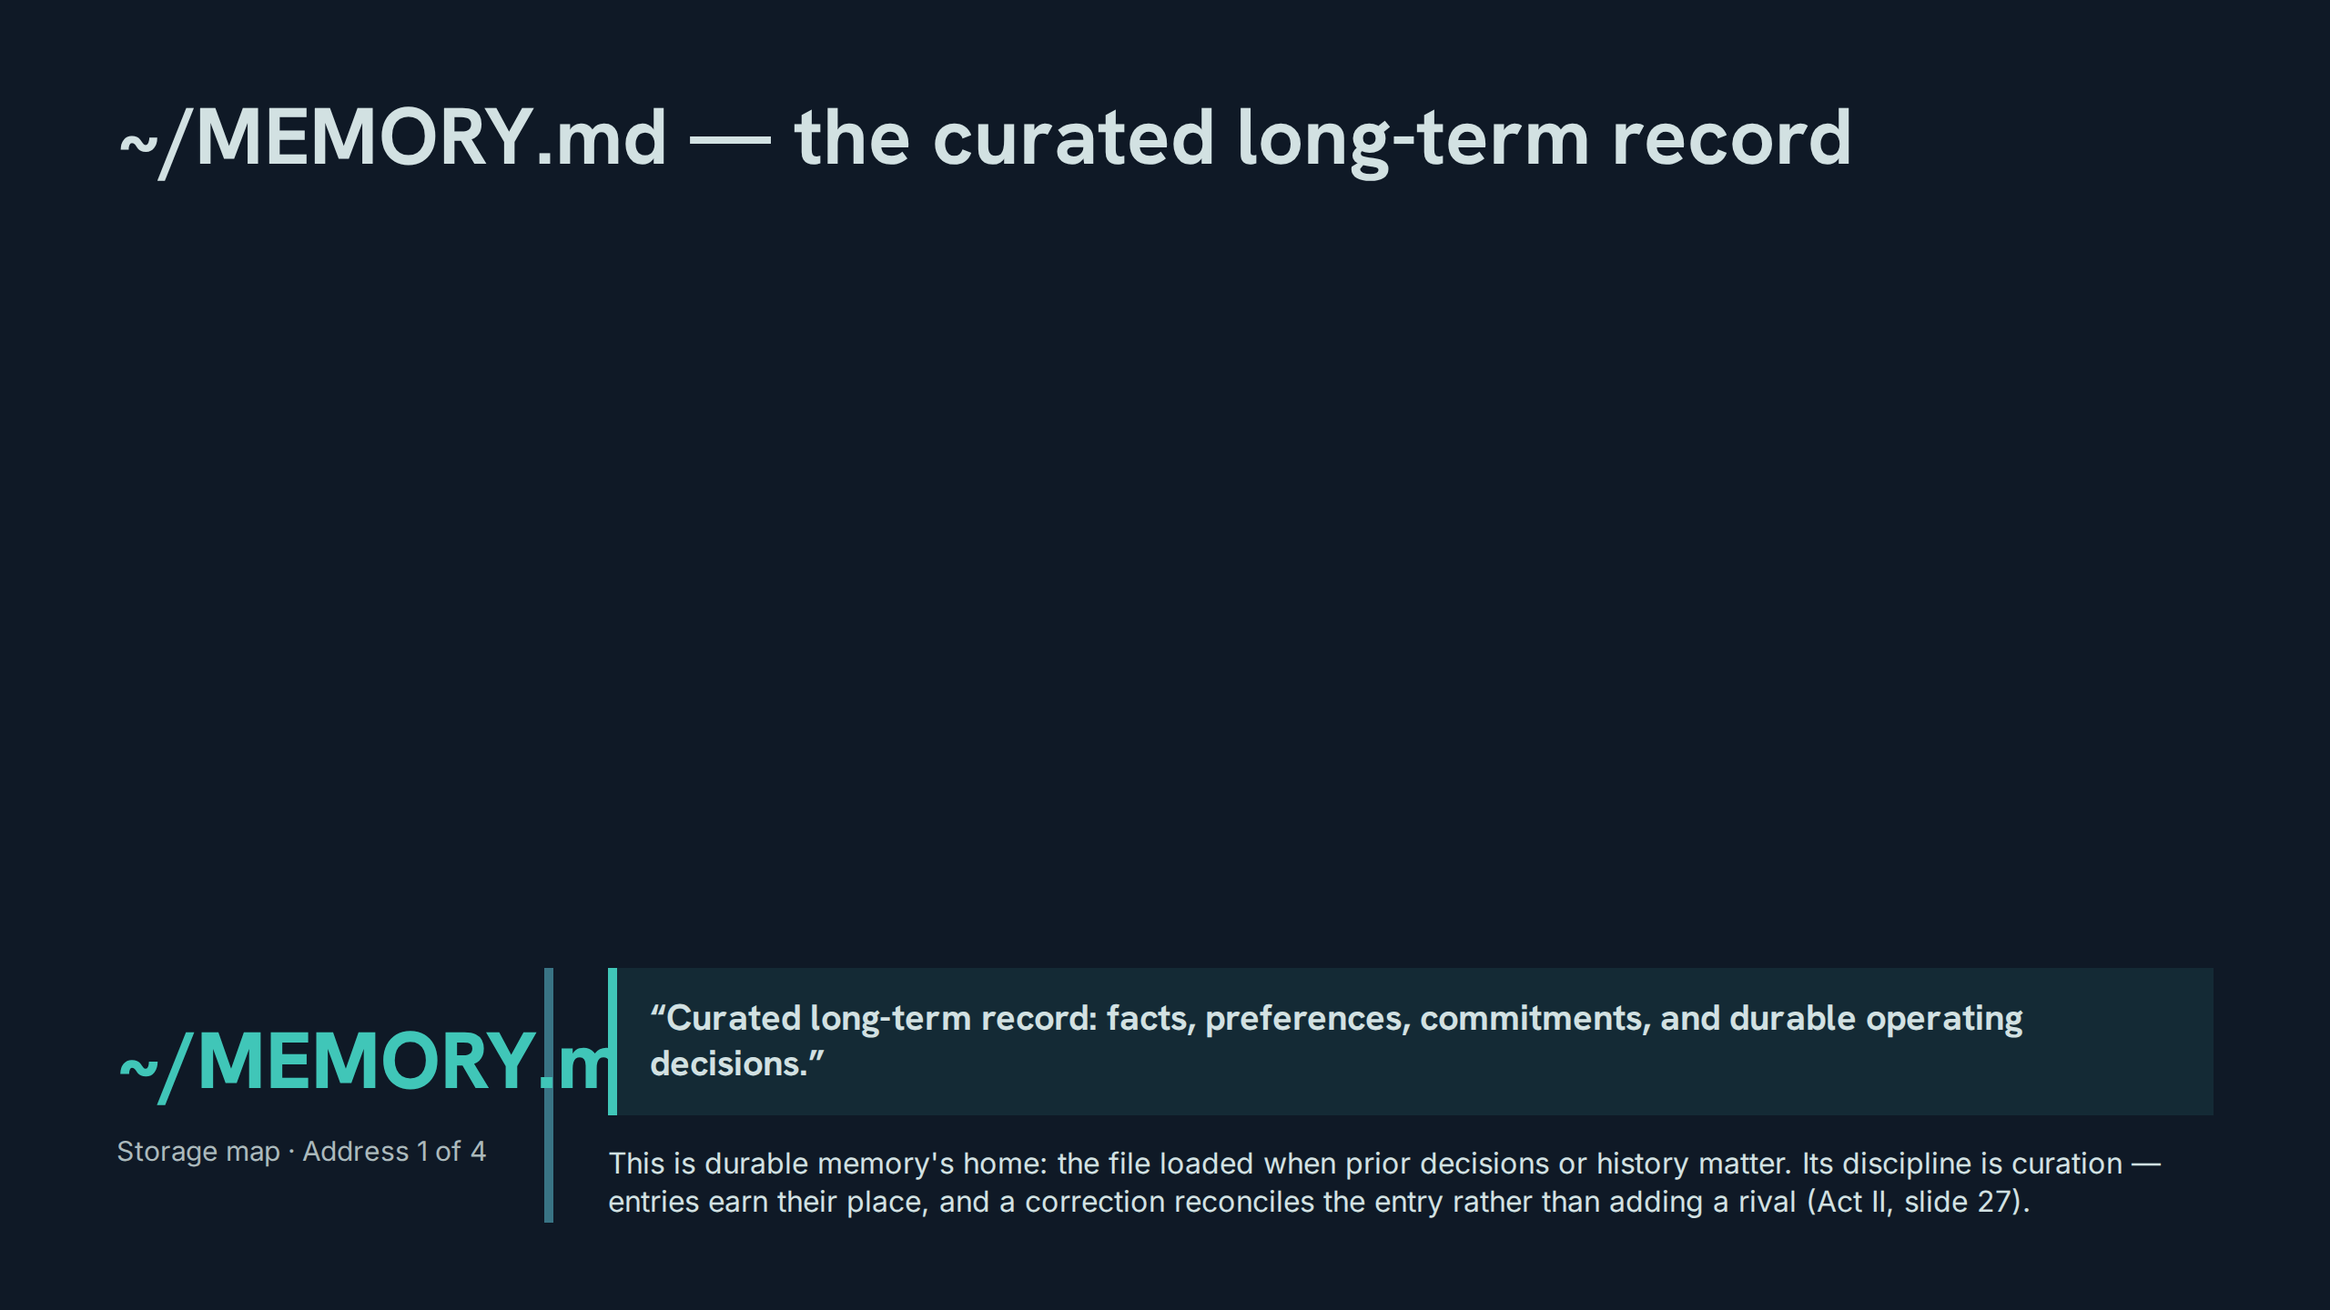
Notes:
~/MEMORY.md — the curated long-term record
Speaker notes: Teaching hook: the word to interrogate is 'curated' — this file is edited like a constitution, not appended like a log. Drill (3–4 minutes): participants draft one entry fit for this file and one that must be refused, and defend the refusal. Discussion prompt: what is the cost of this file growing by an order of magnitude?

Slide 11
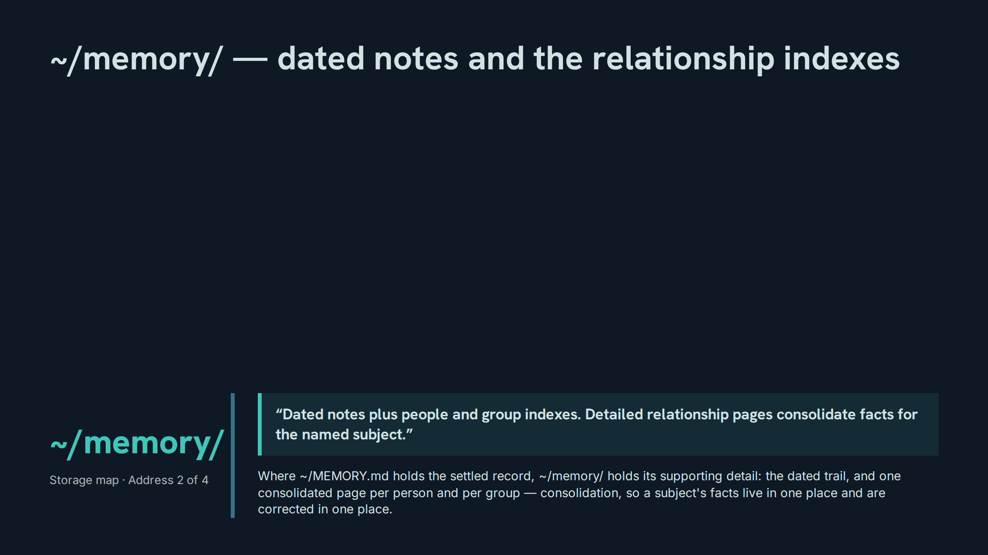
Notes:
~/memory/ — dated notes and the relationship indexes
Speaker notes: Teaching hook: consolidation is the design act — one page per subject means one place to correct, which is what makes the reconciliation rule executable. Drill (3–4 minutes): given three scattered facts about one person, participants state what consolidation does to each and where the correction would land. Discussion prompt: why do the indexes matter as much as the pages they index?

Slide 12
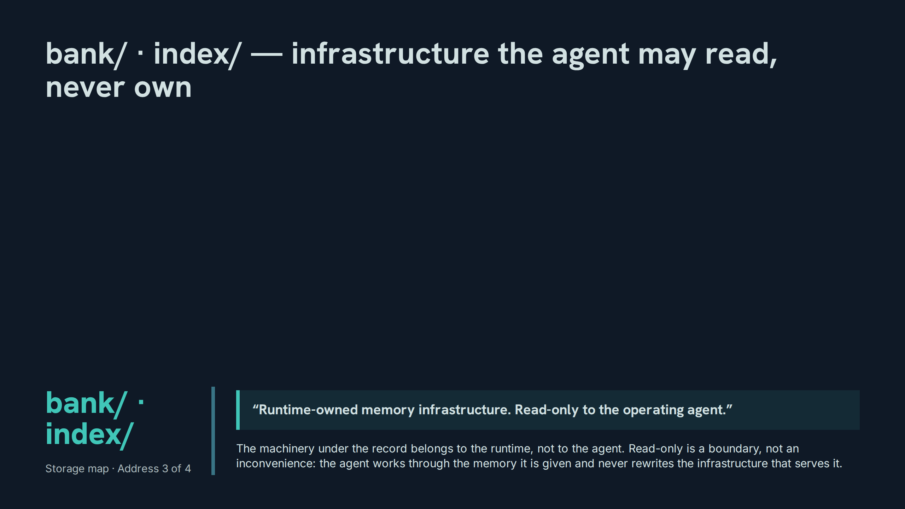
Notes:
bank/ · index/ — infrastructure the agent may read, never own
Speaker notes: Teaching hook: separate the record from its machinery — the agent is accountable for the record’s content, and explicitly not the owner of the store that carries it. Drill (3–4 minutes): participants sort six memory operations into 'agent may do' and 'runtime owns', and defend the two hardest. Discussion prompt: what failure becomes possible the day the agent can edit its own memory infrastructure?

Slide 13
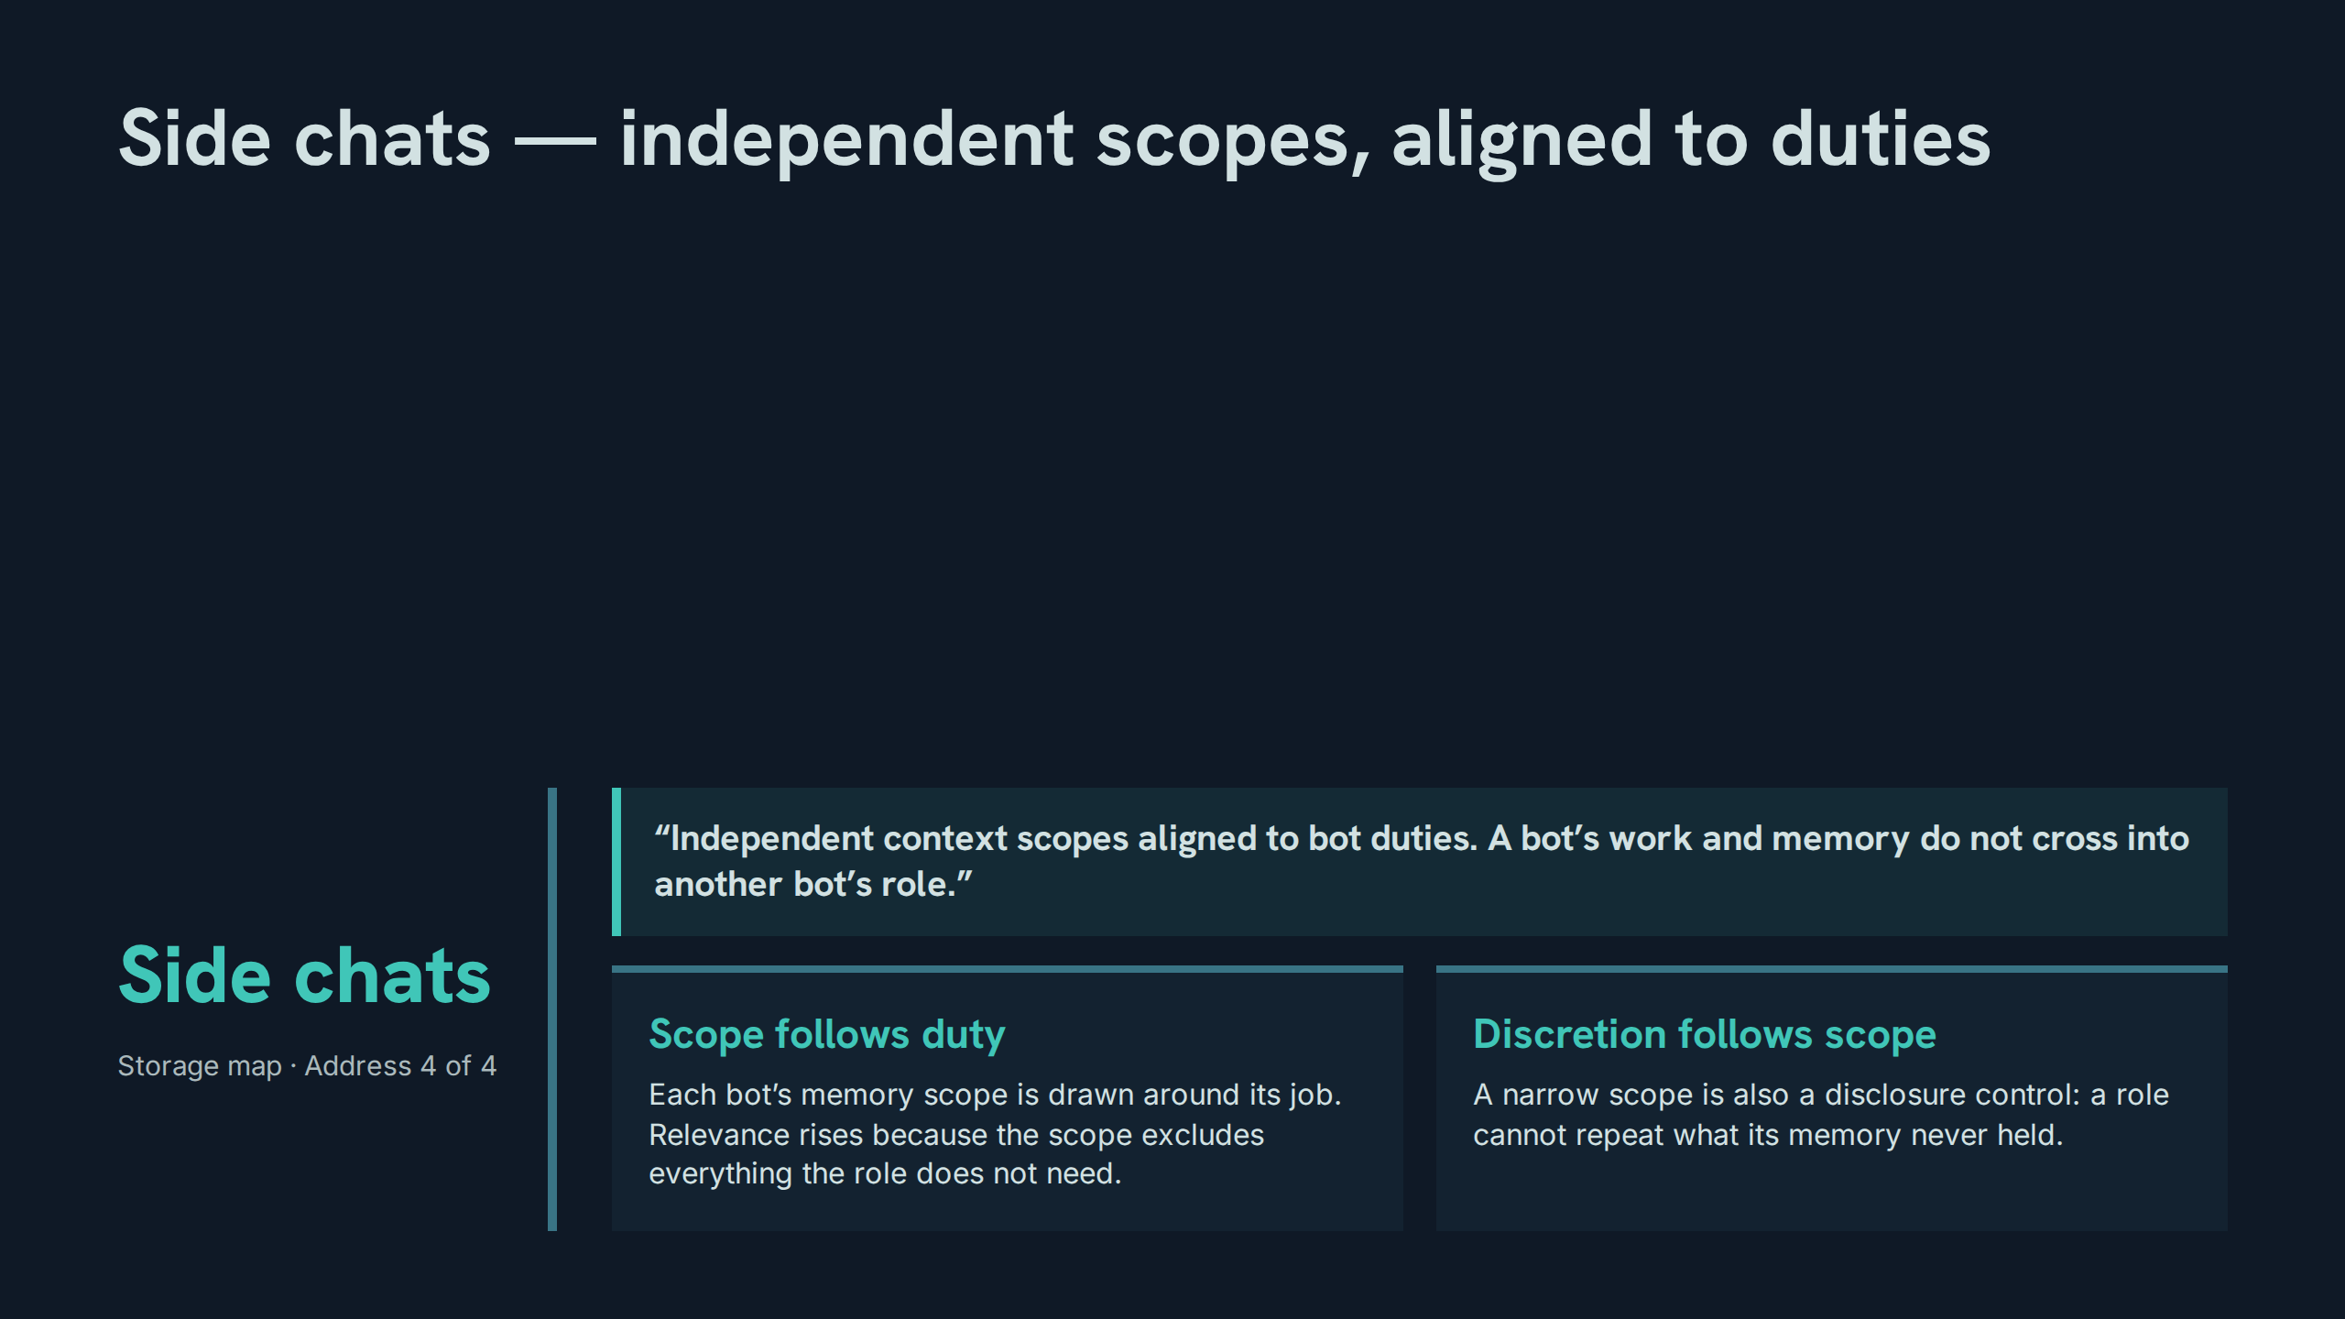
Notes:
Side chats — independent scopes, aligned to duties
Speaker notes: Teaching hook: scoping does double duty — it is a relevance mechanism and a discretion mechanism in the same act. Drill (3–4 minutes): for three sample facts, participants name the one bot whose scope should hold each, and the bots whose scopes must not. Discussion prompt: what is lost when one general scope replaces duty-aligned scopes?

Slide 14
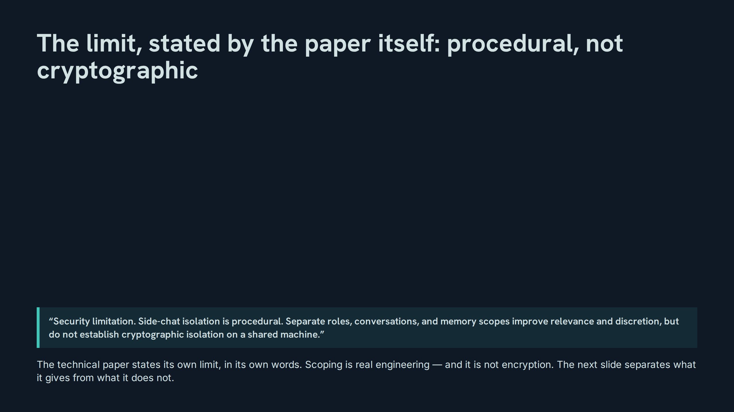
Notes:
The limit, stated by the paper itself: procedural, not cryptographic
Speaker notes: Teaching hook: honour the honesty of this slide — a paper that names its own isolation limit is more trustworthy than one that implies a stronger one. Drill (3–4 minutes): participants restate the limitation in one sentence without weakening any word of it, then name one claim an over-eager summary might wrongly make. Discussion prompt: why must this limitation be quoted, never paraphrased, when the system is described to others?

Slide 15
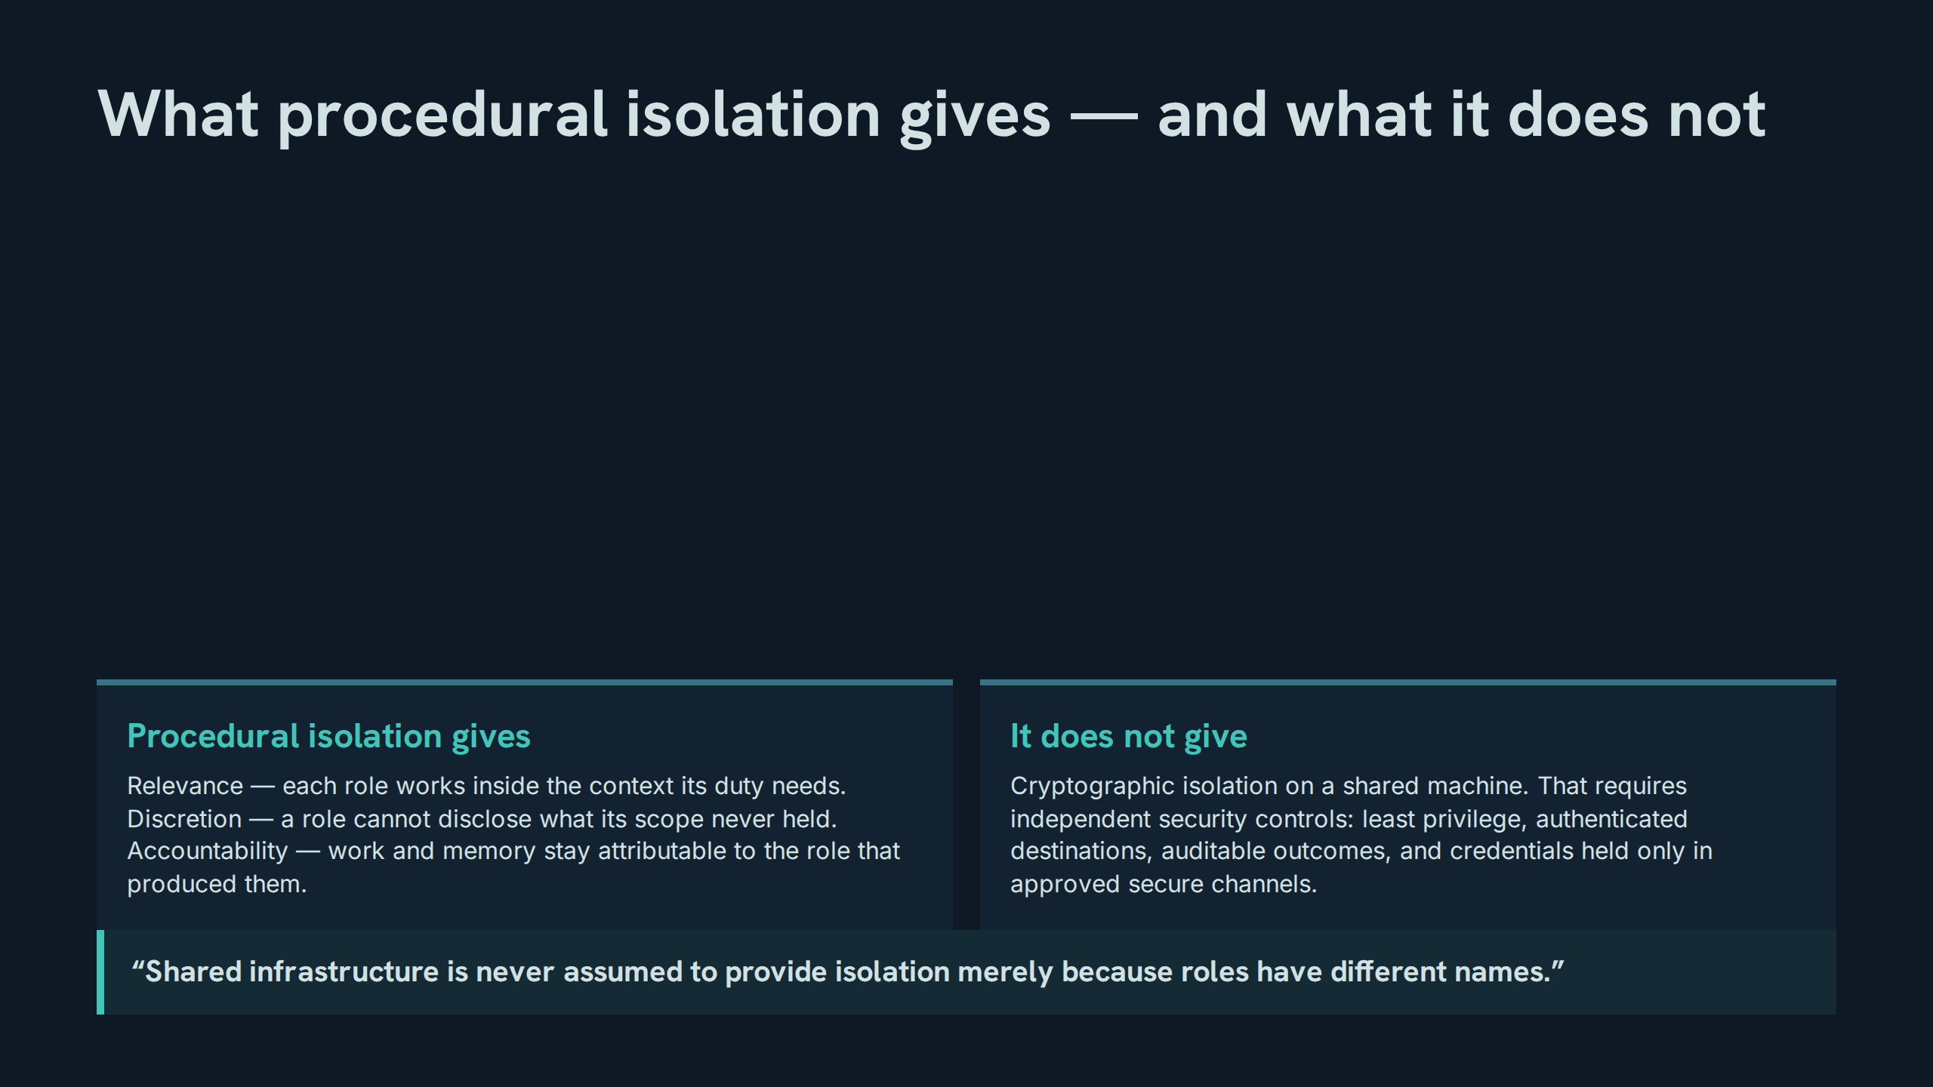
Notes:
What procedural isolation gives — and what it does not
Speaker notes: Teaching hook: the verbatim line at the foot of this slide is the general law of which side-chat scoping is one instance — names are not boundaries. Drill (3–4 minutes): participants take one estate mechanism each and state, in the gives / does-not-give format, exactly what it guarantees. Discussion prompt: where else in the system could a name be mistaken for a boundary?

Slide 16
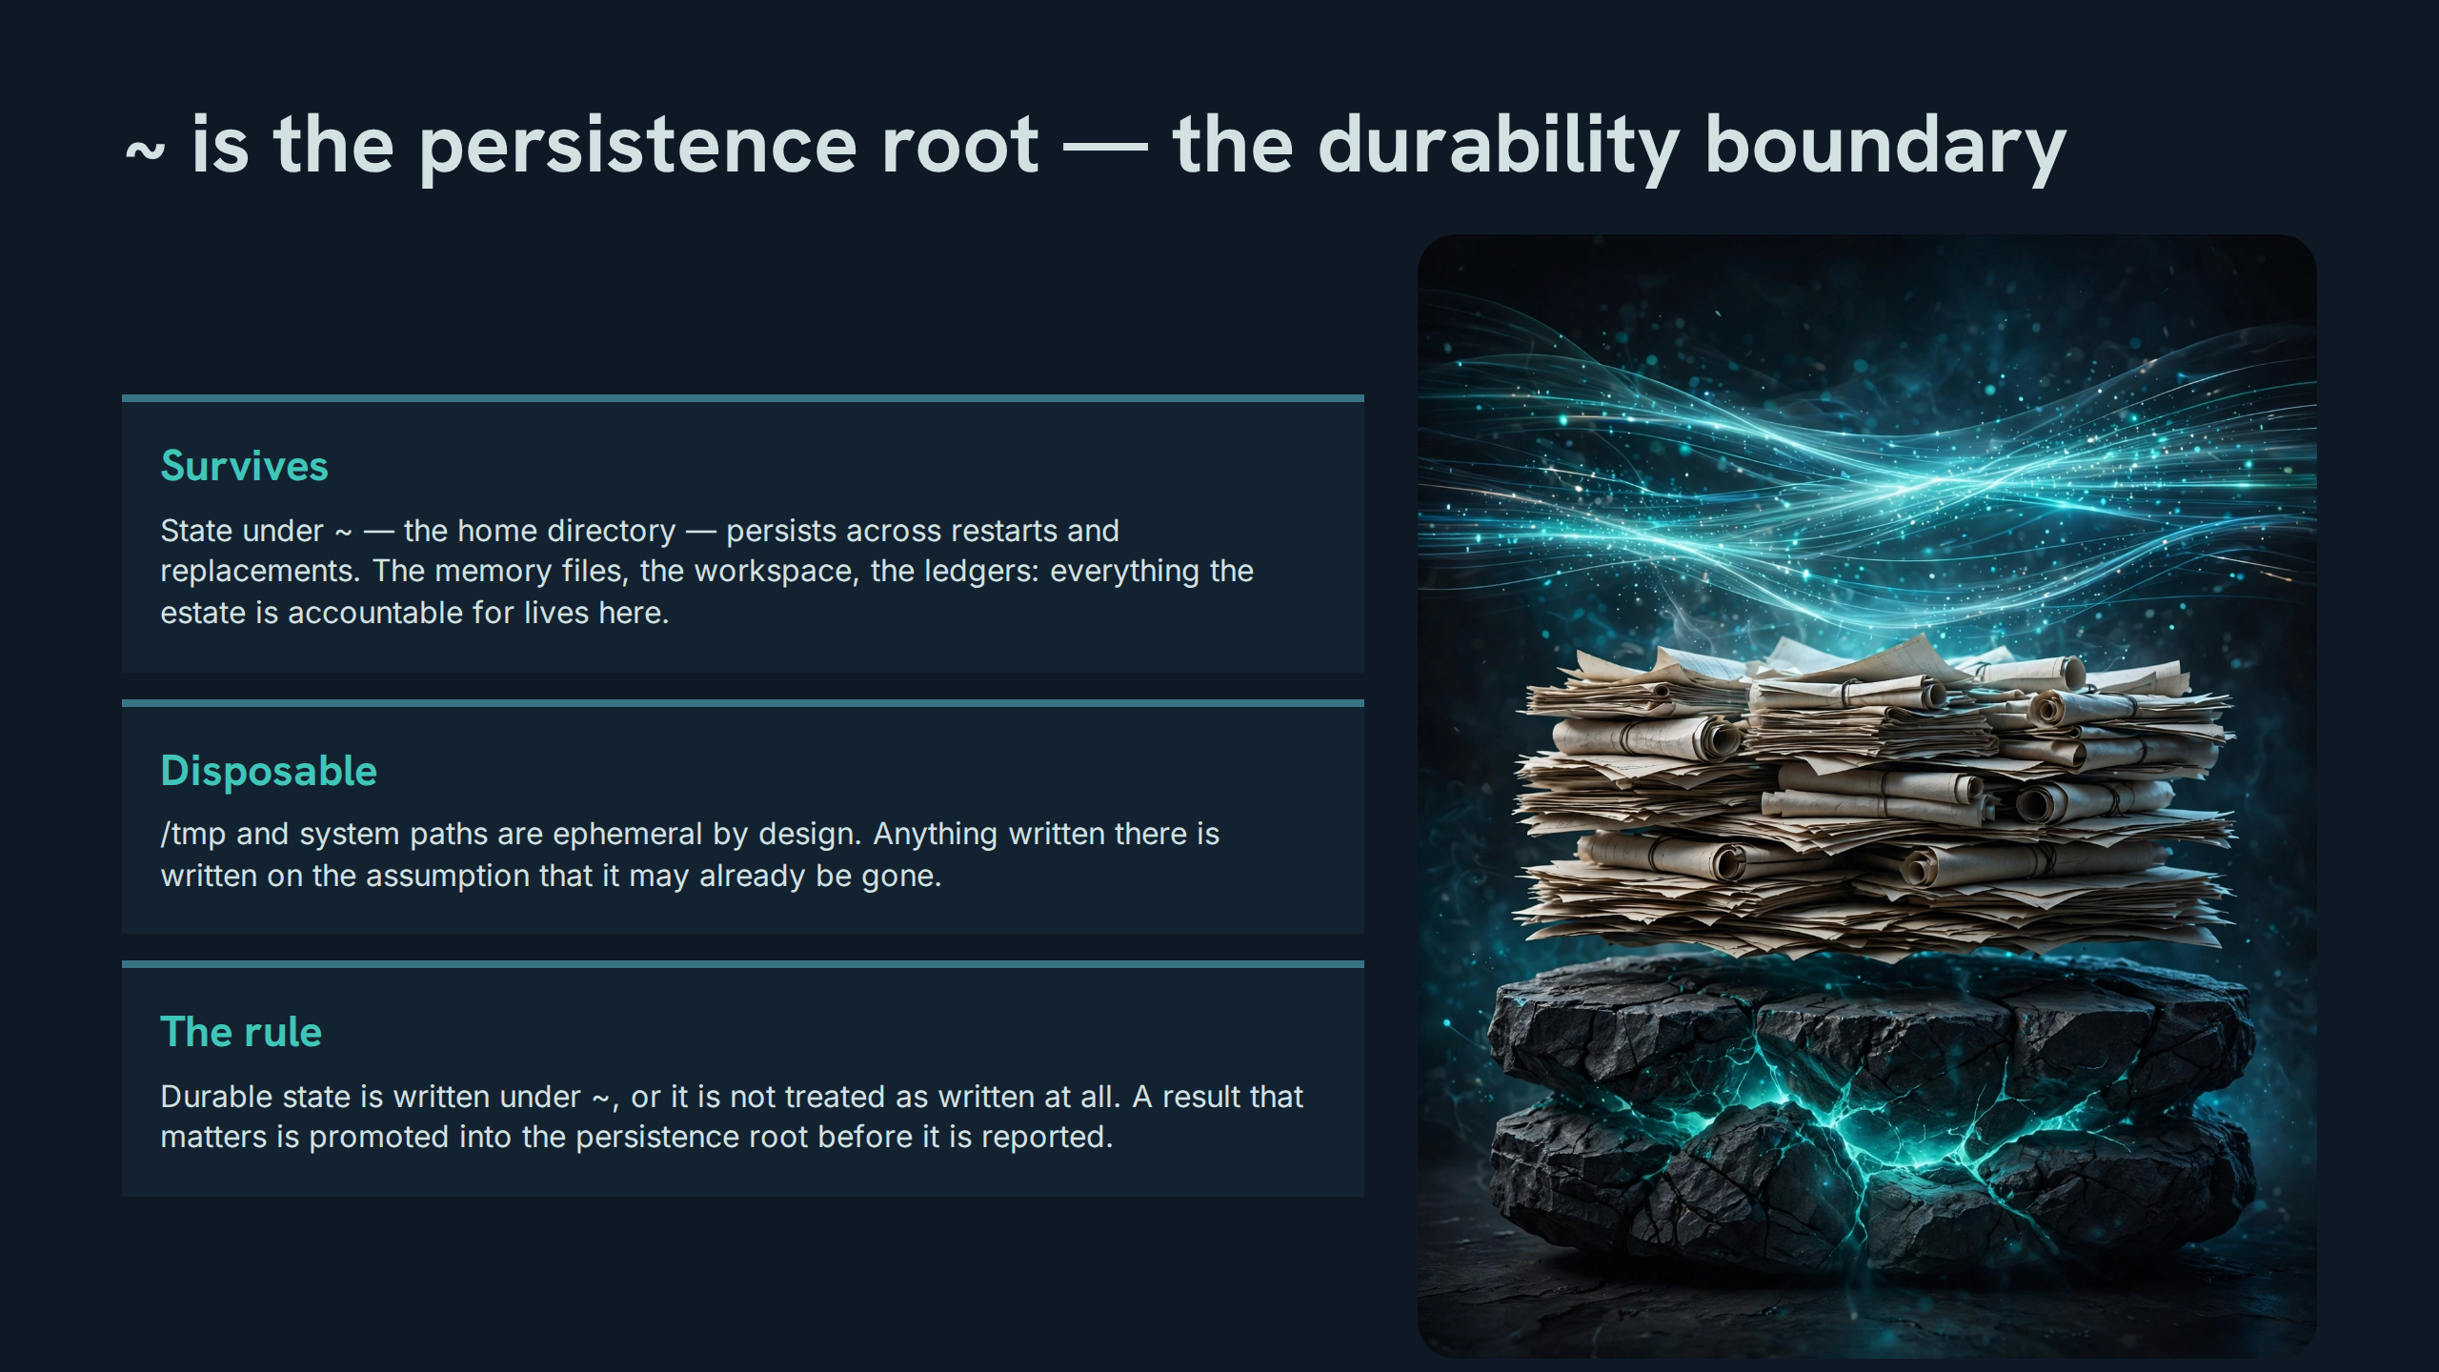
Notes:
~ is the persistence root — the durability boundary
Speaker notes: Teaching hook: the boundary is a line on the filesystem with legal force inside the estate — one side survives, the other side is scratch, and confusing them loses work silently. Drill (3–4 minutes): participants audit five sample artifacts, name where each currently lives, and state which must be promoted before being reported. Discussion prompt: why does the rule say 'not treated as written' rather than merely 'should be moved'?

Slide 17
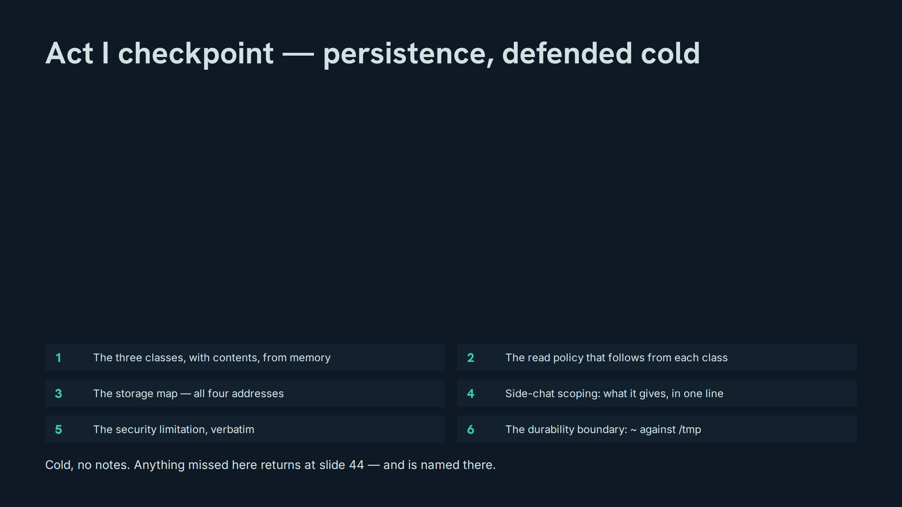
Notes:
Act I checkpoint — persistence, defended cold
Speaker notes: Teaching hook: a checkpoint is a measurement, not a review — misses are data for the closing self-check, not occasions for re-teaching on the spot. Drill (3–4 minutes): run the six items in random order, one participant each, with the verbatim limitation demanded word-perfect. Discussion prompt: which item produced the most hesitation, and what does that say about where the estate’s own practice is weakest?

Slide 18
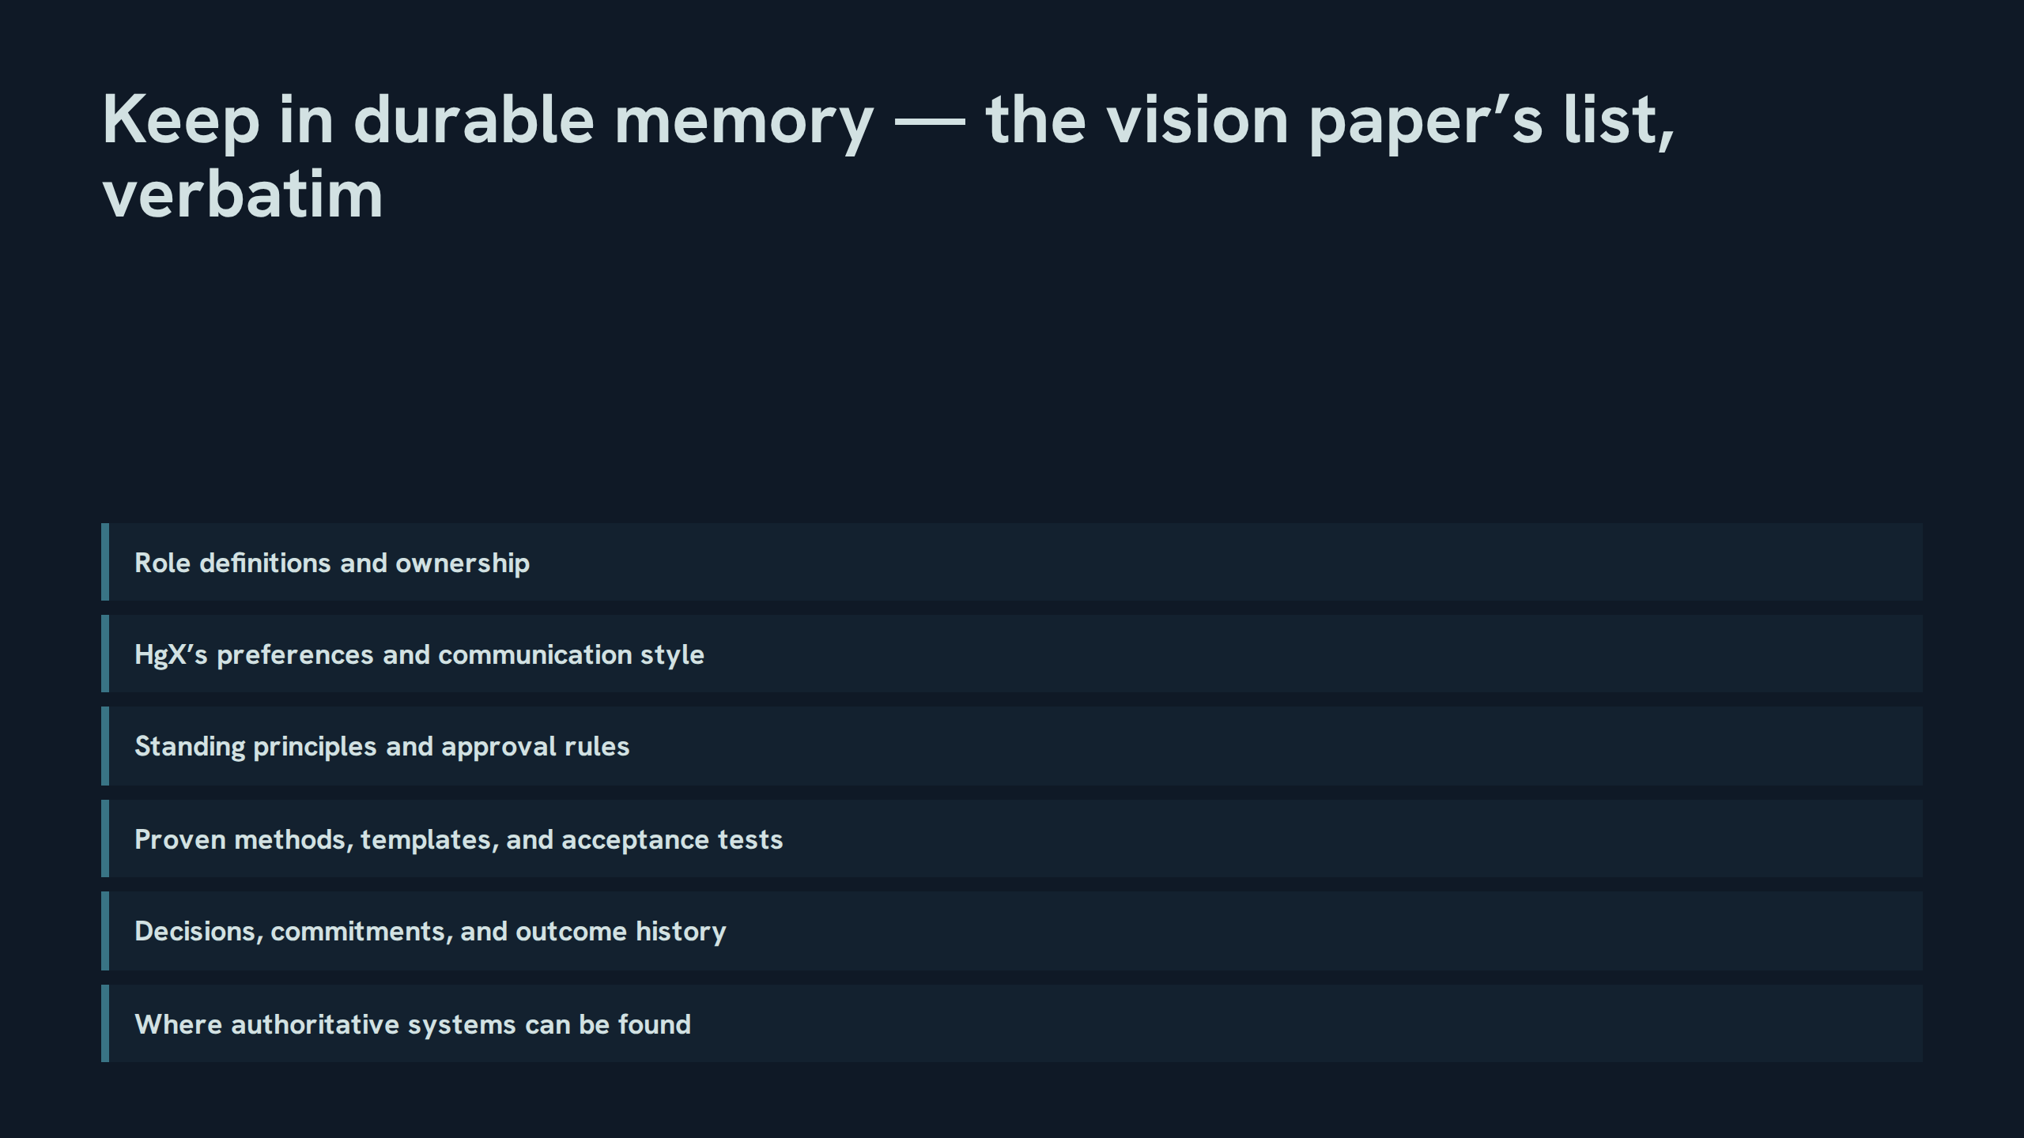
Notes:
Keep in durable memory — the vision paper’s list, verbatim
Speaker notes: Teaching hook: note the last item — durable memory holds pointers to authority, not copies of it; the map is durable, the territory is re-read. Drill (3–4 minutes): the room recites the six items in order, then explains for each why it changes by decision rather than by time. Discussion prompt: which item is most often omitted from real memory systems, and what symptom does its absence produce?

Slide 19
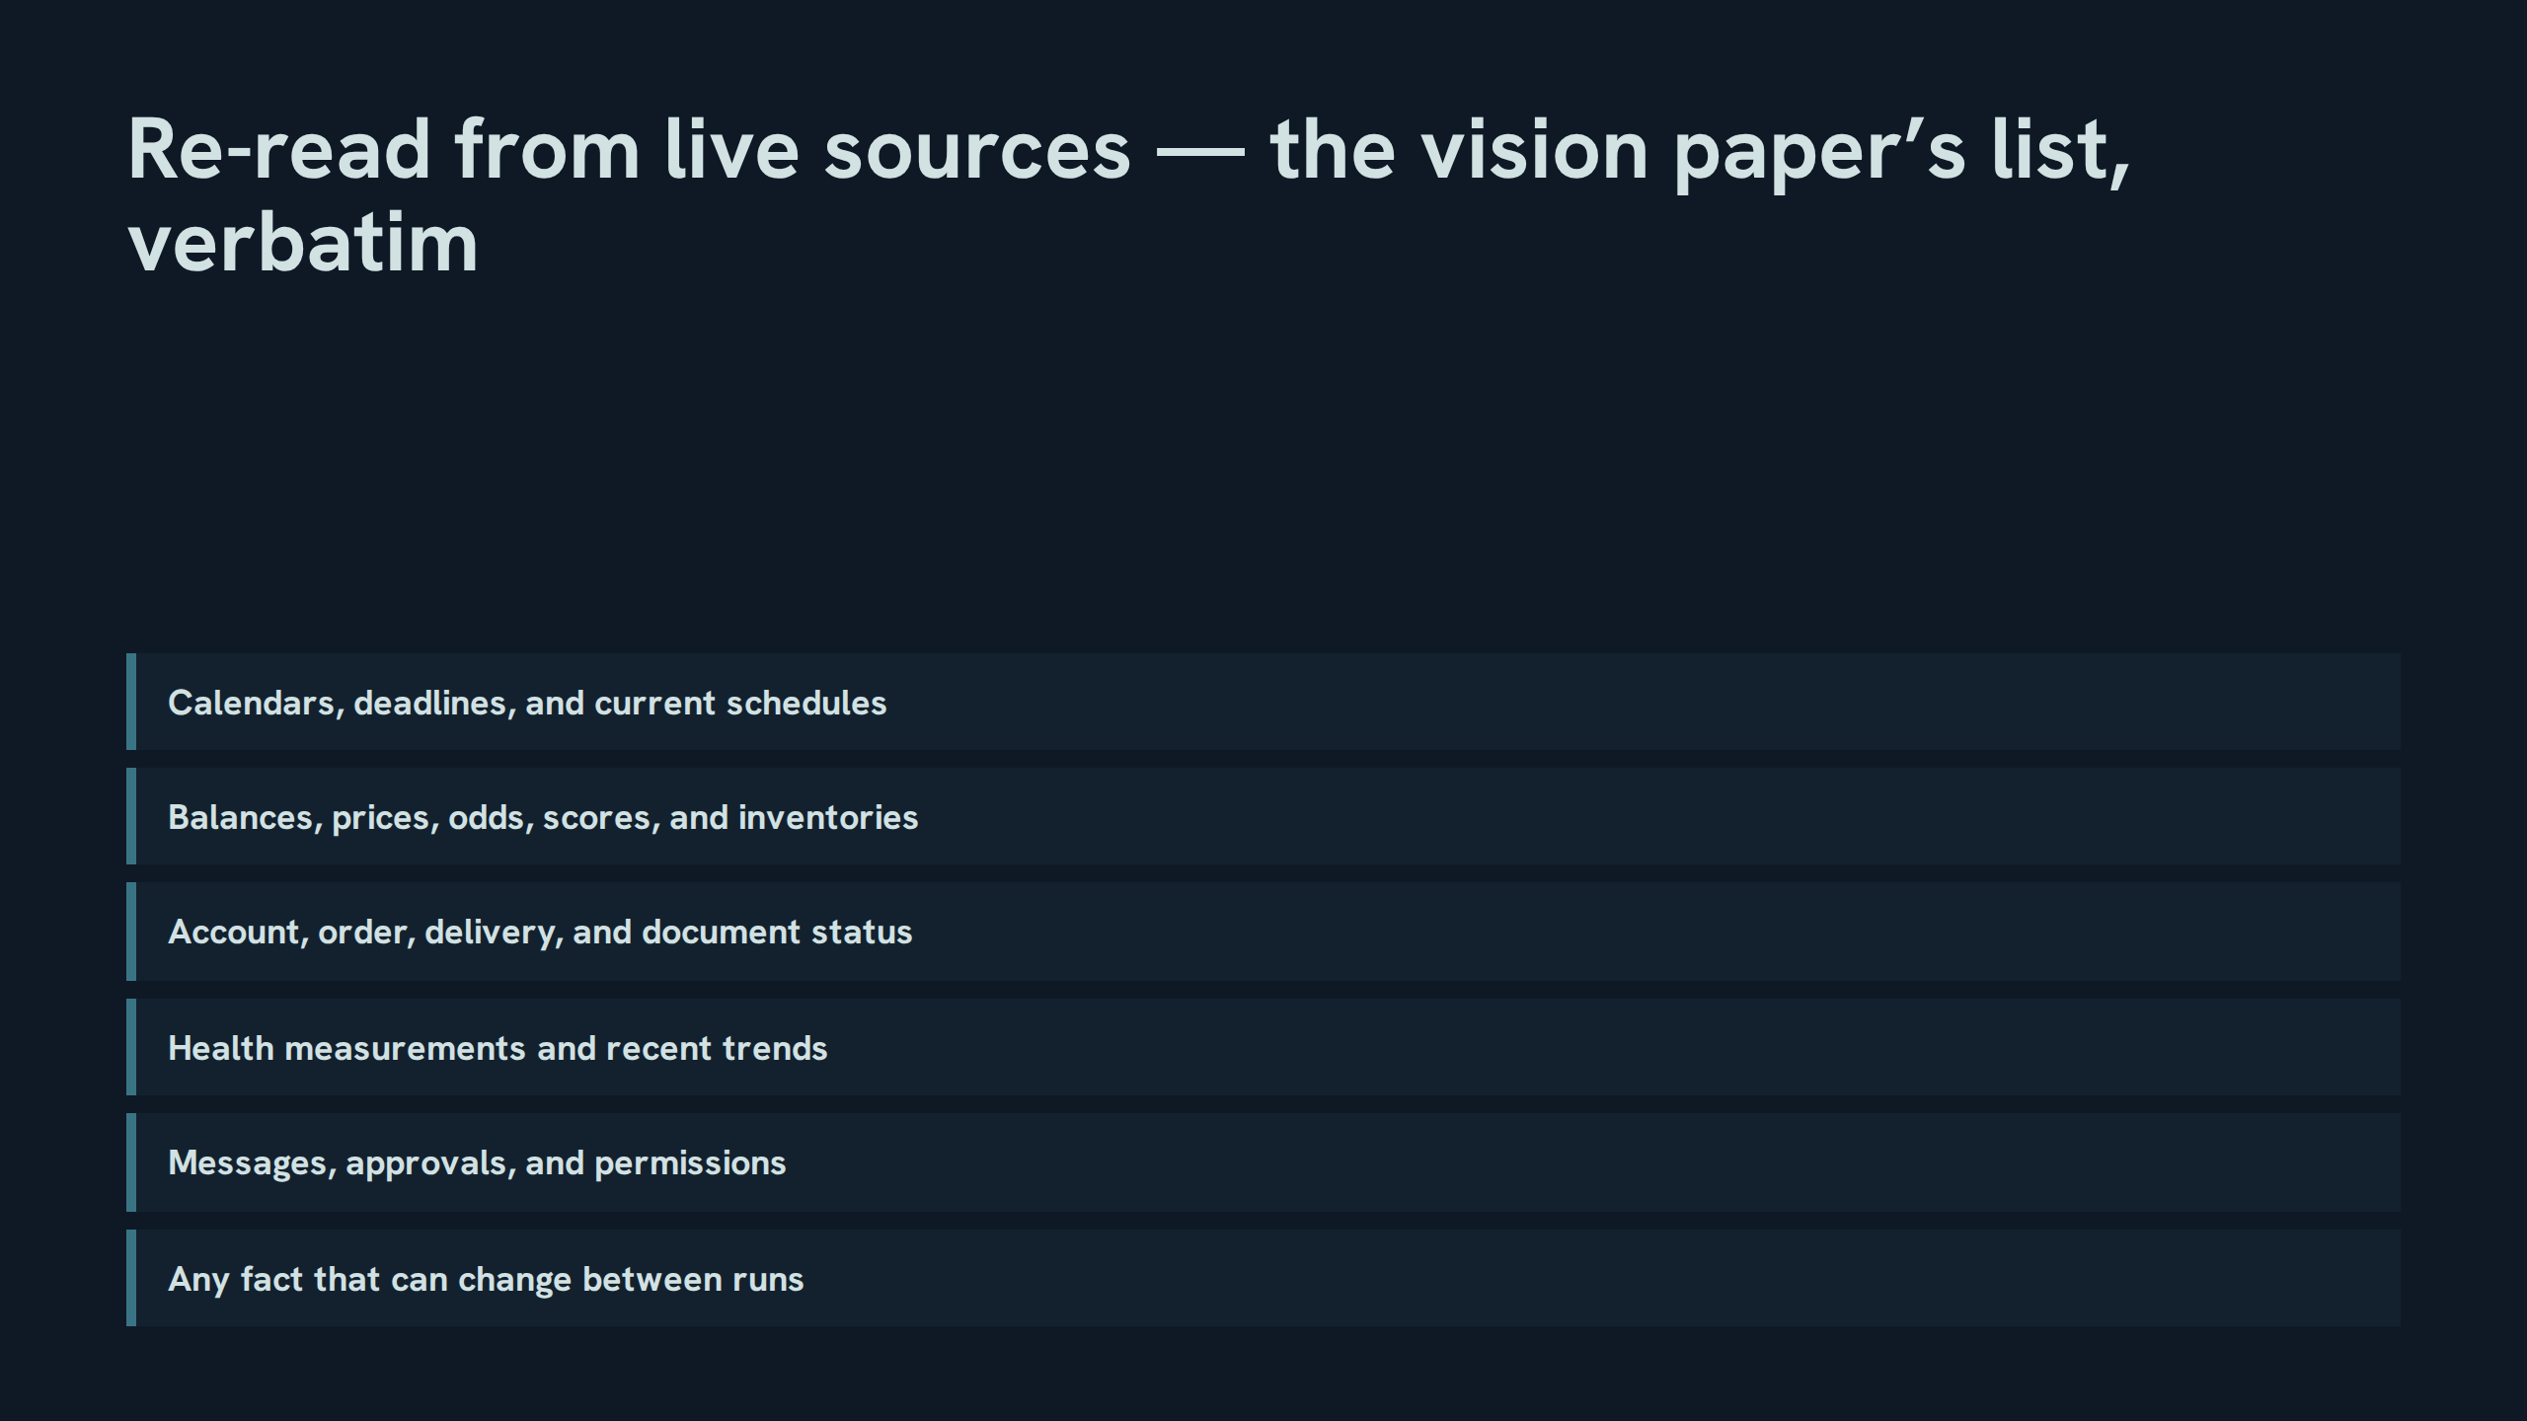
Notes:
Re-read from live sources — the vision paper’s list, verbatim
Speaker notes: Teaching hook: the final item is the generative rule — the first five are examples, the sixth decides every case the list did not foresee. Drill (3–4 minutes): participants propose four new facts; the room rules each in or out using only the sixth item’s test — can it change between runs? Discussion prompt: why does a list that ends in a rule outperform a longer list without one?

Slide 20
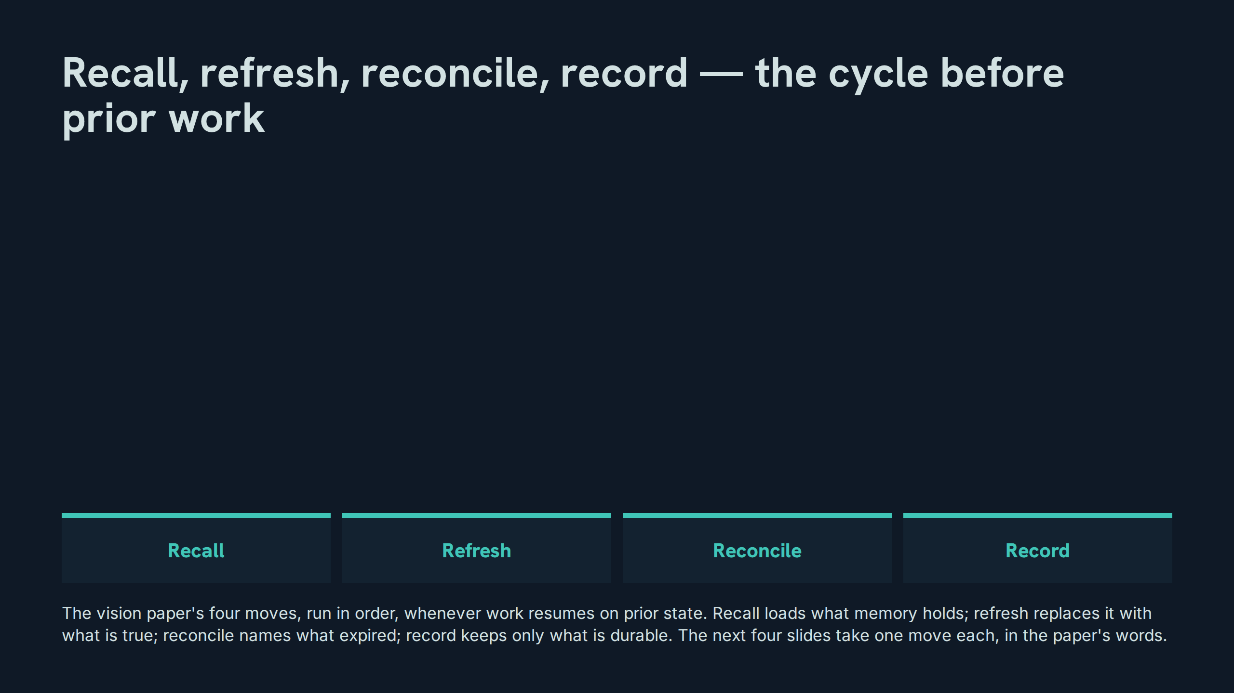
Notes:
Recall, refresh, reconcile, record — the cycle before prior work
Speaker notes: Teaching hook: the order is the doctrine — refresh before reconcile, because you cannot name what expired until you have read what is true now. Drill (3–4 minutes): the room walks one concrete resumption (a paused project) through all four moves aloud, naming the artifact each move touches. Discussion prompt: which move is skipped most often under time pressure, and what does the skip look like a week later?

Slide 21
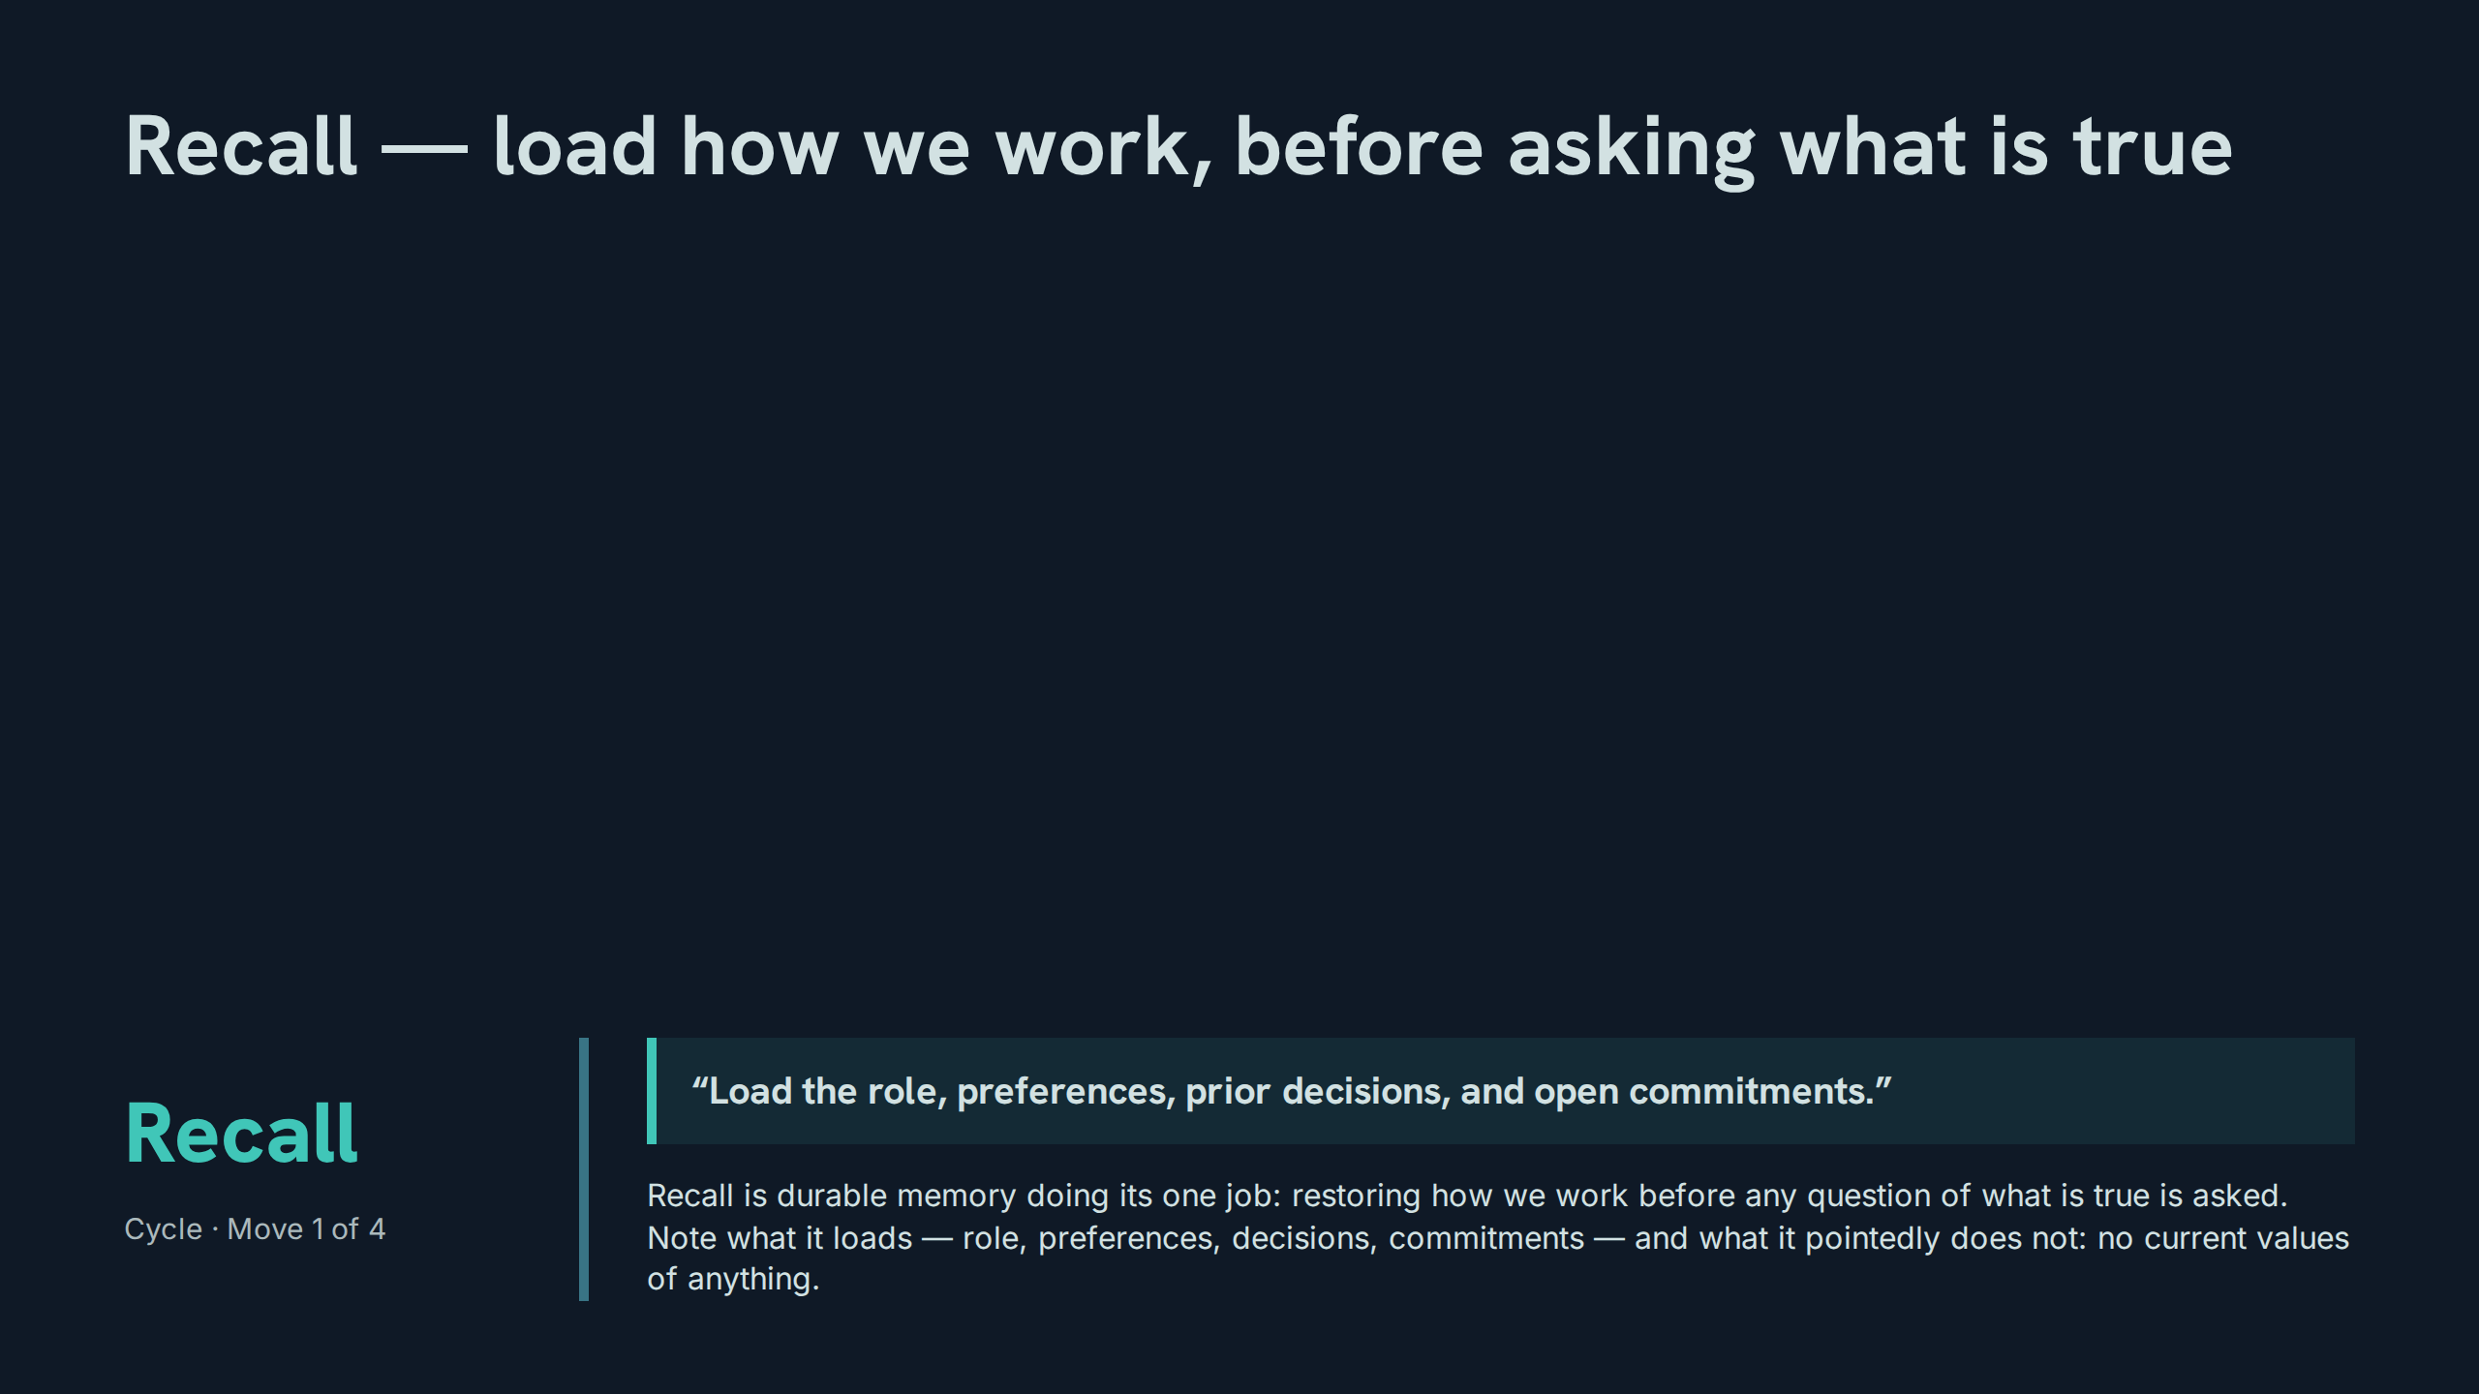
Notes:
Recall — load how we work, before asking what is true
Speaker notes: Teaching hook: recall’s list is a whitelist — if a loaded item can have changed since it was written, it does not belong to this move. Drill (3–4 minutes): participants audit a sample recall list of six items and strike every item that belongs to refresh instead. Discussion prompt: why must open commitments load at recall rather than be discovered mid-task?

Slide 22
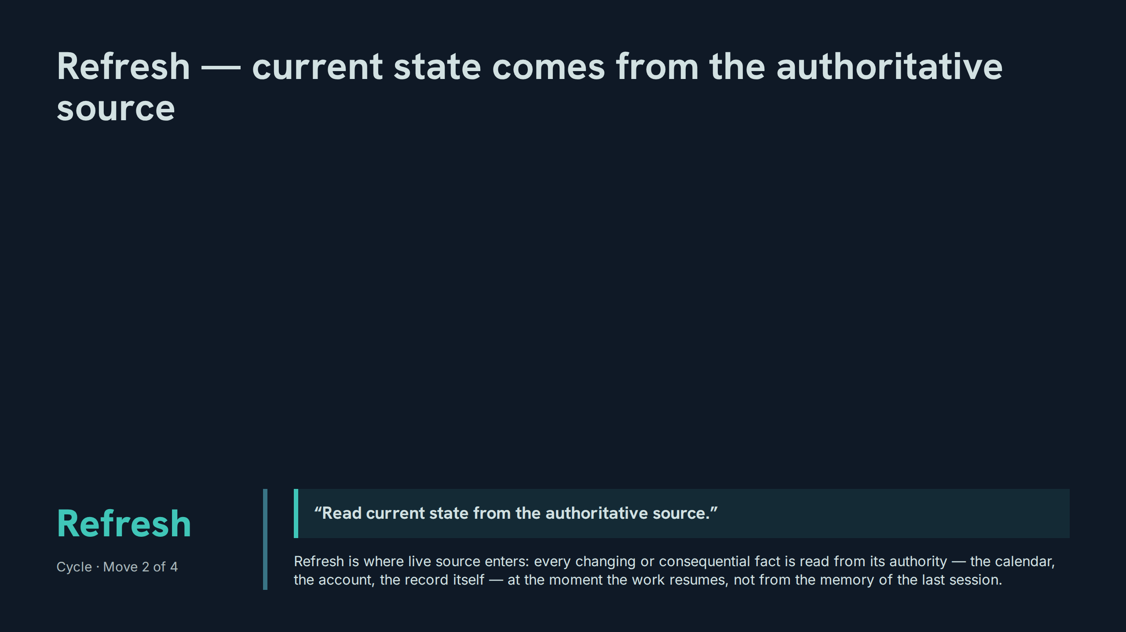
Notes:
Refresh — current state comes from the authoritative source
Speaker notes: Teaching hook: 'the authoritative source' is singular per fact — for each fact there is exactly one system entitled to say what is true, and refresh goes there. Drill (3–4 minutes): for five facts, participants name the authoritative source and the wrong-but-convenient source they must not use. Discussion prompt: what makes a source authoritative — accuracy, ownership, or recency?

Slide 23
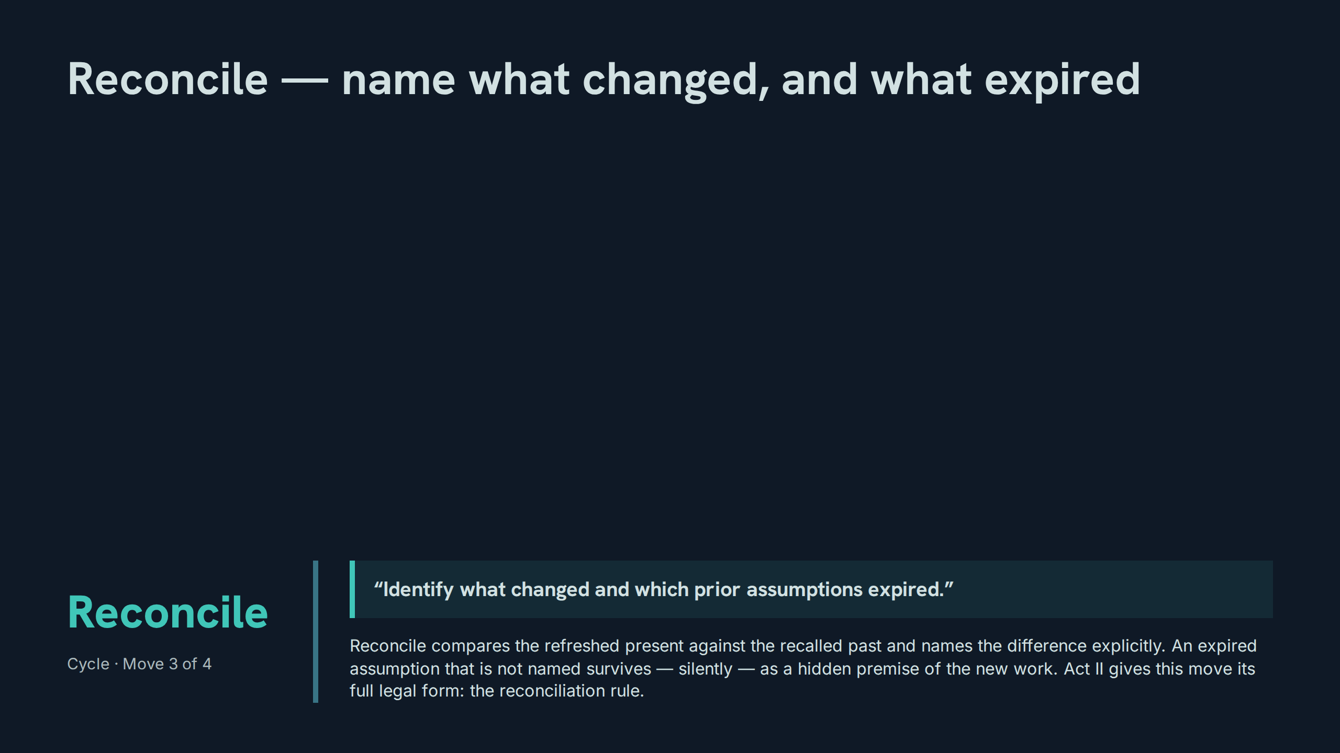
Notes:
Reconcile — name what changed, and what expired
Speaker notes: Teaching hook: expiry is the key word — assumptions do not become false loudly; they lapse, and only an explicit comparison notices. Drill (3–4 minutes): given a recalled decision and a refreshed fact that contradicts it, participants write the one-sentence reconciliation the record should carry. Discussion prompt: why is an unnamed expired assumption worse than a wrong one that is written down?

Slide 24
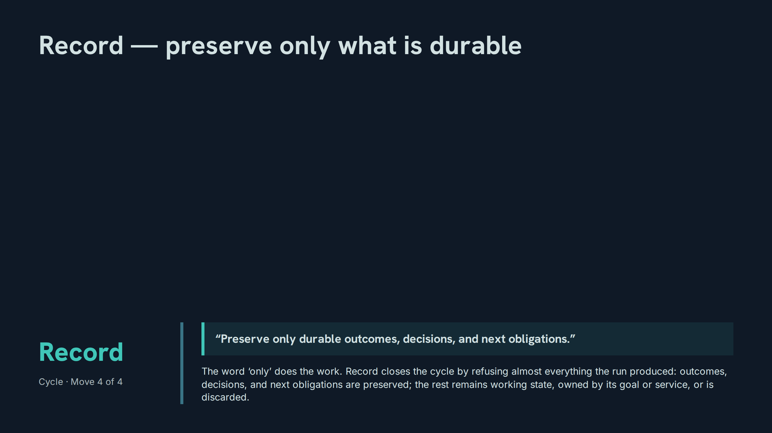
Notes:
Record — preserve only what is durable
Speaker notes: Teaching hook: record is a filter, not a dump — the discipline of Act I ends in a refusal, and Act II begins by explaining why: curated state, not transcript. Drill (3–4 minutes): from a sample run’s eight outputs, participants keep exactly the items that pass the 'only' test and defend each refusal. Discussion prompt: what is the long-term cost of recording one category too much?

Slide 25
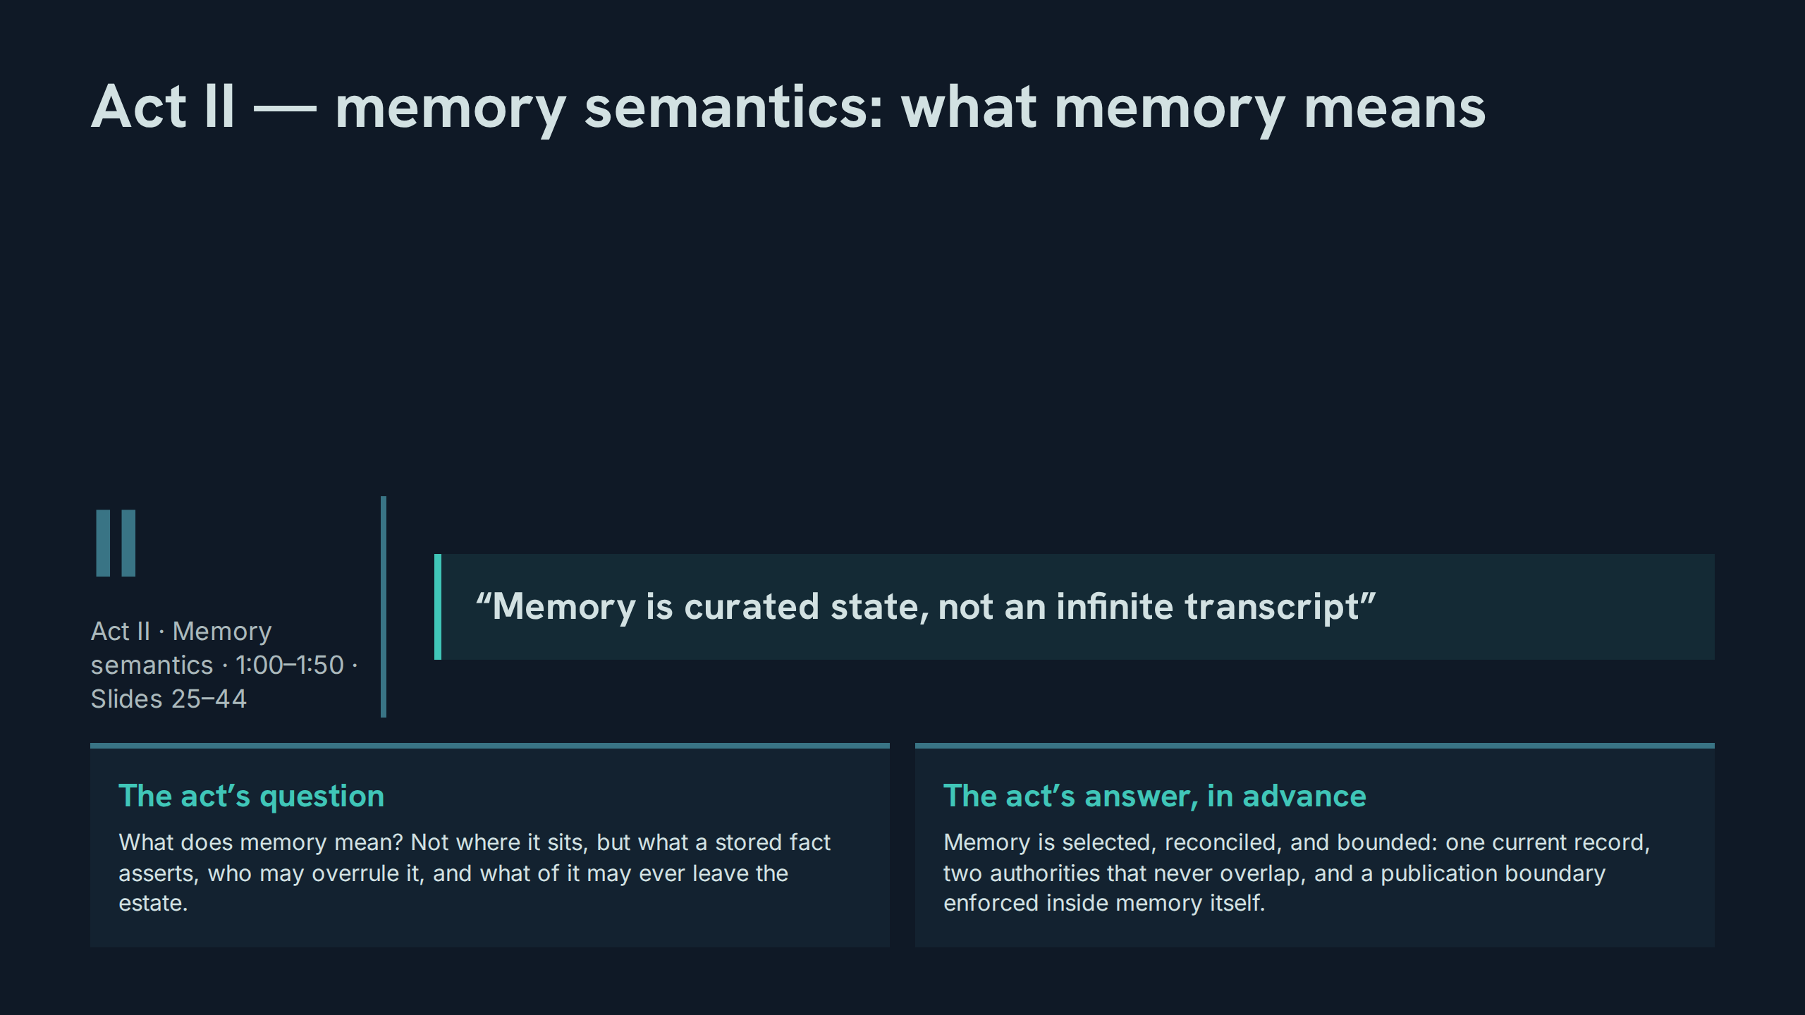
Notes:
Act II — memory semantics: what memory means
Speaker notes: Teaching hook: Act I located memory; Act II interprets it — the same store, read as a set of claims with rules of evidence. Drill (3–4 minutes): participants state one thing a transcript asserts that curated state does not, and one thing curated state asserts that a transcript cannot. Discussion prompt: if memory is an argument rather than an archive, who is it arguing with?

Slide 26
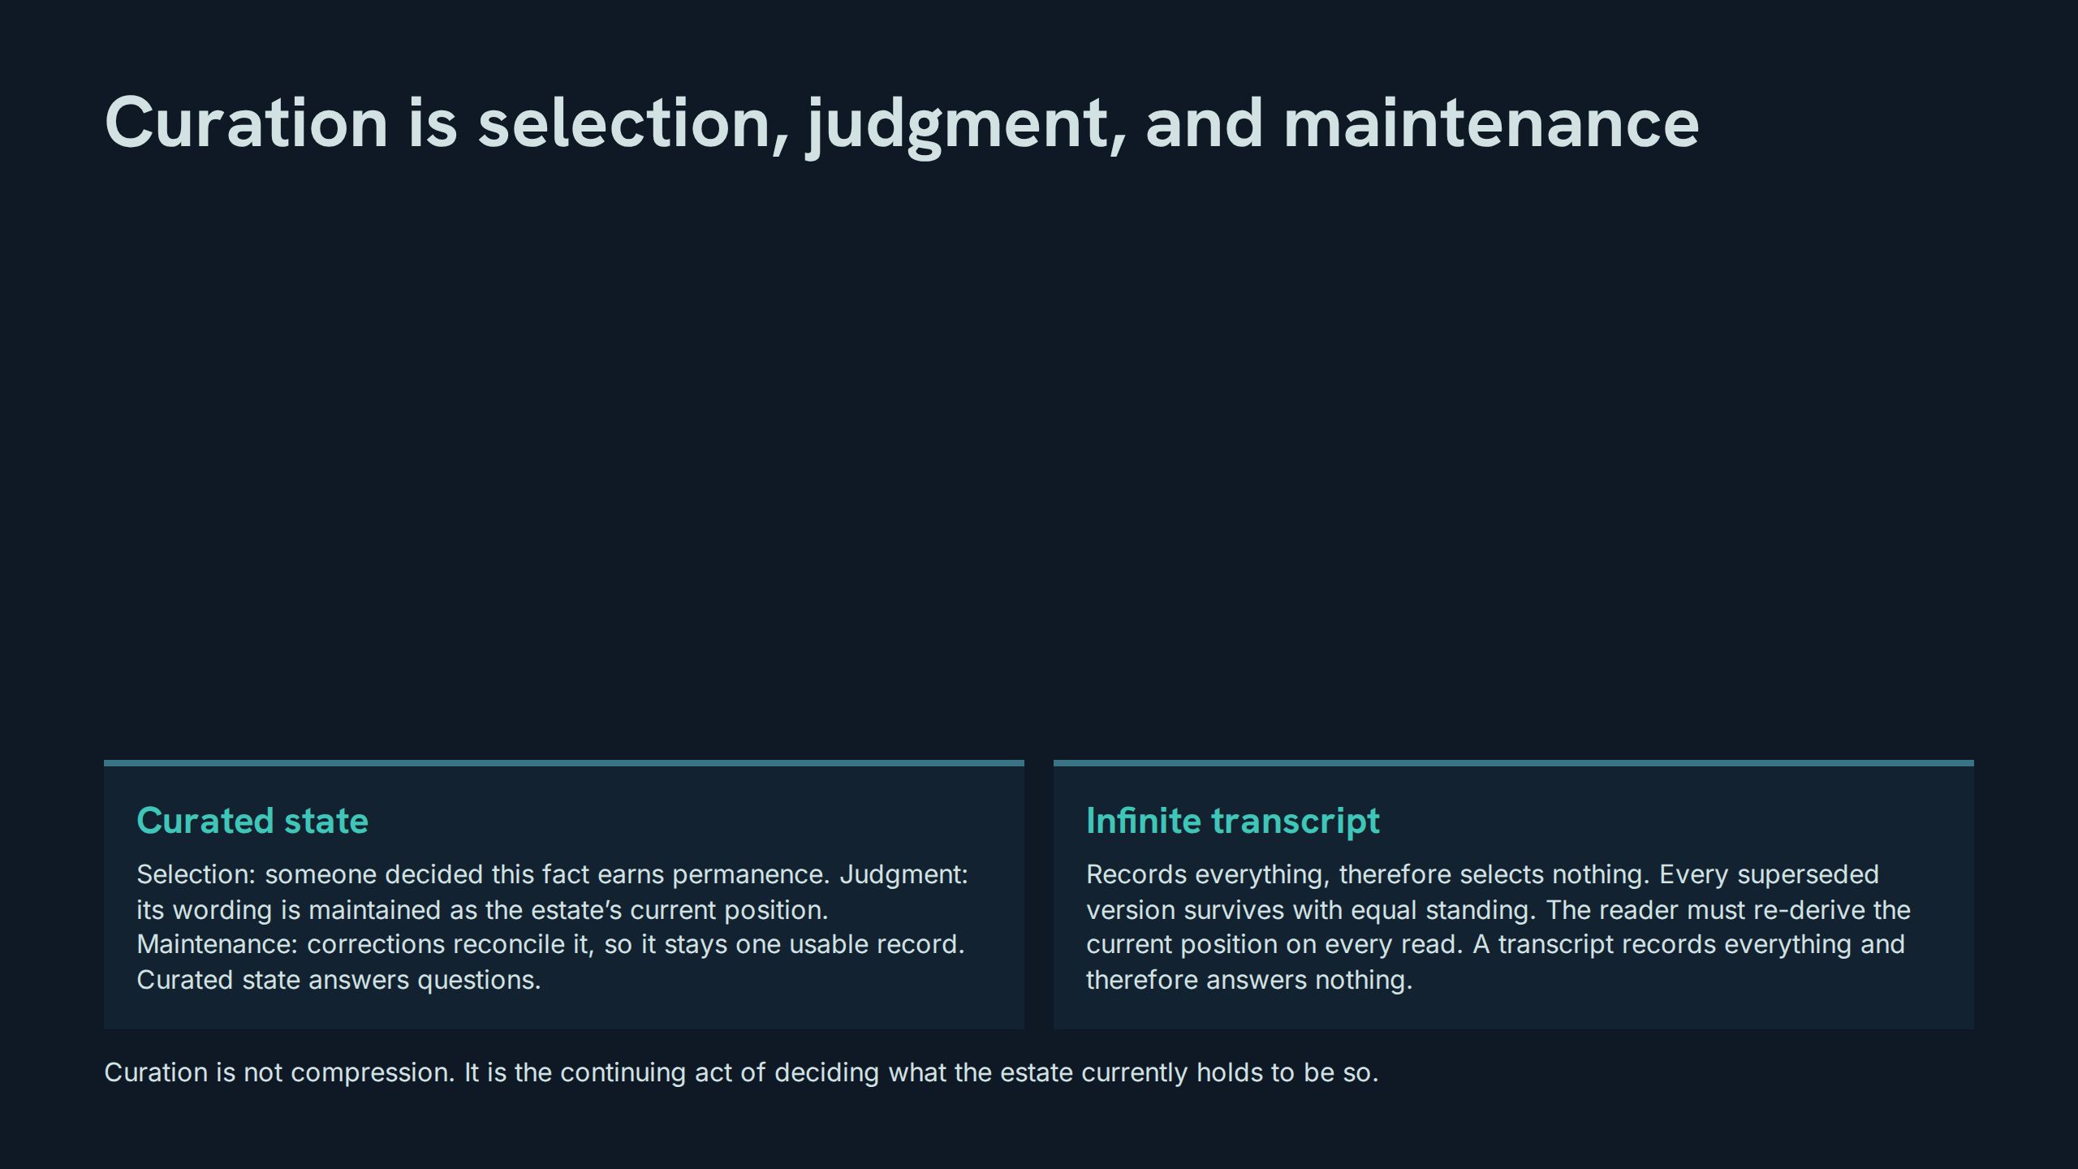
Notes:
Curation is selection, judgment, and maintenance
Speaker notes: Teaching hook: press the asymmetry — a transcript’s completeness is precisely its defect, because equal standing for every version means no version is the position. Drill (3–4 minutes): hand the room a five-line transcript containing one correction; participants extract the current position and time how long the archaeology takes. Discussion prompt: what, if anything, is the transcript still good for once curation exists?

Slide 27
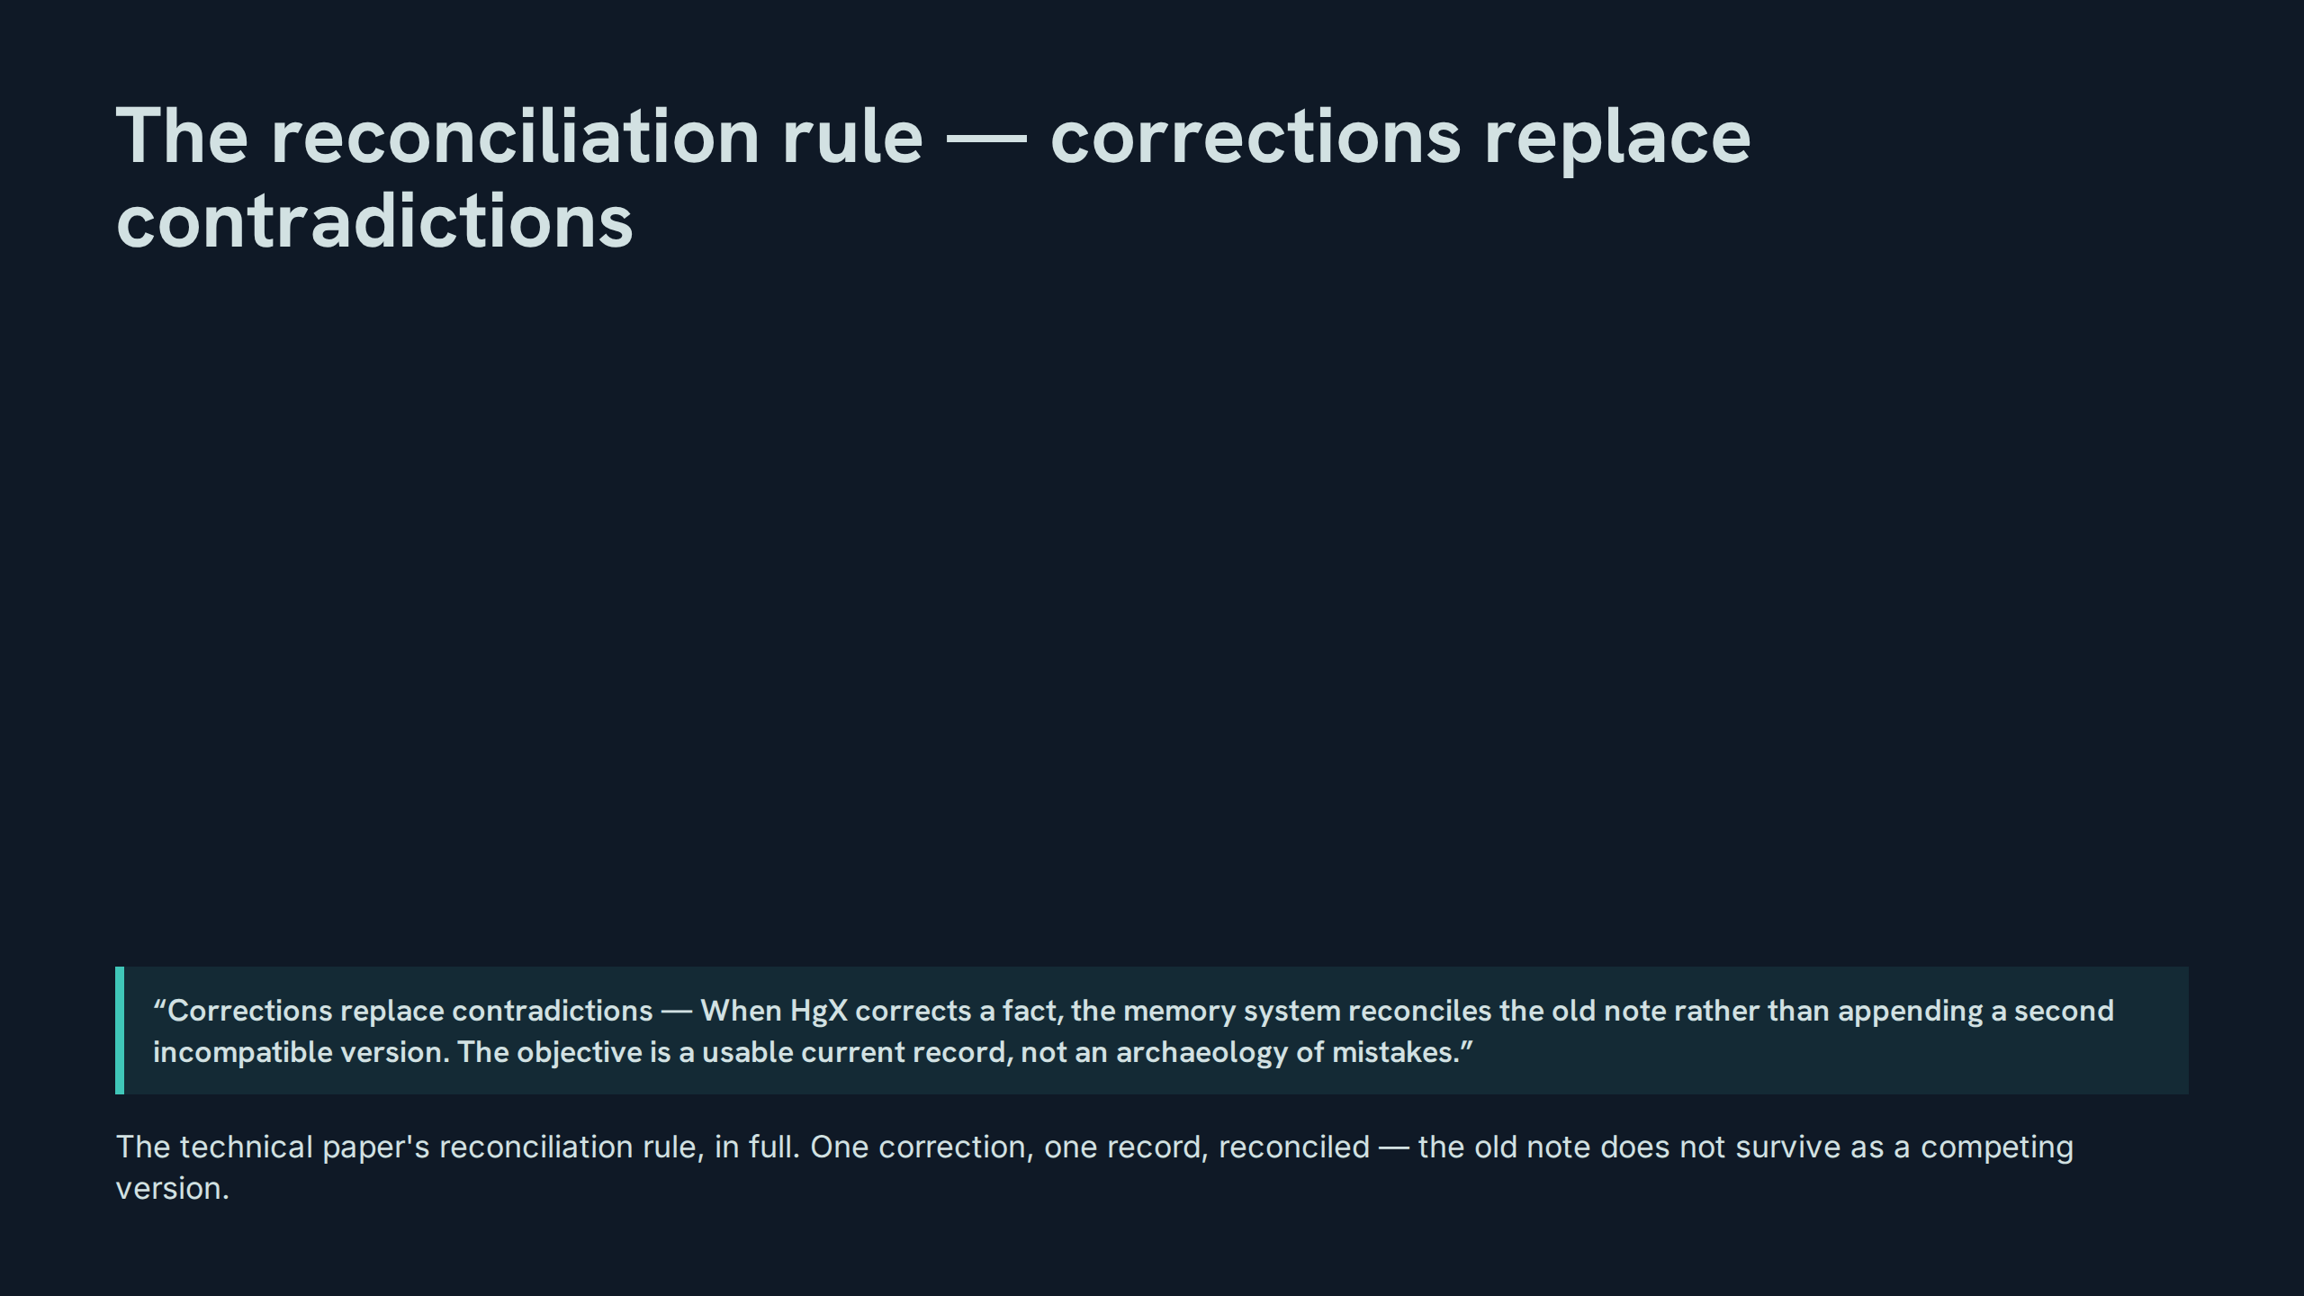
Notes:
The reconciliation rule — corrections replace contradictions
Speaker notes: Teaching hook: teach the rule as a write protocol, not a preference: on correction, the system’s next write is a reconciliation, and an append is a protocol violation. Drill (3–4 minutes): given an old note and HgX’s correction, each participant writes the reconciled entry; compare wordings and judge which preserves everything still true. Discussion prompt: what legitimate information, if any, does reconciliation destroy — and where should that information live instead?

Slide 28
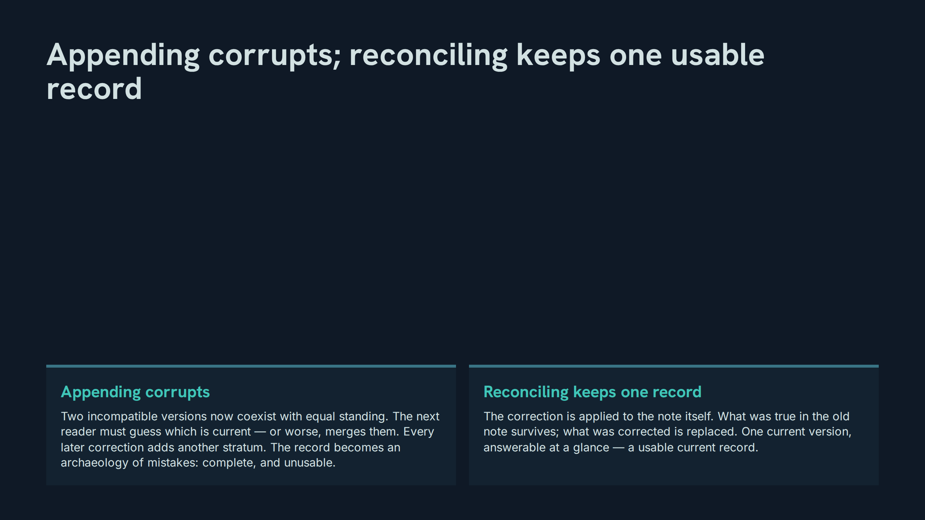
Notes:
Appending corrupts; reconciling keeps one usable record
Speaker notes: Teaching hook: the failure is deferred, not avoided — appending feels safer at write time and bills the cost, with interest, to every future reader. Drill (3–4 minutes): participants take a two-version record and produce the reconciled single version, then list what a third reader would have had to guess before. Discussion prompt: why does appending feel like the cautious option, and what instinct should replace that feeling?

Slide 29
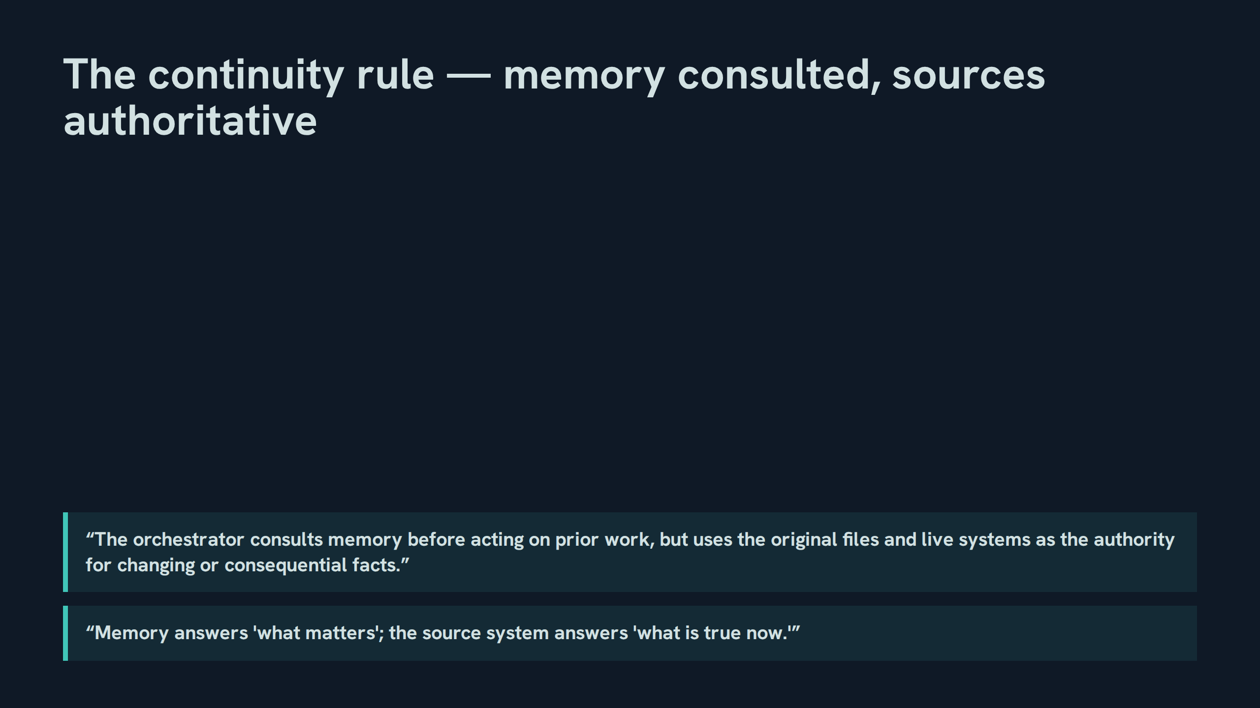
Notes:
The continuity rule — memory consulted, sources authoritative
Speaker notes: Teaching hook: the rule has two halves that must never trade places — memory is consulted first and obeyed on importance; sources are consulted second and obeyed on fact. Drill (3–4 minutes): for four sample actions, participants state which half of the rule governs and what each half contributes. Discussion prompt: why does the rule route authority through original files, not summaries of files?

Slide 30
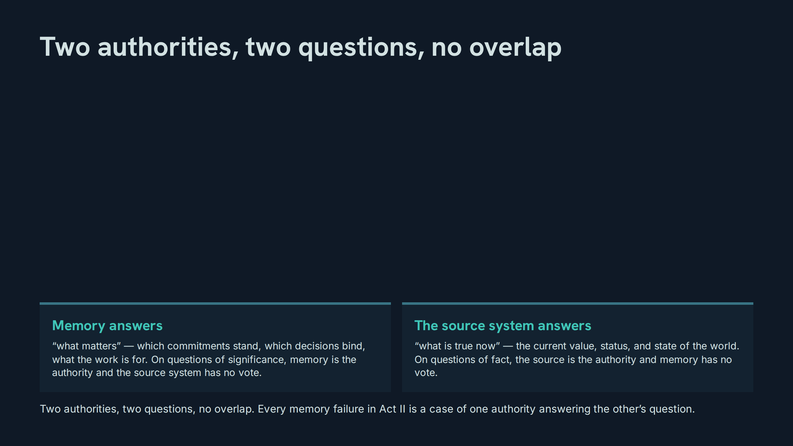
Notes:
Two authorities, two questions, no overlap
Speaker notes: Teaching hook: jurisdiction is the whole doctrine — neither authority is 'higher'; each is supreme inside its question and silent outside it. Drill (3–4 minutes): participants classify six questions as matters-questions or truth-questions and name the authority for each, cold. Discussion prompt: construct a realistic question that appears to belong to both — and show how it splits into two.

Slide 31
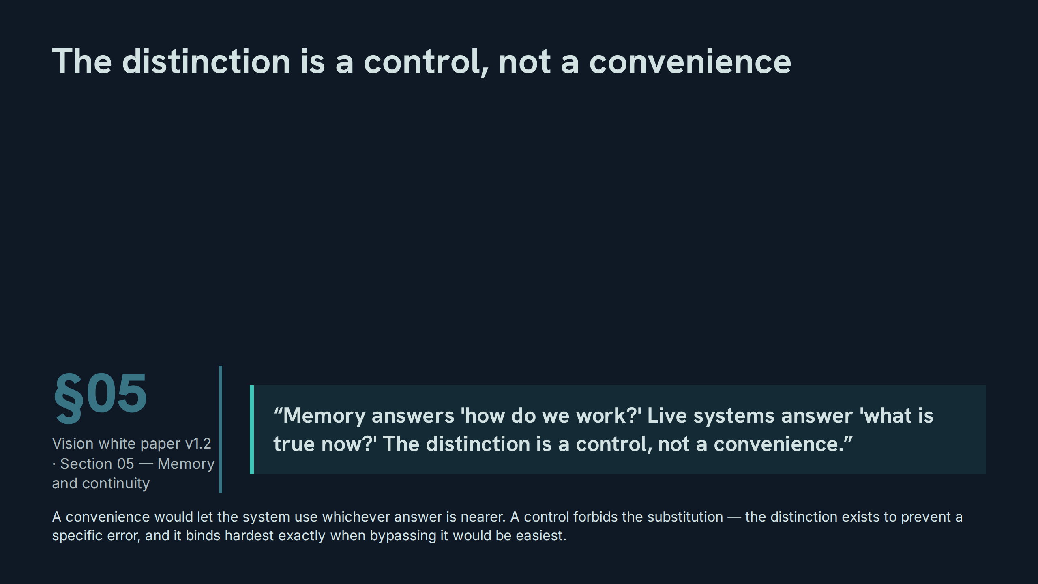
Notes:
The distinction is a control, not a convenience
Speaker notes: Teaching hook: controls are recognised by their behaviour under pressure — a rule that yields whenever it is inconvenient was a convenience all along. Drill (3–4 minutes): participants describe one moment where using memory for a live fact would have been genuinely convenient, and trace the error the control prevented. Discussion prompt: what does it cost, per week, to run this control honestly — and who pays?

Slide 32
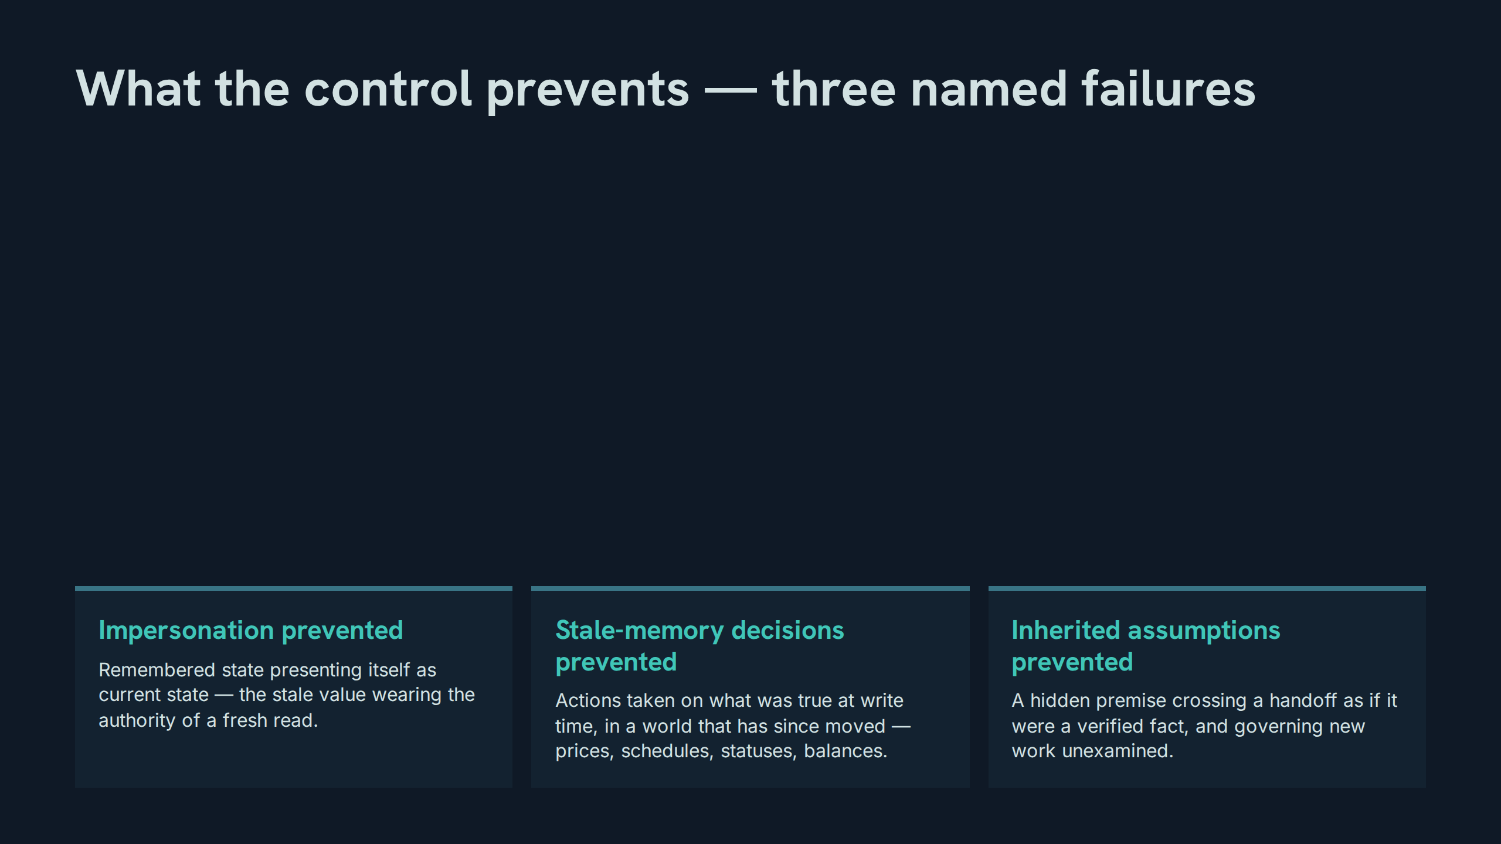
Notes:
What the control prevents — three named failures
Speaker notes: Teaching hook: each card is the same failure at a different distance — impersonation now, staleness at decision time, inheritance at handoff. Drill (3–4 minutes): participants match three short failure stories to the card each belongs to, then name the cycle move that would have caught it. Discussion prompt: which of the three failures leaves the least evidence behind?

Slide 33
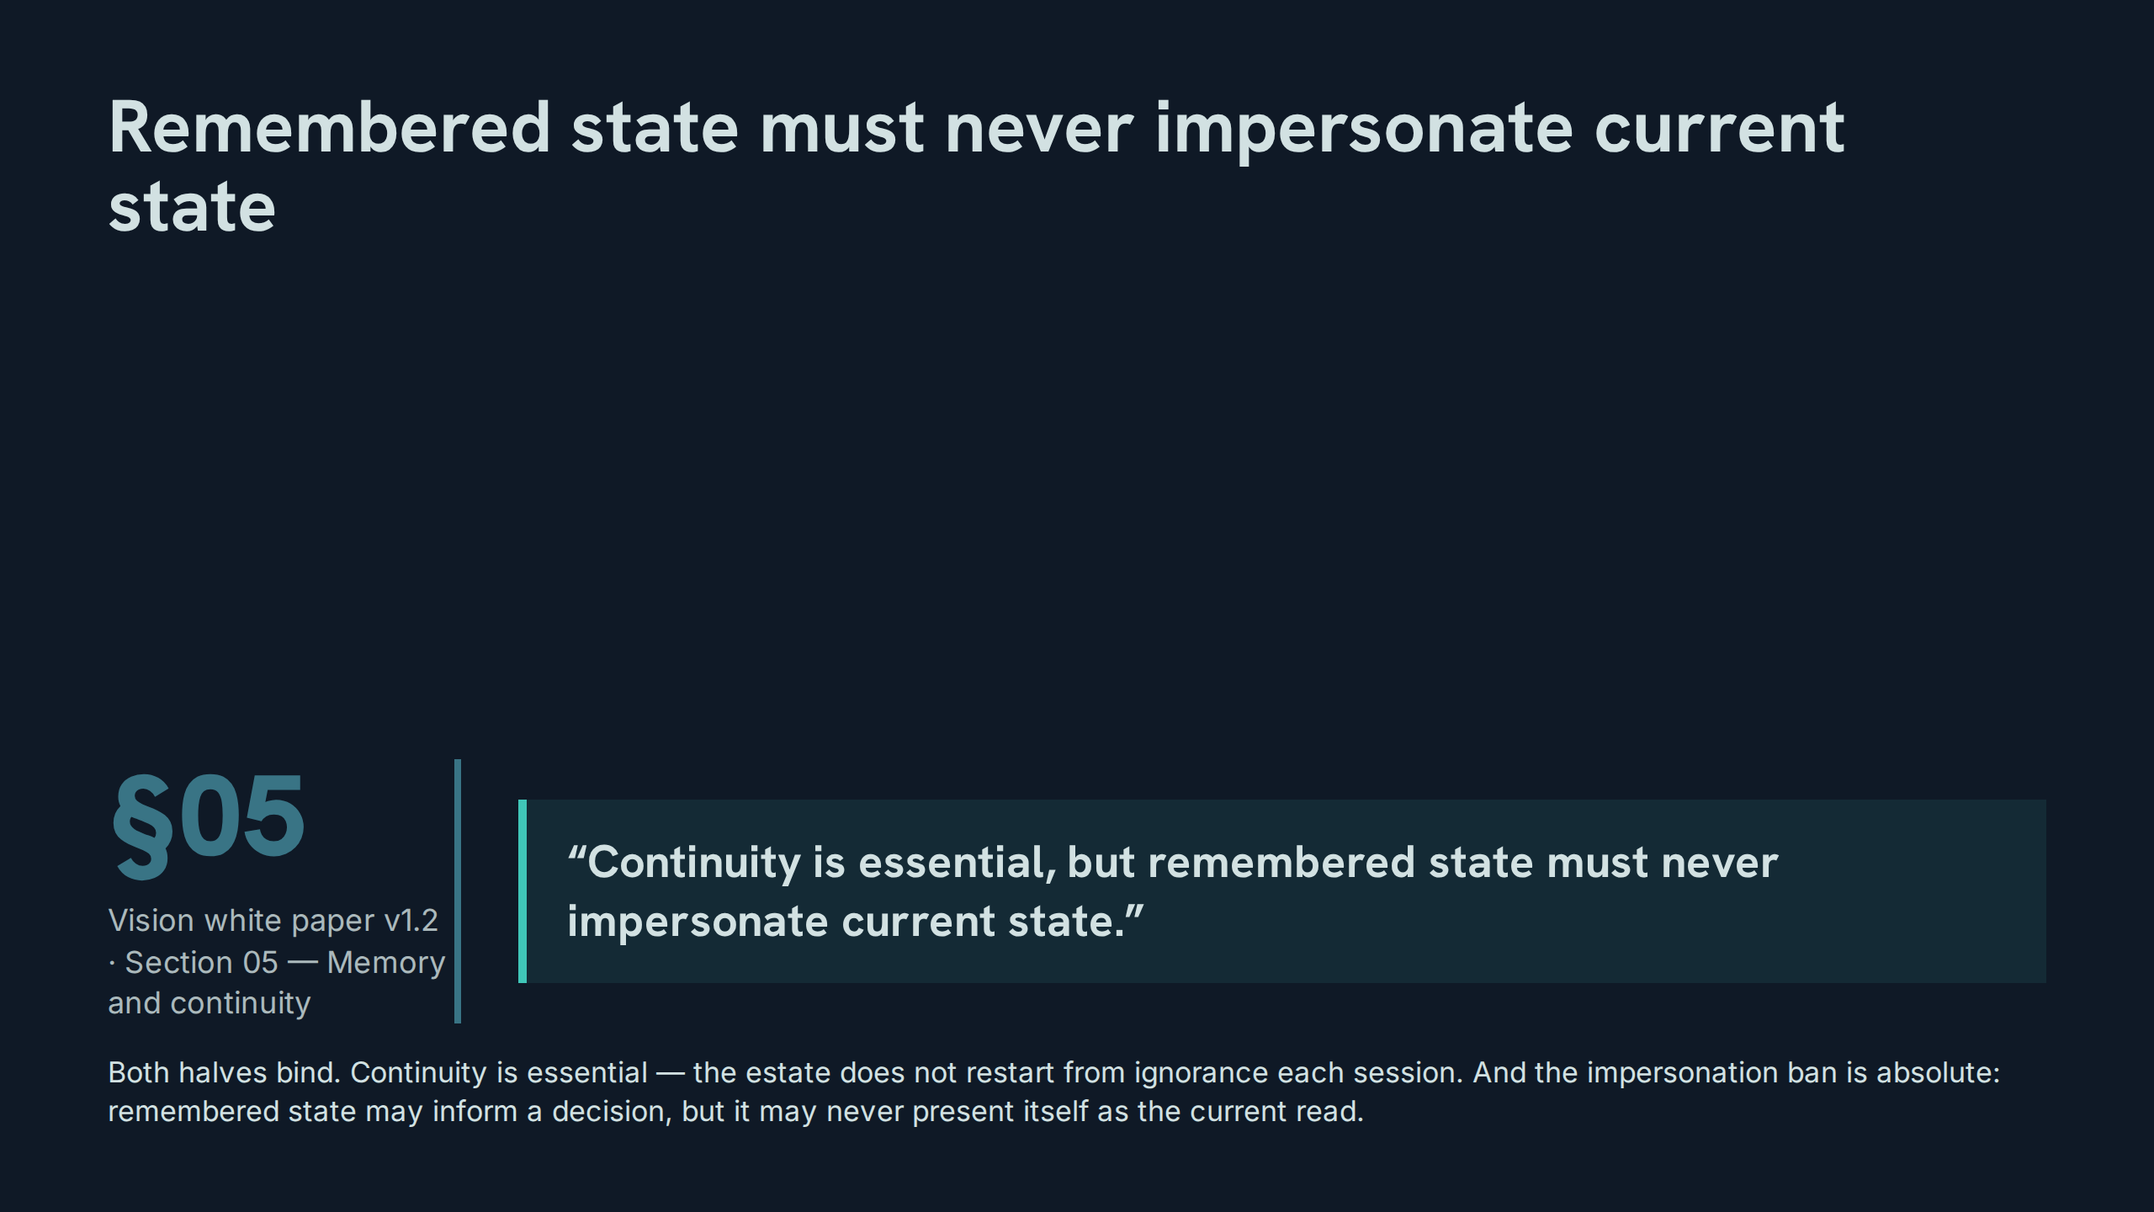
Notes:
Remembered state must never impersonate current state
Speaker notes: Teaching hook: 'impersonate' is the precise verb — the offence is not remembering, it is remembered state claiming the standing of a current observation. Drill (3–4 minutes): participants rewrite three status sentences so that remembered state is honestly labelled as remembered, with its date, instead of impersonating the present. Discussion prompt: what surface features let a reader tell a current read from a remembered one at a glance?

Slide 34
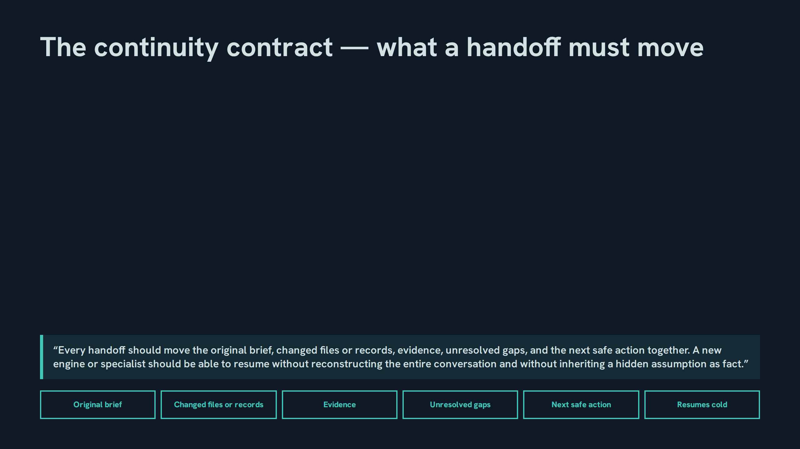
Notes:
The continuity contract — what a handoff must move
Speaker notes: Teaching hook: note the two negatives that define success — no reconstructing the conversation, no inheriting an assumption as fact; a handoff that needs either has failed as a handoff. Drill (3–4 minutes): participants split a sample handoff into the five moving parts and mark the part most likely to be dropped under deadline. Discussion prompt: why are unresolved gaps a required part, rather than an admission the handoff should hide?

Slide 35
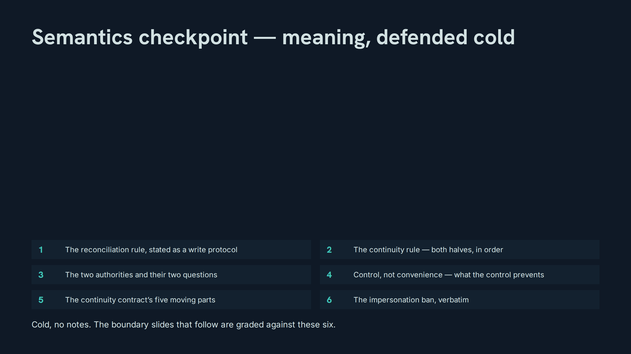
Notes:
Semantics checkpoint — meaning, defended cold
Speaker notes: Teaching hook: this checkpoint closes the meaning half of the session — the remaining slides test whether the boundary holds when publication pressure is applied. Drill (3–4 minutes): run the six items in random order; the impersonation line and the reconciliation rule are demanded verbatim. Discussion prompt: which of the six is a rule about writing, which about reading, and which about authority?

Slide 36
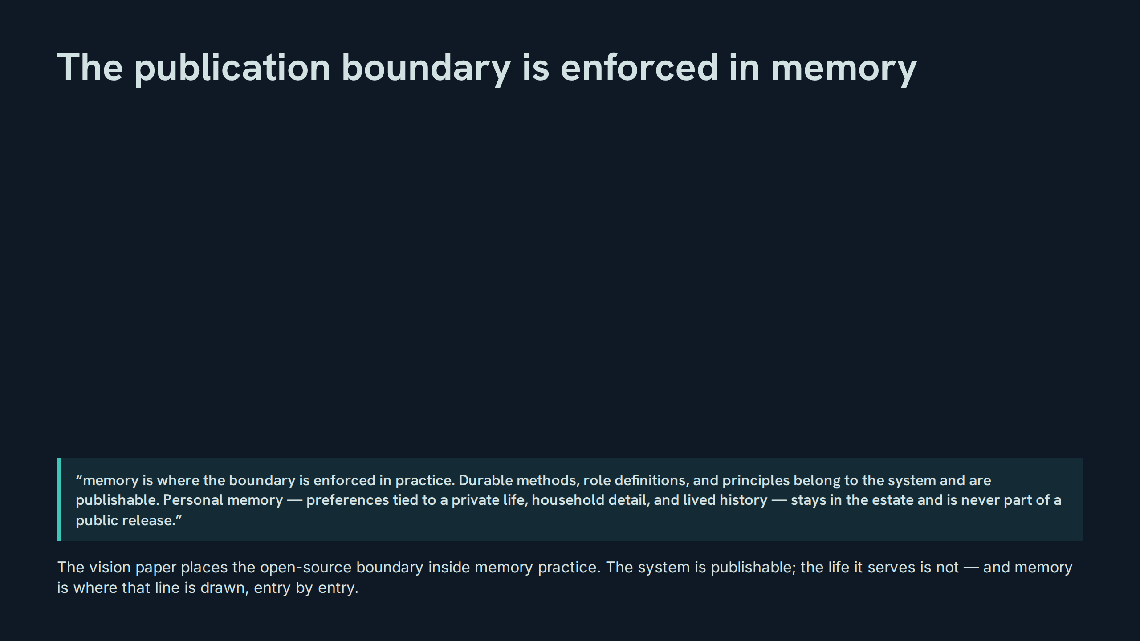
Notes:
The publication boundary is enforced in memory
Speaker notes: Teaching hook: the boundary is not a filter applied at publication time — it is a property of how memory is kept, which is why this slide sits in a memory session and not a publishing one. Drill (3–4 minutes): participants draw the boundary through six sample memory entries, marking each system-side or estate-side with the deciding phrase from the quote. Discussion prompt: why must the boundary be enforced in practice, daily, rather than audited once before a release?

Slide 37
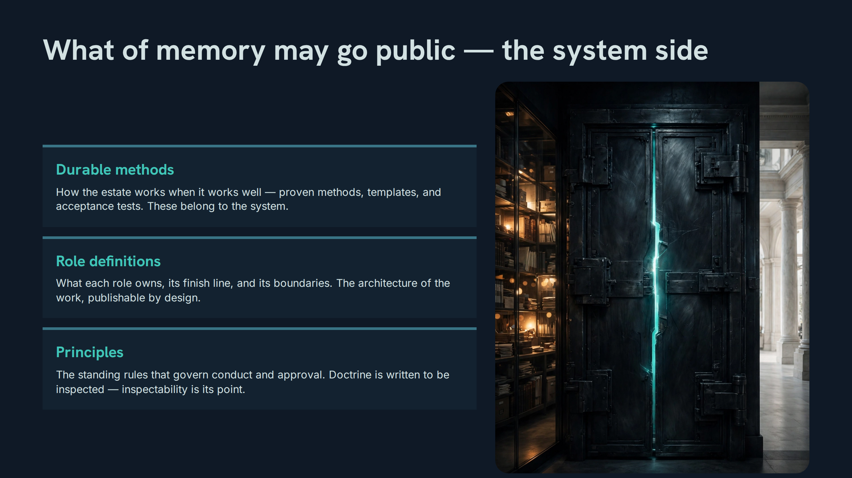
Notes:
What of memory may go public — the system side
Speaker notes: Teaching hook: everything on this slide describes the system, not the person — that single test sorts almost every real case. Drill (3–4 minutes): participants take four memory entries and argue each across the boundary in both directions before settling it. Discussion prompt: a proven method was learned from a private failure — which side of the boundary does the method sit on, and which side does the story?

Slide 38
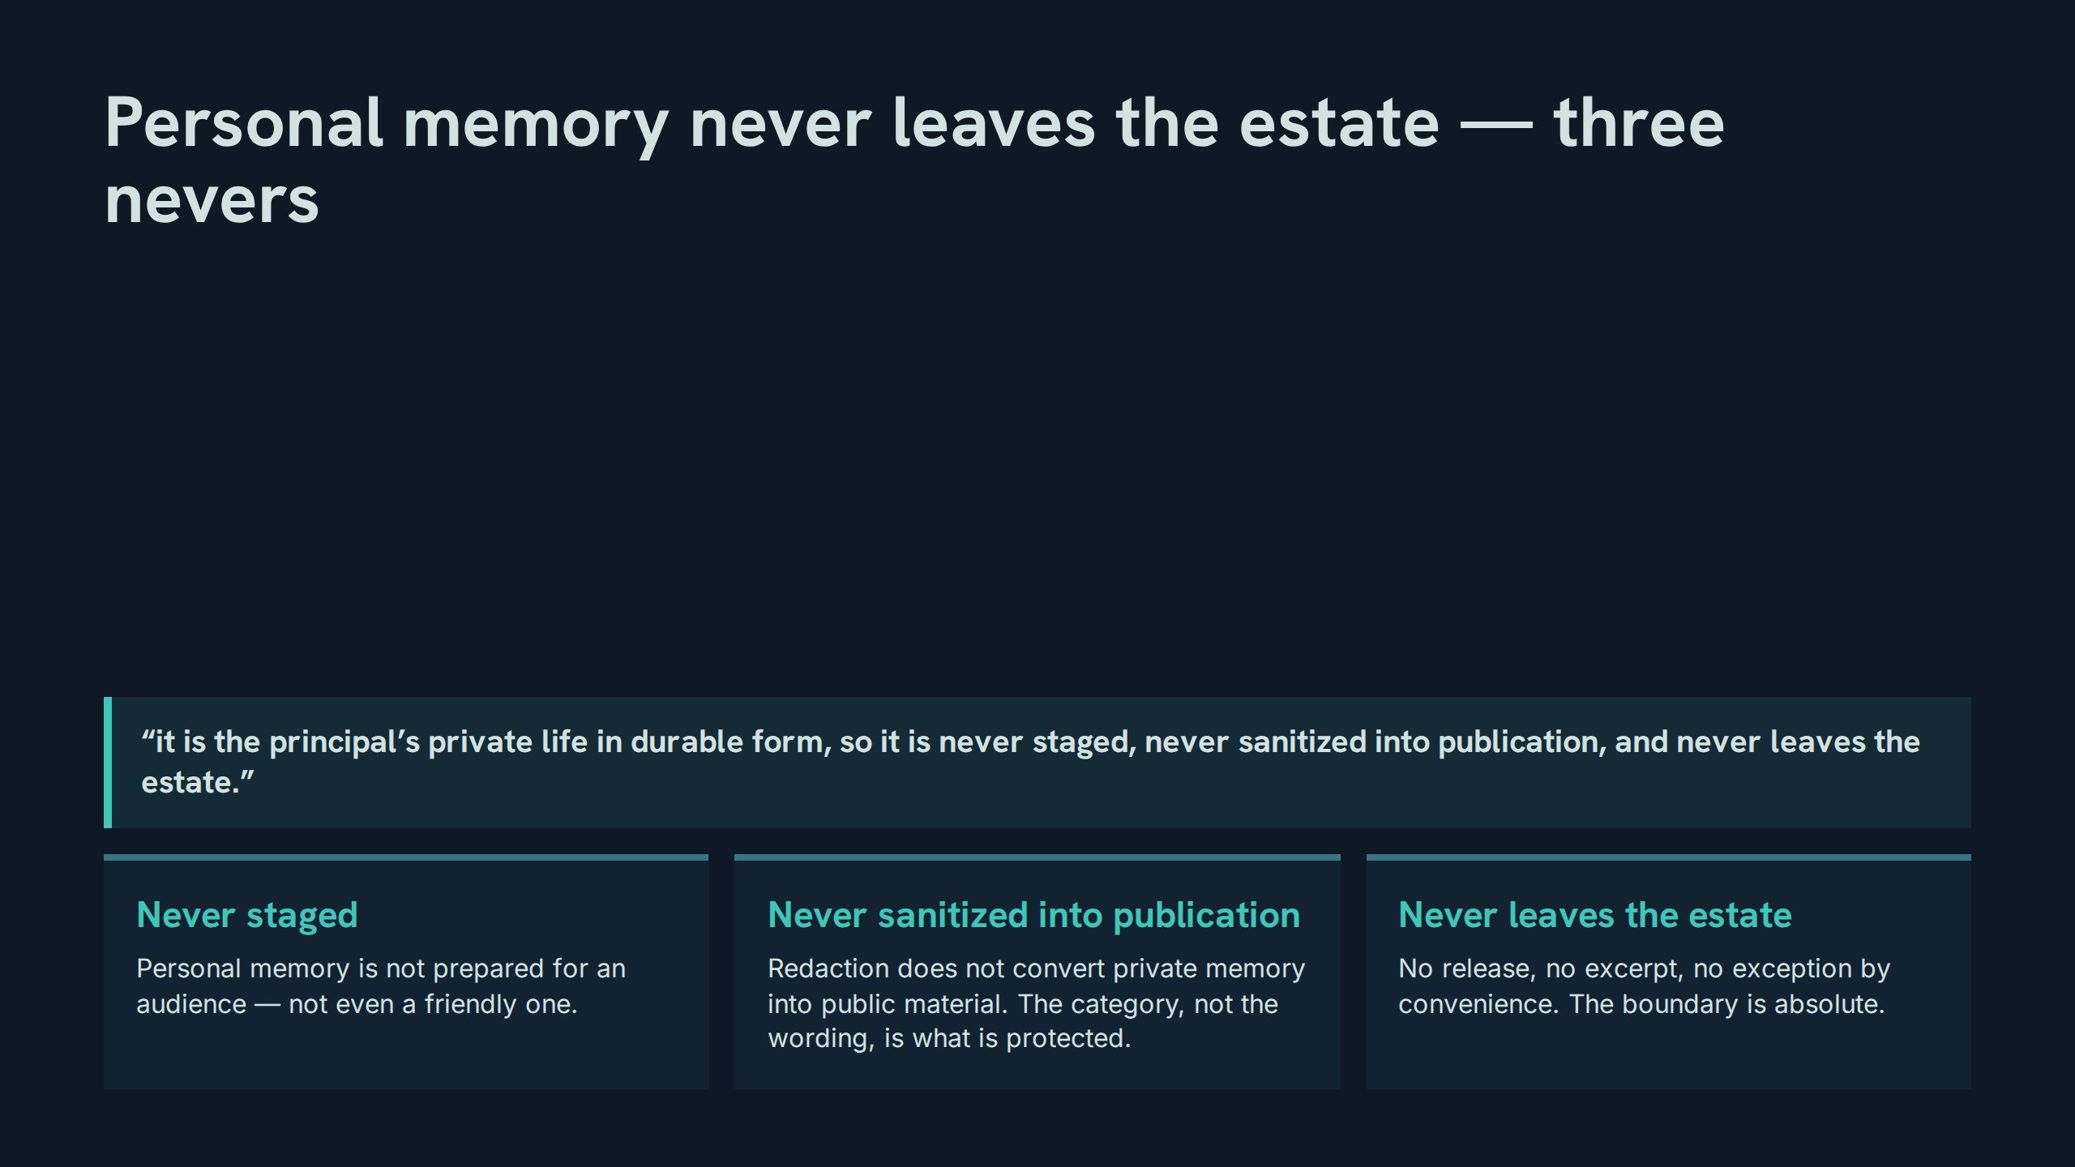
Notes:
Personal memory never leaves the estate — three nevers
Speaker notes: Teaching hook: the middle never is the subtle one — it closes the loophole that redaction opens, by protecting the category rather than the text. Drill (3–4 minutes): participants draft the strongest possible argument for publishing a sanitized personal-memory excerpt, then defeat it using only this slide’s three nevers. Discussion prompt: why does the paper protect the category instead of listing sensitive fields?

Slide 39
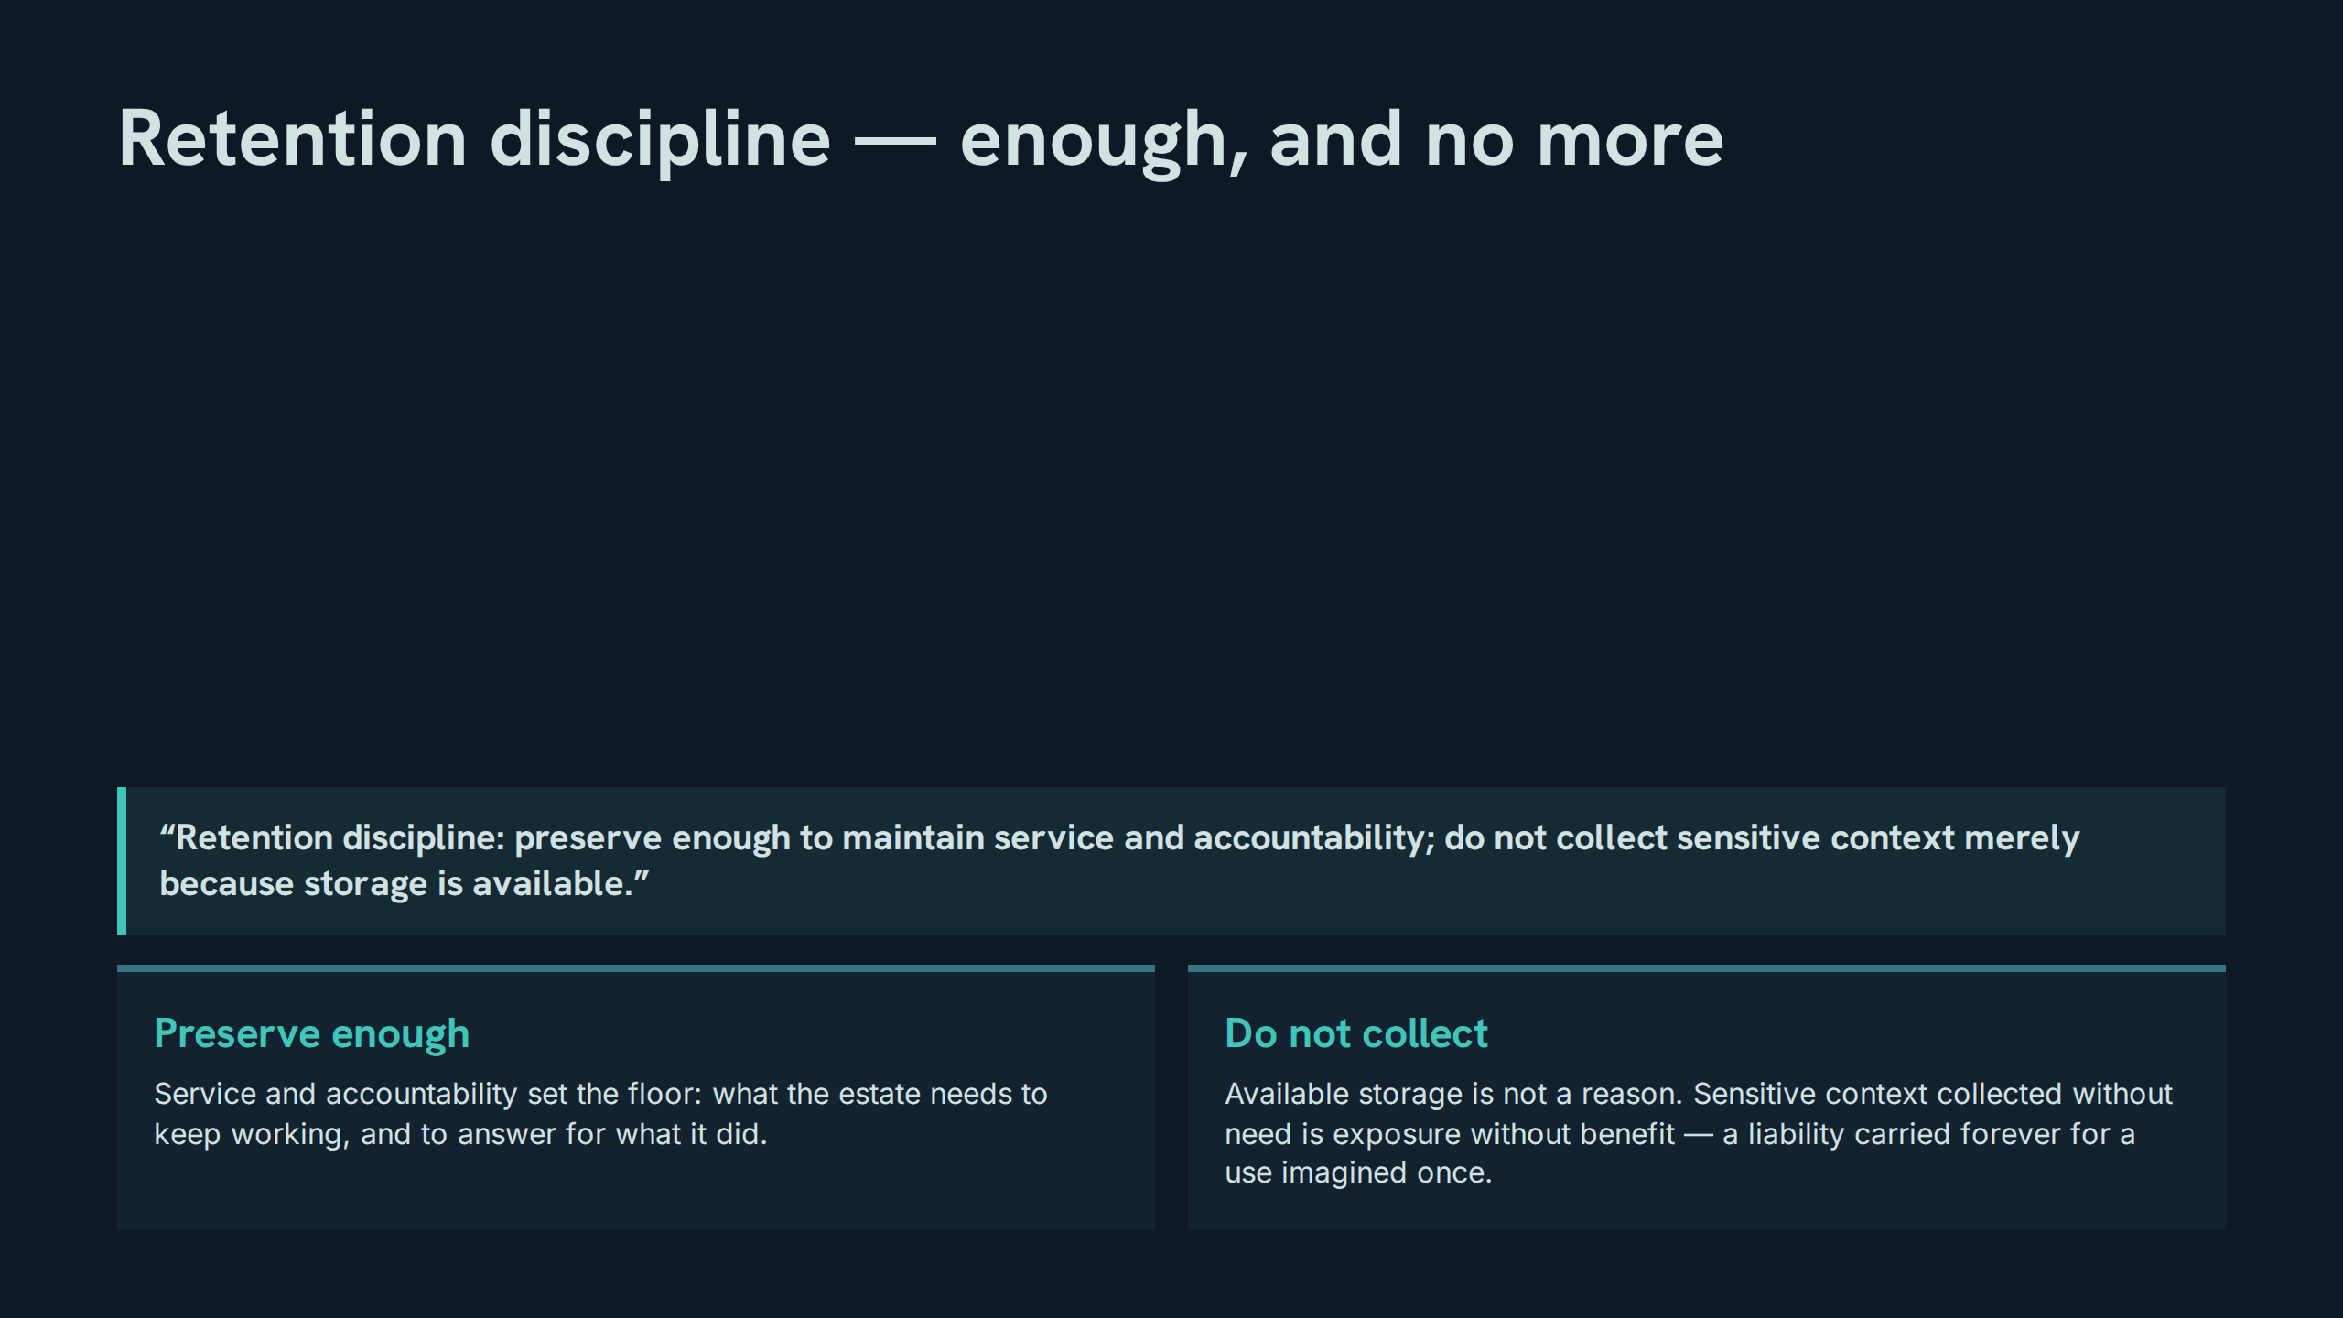
Notes:
Retention discipline — enough, and no more
Speaker notes: Teaching hook: retention is the boundary applied at write time — the cheapest place to protect private life is the moment of deciding not to store it. Drill (3–4 minutes): for four sample contexts, participants rule keep or do-not-collect and name which half of the quote decides it. Discussion prompt: how does retention discipline interact with the reconciliation rule — what happens to detail the record no longer needs?

Slide 40
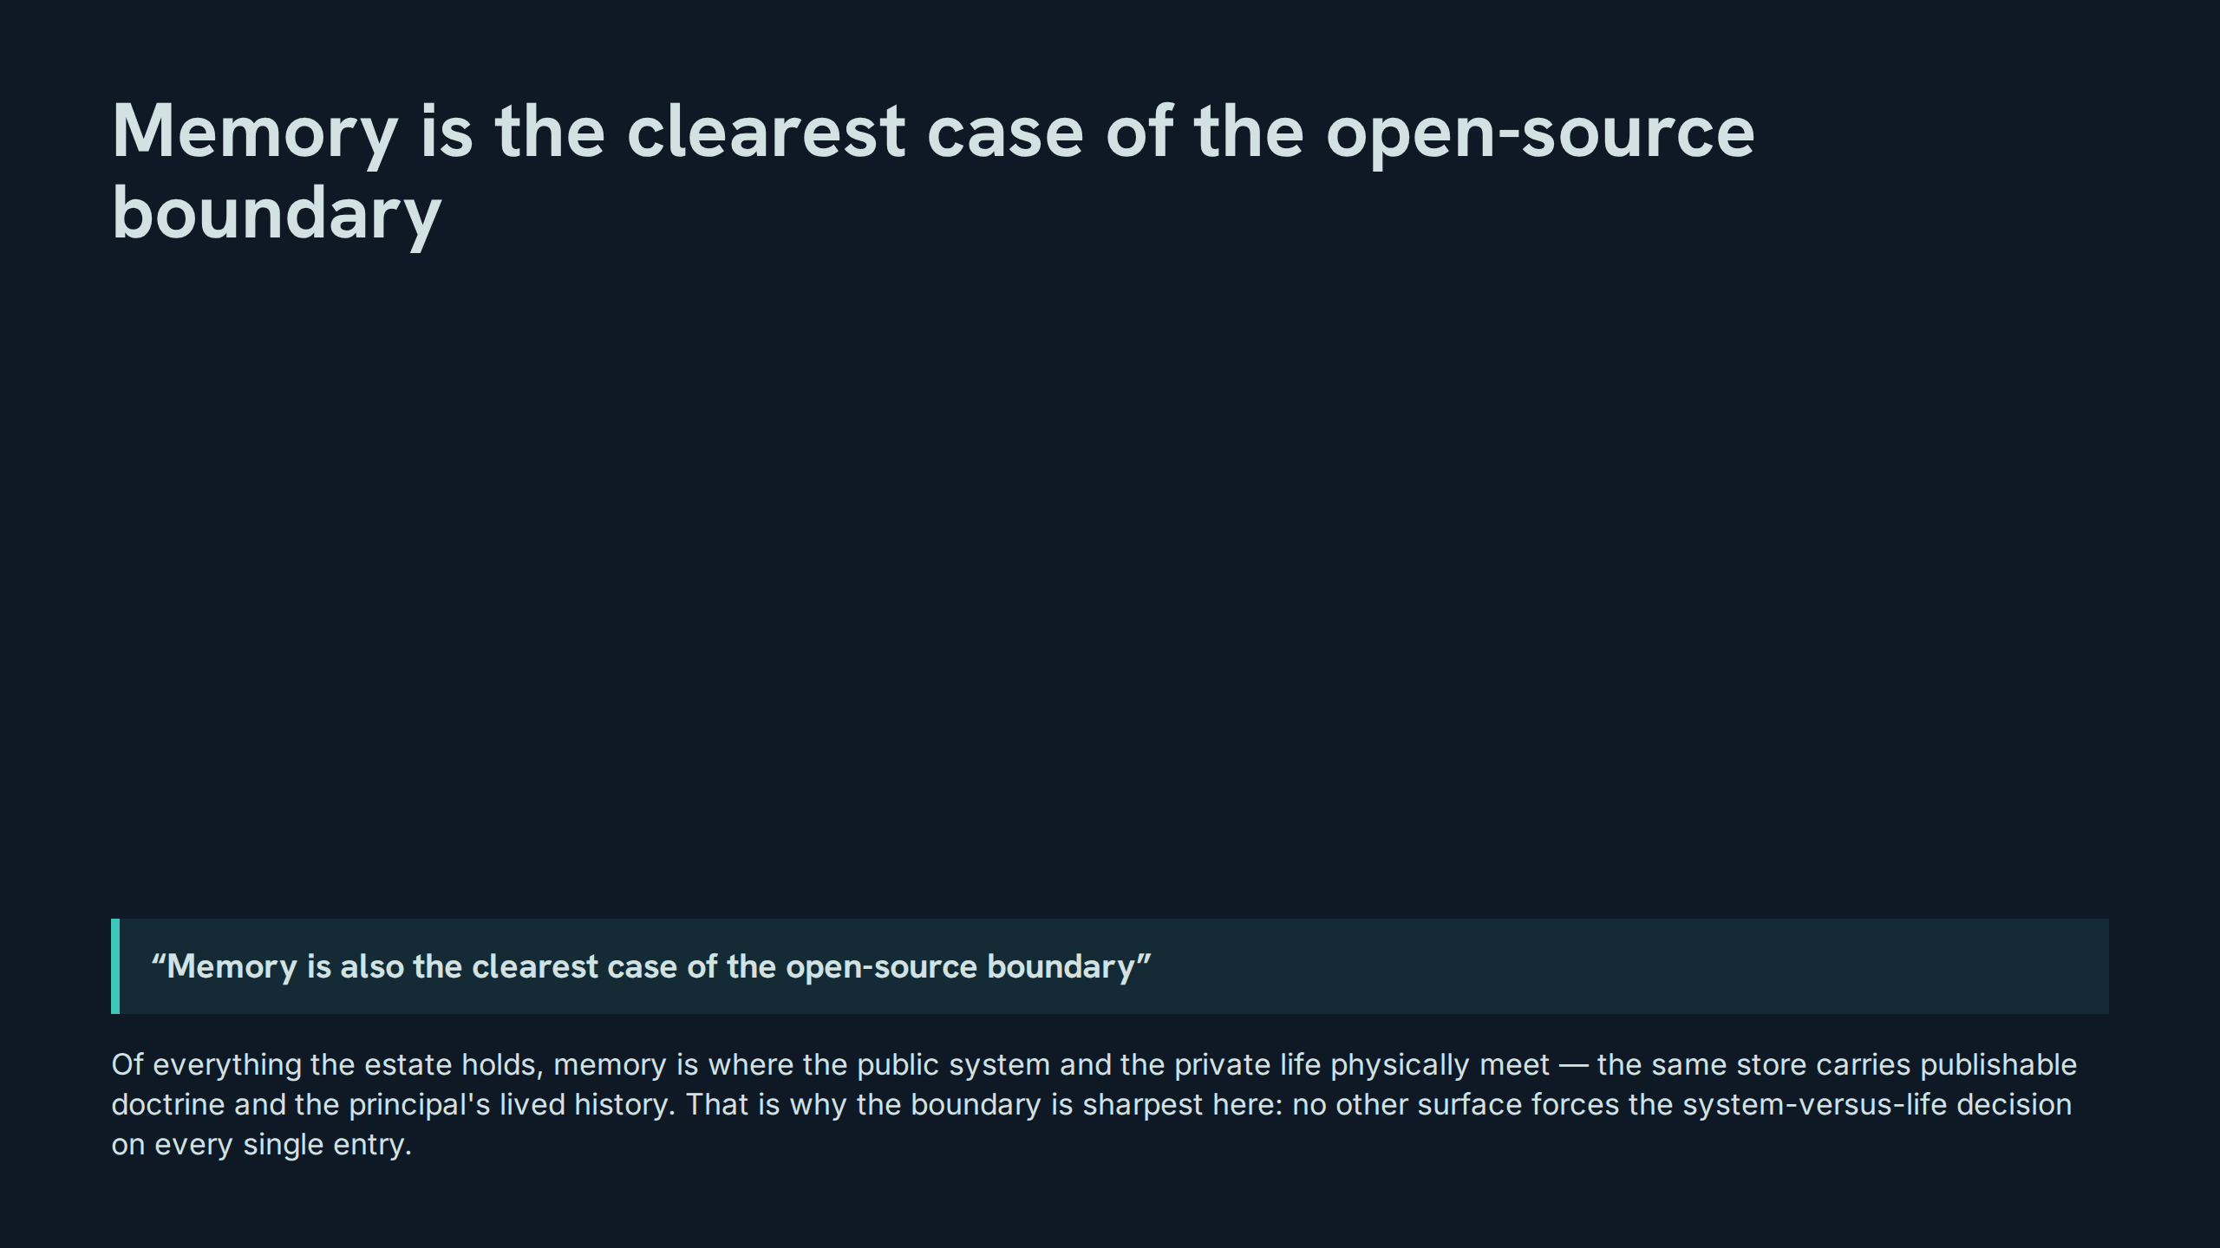
Notes:
Memory is the clearest case of the open-source boundary
Speaker notes: Teaching hook: 'also' matters — the boundary exists everywhere, but memory is where it stops being abstract, because every entry must be sorted. Drill (3–4 minutes): participants name one other estate surface where the boundary applies and explain why memory’s case is still clearer. Discussion prompt: if memory is the clearest case, what doctrine should be designed here first and exported elsewhere?

Slide 41
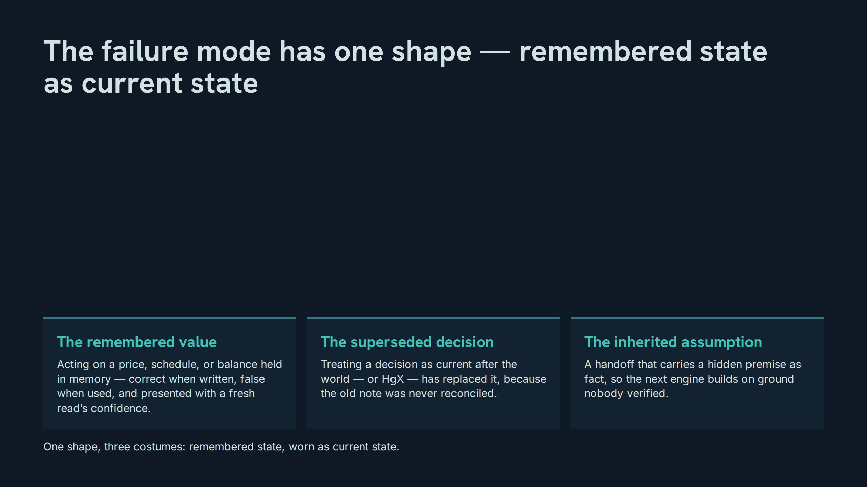
Notes:
The failure mode has one shape — remembered state as current state
Speaker notes: Teaching hook: teach the shape, not the instances — a room that can recognise 'remembered state worn as current state' will catch failures nobody listed. Drill (3–4 minutes): each participant constructs a fourth instance of the shape from their own work and names the control that prevents it. Discussion prompt: which costume is hardest to detect from inside the work?

Slide 42
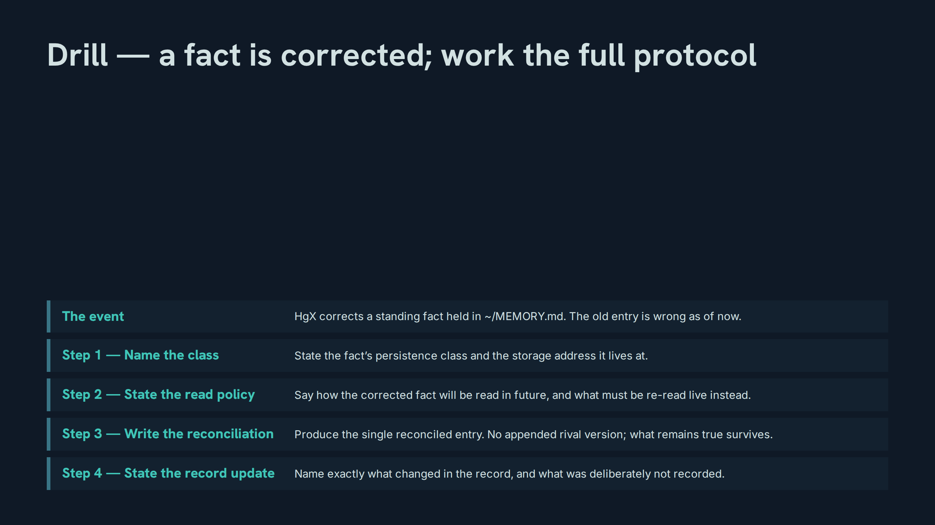
Notes:
Drill — a fact is corrected; work the full protocol
Speaker notes: Teaching hook: this drill is the session in one exercise — class, policy, reconciliation, record; a participant who can run it cold owns Act I and Act II together. Drill (3–4 minutes): run the drill end to end on the clock with a fresh correction supplied by the room; the reconciled entry is read aloud and judged against slide 27. Discussion prompt: where in the four steps does real practice most often cheat?

Slide 43
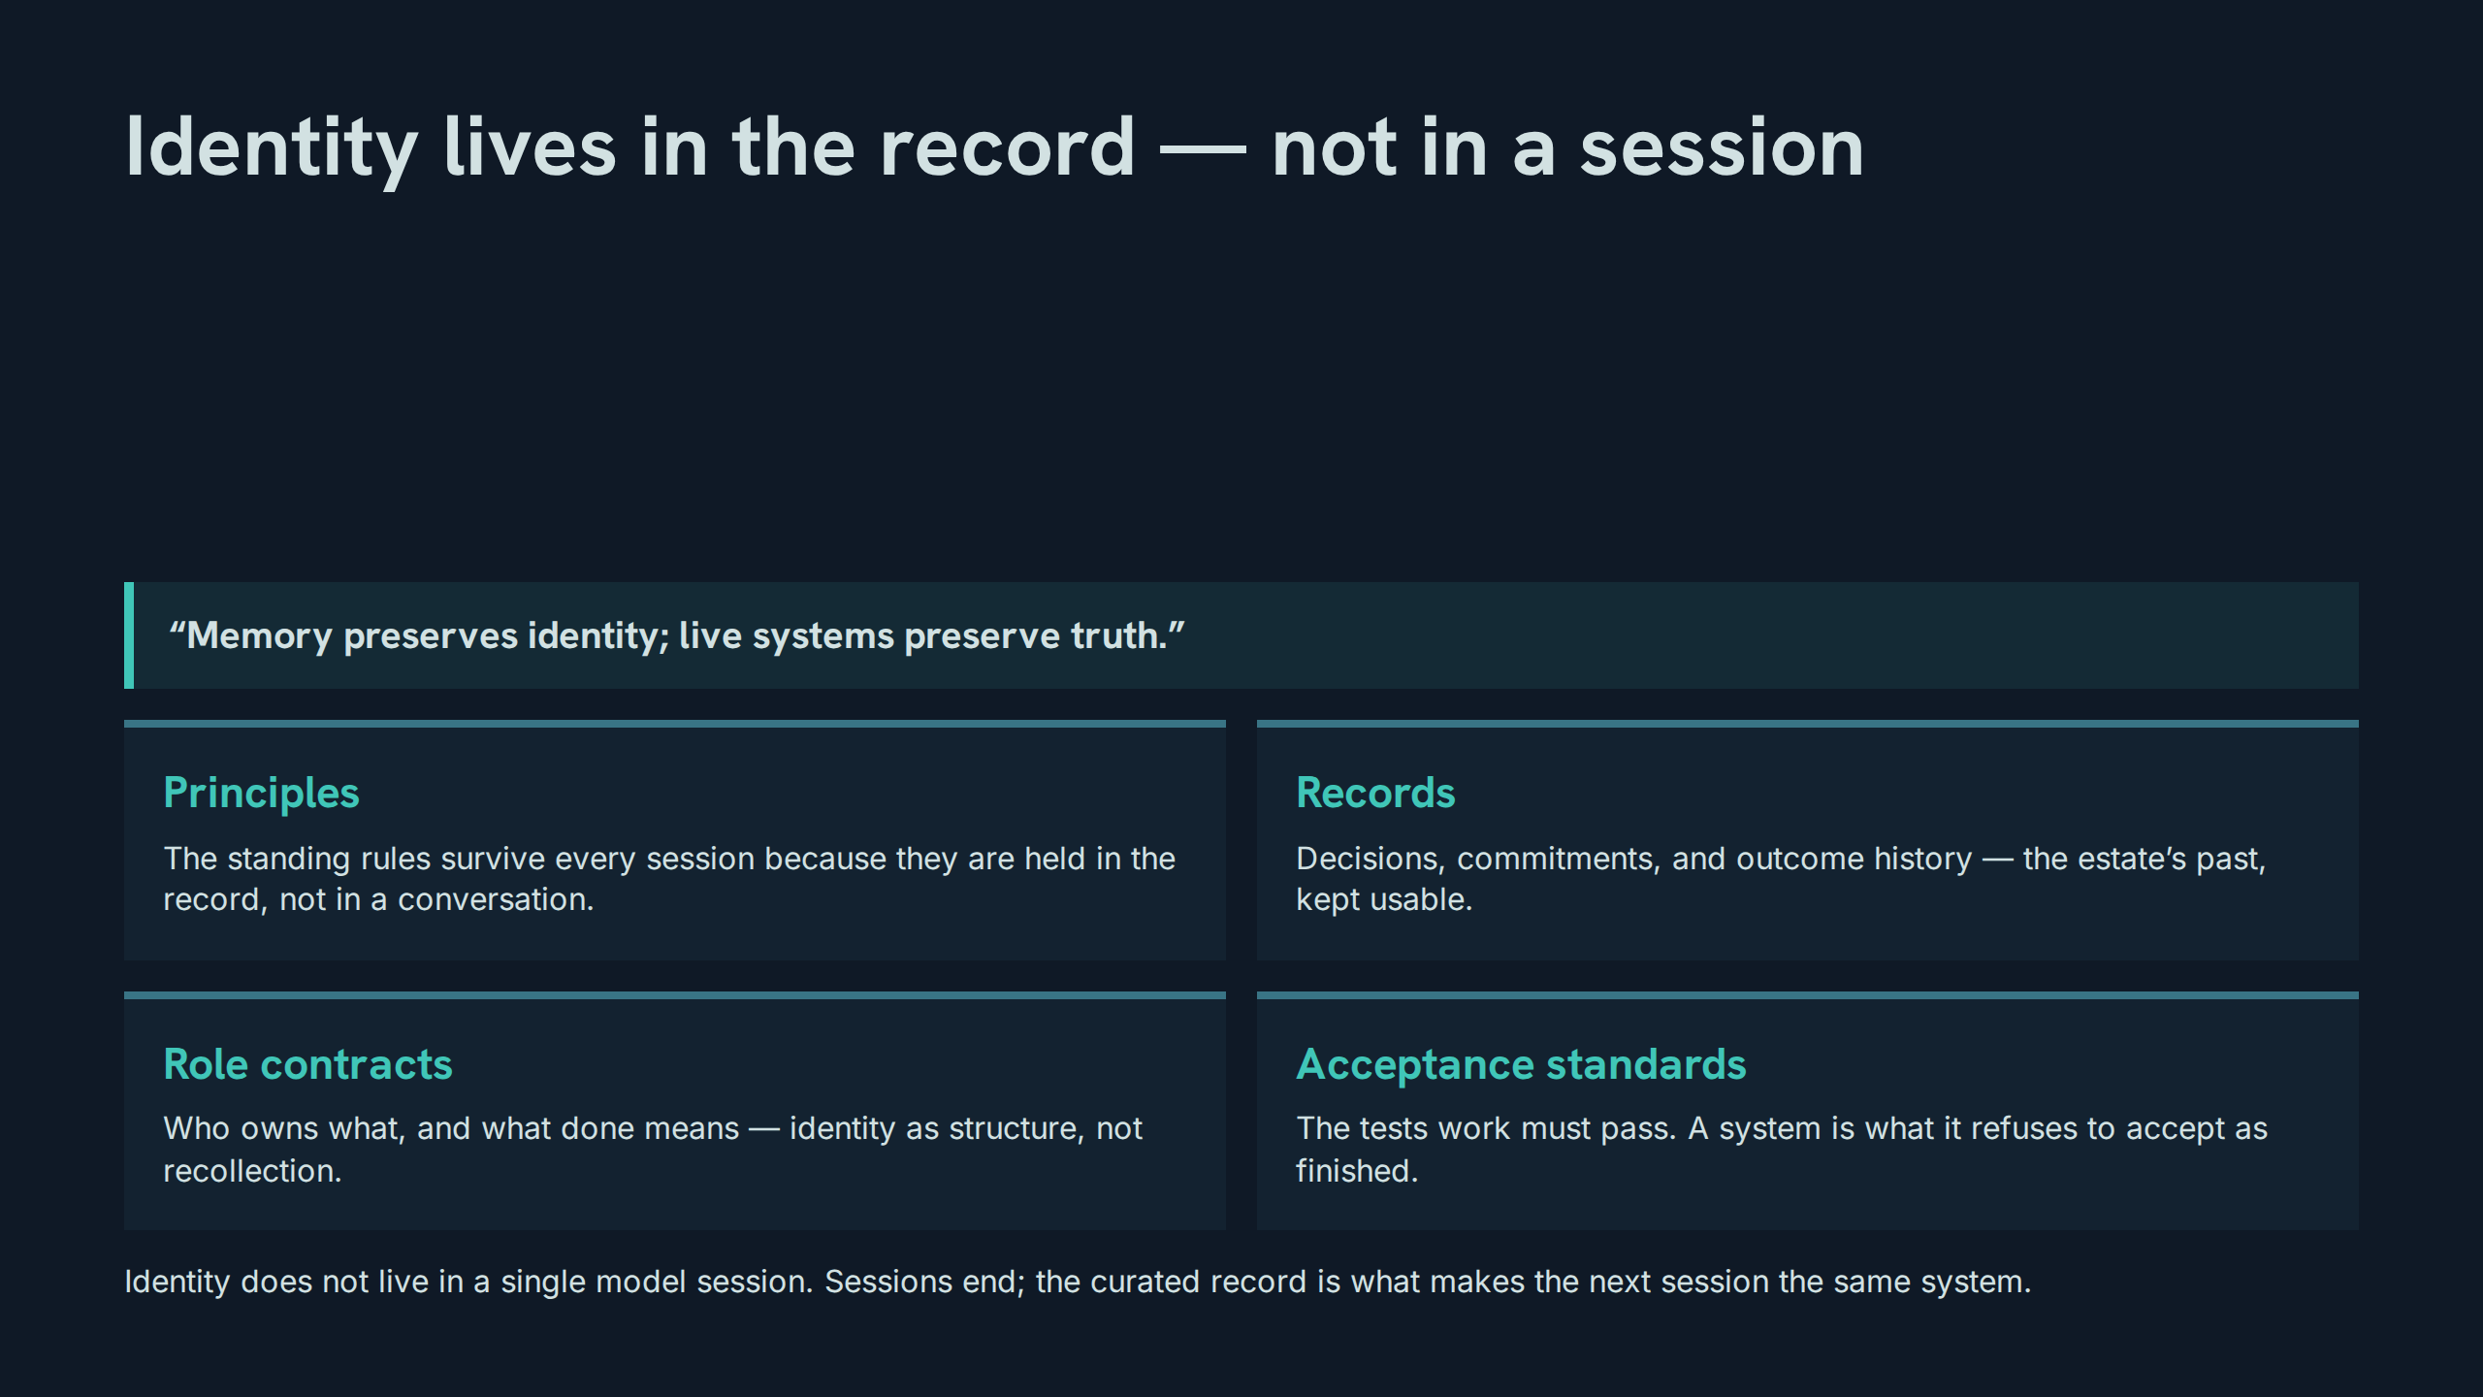
Notes:
Identity lives in the record — not in a session
Speaker notes: Teaching hook: close the identity argument — a session is an occasion, the record is the person of the system; that is the operational meaning of the opening line. Drill (3–4 minutes): participants list what would survive a total session loss, item by item, and mark anything essential that would not survive. Discussion prompt: if identity is in the record, what is the moral status of an unreconciled record?

Slide 44
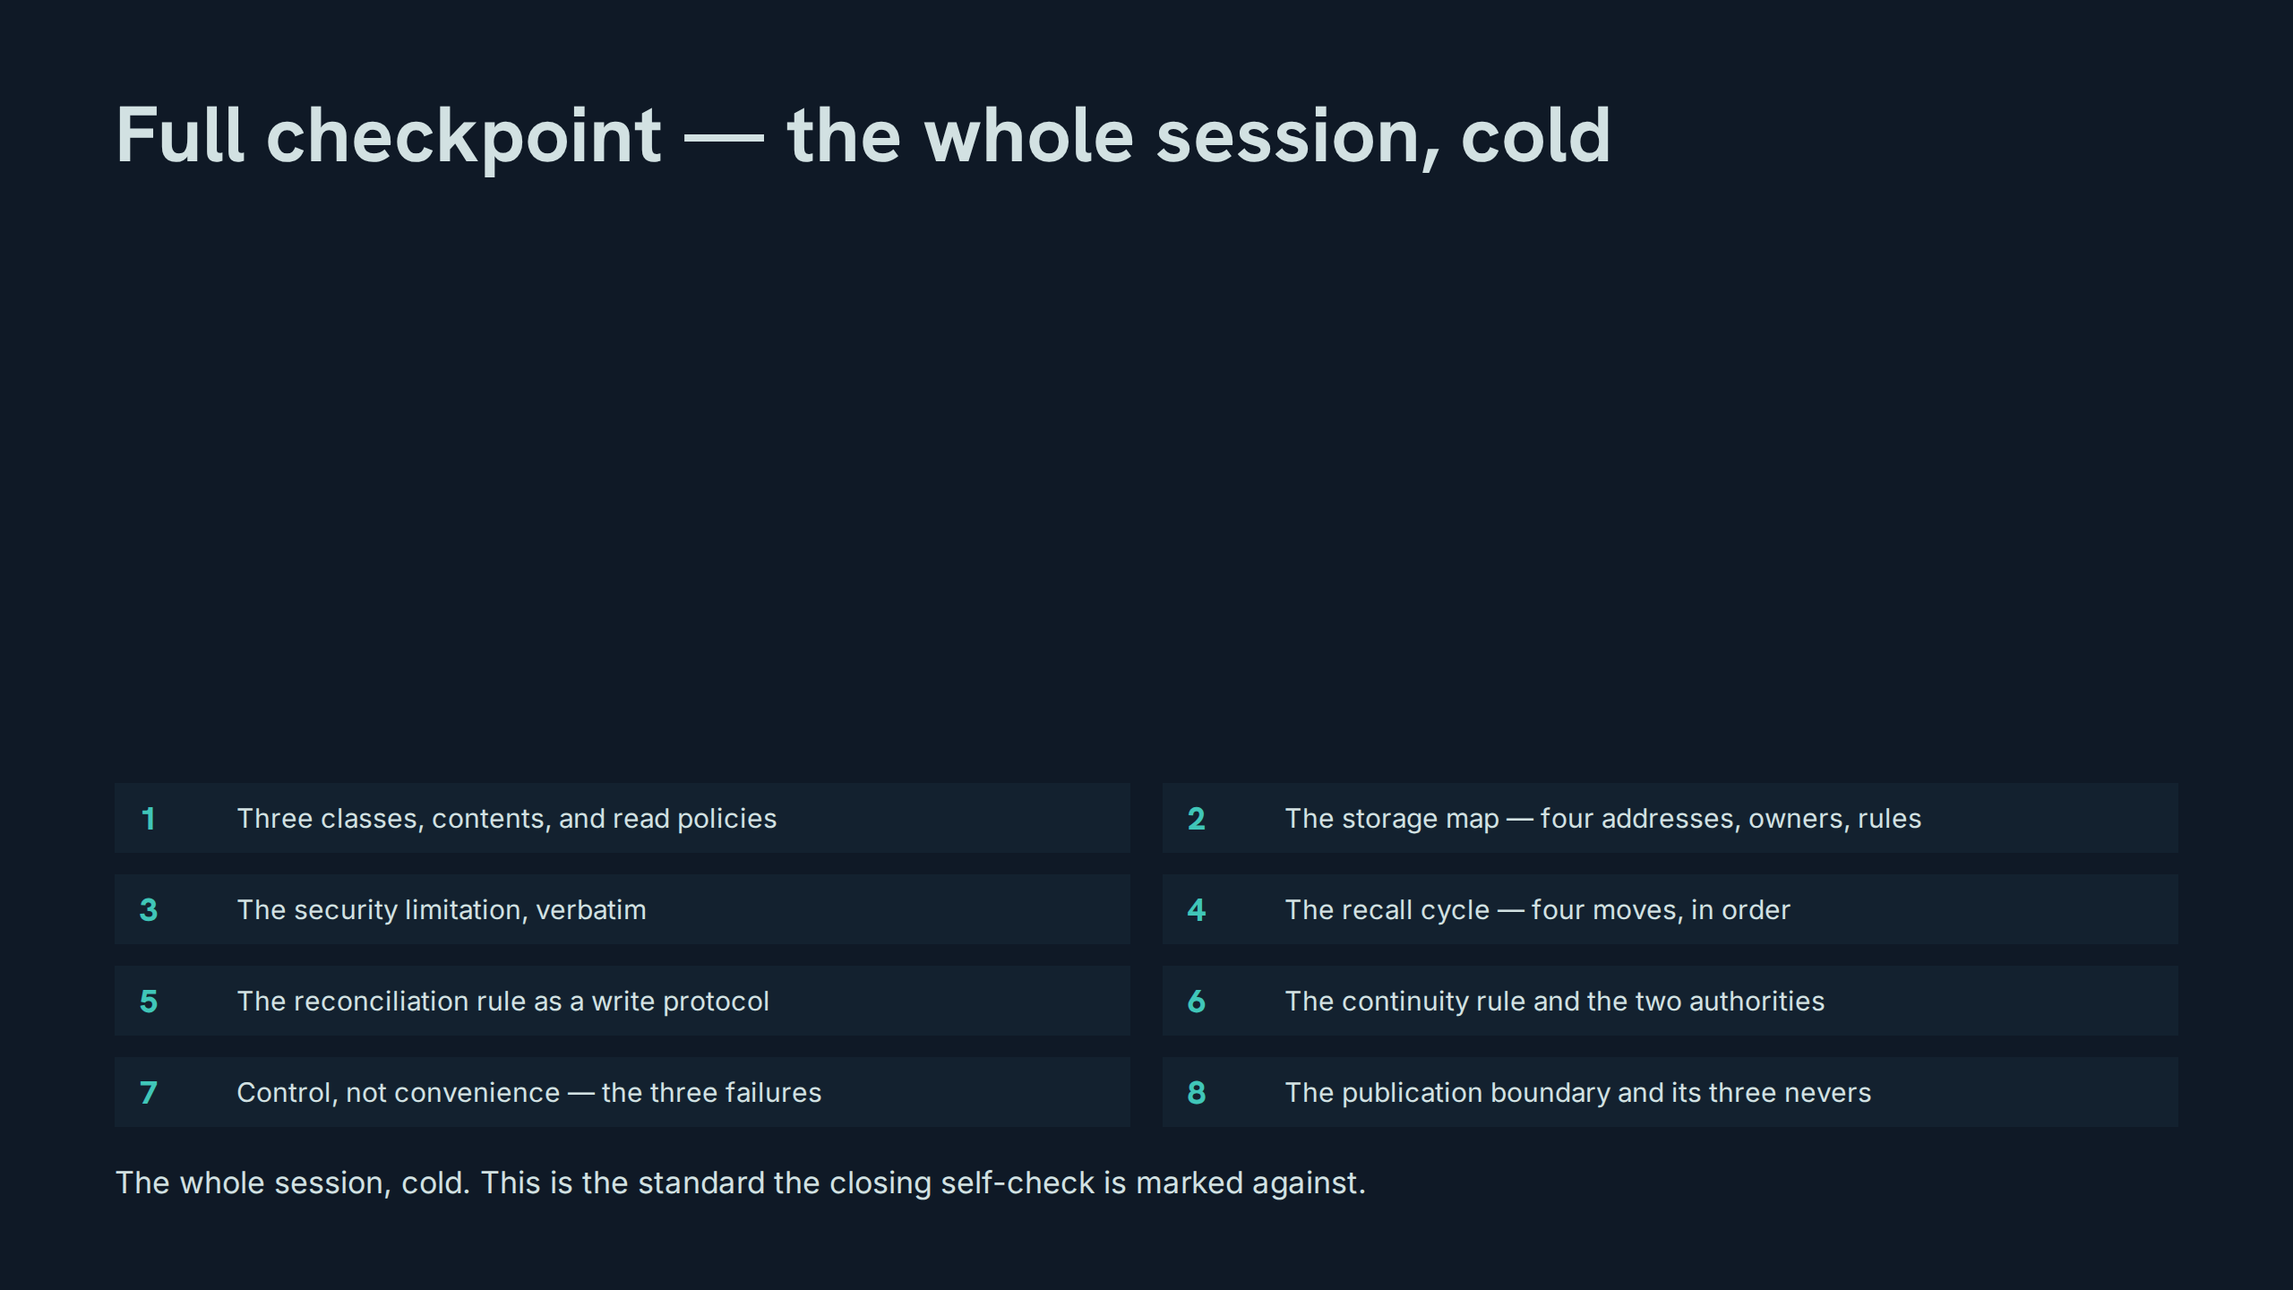
Notes:
Full checkpoint — the whole session, cold
Speaker notes: Teaching hook: run this as the examination it is — eight lines, no notes, misses logged for the self-check rather than argued with. Drill (3–4 minutes): rapid rotation, one item per participant, with the two verbatim demands (limitation, cycle) enforced exactly. Discussion prompt: which item’s miss would do the most damage in live estate work?

Slide 45
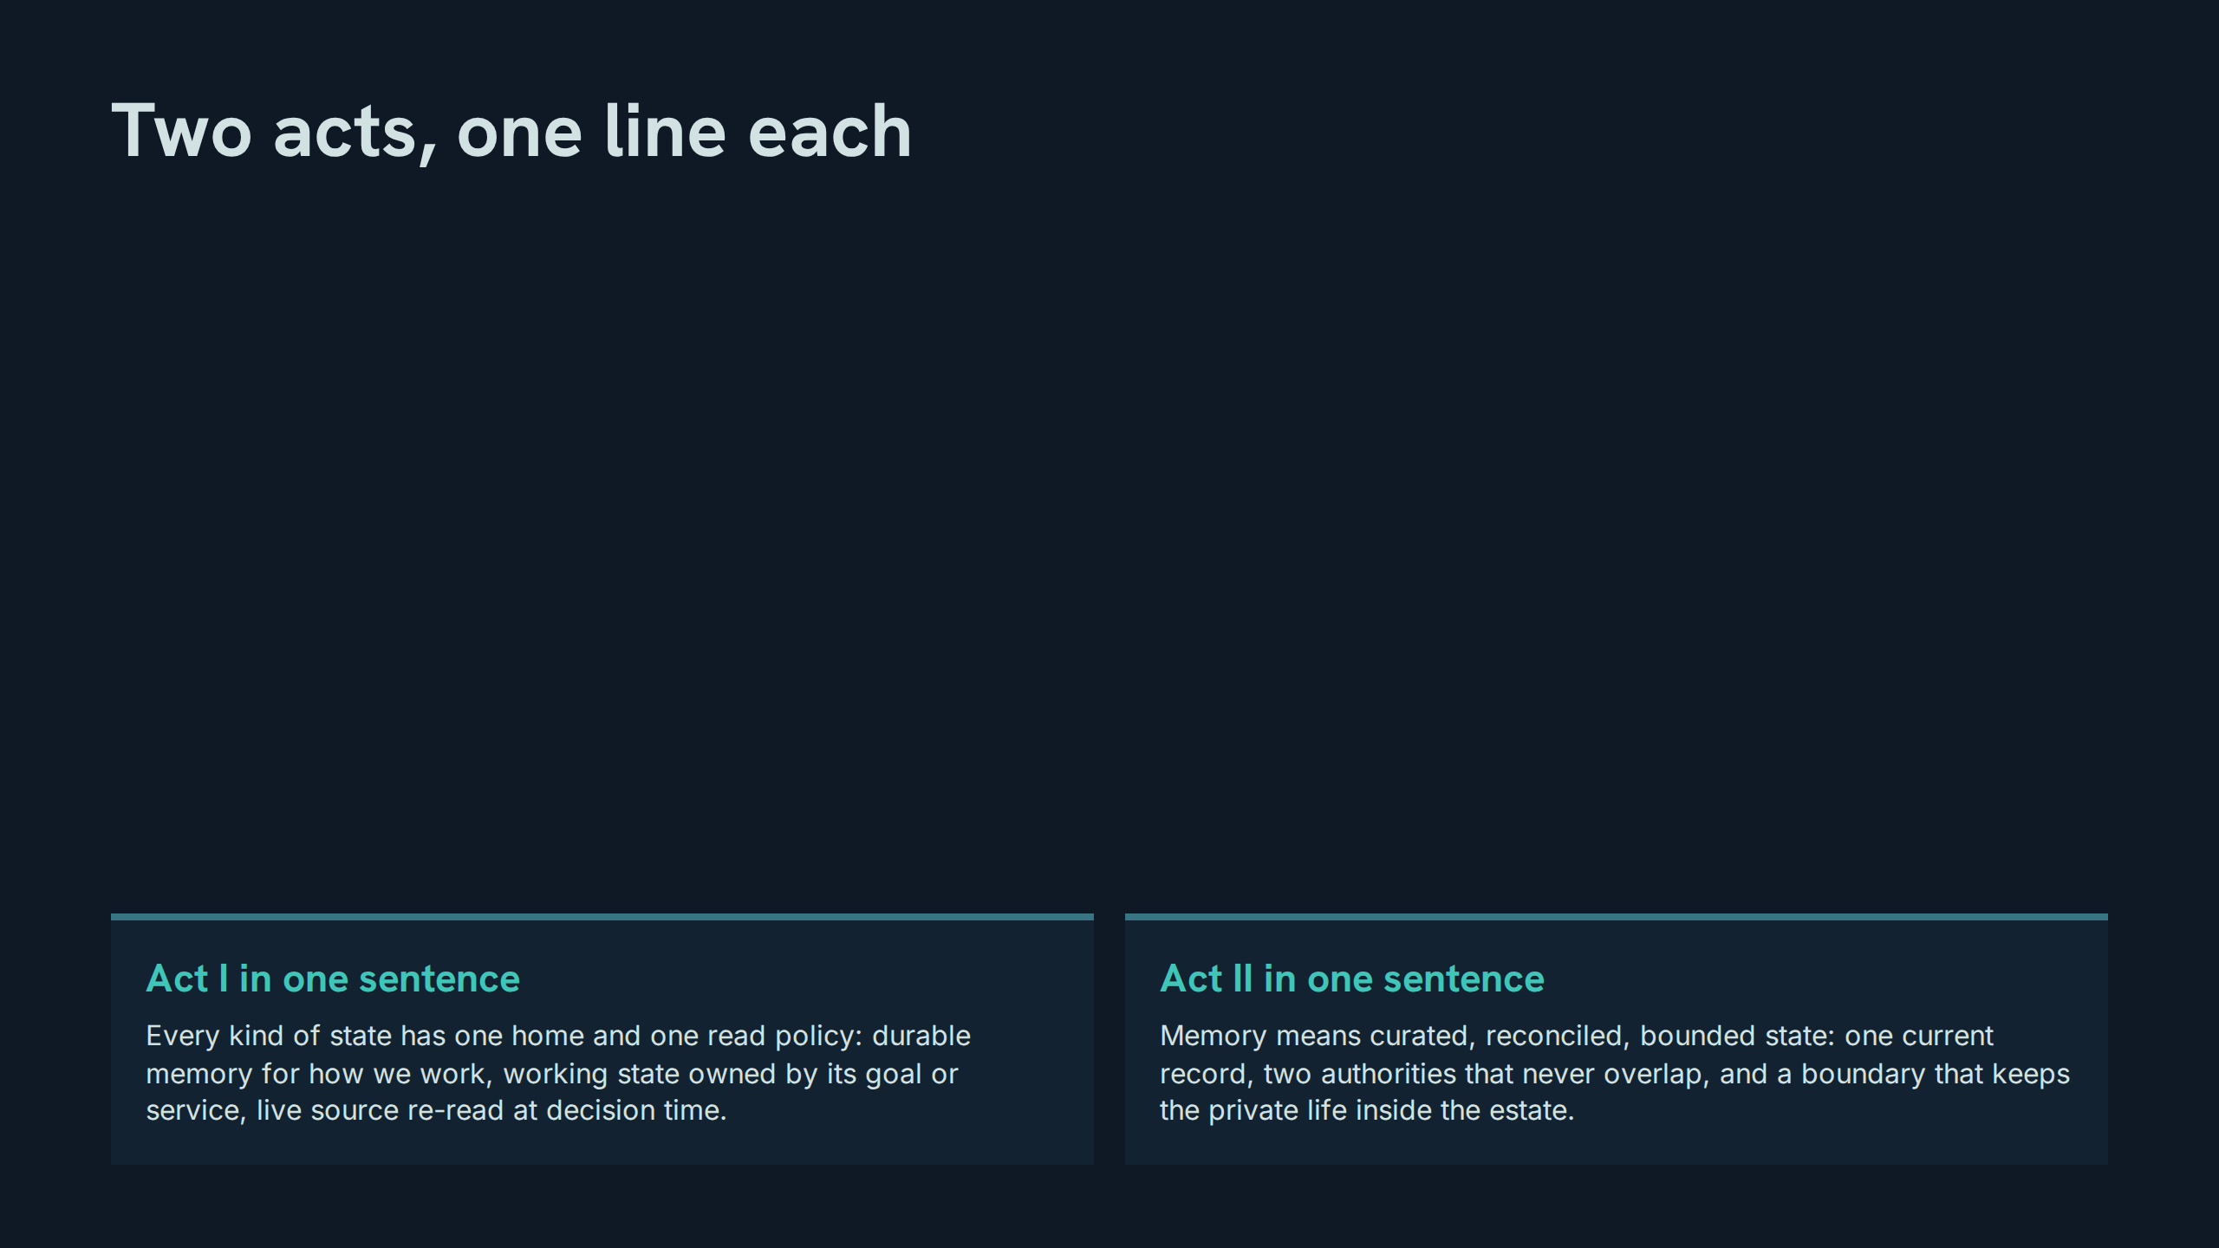
Notes:
Two acts, one line each
Speaker notes: Teaching hook: compression is the test of the two hours — if the session cannot be said in two sentences, it has not yet become knowledge. Drill (3–4 minutes): each participant delivers both sentences from memory, then improves one word and defends the improvement. Discussion prompt: which sentence will be quoted in six months, and does it deserve to be?

Slide 46
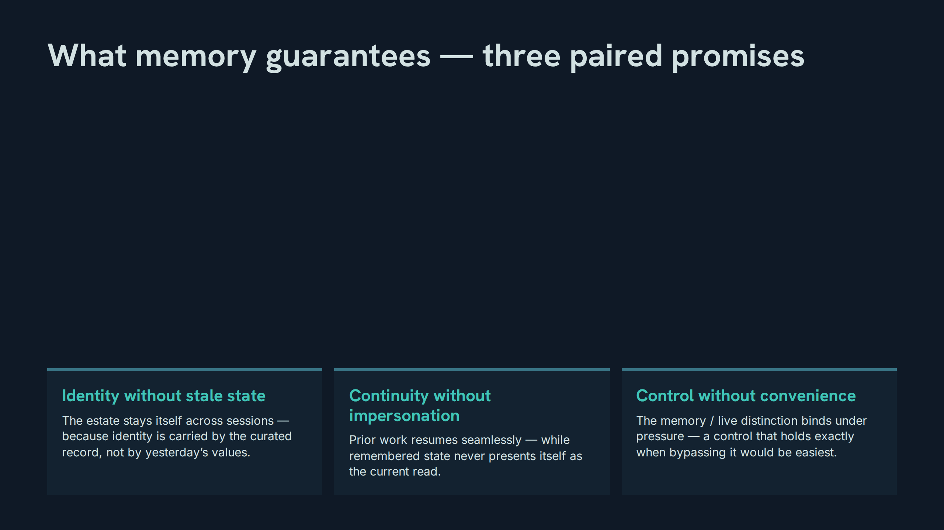
Notes:
What memory guarantees — three paired promises
Speaker notes: Teaching hook: each guarantee is a pair — a benefit and the discipline that keeps the benefit honest; teach the pairs, never the first halves alone. Drill (3–4 minutes): participants match three failure stories to the guarantee each violates, naming both halves of the pair. Discussion prompt: which guarantee is the estate currently keeping best — and what evidence settles that?

Slide 47
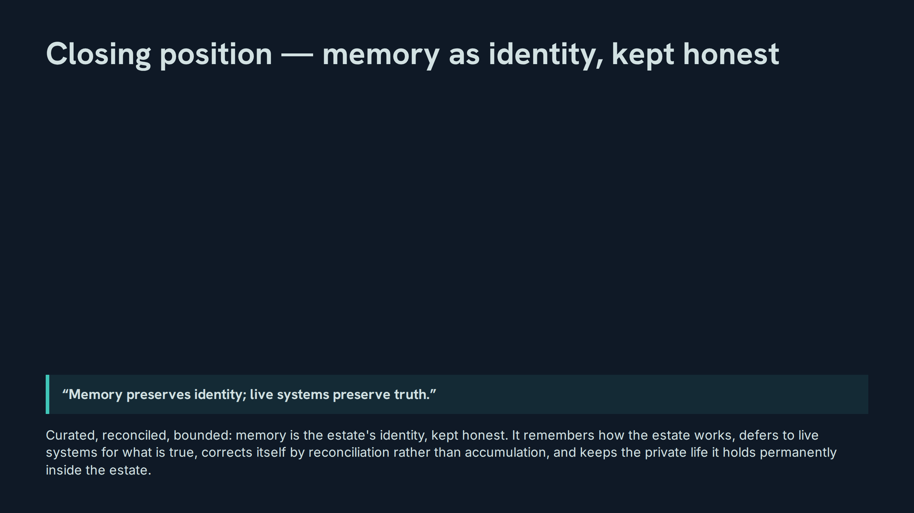
Notes:
Closing position — memory as identity, kept honest
Speaker notes: Teaching hook: end where the session began — the opening line now carries the whole two hours inside it, and the room should hear how much weight it can bear. Drill (3–4 minutes): one participant delivers the closing position in their own words; the room audits it against slides 3, 27, 31, and 38 for any doctrine dropped. Discussion prompt: what is the first practice in the estate that changes on Thursday morning because of this session?

Slide 48
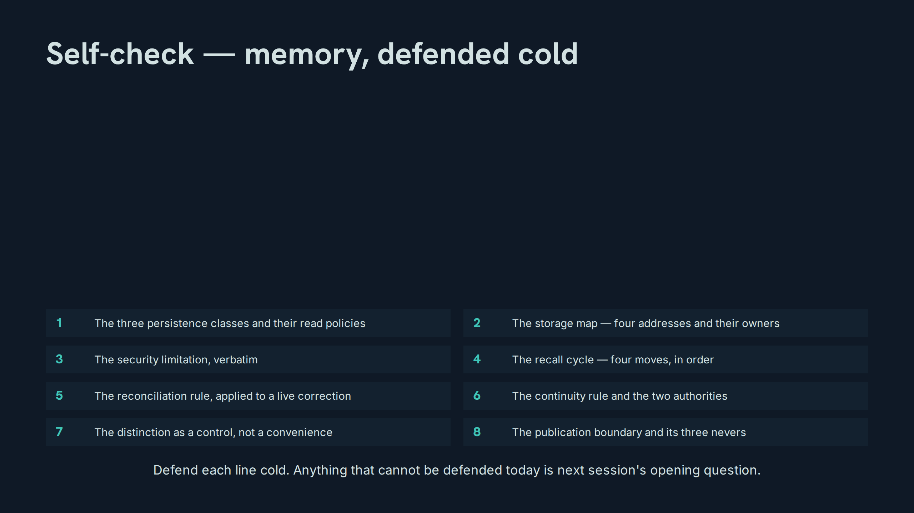
Notes:
Self-check — memory, defended cold
Speaker notes: Teaching hook: run the self-check as the exit examination — eight lines, defended cold, no notes; misses are logged, not argued with. Drill (3–4 minutes): final rotation through all eight lines at speed, one per participant, with the verbatim limitation demanded last and word-perfect. Discussion prompt: which of the eight lines will this room still be unable to defend in a month, and what routine would fix that?

