Slide 1
Computer Vision
sec1

Slide 2
What is Computer Vision?
Computer vision is a field of computer science that teaches computers to understand and interpret images and videos, much like how humans do.
It allows computers to identify objects, faces, or even actions in visual content by analyzing patterns and features.
For example, it’s used in applications like face recognition on phones, self-driving cars to detect obstacles, or medical scans to help diagnose diseases

Slide 3
Using Computer Vision
Detecting faces allows the devices to identify the presence of faces apart from the task of recognizing them.
how it works:
Face Detection: The system first identifies and locates the face within an image or video using algorithms like Haar cascades or deep learning models.
Landmark Detection: Once the face is detected, key facial landmarks (like the eyes, mouth, nose, and eyebrows) are identified to track facial movements.
Feature Extraction: The system then extracts features, such as changes in the shape of the mouth or the squinting of eyes, which are associated with different expressions.
Classification: Based on the extracted features, the system uses machine learning models (like deep neural networks) to classify the faces being displayed by the person

Slide 4
Neural Networks

Slide 5
Neural Networks
Neural networks are a type of machine learning algorithm that are inspired by the structure and function of the human brain
NN reflect the behavior of the human brain, allowing computer programs to recognize patterns and solve problems in fields like AI or deep learning

Slide 6
Neural Networks
NN are composed of interconnected nodes, called neurons, Each neuron in a neural network receives one or more inputs, processes those inputs (mathematically)and then sends the outcome to the layer of neurons below it .
There are typically three parts in a neural network:
input layer: initial data for the neural network.
one or more hidden layers: place where all the computation is done.
output layer: produce the result for given inputs.

Slide 7
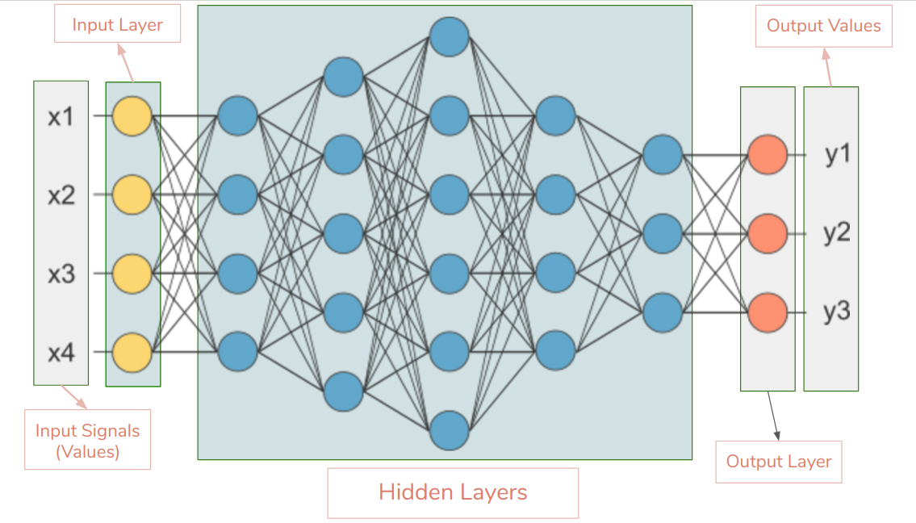
Neural Networks

Slide 8
Activation Functions
An Activation Function decides whether a neuron should be activated or not. This means that it will decide whether the neuron’s input to the network is important or not.
Commonly used activation functions are:
1- step function
2- linear function
3- sigmoid function

Slide 9
The Convolutional Neural Network (CNN)

Slide 10
(CNN) algorithm
is a type of deep learning algorithm that is used to classify images and recognize patterns.
The CNN algorithm works by taking an input image and applying a series of convolutional layers to it.
Each layer consists of a set of filters that are applied to the input image, extracting features from it.
The output from each layer is the input to the next layer. Finally, the output from the last layer is used for classification

Slide 11
A CNN typically has three layers:-
Convolutional layer
pooling
fully connected layer

Slide 12
1- Convolutional layer
The convolution layer is the core building block of the CNN . It carries the main portion of the network’s computational load.
It consists of :
Filters: responsible for detecting patterns (shapes and edges) and extracting the most important information from image.
Feature maps: is the out put of Filters (used in the next layer)

Slide 13
1- Convolutional layer

Slide 14
2- Pooling Layer
A Convolutional Layer is followed by a Pooling Layer.
Pooling Layer minimize the size of the feature map by using some methods (operations)
There are two main types of pooling operations:
Max pooling
Average pooling

Slide 15
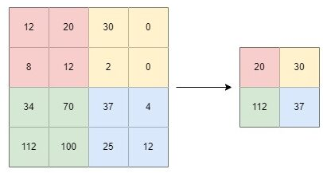
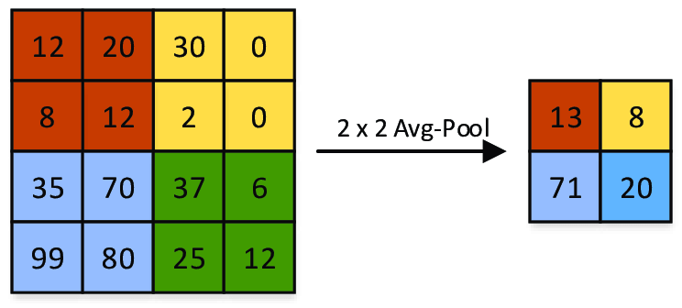
2- Pooling Layer
Max pooling
Average pooling

Slide 16
3- Fully Connected Layer
Is the last layer in CNN before output
Consists of many neurons (simulate brain nerve cells)
connects every input to the output

