Slide 1


Slide 2
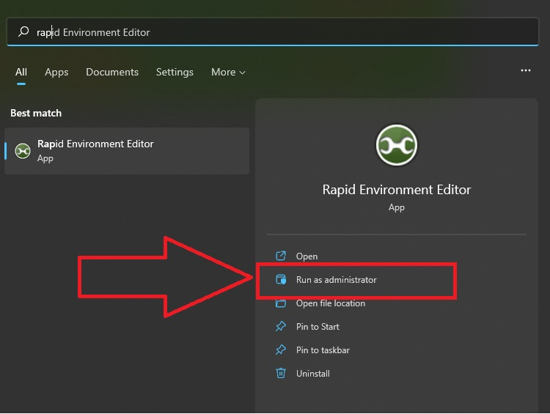

Slide 3
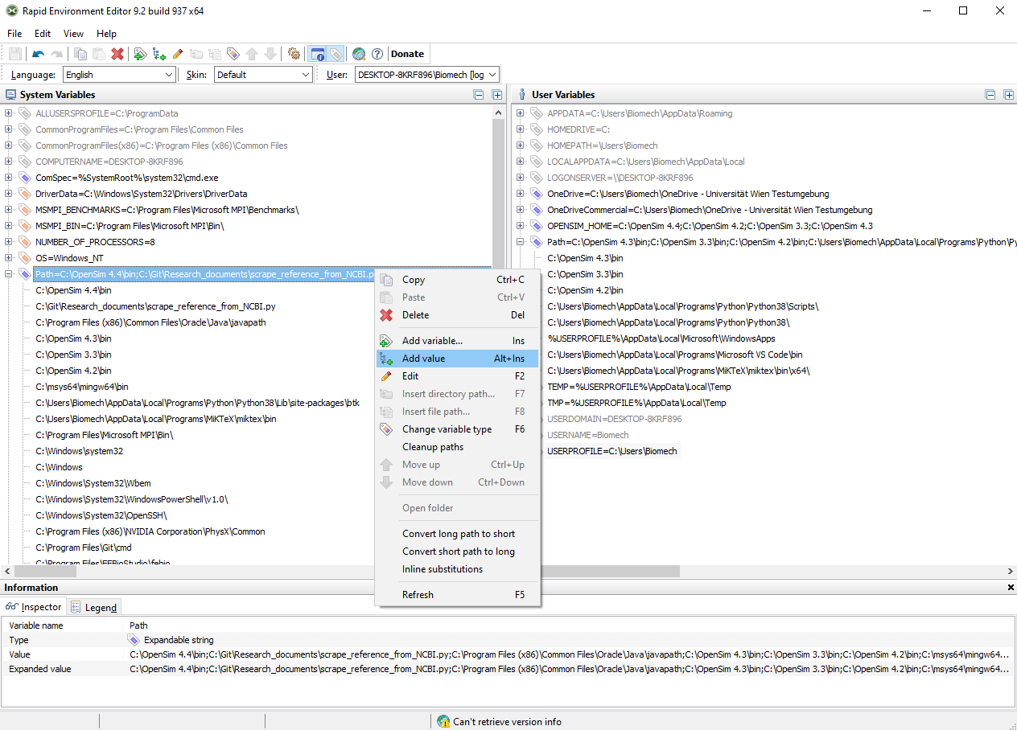
1)
3) Add the path with the version to be used (e.g. C:\OpenSim 4.4\ bin
2)

Slide 4
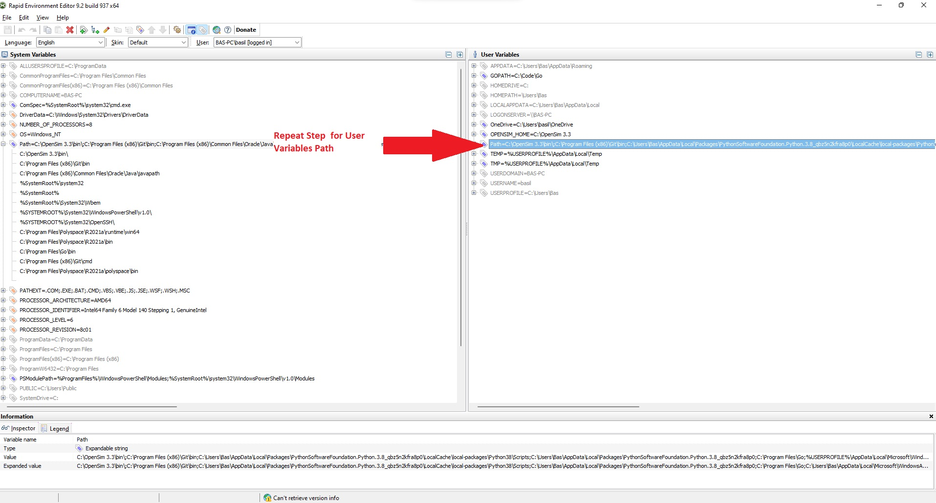

Slide 5
