Slide 1
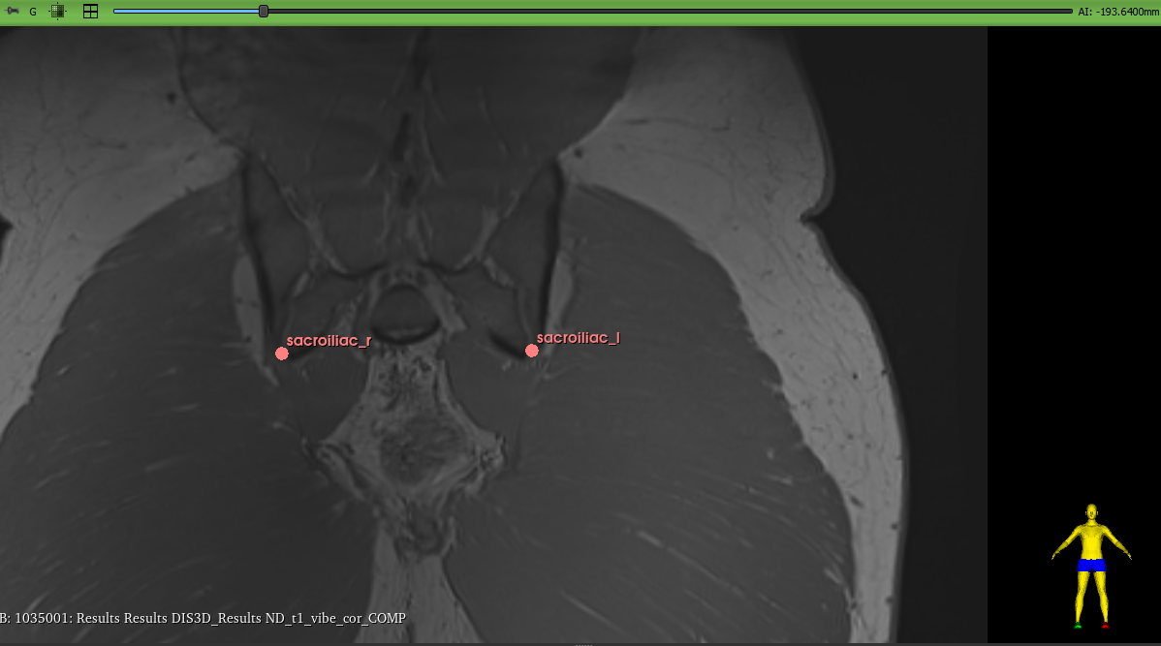

Slide 2
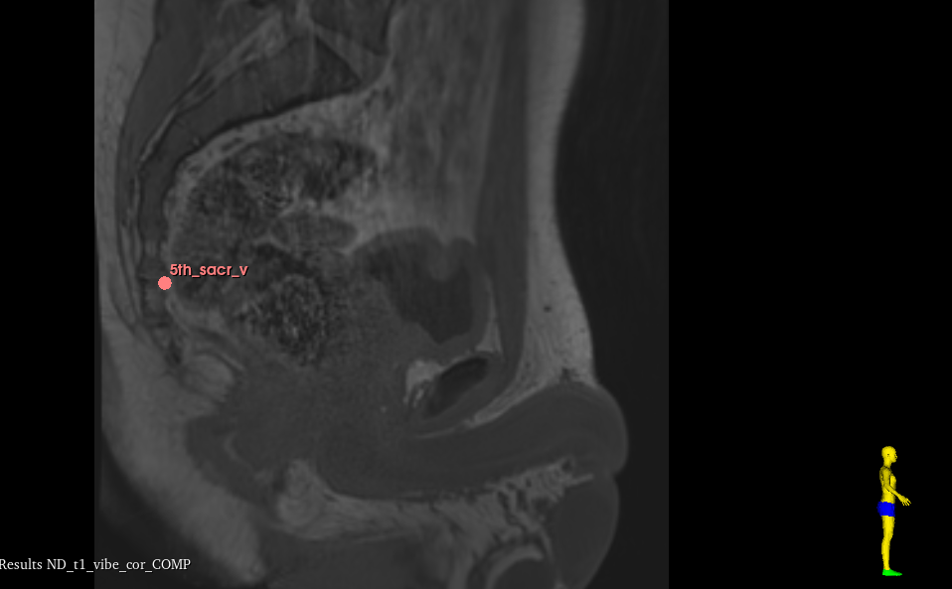

Slide 3
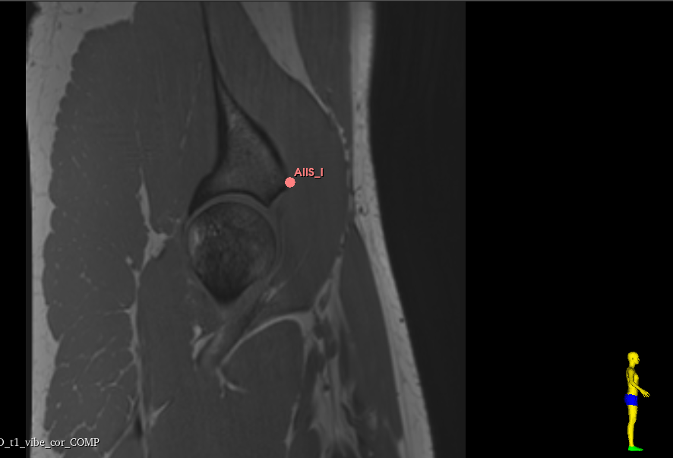

Slide 4
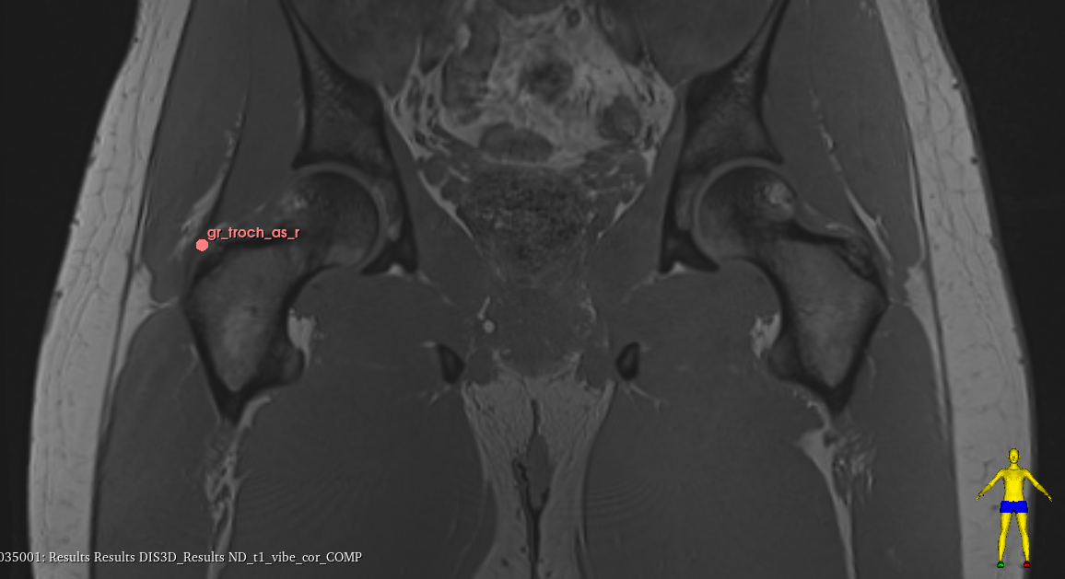

Slide 5
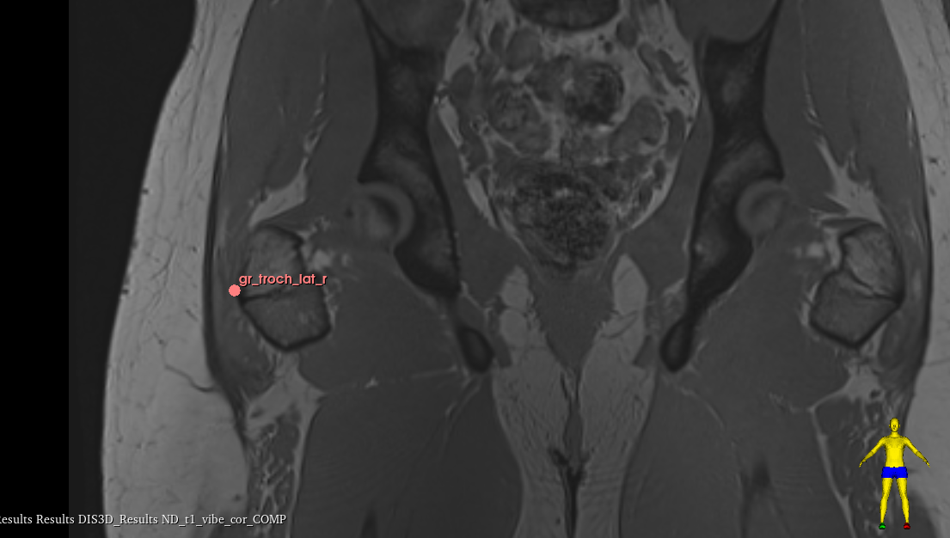

Slide 6
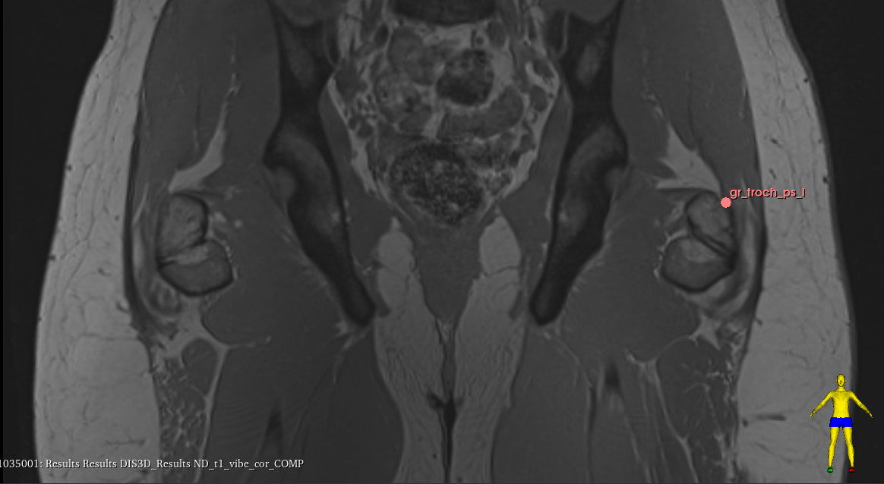

Slide 7
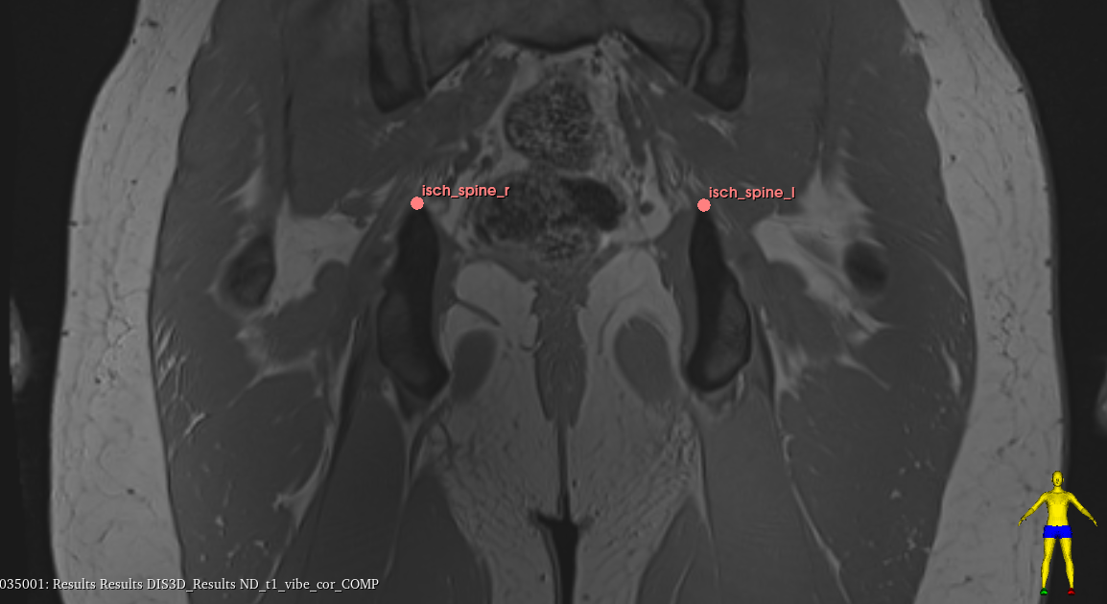

Slide 8
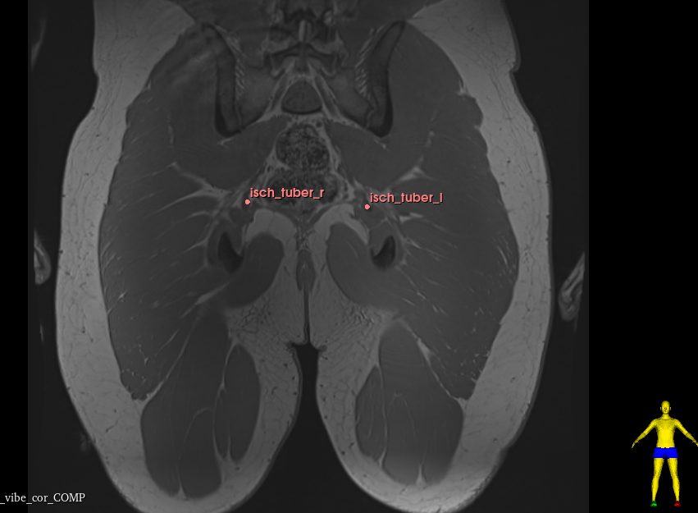


Slide 9
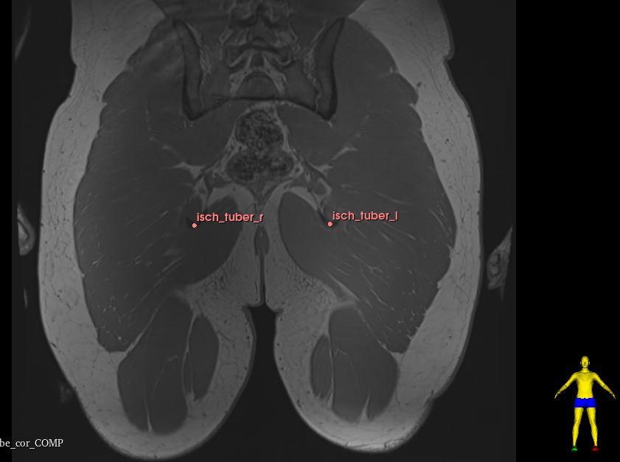
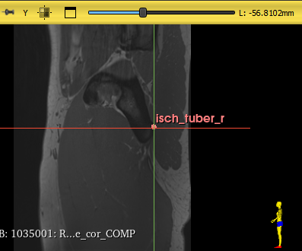

Slide 10
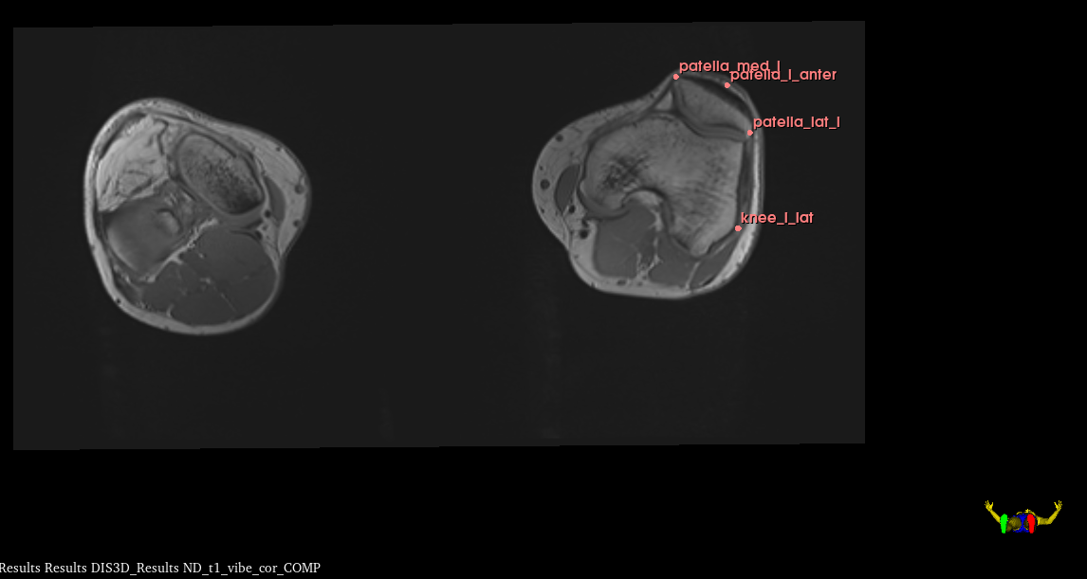

Slide 11
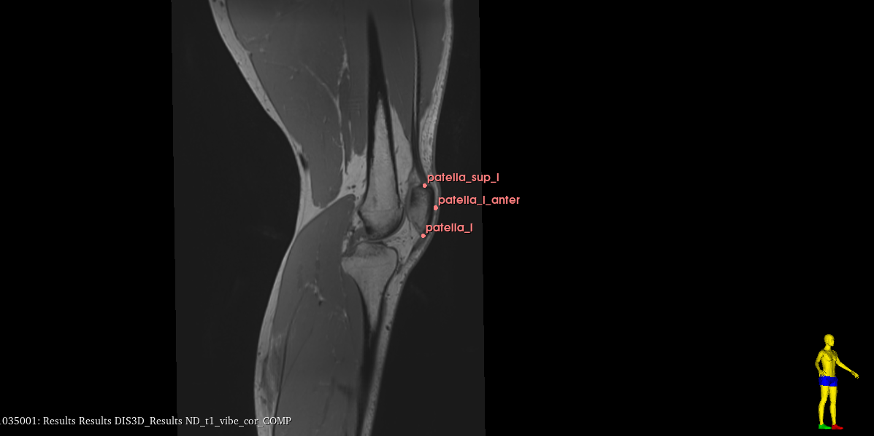

Slide 12


Slide 13
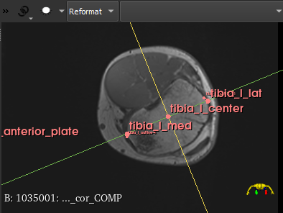


Slide 14


Slide 15


Slide 16
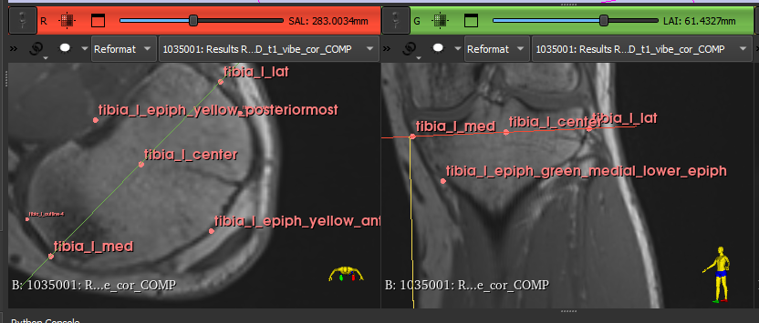

Slide 17
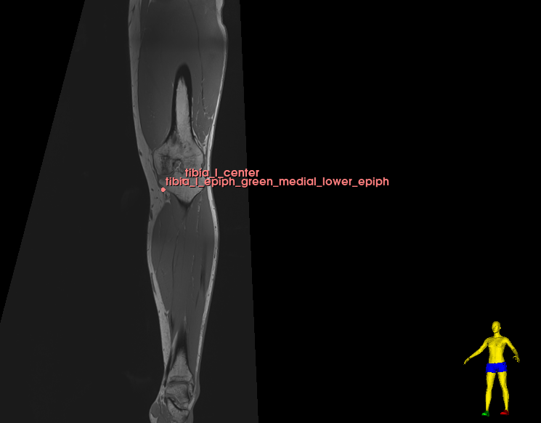
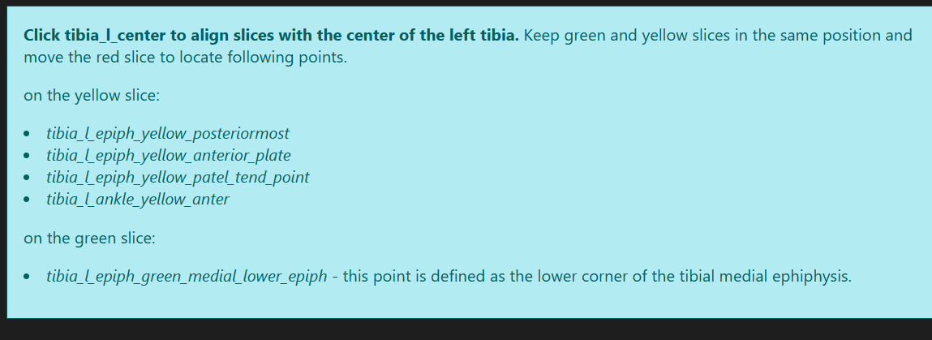

Slide 18


Slide 19
After all points in MRI done:
"E:\DataFolder\Katya_UniVie\athlete_03\001bis\P01\model_update\2.0_tps.ipynb“

Slide 20
Manuel Prigl |  | a12048662@unet.univie.ac.at
Silvana Söllinger |  | a11838333@unet.univie.ac.at
Benjamin Stummer |  | a12137212@unet.univie.ac.at

