Slide 1
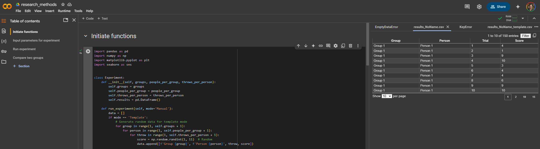
Toolbar
Code content per sections
Current directory
Section header (.md format)
Code editor
File inspector
1
2
6
4
5
3

Slide 2
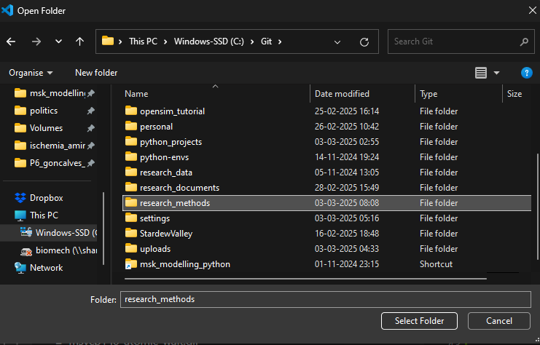

Slide 3
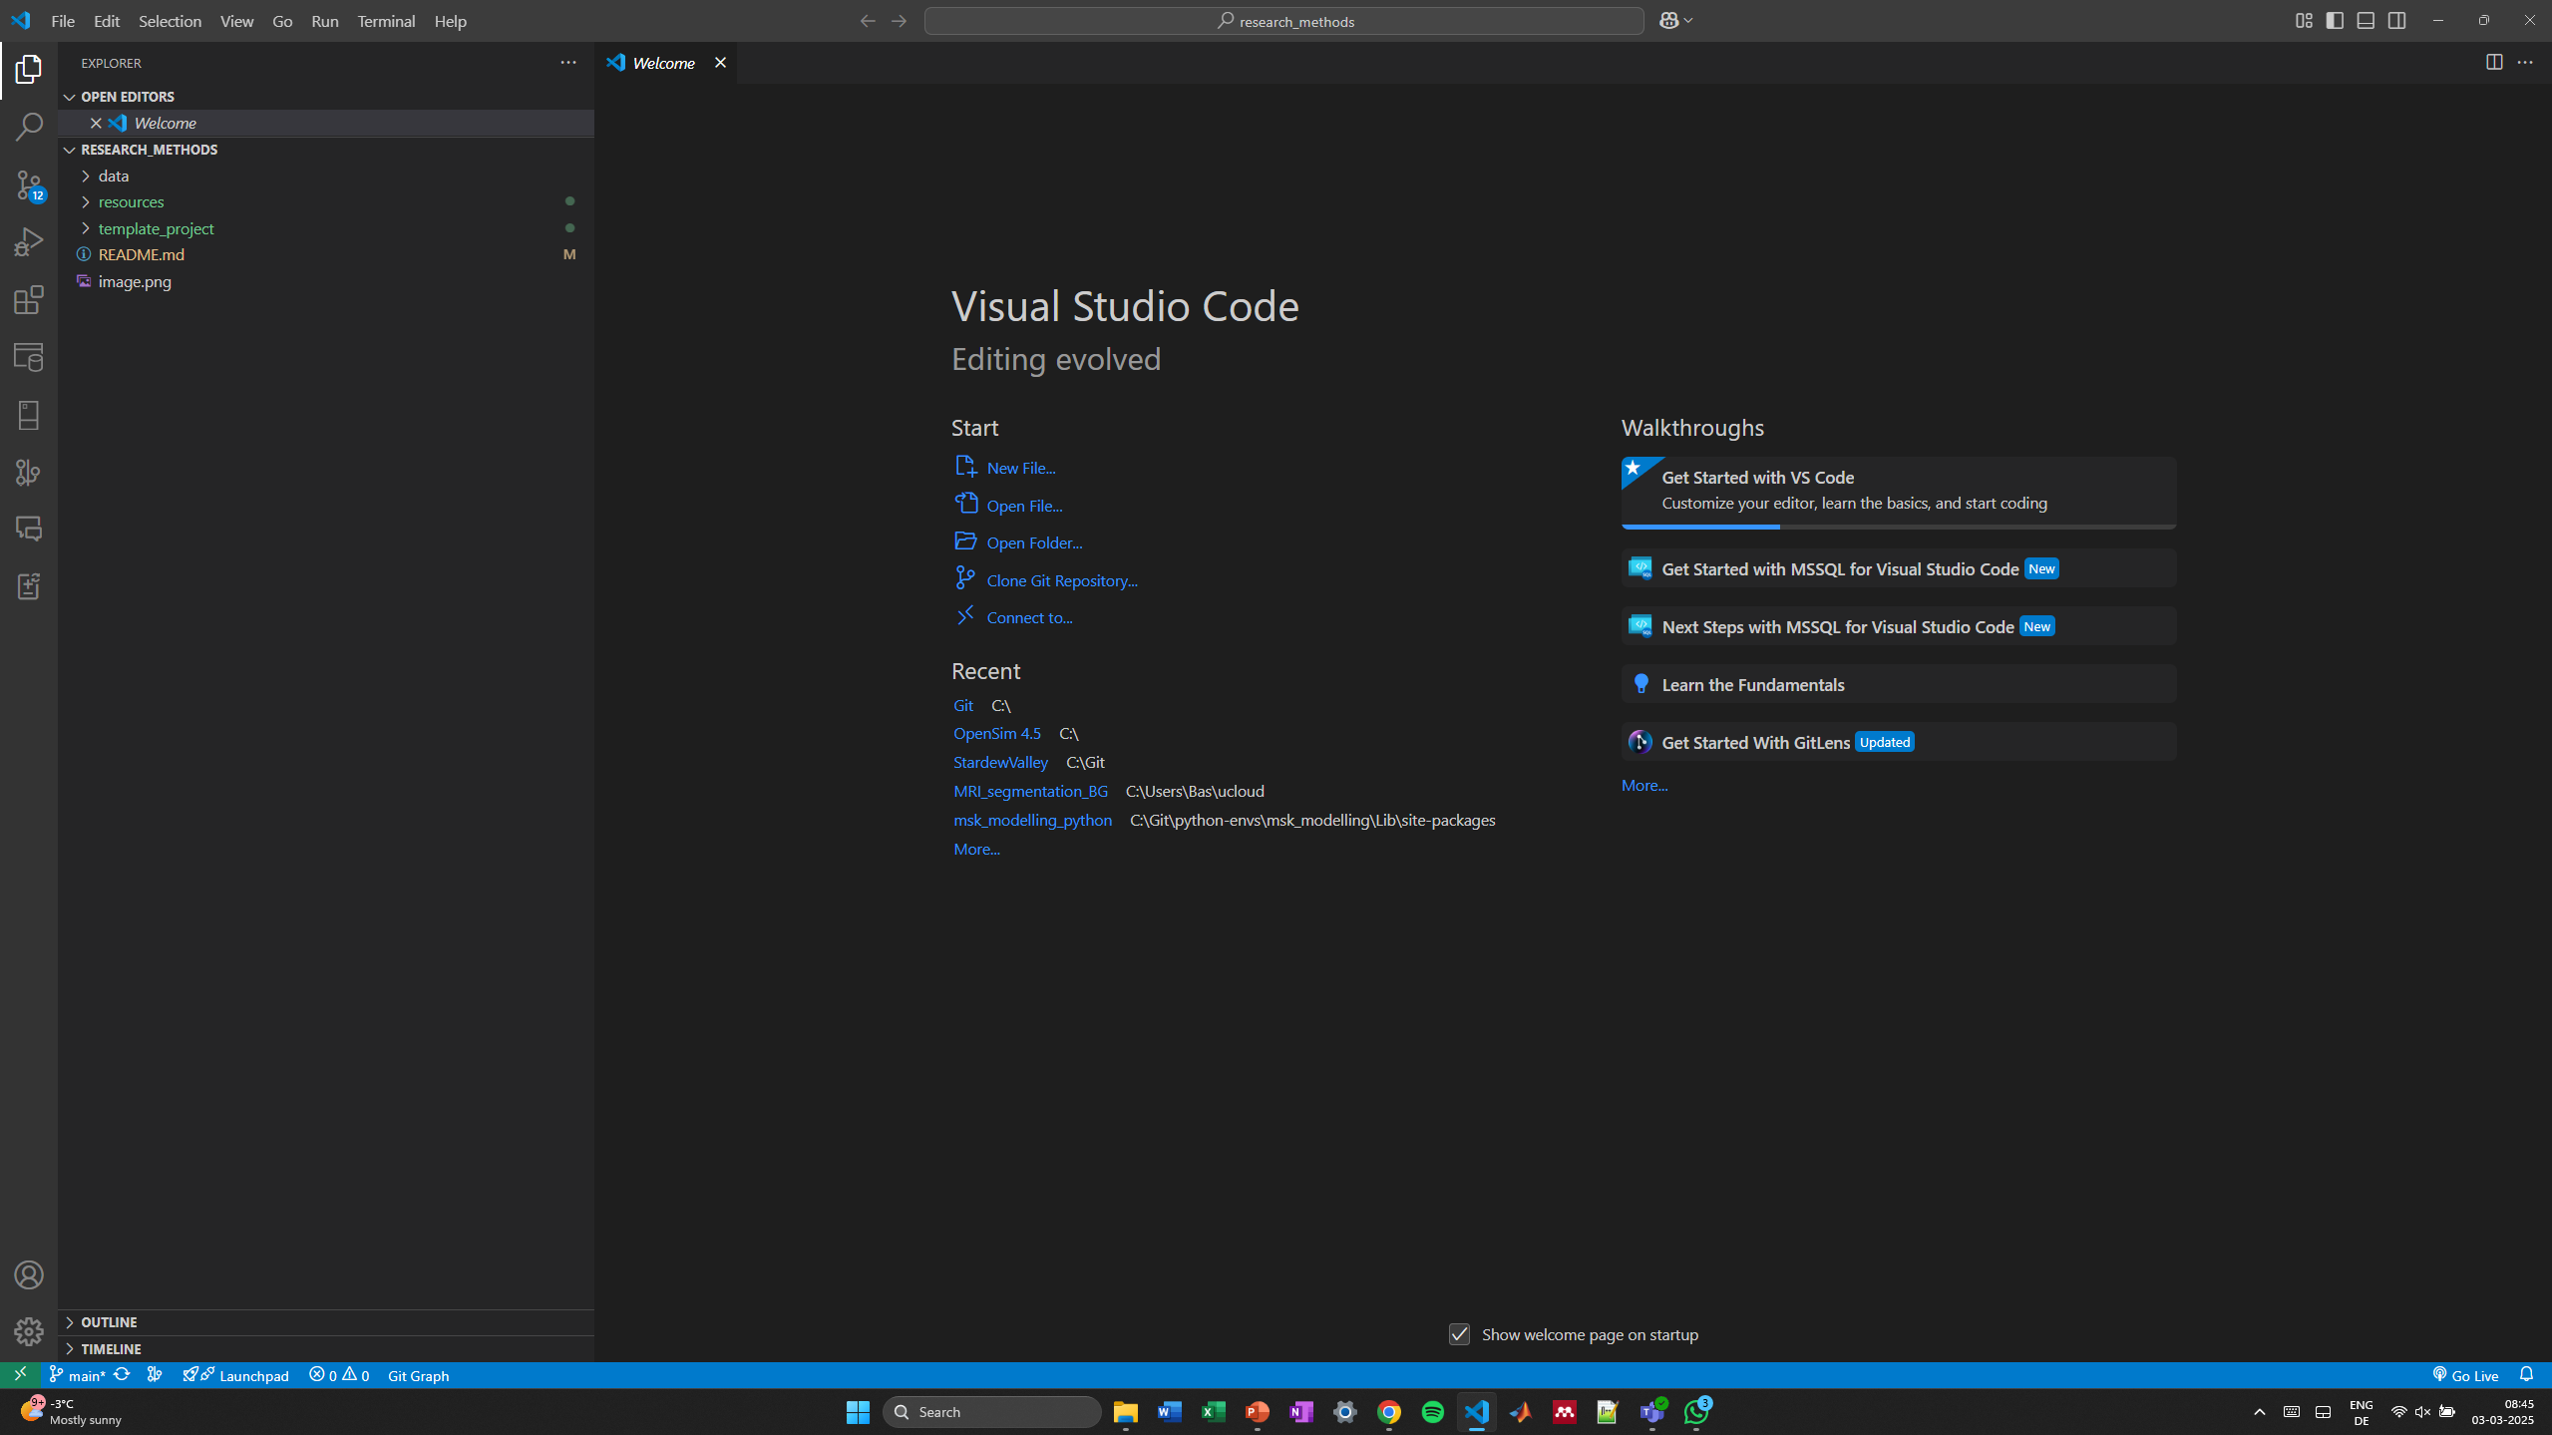

Slide 4
