Slide 1
Pin in CTF
2018.6.28
王奥博 from BIT

Slide 2

What is Instrumentation
A technique that inserts extra code into a program to collect runtime information
Instrumentation approaches
Source instrumentation
  instrument source programs
Binary instrumentation
  instrument executables directly

Slide 3
Advantages of Pin
Easy-to-use Instrumentation:
  Uses dynamic instrumentation
    Do not need source code, recomplication, post-linking
Programmable Instrumentation:
  Provides rich APIs to write in C/C++ you own instrumentation tools(called Pintools)
Multiplatform:
  Support x86, x86-64, Itanium, Xscale
  Support Linux, Windows, MacOS
Efficient:
  Applies complier optimizations on instrumentation code

Slide 4
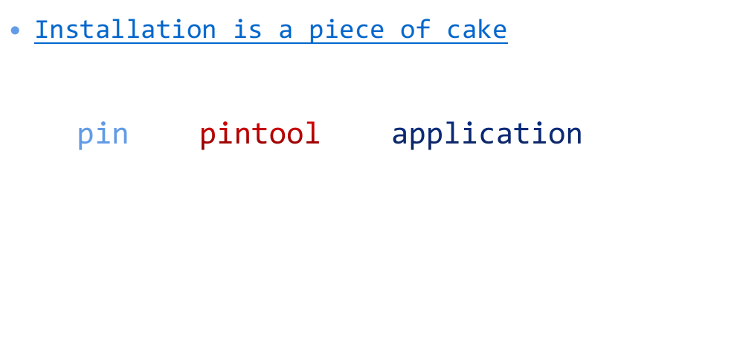


Using Pin
instrumentation engine(provided in the kit)

Slide 5
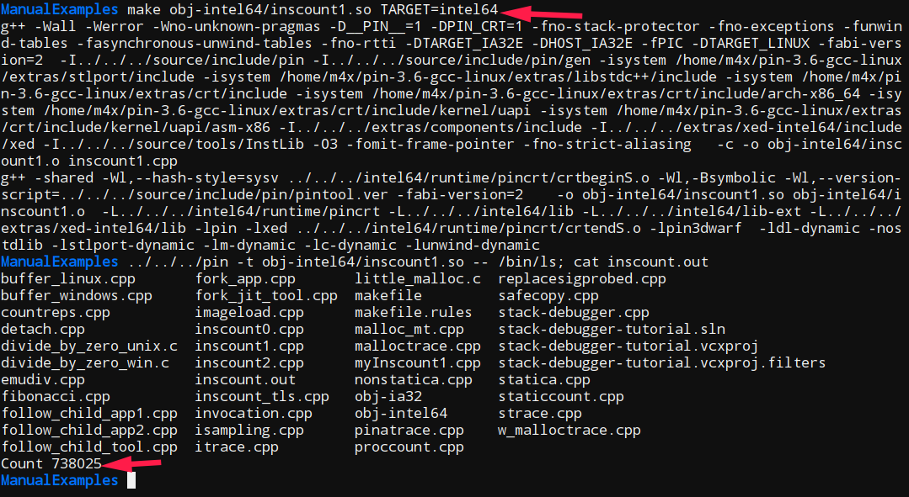
Example: Instruction Count
source/tools/ManualExamples/inscount0/1/2/3.cpp

Slide 6
Using Pin in CTF
side channel analysis
  By counting the number of instruction executed
  By recoding all memory writes
  ans so on

Slide 7
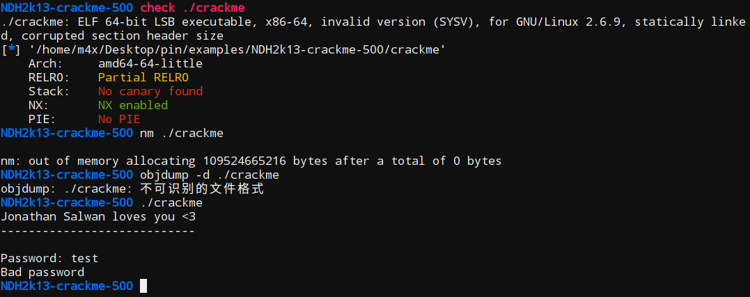
Example 1:
NDH2k13-crackme500

Slide 8
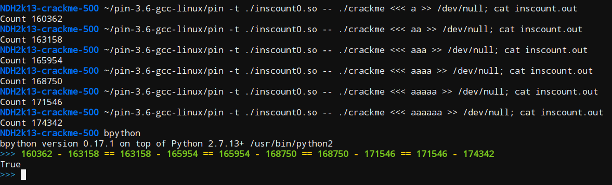
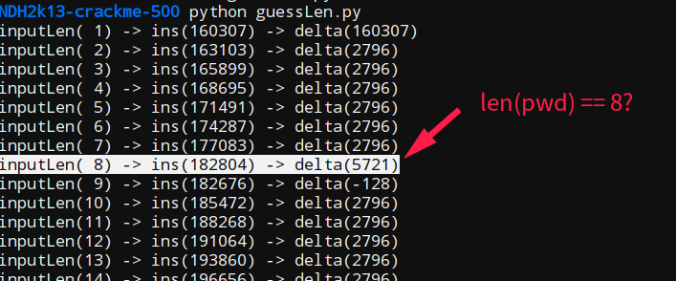
Example 1:
NDH2k13-crackme500

Slide 9
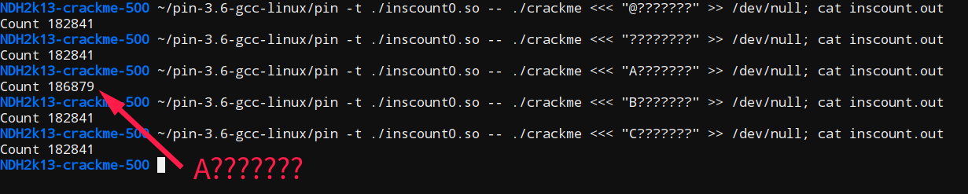
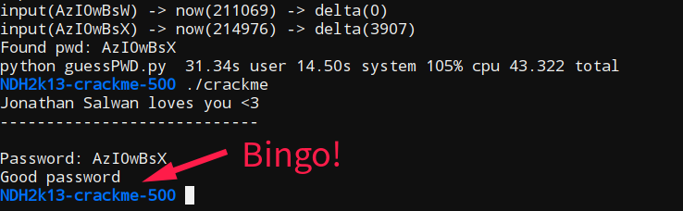
Example 1:
NDH2k13-crackme500
Modified Inscount is More Powerful!

Slide 10
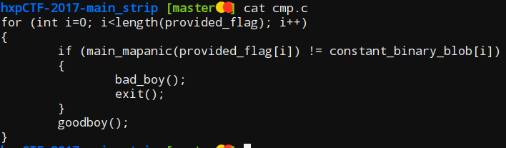
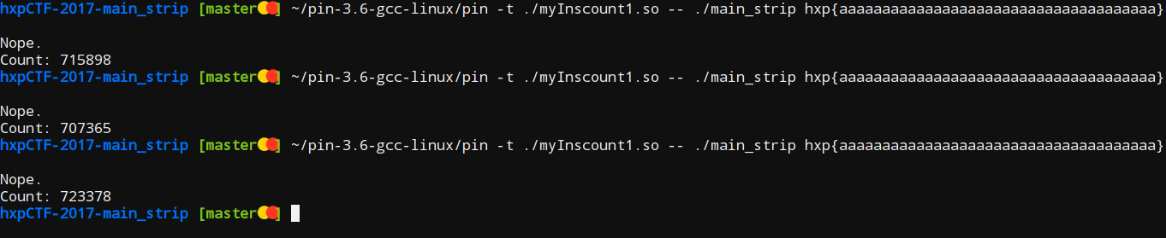
Example 2: hxpCTF2017-main_strip

Slide 11
Example 2: hxpCTF2017-main_strip
VOID docount() {
icount++;
}
VOID docount(void *ip) {
// .text:000000000047B96E cmp al, cl;
// cmp mapanic(provided_flag[i]), constant_binary_blob[i]
if ((long long int)ip == 0x0047B96E)
icount++;
}

Slide 12
Example 3:
AlexCTF2017-move
movfuscator
Writeup:
https://github.com/ctfs/write-ups-2017/tree/master/alexctf-2017/reverse-engineering/re5-packed-movement-350

Slide 13
Experience:
(in CTF Challenges)
inscount1(BB) is faster than inscount0(INS)
dict = map(chr, range(0x20, 0x7f))
Triton
PinCTF

Slide 14
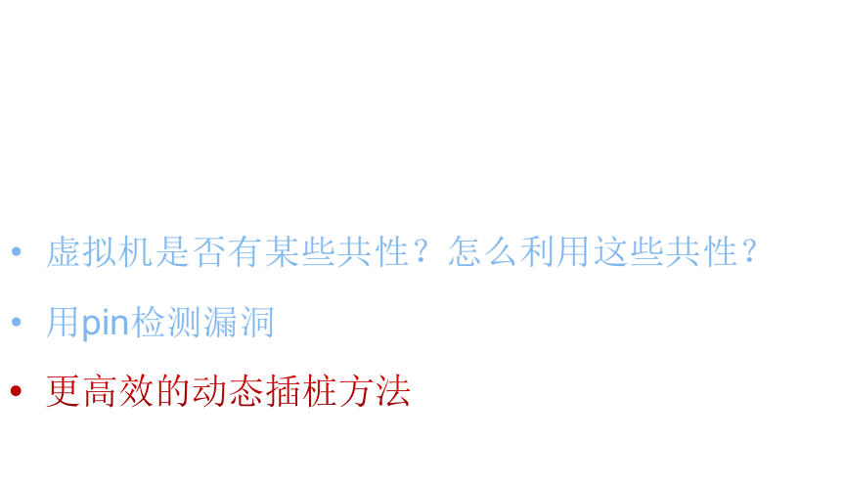
Conclusion:
(in CTF Challenges)

Slide 15

http://shell-storm.org/blog/Taint-analysis-and-pattern-matching-with-Pin/
http://shell-storm.org/blog/Stack-and-heap-overflow-detection-at-runtime-via-behavior-analysis-and-PIN/

Slide 16
Reference:
http://shell-storm.org/blog/A-binary-analysis-count-me-if-you-can/
http://brieflyx.me/2017/binary-analysis/intel-pin-intro/
https://github.com/TeamContagion/CTF-Write-Ups/tree/master/AlexCTF-2017/Reversing/RE5%20-%20Packed%20Movement%20(350)
https://fadec0d3.blogspot.com/2017/04/plaidctf-2017-nomoflo-125.html

Slide 17
End
Thank you~

