Slide 1
CI/CD Architecture​

Slide 2


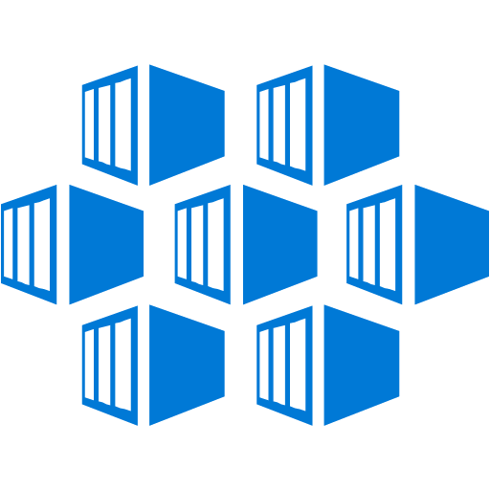



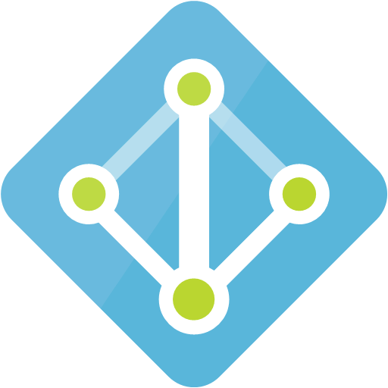
CI/CD ARCHITECTURE USING GITHUB ACTIONS & AKS
PUSH
DevOps
Deveopers push the code GitHub
GitHub actions triggers the workflow actions based on commit.
Below actions has been triggers.
  JDK Setup
  Compile and Package of Java Project
  Docker Image creation
  Push Docker Image to ACR
  Kubectl Setup
  Deploy to AKS
PODs
Vnet with subnets configured & Defined Azure network security groups
Kubernetes Cluster
Azure Resource Group
Host Name Service
Host Name
pod
Using External IP
Linux Utility Box
Container Registry
Azure
Monitoring
Azure AD
Client

Slide 3
THANK YOU.

