Slide 1
Continuous Integration
and
Continuous Delivery & Deployment

Slide 2
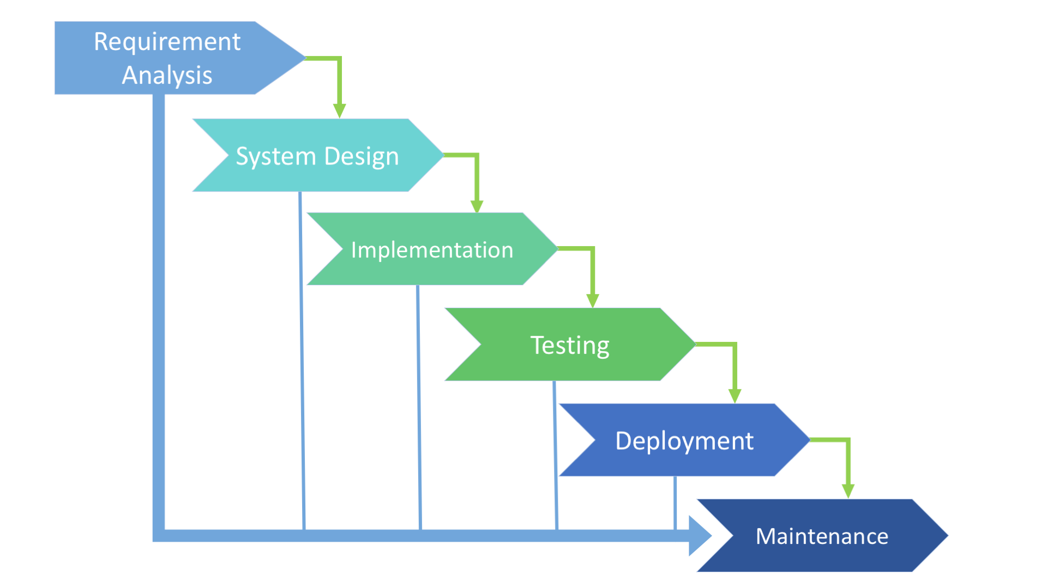
Software Development Life Cycle

Slide 3

Dependency and waiting among the teams
The software is ready only after the last stage is over
Integration is done at the very end, which does not give the option of identifying the problem in advance
The progress of the stage is hard to measure while it is still in the development

Slide 4
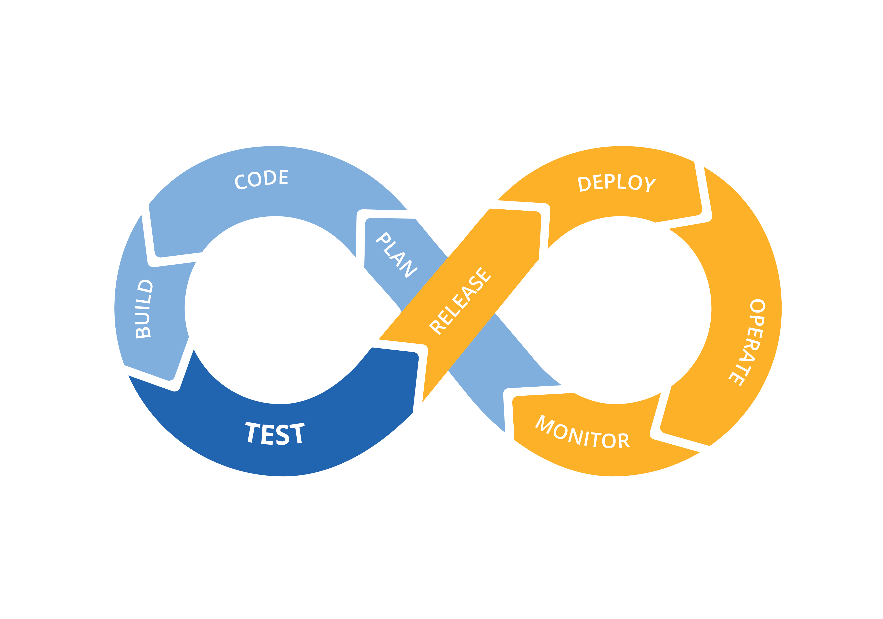
DevOps
Dev
Ops

Slide 5
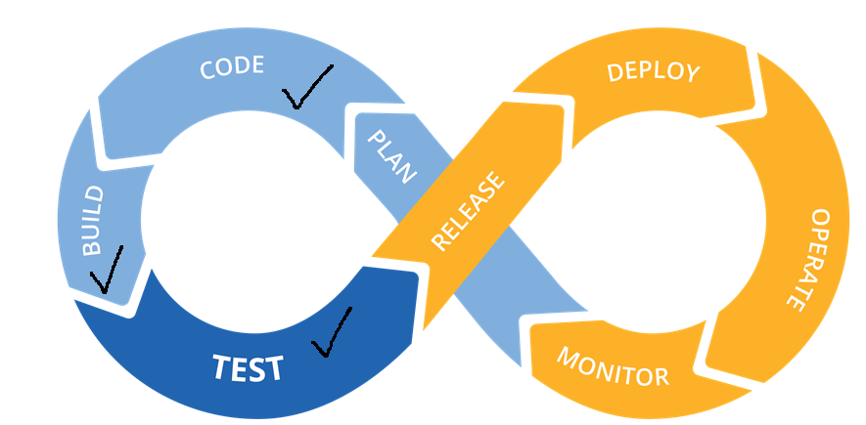
Continuous Integration (CI)
Continuous Integration (CI) is a development practice that requires developers to integrate code into a shared repository several times a day. Each check-in is then verified by an automated build, allowing teams to detect problems early

Slide 6
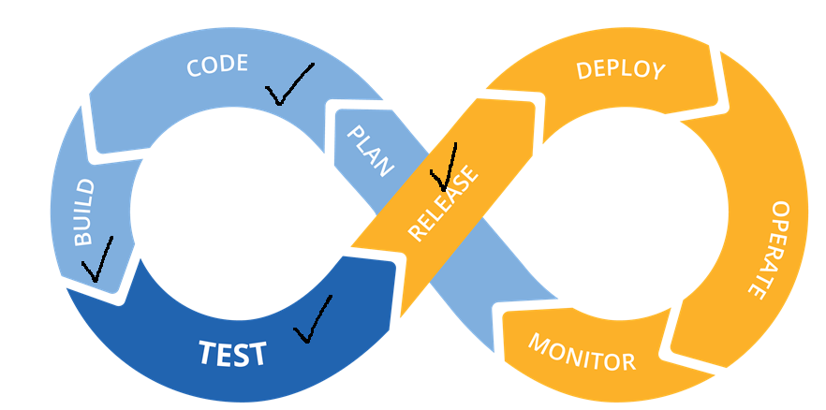
Continuous delivery (CD)
Continuous delivery: is an extension of continuous integration to make sure that you can release the software new changes to your customers quickly in a sustainable way.

Slide 7
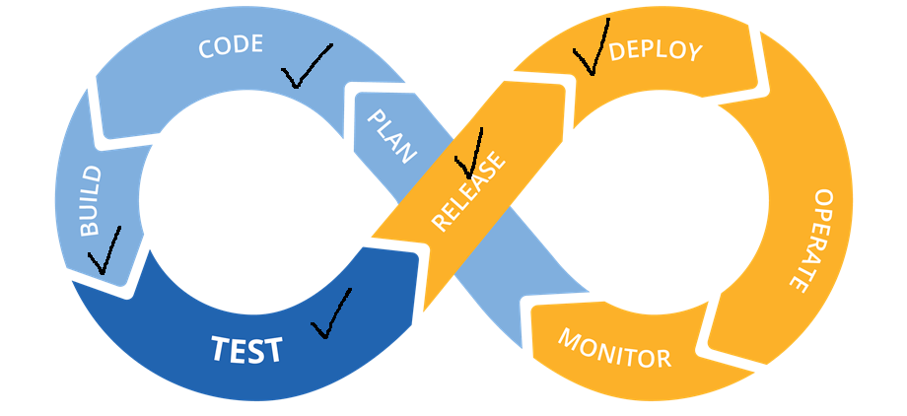
Continuous Deployment
Continuous Deployment is the process by which qualified changes in software code or architecture are deployed to production as soon as they are ready and without human intervention

Slide 8
Advantages of CI & CD over SDLC
Technical benefits:
  Continuous software delivery
  Less complexity to manage
  Faster resolution of problems
Cultural benefits:
  Happier, more productive teams
  Higher employee engagement
  Greater professional development opportunities
Business benefits:
  Faster delivery of features
  More stable operating environments
  Improved communication and collaboration
  More time to innovate (rather than fix/maintain)

Slide 9


Slide 10


