Slide 1
תרגול 2

Slide 2

Loops

Slide 3
Loop through a collection
for name in ['Christopher', 'Susan']:
print(name)
Christopher
Susan

Slide 4
Looping a number of times
for index in range(0, 2):
print(index)
0
1

Slide 5
Looping with a condition
names = ['Christopher', 'Susan']
index = 0
while index < len(names):
print(names[index])
# Change the condition!!
index = index + 1
Christopher
Susan

Slide 6

Error handling

Slide 7
Defining terms
Error handling
Debugging

Slide 8
Error types
Syntax errors
Runtime errors
Logic errors

Slide 9
Syntax errors
# This code won't run at all
x = 42
y = 206
if x == y
print('Success!!')
File "syntax.py", line 3
if x == y
^
SyntaxError: invalid syntax

Slide 10
Runtime errors
# This code will fail when run
x = 42
y = 0
print(x / y)
Traceback (most recent call last):
File "runtime.py", line 3, in <module>
print(x / y)
ZeroDivisionError: division by zero

Slide 11
Catching runtime errors
try:
print(x / y)
except ZeroDivisionError as e:
# Optionally, log e somewhere
print('Sorry, something went wrong')
except:
print('Something really went wrong')
finally:
print('This always runs on success or failure')
Sorry, something went wrong
This always runs on success or failure

Slide 12
When to use try/except/finally
When something might go wrong
User input
Accessing an external system
REST call
File system
You can act upon the error
Logging
Graceful exit

Slide 13
Some final words on try/except/finally
Not used to find bugs
Debugging, not error handling
You don't have to catch all errors
Let it bubble up
Someone else will deal with it
The application will crash
Sometimes, this is exactly what you want to happen

Slide 14
Logic errors
# This code won't run at all
x = 206
y = 42
if x < y:
print(str(x) + ' is greater than ' + str(y))

Slide 15
Figuring out what went wrong
Stack trace
Last calls are on the top
Your code is likely on the bottom
Seek out line numbers
Finding your mistake
Reread your code
Check the documentation
Take a break
Ask someone for help
Search the internet

Slide 16

Handling conditions

Slide 17
Your code needs the ability to take different actions based on different conditions
if price >= 1.00:
tax = .07
print(tax)
Symbol | Operation
> | Greater than
< | Less than
>= | Greater than or equal to
<= | Less than or equal to
== | is equal to
!= | is not equal to

Slide 18
You can add a default action using else
if price >= 1.00:
tax = .07
print(tax)
else:
tax = 0
print(tax)

Slide 19
How you indent your code changes execution
if price >= 1.00:
tax = .07
print(tax)
else:
tax = 0
print(tax)
if price >= 1.00:
tax = .07
else:
tax = 0
print(tax)

Slide 20
Be careful when comparing strings
country = 'CANADA'
if country == 'canada':
print('Oh look a Canadian')
else:
print('You are not from Canada')
String comparisons are case sensitive
You are not from Canada

Slide 21
Use string functions to make case insensitive comparisons
country = 'CANADA'
if country.lower() == 'canada':
print('Oh look a Canadian')
else:
print('You are not from Canada')
Oh look a Canadian

Slide 22
Conditions allow our code to react to different situations
Apply appropriate state or federal taxes based on location
Calculate salary based on job level
What to do if a file is not found
What to do if an expected value is missing

Slide 23

Handling multiple conditions

Slide 24

You may need to check multiple conditions to determine the correct action
if province == 'Alberta':
tax = 0.05
if province == 'Nunavut':
tax = 0.05
if province == 'Ontario':
tax = 0.13
Calculate Canadian sales tax
If the province is Alberta or Nunavut charge 5%
If the province is Ontario charge 13%

Slide 25
If only one of the conditions will ever occur you can use a single if statement with elif
if province == 'Alberta':
tax = 0.05
elif province == 'Nunavut':
tax = 0.05
elif province == 'Ontario':
tax = 0.13
Calculate Canadian sales tax
If the province is Alberta or Nunavut charge 5%
If the province is Ontario charge 13%

Slide 26
When you use elif instead of multiple if statements you can add a default action
if province == 'Alberta':
tax = 0.05
elif province == 'Nunavut':
tax = 0.05
elif province == 'Ontario':
tax = 0.13
else:
tax = 0.15
Calculate Canadian sales tax
If the province is Alberta or Nunavut charge 5%
If the province is Ontario charge 13%
For all other provinces charge 15%

Slide 27
If multiple conditions cause the same action they can be combined into a single condition
if province == 'Alberta' \
or province == 'Nunavut':
tax = 0.05
elif province == 'Ontario':
tax = 0.13
else:
tax = 0.15
Calculate Canadian sales tax
If the province is Alberta or Nunavut charge 5%
If the province is Ontario charge 13%
For all other provinces charge 15%

Slide 28
How OR statements are processed
First Condition | Second Condition | Condition evaluates as
TRUE | TRUE | TRUE
TRUE | FALSE | TRUE
FALSE | TRUE | TRUE
FALSE | FALSE | FALSE

Slide 29
If you have a list of possible values to check , you can use the IN operator
if province in('Alberta', \
'Nunavut','Yukon'):
tax = 0.05
elif province == 'Ontario':
tax = 0.13
else:
tax = 0.15
Calculate Canadian sales tax
If the province is Alberta, Nunavut, or Yukon charge 5%
If the province is Ontario charge 13%
For all other provinces charge 15%

Slide 30
If an action depends on a combination of conditions you can nest if statements
if country == 'Canada':
if province in('Alberta',\
'Nunavut','Yukon'):
tax = 0.05
elif province == 'Ontario':
tax = 0.13
else:
tax = 0.15
else:
tax = 0.0
Calculate Canadian sales tax
For Canadian residents:
If the province is Alberta, Nunavut, or Yukon charge 5%
If the province is Ontario charge 13%
For all other provinces charge 15%
Non Canadian residents do not pay sales tax

Slide 31
Handling real world business rules may require complicated conditional logic, but the code can still be written efficiently
Apply appropriate state or federal taxes based on location
Calculate salary based on job level

Slide 32

Complex condition checks

Slide 33
Sometimes you can combine conditions with AND instead of nesting if statements
if gpa >= .85:
if lowest_grade >= .70:
print('Well done')
if gpa >= .85 and lowest_grade >= .70:
print('Well done')
Requirements for honour roll
Minimum 85% grade point average
Lowest grade is at least 70%

Slide 34
How AND statements are processed
First Condition | Second Condition | Condition evaluates as
TRUE | TRUE | TRUE
TRUE | FALSE | FALSE
FALSE | TRUE | FALSE
FALSE | FALSE | FALSE

Slide 35
If you need to remember the results of a condition check later in your code, use Boolean variables as flags
if gpa >= .85 and lowest_grade >= .70:
honour_roll = True
else:
honour_roll = False
# Somewhere later in your code
if honour_roll:
print('Well done')

Slide 36
Combining operators allows you to handle complex business rules in your code but must be tested very carefully to avoid introducing errors

Slide 37

Collections

Slide 38
Lists are collections of items
names = ['Christopher', 'Susan']
scores = []
scores.append(98) # Add new item to the end
scores.append(99)
print(names)
print(scores)
print(scores[1]) # Collections are zero-indexed
['Christopher', 'Susan']
[98, 99]
99

Slide 39
Arrays are also collections of items
from array import array
scores = array('d')
scores.append(97)
scores.append(98)
print(scores)
print(scores[1])
array('d', [97.0, 98.0])
98.0

Slide 40
What's the difference?
Arrays
Simple types such as numbers
Must all be the same type
Lists
Store anything
Store any type

Slide 41
Common operations
names = ['Susan', 'Christopher']
print(len(names)) # Get the number of items
names.insert(0, 'Bill') # Insert before index
print(names)
names.sort()
print(names)
2
['Bill', 'Susan', 'Christopher']
['Bill', 'Christopher', 'Susan']

Slide 42
Retrieving ranges
names = ['Susan', 'Christopher', 'Bill']
presenters = names[0:2] # Get the first two items
# Starting index and number of items to retrieve
print(names)
print(presenters)
['Susan', 'Christopher', 'Bill']
['Susan', 'Christopher']

Slide 43
Dictionaries
person = {'first': 'Christopher'}
person['last'] = 'Harrison'
print(person)
print(person['first'])
{'first': 'Christopher', 'last': 'Harrison'}
Christopher

Slide 44
What's the difference?
Dictionaries
Key/Value pairs
Storage order not guaranteed
Lists
Zero-based index
Storage order guaranteed

Slide 45

Python Data Structures

Slide 46
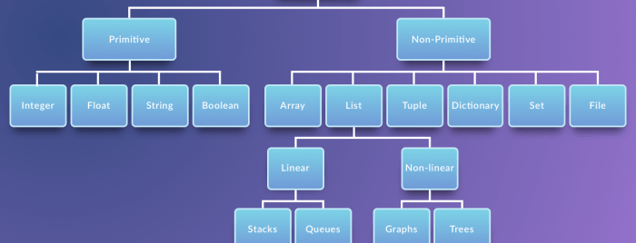

Slide 47
Primitive Data Structures
Note that in Python, you do not have to explicitly state the type of the variable or your data. That is because it is a dynamically typed language. Dynamically typed languages are the languages where the type of data an object can store is mutable.

Slide 48
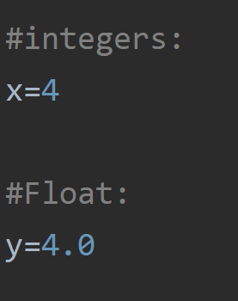
Primitive Data Structures
Integers
You can use an integer represent numeric data, and more specifically, whole numbers from negative infinity to infinity, like 4, 5, or -1.
Float
"Float" stands for 'floating point number'. You can use it for rational numbers, usually ending with a decimal figure, such as 1.11 or 3.14.

Slide 49
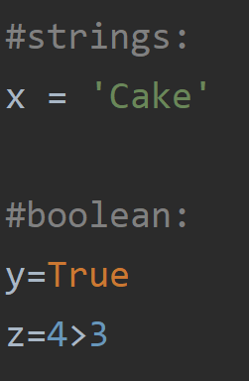
Primitive Data Structures
String
Strings are collections of alphabets, words or other characters. In Python, you can create strings by enclosing a sequence of characters within a pair of single or double quotes. For example: 'cake', "cookie", etc.
Boolean
This built-in data type that can take up the values: True and False, which often makes them interchangeable with the integers 1 and 0.

Slide 50
Non-Primitive Data Structures
Non-primitive types are the sophisticated members of the data structure family. They don't just store a value, but rather a collection of values in various formats.

Slide 51
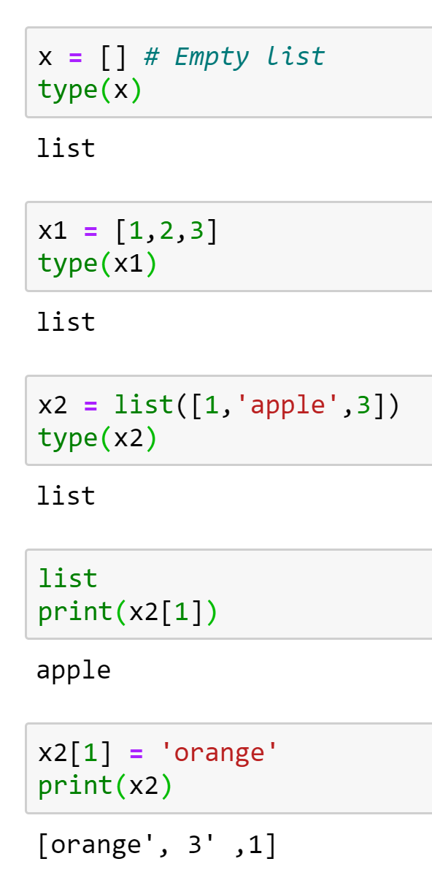
Non-Primitive Data Structures
Lists
Lists in Python are used to store collection of heterogeneous items. These are mutable, which means that you can change their content without changing their identity. You can recognize lists by their square brackets [ and ] that hold elements , separated by a comma , .
[1,’orange’,3]

Slide 52
Non-Primitive Data Structures
Array
First off, arrays in Python are a compact way of collecting basic data types, all the entries in an array must be of the same data type. However, arrays are not all that popular in Python, unlike the other programming languages such as C++ or Java.
In general, when people talk of arrays in Python, they are actually referring to lists. However, there is a fundamental difference between them
Arrays can be seen as a more efficient way of storing a certain kind of list. This type of list has elements of the same data typeץ
In our case, we will use NumPy library.

Slide 53
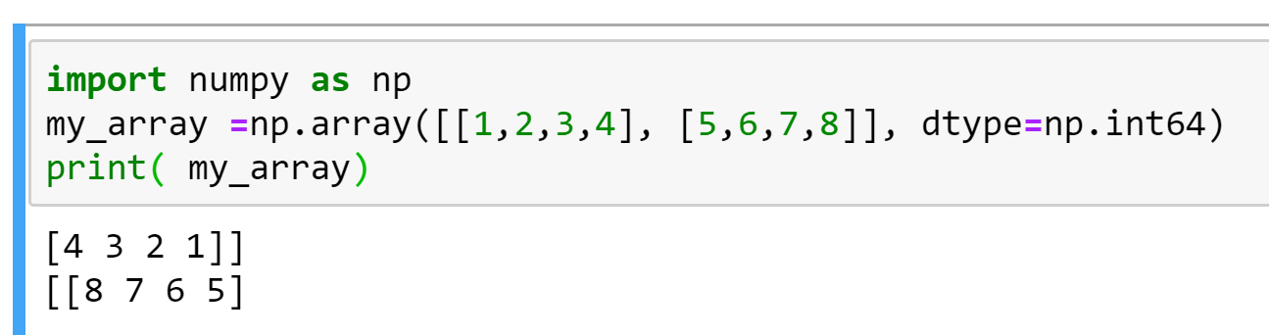
NumPy
However, you should know that, on a structural level, an array is basically nothing but pointers. It’s a combination of a memory address, a data type, a shape, and strides:
The data pointer indicates the memory address of the first byte in the array,
The data type or dtype pointer describes the kind of elements that are contained within the array,
The shape indicates the shape of the array, and
The strides are the number of bytes that should be skipped in memory to go to the next element. If your strides are (10,1), you need to proceed one byte to get to the next column and 10 bytes to locate the next row.
In other words, an array contains information about the raw data, how to locate an element and how to interpret an element.
NumPy is a Python library that is the core library for scientific computing in Python. It contains a collection of tools and techniques that can be used to solve on a computer mathematical models of problems in Science and Engineering. One of these tools is a high-performance multidimensional array object that is a powerful data structure for efficient computation of arrays and matrices.

Slide 54
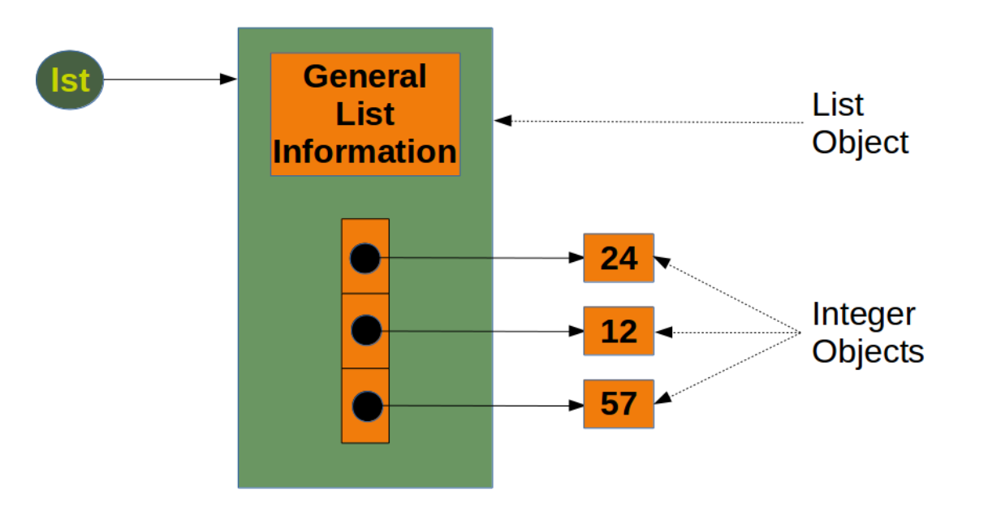
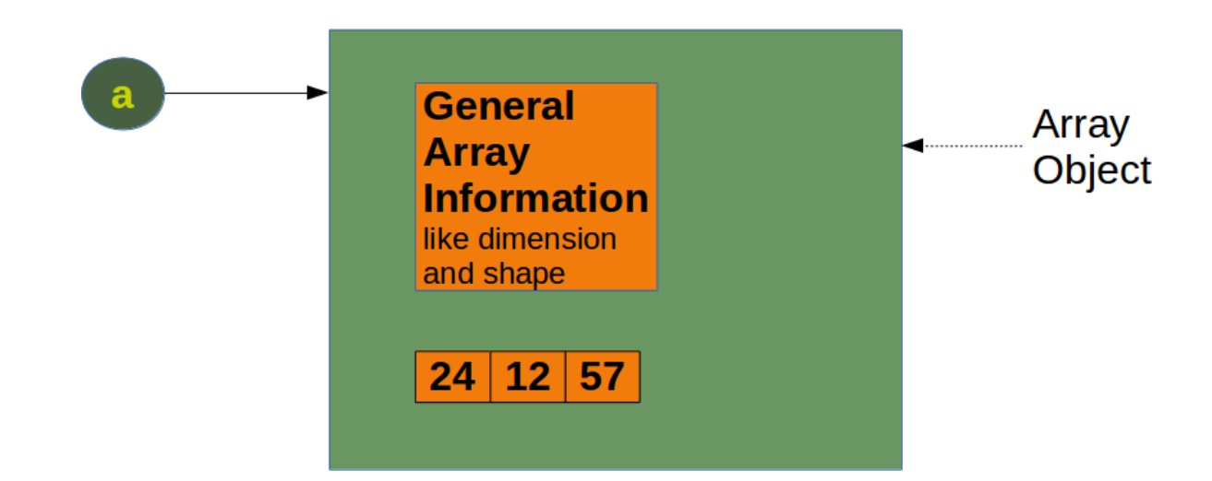
Python Lists vs. NumPy Arrays
Size - NumPy data structures take up less space.
Performance - they have a need for speed and are faster than lists
Functionality - SciPy and NumPy have optimized functions such as linear algebra operations built in.
With arrays, you can perform an operations on all its item individually easily, which may not be the case with lists.

Slide 55
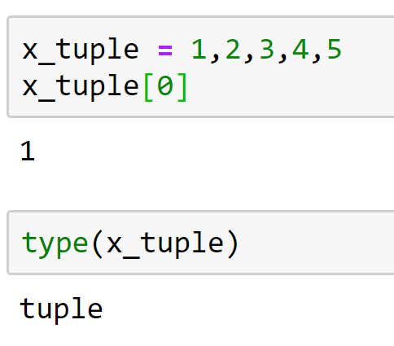
Tuples
Tuples are another standard sequence data type. The difference between tuples and list is that tuples are immutable, which means once defined you cannot delete, add or edit any values inside it. This might be useful in situations where you might to pass the control to someone else but you do not want them to manipulate data in your collection, but rather maybe just see them or perform operations separately in a copy of the data.

Slide 56
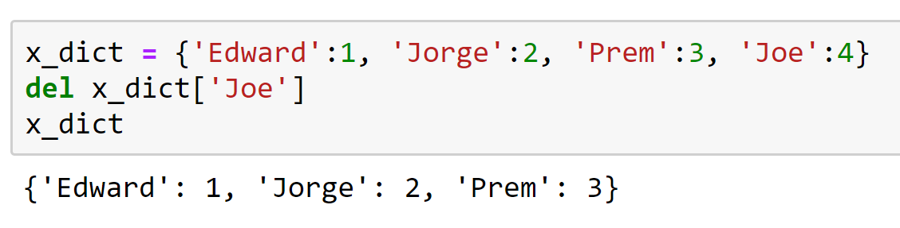
Dictionary
Dictionaries are exactly what you need if you want to implement something like a telephone book. None of the data structures that you have seen before are suitable for a telephone book. This is when a dictionary can come in handy.
Dictionaries are made up of key-value pairs. key is used to identify the item and the value holds as the name suggests, the value of the item.

Slide 57
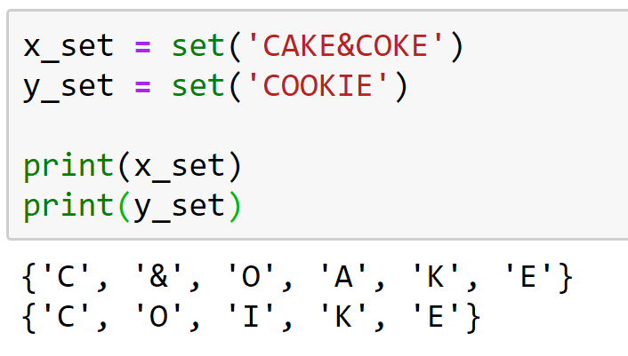
Sets
Sets are a collection of distinct (unique) objects. These are useful to create lists that only hold unique values in the dataset.
It is an unordered collection but a mutable one, this is very helpful when going through a huge dataset.

Slide 58
Files
Files are traditionally a part of data structures. And although big data is commonplace in the data science industry, a programming language without the capability to store and retrieve previously stored information would hardly be useful.

Slide 59
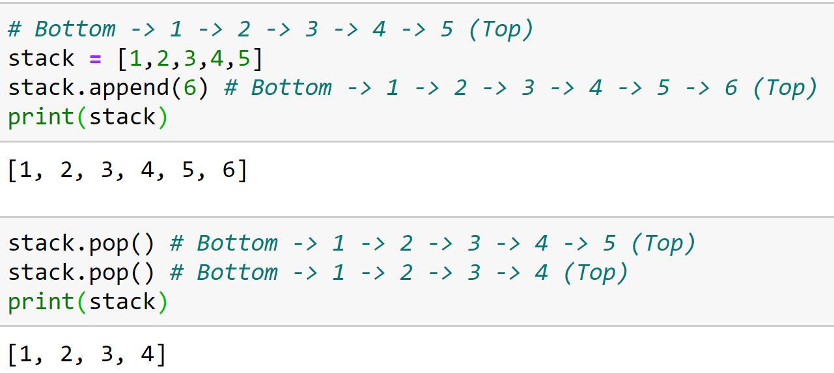
Stacks
A stack is a container of objects that are inserted and removed according to the Last-In-First-Out (LIFO) concept. Think of a scenario where at a dinner party where there is a stack of plates, plates are always added or removed from the top of the pile.
Stacks can be implemented using lists in Python. When you add elements to a stack, it is known as a push operation, whereas when you remove or delete an element it is called a pop operation.

Slide 60
Queue
A queue is a container of objects that are inserted and removed according to the First-In-First-Out (FIFO) principle. An excellent example of a queue in the real world is the line at a ticket counter where people are catered according to their arrival sequence and hence the person who arrives first is also the first to leave
Lists are not efficient to implement a queue, because append() and pop() from the end of a list is not fast and incur a memory movement cost. Also, insertion at the end and deletion from the beginning of a list is not so fast since it requires a shift in the element positions.
https://www.geeksforgeeks.org/queue-in-python/

Slide 61
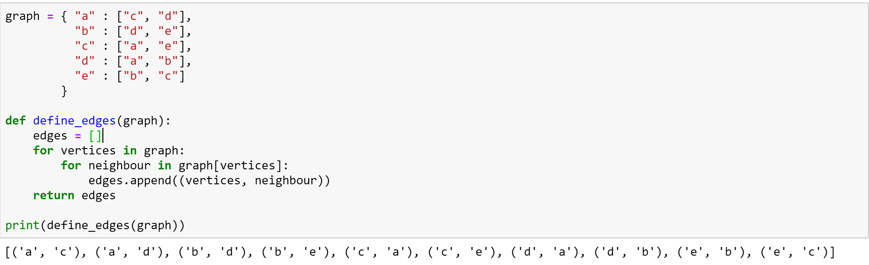
Graphs
A graph in mathematics and computer science are networks consisting of nodes, also called vertices which may or may not be connected to each other. The lines or the path that connects two nodes is called an edge. If the edge has a particular direction of flow, then it is a directed graph, with the direction edge being called an arc. Else if no directions are specified, the graph is called an undirected graph.
However, graphs are an important concept specially in Data Science and are often used to model real life problems.
Graph implementation using a Python Dictionary:

Slide 62
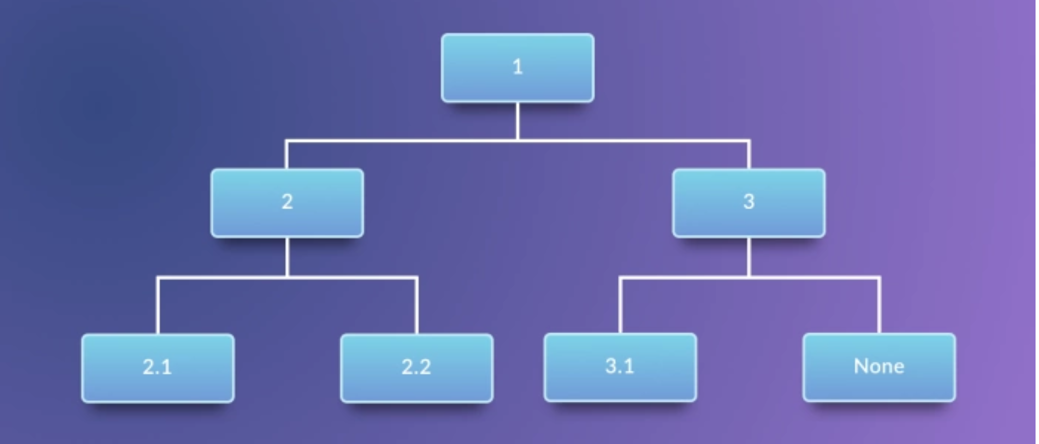
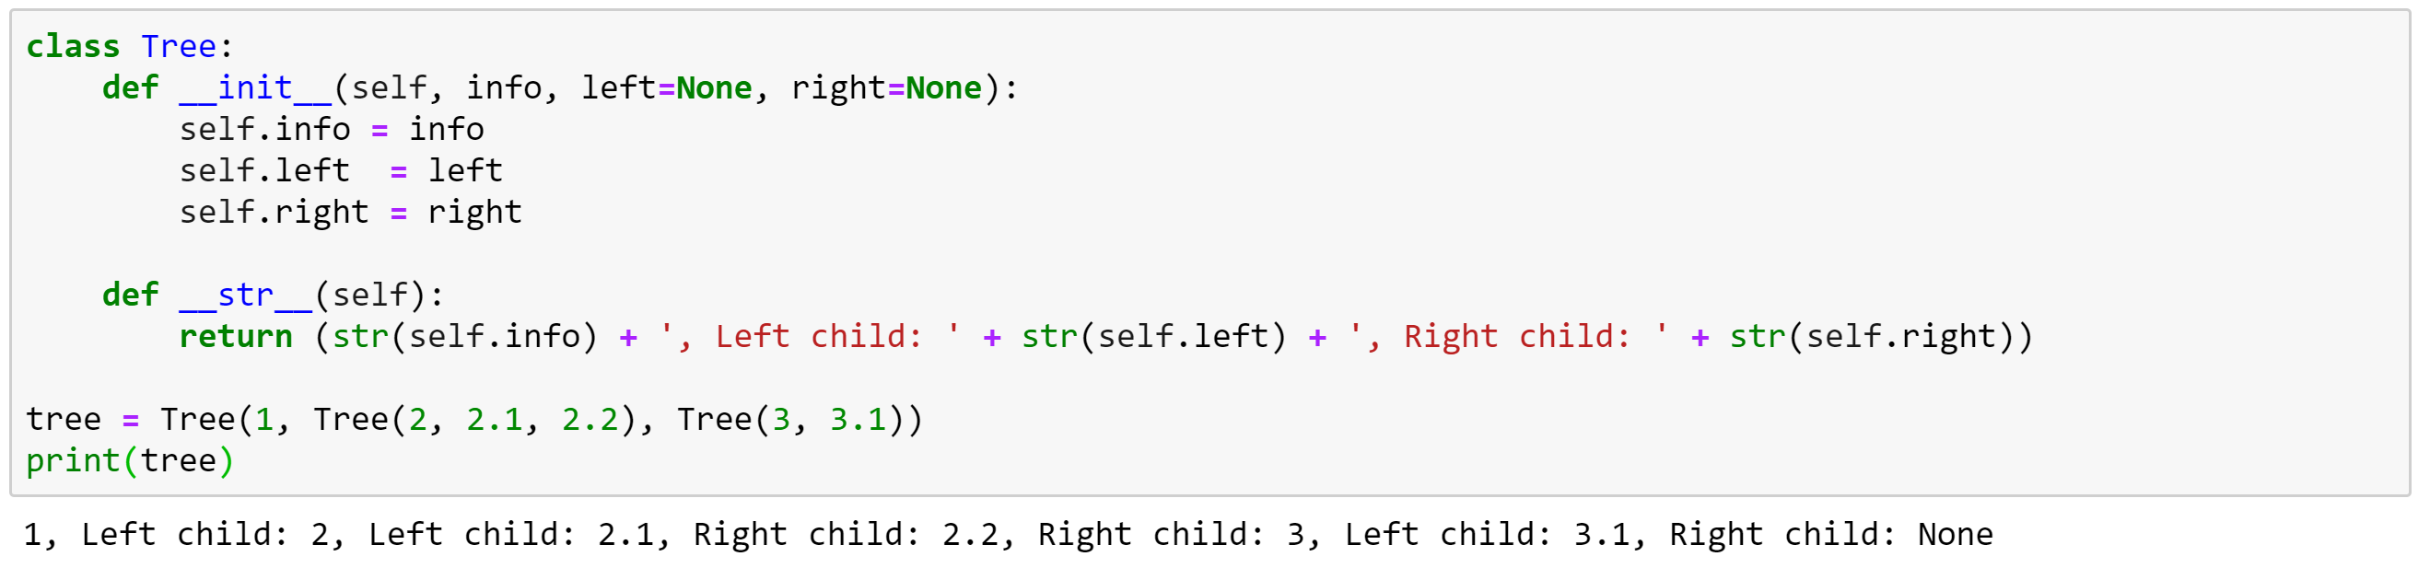
Trees
A tree in the real world is a living being with its roots in the ground and the branches that hold the leaves, fruit out in the open. The branches of the tree spread out in a somewhat organized way. In computer science, trees are used to describe how data is sometimes organized, except that the root is on the top and the branches, leaves follow, spreading towards the bottom and the tree is drawn inverted compared to the real tree. However, graphs are an important concept specially in Data Science and are often used to model real life problems.

Slide 63
Practice – Loops & Conditions
שאלה 1: כתבו סקריפט המקבל כקלט את ציון הקורס אם הציון גדול מ-0 וקטן או שווה מ-20 התוכנה מדפיסה B minus . אם הציון בין 20– ל-50 התוכנה מדפיסה B. אם הציון גדול מ-50 וקטן או שווה מ-70 תוכנה מדפיסה B plus. אם הציון גדול מ-70 וקטן או שווה מ-90 התוכנה מדפיסה A minus. אם הציון גדול מ-90 וקטן שווה מ-100 התוכנה מדפיסה A. אם הציון שלילי או גדול מ-100 התוכנה מדפיס ERROR. _{* יש להשתמש בהשוואות מרובות.}
שאלה 2: כמו השאלה הקודמת עם ifelse
שאלה 3: כתבו סקריפט המדפיס את כל המספרים הזוגיים בין 1 ל-100.
שאלה 4: כתבו סקריפט המדפיס את כל המספרים הראשוניים בין 3 ל-101.

Slide 64
Practice – NumPy
Q1) Create a 1D array of numbers from 0 to 9.
Q2) Create a 3×3 numpy array of all True’s.
Q3) Extract all odd numbers from arr. arr = np.array([0, 1, 2, 3, 4, 5, 6, 7, 8, 9])
Q4) Get the positions where elements of a and b match. a = np.array([1,2,3,2,3,4,3,4,5,6])b = np.array([7,2,10,2,7,4,9,4,9,8])
Q5) Find the mean, median, standard deviation of iris's sepallength (1st column): url = 'https://archive.ics.uci.edu/ml/machine-learning-databases/iris/iris.data‘ iris = np.genfromtxt(url, delimiter=',', dtype='object')
Q6) Bin the petal length (3rd) column of iris_2d to form a text array, such that if petal length is: * Less than 3 --> 'small‘ * 3-5 --> 'medium‘ * '>=5 --> 'large‘ # Inputurl = 'https://archive.ics.uci.edu/ml/machine-learning-databases/iris/iris.data‘ iris = np.genfromtxt(url, delimiter=',', dtype='object') names = ('sepallength', 'sepalwidth', 'petallength', 'petalwidth', 'species')

Slide 65
תרגול נוסף - מומלץ
https://www.machinelearningplus.com/python/101-numpy-exercises-python/
https://www.machinelearningplus.com/python/list-comprehensions-in-python/

