Slide 1


MJPEG
streamer

Slide 2
MJPEG

Slide 3
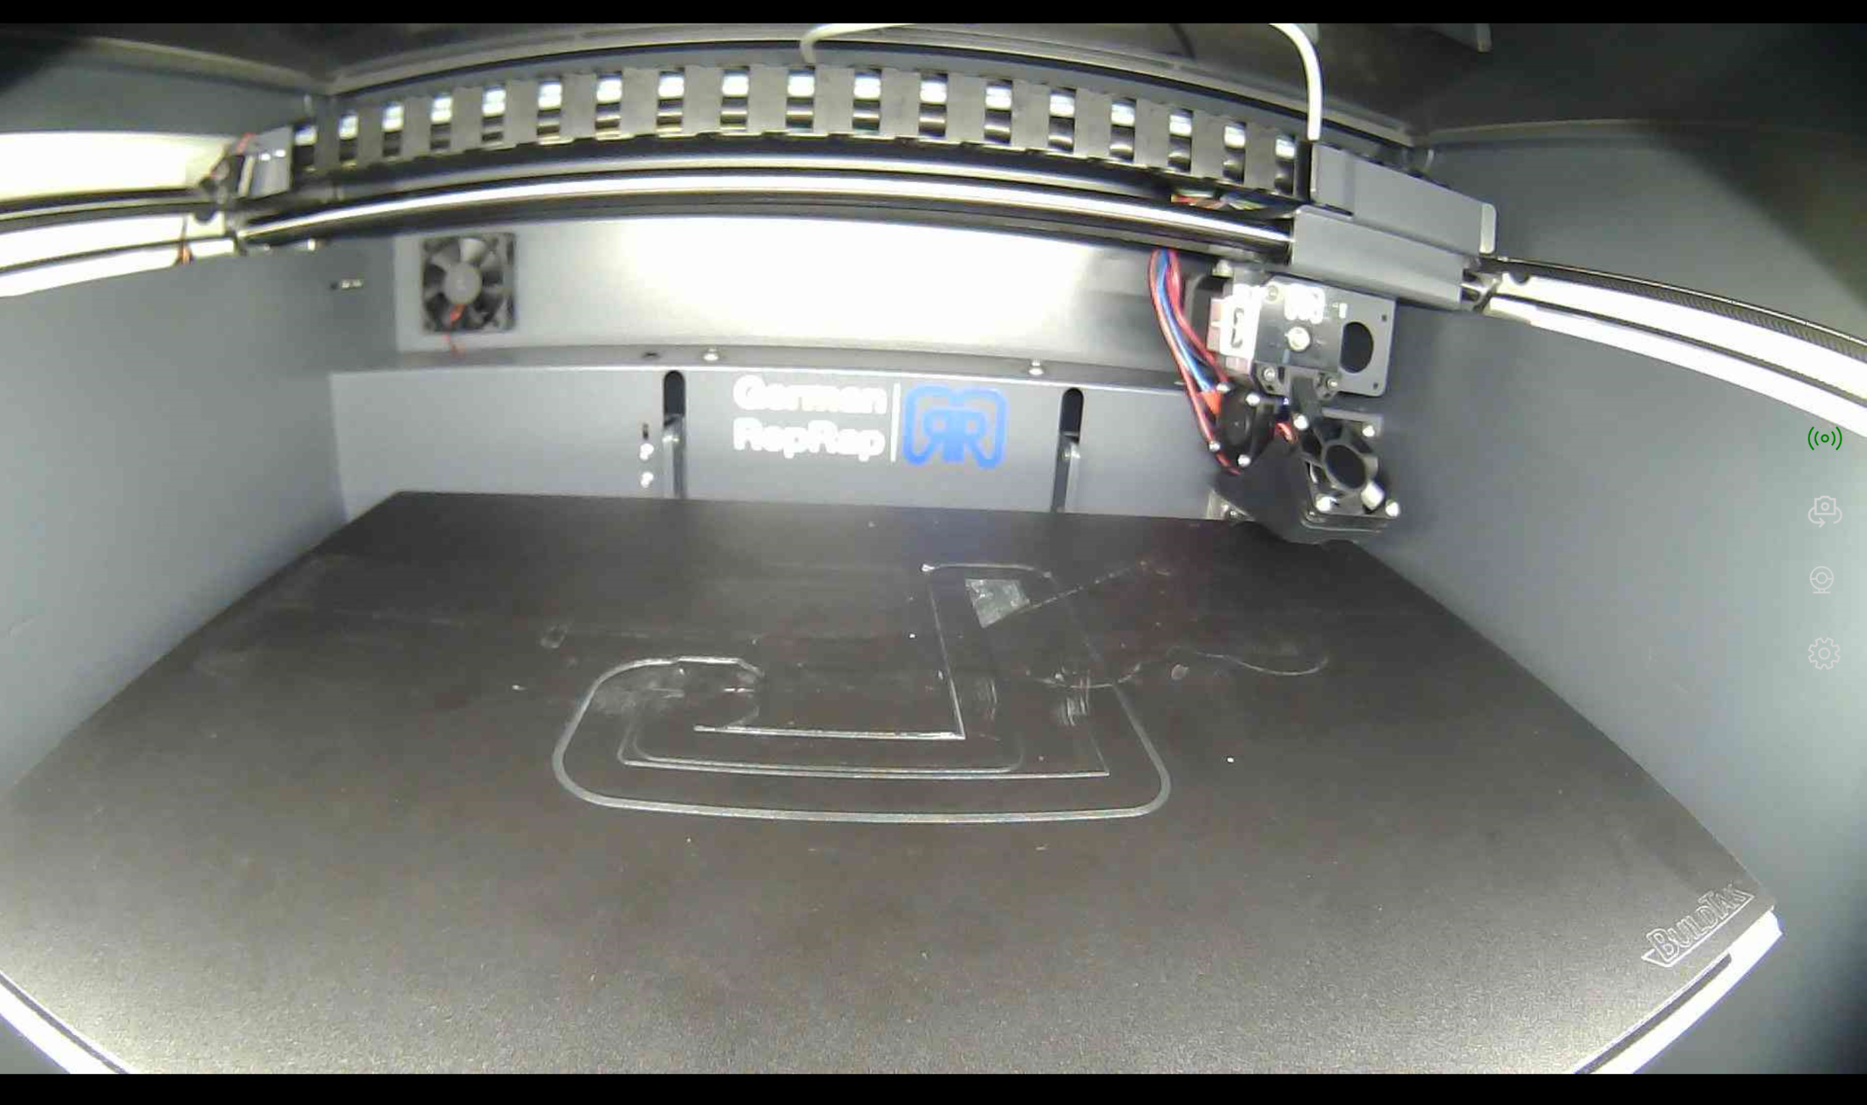
MJPEG
streamer

Slide 4


