Slide 1
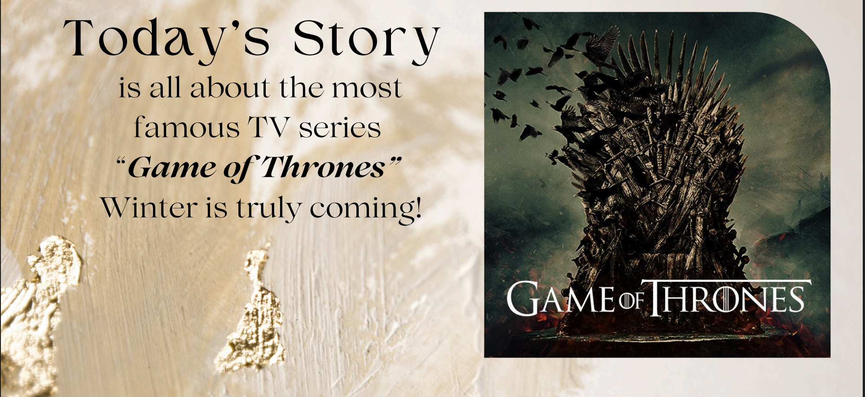
Assignment A — Game of Thrones Character Network
Networks + Text
Notes:
Hi everyone! This is Storytime . Do you love movies or TV series? If yes… today gets very interesting!"
Today’s story is Game of Thrones!

Slide 2
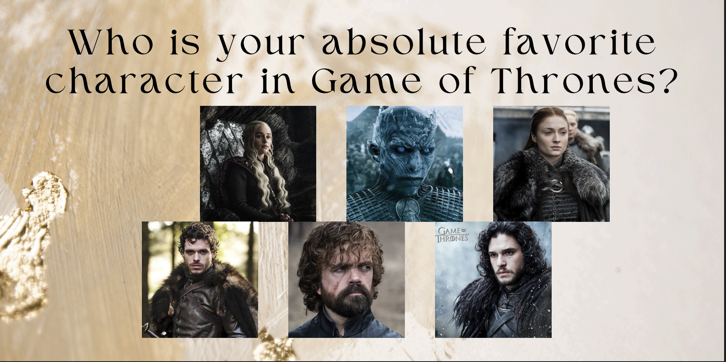
Central Idea
Notes:
We want to find out how power moved between characters. It is like real politics – full of friends, enemies and betrayal. So we will use data to measure that

Slide 3
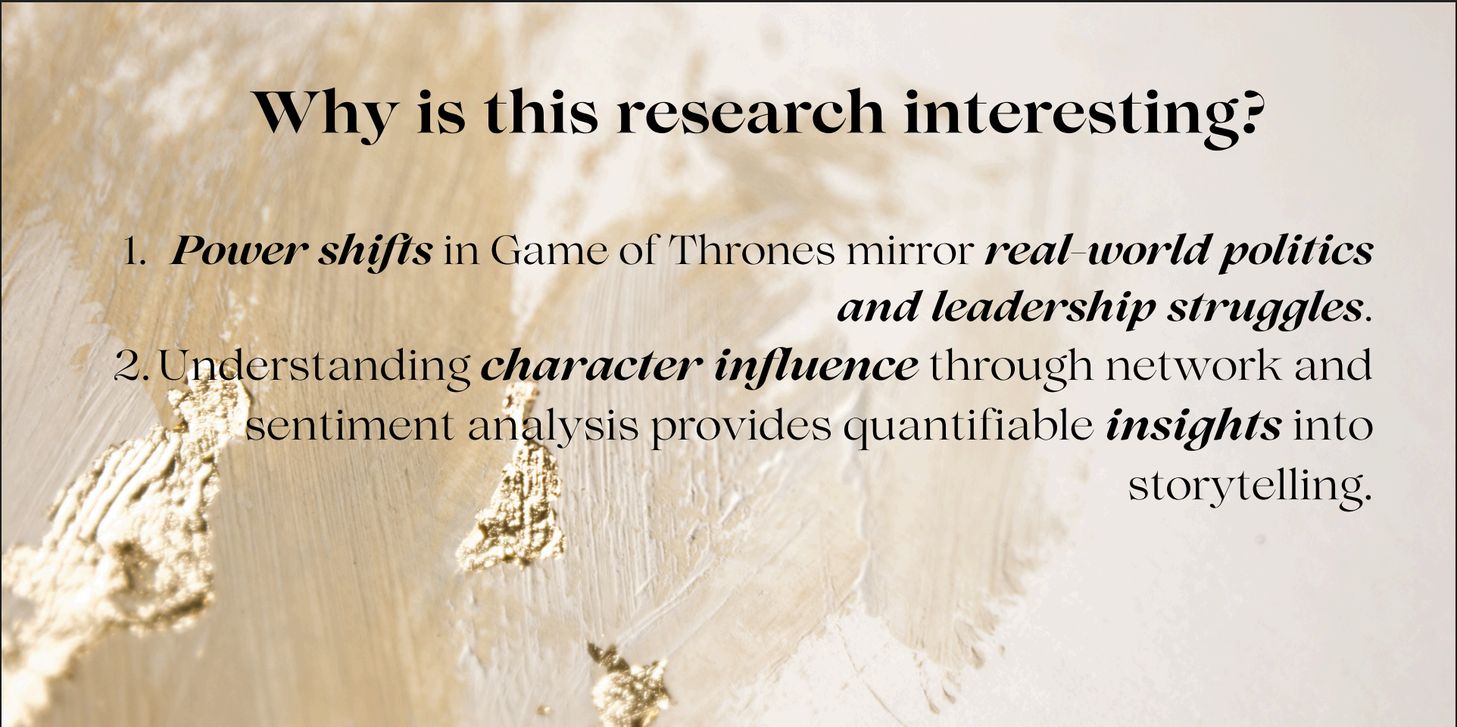
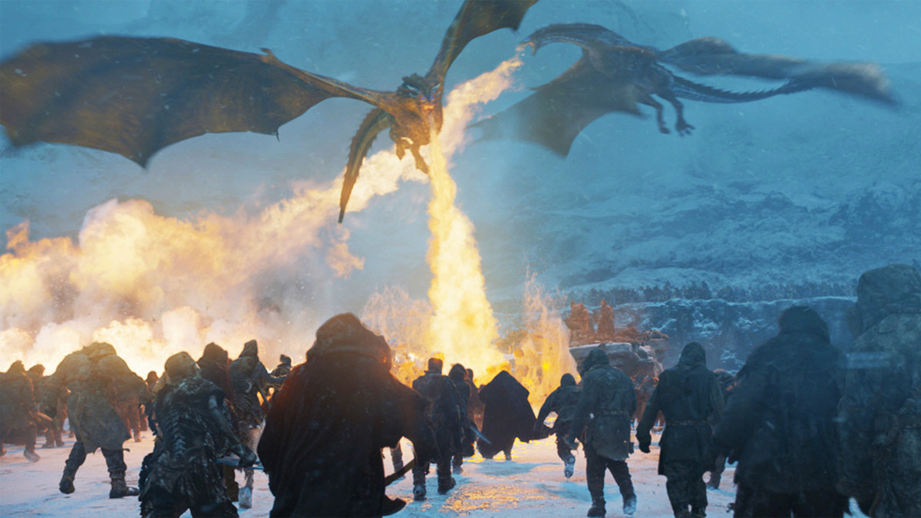
Why is it interesting?
Notes:
We can measure character influence using networks and the feelings in their dialogues.”
“That’s why this research is interesting

Slide 4
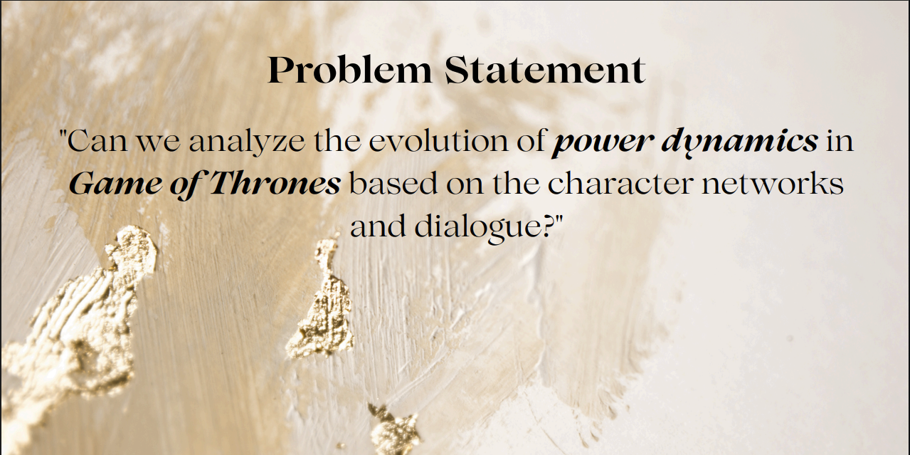
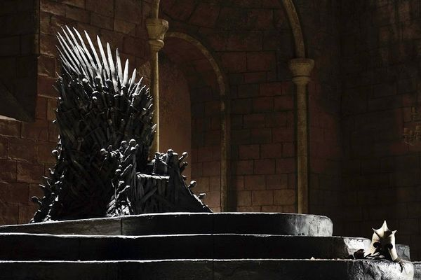
Problem Statement
Notes:
“Our main question: Can we track the evolution of power- using character networks and every single line- they speak?”

Slide 5
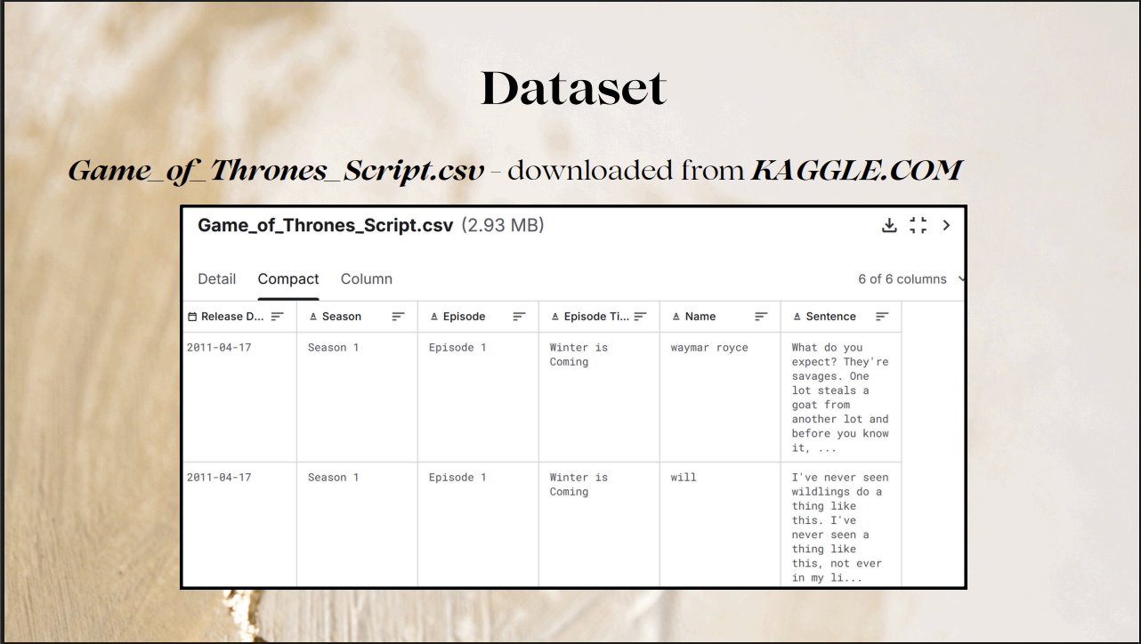
Dataset
Notes:
The used dataset! from Kaggle – of size 2.93 MB, with episodes, and beautiful lines of dialogue.
Everything we need to track- who really ruled Westeros!

Slide 6
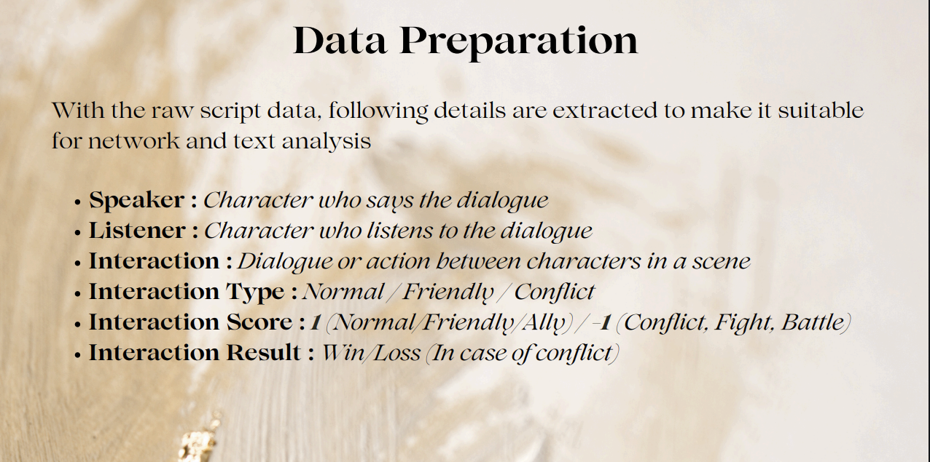
Data Preparation
Notes:
Thenwe extract: who speak, who listen, if it’s friendly or conflict,
and even who wins or loses in fights!"

Slide 7
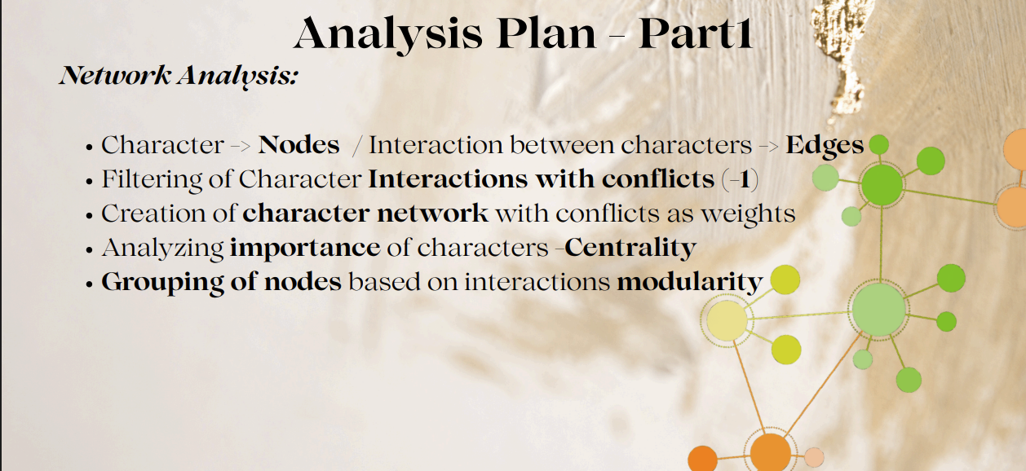
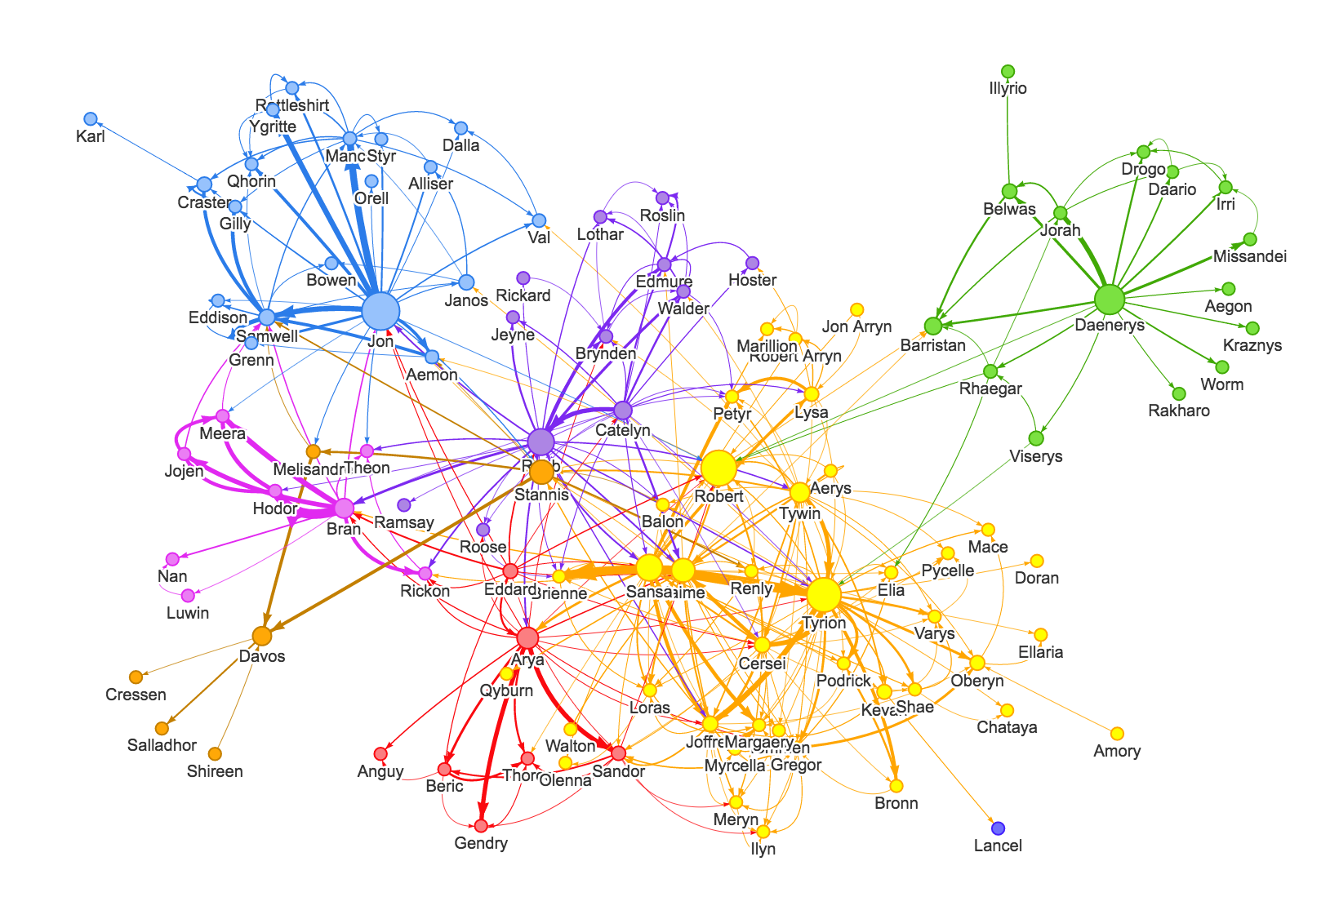
Basic Stats
Notes:
We build the network: and Next, do analysis!
we treat every character as a node… every interaction as an edge.
We give negative weight to conflicts
we measure who is the most important- using centrality,
we group characters into houses or alliances -using modularity.
This way we can see exactly -who held the real power -in Westeros!”

Slide 8
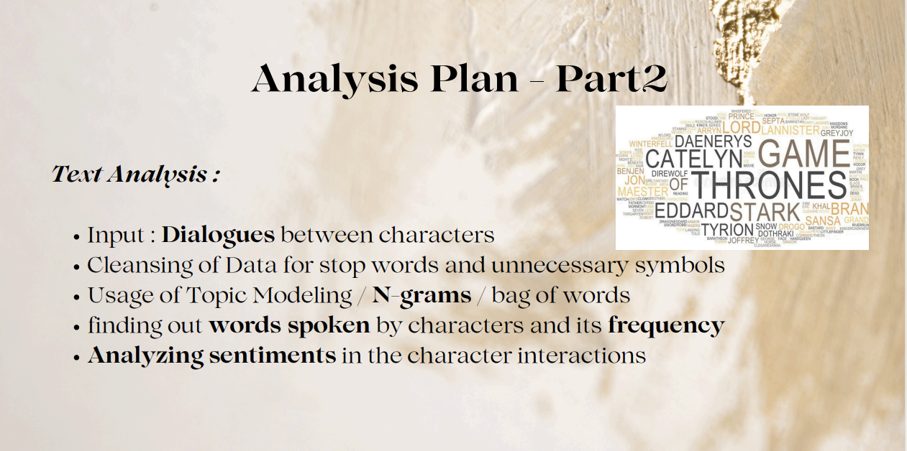
Text Identity (TF‑IDF)
Notes:
“And now the fun part – the words themselves!
We use TF-IDF, n-grams, and topic modeling to discover who says what… and how they really feel, by measuring the sentiment.

Slide 9
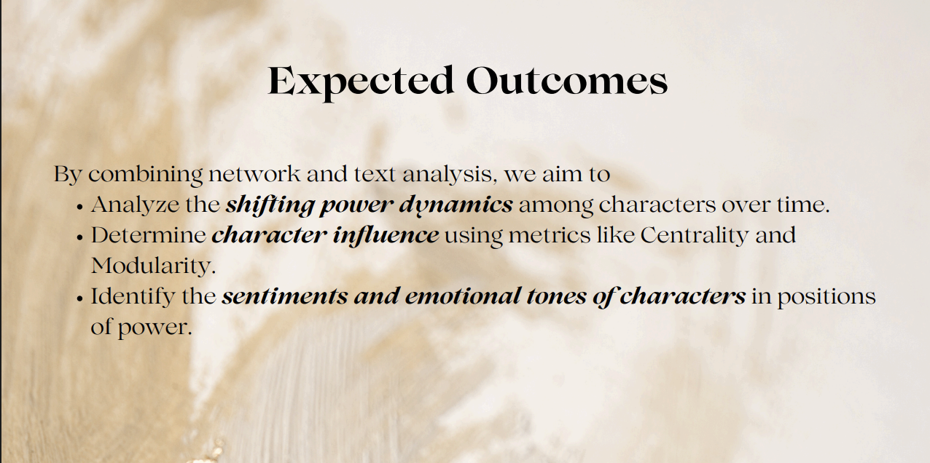
Tie network and text together in the paper
Notes:
Finally By combining Network + words we get the real story of- who won the game.
We will watch power move between characters ,
measure real influence ,
and uncover the true feelings.

Slide 10

Course: 02805 Social Graphs & Interactions
Student: [Bashar Bdewi, s183356], DTU
Notes:
Thank you!

