Slide 1
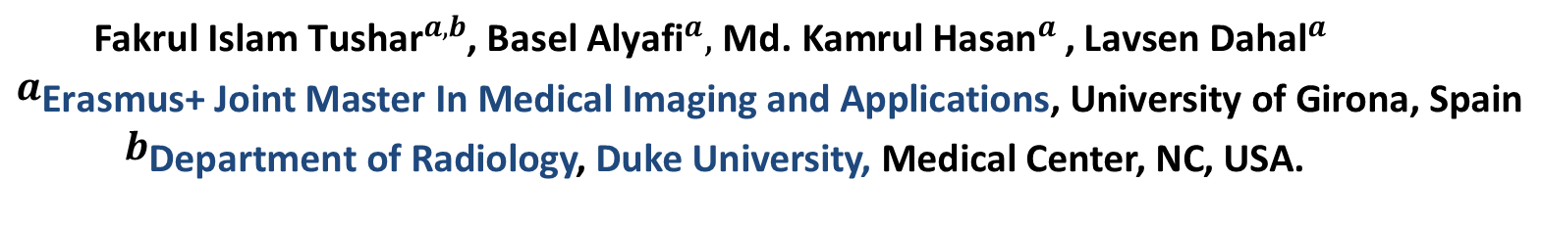
Brain Tissue Segmentation Using NeuroNet With Different Pre-processing Techniques

Slide 2
Outline
Introduction
Dataset
Previous Studies
Methods
Experiments and Results
Conclusion and Future work
Resources
Conclusion

Slide 3
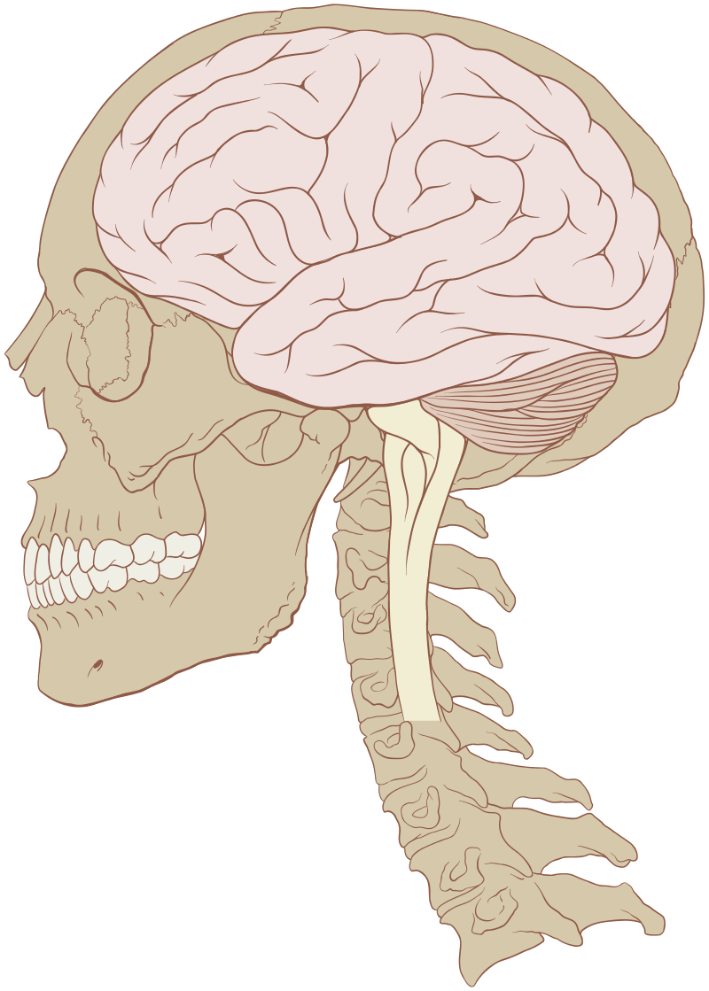
Introduction
Neurological disorders ranked as the second-leading cause group of deaths (9·4 million) comprising 16·8% of global deaths.
Feigin, V. L., et al. (2017). "Global, regional, and national burden of neurological disorders during
1990–2015: a systematic analysis for the Global Burden of Disease Study 2015."
The Lancet Neurology 16(11): 877-897.

Slide 4
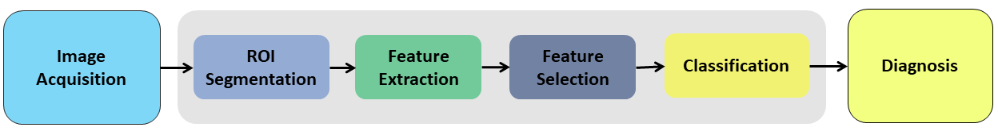
Introduction: CAD
Fig-1. Generalized block diagram of computer-aided diagnosis (CAD) systems.

Slide 5
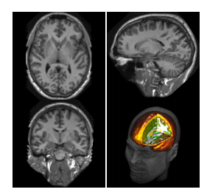
1.Introduction:Magnetic Resonance Imaging
Magnetic Resonance Imaging (MRI)
Widely used in medical practice
A standard tool for: diagnosis, disease follow-up, evaluation.
Provides good contrast between tissues
Fig-2.T1 weighted MR image example.

Slide 6
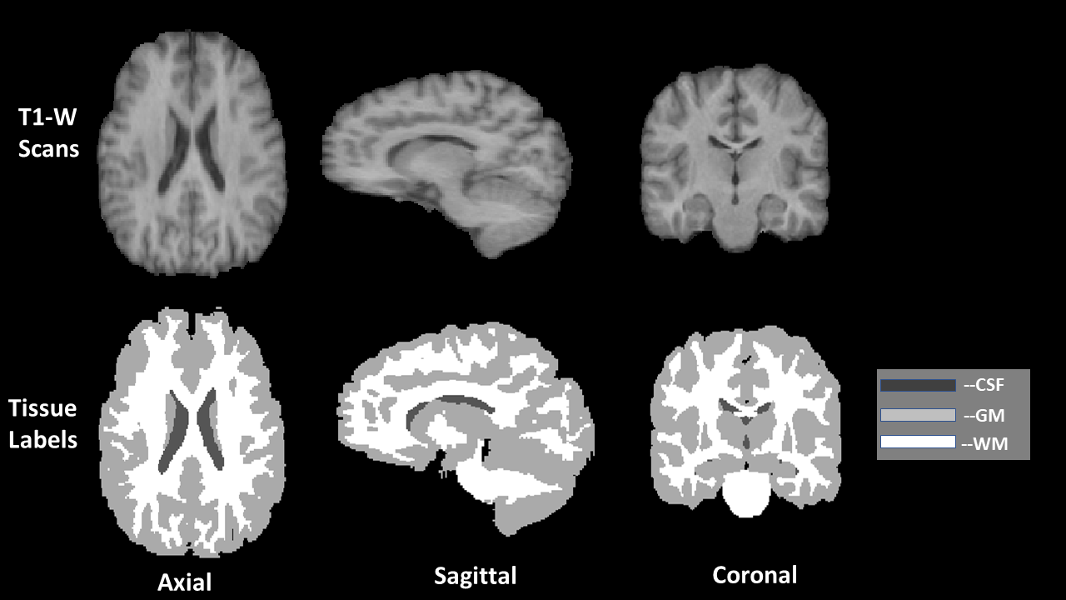
1.Introduction: Brain Tissue Segmentation
Classify each voxel in an input 3D volume into Grey Matter (GM), White Matter (WM) or CerebroSpinal Fluid (CSF).
Fig-3. Graphical representation of a volume and corresponding
tissue labels in axial, sagittal and coronal view.

Slide 7
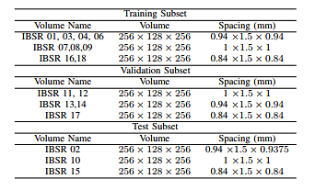
2. Dataset
IBSR-18 Dataset, 18 MR volumes T1 weighted.
Table-1: Summary of IBSR18 dataset used in this paper.
IBSR-18 Dataset. Available at: https://www.nitrc.org/frs/?group id=48. Accessed: 2019-01-05.

Slide 8
3. Previous Studies
Traditional brain tissue segmentation approaches:
Region-based.
Clustering-based.
Statistical based methods.
Classification methods based on Feature engineering.

Slide 9
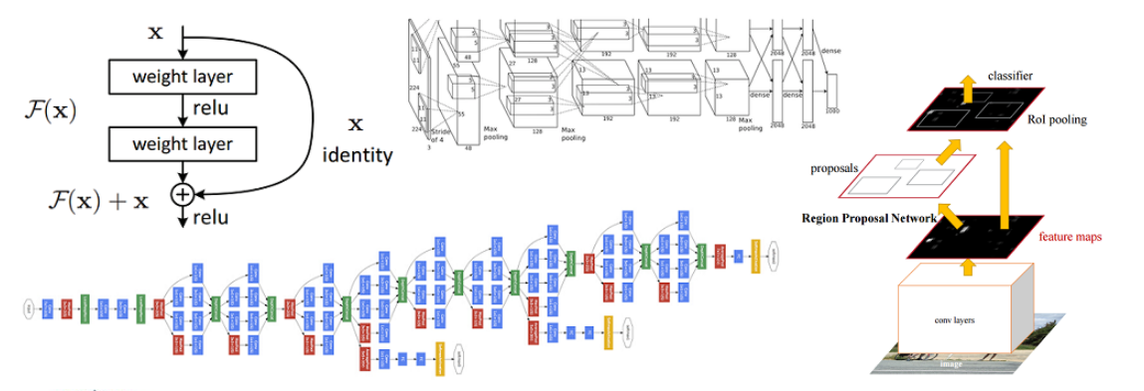
4. Method: DCNN
DNCC Becomes obvious choice to the Computer vision societies
Fig-4. Examples of state-of-the-art CNN architectures.

Slide 10
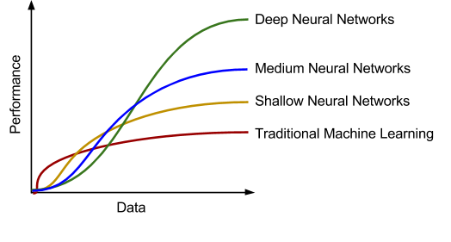
4. Method: DCNN
Limitation of DCNN for Medical Imaging ?
Having huge amount
of data is challenging
for Medical Cases
Fig-5. Graph illustrating the impact of data available on performance.
Tang, A., et al. (2018). "Canadian Association of Radiologists White Paper on Artificial Intelligence in Radiology." Can Assoc Radiol J 69(2): 120-135.

Slide 11
4. Method: Transfer Learning
Transfer Learning
Using a pretrained model and Fine tune it according to need
Fine Tuning Approach:
Use as Fixed Feature Extractor
Replace the last layer with a new classifier
Train the last Convolutional layer only and freeze others
Partially trained the model

Slide 12
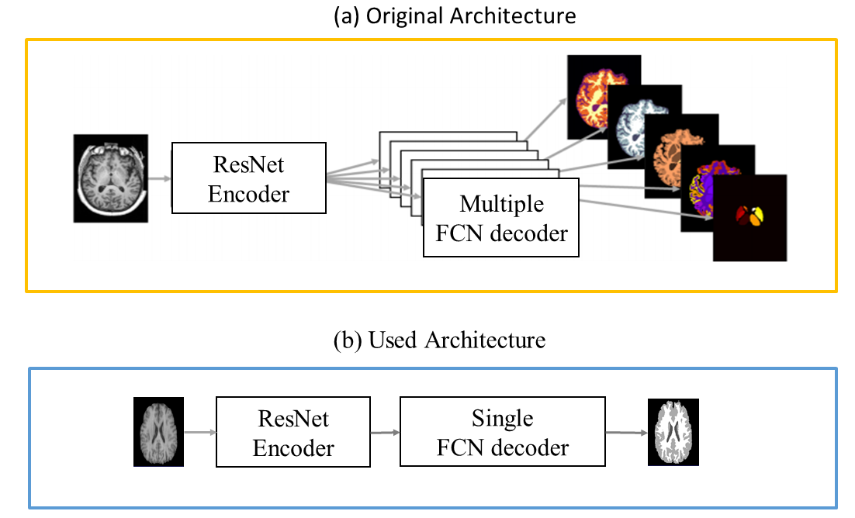
4. Method: NeuroNet
Used CNN architecture:
Resolution scale: 4
Filter: 16,32,64,126.
Down-sampled by Stride Convolution
Linear up-sampled and skip connections
prediction obtained after a softmax layer.
Fig-6. Original and Used NeuroNet Architecture.
M. Rajchl, (2018). NeuroNet: Fast and Robust Reproduction of Multiple Brain ImageSegmentation Pipelines. arXiv e-prints.

Slide 13
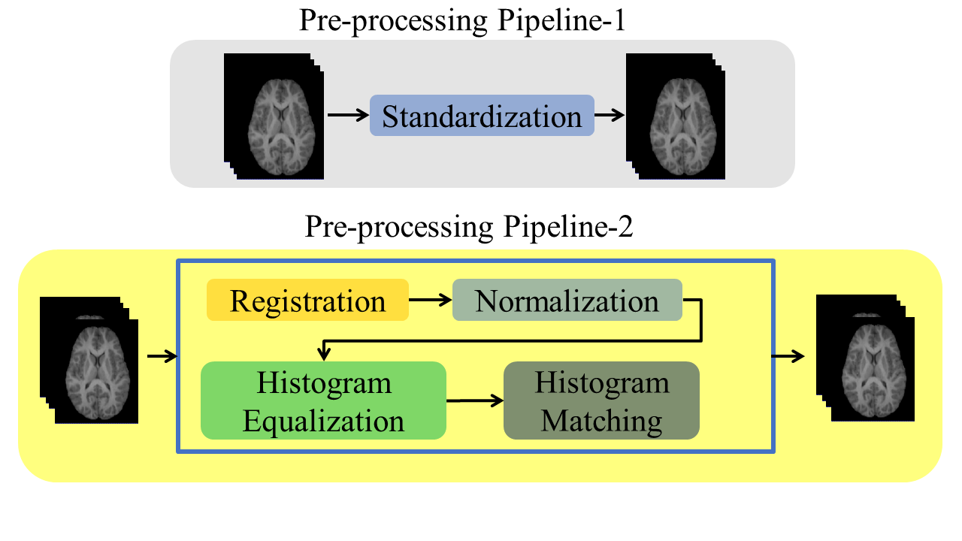
4. Method: Pre-processing Pipelines
Fig-7: Proposed pre-processing pipelines.
.

Slide 14
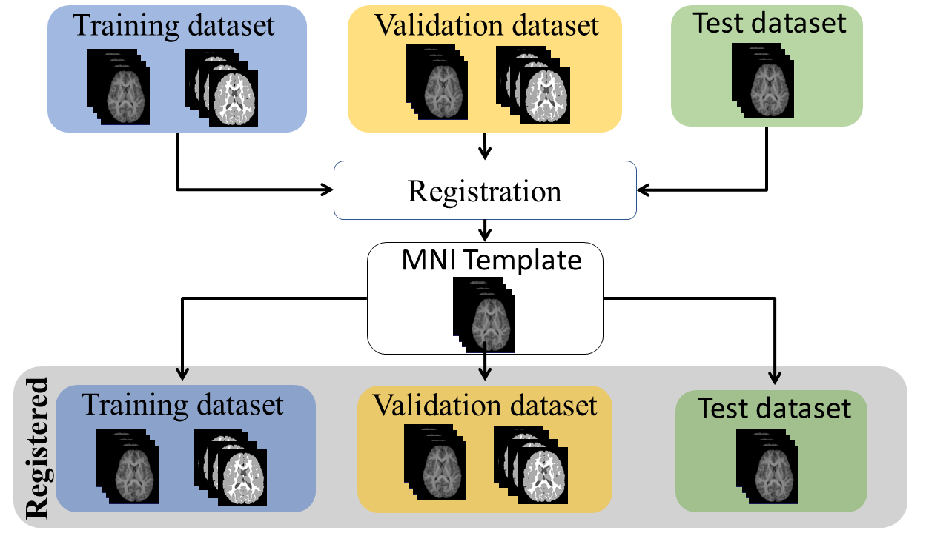
4. Method: Pre-processing pipeline-2
Registration to MNI template.
Fig-8: Registering the whole dataset to MNI template to unify the voxel spacing.

Slide 15
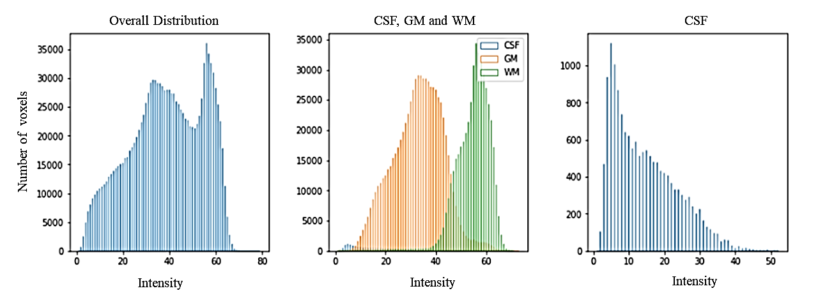
4. Method: Pre-processing pipeline-2
Intensity distributions
Fig-9: IBSR 07 intensity distributions, where, on the left, the complete tissues intensity distribution, while, in the middle, CSF, WM and GM distributions with different colors. The figure on the right is for CSF distribution only.

Slide 16
4. Method: Pre-processing pipeline-2
Histogram pre-processing:
Reference Selection
Histogram Equalization of Reference Volume
Histogram Matching to the Reference One

Slide 17
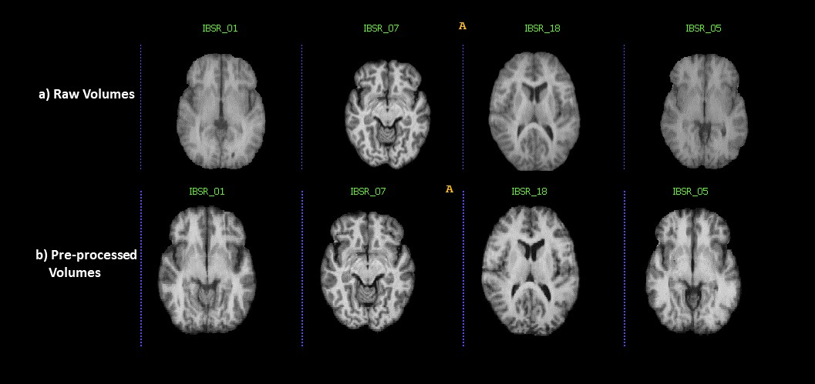
4. Methods: Pre-processing pipeline-2
Fig-10: The effect of pre-processing. At the top, 4 cases before applying the pre-processing pipelines. At the bottom, the final pre-processed dataset

Slide 18
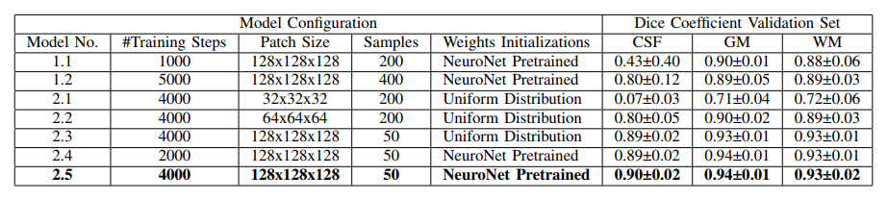
5. Experiments and Results

Slide 19
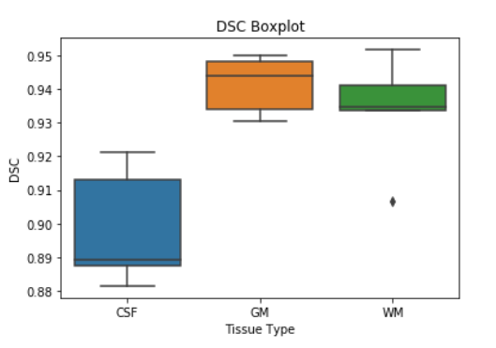
5. Experiments and Results
Test Results
Average Test DSC:
CSF: 0.84
GM: 0.94
WM: 0.94

Slide 20
6. Conclusion and Future work
DL is better than traditional CV methods.
Transfer learning is better choice with less images
Preprocessing plays crucial roles.
Future direction can be focused on improving generalization ability.

Slide 21
7. Resources
Codes and Trained weights: https://github.com/fitushar/Brain-Tissue-Segmentation-Using-Deep-Learning-Pipeline-NeuroNet
Pre-print: https://arxiv.org/abs/1904.00068
Email: fakrulislam.tushar@duke.edu

Slide 22
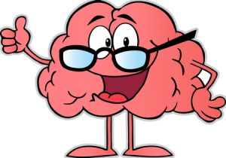
Thank You

